Slide 1

SAFDA presentation to the
DTIC Portfolio Committee
11 May 2021
Dr Siyabonga Madlala
Executive Chairperson

Slide 2

Introducing SAFDA
  Established on the 25th November 2015.
  Walked out of the SA Cane Growers’ Association because of deliberate disregard of black farmer challenges. 30 000 exited sector.
  Registered as an NPO with footprint in KZN and Mpumalanga provinces.
  Focus on unique challenges confronting black farmers in the sugar sector and beyond.
  Home for all progressive farmers black, white, large, small who support transformation.

Slide 3
SAFDA in a nutshell

Slide 4
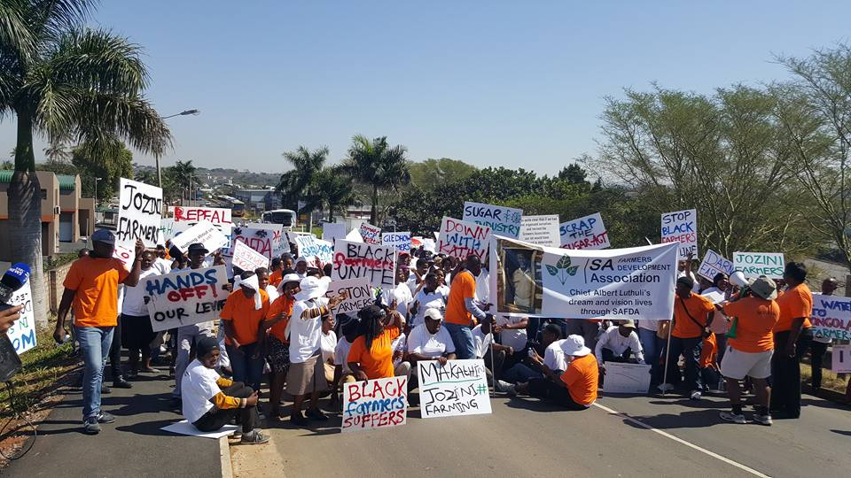
Recognition march to SASA on 25 August 2016

Slide 5
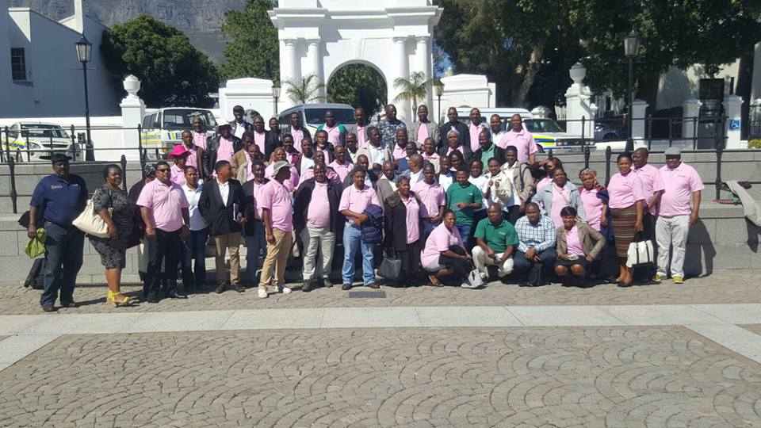
SAFDA farmers visit DTI PPC on 10 Nov 2017

Slide 6
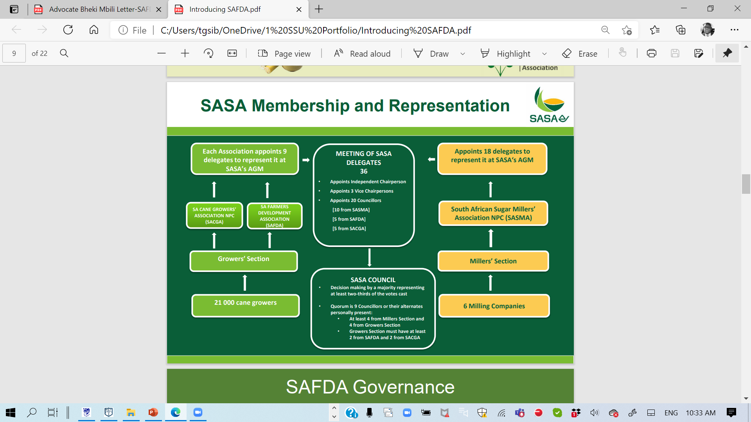
SAFDA is a permanent member of SASA

Slide 7
SAFDA representative and governance structures
Individual Farmer
Small Scale
Local Zones/
Associations
Mill Area
Small Scale Farmers
Individual Farmer
Mill Area
Land Reform Farmers
Regional Executive Committee
Central Executive Committee
Board of Directors
Individual Farmer
Mill Area
Large Scale Farmers

Slide 8
SAFDA Group Organogram
CEO: Dr SW Madlala
Mduduzi Dube
Andile Buthelezi
Sfiso Mnguni
Thandokwakhe Sibiya
Anwhar Madhanpall
Dr Marilyn Govender
Chief Financial Officer
Funding & Enterprise Development
Grower Affairs
Strategic Support Unit
Diversification
Farm Management Services

Slide 9
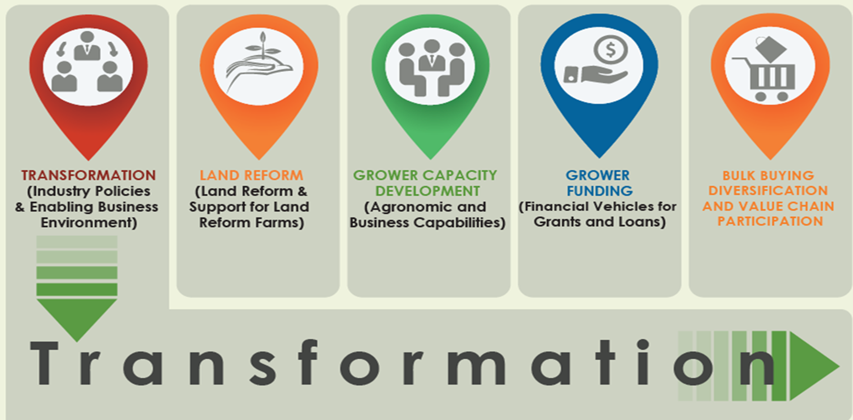
Our 5 Strategic Focus Areas
Land Reform and Small Scale Farmers

Slide 10
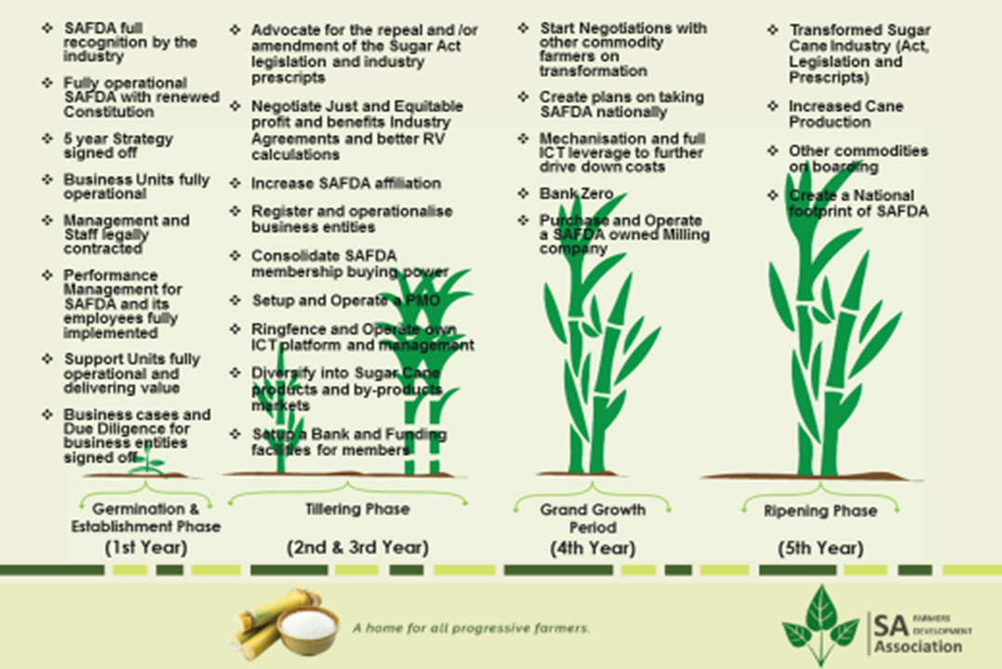
SAFDA’s five-year strategy

Slide 11
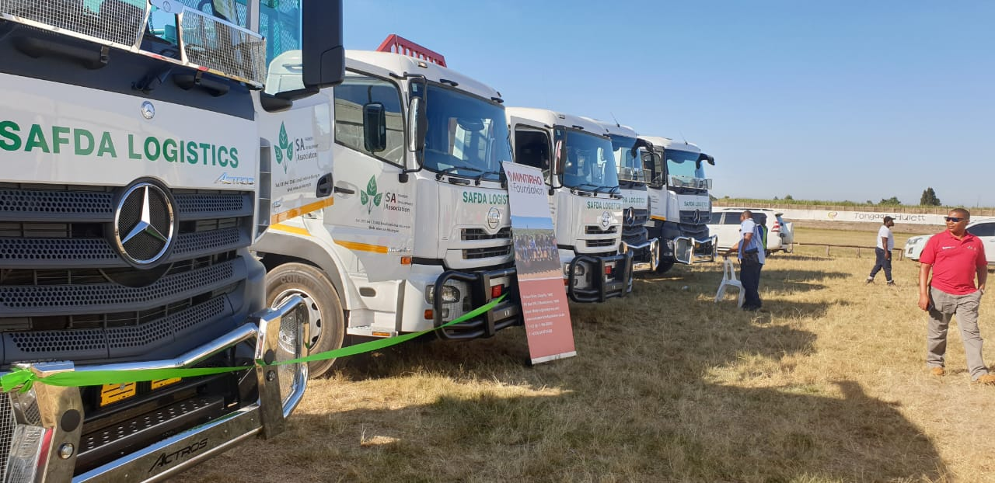
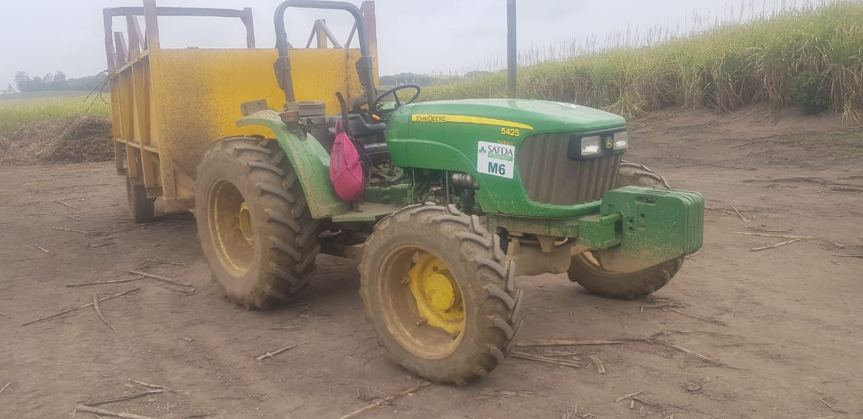
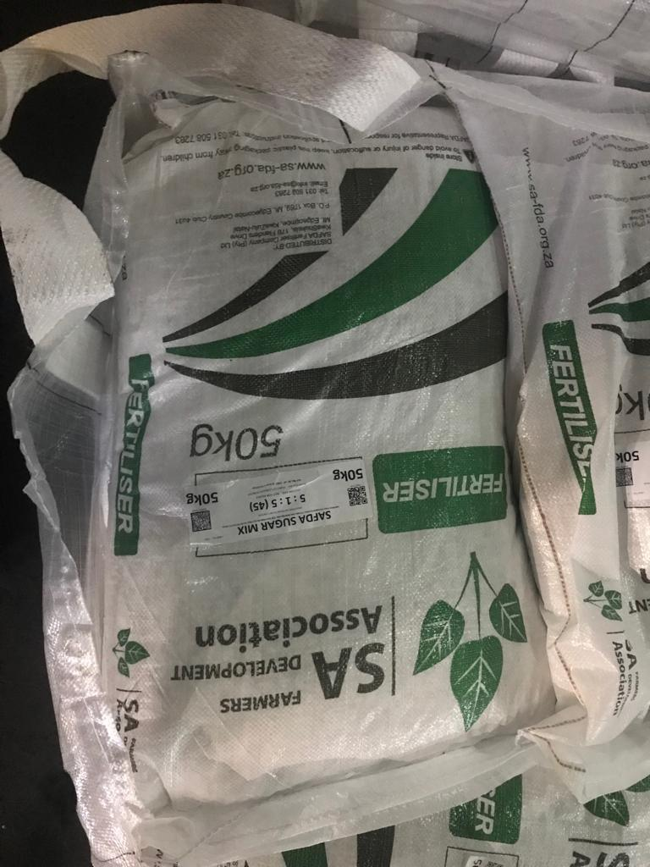
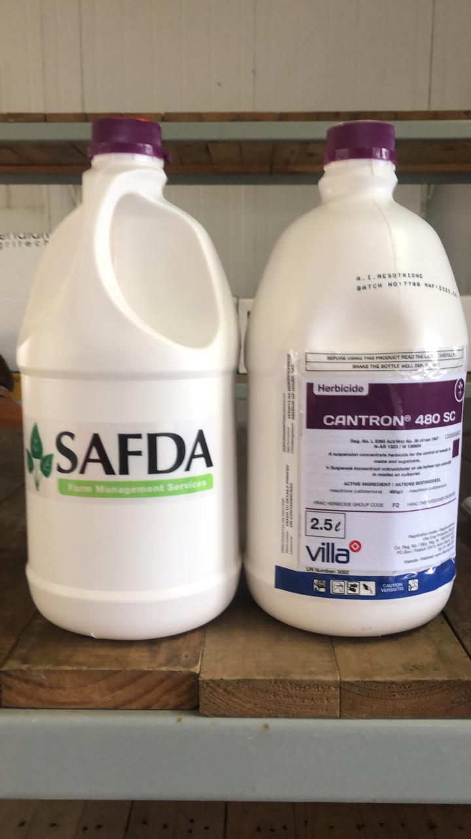
We are transforming the value chain

Slide 12
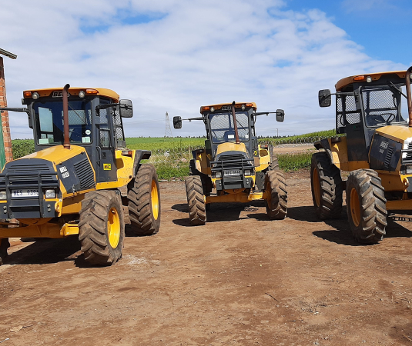
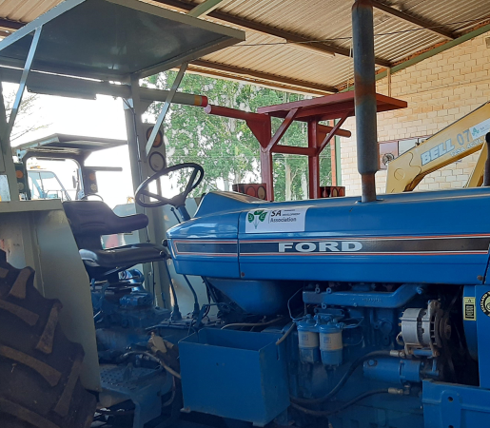
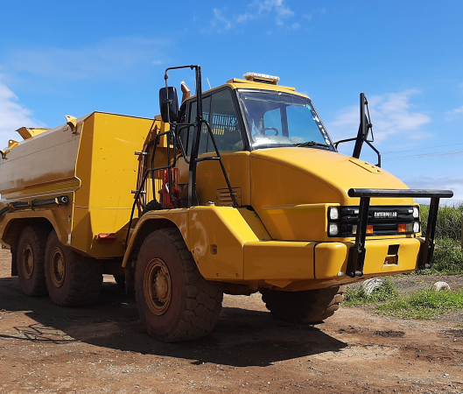
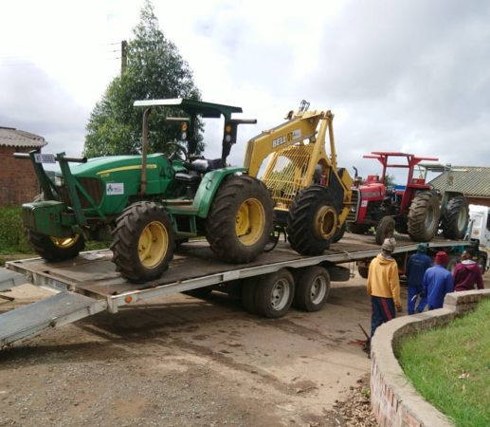
SAFDA ASSETS
TRACTORS
CANE LOADERS
TRUCKS
BAKKIES
IMPLEMENTS
FIREFIGHTING EQUIPMENT
HAULAGE FLEET

Slide 13
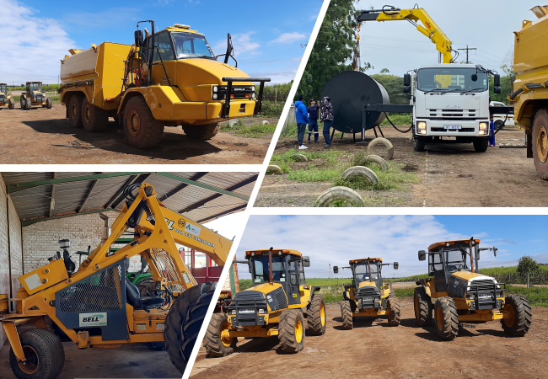

Slide 14
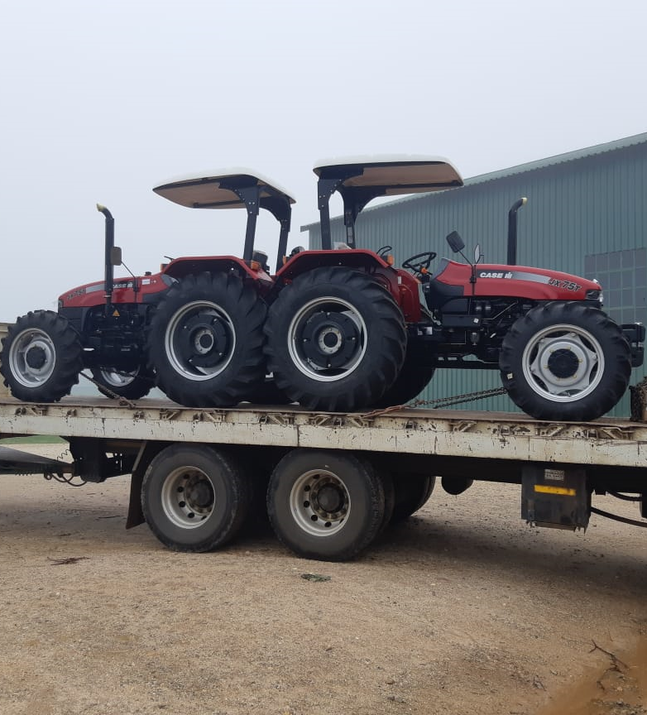
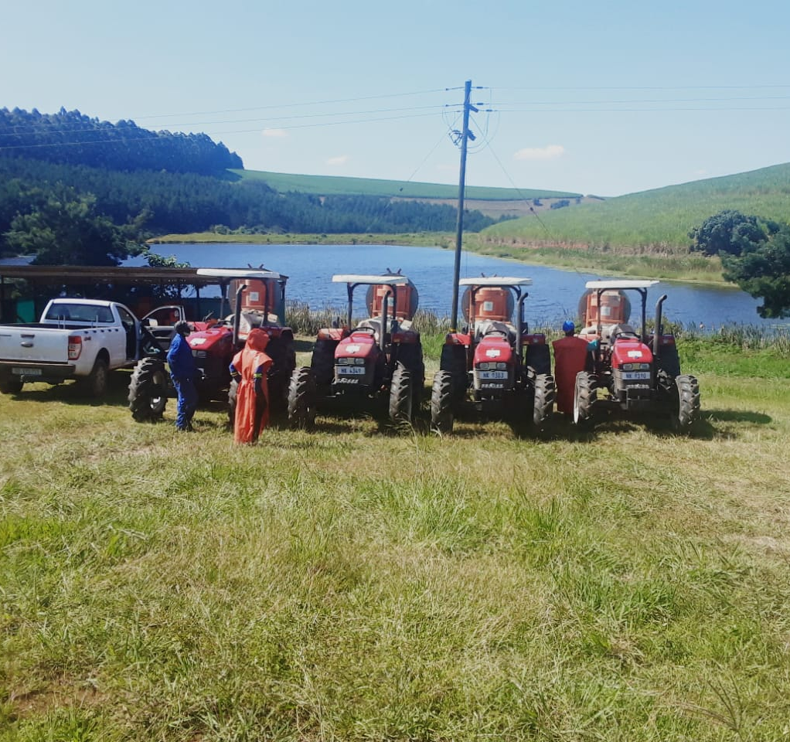
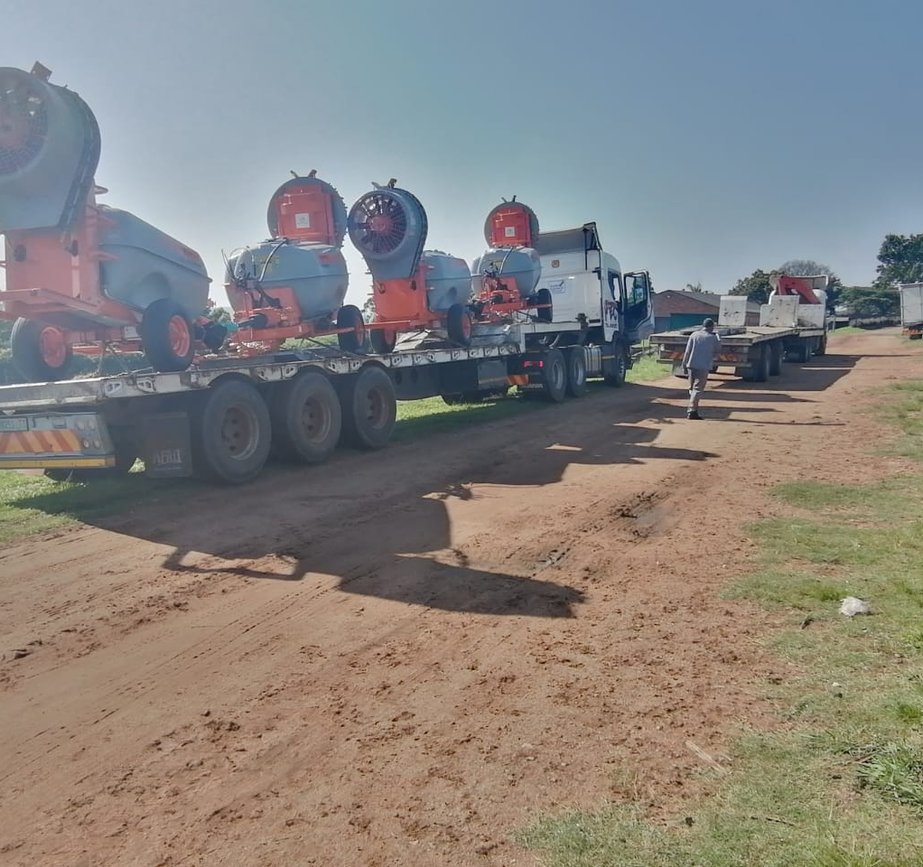
SAFDA ASSETS
AVOCADO SPRAYING EQUIPMENT = R8 MILLION INVESTMENT ACROSS THREE MELMOTH COMMUNITIES

Slide 15
SASA TRANSFORMATION FUND
Notes:
SAFDA FMSC will provide a non

Slide 16
Industry availed R1 billion Transformation Fund over 5 years.
8 Interventions being implemented under the Fund are impacting farmers positively.
Intervention 6 looking at institutional capacity building for new emerging black sugar cane grower associations stops at year 3.
SAFDA calls for Intervention 6 to continue supporting its capacity building needs as a new association that adds value to the industry as demonstrated in our roadmap.
There is a need to guard against value capture amongst sugar sector stakeholders, that defeats the purpose and spirit of transforming the sugar sector.

Slide 17
SUGAR MASTER PLAN
Notes:
SAFDA FMSC will provide a non

Slide 18
Master Plan has started delivering through securing the local market demand. Sugarcane price has been good for farmers thus far at above R5000 per RV tons).
Small-scale farmers are foundational in the Sugar Master Plan.
Premium Price for small-scale farmers expected to be in place six months after the signing of the Master Plan. Master Plan signed on 19 November 2020. Premium price due on 19 May 2021.
Extension of Designation must happen once SSG Premium Price has been agreed.
Tariff application should ensure Reciprocity Commitments are firm unlike 2018.

Slide 19
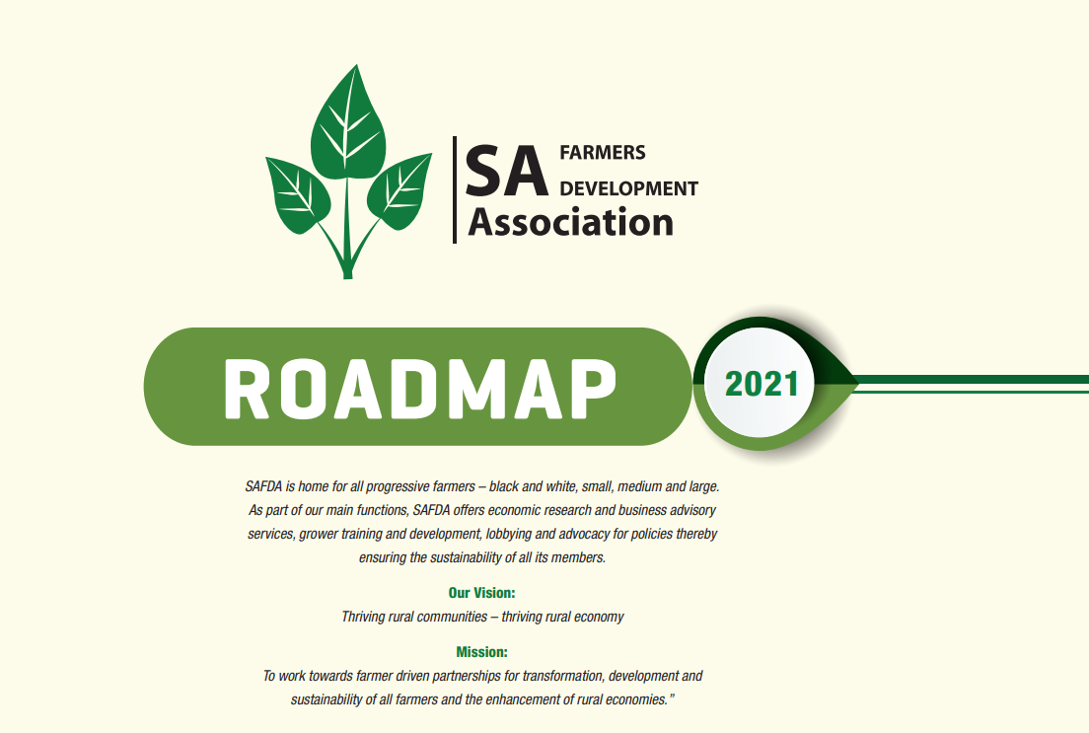

Slide 20
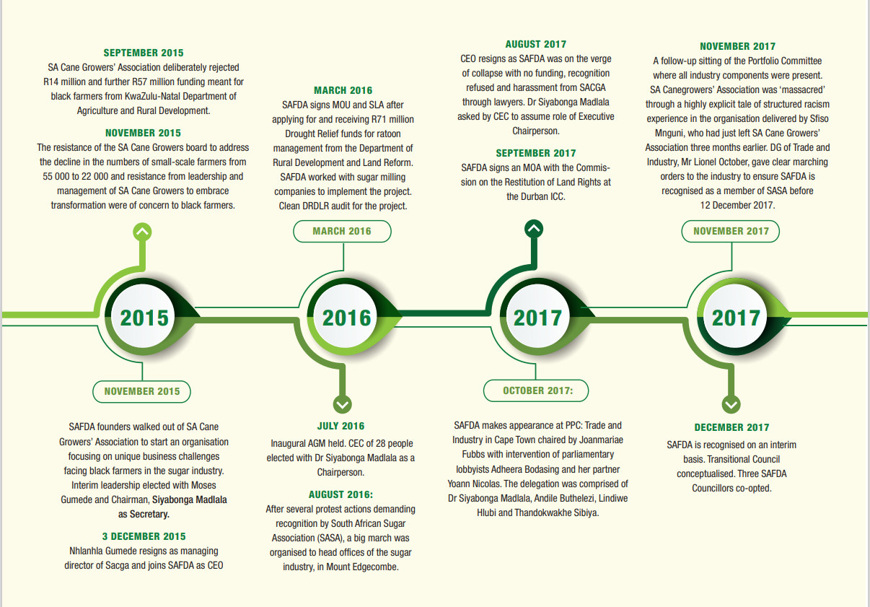

Slide 21
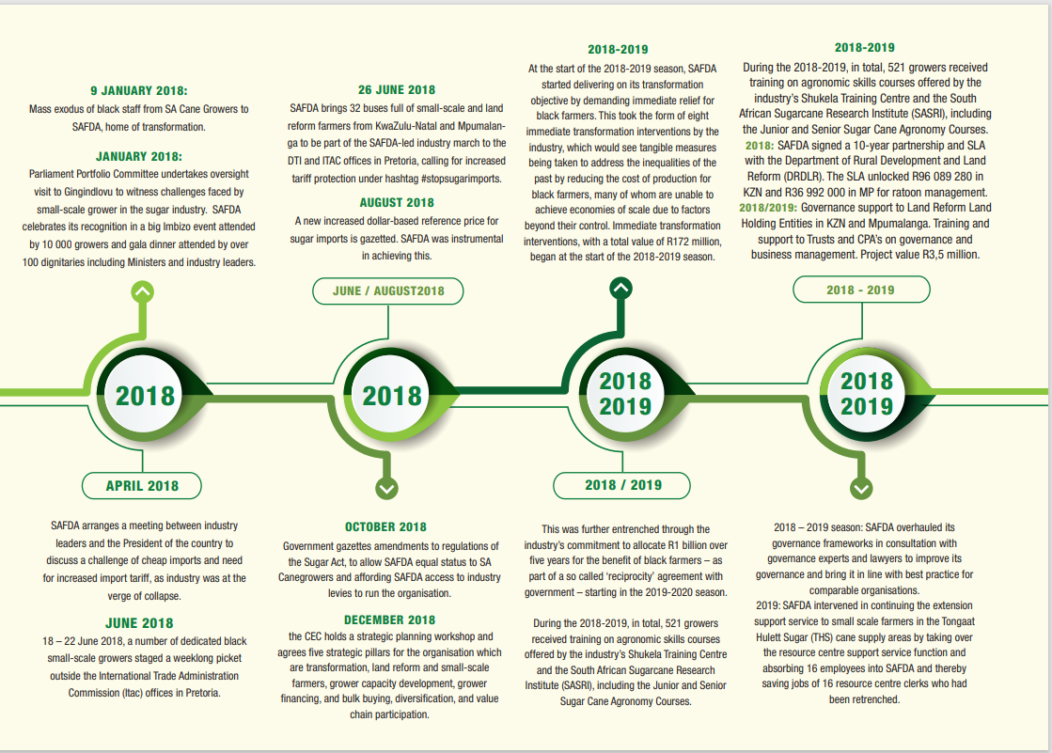

Slide 22
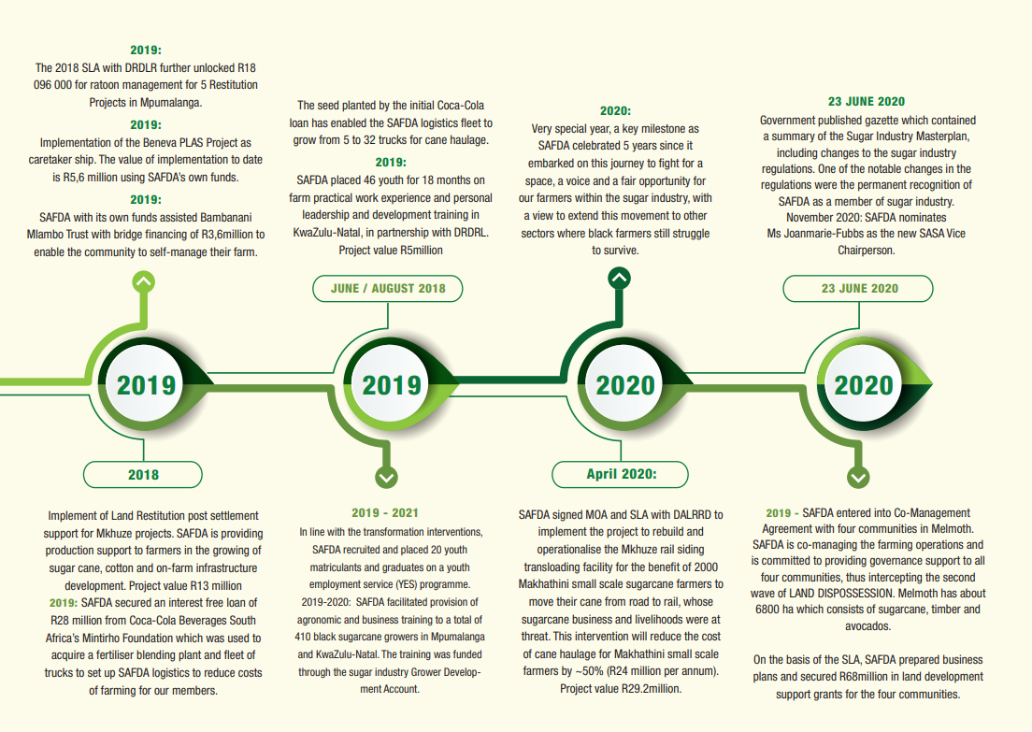

Slide 23
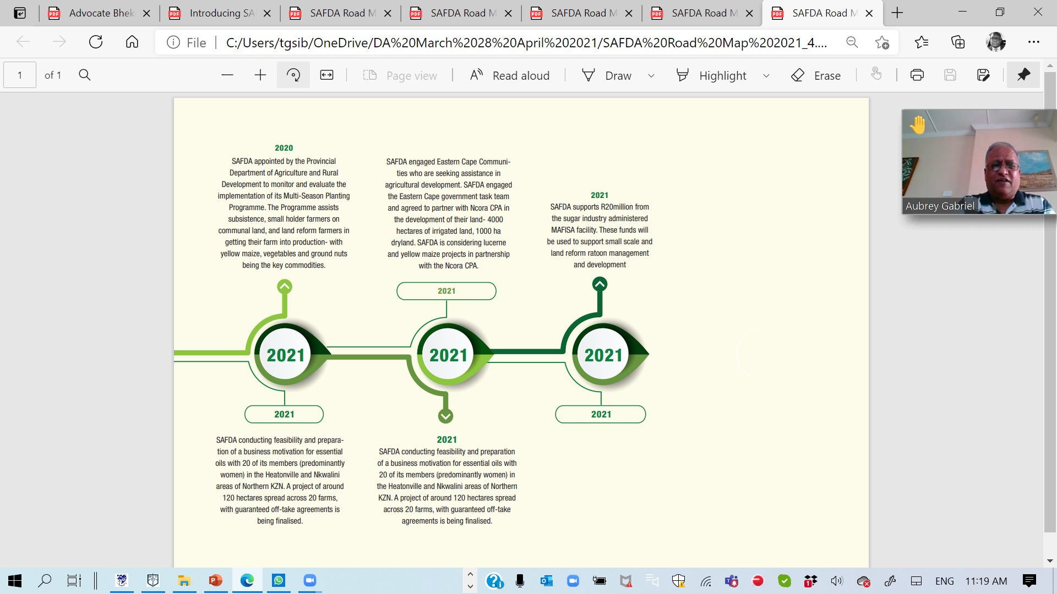

Slide 24

SIYABONGA

