Slide 1
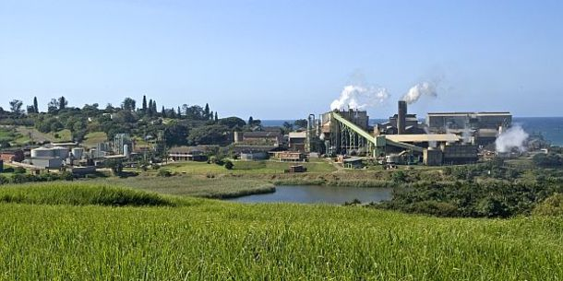
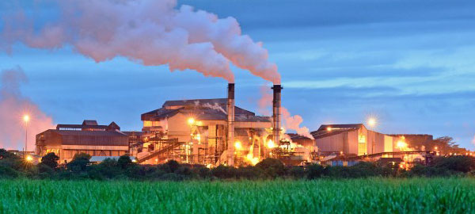
SOUTH AFRICAN SUGAR MILLERS’ ASSOCIATION (SASMA)
Presentation to the Portfolio Committee on Trade, Industry and Competition on the Sugar Masterplan
11 May 2021

Slide 2
SASMA REPRESENTED BY:
Rolf Lütge – Chairman
Robbyn Richards – Deputy Chairman
Deane Rossler – Chief Executive Officer
4. Representatives from the six milling companies

Slide 3
SASMA MEMBERS (Multiple mills and refining)
SASMA is an Association formed to represent South African Sugar Millers and Refiners and its members include:
ILLOVO SUGAR (SOUTH AFRICA) LTD
Operates three sugar mills, one of which has a refinery. Illovo SA also produces a variety of downstream products.
TONGAAT HULETT SUGAR (SOUTH AFRICA) LTD
Operates three sugar mills in South Africa, a central refinery in Durban and an animal feeds operation.
RCL FOODS SUGAR & MILLING (PTY) LTD
Operates three sugar mills, a refinery, cane and sugar transport and an animal feed division.

Slide 4
SASMA MEMBERS (Single mill operations)
GLEDHOW SUGAR COMPANY (PTY) LTD
Gledhow produces high quality refined sugar primarily to the industrial market as well as high quality VHP brown sugar.
UCL COMPANY (PTY) LTD
UCL bags high quality VHP brown sugar.
UMFOLOZI SUGAR MILL (PTY) LTD
Umfolozi bags high quality VHP brown sugar.

Slide 5
South African Sugarcane Value Chain Master Plan to 2030
Having recognised that the Sugar industry is in crisis (sugar imports, low world sugar price and reduced demand following the HPL) the Sugar Masterplan aims to reverse the prevailing downward trends.
Sugar Milling companies are committed to pursuing the restructuring of the industry and diversification for growth.
Together with SACGA and SAFDA, and guided by the DTIC, the objective is to co-craft a sustainable industry framework.
The six sugar milling companies are all signatories to the Master Plan from 16 November, participate in the EOC and the 10 Task Teams where Sugar Miller representation is required.

Slide 6
SUGAR MASTERPLAN OPPORTUNITIES FOR THE INDUSTRY
Increased Local Demand: Sugar Millers are encouraged by the commitment of sugar users to buy South African sugar increasing local market demand in year 1 of the Masterplan, together with the unexpected positive impacts of the COVID environment on sugar demand. Increased Local Market access = higher sustainable returns.
Diversification: The Sugar Masterplan has energised the search for value chain diversification options. The Department of Science and Innovation has granted the Sugar Milling Research Institute over R7 million for research into these options and further funding is required.
Re-investment: More consistent returns and rateable sales will encourage re-investment and re-capitalisation.
New Investment: in milling and refining capacity.

Slide 7
SUGAR MASTERPLAN OPPORTUNITIES FOR THE INDUSTRY
Support for small-scale growers: Sustainable rejuvenation of small-scale sugarcane grower production, which has been in decline.
Transformation: New transformation initiatives linked to diversification opportunities.
Job Protection: Preserving existing jobs by halting the decline in sugar production and job creation opportunities through possible diversification.
Restructuring: Restructuring to improve efficiencies and output.
Avoid more mill closures: Preventing more mills and refineries from closing.

Slide 8
TASK TEAM PROGRESS
While agreement on all issues is pending stakeholders continue to engage and good progress has been made to date.
Competition Commission exemption has been valuable although an extension will be required. The DTIC’s support in this regard is much appreciated.
Inter sugar miller issues also require attention.
Early signs are promising, particularly in relation to local market demand and re-investment.

Slide 9
IMMEDIATE FOCUS AREAS FOR SUGAR MILLERS
Sustain growth in the domestic market. As sugar prices into the market are capped at CPI but certain input costs continue to rise at well above inflation, growth in volumes will have to sustain the industry and fund investments.
Ensuring that sugar stock levels are adjusted to meet the 10% increase in the size of the SACU market in 2020/21.
Rebuilding skills and milling capacity following years of difficulty characterised by shrinking cane areas and reduced capital reinvestment.
Sustainable transformation – millers continue to contribute R105 million per annum through SASA to black small-scale and land reform sugarcane growers. Over and above this commitment, sugar milling companies have their own transformation programmes.

Slide 10
CONCLUSION AND ACKNOWLEDGEMENTS
SASMA views the Sugar Masterplan as having created renewed hope for the sugar industry after shrinking seemed inevitable.
The Sugar Masterplan is facilitating a move from intensive care into high care but much work remains to be done to ensure that there is no relapse, which could come from increased sugar imports and higher HPL taxes.
SASMA would wish to thank President Ramaphosa and Minister Patel for their vision in creating the Masterplan process and supporting its ongoing implementation. Our appreciation also goes to the Sugar Masterplan facilitators and the DTIC for their commitment and dedication to delivering the Sugar Masterplan.

