Slide 1

BROADBAND INFRACO SOC LIMITED
CORPORATE PLAN & ANNUAL PERFORMANCE PLAN
2021/22
Portfolio Committee
M. Ngcobo
Chairperson of the Board of Directors
2021

Slide 2
Capitalisation….Shareholder Funding
BBI Act & established
BBI Licensed
Neotel ROU End
 | 2006 /2007 | 2007/2008 | 2008/2009 | 2009/2010 | 2010/2011 | 2011/2012 | Total
DPE * | - | R 627 000 000 | R 377 000 000 | R 208 530 000 | R 138 599 926 | - | R 1 351 129 926
IDC | - | - | R 352 756 756 | R 73 267 298 | R 48 697 297 | - | R 474 721 351
Total | - | R 627 000 000 | R 729 756 856 | R 281 797 298 | R 187 297 223 | - | R 1 825 851 277
The above is an indication of the capitalisation received by BBI to date from Shareholders.
BBI is a Schedule 2 entity in terms of the PFMA, and can raise capital from the markets using its Balance Sheet.
In FY 2016/17 there was a change in accounting standards which classified the above Shareholders’ Loans as liabilities. BBI started the process of having these Shareholders’ Loans converted to Equity, in order to strengthen the Balance Sheet and make it possible to raise funding.
The Minister of Communications and Digital Technologies approved the conversion of the DCDT Shareholder Loan to Equity on 7 June 2019.
The IDC only received approval for the conversion of its Shareholder loan in BBI in March 2021, from their Shareholder Minister, the Minister of Trade, Industry & Competition (DTIC)
The Company requires further capitalisation to remain financially sustainable as it is unable to meet customer service requirements due to its aged network. The Company survived since the last capitalisation from Cash Generated from Operations.

Slide 3
Performance at a glance

Slide 4
Performance at a glance

Slide 5

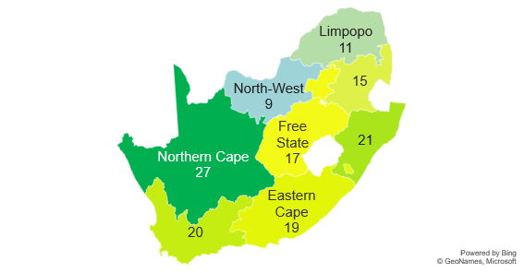
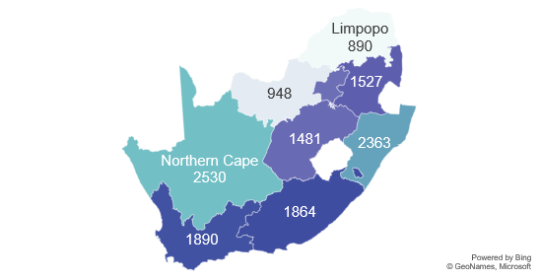
BBI Network Footprint
DCDT KEY FOCUS AREAS
Gauteng
1461
DIGITAL TRANSFORMATION
Mpumalanga
ENABLING DIGITAL ENVIRONMENT
NW
KZN
DIGITAL
INFRASTRUCTURE
Free
State
Km of Fibre per Province
KM of fibre
KEY DELIVERY PARTNERS
EC
WC
# of PoP
Gauteng
17
Mpumalanga
DISTRICT
MUNICIPALITY
PROVINCE
KZN
Number of PoPs per Province
WC

Slide 6
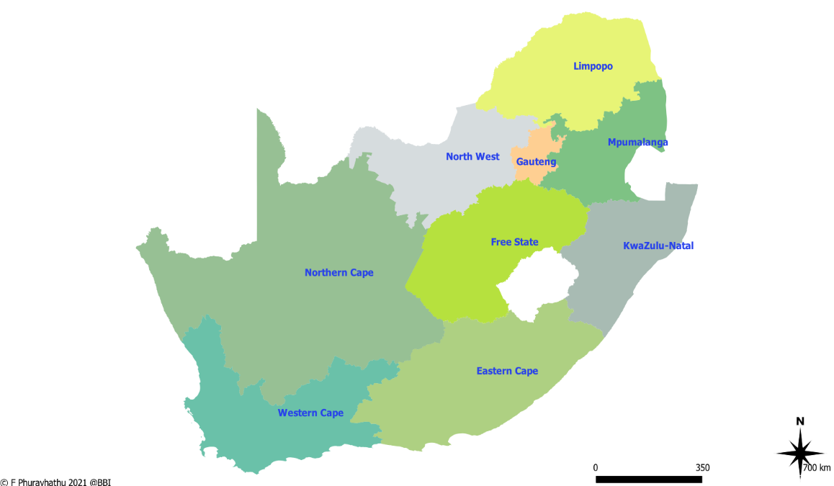
SA Connect per Province
Number of Completed SA Connect sites
Zimbabwe
DCDT KEY FOCUS AREAS
DIGITAL TRANSFORMATION
Botswana
51
Mozambique
125
77
eSwatini
ENABLING DIGITAL ENVIRONMENT
Namibia
122
122
DIGITAL
INFRASTRUCTURE
54
Lesotho
SA CONNECT
KM of fibre
KEY DELIVERY PARTNERS
162
Province | Completed | Planned: 2021/22
Eastern Cape | 162 | 78
Free State | 122 | 75
KwaZulu Natal | 122 | 156
Limpopo | 51 | 78
Mpumalanga | 77 | 78
North West | 125 | 75
Northern Cape | 54 | 60
Gauteng
Western Cape
# of PoP
DISTRICT
MUNICIPALITY
PROVINCE
Number of Completed and Planned SA Connect Sites

Slide 7
Performance at a glance
Cost of Sales
^{Normalised}
^{SA Connect implemented}
^{Contracts Negotiated}
EBITDA
Increased due to SA Connect allowance
Remain positive and continues to improve through improved sales
Service Availability
Performed above SLA though slightly lower than the previous year

Slide 8



New Strategic Focus
LEGISLATIVE AND REGULATORY
NATIONAL PLANS
Department of Communications and Digital Technologies
DEPARTMENTAL PLANS
Broadband Infraco Act No. 33 of 2007
The Electronic Communications Act No. 36 of 2005 (ECA)
NDP 2030
MTSF Outcomes
9 Point Plan
SIP 15: Sub-outcome 15
Key Focus Areas:
Financial and Operational Sustainability Organisational Enablement
Digital Transformation and Infrastructure
Last Mile Connectivity
VISION
10 Year Outlook
Provide communication services to enable a connected and transformed society
MISSION
10 Year Outlook
Expand the availability and affordability of access to communication services, including but not limited to underdeveloped and underserviced areas; and
Enable the acceleration of the state’s digital transformation through broadband connectivity
IMPACT
10 Year Outlook
Increased availability and affordability to communication services including, but not limited to, underdeveloped and underserviced areas
Implemented innovative, efficient and cost-effective communication services
A State supported through broadband connectivity
A strategically positioned, reputable, competitive and profitable industry player

Slide 9
BBI’s VALUE CHAIN…….Product and Services
Hardware
Connectivity
Value Added Services
Telecom Infrastructure
Network Equipment
Network Operator
Cloud and IoT Services
Content Portals / Aggregators
Subscribers
Free
State
Layer 1
Physical Layer
Layer 2
Data Link Layer
Layer 3
Network Layer
The current infrastructure limits the capacity to sell and drive more revenue
Inhibiting factors:
Ageing infrastructure
Limited capacity on current network
Old infrastructure (ADLash)
Limited funding to maintain and grow network
Services
Services
Products
SDH, DWDM, and Ethernet Services
WACS Connectivity
Customer Tie Cable Maintenance Service
NOC as a Service
Colocation
IP Transit

Slide 10
SWOT
High Priorities
Broader SOC consolidation and SOC Rationalisation
Leverage SA Connect to drive network extension
To build a state-of-the-art, resilient and redundant network and IP network
Automation – (1) business process internally (2) operational externally
Expansion of IP based product suite
Alien wavelength
Dark Fibre
Agility in execution (speed of execution)
Decision making due to access to executives and the speed thereof
Easy access to senior leadership by staff and customers
Operational ability to deliver (SLAs)
New Product development (in terms of engineering services, technical services etc.)
SA Connect is opening a market that allows smaller players to participate
HR policies and procedure that make people management effective
Innovative culture
Knowledge management (transfer of skills)
Medium Priorities
Strategic partnerships with OTTs – incremental revenue
SADC expansion and beyond- utilise subsea cable
Competitive advantage of reach and network capacity
Leveraging off entrepreneurs and startups to drive innovation in the public sector
Data Centres
Low Priorities
Fibre-to-the-home
STRENGTHS
OPPORTUNITIES
Legacy Technology
Lack of business process automation
Lack of Funding (DTPS shareholder loan conversion authorised; authorisation of IDC shareholder loan still outstanding)
Brand awareness
Capacity of the organisation (i.e. number of people) and the inability to fill vacant positions
WEAKNESSES
THREATS
Customer self provision of own infrastructure
Competitors and Non-ICT SOCs
offering dark fibre
Fibre swaps
OTTs price makers
Virtual network operators
Consolidation in the market
Inconsistencies in Government policy
Continuous loss of critical and scare skills
Speculations about the proposed merger
Uncertainty around the future of SA Connect

Slide 11
2030 Strategic Horizon
Phase 3: Grow Services to Enable Digital Transformation
ENABLE LAST MILE CONNECTIVITY
4. The preferred partner of Government in enabling the digital transformation
Phase 3 considers growth beyond the infrastructure core mandate that will enable the digital transformation of the state
5. Facilitated Socio-Economic Transformation
Focus Area
Outcome
Phase 2: Build Infrastructure and Grow Customer Base
ENABLE DIGITAL TRANSFORMATION AND INFRASTRUCTURE
3. An increased base achieved through customer fulfilment and state-of-the-art infrastructure and services
ENABLE LAST MILE CONNECTIVITY
4. The preferred partner of Government in enabling the digital transformation
Focus Area
Outcome
Phase 1: Stabilise and Mobilise
Supports the attainment of key DCDT Focus Areas as well as NDP targets
FINANCIAL AND OPERATIONAL SUSTAINABILITY
1. To strengthen BBI's financial position for growth and sustainability
DIGITAL TRANSFORMATION
ENABLING DIGITAL ENVIRONMENT
ORGANISATIONAL ENABLEMENT
2. To enable the organisation to deliver upon the mandate
DIGITAL
INFRASTRUCTURE
Focus Area
Outcome
FY2020/21
FY2024/25
FY2030/31

Slide 12
Outcomes, Focus Areas and Priorities
FOCUS AREAS
OUTCOMES
OUTCOME INDICATORS
IMPACT
Provide communication services to enable a connected and transformed society
Increased availability and affordability to communication services including, but not limited to, underdeveloped and underserviced areas
Implemented innovative, efficient and cost-effective communication services
A State supported through broadband connectivity
A strategically positioned, reputable, competitive and profitable industry player
Financial and
Operational
Sustainability
A strengthened financial position for growth and sustainability
Increased access to state-owned fibre infrastructure
Improved cash position
Improved financial ratios
Improved cost optimisation
Organisational
Enablement
An organisation enabled to deliver upon the mandate
Aligned organisational development models
Increased Overall Employee Performance
Reviewed and implemented improved Corporate Governance
Improved Leadership Effectiveness Rating
Improved perception of innovative culture
An increased base achieved through customer fulfilment and state-of-the-art infrastructure and services
Increased market share value
Increased fibre infrastructure
Increased innovations implemented
Improved network restoration turnaround time
Lowered cost of network infrastructure
Enable Digital Transformation and Infrastructure
Last Mile
Connectivity
The preferred partner of Government in enabling the digital transformation
Increased collaborations established and executed with relevant stakeholders and other SOEs to facilitate innovation
Increased the delivery of SA Connect Sites
Facilitated Socio-Economic Transformation
Increased initiatives supporting socio-economic transformation

Slide 13
Annual Performance Plan 2021 - 22
OUTCOME | OUTPUTS | KPI | 2020/21 BASELINE | 2021/22 TARGET | Q1 TARGETS | Q2 TARGETS | Q3 TARGETS | Q4 TARGETS
1. A strengthened financial position for growth and sustainability | New Sales Contracts | New sales contracts signed annually | R116 million | R400 million new sales contracts signed | R150 million new sales contracts signed | R100 million new sales contracts signed | R50 million new sales contracts signed | R100 million sales contracts signed
 |  | % Revenue year-on-year growth (including SA Connect) | 12% revenue year-on-year growth | 36% revenue year-on-year growth | 26% revenue year-on-year growth | 29% revenue year-on-year growth | 45% revenue year-on-year growth | 44% revenue year-on-year growth (Including SA Connect)
 |  | # of days per outstanding customer invoice per month | 67 Debtors days | Debtors collection of 60 days per contract | Debtors collection of 60 days per contract | Debtors collection of 60 days per contract | Debtors collection of 60 days per contract | Debtors collection of 60 days per contract
 | Improved Debt to Equity Ratio | Gearing Ratio | 63% Gearing Ratio | 107% Debt to Equity | 95% Debt to Equity | 104% Debt to Equity | 105% Debt to Equity | 107% Debt to Equity
 | Increased investment and funding | Maintain Positive Cash Balance monthly | R17 million cash and cash equivalent available | R15 million cash and cash equivalent available | R15 million cash and cash equivalent available | R15 million cash and cash equivalent available | R15 million cash and cash equivalent available | R15 million cash and cash equivalent available

Slide 14
Annual Performance Plan 2021 - 22
OUTCOME | OUTPUTS | KPI | 2020/21 BASELINE | 2021/22 TARGET | Q1 TARGETS | Q2 TARGETS | Q3 TARGETS | Q4 TARGETS
1. A strengthened financial position for growth and sustainability | Improved Operating Profit before Depreciation after Interest | Improve operating profit before depreciation after interest | Decline by R34 million | Improve by R37 million | Decline by R5 million | Improve by R8 million | Improve by R15 million | Improve by R18 million
 | SMMEs supported | # of days within which SMMEs invoices are paid | SMME invoice paid within 25 days | SMME invoice paid within 30 days | SMME invoice paid within 30 days | SMME invoice paid within 30 days | SMME invoice paid within 30 days | SMME invoice paid within 30 days
2. An organisation enabled to deliver upon the mandate | Drive SOC Rationalisation process | Finalised Integration Plan for merger | Draft Strategy for State Digital Infrastructure Company | Integration Plan finalised and signed-off by key stakeholders | Approved strategy for the SDIC | Develop a Change Management Process | Consultation of key stakeholders | Develop integration plan and assign resources
 | Aligned HR Capacity building and optimisation | % of payroll spend on training per annum | 1% of the salary bill spend on Targeted training and development by end of year | 1% of the salary bill spend on Targeted training and development by end of year | Compile Workplace Skills Plan and Annual training report | Training spent at 0.30% of payroll | Training spent at 0.35% of payroll | Training spent at 0.35% of payroll
 | Improved Corporate Governance | Unqualified external audit report maintained | Unqualified external audit report | Maintain unqualified external audit report | Resolve external audit findings | Resolve external audit findings | Resolve external audit findings | Resolve external audit findings

Slide 15
Annual Performance Plan 2021 - 22
OUTCOME | OUTPUTS | KPI | 2020/21 BASELINE | 2021/22 TARGET | Q1 TARGETS | Q2 TARGETS | Q3 TARGETS | Q4 TARGETS
3. An increased base achieved through customer fulfilment and state-of-the-art infrastructure and services | Expanded network ensuring robustness and resilience | Improve Actual Time to Restore Core Network Faults | 7.1 hrs to Restore Core Network Faults | 7.5hrs to Restore Core Network Faults | 7.5hrs to Restore Core Network Faults | 7.5hrs to Restore Core Network Faults | 7.5hrs to Restore Core Network Faults | 7.5hrs to Restore Core Network Faults
 |  | % of gross revenue paid as network performance rebates | 0.71% of gross revenue | ≤0.3% of gross revenue | ≤0.3% of quarterly gross revenue | ≤0.3% of quarterly gross revenue | ≤0.3% of quarterly gross revenue | ≤0.3% of quarterly gross revenue
4. The preferred partner of Government in enabling the digital transformation | SA Connect Sites delivered and maintained | # of SA Connect Sites connected to Broadband Infraco network | 713 SA Connect Sites connected to Broadband Infraco Network | Maintain 713 SA Connect Sites connected to Broadband Infraco Network | Maintain 713 SA Connect Sites connected to Broadband Infraco Network | Maintain 713 SA Connect Sites connected to Broadband Infraco Network | Maintain 713 SA Connect Sites connected to Broadband Infraco Network | Maintain 713 SA Connect Sites connected to Broadband Infraco Network

Slide 16
Annual Performance Plan 2021 - 22
OUTCOME | OUTPUTS | KPI | 2020/21 BASELINE | 2021/22 TARGET | Q1 TARGETS | Q2 TARGETS | Q3 TARGETS | Q4 TARGETS
5. Facilitated Socio-Economic Transformation | SMMEs supported | # of SMMEs allocated installation work | Six SMMEs allocated installation work | Three SMMEs allocated installation work | Identify the SMMEs | Allocate work to first SMME | Allocate work to second SMME | Allocate work to third SMME
 |  | % of total discretionary budget to be spend on B-BBEE | 119% of total discretionary budget spend on B-BBEE | 70% of total discretionary budget to be spend on B-BBEE | 70% of total discretionary budget to be spend on B-BBEE | 70% of total discretionary budget to be spend on B-BBEE | 70% of total discretionary budget to be spend on B-BBEE | 70% of total discretionary budget to be spend on B-BBEE
 |  | % of total B-BBEE spend to be spend on black-owned entities | 54% of total spend B-BBEE spend on black-owned entities | 40% of total B-BBEE spend to be spend on black-owned entities | 40% of total B-BBEE spend to be spend on black-owned entities | 40% of total B-BBEE spend to be spend on black-owned entities | 40% of total B-BBEE spend to be spend on black-owned entities | 40% of total B-BBEE spend to be spend on black-owned entities
 |  | % of total spend on BOEs to be spend on Black Women-Owned entities | 43% of total spend on BOEs spend on Black Women-Owned entities | 10% spend of 40% spend on Women-Owned entities | 10% spend of 40% spend on Women-Owned entities | 10% spend of 40% spend on Women-Owned entities | 10% spend of 40% spend on Women-Owned entities | 10% spend of 40% spend on Women-Owned entities
 |  | Improve B-BBEE Level | Level 4 | Maintain Level 4 | Appoint service provider | Conduct verification audit
 | Connected schools | # of Schools provided with broadband connectivity | Three school provided with broadband connectivity | Broadband connectivity provided to one school identified with DCDT | Identify the province and the school with DCDT | Identify partners to provide sponsorship | Acquire and connect telematics on distance platform | Train teachers on the use of telematics and cybersecurity for also learners

Slide 17
Sales Strategy
1. Strategic Route Planning and investment enabling competitiveness.
1. Strategic Route and Network Planning
2.Competitive Product Development
2. Product Development
STRATEGY
Key
Enablers
3. Align strategic route planning to ISP development.
3. Leverage ISP Growth
4. For Public Sector acquisition and product extension
4. Strategic Collaborations
5. Capacity Swapping

Slide 18
Financial Position
Assumptions
Capex
Cashflow
Funding

Slide 19
Financial Performance
Revenue Detail
Head Count

Slide 20
Statement of Cash Flow
Back

Slide 21



Budget guidelines and assumptions
Cost of Sales
Cost of Sales based on actual contracted costs
Includes access network service provider costs
New contracted costs for Eskom and TFR included, including additional fibre to mitigate AdLash
Expenditure
Zero-based Budget, line by line, bottom-up approach was followed, per cost centre
Specific inflation factored i.e. IT costs and building rentals
NO Salary increases budgeted for in 2022. as was the case in 2021, and 5% after 2022
No Performance bonus/retention incentive included in the budget
Employees
Employees head count at 181, including 25 interns and trainees and 4 new appointments under the auspices of the SA Connect Phase 1C rollout
Head count increase to mitigate reduction in outsourced costs by 18 people
Back

Slide 22
Budget guidelines and assumptions
Shareholder Support
First time in more than 10 years operating history, the support from shareholders, in the form of equity or an allocation of R100 million will be required.
This comes off the back of BBI exclusively using its own generated funds to fund infrastructure roll out. Funds that should have been used and accumulate to fund working capital. This capex spend has accumulated to an excess of R464 million over the last 6 years.
BBI requires this injection to ensure future sustainability to ensure/enable them to fulfil its mandate, by continuing to provide connectivity to underserviced area and remain relevant in the market
Critical External Enablers to ensure sustainability
Conversion of shareholders’ loans before 1 April 2021
Shareholder support to raise funding and provide equity
SA Connect Phase 1C is awarded before 31 March 2021
Moratorium lifted on the sourcing of resources on a fixed-term contract (FTC)basis
OEM and SOE arrear accounts resolved and up to date
Back

Slide 23
Capex- Classification
Generation of revenue projects will be most important (74%) in delivering services customers, and includes 2Tbps network capacity upgrade.
Essential upgrades and refurbishments (15%) will ensure better network autonomy and management and includes the SDH to IP network upgrade.
There will be a focus on Protection of revenue (3%), within above principles. This will include replacement of critical sections of AdLash fibre and relocation of data centres.
Operation capex (7%) is required to ensure continues monitoring of the network and includes new commercial vehicles, security upgrades, technical tools and splicers.
Back

Slide 24
Funding
Total funds to be raised in 2022 is R464 mil
R20 mil Asset Finance for Motor Vehicles, New laptops and NOC TC Screens
R32 mil from Project Finance to fund specific capacity upgrades on Northern Ring, cooling and secondary routes to SADC countries
R286 million Debt Funding to supplement funding generated from operations required for customer and refurbishment projects and includes 2TB upgrade
R103 million from Vendor Financing to fund the upgrade from SDH to IP network and OSS/BSS.
Sustainable assets of R6 million financed through equity
Back

Slide 25
Revenue Analysis
Total revenue of R178 million (28%) existing
High Probability Revenue (>80%) R35 million (5%)
Low Probability Revenue (<80%) R13 million (2%)
SA Connect contracted sales of R142 million (22%)
SA Connect Phase 1C revenue of R38 million (6%) included
Phase 1C Capex allocation of R273 excluded
WACS revenue of R68 million (11%) included.
Renewal revenue of R14 million (2%) included.
Growth of existing and new customers of R118 million (18%) included
KZN EDTEA R36 million (6%)
Back

Slide 26
Operating Expenses - Salaries
13 Interns and 16 retained trainees
6,5% salary adjustment expected
Employee numbers expected to remain the same for 2020/21
Back

Slide 27
Strategic Risks
Risk No | Risk | Mitigation
1 | Possible failure to continue as a going concern | 1. Continue with implementing the sales drive strategy. 2. Cost containment intervention. 3. Continue to apply for funding from external parties.
2 | Difficulty to raise Funds | 1. Continue to apply for funding from external parties. 2. Engage Shareholders on funding requirements.
3 | Regulatory constraints impeding organisational agility | 1. Demand planning and strategic sourcing. 2. Provide input to regulatory amendments process.
4 | Margin pressure | 1. Pricing strategy. 2. Cost containment. 3. Network technology upgrade.
5 | Commercialisation of fibre infrastructure. | 1. Current engagement with non ICT SOCs. 2. Engage the DTPS on workable solutions.
6 | Lack of access to state-owned fibre infrastructure. | 1. Lobbying and engagement with ICTS SOCS and stakeholders
Risk No | Risk | Mitigation
7 | Inadequate stakeholder management | 1. Develop a Stakeholder Management Strategy and Plan. 2. Review the current communication strategy. 3. Continuous engagement with all stakeholders.
8 | Inability for the organisation to respond to rapid changes in market and technology | 1. The completion of network upgrades (M-Tera and IP Core Upgrade. 2. The bps project has been approved at CISC to be implemented.
9 | Cyber security risk | 1. Information System policies in place. 2. Cyber security cover is in place 3. SharePoint and Mimecast are being used for back up.
10 | Failure to innovate or to embrace innovation. | 1. Corporate values. 2. Training program
11 | Delays in conversion of the Shareholders’ Loans to Equity | 1. Escalate the outstanding IDC Shareholder Loan conversion as a risk. 2. Shareholder's agreement in place. 3. Continue to engage with the Stakeholders.
12 | Outbreak of COVID -19 | 1. Contingency plan put in place to maintain delivery of service. 2. Emergency supply chain process activated. 3. Communicated procedures on dealing with the pandemic and use of ICAS. 4.NOC/ IT and HR business continuity plan activated. 5. IT capacitated in terms of resources. 6. Implemented remote working or working from home process.
Slide 27

Slide 28
Benefits of SOC Rationalisation
Strategic positioning
I/S Optimisation
B/S and Tax enhancement
Multiple uplift
Overlay of BBI and Sentech network & interconnection points
Use BBI’s network and new satellite technology to drive digital migration and shift away from terrestrial signal distribution
A combined BBI Sentech cable network enhancing SABC OTT streaming platform
Extension of current BBI and Sentech footprint and reach
Capability to digitize health, education and Government services
Revenue Enhancement::
  New Products & services
  Revised pricing and offering to be more agile and competitive
Cost optimization:
  Rationalisation of duplicated or overlap roles in roles and functions
  Rationalisation of vendors
  Colocation in properties owned vs leased where overlap exists
Duplicated overheads (audit fees, insurance, security etc.)
Optimisation of working capital
Stronger balance sheet
Rationalisation of properties
Tax structuring that limits direct and indirect tax exposure and leverages BBI’s assessed loss
Build a positive perception of the combined business.
Improved network and reliability
Aligned culture and ways of work
Retention of key staff
Slide 28

Slide 29
Services for SDIC
SOC RATIONALISATION
Connectivity
Content & Multimedia
VAS
Extended Services
New Offering
Managed fibre services (FTTX)
Managed wireless services
VSAT services
Enterprise Content Management (ECM)
TV terrestrial
Satellite TV
Frequency modulation (FM)
MW
OTT
Digital Audio
E-Learning
Co-location
3^{rd.} Party site management
Consulting
NOC + call centre as a service
Maintenance
Internet (Wholesale)
White labelling and unified solutions
4IR (IOT Solutions)
Voice over internet protocol (VOIP)
TV and FM broadband
Virtual education and healthcare
Video on demand (as part of OTT)
New
IOT Network
Backhaul services
Data Centres
Enterprise internet
Innovation hub
Disaster recovery
Cloud (Platforms and software)
Immediate
Scale and Build

Slide 30

Thank You

