Slide 1
Presentation to Portfolio Committee on Transport – 15 May 2021
Strategic Plan and Annual Performance Plan
Presented by : RTMC

Slide 2
Contents
Key policies and alignment
Organisational overview
SP&APP
Budget Allocation
Discussion
Strategic Risks

Slide 3

The Constitution of the Republic
Schedule 4
Concurrent National and Provincial Legislative Competence
Public Transport
Road Traffic Regulation
Vehicle Licensing
Schedule 5
Exclusive Provincial Legislative Competence
Part A: Provincial Roads and Traffic
Part B: Traffic and Parking

Slide 4
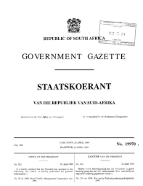
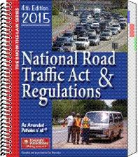
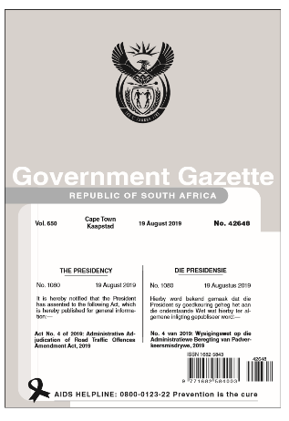
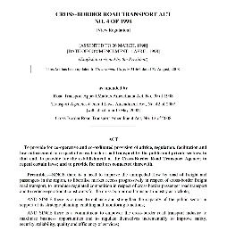
Some of the key legislation that govern the RTMC..
RTMCA
NRTA
CBRTA
Envisaged implementation of the AARTO Amendment Act going

Slide 5
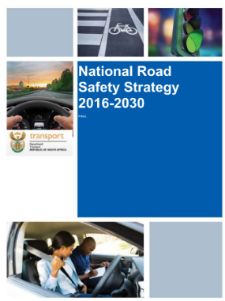


Other key policies that bind us…

Slide 6



Global Policies
By 2020, halve the number of global deaths and injuries from road traffic accidents
Provide access to safe, affordable, accessible and sustainable transport systems for all, improving road safety, notably by expanding public transport, with special attention to the needs of those in vulnerable situations, women, children, persons with disabilities and older persons

Slide 7




The 2nd Decade of Action for Road Safety
From forgotten goal to expression in the SDG

Slide 8
The development of the RTMC strategic is aligned to the following key priorities…
SDG’s
NDP
Govt. 7 Priorities
RTMC Key Priorities
RTMC’s strategic future direction…
No Poverty
Zero hunger
Good health and well-being
Quality education
Gender equality
Affordable and clean energy
Clean water and sanitation
Decent work and economic growth
Industry, innovation and infrastructure
Reduced inequality
Sustainable cities and communities
Responsible consumption and production
Climate action
Life below water
Life on land
Peace, justice and strong institutions
Partnerships for the goals
A social compact to reduce poverty and inequality, and raise employment and investment
Priority 1: A Capable, Ethical and Developmental State
Priority 1: Transfer of the three functions
Vision
Safe Roads In South Africa
Develop strategies to address poverty
Priority 2: Economic Transformation and Job Creation
Priority 2: Revenue generation and commercialisation
professionalise the public service
Boost private investment in labor-intensive areas, competitiveness and exports
Priority 3: Education, Skills and Health
Priority 3: Create strategic partnerships with public and private sector
Safe, Secure and Responsible use of roads in South Africa Through:
Education
Enforcement
Engineering
Evaluation
Planning and Coordination
Partnership
Education accountability
Priority 4: Consolidating the Social Wage through Reliable and Quality Basic Services
Priority 4: Integrate, innovate & modernise our business processes
Mission
Provide health care for all
Priority 5: Spatial Integration, Human Settlements and Local Government
Priority 5: Restructure and rationalise (new, upskilling and multiskilling)
Public infrastructure investment
Priority 6: Social Cohesion and Safe Communities
Priority 6: Regional expansion (NaTis and Training)
Interventions to ensure environmental sustainability and resilience to future shocks
New spatial norms and standards
Priority 7: A better Africa and World
Priority 7: Balancing security, safety and the economy in traffic enforcement
Strategic Plan and Annual Performance Plan
Reduce crime by strengthening criminal justice and improving community environments
Alignment to national policy

Slide 9
Contents
Key policies and alignment
Organisational overview
SP&APP
Budget Allocation
Discussion
Strategic Risks

Slide 10
The role of the Road Traffic Management Corporation, as a lead agency in road safety
  To effect the pooling of road traffic powers of the Minister, MECs and the resources of national and provincial spheres of government responsible for road traffic management, in support of enhanced co-operative and co-ordinated road traffic strategic planning, regulation, facilitation and law enforcement;
  To enhance the overall quality of road traffic services and, in particular, to ensure safety, security, order, discipline and mobility on the roads;
  To phase out, where appropriate, public funding and phase in private sector investment in road traffic on a competitive basis;
  To introduce commercial management principles to inform and guide road traffic governance and decision-making in the interest of enhanced service provision;
  To regulate, strengthen and monitor intergovernmental contact and co-operation in road traffic matters;
  To improve the exchange and dissemination of information on road traffic matters;
  To stimulate research in road traffic matters and effectively utilise the resources of existing institutes and research bodies; and
  To develop human resources in the public and private sectors that are involved in road traffic.

Slide 11
RTMC unique governance structures of the RTMC
Shareholders Committee
Board of Directors
Chief Executive Officer
Executive Committee Members
The Shareholders Committee consists of—
(a) the Minister;
(b) every MEC; and
(c) two representatives nominated by the national organisation recognised in
terms of section 2(a) of the Organised Local Government Act, 1997 (Act No. 50
52 of 1997).

Slide 12
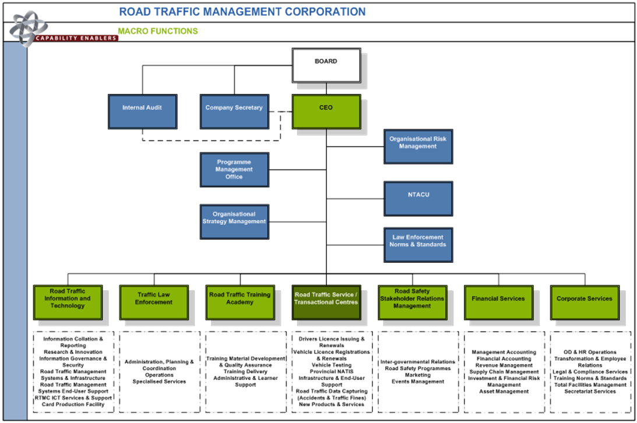
…Organisational Structure

Slide 13
Functional Areas
Road Traffic Law Enforcement
Law Enforcement
Administrative Adjudication of Road Traffic Offences
Vehicle and Roadworthiness Testing
Testing and Licensing of Drivers
Road Safety
Communication and Education
RTMC Functional Areas
Infrastructure Safety Audits
Capacity Development
Training of Traffic Personnel
 | Transferred
 | Within the RTMC
 | Concurrent Mandate
 | Withheld
Vehicle Registrations and Licensing
Data Management
Road Traffic Information
Accident Investigations and Recording

Slide 14
Key programmes that have been implemented

Slide 15
Organisational Performance

Slide 16
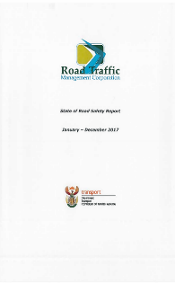
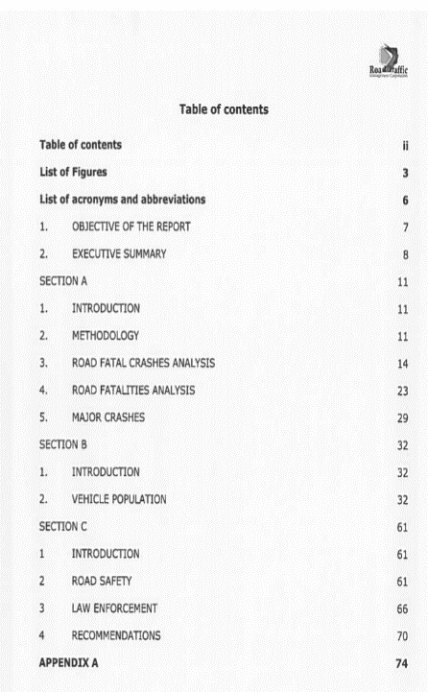
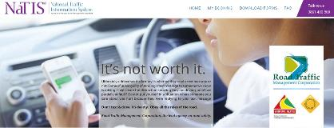
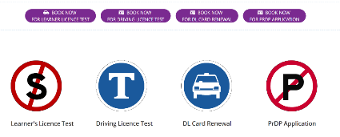
…the production of road traffic information and management of the NaTIS…
Production and dissemination of road traffic Information
Road traffic information systems Systems

Slide 17
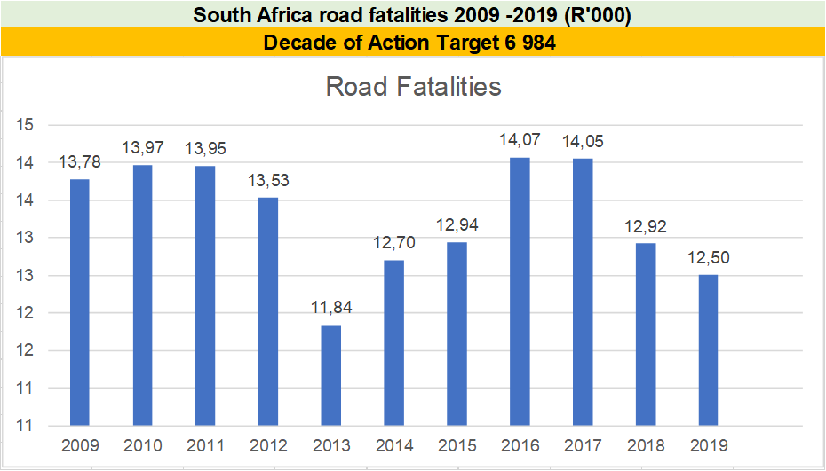
…the production of road traffic information and management of the NaTIS…
2020 and
the
impact
of
covid-19 ?

Slide 18
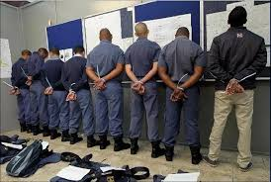

…Anti fraud and corruption.…

Slide 19
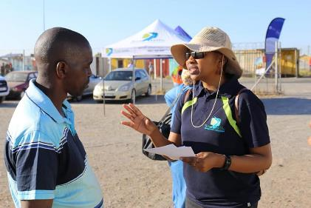
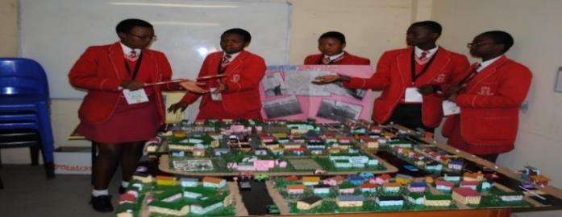

Road Safety educational and communication programmes
School based programmes
Community Participation
Educational campaigns

Slide 20
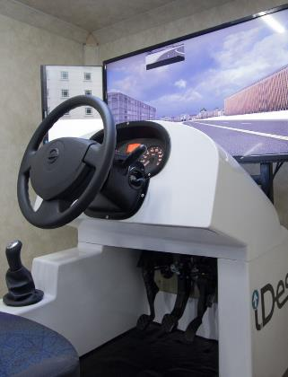
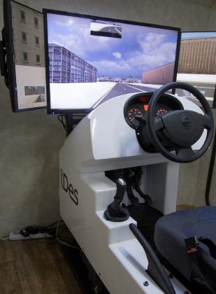
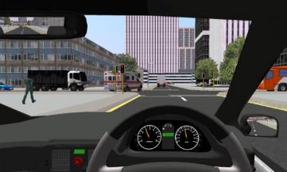
Driving Simulators
Learner and drivers licence programmes

Slide 21
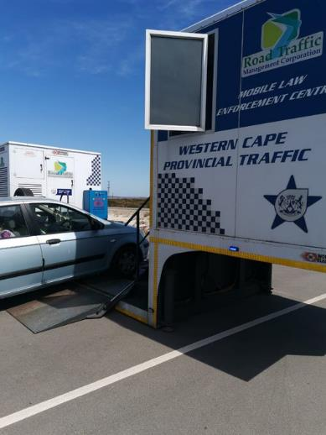
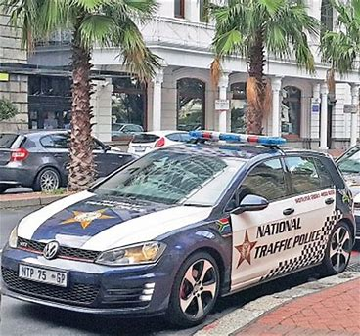
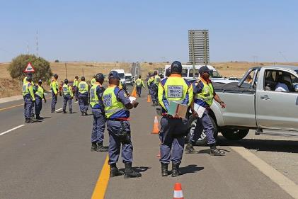
Law Enforcement interventions in collaboration with other law enforcement agencies…

Slide 22
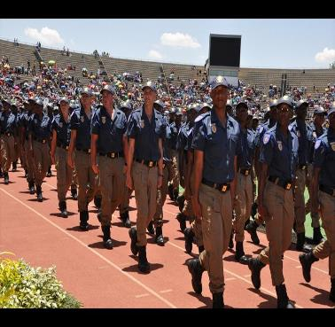
…training of traffic personnel…
Training
Curriculum Development
NQF level 6 traffic officer qualification
NQF level 6 road safety officer qualification
NQF level 4 driving school instructor qualification

Slide 23
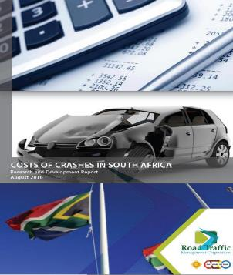
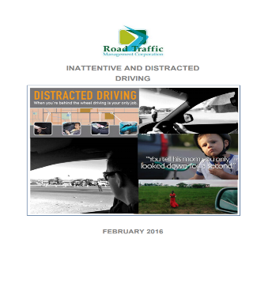
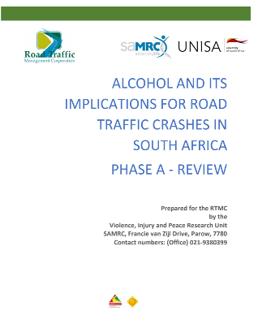
…the production of research…

Slide 24
Contents
Key policies and alignment
Organisational overview
SP&APP
Budget Allocation
Discussion
Strategic Risks

Slide 25
Methodology and approach in the development of the strategy
STRATEGIC PLANNING PROCESS
WORKSHOPS
✓
✓
MANAGEMENT WORKSHOP
BOARD OF DIRECTORS WORKSHOP
FOCUS
✓
✓
✓
STRATEGIC PLAN DEVELOPMENT
ANNUAL PERFORMANCE
PLAN DEVELOPMENT
SP AND APP REFINEMENT
KEY AREAS COVERED
Situational analysis
Theory of change
Impact statement development
Outcome and Outcome Indicator development
Target development
Output Development
Output Indicator development
Target development and refinement
Review and input into the planning completed thus far
DELIVERABLE
Draft 1 of the SP
Draft 1 of the APP
Input into refinement of the SP and the APP
✓
Completed
Source: Letsema Consulting and Advisory

Slide 26

Situational Analysis using the revised framework…
CORE PROBLEM: UNSAFE SOUTH AFRICA ROAD TRAFFIC ENIRONMENT
CORE PROBLEM: UNDERPERFORMING ORGANISATION
1
2
EFFECT
Increased Road Injuries
Increased property damage
Increased Road Injuries
Fraud and Corruption
Increased losses productivity
Limited impact from programmes with key partners
Poor delivery of key projects
Increased road accidents
Poor driver behaviour
Poor Perceptions by Internal Stakeholders
Increased medical burden on the state
Disengaged workforce
Increased Road Fatalities
UNDERPERFORMING ORGANISATION
Poor Perceptions by External Stakeholders
UNSAFE SOUTH AFRICAN ROAD ENVIRONMENT
Uneducated road users
CAUSE
Limited awareness on road safety
Unsafe vehicles
Limited focus on research
“SILO Mentality”
Limited monitoring & evaluation controls
Poor road infrastructure
Corruption within the Road Safety Fraternity
Budget constraints & resource constraints
Limited ownership and accountability
Weak law enforcement
Inefficient use of resources
High impact area that key interventions need to address
,

Slide 27
Impact statement, outcomes and outcome indicators…
Impact
Outcome
Outcome Indicators
Baseline
Five – Year Target
Safe Mobility on SA Roads
1.1 Reduced Road Fatalities
Reduced Road Fatalities
Number of Road Fatalities
12,921
9,960 (-3,231)
High Performance Organisation
External Stakeholder Satisfaction Survey
New Indicator
80%+
Internal Stakeholder
Satisfaction Survey
New Indicator
80%+
Source: Letsema Consulting and Advisory

Slide 28
RTMC Programme Structure

Slide 29
Output indicators and quarterly targets
No. | Output Indicators | Annual Target | Q1 | Q2 | Q3 | Q4
1 | Number of state of road safety reports published | 1 state of road safety reports published | - | 1 state of road safety reports published | -
2 | Number of research studies published | 4 research studies published | - | 1 | 1 | 2
3 | Number of targeted law enforcement interventions | 4752 | 950 | 1226 | 1606 | 970
4 | Number of inspections conducted | 325 000 | 67 000 | 84 000 | 89 000 | 85 000
5 | Number of road safety educational programmes implemented | 4 road safety educational programmes implemented | - | 1 road safety educational programmes implemented | 2 road safety educational programmes implemented | 1 road safety educational programmes implemented
6 | Percentage of reported fraud and corruption complaints investigated | 100% | 100% | 100% | 100% | 100%
7 | Number of self-initiated fraud and corruption cases investigated | 160 | 35 | 35 | 55 | 35

Slide 30
Output indicators and quarterly targets
NO. | Output Indicators | Annual Target | Q1 | Q2 | Q3 | Q4
8 | Number of learner’s license testing centres computerized | 100 | 25 | 25 | 25 | 25
9 | Number of vehicle testing stations utilising digitized roadworthiness testing sheet form | 100 | 25 | 25 | 25 | 25
10 | Number of traffic officer modules delivered to existing traffic officers | 3 | - | - | 1: EDL module | 2: EOV module and Advanced driving module
11 | Number of modules on NQF level 6 traffic officer qualification completed for traffic trainees | 17 | - | - | - | 17
12 | Number of modules on NQF level 6 road traffic safety officer qualification completed for road safety practitioners | 9 | - | - | - | 9
13 | Number of talent management initiatives implemented | 4 | 1 | 1 | 1 | 1
14 | Percentage revenue change from previous | 13% | - | - | - | 13%

Slide 31
Output indicators and quarterly targets
NO. | Output Indicators | Annual Target | Q1 | Q2 | Q3 | Q4
15 | Percentage responses to Parliament Questions within stipulated timelines | 100% | 100% | 100% | 100% | 100%
16 | Percentage investigation of internally reported incidents of corruption | 100% | 100% | 100% | 100% | 100%
17 | Ethics committees established and operationalised | 2 reports on the status and operations of the Ethics Management Committees | - | Bi Annual Report on the status and operations of ethics committee completed | - | Bi Annual Report on the status and operations of ethics committee completed
18 | Monitoring of the implementation of action plans to address audit findings | Action plan to address audit findings developed and monitored | - | - | Develop action plans to address audit findings for the 2020/21 financial year | Annual Report on efforts taken to achieve an unqualified audit report with no significant findings submitted to DOT

Slide 32
Output indicators and quarterly targets
NO. | Output Indicators | Annual Target | Q1 | Q2 | Q3 | Q4
19 | Regulatory Audit Outcome by the Auditor-General of South Africa (AGSA) | Annual Report on efforts taken to achieve an unqualified audit report with no findings | - | - | - | Annual Report on efforts taken to achieve an unqualified audit report with no findings Submitted to DOT
20 | Monitoring the reduction of cases of irregular expenditure | 2 Reports on the management of wasteful and fruitless expenditure submitted to DOT | - | Bi Annual Report on the management of wasteful and fruitless expenditure submitted to DOT | - | Bi Annual Report on the management of wasteful and fruitless expenditure submitted to DOT
21 | Monitoring of reduction of cases of irregular expenditure | 2 Reports on the management of irregular expenditure submitted to DOT | - | 2 Reports on the management of irregular expenditure submitted to DOT | - | 13%
22 | Percentage compliance to 30-day payment requirement | 100% compliance to 30-day payment requirement | 100% | 100% | 100% | 100%

Slide 33

Lesson from performance reporting
The Covid-19 Pandemic is still with us:
  Road Transport Inspectorate targets dependent on the full operations of borders
  Communication on protocols related to Road Traffic Management Services
  Revenue resulted in a reduction of revenue for the Corporation
  Disruptions in the training programme, especially on practical modules

Slide 34
Contents
Key policies and alignment
Organisational overview
SP&APP
Budget Allocation
Discussion
Strategic Risks

Slide 35
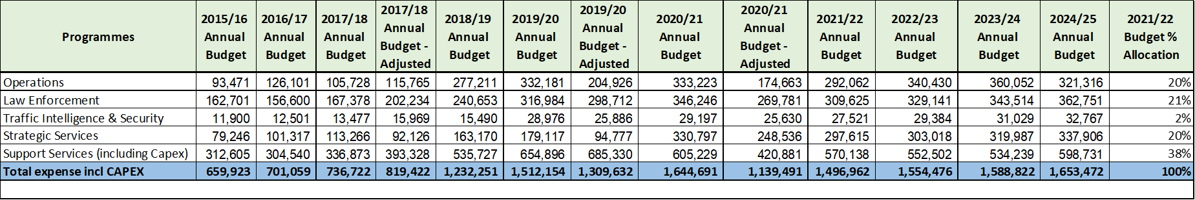
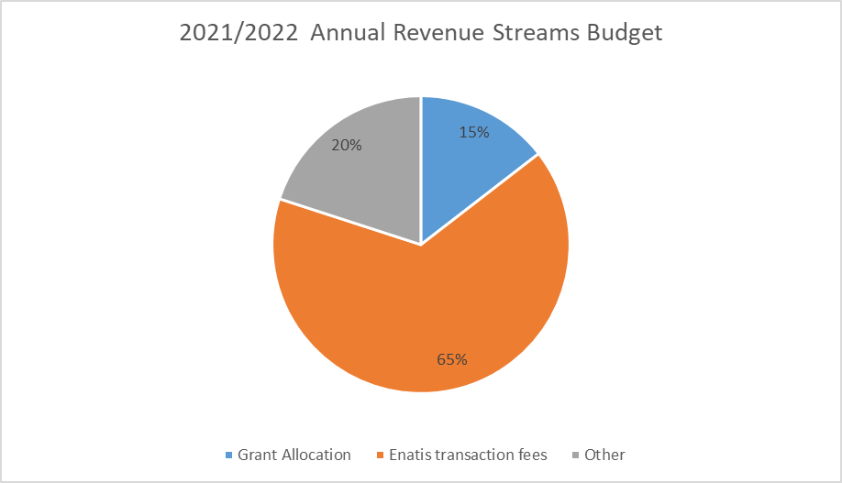
Budget per programme
Budget allocation dependent on the ability to generate revenue
Decrease in grant allocation from R220m for 2020/2021 to R217million for 2021/22
Implementation of revenue streams urgent

Slide 36
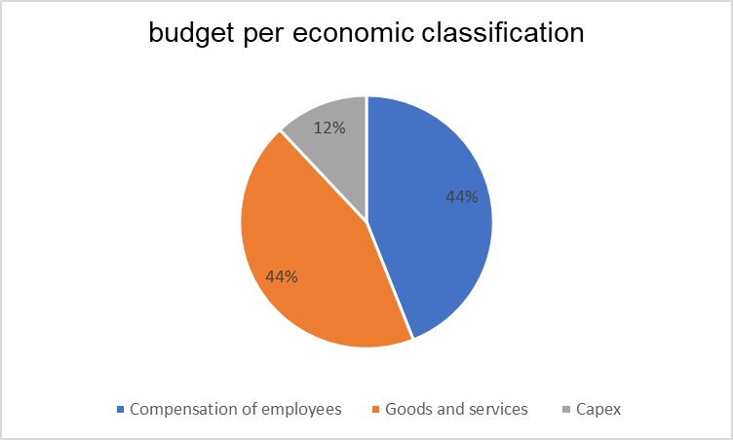
Budget per economic classification
Some of the budget pressures include:
Training of traffic trainees throughout the next three years
NaTIS – provisioning of equipment, upgrade, and maintenance of the system
Establishing of a Centre of Excellence Implementation of the National Road Safety Strategy Permanent office accommodation

Slide 37
Contents
Key policies and alignment
Organisational overview
SP&APP
Budget Allocation
Discussion
Strategic Risks

Slide 38
Strategic Risks
Outcome | Key Risk
Reduced Road Fatalities | Inability to deliver on our mandate thus leading to the Corporation losing relevance amongst stakeholders.
High Performing Organisation | The Corporation's new operating model and the resultant new Organizational Structure failure to achieve its intended objectives. Lack of comprehensive disaster recovery planning encompassing plans to minimize the risk of pandemics like COVID-19 .
Reduce Fraud and Corruption | Failure to reduce fraud and corruption within the traffic fraternity. Risk of non-compliance with laws and regulations including inadequate preparedness to fully comply with all provisions of the Protection of Personal Information Act- The RTMC is the custodian of confidential personal information which must be protected.
Implementation of innovative technology to protect road infrastructure | Lack of comprehensive ICT Strategy aimed at providing the necessary alignment between business and our ICT trajectory thus ensuring optimal technologies are thus implemented. *

Slide 39
Contents
Key policies and alignment
Organisational overview
SP&APP
Budget Allocation
Discussion
Strategic Risks

Slide 40
In closing

