Slide 1
Presentation to the Parliamentary Portfolio Committee on Higher Education, Science and Technology
7 May 2021

Slide 2
Contents
Implementing NRF Strategy 2025
Annual Performance Plan (APP)
Financial Overview
Concluding Remarks

Slide 3
Outcomes
Implementing NRF Strategy
2025
Numerical Targets
Interventions

Slide 4
Strategy 2025 Outcomes and Targets
Outcome | Outcome Indicator | Baseline | Five year target
A transformed (internationally competitive and sustainable) research workforce | Profile of NRF-funded post-graduate students who have completed their studies | Black 74% Women 54% | Black 80% Women 55%
 | Profile of NRF-funded researchers producing research outputs | Black 31% Women 33% | Black 48% Women 42%
Enhanced impact of the research enterprise | Entrenchment of knowledge and societal impacts in excellent research supported by the NRF | Focus on knowledge impact assessment ex-ante only | Portfolio of excellent research supported by the NRF justified with sound ex-ante and ex-post Knowledge and Societal Impact
 | Inclusive support of all domains of science | Portfolio of investments in different research domains | Balanced portfolio of NRF research investments across the knowledge domains
 | Evidence-based decision-making to enhance the impact of the research enterprise | Decision-making currently based on limited information and data | Improved organisational and NSI analytics and its use in strategic decision-making
Enhanced impact of science engagement (SE) | Engaged science entrenched in the research enterprise | Once-off, short-term, activity-based interventions, within a limited resource base | A fully integrated science engagement programme which meets the needs of the diverse NRF engagement chain
A transformed organisation that lives its culture and values | Representation of designated groups in leadership, management, and supervisory (P1-7 occupational levels) | Women 26.7% Black 45.8% | Women 38% Black 55% (Towards mirroring the NRF Employment Equity Plan targets)
 | Inclusive, enabling and learning organisation | Baseline employee survey results | Annual 10% improvement on employee satisfaction index
 | A co-created culture enhancing high performance and service excellence | Baseline culture survey results | Annual 10% improvement on employee satisfaction index

Slide 5
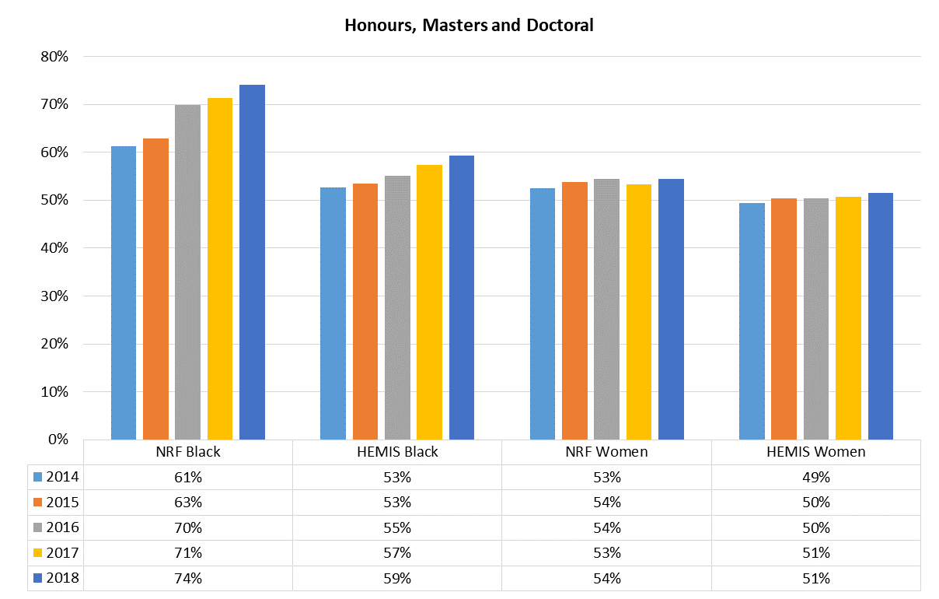
Outcome 1: A Transformed Research Workforce
A. NRF Funded Student Graduation vs HEMIS Student Graduation Profiles
Strategy 2025
80%
Strategy 2025
55%

Slide 6
B. NRF Funded Researchers vs HEMIS Staff Profiles
Strategy 2025
48%
Strategy 2025
42%

Slide 7
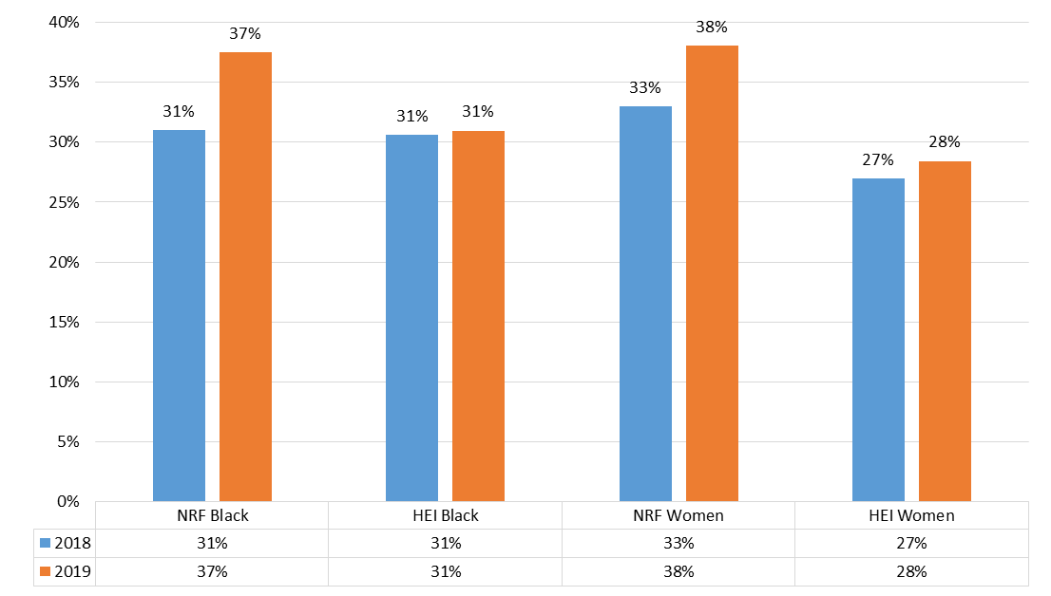
C. NRF-funded Researchers Producing Research Outputs vs HEI Author Profiles
Strategy 2025
48%
Strategy 2025
42%

Slide 8
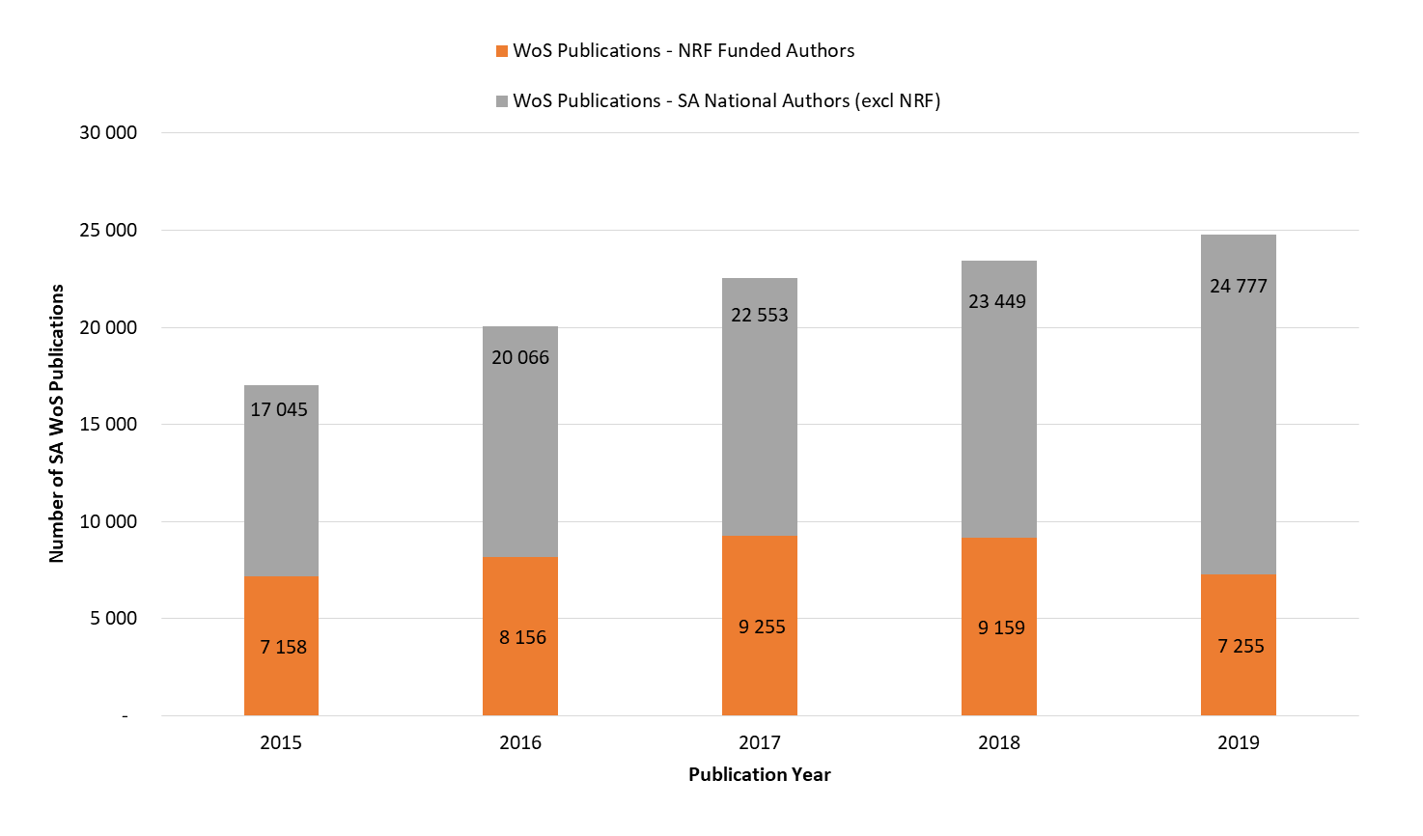
Web of Science Publications – NRF Funded Authors (2015 to 2019)
Outcome 2: Enhanced Impact of the Research Enterprise
NOTE: 2019 Decline is due to changes in the Incentive Funding for Rated Researchers programme, resulting in a significant reduction in the number of NRF-rated researchers receiving funding from the NRF on an annual basis.

Slide 9
Interventions over the MTSF Period
Develop and implement a Leading Researchers and Scholars Programme (LRSP) in consultation with the DSI and DHET.
Advance the NRF Framework on Equality, Diversity and Inclusivity (EDI) with a specific focus on African and Coloured women.

Slide 10
Interventions over the MTSF Period
Develop and implement an NRF Research Agenda to inform investments as a mechanism for steering the knowledge enterprise towards impact. The Research Agenda will be aligned to the DSI Strategy and will factor in dimensions from the DSI Decadal Plan.
Develop a Research and Development Information Platform (RDIP) as a single point of entry to obtain comprehensive R&D data and analysis.
Develop and implement a Research Impact Framework to provide direction on the design and execution of NRF programmes to facilitate the organisation’s contribution to national development.

Slide 11
Outcome 3: Enhanced Impact of Science Engagement
Focus areas and Interventions over the MTSF Period:
Embed an Engaged Research Framework within the research enterprise to encourage approaches to science and society engagement and involvement across the NRF.
Support the development of STEMI education.
Enable public access to research and science engagement infrastructure.
Build science engagement capacity and capability.
Facilitate public/private sector relations in science engagements for public benefit.

Slide 12
Outcome 4: A Transformed Organisation that lives its Culture and Values
Focus areas and interventions over the MTSF Period:
Introduced the re-alignment of the NRF to enhance strategic planning informed by information and enhancing leadership.
Position the organisation to impact, shape and influence all aspects of the research and knowledge enterprise.
Enable a fit for purpose structure to support agility, responsiveness and sharing of resources and expertise across the organization.
Continue transformation efforts in line with employment equity targets and affirmative action measures.
Develop a strategically-oriented funding framework which would enable a greater degree of long term planning and enable the NRF to better achieve its mandate and strategy.

Slide 13
Programmes, Indicators
and Targets
Annual Performance Plan
Planned Activities / Priorities

Slide 14
Delivery of the APP through NRF Programmes
The NRF has four (4) Programmes, viz.:
Programme 1: Administration which includes Finance and Business Systems; HR and Legal Services; Corporate Communications; and Strategy, Planning and Partnerships.
Programme 2: Science Engagement supporting and promoting public awareness of, and engagement with, science.
Programme 3: Research and Innovation Support and Advancement (RISA) which includes the support and funding of researchers and postgraduate students across the NSI through various programmes and strategic interventions.
Programme 4: National Research Infrastructure Platforms (NRIPs) for provision of domain-balanced and globally competitive research infrastructure platforms for the research enterprise.

Slide 15
Programme 1: Administration Indicators and Targets
Output/ | Indicators | Audited Actual Performance |  | Estimate | Annual Targets MTEF Period
 |  | 2018/19 | 2019/20 | 2020/21 | 2021/22 | 2022/23 | 2023/24
A transformed leadership and management cohort | Proportion of employees from designated groups at Peromnes levels 1-7 | - | 46% | 48% | 49% | 51% | 53%
Predictable and sustainable resourcing of the NRF mandate | Organisation overheads as a proportion of total expenditure | 7.5% | 7.7 % | <10% | <10% | <10% | <10%

Slide 16
Planned Performance over the Medium-term Period
Fully roll out the Research output harvesting tool.
Operationalise the African Open Science Platform (AOSP).
Fully implement the Enterprise Resource Planning (ERP) system.
Advance the Monitoring and Evaluation Framework.
Continue with the Diversity Management Programme.
Advance the Stakeholder Engagement Strategy.
Programme 1
Notes:
In order for the NRF to deliver on its mandate and support the knowledge enterprise, it requires:

Slide 17
Programme 2: Science Engagement Indicators and Targets
Output/ | Indicators | Audited Actual Performance |  | Estimate | Annual Targets MTEF Period
 |  | 2018/19 | 2019/20 | 2020/21 | 2021/22 | 2022/23 | 2023/24
Support of the development of STEMI education | Number of learners, educators and students reached through school/HEI based initiatives (in support of the school and HEI curriculum). | 174 081 | 226 813 | 70 000 | 31 265 | 31 265 | 31 265
Support for Engaged Research | Number of NRF grant holders and National Facility scientists undertaking/supporting science engagement and engaged science. | - | - | - | 240 | 220 | 250
Enabling public access to research and science engagement infrastructure | Number of NRF supported public Science Engagement interventions at research and science engagement infrastructure across the NSI. | 15 | 19 | 9 | 10 | 10 | 10
Building science engagement capacity and capability | Number of scientist/journalists that use indigenous languages in science communication. | - | - | - | 320 scientists /journalists | 352 scientists /journalists | 387 scientists /journalists

Slide 18
Planned Performance over the Medium-term Period
Creating a fit-for-purpose SAASTA to fulfil its leadership role of the science engagement mandate of the NRF and its role as a National Coordinator of Science Engagement across the NSI.
Focussing NRF investment on identifying and nurturing talent in STEMI.
Programme 2
Notes:
In order for the NRF to deliver on its mandate and support the knowledge enterprise, it requires:

Slide 19
Programme 3: Research and Innovation Support and Advancement Indicators and Targets
Output | Indicators | Audited Actual Performance |  | Estimate | Annual Targets MTEF Period
 |  | 2018/19 | 2019/20 | 2020/21 | 2021/22 | 2022/23 | 2023/24
Funded Postgraduate students | Number of NRF funded postgraduate students at all qualification levels | 12 732 | 11 167 | 10 255 | 7 414 | 6 476 | 6 265
Funded Researchers | Number of NRF funded researchers (including next generation-, emerging-, and established-researchers) | 5 441 | 3 985 | 4 412 | 4 521 | 4 526 | 4 526
Knowledge produced by NRF supported researchers | Number of peer-reviewed publications produced by NRF Funded researchers (including from NNEP, NEP and SRE) | 9 159 | 7 255 | 9 342 | 9 250 | 9 300 | 9 400
Note: Reduction in PG students due to implementation of the DSI/NRF Postgraduate Student Funding Policy.

Slide 20
Planned Performance over the Medium-term Period
In 2021/22 the first cohort of students are being funded under the new DSI-NRF Postgraduate Student Funding Policy.
The 2020/21 equipment grant budget will be deployed in support of new NEP grants and the SRE grant for the Hydrogen Intensity and Real-time Analysis eXperiment (HIRAX) Telescope.
Continue the development and implementation of a new framework for training Instrument Scientists and Technical Professionals.
Programme 3
Notes:
In order for the NRF to deliver on its mandate and support the knowledge enterprise, it requires:

Slide 21
Programme 4: National Research Infrastructure Platforms Indicators and Targets
Output | Indicators | Audited Actual Performance |  | Estimate | Annual Targets MTEF Period
 |  | 2018/19 | 2019/20 | 2020/21 | 2021/22 | 2022/23 | 2023/24
Diversity of student cohorts accessing RIPs | Proportion of South African Postgraduate Students from designated groups who are users of NFs. | - | - | 76% | 76% | 80% | 81%
Diversity of researchers accessing RIPs | Proportion of South African Researchers from designated groups who are users of NFs | - | - | 34% | 39% | 40% | 41%

Slide 22
Programme 4 - NRIPs Indicators and Targets
Output | Indicators | Audited Actual Performance |  | Estimate | Annual Targets MTEF Period
 |  | 2018/19 | 2019/20 | 202021 | 2021/22 | 2022/23 | 2023/24
Socio-Economic contribution of NFs | Foreign income (Rand million) derived from NFs activities or operations | - | - | R61.8 | R63.8 | R147.6 | R391.4
 | Number of employees from rural towns adjacent to NFs operating sites that are employed by the NFs | - | - | - | 265 | 266 | 266
Knowledge translation for societal benefit | Number of patient doses generated from radioisotopes produced by iThemba LABS | - | - | 147,000 | 167,500 | 171,500 | 275,000
Knowledge | Number of WoS publications by NFs | 567 | 640 | 557 | 455 | 445 | 445
Successful establishment of scientific infrastructure by NFs | Number of MeerKAT+ antenna foundations, and related Infrastructure completed by SARAO | - | - | - | 10 MK+ foundations completed | 14 x MK + foundations completed | Nil
 | Progress in implementation of the SAIF Project by iThemba LABS | - | - | - | 75% | 95% | 100%
 | Number of SALT Gen 1.5 sub-projects being implemented by SAAO | - | - | 2 installed | 4 installed | 1 completed | 2 completed

Slide 23
Planned Performance over the Medium-term Period
Conceptualisation of social sciences and e-infrastructure research platforms.
Manage the build of the South African Isotope Project (SAIF) at iThemba LABS.
MeerKAT Extension Project for SARAO and build up to the initiation of the SKA-MID1 Project.
South African Large Telescope Generation 1.5 Strategic Instrumentation Initiative (SALT Gen 1.5 SII) by the SAAO.
Further roll out of the Expanded Freshwater & Terrestrial Environmental Observation Network (EFTEON) for SAEON.
Refurbishment of the Research Vessel Phakisa and roll out of specialized Marine Science Laboratories at partner HBUs at SAIAB.
Programme 4
Notes:
In order for the NRF to deliver on its mandate and support the knowledge enterprise, it requires:

Slide 24
Income Trends
Financial Overview
Expenditure Trends
Budget Allocation

Slide 25
NRF Financial Overview
NRF funding is primarily received through four income streams:
Parliamentary grant (20%);
DSI contract funding (72%);
Other contract income (5%); and
Sundry income (3%).
72% of the total budget is pre-determined through DSI and other contracts whilst only 28% can be directed by the Board with Ministerial approval though the APP.

Slide 27
Other Sources of Funding
NRF uses funding instruments that include co-investments by partners for programmes such as SARChI, CoEs, Thuthuka, etc. These result in an additional annual average funding of R1,4 billion.
Intellectual Property (IP) generated through investment in the SKA project is being tracked and in the process of being interrogated with potential partners to be exploited towards further benefit to the country and the research endeavor.
Strategic Research Infrastructure projects such as the SKA project, SALT, etc. involve inflows of foreign direct investment for SA from partner countries.
The investment in the SA Isotope Facility (SAIF) project is expected to increase radio-isotope sales from an average of R50 million per annum to in excess of R200 million per annum once fully operational.
Notes:
Foreground:
cost of living and
Forex
During the 2018/19 financial year, the NRF will receive parliamentary grant appropriation of R905m. This will be augmented by R3,418bn of contracts making annual income of R4,323bn . This is a reduction of R823m in nominal terms. While this translates to a decrease of 20% in real terms, the NRF will continue to, effectively and efficiently, within these parameters, support the research community in terms of its mandate. The organisation will also continue to uphold its unwavering commitment to transformation, a strong service culture, good governance, sustainability, and research excellence.

Slide 28
NRF Expenditure Trend
Note: **The negative net capital expenditure is due to depreciation following the capitalization and commissioning of the MeerKAT telescope in 2019.
Notes:
Foreground:
cost of living and
Forex
During the 2018/19 financial year, the NRF will receive parliamentary grant appropriation of R905m. This will be augmented by R3,418bn of contracts making annual income of R4,323bn . This is a reduction of R823m in nominal terms. While this translates to a decrease of 20% in real terms, the NRF will continue to, effectively and efficiently, within these parameters, support the research community in terms of its mandate. The organisation will also continue to uphold its unwavering commitment to transformation, a strong service culture, good governance, sustainability, and research excellence.

Slide 29
PG Budget Allocation for Programmes
Programme | NRF baseline allocation from DSI | 2019/20 | 2020/21 | 2021/22 | 2022/23 | 2023/24
 |  | R’000 | R’000 | R’000 | R’000 | R’000
1 | Administration* | 97 646 | 85 156 | 109 836 | 110 905 | 110 438
2 | Science Advancement | 26 366 | 27 013 | 28 229 | 28 999 | 29 151
3 | RISA | 502 107 | 470 242 | 491 402 | 504 528 | 507 007
4 | National Research Infrastructure Platforms (NRIP) | 317 266 | 312 076 | 333 120 | 341 770 | 343 395
 | Deferred infrastructure projects |  | (25 000)
 | Total NRF Parliamentary Grant | 943 385 | 869 487 | 962 587 | 986 202 | 989 991
 | Year-on-year baseline movement | 4,3% | -7,8% | 10,7% | 2,5% | 0,4%
* Includes the ERP and contingency funding in the event of budget cuts.

Slide 30
Internationalisation and Partnerships
COVID-19 Africa Rapid Grant fund was launched in May 2020 for two-year grants in 17 countries supported by a number of international funders.
Additional international grants through Africa partnerships and initiatives like the Belmont Forum’s Collaborative Research Actions (CRAs), Future Earth initiatives, etc. will also be supported.
A partnership between the Government Technical Advisory Committee (GTAC), the DPME and the NRF has been formalised to develop the report, assessing the effectiveness of interventions adopted by SA to combat the spread and socio-economic impact of the pandemic.

Slide 31
Internationalisation and Partnerships
SA-BRICS Research Collaboration
For the past 5-years the NRF has been participating in the BRICS STI Framework Programme (BRICS STI-PF) and is party to the annual joint multilateral calls for research proposals.
A total of 93 joint projects, of which 31 for NRF have been supported through this partnership.
A BRICS call focusing on health, in particular the COVID-19 pandemic, was launched in 2020 to support joint projects starting from 2021 – 2023.
In order to strengthen this research collaboration, during 2021-2025 all BRICS countries have approved the second Phase of the BRICS STI Framework Programme.

Slide 32
Emerging Priorities
NRF contributes to the Economic Reconstruction and Recovery Plan through the funding of research directed at solving some the grand challenges like pandemics (e.g., HIV/AIDS and COVID-19), Climate Change, Marine Research, and contributing to job creation through its research infrastructure built programme.
NRF will conduct a feasibility study for establishing a South African Centre for the Study of Pandemics (SACSoP) . The NRF anticipates that the SACSoP will be a multi-disciplinary virtual centre, akin to the DSI-NRF Centres of Excellence (CoEs).
Some specifics which the NRF will explore include the following:
Ensure the COVID-19 recovery is informed by the best available research;
Investigate the creation of a data platform for seamless sharing of research data.
Enable increased participation by SA researchers in international collaborations.

Slide 33
Concluding Remarks
Any planning for the future must factor in the potential impact of the COVID-19 pandemic on the performance and delivery of the NRF mandate. Resources are limited and the availability of public funds have been severely impacted upon due to the pandemic.
The transition towards implementing the DSI/NRF Post-graduate student funding policy will result in a decrease in the number of students funded as we move towards Full Cost of Study. The NRF with the DSI will continue to explore opportunities to fund those applications considered fundable.
Key large research infrastructure projects, viz., MeerKAT+ and SAIF are progressing well despite the COVID-19 lags.
The NRF has invested considerable efforts to manage recurring costs such as salaries and utility bills.
The NRF will take into consideration the outcomes of the Decadal Plan and the HESTIIL Review in its forward planning.

