Slide 1
PORTFOLIO COMMITTEE ON HIGHER EDUCATION, SCIENCE AND TECHNOLOGY
Virtual Meeting
7 May 2021

Slide 2
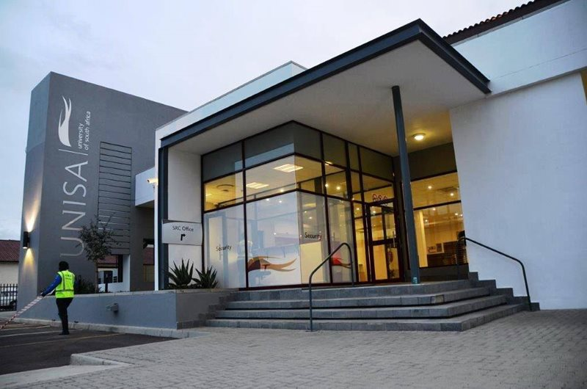
PROVIDING ACCESS TO QUALITY HIGHER EDUCATION FOR THE POOR AND WORKING CLASS
UNISA has been the single constant by being a genuine, dependable beacon of hope where, at times, there seemed to be no other in the provisioning of distance education in Africa. UNISA provides access to more that 400 000 adult learners for 130 countries globally. It’s a key driver of the higher education aspiration to achievement of NDP vision 2030
CONTRIBUTION TO LABOUR MARKETS
Continues to turn out more than 50 000 skilled and competent graduates annually
A third of South Africa’s Chartered Accountants annually graduate from UNISA
More than half of South African Teachers annually come from UNISA
Only Comprehensive open distance education institution that provides Quality Science, Engineering and Technology qualifications in the country
SHIFTING DEMOGRAPHICS
They indicate that the University has evolved from being primarily an education provider for working, part-time students.
Indeed, UNISA has evolved into being an institution that is now comprised of 30% of under-24-year-old and 40% unemployed students who might be studying on a full-time basis.
DIVERSE POPULATIONS
Caters for people with disabilities
Members of the working class
Mid career workers
School leavers
UNISA’s ROLE IN THE NATIONAL HE LANDSCAPE

Slide 3
PROVIDING ACCESS TO QUALITY HIGHER EDUCATION FOR THE POOR AND WORKING CLASS
RESPONSE TO COVID 19
Migration to online examinations in response to Covid-19
Research and innovation in the fight against Covid-19 (CSET):
Sanitisers
Masks
PROFILING OF UNISA ACADEMICS
Provision of commentary on national developments (Budget speech, State of the Nation address, State of the Nation, State capture commission, Opening of the school year, etc.)
Profiling of Unisa research and innovation initiatives in the media
TRANSFORMATION
Memorial lectures on National figures: contribution to nation transformation discourse
Integrated student support initiative (rapid response to students’ queries)
UNISA’s HIGHLIGHTS

Slide 4
CONTENTS
ITEM 04
Outcome of the court case lodged by the EFF Student Command and the Black Lawyers Association (BLA) Student Chapter against the Minister of Higher Education, Science and Innovation and UNISA.
ITEM 03
Consequence Management.
ITEM 02
Reasons for the non-compliance of the UNISA Enrolment Plan.
ITEM 01
Five-year UNISA Enrolment Plan.

Slide 5
ITEM0-1: FIVE-YEAR UNISA ENROLMENT PLAN
Outline
Corrective Measures
Enrolment Management - An Elusive Target
Unisa Enrolment Management
Enrolment Planning at UNISA
UNISA’s role in the National HE land scape
FTEN vs NSFAS

Slide 6
ENROLMENT PLANNING PROCESS
AEAHRPC
Recommendation to Senate as per TOR
Senate
Recommend to Council for approval as per DOA 7.3
ASACoC
Council approval as per DOA 7.3
Council
Recommend to Council for approval as per DOA 7.3
College
College Board engagement and sign off
ENROLMENT PLANNING AT UNISA
* Subject to the Council and Ministerially approved Six Year Plan

Slide 7
APPROVED DHET-UNISA
SIX-YEAR ENROLMENT PLAN

Slide 8
2020 ENROLMENT PLAN
Focus |  | Council and Ministerial Approved 2020 Targets |  | 2020 Actual (Unaudited) |  | % Deviation
Headcount enrolments |  | 376 000 |  | 402 632 |  | 7%
First-Time Entering undergraduate headcounts enrolments |  | 57 703 |  | 82487 |  | 43%
FTE enrolments |  | 221 840 |  | 237 935 (projected) |  | 7%
FTE to head count enrolments |  | 59% |  | 59% |  | 0%
Qualification levels | Undergraduate diplomas & certificates | 93 860 | 25% | 131 169 | 33% | 40%
 | Advanced diploma | 11 287 | 3% | 7727 | 2% | 32%
 | Undergraduate degrees | 210 016 | 56% | 213 993 | 53% | 2%
 | Postgraduate to masters level | 41 381 | 11% | 35 642 | 9% | -14%
 | Masters | 5 662 | 2% | 5723 | 1% | 1%
 | Doctors | 2 850 | 1% | 3624 | 1% | 27%
 | Occasional | 10 944 | 3% | 4748 | 1% | -57%
Fields of study | Science, engineering, technology | 44 422 | 12% | 36 559 | 9% | -19%
 | Business/management | 130 150 | 35% | 109 720 | 27% | -16%
 | Education | 96 966 | 26% | 103 693 | 26% | 7%
 | Other humanities | 104 462 | 28% | 116 237 | 29% | 11%
 | Unknown |  |  | 36 417
Distance headcount enrolments |  | 376 000 |  | 402 632 |  | 7%

Slide 9
REVISED 2021 ENROLMENT PLAN
Focus |  | Council and Ministerial Approved 2021 Targets |  | 2021 Post Court Case Enrolments |  | % Deviation
Headcount enrolments |  | 376 468 |  | 396 468 |  | 5%
First-Time Entering undergraduate headcounts enrolments |  | 57 857 |  | 57 857 |  | 0%
FTE enrolments |  | 210 822 |  | 222 022 (projected) |  | 5%
FTE to head count enrolments |  | 56% |  | 56% |  | 0%
Qualification levels | Undergraduate diplomas & certificates | 93 860 | 25% | 114 081 | 29% | 22%
 | Advanced diploma | 11 287 | 3% | 11 071 | 3% | -2%
 | Undergraduate degrees | 210 484 | 56% | 222 988 | 56% | -3%
 | Postgraduate to masters level | 41 381 | 11% | 33 749 | 9% | -18%
 | Masters | 5 662 | 2% | 5 199 | 1% | -8%
 | Doctors | 2 850 | 1% | 3 330 | 1% | 17%
 | Occasional | 10 944 | 3% | 6 050 | 2% | -45%
Fields of study | Science, engineering, technology | 44 422 | 12% | 44 019 | 12% | -1%
 | Business/management | 130 150 | 35% | 110 737 | 29% | -15%
 | Education | 96 966 | 26% | 113 840 | 28% | 7%
 | Other humanities | 104 462 | 28% | 127 872 | 31% | 13%
Distance headcount enrolments |  | 376 468 |  | 396 468 * |  | 5%
Notes:
* The difference between 376 468 and 396 468 is to due to the additional 20 000 FTENs

Slide 10
2021 PROJECTED ENROLMENT PLAN
As 5 May 2021
Focus |  | 2021 Post Court Case Enrolments |  | % Deviation | 2021* Registrations | 2021 Temporary Registrations | % Deviation | % Deviation (Incl TP)
Headcount enrolments |  | 396 468 |  | 5% | 369 342 | 61493 | -7% | 9%
First-Time Entering undergraduate headcounts enrolments (DSAR) |  | 57 857 |  | 0% | 37 484 | 8 727 | -35% | -20%
First-Time Entering undergraduate headcounts enrolments (DII) |  | 57 857 |  | 0% | 39 450 | 8718 | -32% | -17%
FTE enrolments |  | 210 822 (projected) |  | 5%
FTE to head count enrolments |  | 56% |  | 0%
Qualification levels | Undergraduate diplomas & certificates | 114 081 | 30% | 22% | 113 638 | 19 319 | -0,4% | 17%
 | Advanced diploma | 11 071 | 3% | -2% | 7 261 | 2 167 | -34% | -15%
 | Undergraduate degrees | 222 988 | 54% | -3% | 206 831 | 27 279 | -7% | 5%
 | Postgraduate to masters level | 33 749 | 9% | -18% | 31 620 | 10 088 | -6% | 24%
 | Masters | 5 199 | 1% | -8% | 5 115 | 1 356 | -2% | 24%
 | Doctors | 3 330 | 1% | 17% | 2 883 | 895 | -13% | 13%
 | Occasional | 6 050 | 2% | -45% | 1 994 | 389 | -67% | -61%
Fields of study | Science, engineering, technology | 44 019 | 12% | -1% | 33 253 | 6 191 | -24% | -10%
 | Business/management | 110 737 | 29% | -15% | 96 764 | 18 342 | -13% | 4%
 | Education | 113 840 | 28% | 7% | 95 312 | 13 067 | -16% | -5%
 | Other humanities | 127 872 | 31% | 13% | 113 353 | 19 393 | -11% | 4%
 | Unknown |  |  |  | 30 660 | 4 500
Distance headcount enrolments |  | 396 468 |  | 5% | 369 342 | 61 493 | -7% | 9%
Notes:
Unknown: Not yet classified in AIMS

Slide 11
Processes after Court Order as of 25 March 2021
16 442
FTENs were registered
19 486
Temporary Registration (TPs)
35 928
Registrations + TPs
30 000
Offers made to FTENs
Processes after Court Order as of 6 May 2021
37 484
FTENs were registered
8 727
Temporary Registration (TPs)
46 211
Registrations + TPs
881
Cancellations

Slide 12
Internal and External Factors
Balancing Temporary Registrations (TPS) with confirmation from NSFAS
Managing the processing of Acknowledgement of Debts (AoDs) in relation to TPs
Balancing compliance with Court Order and compliance with approved Enrolment Plan
More importantly, attentive to disadvantaged students requiring entry not higher education
UNISA ENROLMENT MANAGEMENT

Slide 13
Dedicated Committee to Oversee enrolments
Monitors Enrolments against targets on a weekly basis
Multiple stakeholder task team with Academic at the core of the team
Analytics reviewed weekly to allow better decision making
Dashboards at Institutional, College, Qualification level, powered by real-time data
UNISA ENROLMENT MANAGEMENT

Slide 14
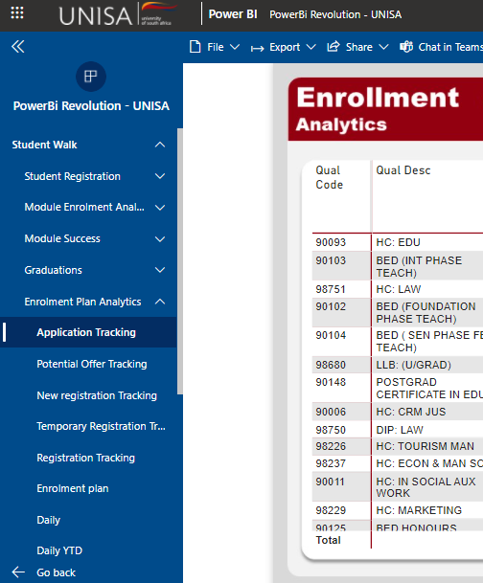
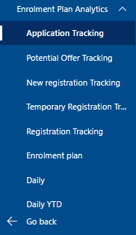
Monitoring System via PowerBI
UNISA ENROLMENT MANAGEMENT

Slide 15
HISTORICAL ACCOUNT OF ENROLMENTS AT UNISA
Unisa is just under 40% of public sector HE ( 400 000)
Historical challenges in managing enrolments due to a number of issues
2016 (Under enrolled)
2018 (Over enrolled)
2020 (Over enrolled)
2019 (Under enrolled)
2017 (Under enrolled) within 2%
ENROLMENT MANAGEMENT –
AN ELUSIVE TARGET

Slide 16
ACTUAL ENROLMENT PLAN vs PLAN 2104 – 2020
-17%
Attempted shift to new Stud System
+5%
Walk in applications on the back of Dec 2017 free fee pronouncement
+7%
Over mostly enrolment in HCs
-9% -6% -17% -2% 5% -4% 7%

Slide 18
KEY POINTS
The total NSFAS student number now represents 41% of total enrolments.
This has grown from sub 20% five years ago.
Within the 2020 FTEN cohort, the NSFAS ratio is 75%, which has rapidly grown over the past 5 years.
There are no quotas set.
2020 FTEN ENROLMENTS
Total NSFAS including non 2020 FTEN enrolments 165 658
2020 Target: 57 703
2020 FTEN Provisional Enrolment: 82 487
2020 FTEN NSFAS: 61 015
FTEN vs NSFAS ENROLMENTS

Slide 19
ITEM02: REASONS FOR THE NON-COMPLIANCE WITH THE UNISA APPROVED ENROLMENT PLAN

Slide 20
REASONS FOR OVER ENROLMENTS
The fact that student culture of not adhering to the 10 day acceptance period, due to access to communication channels, email access, smartphone access, etc. or simply a culture of non-acknowledgement exacerbates the challenges of managing the FTEN cohort.
As part of the cooperative agreement with the TVET colleges are obligated to accommodate student for Higher Certificate
Systems that are fit for purpose for the complexities of planning and managing in a mega University enrolment are currently in development and hence the management in enrolments remain a challenge.
A high demand for space for the Higher Certificate (an articulation route as an access form a key attribute of a comprehensive university)
NSFAS cases, which also would have been confirmed post registration finalisation
A considerable number of NSFAS FTEN recipients only received confirmation late into the registration process.
Being among one of the Universities that allow access through the higher certificate as an entry point to University education

Slide 21
ITEM03: CONSEQUENCE MANAGEMENT
Major challenge is to reconsider the Temporary Registrations (TPs) and Mancom is reviewing this process to require that students pay to register.
Streamline enrolment committee processes and decisions to utilise the newly developed Analytics
The University has engaged with the two committees responsible for this function to request them to take corrective measures on over enrolments
Consider the full implementation of corrective measures

Slide 22
Culture Change
Balance between demand and supply (and political pressure)
Student confirmation of offers and better NSFAS liaison
Automation
Dedicated Committee to Oversee enrolments
Automate current Enrolment Plan workbook (Excel Format
build a component within student system to autonomously manage enrolment
build a report or dashboard to monitor the enrolment against targets per qualification
Monitors Enrolments against targets on a weekly basis
Multiple stakeholder task team with Academic at the core of the team
Analytics reviewed weekly to allow better decision making
Dashboards at Institutional, College, Qualification level, powered by real-time data
CORRECTIVE MEASURES

Slide 23
Things to consider
Creating a favourable policy context for UNISA to manage its enrolments within agreed upon targets over a 3 or a 5 year period but not annually due to its size and complexities it deals with.
Government to subsidies students up to what is affordable for the state and UNISA to be allowed increase up to its carrying capacity and the state not to fund extra capacity.
UNISA be allowed to increase its numbers to cover HE short fall in respect to the NDP targets while maintain quality and appropriate workloads for staff.
The University be allowed to work with TVET sector to accommodate the Higher Certificate courses and those numbers carried as TVET numbers.

Slide 24
The purpose of Higher Certificates (NQF 5)
Access pathway
Vocational purpose - example
To provide an opportunity for access, with a reasonable chance of success, to candidates with potential who otherwise would not meet the entry requirements to first year undergraduate Degree/Diploma qualifications offered.
The curriculum is aimed at providing students with the necessary basic skills to succeed in the Open Distance Learning (ODeL) environment.
The purpose of the learning therefore will be to enhance generic competencies within ODeL such as basic language and learning skills, information management skills and discipline specific knowledge.
Completion does not guarantee acceptance.
Qualifying students will have acquired the knowledge and skills specified by the South African Veterinary Council for the para-veterinary profession of Veterinary Welfare Assistant.
The qualification strives to promote animal welfare awareness and a commitment to ethical animal care and well-being.
It further aims to alleviate the severe shortage of veterinary-related skills in South Africa by providing qualified Veterinary Welfare Assistants to work in support of animal welfare organisations in communities across the country.

Slide 25
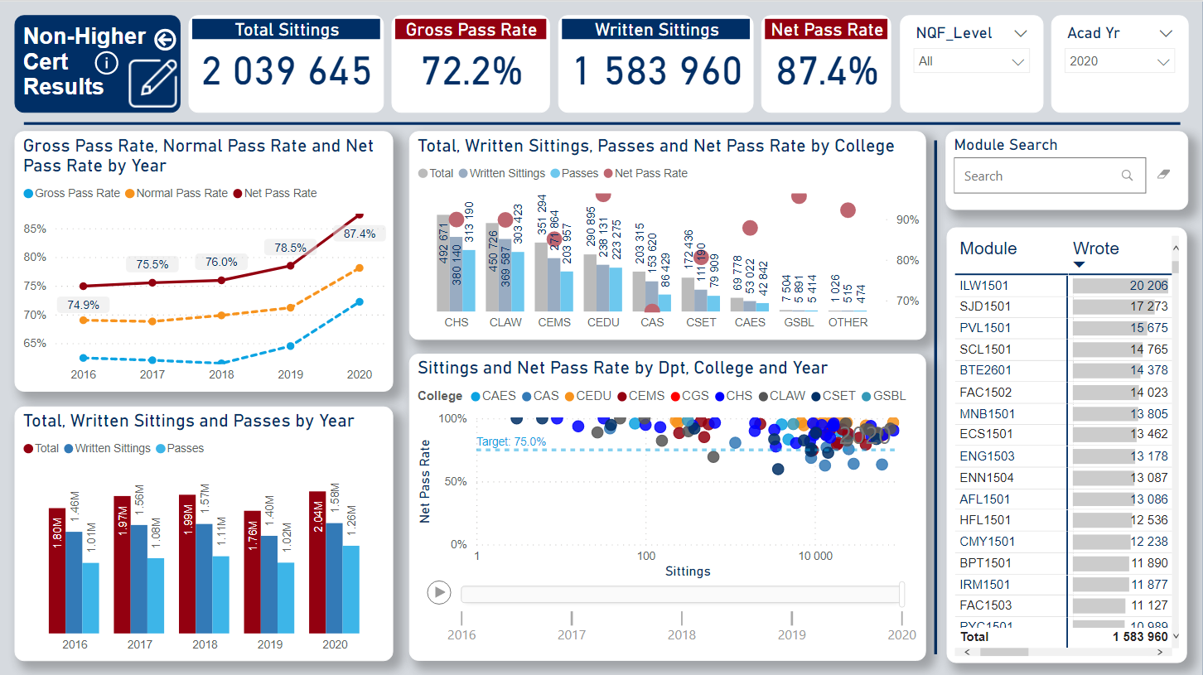
How the FTE Students Performed

Slide 26
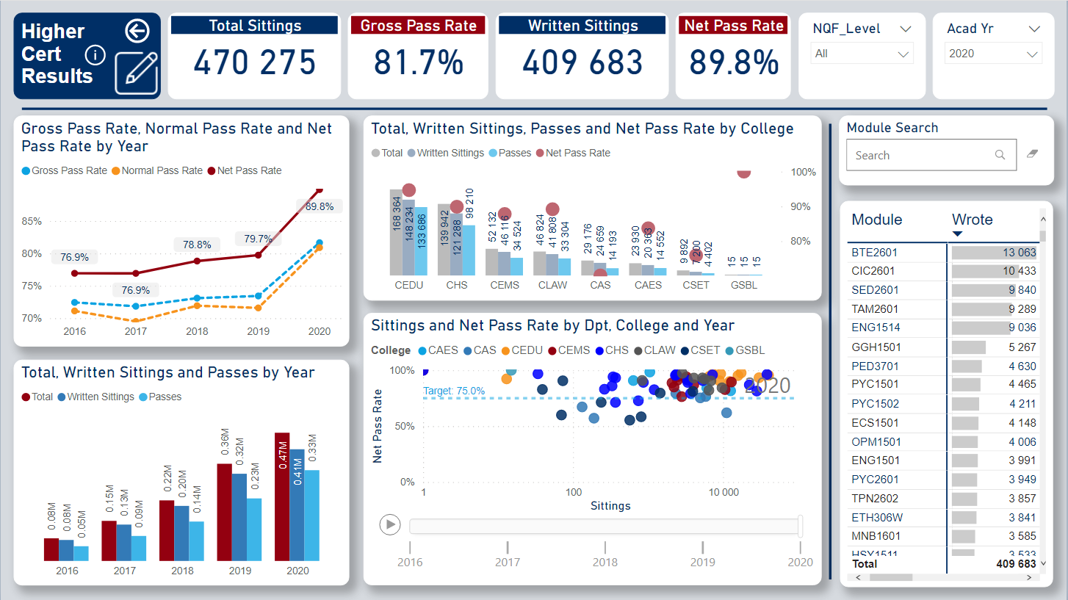
How Higher Certificate Students Performed

Slide 27
ITEM04: OUTCOME OF THE COURT CASE LODGED BY THE EFF STUDENT COMMAND AND THE BLACK LAWYERS ASSOCIATION (BLA) STUDENT CHAPTER AGAINST THE MINISTER OF HIGERE EDUCATION, SCIENCE AND INNOVATION AND UNISA.
Outline
Basis for the Implementation of the Court Orders
The Court Order
Hearing of the Cases
Introduction
The Court Cases
Appeal and Implementation of the Orders

Slide 28
During March 2021 two court applications were filed against the university by:
The Economic Freedom Fighters Students Command (EFFSC) under Case number 9388/21(BLASC)
The Black Lawyers Association Students Chapter (BLASC) under Case number 7146/21 (EFFSC)
THE COURT CASES
The Parties
The EFFSC and BLASC (Applicants) brought two separate applications against the following Respondents:
The Minister of Higher Education Science and Technology
University of South Africa and
Executive Council: UNISA
Council of university of South Africa
Senate of the university of South Africa
The South African Human Rights Commission was cited as Amicus Curiae

Slide 29
INTRODUCTION AND HEARING OF THE CASES
Applications
Impugned decisions
The applications were brought in terms of the Promotion of Administrative Justice Act 3 of 2000 (PAJA).
The directive by the MINISTER to the University, Executive Council and Council to reduce 2021 intake of first-time entering (FTEN) students by 20000 from the planned 57857 to 37857.
Hearing of the Cases
Alternatively in the principles of legality concerning the impugned decisions of the 1st and 2nd Respondents
The applications were opposed by both the Minister of Higher Education, Science and Technology and the University of South Africa
The decision by UNISA through the UNISA Executive Council for taking a decision to acquiesce to the decision of the MINISTER
The applications were heard together on the 04th of March 2021
The application were heard on an urgent basis as registration of students for academic year 2021 was closing on the 12th of March 2021.
The Court on the 11th of March 2021 granted the orders against the Respondent without providing the reasons for the orders. Thereafter reasons for order were requested

Slide 30
THE COURT ORDER: CASE NO. 9388/21(BLASC)
It is ordered that:
Decision reviewed and set aside
Application is heard as one of urgency in terms of Rule 6(12) of the Uniform Rules of the Court
3.1 The decision taken by the First Respondent to instruct the Second Respondent to reduce the number first time entering student by twenty thousand
It is ordered that:
4 the Second Respondent admit those students who have completed the Higher Certificate in law and Higher Certificate in Justice and meet the requirements for admission into the LLB degree
Applicant is exempted from pursuing any internal remedy referred in section 7(2) (a) and (b) of PAJA.
3.2 The decision taken by the Second Responded to reduce the number of first entering students by twenty thousand
3.3 The decision of the Second Respondent to scrap the semester systems and replace it with a year systems to the extent that it affects student who were enrolled at UNISA college of law in 2020 or at an earlier date but has not completed their studies with UNISA
5 Condonation is granted for late filing of first Respondent’s answering affidavit and heads of arguments
6 First and Second Respondents are order to pay the applicant’s costs jointly and severally on a party to party scale including the costs of two counsel.

Slide 31
THE COURT ORDER: CASE NO. 7146/21 (EFFSC)
It is ordered that:
Decision reviewed and set aside
The application is enrolled and heard as one of urgency under Rule 6(12) of the Uniform Rules of Court
5.1 Decision taken by the 1st Respondent to instruct the 2nd Respondent to reduce the number of first time entering students by twenty thousand
It is so ordered
Condonation is granted for late filing of the 1st Respondent’s answering affidavit.
Condonation is granted for late filing of application for admission of amicus Curiae and for truncating the time periods prescribed in Rule 16A(12) of the Uniform Rules of the Court
The 6th Respondent is admitted as Amicus Curiae
5.2 The decision taken by the 2nd Respondent to reduce the number of first time entering students by twenty thousand
6. The 1st and 2nd Respondents are ordered jointly and severally to pay the applicant’s coasts as between party and party including the costs of two counsels

Slide 32
APPEAL AND THE IMPLEMENTATION OF THE ORDERS
After the written reasons for the orders were received from the Judge; the Counsels appointed for both cases submitted to the university the MEMORANDUM of legal advise.
The Legal Service Office (LSO ) of the university reviewed both the written reasons of the judge and the MEMORANDUM of counsels and submitted a legal advisory MEMO to the Principal and Vice Chancellor for the university’s Management Committee’s(MANCOM) decision
After consideration of the legal advise obtained, MANCOM resolved to implement the Court Order with respect to case number 7146/21 (EFFSC) and order 1, 2, 3 (3.1), 3(3.2) and 4 of the Court Order with respect to case number 9388/21(BLASC)
The university’s Management Committee’s(MANCOM) took a decision to appeal order 3(3.3) of Court Order with respect to case number 9388/21(BLASC)

Slide 33
APPEAL ORDER 3(3.3): CASE NUMBER 9388/21 (BLASC)
Appeal Order 3(3.3)
Reasons for the appeal
The LSO of the university was authorised to instruct counsels to file leave to appeal order 3(3.3) of case number 9388/21(BLASC) .
The appeal with respect to order 3(3.3) of the Court Order on case number 9388/21 (BLASC) is aimed at ensuring that there is no judicial overreach on administrative expertise reserved for university academics and managers who have expertise and experience on what must be done or undertaken in improving the efficiency and effectiveness of academic programmes
Reasons for the appeal
3. The appeal, therefore, will correct the domineering of judicial order 3(3.3) over the expertise of university academics and the university executives and in so doing bringing about legal certainty.
On the 04th of May 2021 the university management had an online consultation with the Counsels appointed to prosecute the appeal. The Counsel will file and application to lead further evidence through affidavit in support for leave to appeal.
During consultation the Counsel informed the management that they are awaiting the Judge’s directive in respect of the set down of the leave to appeal.
4. In the event that the impugned order is not challenged and appealed against, it will remains a precedents for all the universities that the Courts can restrict and outwit the proficiency of academic experts in the determination and implementation of academic policies that are meant to enhance the efficient functioning and attainment of strategic goals of the university
In terms of the legal principles of precedents, order 3(3.3) is imperious on the expertise of the university executives in respect of implementation of university policies to ensure the attainment of strategic objectives of the university

Slide 34
BASIS FOR THE IMPLEMENTATION OF COURT ORDERS
There are legal and factual basis which the university has considered when taking a decision to implement
and NOT appeal the rest of the orders except order 3(3.3) for case number 9388/21 (BLASC).
The following are the factual and legal basis:
Interpretation of section 42(1) and section 39(3A) by the court.
Interpretation of section 37 of the Act read with section 7(2)(j) of the university Statutes
Interpretation of section 42(1) and section 39(3A) by the court.
Interpretation of section 37 of the Act read with section 7(2)(j) of the University Statutes
UNISA, through EXCOC failed to meaningfully and extensively consider the decision of Minister before taking its own decision due to truncated time frames imposed by the Minister
Legal Basis
Factual and Legal Basis
Section 42(1) read with section 39(3A) empowers the Minister to issue directive to Council if the Minister believes the institution has transgressed BUT it does not empower the Minister to issue a directive to temper or to instruct the institution to temper with its enrolment plan even if the over enrolment has financial implications
1.The Minster truncated the time frames such that the Council was unable to consult with the Senate. The Minister wrote the letter on 28 December 2020 giving 7 days to comply with the directive
Section 42(2) read with section 39(3B) ONLY empowered the Minister to withhold the payment if the institution fails to comply with the directive
2. EXCOC although acting on behalf of the Council it did not consult the Senate when it decided to implement the decision of the Minister or acquiesce to it
3. Section 37 of the Act requires Council to consult the Senate on admission policy. Council can determine the number of students to be enrolled with the approval of Senate

Slide 35
Rea Leboha

