Slide 1
Annual performance plan 2021/22
Portfolio Committee on Higher Education, Science and Technology
7 May 2021

Slide 2







Overview of presentation
01
02
03
04
05
06
Updates to situational analysis
Institutional performance information
Adjustments to Annual Performance Plan targets
Programme resource considerations
Key risks
Key projects and initiatives
Programme 1
Programme 2
HSRC Outcomes
Output indicator targets
Institutional revenue estimates
Estimates of expenditure
2

Slide 3
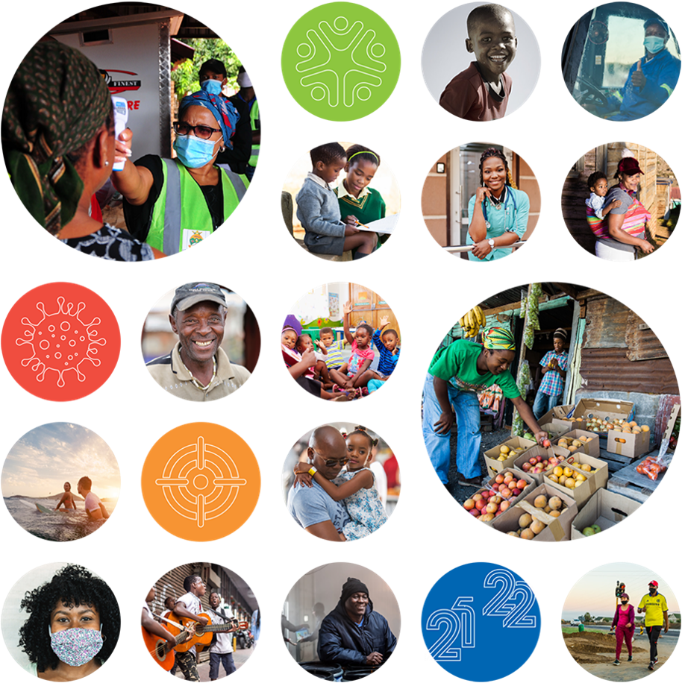
Updates to Situational Analysis
Covid-19
Opportunities
  Social sciences contribution
Threats
  Impact on economic environment and financial resources
Human Resources
Reduced CoE, wage freeze, salary cap
3
Notes:
COVID-19
Opportunities
There are positive indications that the new administration in the USA will put aid at the centre of its foreign policy. Focus areas are likely to include, amongst other, strengthening of health systems and addressing other impacts of COVID-19 and supporting democracy.
As a public social science institute, the HSRC has a definitive and distinct role to play in generating an understanding of a pandemic for which the best guidance available is based on social factors – social distancing and associated behavioural changes. The complexities around those factors in a society which is grossly unequipped for it, are questions for which social scientists are best prepared to respond. Paying attention now only to the biomedical and the pharmaceutical aspects of the crisis will not sufficiently address its complexity. A fuller response demands insights into and understanding of human behaviour and the multi-dimensional socio-economic fabric underpinning and influenced by such behaviour. Out of this could come an integrated and multidisciplinary response to the crisis. In this the HSRC will play a convening role in the social science community.
A further important point in addressing Covid-19 is acknowledging how significantly it is exacerbating the challenges of poverty and inequality in South Africa and globally. Mindful of its strategic commitment to assisting government in its objective of alleviating poverty and reducing inequality, the HSRC seeks also to assist the country and the world in finding ways of using the opportunity presented by the crisis to reset their political and social agendas.
Threats
Declining budgets as money is repurposed towards the COVD-19 response
As was highlighted in all previous institutional reviews, as well as in a climate survey conducted among all HSRC staff in 2016, the organisation needs to employ more senior researchers on permanent conditions of service to ease the burden of fund raising, and to provide reliable mentoring to its research trainees. Filling of vacancies for senior research staff has been constrained by salary caps implemented by the National Treasury and further reductions in the allocation for the Compensation of Employees (CoE). While the appointment of additional, new research staff is not possible to the extent required, opportunities for providing tenure to existing staff are being considered within the framework of enabling organisational policies.

Slide 4
Institutional performance information
Programme 1:
Administration
Office of the CEO
Office of the DCEO: Research
Group Executive: Impact Centre
Office of the CFO
Group Executive: Shared Services
Responsible for strategic direction and overall management of the HSRC

Slide 5
Institutional performance information (continued)
 | Sub-programme 1: Inclusive economic development
 | Sub-programme 2: Human and social capabilities
 | Sub-programme 3: Developmental, capable and ethical state
 | Sub-programme 4: Africa Institute of South Africa
 | Sub-programme 5: Centre for Science, Innovation and Technology Indicators
Programme 2:
Research, Development and Innovation
Basic and applied research to generate and apply knowledge with a distinct social science and humanities focus to support national developmental priorities

Slide 6
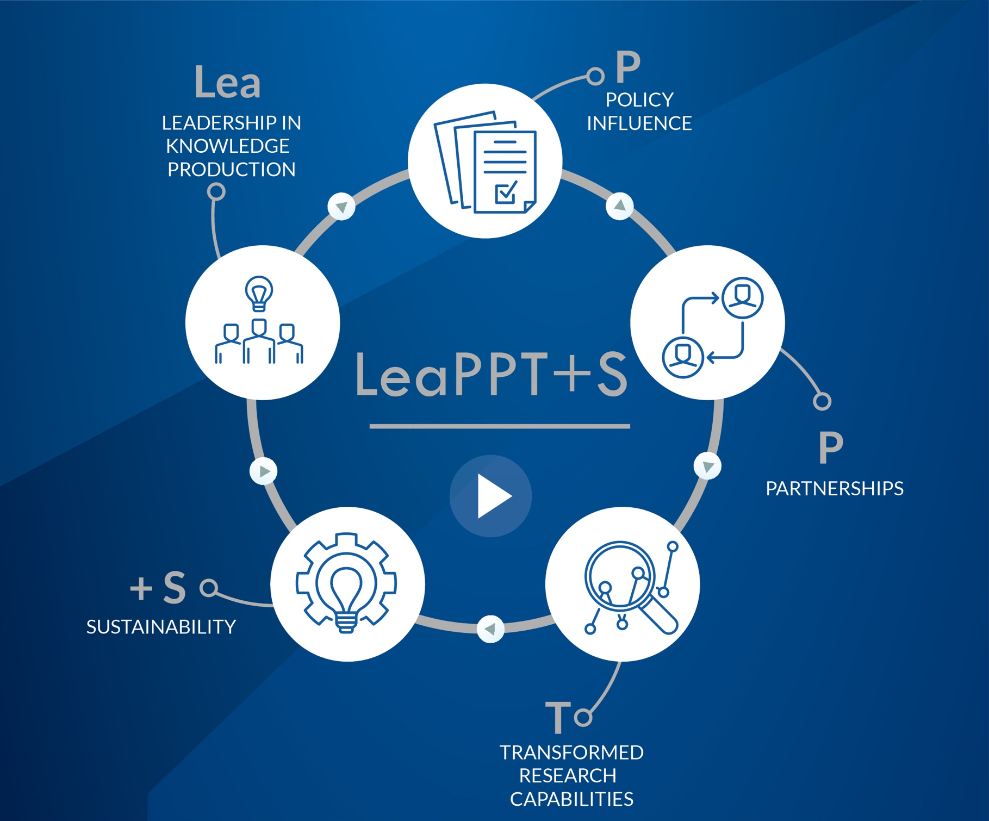
HSRC
Outcomes
6
Notes:
National, regional and global leadership in the production and use of knowledge to support the eradication of poverty, the reduction of inequalities and the promotion of employment (LEADERSHIP)
A consolidated relationship of trust and influence with Government to help guide and inform policy (POLICY INFLUENCE)
Recognition as a trusted and engaged research partner with scientific communities and civil society (PARTNERSHIPS)
Transformed research capabilities (TRANSFORMED CAPABILITIES)
Sustainable income streams (SUSTAINABILITY)

Slide 7
HSRC
Institutional Output Indicator targets: 2021/22

Slide 8
Output indicators
Output indicator | Annual Target | Q1 | Q2 | Q3 | Q4
1.1 The number of peer-reviewed journal articles published per HSRC researcher | 1 | 0.1 | 0.3 | 0.5 | 1.0
1.2 The number of peer-reviewed journal articles published with at least one non-HSRC co-author from an African country other than South Africa | 12 | 1 | 3 | 6 | 12
1.3 The number of scholarly books published by HSRC researchers | 8 | 0 | 2 | 4 | 8
1.4 The number of scholarly book chapters published by HSRC researchers | 47 | 4 | 15 | 25 | 47
1.5 The number of HSRC research articles that have achieved a citation count of at least 10 within five years of initial publication | 160 | N/A | N/A | N/A | 160
1.6 The number of curated datasets downloaded for secondary use | 546 | N/A | N/A | N/A | 546
1.7 The number of events dealing with the eradication of poverty, reduction of inequalities and/or promotion of employment convened by the HSRC | 2 | 0 | 0 | 1 | 2
Outcome 1
National, regional and global leadership in the production and use of targeted knowledge to support the eradication of poverty, the reduction of inequalities and the promotion of employment.
8

Slide 9
Output indicators
Output indicator | Annual Target | Q1 | Q2 | Q3 | Q4
2.1 The number of policy briefs and/or evidence reviews completed and published | 9 | 0 | 2 | 4 | 9
2.2 The number of structured research engagements with government, policy makers and implementers | 6 | 0 | 1 | 2 | 6
Outcome 2
A consolidated relationship of trust and influence with government to help guide and inform policy
9

Slide 10
Output indicators
Output indicator | Annual Target | Q1 | Q2 | Q3 | Q4
3.1 The number of research-related engagements with communities and civil society forums | 6 | 1 | 2 | 3 | 6
3.2 The number of solution-orientated communities of practice created or supported with active involvement of HSRC researchers | 1 | 0 | 0 | 1 | 1
3.3 The number of community innovations supported or enabled by HSRC research | 1 | N/A | N/A | N/A | 1
3.4 The number of collaborative research projects with universities (including HDIs) and science councils in South Africa | 4 | 1 | 1 | 2 | 4
3.5 The number of incoming international exchange visits or fellowships active during the period under review) | 4 | 1 | 2 | 2 | 4
Outcome 3
Recognition as a trusted and engaged research partner within scientific communities and civil society
10

Slide 11
Output indicators
Output indicator | Annual Target | Q1 | Q2 | Q3 | Q4
4.1 The percentage of senior researchers (SRS/SRM+) who are black | 48% | 44% | 45% | 46% | 48%
4.2 The percentage of senior researchers (SRS/SRM+) who are female | 37% | 33% | 34% | 35% | 37%
4.3 The percentage of researchers (excluding trainees) with PhDs | 76% | 73% | 74% | 75% | 76%
4.4 The number of PhD trainees | 27 | 20 | 22 | 24 | 27
4.5 The number of conferences or training academies for emerging scholars | 2 | N/A | N/A | N/A | 2
Outcome 4
Transformed research capabilities.
11

Slide 12
Output indicators
Output indicator | Annual Target | Q1 | Q2 | Q3 | Q4
5.1 The percentage of total income that is extra-parliamentary | 45% | 10% | 20% | 30% | 45%
5.2 The number of internationally funded collaborative projects involving multi-year grants of R5 million or more | 3 | 1 | 1 | 1 | 3
Outcome 5
Sustainable income streams
12

Slide 13
Adjustments to Annual Performance Plan targets
2020/21
DPME issued Circular 2 of 2020 (special budget adjustment)
Incoming international exchange visits or fellowship 4 (6)
PhD trainees 25 (40)
2021/22
Incoming international exchange visits of fellowships 4 (8)
PhD trainees 27 (42)
Extra-Parliamentary income 45% (48%)

Slide 14
Programme resource considerations

Slide 15
Institutional revenue estimates
15

Slide 16
Institutional revenue estimates 2021/2022
16

Slide 17
Estimates of expenditure: Programmes 1 and 2
17

Slide 18
Estimates of expenditure: Programmes 1 and 2 2021/2022
18

Slide 19
Estimates of expenditure: Programmes 1 and 2 2021/2022
19

Slide 20




Key Risks
Sustainability
Relevance and Impact
Human Resources
Ageing infrastructure
20

Slide 21
Key Projects and Initiatives underway

Slide 22
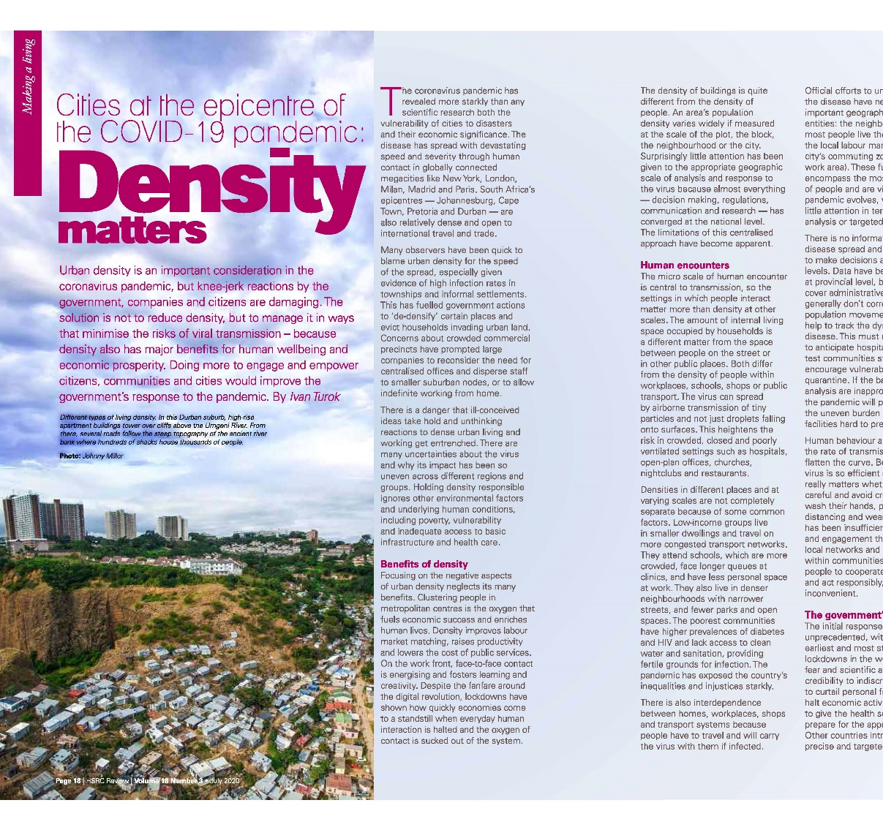
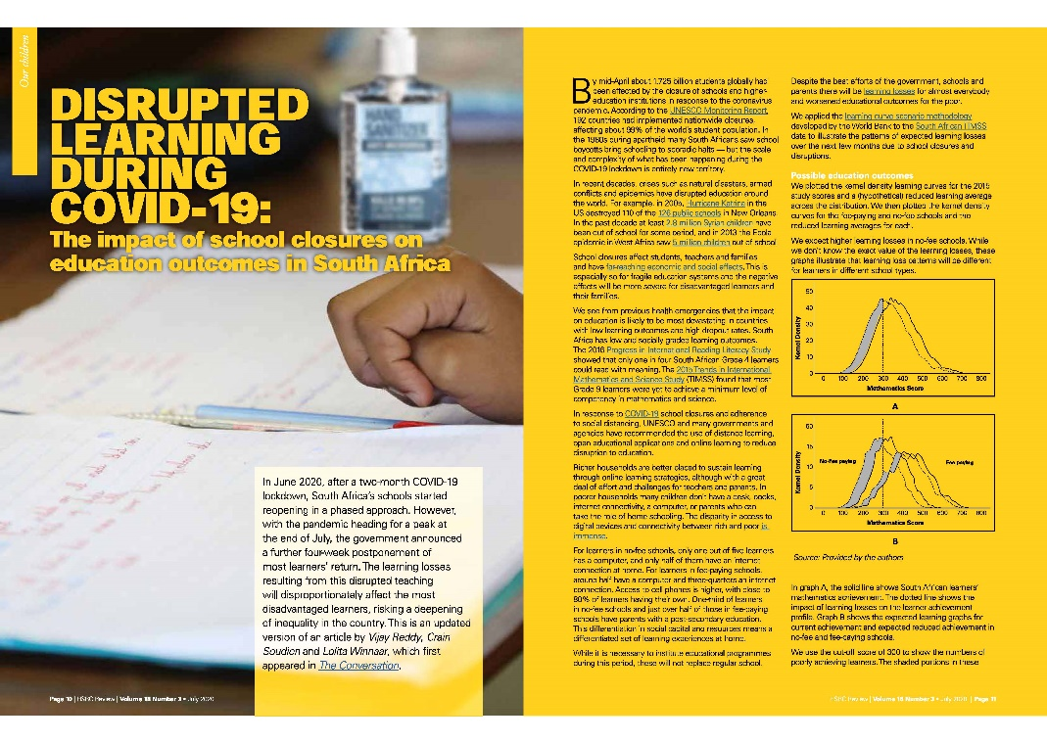

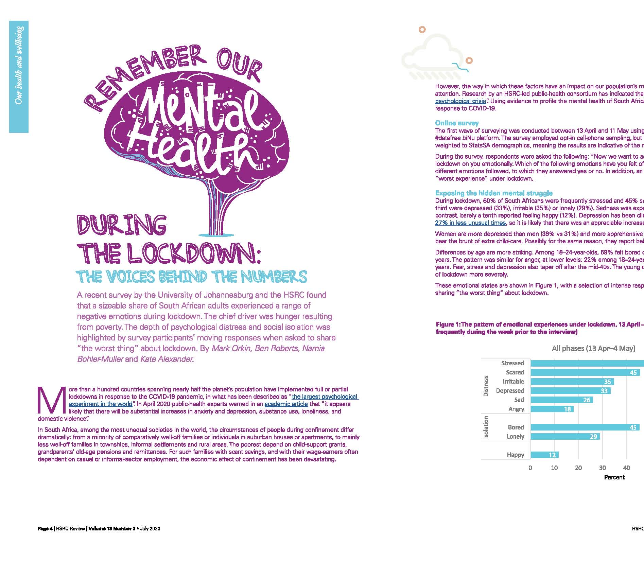
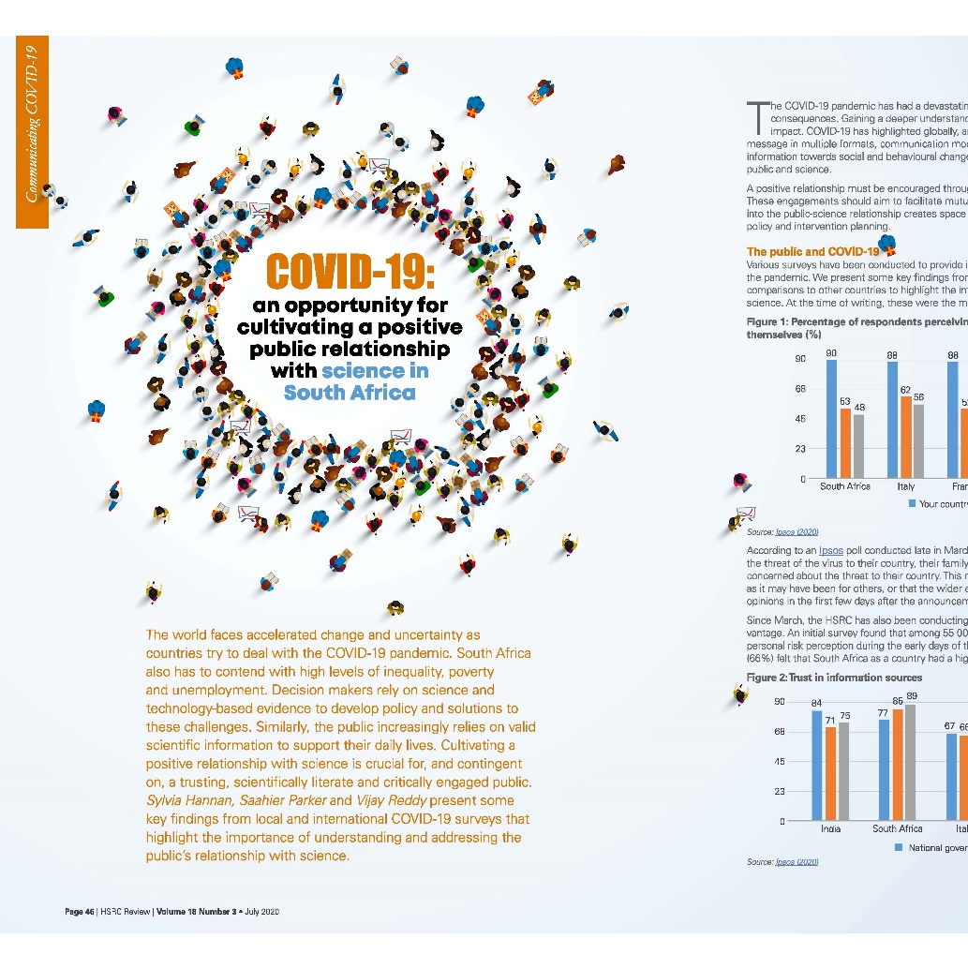
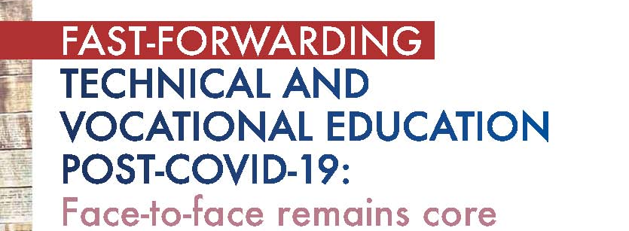
22

Slide 23




The COVID-19 antibodies sero-prevalence-survey
The Department of Agriculture, Land Reform and Rural Development National Food and Nutrition Security survey
UJ/HSRC Surveys on COVID-19 attitudes
SABSSM6 (HIV plus COVID-19)
SASAS
Food security work
Macro-economic dialogues including dialogue in parliament
Policy briefs on COVID-19 and recovery
Planning for the DSI Internship Programme
23

Slide 24
Thank you

