Slide 1
GOVERNMENT PRINTING WORKS PRESENTATION: ANNUAL PERFORMANCE PLAN (APP) 2021/22
DATE: 07 MAY 2021
Celebrating 130 years

Slide 2
Presentation Overview
Purpose
Background
Performance targets for the financial year 2021/22
APP 2021/22 Performance
4.1. Office of the CEO
4.2. Branch Operations and Production
4.3. Branch Strategic Management
4.4. Branch Financial Services
4.5. Branch Human Resources
5. Budget
6. Balance Sheet: 2021-2022
7. Capital Expenditure: 2021-2022
8. Budget for management of COVID 19
9. Management of COVID-19
10. Management of Risk and Audit processes
11. Risks linked to the strategic plan
12. Key strategic projects

Slide 3
1. Purpose
The purpose of this presentation is to brief the Portfolio Committee on Home Affairs on Government Printing Work’s (GPW) Annual Performance Plan (APP) and budget for 2021-2022.

Slide 4
2. Background
The APP was developed based revised Framework for Strategic Plans and Annual Performance Plan and guidance of the Department of Planning, Monitoring and Evaluation for implementation by the national and provincial spheres of government.
The Annual Performance Plan (APP) outlines all performance targets, outcomes, and indicators that have been set by the Government Printing Works (GPW), in order to ensure that initiatives as outlined in the Strategic Plan are achieved.

Slide 5
ANNUAL PERFORMANCE PLAN (APP) 2021/22

Slide 6
3. Performance targets for the financial year 2021/22
GPW’s APP 2021/22 has a total of 18 performance targets, with critical targets aligned to the Strategic Plan, to ensure that all outcomes and desired impacts are achieved.
The targets are allocated as follows:
Branch/Office | Number of targets
1. Office of the CEO | 3
2. Operations and Production | 5
3. Strategic Management | 4
4. Financial Services | 4
5. Human Resources | 2
Total number of targets | 18

Slide 7
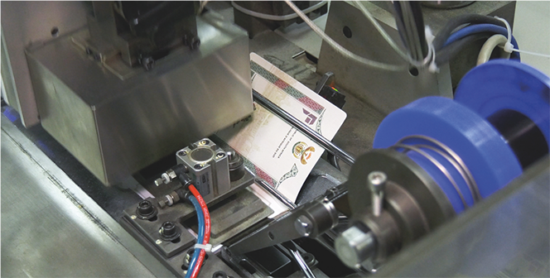
OFFICE OF THE CEO

Slide 8
4.1. Office of the CEO
Outcome | Outputs | Output Indicators | Audited/Actual Performance 2018/19 | Audited/Actual Performance 2019/20 | Estimated Performance 2020/21 | Medium Term Targets
 |  |  |  |  |  | 2021/22 | 2022/23 | 2023/24
4.1.1. ICT
Secured and protected ICT environment | 100% security vulnerabilities mitigated | Percentage of security vulnerabilities detected by security assessments mitigated | 99.67% security vulnerabilities detected by security assessments mitigated | 100% security vulnerabilities detected by security assessments mitigated | 100% security vulnerabilities detected by security assessments mitigated | 100% security vulnerabilities detected by security assessments mitigated | 100% security vulnerabilities detected by security assessments mitigated | 100% security vulnerabilities detected by security assessments mitigated
Annual Target Information for 2021/22
Output Indicator: Percentage of security vulnerabilities detected by security assessments mitigated
Annual Target: 100% security vulnerabilities detected by security assessments mitigated
Reporting Period: Quarterly
Quarter 1 Target: 100% Microsoft patches released, applicable to GPW environment
Quarter 2 Target: 100% Microsoft patches released, applicable to GPW environment
Quarter 3 Target: 100% Microsoft patches released, applicable to GPW environment
Quarter 4 Target: 100% Microsoft patches released, applicable to GPW environment

Slide 9
4.1. Office of the CEO, cont..
Outcome | Outputs | Output Indicators | Audited/Actual Performance 2018/19 | Audited/ Actual Performance 2019/20 | Estimated Performance 2020/21 | Medium Term Targets
 |  |  |  |  |  | 2021/22 | 2022/23 | 2023/24
ICT servers uptime availability maintained | 95.5% servers uptime availability | Percentage servers uptime availability of ICT systems | 97.79% system availability | 99.5% system availability | 95.5% servers uptime availability | 95.5% servers uptime availability | 95.5% servers uptime availability | 95.5% servers uptime availability
Quarterly Target Information for 2021/22
Output Indicator: Percentage servers uptime availability of ICT systems
Annual Target: 95.5% servers uptime availability [measuring uptime of the server hosting business systems]
Reporting Period: Quarterly
Quarter 1 Target: 95.5% servers uptime availability
Quarter 2 Target: 95.5% servers uptime availability
Quarter 3 Target: 95.5% servers uptime availability
Quarter 4 Target: 95.5% servers uptime availability

Slide 10
4.1. Office of the CEO, cont..
Outcome | Outputs | Output Indicators | Audited/Actual Performance 2018/19 | Audited/Actual Performance 2019/20 | Estimated Performance 2020/21 | Medium Term Targets
 |  |  |  |  |  | 2021/22 | 2022/23 | 2023/24
4.1.2. Internal Audit
Effective and efficient internal corporate governance to enable organisational performance | 90% of approved annual internal audit plan implemented | Percentage implementation of the annual internal audit plan | 100% of approved annual internal audit plan implemented | 100% of approved annual internal audit plan implemented | 90% of approved annual internal audit plan implemented | 90% of approved annual internal audit plan implemented | 90% of approved annual internal audit plan implemented | 90% of approved annual internal audit plan implemented
Quarterly Target Information for 2021/22
Output Indicator: Percentage implementation of the annual internal audit plan
Annual Target: 90% of approved annual internal audit plan implemented
Reporting Period: Quarterly
Quarter 1 Target: 20% of approved annual internal audit plan implemented
Quarter 2 Target: 25% of approved annual internal audit plan implemented
Quarter 3 Target: 25% of approved annual internal audit plan implemented
Quarter 4 Target: 20% of approved annual internal audit plan implemented

Slide 11
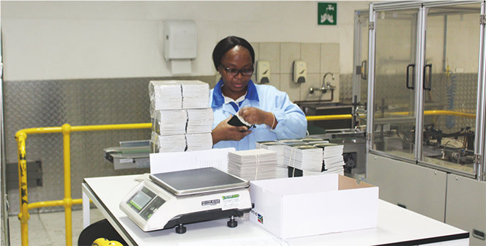
BRANCH: OPERATIONS AND PRODUCTION

Slide 12
4.2. Branch: Operations and Production
Outcome | Outputs | Output Indicators | Audited/Actual Performance 2018/19 | Audited/Actual Performance 2019/20 | Estimated Performance 2020/21 | Medium Term Targets
 |  |  |  |  |  | 2021/22 | 2022/23 | 2023/24
Security printed materials Produced | Identity Documents/ cards that conform to client specifications distributed | Percentage of Identity Documents/ cards distributed that conform to client specifications | 100% of 3 122 489 Identity Documents/ cards delivered that conform to client specifications | 100% of 2 822 174 Identity Documents/ cards delivered that conform to client specifications | 100% of Identity Documents/ cards delivered that conform to client specifications | 100% of Identity Documents/ cards delivered that conform to client specifications | 100% of Identity Documents/ cards delivered that conform to client specifications | 100% of Identity Documents/ cards delivered that conform to client specifications
Quarterly Target Information for 2021/22
Output Indicator: Percentage of Identity Documents/ cards delivered that conform to client specifications
Annual Target: 100% of Identity Documents/ cards delivered that conform to the client specifications
Reporting Period: Quarterly
Quarter 1 Target: 100% of Identity Documents/ cards delivered that conform to client specifications
Quarter 2 Target: 100% of Identity Documents/ cards delivered that conform to client specifications
Quarter 3 Target: 100% of Identity Documents/ cards delivered that conform to client specifications
Quarter 4 Target: 100% of Identity Documents/ cards delivered that conform to client specifications

Slide 13
4.2. Branch: Operations and Production, cont..
Outcome | Outputs | Output Indicators | Audited/Actual Performance 2018/19 | Audited/Actual Performance 2019/20 | Estimated Performance 2020/21 | Medium Term Targets
 |  |  |  |  |  | 2021/22 | 2022/23 | 2023/24
Security printed materials produced | Travel documents that conform to client specifications delivered | Percentage of Travel documents delivered that conform to client specifications | 100% of Travel 993 726 documents delivered that conform to the client specifications | 100% of 987 831 Travel documents delivered that conform to the client specifications | 100% of Travel documents delivered that conform to client specifications | 100% of Travel documents delivered that conform to client specifications | 100% of Travel documents delivered that conform to client specifications | 100% of Travel documents delivered that conform to client specifications
Quarterly Target Information for 2021/22
Output Indicator: Percentage of travel documents delivered that conform to client specifications
Annual Target: 100% of Travel documents delivered that conform to client specifications
Reporting Period: Quarterly
Quarter 1 Target: 100% of Travel Documents delivered that conform to client specifications
Quarter 2 Target: 100% of Travel Documents delivered that conform to client specifications
Quarter 3 Target: 100% of Travel Documents delivered that conform to client specifications
Quarter 4 Target: 100% of Travel Documents delivered that conform to client specifications

Slide 14
4.2. Branch: Operations and Production, cont..
Outcome | Outputs | Output Indicators | Audited/Actual Performance 2018/19 | Audited/Actual Performance 2019/20 | Estimated Performance 2020/21 | Medium Term Targets
 |  |  |  |  |  | 2021/22 | 2022/23 | 2023/24
Security printed materials produced | Examination papers that conform to client specifications delivered | Percentage of examinations papers delivered that conform to client specifications | 100% of 30 614 803 examination papers delivered conformed to client’s specifications | 100% of 25 217 879 examination papers delivered that conform to client specifications | 100% of examination papers delivered that conform to client specifications | 100% of examination papers delivered that conform to client specifications | 100% of examination papers delivered that conform to the client specifications | 100% of examination papers delivered that conform to client specifications
Quarterly Target Information for 2021/22
Output Indicator: Percentage of examinations papers delivered that conform to client specifications
Annual Target: 100% of examination papers delivered that conform to the client specifications
Reporting Period: Quarterly
Quarter 1 Target: 100% of examination papers delivered that conform to client specifications
Quarter 2 Target: 100% of examination papers delivered that conform to client specifications
Quarter 3 Target: 100% of examination papers delivered that conform to client specifications
Quarter 4 Target: 100% of examination papers delivered that conform to client specifications

Slide 15
4.2. Branch: Operations and Production, cont..
Outcome | Outputs | Output Indicators | Audited/ Actual Performance 2017/18 | Audited/ Actual Performance 2018/19 | Audited/ Actual Performance 2019/20 | Estimated Performance 2020/21 | Medium Term Targets
 |  |  |  |  |  |  | 2021/22 | 2022/23 | 2023/24
Government information coordinated and distributed | Government Gazettes that conform to client specifications published | Percentage of Government Gazettes published that conform to client specifications | 100% 176 300 of Government Gazettes published conformed to quality and timeline specifications | 100% of 2056 Government Gazettes published conformed to client specifications | 100% of 2000 Government Gazettes published that conform to client specifications | 100% of Government Gazettes published that conform to client specifications | 100% of Government Gazettes published that conform to client specifications | 100% of Government Gazettes published that conform to client specifications | 100% of Government Gazettes published that conform to client specifications
Quarterly Target Information for 2021/22
Output Indicator: Percentage of Government Gazettes published that conform to client specifications
Annual Target: 100% of Government Gazettes published that conform to client specifications
Reporting Period: Quarterly
Quarter 1 Target: 100% of Government Gazettes published that conform the client specifications
Quarter 2 Target: 100% of Government Gazettes published that conform the client specifications
Quarter 3 Target: 100% of Government Gazettes published that conform the client specifications
Quarter 4 Target: 100% of Government Gazettes published that conform the client specifications

Slide 16
4.2. Branch: Operations and Production, cont..
Outcome | Outputs | Output Indicators | Audited/Actual Performance 2018/19 | Audited/Actual Performance 2019/20 | Estimated Performance 2020/21 | Medium Term Targets
 |  |  |  |  |  | 2021/22 | 2022/23 | 2023/24
Security printed materials produced | High Security Certificates that conform to client specifications delivered | Percentage of High Security Certificates delivered that conform to client specifications | N/A | 98.6 % of 13 488 576 High Security Certificates delivered that conform to client specifications. | 99% of High Security Certificates delivered that conform to client specifications | 99% of High Security Certificates delivered that conform to client specifications | 99% of High Security Certificates delivered that conform to client specifications | 99% of High Security Certificates delivered that conform to client specifications
Quarterly Target Information for 2021/22
Output Indicator: Percentage of High Security Certificates delivered that conform to client specifications
Annual Target: 99% of High Security Certificates delivered that conform to client specifications
Reporting Period: Quarterly
Quarter 1 Target: 99% of High Security Certificates delivered that conform to client specifications
Quarter 2 Target: 99% of High Security Certificates delivered that conform to client specifications
Quarter 3 Target: 99% of High Security Certificates delivered that conform to client specifications
Quarter 4 Target: 99% of High Security Certificates delivered that conform to client specifications
[

Slide 17
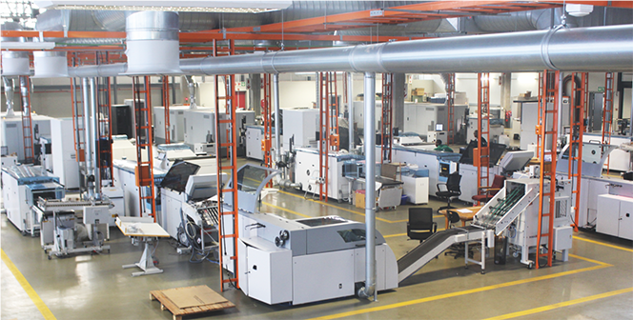
BRANCH: STRATEGIC MANAGEMENT

Slide 18
4.3. Branch: Strategic Management
Outcome | Outputs | Output Indicators | Audited/ Actual Performance 2018/19 | Audited/ Actual Performance 2019/20 | Estimated Performance 2020/21 | Medium Term Targets
 |  |  |  |  |  | 2021/22 | 2022/23 | 2023/24
4.3.1. Marketing and Stakeholder Relations
GPW’s Marketing and Internal Communication initiatives enhanced | Integrated Marketing and Communication Strategy and Plan implemented | Percentage of Integrated Marketing and Communication Strategy and Plans reviewed and implemented | 100% of integrated marketing and communication strategy and plan implemented | 29 local customers engaged | 10 local customers engaged | Integrated Marketing and Communication Strategy reviewed and Implementation plan developed | Phase 2 of the Integrated Marketing and Communication Strategy and plan deliverables implemented | Phase 3 of the Integrated Marketing and Communication Strategy and plan deliverables implemented
Quarterly Target Information for 2021/22
Output Indicator: Percentage of Integrated Marketing Communication Strategy and Plans reviewed and implemented
Annual Target: Integrated Marketing and Communication Strategy reviewed and implementation plan developed
Reporting Period: Quarterly
Quarter 1 Target: Integrated Marketing and Communication Strategy reviewed and Implementation Plan developed
Quarter 2 Target: Draft Integrated Marketing and Communication Strategy and Implementation Plan submitted for approval
Quarter 3 Target: Phase 1 deliverables executed in line with the Integrated Marketing and Communication Strategy and Implementation Plan
Quarter 4 Target: Phase 1 deliverables executed in line with the Integrated Marketing and Communication Strategy and Implementation Plan

Slide 19
4.3. Branch: Strategic Management, cont..
Outcome | Outputs | Output Indicators | Audited/ Actual Performance 2018/19 | Audited/ Actual Performance 2019/20 | Estimated Performance 2020/21 | Medium Term Targets
 |  |  |  |  |  | 2021/22 | 2022/23 | 2023/24
4.3.1 Marketing and Stakeholder Relations
SADC countries informed of GPW product and service offerings | Integrated Marketing and Communication Strategy and Plan implemented | Percentage of follow up engagements conducted with potential customers in the SADC region | N/A | 10 countries in the SADC region engaged | 5 countries in the SADC region engaged as follow up | Follow up engagements conducted with 8 potential customers in the SADC region | Follow up engagements conducted with 8 potential customers in the SADC region | Follow up engagements conducted with 8 potential customers in the SADC region
Quarterly Target Information for 2021/22
Outcome Indicator: Number of countries engaged in the SADC region
Annual Target: Follow up engagements conducted with 8 potential customers in the SADC region
Reporting Period: Quarterly
Quarter 1 Target: 2 Potential customers in the SADC region engaged
Quarter 2 Target: 2 Potential customers in the SADC region engaged
Quarter 3 Target: 2 Potential customers in the SADC region engaged
Quarter 4 Target: 2 Potential customers in the SADC region engaged

Slide 20
4.3. Branch: Strategic Management, cont..
Outcome | Outputs | Output Indicators | Audited/ Actual Performance 2018/19 | Audited/ Actual Performance 2019/20 | Estimated Performance 2020/21 | Medium Term Targets
 |  |  |  |  |  | 2021/22 | 2022/23 | 2023/24
4.3.2. Strategic Support
Resilient, agile and sustainable business in the event of disaster | All Business Continuity Management activities implemented | Percentage implementation of the Business Continuity Management activities | N/A | Business Continuity Plan submitted for approval and implemented | Business Continuity Management activities 100% implemented | 100% implementation of Business Continuity Management identified outputs | 100% implementation of Business Continuity Management identified outputs | 100% implementation of Business Continuity Management identified outputs
Quarterly Target Information for 2021/22
Output Indicator: Percentage implementation of the Business Continuity Management activities
Annual Target: 100% implementation of Business Continuity Management identified outputs
Reporting Period: Quarterly
Quarter 1 Target: 100% BCM activities implemented in accordance with the approved Risk and Compliance Management Implementation Plan
Quarter 2 Target: 100% BCM activities implemented in accordance with the approved Risk and Compliance Management Implementation Plan
Quarter 3 Target: 100% BCM activities implemented in accordance with the approved Risk and Compliance Management Implementation Plan
Quarter 4 Target: 100% BCM activities implemented in accordance with the approved Risk and Compliance Management Implementation Plan

Slide 21
4.3. Branch: Strategic Management, cont..
Outcome | Outputs | Output Indicators | Audited/ Actual Performance 2018/19 | Audited/ Actual Performance 2019/20 | Estimated Performance 2020/21 | Medium Term Targets
 |  |  |  |  |  | 2021/22 | 2022/23 | 2023/24
4.3.3. Security Management
Secured management of GPW operations, facilities, information and people | 100% of the approved GPW security model implemented | Reviewed security model for GPW implemented | 100% of planned activities as per the approved security plan implemented | GPW security model reviewed and implemented | Implementation of the reviewed security model for GPW | Implementation of the reviewed security model for GPW | Implementation of the reviewed security model for GPW | Evaluation of the reviewed security model for GPW
Quarterly Target Information for 2021/22
Output Indicator: Reviewed security model for GPW implemented
Annual Target: Implementation of the reviewed security model for GPW
Reporting Period: Quarterly
Quarter 1 Target: Threat and Risk Assessment for Visagie Security Printing Facilities conducted.
Quarter 2 Target: Case Management System developed.
Quarter 3 Target: Reviewed security vetting processes implemented.
Quarter 4 Target: Service provider appointed for the development of ISO 18788 security operation management system processes

Slide 22
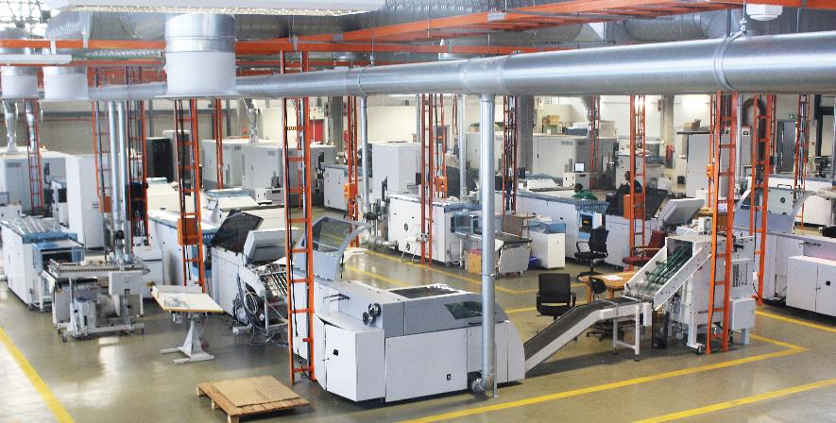
BRANCH: FINANCIAL SERVICES

Slide 23
4.4. Branch: Financial Services
Outcome | Outputs | Output Indicators | Audited/ Actual Performance 2018/19 | Audited/ Actual Performance 2019/20 | Estimated Performance 2020/21 | Medium Term Targets
 |  |  |  |  |  | 2021/22 | 2022/23 | 2023/24
Quality financial and supply chain management services compliant with legislation and policies | Clean audit report maintained | Audit outcome | Unqualified audit opinion for 2017/18 maintained | Qualified audit opinion for 2018/19 | Unqualified audit opinion for 2019/20 | Unqualified audit opinion for 2020/21 | Unqualified audit opinion for 2021/22 | Unqualified audit opinion for 2022/23
Annual Target Information for 2021/22
Output Indicator: Audit outcome
Annual Target: Unqualified audit opinion for 2020/21
Reporting Period: Quarterly
Quarter 1 Target: Submission of Annual Financial Statements
Quarter 2 Target:100% post audit action plan implemented
Quarter 3 Target:100% post audit action plan implemented
Quarter 4 Target:100% post audit action plan implemented

Slide 24
4.4. Branch: Financial Services, cont..
Outcome | Outputs | Output Indicators | Audited/ Actual Performance 2018/19 | Audited/ Actual Performance 2019/20 | Estimated Performance 2020/21 | Medium Term Targets
 |  |  |  |  |  | 2021/22 | 2022/23 | 2023/24
Quality financial and supply chain management services compliant with legislation and policies | 6 Positive working capital ratio maintained | Positive working capital ratio | 18,1 positive working capital maintained | 10.08 positive working capital ratio maintained | 3 Positive working capital ratio maintained | 3 Positive working capital ratio maintained | 3 Positive working capital ratio maintained | 3 Positive working capital ratio maintained
Annual Target Information for 2021/22
Output Indicator: Positive working capital ratio
Annual Target: 3 Positive working capital ratio maintained
Reporting Period: Quarterly
Quarter 1 Target: 3 positive working capital ratio maintained
Quarter 2 Target: 3 positive working capital ratio maintained
Quarter 3 Target: 3 positive working capital ratio maintained
Quarter 4 Target: 3 positive working capital ratio maintained

Slide 25
4.4. Branch: Financial Services, cont..
Outcome | Outputs | Output Indicators | Audited/ Actual Performance 2018/19 | Audited/ Actual Performance 2019/20 | Estimated Performance 2020/21 | Medium Term Targets
 |  |  |  |  |  | 2021/22 | 2022/23 | 2023/24
Quality financial and supply chain management services compliant with legislation and policies | 10% net profit margin maintained | Percentage of Net Profit Margin | 40% net profit margin | 10% net profit margin achieved | 10% net profit margin achieved | 10% net profit margin achieved | 10% net profit margin achieved | 10% net profit margin achieved
Annual Target Information for 2021/22
Output Indicator: Percentage of Net Profit Margin
Annual Target: 10% net profit margin achieved
Reporting Period: Quarterly
Quarter 1 Target: 10% net profit margin achieved
Quarter 2 Target: 10% net profit margin achieved
Quarter 3 Target: 10% net profit margin achieved
Quarter 4 Target: 10% net profit margin achieved

Slide 26
4.4. Branch: Financial Services, cont..
Outcome | Outputs | Output Indicators | Audited/ Actual Performance 2018/19 | Audited/ Actual Performance 2019/20 | Estimated Performance 2020/21 | Medium Term Targets
 |  |  |  |  |  | 2021/22 | 2022/23 | 2023/24
Quality financial and supply chain management services compliant with legislation and policies. | Number of annual financial statements (AFS) and in year monitoring reports (IYM) compiled per year that comply with guidelines issued by the national treasury. | Annual financial statements submitted to the national treasury by the 31 May each year. 3 IYM reports submitted to the national treasury due dates as determined national treasury | N/A | N/A | N/A | AFS submitted by 31 May and 3 in-year monitoring report submitted 30 days after each quarter. | AFS submitted by 31 May in-year monitory report submitted 30 days after each quarter. | AFS submitted by 31 May and 3 in-year monitoring report submitted 30 days after each quarter
Quarterly Target Information for 2021/22
Output Indicator: Annual financial statements submitted to the national treasury by the 31 May each year. 3 IYM reports submitted to the National Treasury (due dates as determined National Treasury)
Annual Target: AFS submitted by 31 May and 3 in-year monitoring report submitted 30 days after each quarter.
Reporting Period: Quarterly
Quarter 1 Target: AFS summited by 31 May 2021
Quarter 2 Target: In-year monitoring report summited by 31 July 2021
Quarter 3 Target: In-year monitoring report summited by 31 October 2021
Quarter 4 Target: In- year monitoring report summited by 31 January 2022

Slide 27
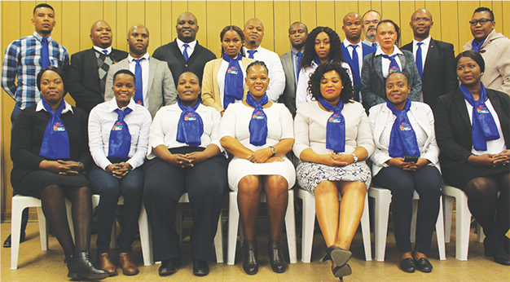
BRANCH: HUMAN RESOURCES

Slide 28
4.5. Branch: Human Resources
Outcome | Outputs | Output Indicators | Audited/ Actual Performance 2018/19 | Audited/ Actual Performance 2019/20 | Estimated Performance 2020/21 | Medium Term Targets
 |  |  |  |  |  | 2021/22 | 2022/23 | 2023/24
Young people and women equipped with Artisan and other professional skills | Recruitment plan implemented in relation to the filling of identified positions | Number of young people and women taken through Artisan and Graduate programme(s) | N/A | N/A | 20 unemployed young people and women recruited for Artisan and Graduate skills development programmes | 20 unemployed young people and women recruited for Artisan and Graduate skills development programmes | 20 unemployed young people and women recruited for Artisan and Graduate skills development programmes | 20 unemployed young people and women recruited for Artisan and Graduate skills development programmes
Quarterly Target Information for 2021/22
Output Indicator: Number of young people and women taken through Artisan and Graduate programme(s)
Annual Target: 20 unemployed young people and women recruited for Artisan and Graduate skills development programmes
Reporting Period: Quarterly
Quarter 1 Target: Skills and areas of placement for the 2022/2023 intake identified
Quarter 2 Target: Skills development programmes submitted for approval
Quarter 3 Target: Skills development programmes advertised and shortlisting completed
Quarter 4 Target: Interviews completed and appointment letters issued

Slide 29
4.5. Branch: Human Resources, cont..
Outcome | Outputs | Output Indicators | Audited/ Actual Performance 2018/19 | Audited/ Actual Performance 2019/20 | Estimated Performance 2020/21 | Medium Term Targets
 |  |  |  |  |  | 2021/22 | 2022/23 | 2023/24
Capacity of workforce developed to support service delivery | 80% of total workforce trained as per the Workplace Skills Plan (WSP) identified priorities | Percentage of total workforce trained as per the Workplace Skills Plan (WSP) identified priorities | For the year 86 out of 102 managers were trained, which translates to 84.3%. | 50% of total workforce trained as per the WSP identified priorities | 40% of total workforce trained as per the WSP identified priorities | 50% of total workforce trained as per the WSP identified priorities | 60% of total workforce trained as per critical WSP identified priorities | 70% of total workforce trained as per critical the WSP identified priorities
Quarterly Target Information for 2021/22
Output Indicator: Percentage of total workforce trained as per the WSP identified priorities
Performance Indicator: Percentage of total workforce trained as per the Workplace Skills Plan (WSP) identified priorities
Annual Target: 50% of total workforce trained as per the WSP identified training priorities
Reporting Period: Quarterly
Quarter 1 Target: 15% of total workforce trained as per the WSP identified priorities
Quarter 2 Target: 20% of total workforce trained as per the WSP identified priorities
Quarter 3 Target: 10% of total workforce trained as per the WSP identified priorities
Quarter 4 Target: 5% of total workforce trained as per the WSP identified priorities

Slide 30
5. Budget
Description | ACTUAL |  |  | Budget
 | Actuals 2018/19 R'000 | Actuals 2019/20 R'000 | Actuals 2020/21 R'000 | ENE Budget 2021/22 R'000 | ENE Budget 2022/23 R'000 | ENE Budget 2023/24 R'000
TOTAL SALES | 1 510 273 | 1 621 672 | 608 235 | 1 449 259 | 1 774 770 | 1 870 367
COST OF SALES | 732 344 | 885 644 | 488 598 | 913 811 | 1 143 560 | 1 163 314
Direct Material | 191 103 | 364 934 | 92 494 | 389 144 | 524 300 | 465 161
Direct Labour | 124 618 | 147 128 | 133 591 | 200 138 | 218 473 | 228 304
Operating Expenditure | 96 886 | 142 572 | 92 213 | 191 906 | 235 724 | 295 913
Finished Goods | 319 737 | 231 010 | 170 300 | 132 623 | 165 063 | 173 935
GROSS PROFIT | 777 929 | 736 028 | 119 637 | 535 448 | 631 210 | 707 054
GP % | 51.51% | 45.39% | 19.67% | 36.95% | 35.57% | 37.80%
OTHER INCOME | 9 675 | 12 941 | 42 950 | 46 501 | 46 726 | 46 490
Interest received | 1 647 | 1 967 | -
Loss on foreign exchange | -21 095 | -4 168 | -811
TOTAL EXPENSES | 250 716 | 249 619 | 209 642 | 437 023 | 500 459 | 566 507
Employee Benefits | 109 972 | 123 175 | 128 201 | 157 778 | 165 671 | 173 127
Administrative Expenditure | 35 590 | 31 686 | 23 020 | 66 373 | 69 300 | 73 235
Production and Stores | 1 280 | 2 944 | 1 881 | 1 740 | 1 836 | 1 950
Equipment | 1 407 | 1 563 | 1 589 | 2 855 | 3 012 | 3 176
Professional Services | 60 965 | 75 810 | 40 845 | 152 413 | 163 089 | 171 547
Depreciation and Provisions | 19 995 | 13 837 | 13 834 | 29 088 | 69 304 | 113 671
Sundry Expenditure | 411 | 604 | 272 | 26 775 | 28 248 | 29 801
NET SURPLUS/(LOSS) | 517 440 | 497 149 | -47 866 | 144 926 | 177 477 | 187 037
Net Profit % | 34.26% | 30.66% | -7.87% | 10.00% | 10.00% | 10.00%

Slide 31
6. Balance Sheet: 2021-2022

Slide 32
7. Capital Expenditure: 2021-2022

Slide 33
8. Budget for management of COVID 19 GPW has allocated the budget for management of COVID 19 as follows:
The COVID-19 budget for the 2021/2022 fiscal has been capped at R 3 500 000 as the COVID 19 regulatory infrastructure is securely in place and the current budget is to maintain and uphold the standards that have been set.

Slide 34
9. Management of COVID-19
GPW developed protocols in line with the Department of Public Service and Administration (DPSA) and in accordance with regulations as issued by the Minister of Cooperative Governance and Traditional Affairs.
Risk Management Strategy and Risk Register aligned to COVID 19 management developed and being implemented
Risk assessments were conducted and the COVID-19 Steerco established in the previous financial year. The COVID-19 Steering Committee, inclusive of labour unions, continues to handle matters pertaining to the management of the pandemic and feedback provided to EXCO on a regular basis.
GPW sadly lost an employee to COVID-19 related complications in the previous financial year.
Two employees have been placed on a long-term ill health leave after testing positive for COVID-19 and being hospitalised

Slide 35
9. Management of COVID-19 cont..
During the 2020/2021 financial year GPW suffered massive losses due to the COVID-19 pandemic and the subsequent national lockdown. As GPW was not classified as essential services no operations took place.
Financial losses were due to COVID-19 lockdown since Department of Home Affairs stopped the issuance of ID’s and passports as a result of the travel restrictions. GPW could not print passports and ID’s during the same period.
The printing of Smart ID cards was also halted in the first quarter of 2020/21, owing to the second wave of COVID 19 restrictions, thereby affecting printing of these documents by GPW.

Slide 36
10. Management of Risk and Audit processes
GPW has put in place an enterprise wide risk management process, inclusive of business continuity management, to ensure that risk is being managed at strategic and operational levels.
Key documents such as the Risk Management Policy, Risk Management Strategy and the Annual Risk Implementation Plan are annually reviewed, together with the Risk Committee and approved by the CEO.
Risk assessments have been conducted periodically and risk exposure areas allocated to various branches to manage and monitor.
Progress monitoring of risk is then tabled at the management committee meetings as well as GPW Risk and Audit committees.
Post audit action plan is monitored through the Audit matrix which is presented by EXCO members at every EXCO and MANCO meetings to hold management accountable and ensure resolution of audits
The established Internal Controls Committee (ICC) is composed of management, and sits on a monthly basis to focus on all control deficiencies to facilitate effective resolution of all matters raised by both internal audit and AGSA
Due to the escalation of the audit process to the Auditor General of SA by GPW management, the 2019/2020 year’s audit has not yet been finalized. Awaiting feedback from AGSA.

Slide 37
11. Risks linked to the strategic plan
Outcomes | Key risks | Risk Ratings | Mitigations
Security printed material produced | Failure to secure paper for the production of secure printed material due to among other things, a global move towards becoming green and moving away from printing towards digitisation | High | Conduct research into acquiring own paper mill (vertical integration) Invest in research and development to monitor trends and strategic direction of the printing sector Sign strategic relationship agreements with critical vendors, whereby any decisions to change or discontinue equipment and/or consumables is done in partnership with GPW and/or the Printing SA
Young people and women equipped with Artisan and other requisite professional skills | Readiness to execute the project, considering limitations on finalisation of the facilities | Medium | Project manage the initiative and define milestones or targets annually.
Capacity of workforce developed to support service delivery | Value for money with regard to training programmes provided by successfully appointed service providers. |  | Evaluation through supply chain processes and screening of service providers
 | Value for money with regard to trainees |  | Ensure each training has SAQA unit standards
Effective and efficient internal corporate governance | Inadequate coordination and implementation of governance activities including compliance and risk, management of previous audit findings and implementation of recommendations by Internal Audit. | Medium | Discussions on compliance, risk management and audit matrix remain standard agenda items at MANCO and EXCO structures. Implement decisions taken at the Internal Control Committee meetings
Secured management of GPW operations, facilities, information and people | Delay in the implementation of the new security model for GPW |  | Collaborate and engage with security departments and entities in the public sector to facilitate implementation of the security model (benchmark with SARB, SABN and SA Mint)

Slide 38
12. Key strategic projects Strategic priorities include, amongst others, the following:
Projects | Details
Branch: Operations and Productions
ePassport series | Refreshment of the South African Passport Series Current contracted supplier (Enstra Paper) contract ended in July 2019 Recommendations: GPW to issue a tender to find a suitable manufacturer (specification review in-progress) Security features of the paper substrate be refreshed (design in progress with SSA) Tender process be developed with DTI to maximize localization
Polycarbonate Plant | Establishment of a polycarbonate plant within South Africa The polycarbonate used to produce the ID Smart Card and the data page for the passport is sourced from Gemalto which is based in France The plan is to open a plant to produce the product locally: Techno-economic study planned for implementation in FY 2021/22 Polycarbonate plant planned for implementation in FY 2022/23, following the recommendations of the Techno-economic study
Branch: Financial Services
Master Plan construction | Construction of the Factory at 83 Visagie Street. Project Managed by Department of Public Works The GPW precinct will, upon completion estimated in 2025, comprise the remaining development of the Visagie Street site, and incorporate the adjacent vacant land known as the Minaar Street site. This will fulfil the total spatial requirements of GPW, allowing it to consolidate its entire operation in one precinct, and will enable the transition from the legacy Bosman Street site. The envisaged GPW precinct will consist of a number of designated, function-oriented campuses, made up of self-contained and product-oriented processing centres, which will allow for secure, efficient and high quality business operations. Project status: Drafting of specifications Engagements with DPWI to facilitate completion of the project within the shorter turn around times (as opposed to the 6 years contained in their project plan)

Slide 39
12. Key strategic projects, cont.. Strategic priorities include, amongst others, the following:
Projects | Details
Branch: Financial Services
GPW Administration Head Office | Refurbishment of the Head Office (corner Sophie de Bruyn and Visagie Streets) The facility will be renovated into a modern building with pedestrian bridge connecting Visagie factory precinct and Administration Building across the street. All administration personnel will be housed in the building. Overall estimated cost is at R100 million and completion is planned for 2021/2022. Project status: Reviewing the draft specifications Collaborating with Construction Industry Development Board (CIDB) as specialists in the construction industry to ensure compliance with construction industry regulations. To go out on a tender by June 2021.
Branch: Strategic Management
Enabling legislation: Security Printers Bill | Finalisation and tabling of the Security Printers Bill to Parliament (incl. NCOP). GPW is pursuing promulgation of the Bill to facilitate printing of State security documents. GPW has been assisted by DHA: Legal Services to present the Bill to both National and Provincial Departments. Project status: The Bill has thus been jointly presented by GPW and DHA to a cohort of HoD’s and MEC’s in Limpopo, KZN and Mpumalanga. DHA is facilitating presentations to other provinces before the end of the year

Slide 40
12. Key strategic projects, cont..
GPW has to date managed to engage SADC countries with a strategic intent of expanding its footprint into the SADC Regions. The following countries: eSwatini, Democratic Republic of Congo (DRC), AU Commission and Namibia have already been engaged in the past financial year for printing of their security documents.
Research has proven that some countries have historically been printing with their colonies. However, GPW continues to have follow up engagements with all other SADC countries, in order to introduce its capabilities for security printing, using among others the embassies in South Africa, in order to secure presence in African market
Aggressive positioning of GPW will include focused engagements with Departments within the countries, including face to face engagements where COVID 19 status allows.
The targeted countries for this financial year are: Swaziland, Botswana, Lesotho, Zambia, Malawi, DRC, Kenya and Zimbabwe

Slide 41
THANK YOU
Celebrating 130 years

