Slide 1
FY2021/2022 ANNUAL PERFORMANCE PLAN

Slide 2
CONTENTS
Part A: SA Tourism Mandate
Constitutional & Legislative Mandates
Policy Mandates
Institutional Policies & Strategies
Part B: SA Tourism Strategic Focus
External Situational Analysis
The Tourism Road to Recovery
Internal Situational Analysis
Ensuring Efficiency & Productivity: Priorities for FY21/22
Part C: Measuring SA Tourism Performance
Five-Year Strategic Plan Outcomes
Priorities Informing FY21/22 APP
APP Programmes
APP & AOP Output Indicators & Annual Targets Per Programme
Total Budget Allocation
Budget Allocation Per Programme

Slide 3
CONSTITUTIONAL AND LEGISLATIVE MANDATES

Slide 4
POLICY MANDATES

Slide 5
INSTITUTIONAL POLICIES & STRATEGIES
COVID-19 and the economic shutdown has had a severe impact on the tourism sector, with many businesses struggling to recover from the related hard lockdown. Industry consultations have surfaced critical business continuity risks across the value chain. The Economic Reconstruction and Recovery Plan was published in late 2020, as the country’s plan for overall recovery of the economy post the impact of COVID-19. The Plan identified 8 priority interventions, one of which is support for tourism recovery and growth. This priority emphasises 3 recovery phases: re-igniting demand; rejuvenating supply and building enabling capability.
The fundamental consideration is the manner in which South Africa will protect its tourism sector and outcompete in a market where every destination is simultaneously chasing recovery. Thus, the Tourism Sector Recovery Plan is anchored on the same pillars identified as the recovery phases in the ERRP.
The following strategic interventions will be implemented through the Tourism Sector Recovery Plan:
Implement biosecurity norms and standards across the value chain to enable safe travel and rebuild traveller confidence;
Stimulate domestic demand through targeted initiatives and campaigns;
Launch an investment and resource mobilisation programme to support supply requirements of the post-COVID-19 era;
Support for the protection of core tourism infrastructure and assets;
Execute a global marketing programme to reignite international demand;
Tourism regional integration; and
Review the tourism policy to provide enhanced support for sector growth and development outlines specific interventions under each strategic theme, with timeframes and lines of accountability.

Slide 6
INSTITUTIONAL POLICIES & STRATEGIES cntd
Marketing and Investment Framework: Focused on identifying markets, optimising marketing investments, and distributing resources to help meet the set objectives.
Twenty-four (24) markets were identified and segmented into 16 “`Growth” and 8 “Defend” markets, with a set of markets earmarked as Watchlist. The growth markets are those that hold considerable outbound potential and provide an ample opportunity to grow based on their size. The defend markets hold a substantial market share and requires continued intervention to ensure arrivals. They hold both volume and value importance for SA and thus SA Tourism needs to maintain or defend the country’s share of these markets.
Considering the impact of COVID-19, the relative priority of each of the 24 markets is considered in conjunction with dynamic and up to date information of variables that will affect the likelihood of travel from each market.
Source: National Tourism Recovery Strategy

Slide 7
STRATEGIC FOCUS
VISION
South Africa positioned as an exceptional tourist and business events destination that offers a value-for-money, quality tourist experience that is diverse and unique.
MISSION
Marketing South Africa both internationally and domestically to increase the volume of tourists and the value they add to the economy, by: Implementing an integrated tourism marketing strategy for South Africa. Promoting South Africa as a world class business event destination. Facilitating the delivery of service orientated, quality assured tourism experiences. Positioning SA Tourism as an industry thought leader. Championing a digital outlook for the industry. Enhancing stakeholder participation and collaboration.
Integrity
Respect
Authentic / Caring
Responsibility
Excellence
VALUES

Slide 8
EXTERNAL SITUATIONAL ANALYSIS
UNWTO: 2019 was a year of strong growth (3.8%), although slower compared to the exceptional rates of 2017 (+7%) and 2018 (+6%).
2020 world changed with outbreak of COVID-19 with many economies shut down. UNWTO: international tourist arrivals declined by 72% over the first ten months of 2020 compared to 2019 and expects overall declined by 70% to 75% for 2020.
Recovery seen in third quarter. With the pandemic continuing to spread, many countries have slowed reopening, and some are reinstating partial lockdowns to protect susceptible populations.
Announcement of a vaccine and the start of vaccination are expected to gradually increase consumer confidence. At the same time, a growing number of destinations are easing or lifting restrictions on travel.
The extended scenarios for 2021-2024 point to a return to 2019 levels for international arrivals could take between two-and-a-half and four years.
Evolution of pandemic.
Unpredictability of vaccine roll-out.
Consumer confidence.
Deteriorating economic outlook adversely impacting jobs & disposable income.
For SA, while there is pressure to re-open, most source markets remain severely constrained by travel restrictions & shortage of air access options. While screening and/or testing is being introduced, a majority of passengers are restricted.
Source: United Nations World Tourism Organisation Barometer, December 2020 & UNTWO. Org, accessed 17 December 2020

Slide 9
THE ROAD TO RECOVERY
Pertinent information related to Covid-19 pandemic status
When considering the current unpredictable and volatile travel environment the question begs where and how does SA Tourism direct its efforts towards the country’s road to recovery.
Government stringencies
Accessibility to travel
Travel from the Americas and Europe is likely to be low, due to poor COVID-19 statuses, high government stringencies and reduced flight capacity. While COVID-19 outlook is more positive in Australasia, travel will still be low due to source market travel and border restrictions and markedly reduced air accessibility. The outlook for tourism both from Africa and domestic tourism is, however, more promising compared to other regions due to lower COVID-19 statuses, lower government stringency and greater accessibility into South Africa.
Thus, a short to medium term focus on domestic and regional travel is critical for recovery. SA Tourism’s marketing efforts will be dynamic and adaptive to differing pandemic phases in relevant markets. Messaging will be current and pertinent in terms of SA’s management of the pandemic. SA Tourism will ensure a consistent presence (passive marketing) in the prioritised markets during “the year of the vaccine” to ensure that SA remains a top of mind destination.
Source: SA Tourism - The Road to Recovery Report

Slide 10
THE ROAD TO RECOVERY cntd.
This is the travel outlook from priority markets for 2021 based on COVID-19 status, Government responses and flight capacity:
Source: SA Tourism - The Road to Recovery Report

Slide 11
INTERNAL SITUATIONAL ANALYSIS

Slide 12
INTERNAL SITUATIONAL ANALYSIS
SA Tourism has been in a process of transformation since the recommendations of the 2015 Ministerial Review were adopted.
This process has been accelerated by the COVID-19 crisis.
The Institutional Architecture (IA) project is a strategic response to the challenge of how SA Tourism can lead sector recovery while simultaneously pursuing its transformation imperative to emerge as a more agile, efficient and effective organisation in support of its vision, mandate and outcomes.
SA Tourism - as the national Destination Marketing Organisation (DMO) - has a responsibility to lead recovery efforts against a backdrop of uncertainty, economic devastation and significant fiscal constraints.
Several factors have emerged as having the potential to significantly impact the design of the new operating model and organisation structure that is in progress.
These are the review of the service model for international presence, the review and repurposing of entities including the possible consolidation of these entities, and the governmental review panel looking at legislation which could potentially influence SA Tourism’s mandate.
Until the implications of these emerging factors on SA Tourism’s operating model and organisational design can be fully understood, the institutional architecture project is focusing on enhancing core competencies, ways of working and capability, in order to enhance organisational effectiveness ahead of any formal structural changes that may be required by policy decisions.

Slide 13
5 YEAR STRATEGIC PLAN OUTCOMES
In contributing towards the overall impact of “tourism in South Africa grows and increasingly contributes to GDP, job creation, inclusive economic participation, and is enjoyed by all South Africans”, the SA Tourism FY21/22 Annual Performance Plan (APP) focuses on the following outcomes:
1. Increase the tourism sector’s contribution to inclusive economic growth
2. Achieve good corporate and co-operative governance

Slide 14
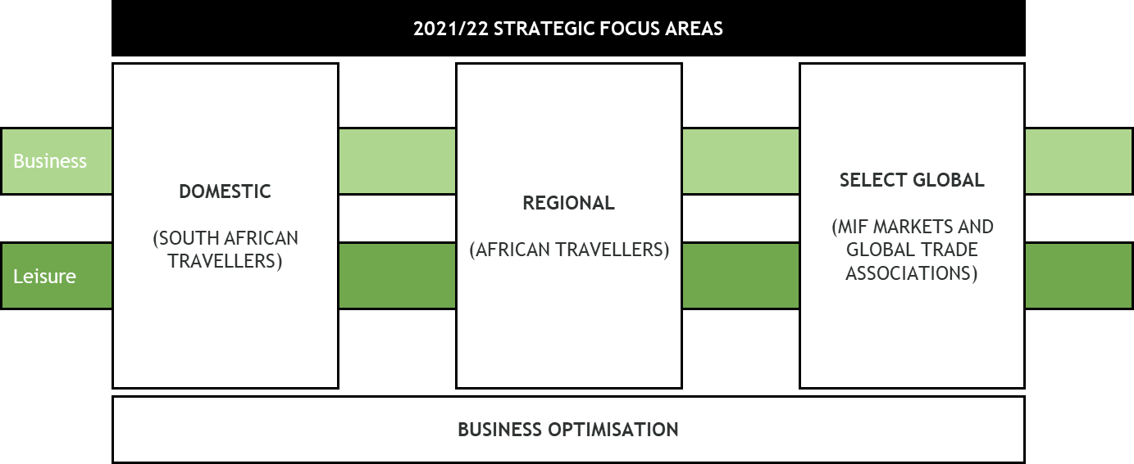
PRIORITIES INFORMING FY21/22 ANNUAL PERFORMANCE PLAN
Given the fast-changing dynamic of the COVID-19 pandemic and related uncertainty, and taking the lead from the Tourism Sector Recovery Plan, the broader SA Tourism strategic focus will be to re-ignite demand in SA’s domestic, regional and select overseas markets.
Tourism Sector Recovery Plan: Key roles for SA Tourism which informs the strategic focus areas:
Stimulate domestic demand through targeted initiatives and campaigns.
Execute a global marketing programme to reignite international demand.
Form targeted, strategic partnerships between government and industry.

Slide 15
FY21/22 ANNUAL PERFORMANCE PLAN PROGRAMMES
SA Tourism is constituted by the following programmes, which informs the APP:
Programme | Programme Description
Programme 1 | Corporate Support To provide effective support services to the organisation, as well as ensure compliance with statutory requirements; and To ensure strategy development and integration with business performance monitoring, governance and evaluation.
Programme 2 | Business Enablement To enhance collaboration with various stakeholders; and To provide centralised tourism intelligence to support evidence-based decision-making.
Programme 3 | Leisure Tourism Marketing To create demand through travel acquisition and growing brand equity for South Africa as a leisure and business events destination, in identified markets.
Programme 4 | Business Events To grow the nation’s business events industry.
Programme 5 | Tourist Experience To ensure the delivery of quality assured tourist/ visitor experiences, which are diverse, unique and enriched.

Slide 16
PROGRAMME 1: APP Output Indicators & Annual Targets
OUTPUT | OUTPUT INDICATORS | 2021/22 ANNUAL TARGET | QUARTERLY TARGETS
 |  |  | Q1 Apr - Jun 2021 | Q2 Jul - Sep 2021 | Q3 Oct - Dec 2021 | Q4 Jan - Mar 2022
2.1. Internal control | Percentage implementation of valid internal and external audit recommendations | 100% implementation of valid audit recommendations | - | - | - | 100% implementation of valid audit recommendations
2.2. Financial management | Payment of compliant invoices within 30 days from date of receipt | 100% | 100% | 100% | 100% | 100%
2.3. Business process automation | Identified business processes automated | ICT, TE, CMO, TGCSA, NCB business processes automated | Testing processes concluded in Q4 20/21 | 40% ICT, TE, CMO, TGCSA, NCB business processes automated | 80% ICT, TE, CMO, TGCSA, NCB business processes automated | 100% ICT, TE, CMO, TGCSA, NCB business processes automated
2.4. Human resources management and development | Staff engagement score | 3.4 Staff engagement score | - | - | - | 3.4 Staff engagement score
 | Implementation of Employment Equity Plan: Percentage of women in South African Tourism Percentage of women in senior and top management positions Percentage of people with disabilities employed Maintain at least 60% Black people (Africans, Coloureds and Indians) across all occupational levels | 60% 50% 2% 60% | 60% 50% 2% 60% | 60% 50% 2% 60% | 60% 50% 2% 60% | 60% 50% 2% 60%

Slide 17
PROGRAMME 2: Output Indicators & Annual Targets
OUTPUT | OUTPUT INDICATORS | 2021/22 ANNUAL TARGET | QUARTERLY TARGETS
 |  |  | Q1 Apr - Jun 2021 | Q2 Jul - Sep 2021 | Q3 Oct - Dec 2021 | Q4 Jan - Mar 2022
2.5. Stakeholder relations | Percentage of approved MOUs with provinces implemented | 100% approved MOUs with provinces implemented | - | 30% approved MOUs with provinces implemented | 65% approved MOUs with provinces implemented | 100% approved MOUs with provinces implemented
2.6. Industry engagement | B2B and B2C portal supported | Go-Live and support B2B and B2C portals | User Acceptance Testing | Go-Live and Support | Support B2B and B2C portals | Support B2B and B2C portals
 | SA Tourism Reputation Index | Conduct survey to establish new baseline | - | Conduct survey to establish new baseline | - | -
2.7. Thought leadership/ Analytics and Insights | Number of reports assessing performance of tourism sector produced | 4 tourism sector performance reports | 1 tourism sector performance report | 1 tourism sector performance report | 1 tourism sector performance report | 1 tourism sector performance report
 | Number of sector engagements | 4 sector engagements | 1 sector engagement | 1 sector engagement | 1 sector engagement | 1 sector engagement

Slide 18
PROGRAMME 3: Output Indicators & Annual Targets
OUTPUT | OUTPUT INDICATORS | 2021/22 ANNUAL TARGET | QUARTERLY TARGETS
 |  |  | Q1 Apr - Jun 2021 | Q2 Jul - Sep 2021 | Q3 Oct - Dec 2021 | Q4 Jan - Mar 2022
1.1. International tourist arrivals | Number of international tourist arrivals | 2.6 million | - | - | - | 2.6 million
1.2. Regional tourist arrivals | Number of regional tourist arrivals | 2.0 million | - | - | - | 2.0 million
1.3. Domestic holiday trips | Number of domestic holiday trips | 3.1 million | - | - | - | 3.1 million
1.4. Domestic holiday spend | Rand value of domestic holiday direct spend | R10.1 bn | - | - | - | R10.1bn
1.5. Domestic day trips | Number of day trips | 116.1 million | - | - | - | 116.1 million
1.6. Destination brand strength | Brand strength index (leisure) | 39.9 | - | - | - | 39.9
1.7. Domestic marketing campaigns | Number of domestic deal-driven campaigns implemented | 4 domestic deal-driven campaigns implemented | 1 domestic deal-driven campaign | 1 domestic deal-driven campaign | 1 domestic deal-driven campaign | 1 domestic deal-driven campaign
 | Number of digital engagements - domestic | 481 720 | - | - | - | 481 720
1.8. regional marketing campaign | New regional brand campaign implemented | 1 regional brand campaign implemented | 1 regional campaign launched | Implementation of regional campaign | Implementation of regional campaign | Implementation of regional campaign
 | Number of digital engagements - regional | 85.7m | - | - | - | 85.7m
1.9. Global tourism brand campaign | Global tourism brand campaign implemented | 1 Annual campaign launched and global roll-out | 1 Annual campaign launched | Implementation of annual campaign | Implementation of annual campaign | Implementation of annual campaign
 | Tourism activation at the World Expo 2020 in Dubai | Tourism activation at the World Expo 2020 in Dubai implemented | - | Preparations for tourism activation at the World Expo 2020 in Dubai | Tourism activation at the World Expo 2020 in Dubai implemented | Tourism activation at the World Expo 2020 in Dubai implemented
.

Slide 19
PROGRAMME 4: Output Indicators & Annual Targets
OUTPUT | OUTPUT INDICATORS | 2021/22 ANNUAL TARGET | QUARTERLY TARGETS
 |  |  | Q1 Apr - Jun 2021 | Q2 Jul - Sep 2021 | Q3 Oct - Dec 2021 | Q4 Jan - Mar 2022
1.10. Business Events Destination brand strength | Business Events brand strength index | Baseline determined in 2021/22 |  | - | Study conducted and baseline determined | Targets to be defined once baseline determined – for inclusion in 2022/23 APP
1.11. Positioning South Africa as a business events destination | Global business events campaign implemented | 1 global business events campaign | Development of content brief and first review and revert | 1 global business events campaign launched | 1 global business events campaign implemented | 1 global business events campaign implemented
 | Domestic business events campaign implemented | 1 domestic business events campaign | Development of content brief and first review and revert | 1 domestic business events campaign launched | 1 domestic business events campaign implemented | 1 domestic business events campaign implemented
1.12. Bid support for international business events | Number of bid submissions | 77 bid submissions | 25 bid submissions | 25 bid submissions | 13 bid submissions | 14 bid submissions
1.13. National business events hosted in VTSDs | Number of national business events hosted in VTSDs | 3 national business events to be piloted in VTSD | Infrastructure and supplier assessment conducted in VTSD in preparation for the event hosting pilot | 1 national business event piloted in VTSD | 1 national business event piloted in VTSD | 1 national business event piloted in VTSD
1.14. Business events hosted | Indaba and Meetings Africa hosted | Hosting of Indaba and Meetings Africa in a hybrid format | Hosting of Indaba and Meetings Africa in a hybrid format | - | - | -
1.15. Strategic platforms hosted | Lilizela Awards hosted | Hosting of Lilizela Awards in a hybrid format | - | - | National Lilizela Awards hosted | -

Slide 20
PROGRAMME 5: Output Indicators & Annual Targets
OUTPUT | OUTPUT INDICATORS | 2021/22 ANNUAL TARGET | QUARTERLY TARGETS
 |  |  | Q1 Apr - Jun 2021 | Q2 Jul - Sep 2021 | Q3 Oct - Dec 2021 | Q4 Jan - Mar 2022
1.16. Quality assured visitor services | Net Promoter Score improvement plan implemented | NPS improvement plan implemented | - | NPS improvement plan developed | NPS improvement plan implemented | NPS improvement plan implemented
1.17. Accommodation establishments graded | Number of graded establishments | 4 707 | 3 621 | 3 983 | 4 345 | 4 707
1.18. Enterprise and supplier development | E&SD programme implemented | E&SD programme developed and thereafter implemented | E&SD programme launched | Onboarding of SMMEs onto E&SD programme | E&SD programme implemented | E&SD programme implemented
 | Percentage of total seats at SA Tourism tradeshow platforms dedicated for SMME participants | 25% of total seats at SA Tourism tradeshow platforms dedicated for SMME participants | 25% of total seats for SMME participants | 25% of total seats for SMME participants | 25% of total seats for SMME participants | 25% of total seats for SMME participants
 | Basic Quality Verification programme to support new accommodation entrants implemented | Baseline established Targets for 2022/23-2024/25 defined | - | Study conducted to establish baseline | Baseline established Targets for 2022/23-2024/25 defined | -
 | Percentage of qualifying expenditure achieved on procurement from B-BBEE contributor status levels 1-5 | 100% procurement from B-BBEE contributor status levels 1-5 | - | - | - | 100% procurement from B-BBEE contributor status levels 1-5
 | Minimum percentage expenditure achieved on procurement of goods and services from targeted groups | 30% SMME 40% Women-owned 30% Youth-owned 7% PWD-owned | - | - | - | 30% SMME 40% Women-owned 30% Youth-owned 7% PWD-owned

Slide 21
CONSOLIDATED FINANCIAL PLAN AND 2021/22 MTEF BUDGET ESTIMATES
Projected Revenue for 2021/22 MTEF
Revenue | 2017/18 | 2018/19 | 2019/20 | 2020/21 |  |  | 2021/22 | 2022/23 | 2022/24
(R’000) | Audited | Audited | Audited | Approved | Special Adjustments | Revised Budget | Estimates | Estimates | Estimates
Department of Tourism Allocation | 1,129,288 | 1,208,048 | 1,256,523 | 1,304,306 | -866,000 | 438,306 | 1,297,038 | 1,329,206 | 1,344,672
TOMSA levies | 116,841 | 121,516 | 133,304 | 144,224 | -144,224 | 0 | 50,000 | 52,400 | 53,972
Indaba, Meetings Africa & other exhibitions | 74,659 | 58,999 | 110,189 | 63,503 | -62,823 | 680 | 33,498 | 35,106 | 36,159
Grading fees | 20,646 | 21,739 | 23,164 | 25,134 | -25,134 | 0 | 12,239 | 12,826 | 13,211
Sundry revenue | 28,642 | 37,611 | 22,498 | 23,552 | -23,552 | 0 | 24,847 | 26,040 | 26,821
TOTAL | 1,370,076 | 1,447,913 | 1,545,678 | 1,560,719 | -1,121,733 | 438,986 | 1,417,622 | 1,455,578 | 1,474,835

Slide 22
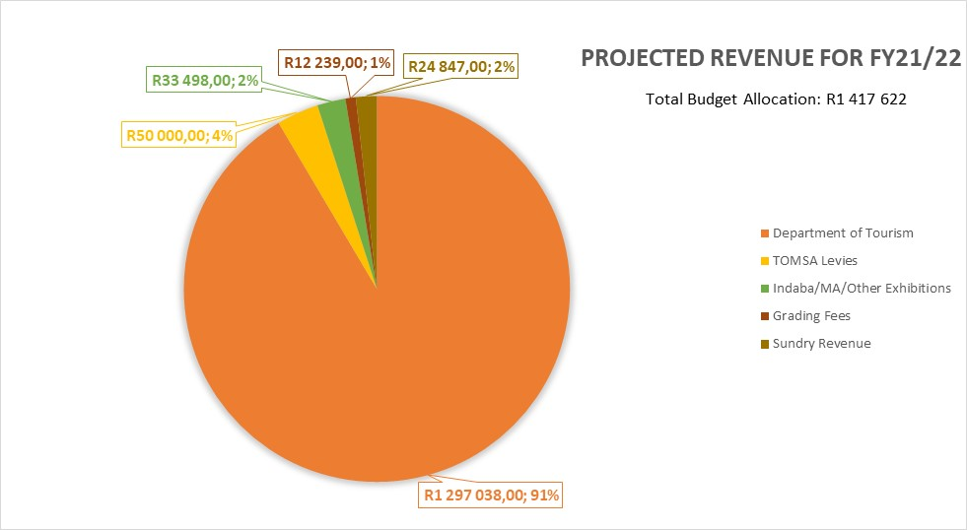
TOTAL BUDGET ALLOCATION

Slide 23
Projected Expenditure for 2021/22 MTEF
Name of the Programme |  | 2017/18 | 2018/19 | 2019/20 | 2020/21 |  |  | 2021/22 | 2022/23 | 2023/24
 |  | Audited | Audited | Audited | Approved Budget | Special adjustments | Revised Budget | Budget | Budget | Budget
 |  | (R’000) | (R’000) | (R’000) | (R’000) | (R’000) | (R’000) | (R’000) | (R’000) | (R’000)
1 | Corporate Support | 151,212 | 158,725 | 152,190 | 140,936 | -29,491 | 111,445 | 126,463 | 129,849 | 131,566
2 | Business Enablement | 60,926 | 85,929 | 79,059 | 94,710 | -60,903 | 33,807 | 84,985 | 87,260 | 88,414
3 | Leisure Tourism Marketing | 955,996 | 1,045,306 | 948,603 | 1,111,609 | -885,227 | 226,382 | 1,014,633 | 1,041,799 | 1,055,582
4 | Business Events | 172,123 | 129,287.00 | 178,855 | 140,932 | -117,641 | 23,291 | 126,459 | 129,845 | 131,563
5 | Tourist Experience | 49,596 | 65,807.00 | 77,021 | 72,532 | -28,471 | 44,061 | 65,083 | 66,825 | 67,710
Total |  | 1,389,853 | 1,485,054 | 1,435,727 | 1,560,719 | -1,121,733 | 438,986 | 1,417,622 | 1,455,578 | 1,474,835

Slide 24
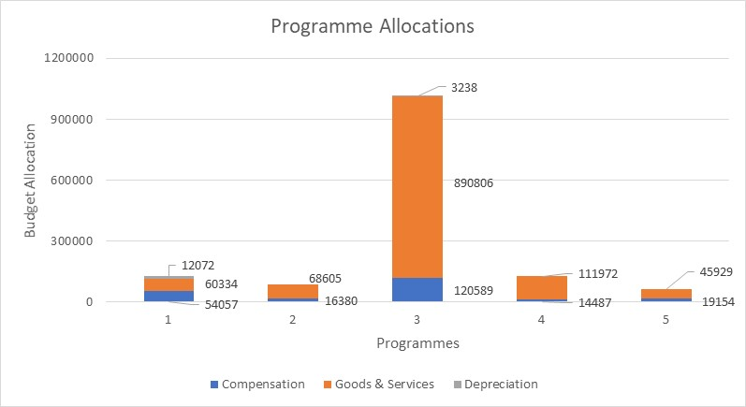
BUDGET ALLOCATION PER PROGRAMME
Total Budget Allocation: R1 417 622

Slide 25
PROGRAMME 1: ECONOMIC CLASSIFICATION
Programme 1: Administration (R’000) | Audited Outcomes |  |  | Estimated Expenditure | MTEF Expenditure Estimates
 | 2017/18 | 2018/19 | 2019/20 | 2020/21 | 2021/22 | 2022/23 | 2023/24
Economic classification:
Compensation of employees | 43 512 | 45 992 | 48 568 | 56 507 | 54 057 | 56 161 | 56 833
Goods and Services | 86 762 | 76 008 | 75 757 | 45 139 | 60 334 | 69 111 | 68 872
Depreciation | 9717 | 10 271 | 10 846 | 9 800 | 12 072 | 4 577 | 5 861
Total expenses | 139 991 | 132 271 | 135 171 | 111 445 | 126 463 | 129 849 | 131 566
Staff complement (no.) | 56

Slide 26
PROGRAMME 2: ECONOMIC CLASSIFICATION
Programme 2: Business Enablement (R’000) | Audited Outcomes |  |  | Estimated Expenditure | MTEF Expenditure Estimates
 | 2017/18 | 2018/19 | 2019/20 | 2020/21 | 2021/22 | 2022/23 | 2023/24
Economic classification:
Compensation of employees | 13 185 | 13 937 | 14 717 | 13 517 | 16 380 | 17 018 | 17 222
Goods and Services | 68 110 | 71 993 | 74 983 | 20 290 | 68 605 | 70 242 | 71 192
Total expenses | 81 295 | 85 929 | 89 700 | 33 807 | 84 985 | 87 260 | 88 414
Staff complement (no.) | 11

Slide 27
PROGRAMME 3: ECONOMIC CLASSIFICATION
Programme 3: Leisure Tourism Marketing (R’000) | Audited Outcomes |  |  | Estimated Expenditure | MTEF Expenditure Estimates
 | 2017/18 | 2018/19 | 2019/20 | 2020/21 | 2021/22 | 2022/23 | 2023/24
Economic classification:
Compensation of employees | 113 491 | 103 472 | 108 916 | 131 029 | 120 589 | 127 772 | 129 301
Goods and Services | 856 861 | 920 043 | 954 777 | 92 284 | 890 806 | 910 663 | 922 877
Depreciation | 2 606 | 2 755 | 2 909 | 3 069 | 3 238 | 3 364 | 3 404
Total expenses | 972 958 | 1 026 270 | 1 066 602 | 226 382 | 1 014 633 | 1 041 799 | 1 055 582
Staff complement (no.) | 83

Slide 28
PROGRAMME 4: ECONOMIC CLASSIFICATION
Programme 4: Business Events (R’000) | Audited Outcomes |  |  | Estimated Expenditure | MTEF Expenditure Estimates
 | 2017/18 | 2018/19 | 2019/20 | 2020/21 | 2021/22 | 2022/23 | 2023/24
Economic classification:
Compensation of employees | 11 209 | 11 994 | 12 833 | 18 067 | 14 487 | 15 051 | 15 231
Goods and Services | 107 791 | 117 293 | 124 855 | 5 224 | 111 972 | 114 794 | 116 332
Total expenses | 119 000 | 129 287 | 137 689 | 23 291 | 126 459 | 129 845 | 131 563
Staff complement (no.) | 14

Slide 29
PROGRAMME 5: ECONOMIC CLASSIFICATION
Programme 5: Tourist Experience (R’000) | Audited Outcomes |  |  | Estimated Expenditure | MTEF Expenditure Estimates
 | 2017/18 | 2018/19 | 2019/20 | 2020/21 | 2021/22 | 2022/23 | 2023/24
Economic classification:
Compensation of employees | 15 418 | 16 297 | 17 209 | 18 861 | 19 154 | 19 899 | 20 137
Goods and Services | 61 203 | 49 510 | 51 487 | 25 200 | 45 929 | 46 926 | 47 573
Total expenses | 76 621 | 65 807 | 68 695 | 44 061 | 65 083 | 66 825 | 67 710
Staff complement (no.) | 22

Slide 30
ABBREVIATIONS & ACRONYMS
AG/AGSA | Auditor-General of South Africa
AI | Analytics and Insights
APP | Annual Performance Plan
B2B | Business to Business
B2C | Business to Consumer
B-BBEE | Broad-Based Black Economic Empowerment
BEE | Black Economic Empowerment
CEO | Chief Executive Officer
CFO | Chief Financial Officer
CMO | Chief Marketing Officer
COO | Chief Operations Officer
COVID-19 | Corona Virus Disease, 2019
DMO | Destination Marketing Organisation
DT | Department of Tourism
E&SD | Enterprise and Supplier Development
EE | Employment Equity
ERRP | Economic Reconstruction and Recovery Plan
Exco | Executive Management Committee
FY | Financial Year
GDP | Gross Domestic Product
GMA | Global Marketing Association
IATA | International Air Transport Association
ICT | Information and Communication Technology
IMF | International Monetary Fund

Slide 31
ABBREVIATIONS & ACRONYMS
LGBTQI | Lesbian, Gay, Bisexual, Transgender/Transsexual, Queer/Questioning and Intersex
LTA | Local Tourism Authority
MICE | Meetings, Incentives, Conferences and Trade Exhibitions
MIF | Marketing and Investment Framework
MOU | Memorandum of Understanding
MTEF | Medium-Term Expenditure Framework
MTSF | Medium-Term Strategic Framework
NCB | National Conventions Bureau
NDP | National Development Plan
NPS | Net Promoter Score
OLA | Operational Service Level Agreement
PFMA | Public Finance Management Act
PTA | Provincial Tourism Authority
PWD | People with Disability
RPK | Revenue Passenger Kilometres
SA | South Africa
SA Tourism | South African Tourism
SANCB | South African National Convention Bureau
SAPO | South Africa Product Owner
SLA | Service Level Agreement
SMME | Small, Medium, and Micro Enterprise
SONA | State of the Nation Address
StatsSA | Statistics South Africa
TDM | Tourism Decision Metrics
TE | Tourism Execution Programme
TGCSA | Tourism Grading Council of South Africa
TOMSA | Tourism Marketing South Africa
UNWTO | United Nations World Tourism Organisation
US/USA | United States of America
VTSD | Villages, Towns and Small Dorpies
WEO | World Economic Outlook
ZAR | South African Rands

Slide 32
Thank You.

