Slide 1

2021-2025 Strategic Plan &
2021/22 Annual Performance Plan
Presentation to the
Portfolio Committee on Transport
5 May 2021
Presentation to the Organisational Performance Leadership Forum July 2020

Slide 2
Outline of Presentation
Mandate, Core Functional Areas and the Cross Border Environment
Strategic Overview
  Vision, Mission and Core Values
  C-BRTA’s Theory of Change
C-BRTA Outcomes and Alignment to Government Priorities
Information on key priority areas and projects
Outcomes and Outputs per Programme
  Programme 1 : Regulatory Services
  Programme 2 : Law Enforcement
  Programme 3 : Facilitation
  Programme 4 : Research and Advisory
  Programme 5 : Administration
Financial Information
Audit Outcomes – 2019/20
Governance Matters

Slide 3

Cross Border Environment
Mandate, Core Functional Areas & the Cross Border Environment
OUTCOME AND OUTPUTS PER PROGRAMME

Slide 4
C-BRTA’s Mandate
The C-BRTA is established in terms of C-BRT Act No. 4 of 1998 to primarily issue permits and regulate cross border industry through:
  Eliminating impediments that constrain the flow of passengers and freight across regional borders;
  Regulating competition of passenger transport operators;
  Granting market access for freight transport operators;
  Reducing operational constraints that have a negative impact on cross-border road transport industry;
  Enhancing and strengthen the capacity of public sector; and
  Building industry partnerships in order to empower the cross-border road transport industry.
6

Slide 5
Core Functional Areas
ADVISORY | Monitoring and counteracting any restrictive measures that may be implemented by other member states in the SADC region and advising the Minister of Transport on regional transport imperatives and challenges
FACILITATION | Developing partnerships with SADC counterparts and fostering positive relationships aimed at improving transport facilitation and development of trade among SADC countries
LAW ENFORCEMENT | Monitors the carriers adherence to the law by carrying inspections – through the C-BRTA Profiling Unit and Road Transport Inspectorate (principal/agency relationship with RTMC)
REGULATORY | Responsible for the issuing and managing processes pertaining to cross border permits
7

Slide 6
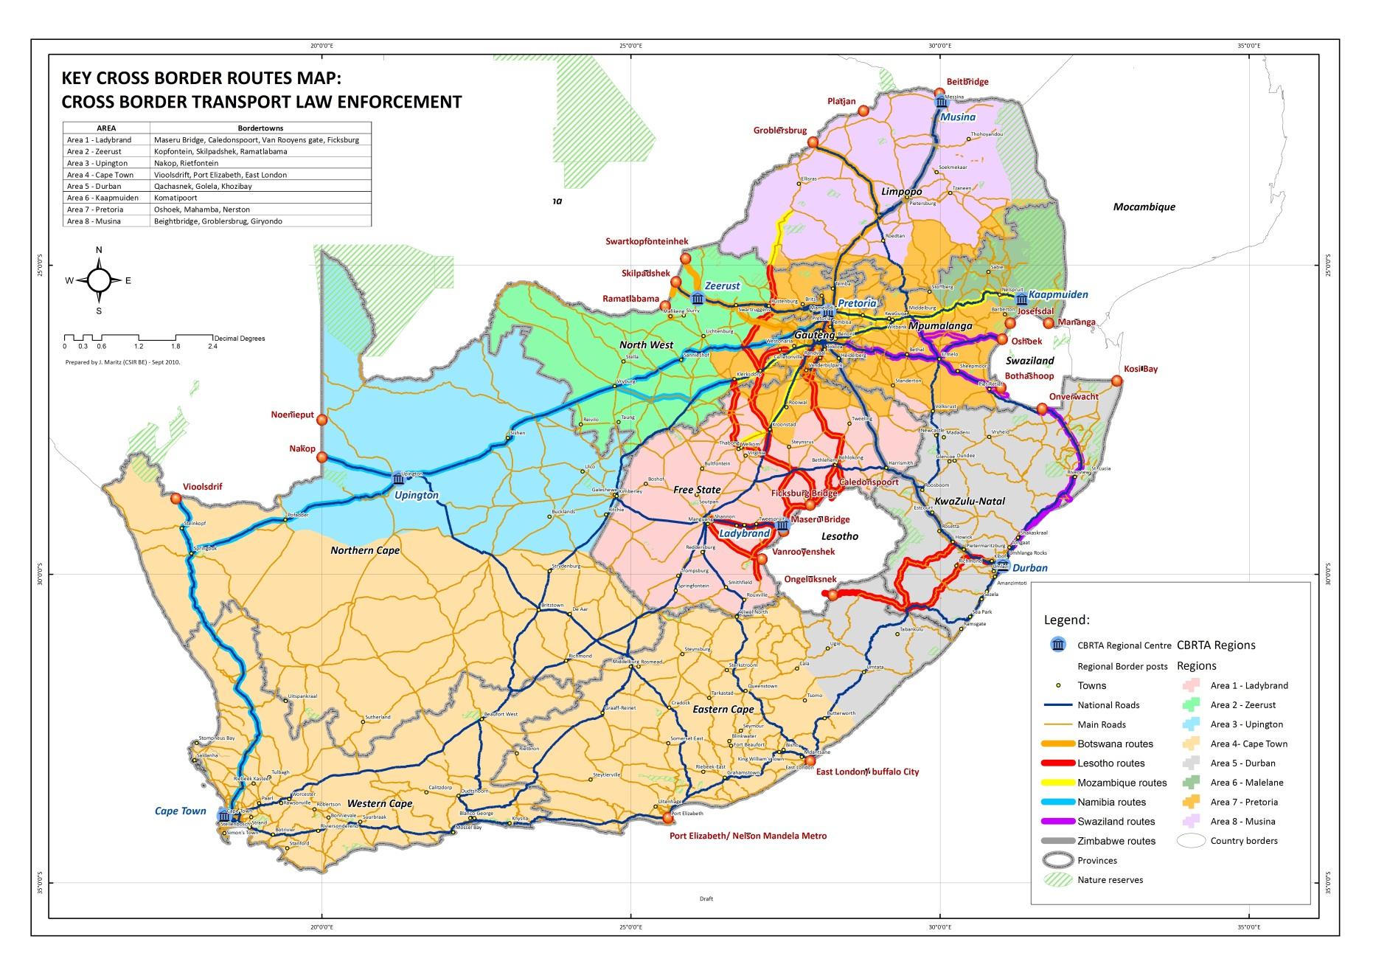
Key Cross-Border Routes and Border Posts
8

Slide 7
Border and Corridor Environment
There are 53 land border posts between South Africa and neighbouring countries -19 designated as commercial border posts;
There are 4 border posts that carry significant volume of commercial traffic: Beitbridge, Lebombo, Maseru and Skilpadshek (listed by traffic volume);
These border posts are located in the busiest corridors linking South Africa to the SADC region namely the North-South Corridor, Maputo/ N4 Corridor and Trans-Kalahari Corridor;
Key role players at border posts are:
  DHA (Immigration/ Border Management Authority);
  SARS (Customs);
  SAPS (Border Police);
  Environment, Forestry and Fisheries;
  Agriculture, Land Reform and Rural Development
  DOH (Port Health); and
  State Security Agency.
9

Slide 8

Cross Border Environment
Strategic Overview
GOVERNANCE MATTERS

Slide 9
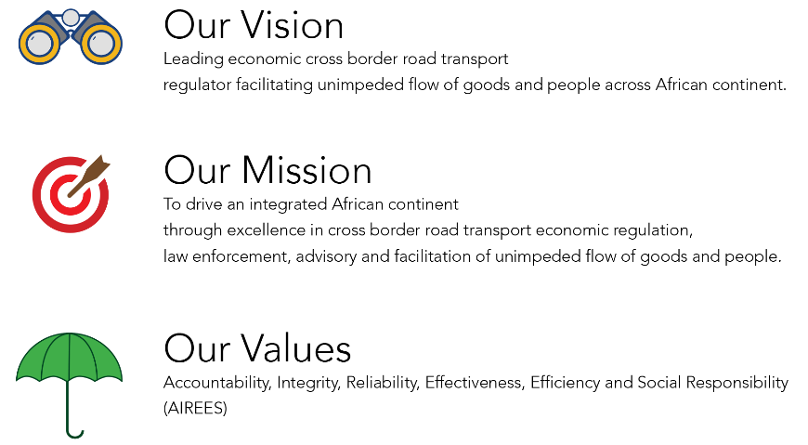
Mission, Vision and Core Values
Mission, Vision and Core Values
Mission, Vision and Core Values
11

Slide 10
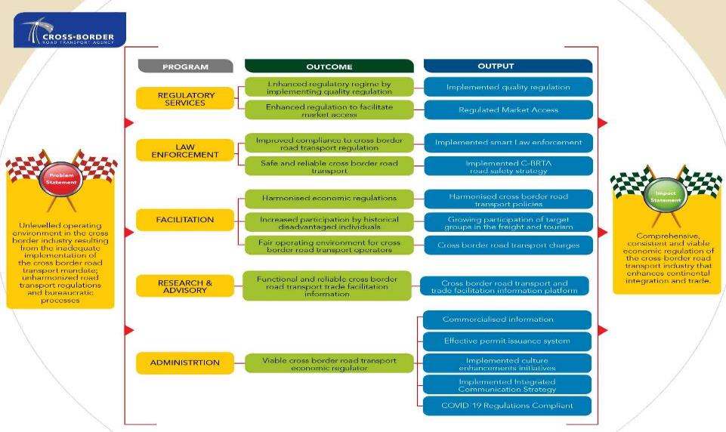
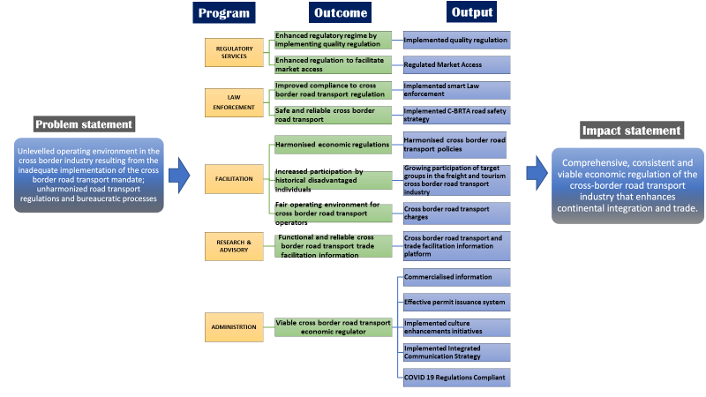
Theory of Change
Theory of Change

Slide 11
Cross Border Environment
Alignment of C-BRTA Outcomes to Government Priorities
OUTCOME AND OUTPUTS PER PROGRAMME

Slide 12
ALIGNMENT TO GOVERNMENT PRIORITIES
Alignment to Government Priorities
Government Priorities | Link to C-BRTA’s Outcomes
Priority 1: A Capable, Ethical and Developmental State Outcome: Improved leadership, governance and accountability Professional, meritocratic and ethical public administration Functional, efficient and integrated government DoT’s Strategic Thrust (Ministers Performance Agreement): Functional, efficient and integrated government | Outcome: Viable cross border road transport economic regulator Improved governance and strengthened control environment
14

Slide 13
Alignment to Government Priorities
Government Priorities | Link to C-BRTA’s Outcomes
Priority 2: Economic Transformation and Job Creation Outcomes: Investing in accelerated inclusive growth. Increased ownership and participation by historically disadvantaged individuals Re-industrialisation of the economy and emerging of globally competitive sectors Improve competitiveness through ICT adoption Competitive and accessible markets through reduced share of dominant firms in priority sectors and expanded small business Increased economic participation, ownership and access to resources and opportunities by women, youth and persons with disabilities DoT’s Strategic Thrust: Increased access to affordable and reliable transport system Develop strategy for the implementation of the “user pay principle” Industrialisation, Localisation and Exports Create a conducive environment that enables national priority sectors to support industrialisation and localisation, leading to increased experts, employment, and youth and women owned SMME participation | Outcomes: Increased participation by historical disadvantaged individuals Fair operating environment for cross border road transport operators Functional and reliable cross border road transport and trade facilitation information Viable cross border road transport economic regulator Improved governance and strengthened control environment
15

Slide 14
Alignment to Government Priorities
Government Priorities | Link to C-BRTA’s Outcomes
Priority 6: Social Cohesion and Safe Communities Outcomes: Promoting social cohesion through increased interaction across space and class DoT’s Strategic Thrust: A diverse socially cohesive society with a common national identity | Outcomes: Safe and reliable cross border road transport Improved compliance to cross border road transport regulation through smart law enforcement At operational level; - Communication unit promotes all national initiatives on social cohesion issues digital campaigns
Priority 7: A better Africa and World Outcome: Increased foreign direct investment into South Africa DoT’s Strategic Thrust: None | Outcomes: Harmonised economic regulations Improved compliance to cross border road transport regulation Enhanced regulatory regime by implementing quality regulations Enhanced regulation to facilitate market access
16

Slide 15
Cross Border Environment
Information on key priority areas and projects
OUTCOME AND OUTPUTS PER PROGRAMME

Slide 16
Implementation of the 1996 SADC Protocol on Transport, Communication and Meteorology
The Agency championed the establishment of the Cross-Border Road Transport Regulators Forum (CBRT-RF) in the SADC region to drive the regional harmonisation agenda.
The CBRT-RF adopted an annual work/action plan agreed upon by regulators of twelve (12) SADC member states.
The activities focus on specific areas of Chapter 5 and 6 of the SADC Protocol on Transport, Communication and Meteorology.
The C-BRTA target for 2020/21 is to have implemented 20% of the CBRT-RF Workplan.
18

Slide 17
Resolution of the RSA/Kingdom of Lesotho Cross-Border Route impasse
A National Ministerial Task Team (NMTT) consisting of officials from National Department of Transport, Cross-Border Road Transport Agency and the Free State Department of Police, Roads & Transport, was established by the Minister to work on measures of resolving the impasse.
An MoU was concluded between the International Cross Border Taxi Organization (ICBTO) and Madiboho Taxi Forum led by Free State Santaco.
The aim of the MoU was to forge working and operational relations between ICBTO and SANTACO,
A draft bilateral agreement between RSA and the Kingdom of Lesotho was escalated to the SADC Secretariat to take a decision on some issues that both countries could not agree on.
A follow-up meeting was held with Lesotho Transport Ministry in August 2020 to discuss progress on the agreement between the two countries. The meeting resolved inter alia that a letter should be written to SADC Secretariat to request the feedback on the meeting which was to be arranged between the two (2) Ministers of Transport.
On-going follow-up with SADC Secretariat to finalize the bilateral agreement.
19

Slide 18
Linking Africa Plan (LAP
Linking Africa Plan (LAP):
  Aimed at improving African economies through transformation of the cross-border transport system, cross-border trade and creating an environment that seeks to promote meaningful intra-Africa trade;
  The objectives are to:
    Enhance cross-border transport system efficiency and intra-Africa trade;
    Enhance harmonisation of cross-border trade and transport governance matters, policies, standards and systems;
    Enhance collaboration, coordination and integration of stand-alone initiatives geared towards realisation of objectives of AfCFTA, Agenda 2063: the Africa we want and various other programmes; and
  The Plan provides interventions needed to unlock Africa’s trade potential and thus position Africa as a significant trading player in the world economic system.
  Progress to date: The Agency has engaged various stakeholders to support the implementation of various identified programmes
20

Slide 19
Integrated Cross Border Management System
The Agency is developing the Integrated Cross Border Management System (ICMBS) to replace the old permit issuing system. The system will go-live in the coming financial year.
Benefits of the new ICMBS:
Convenience
  Apply for permits anytime, anywhere;
  Improve turnaround times; and
  Get online notifications.
Cost Saving
  Reduction of operational costs for operators – travelling to CBRTA offices;
  Renew permits online.
Simplicity
  Simplified application process with ability to attach supporting documents;
  Track and trace permits online;
  Perform payments online.
21

Slide 20
Pilot of the Integrated Cross Border Management System in the Region
The ICBMS is also positioned as a tool for harmonising cross-border management systems in the region. This is envisaged to improve the regulation of cross border road transport in the region critical for enhancing seamless cross-border road transport movements.
At a strategic level, ICBMS will be implemented with a view to:
  Standardise cross-border authorisation systems or permits;
  Enhance cross-border road transport system efficiency;
  Facilitate regional and intra-Africa trade; and
  Regional integration.
At system level:
  ICBMS has capabilities that will guarantee the integrity of authorisation or permits issued by each member state;
  Permits issued using the system will be fully recognised and certified by member states; and
  Holders of permits will be certified to fully comply with regulatory requirements, thus assuring and guaranteeing quicker movements, seamless flow of cross-border transport and trade across border posts and corridors.
The Agency is engaging countries in the region for piloting of the ICBMS once launched.
22

Slide 21
Operator Compliance Accreditation System
  In line with the shift towards quality regulation, the Agency is developing OCAS which is a tool that will used to regulate cross border road transport in line with quality regulation requirements.
  It is:
  A risk-based regulatory system for certifying and licencing cross-border operators based on quality regulation and will be operated on the ICBMs.
  Underpinned by introduction of market access criteria, auditing, operator registration, registration of responsible competent persons, operator profiling, certification and accreditation for authorization of operations;
  Connects the region through a coherent and harmonised regulatory regime that facilitates transport transit, improve compliance and operational quality, and enhances trade whilst addressing transport challenges and corridor inefficiencies;
  A tool that will facilitate seamless legitimate cross-border road transport movements and trade flow through mutual recognition of accreditation status; and
  OCAS will be integratable to other risk-based systems such as the Authorised Economic Operator (there are current discussion with SARS to pilot AEO and OCAS).
    23

Slide 22
Cross-Border Flow Calculator
In order to effectively facilitate cross transport movements, the Agency developed a tool to identify corridor bottlenecks and measure transit times at border posts and corridor sections.
  Aimed at assessing:
    Bottlenecks which lead to delays and long transit time which in-turn increases the cost of doing business, affect trade flow, competitiveness of the region, productivity and sustainability;
    Transit time experienced by cross-border road transport and trade along corridors; and
    Assessing the economic impact of delays and long transit times.
  Project is expected to contribute towards targeted addressing of corridor bottlenecks, targeting those with highest impact, targeted infrastructure interventions and informed policy advocacy; and
The Agency has conducted pilot of the tool at three border posts (Beitbridge, Lebombo and Skilpadshek) and one section of the TKC corridor. There are on-going engagements with the border stakeholders and TKC Corridor Secretariat on the outcomes and recommended interventions from the pilot.
24

Slide 23
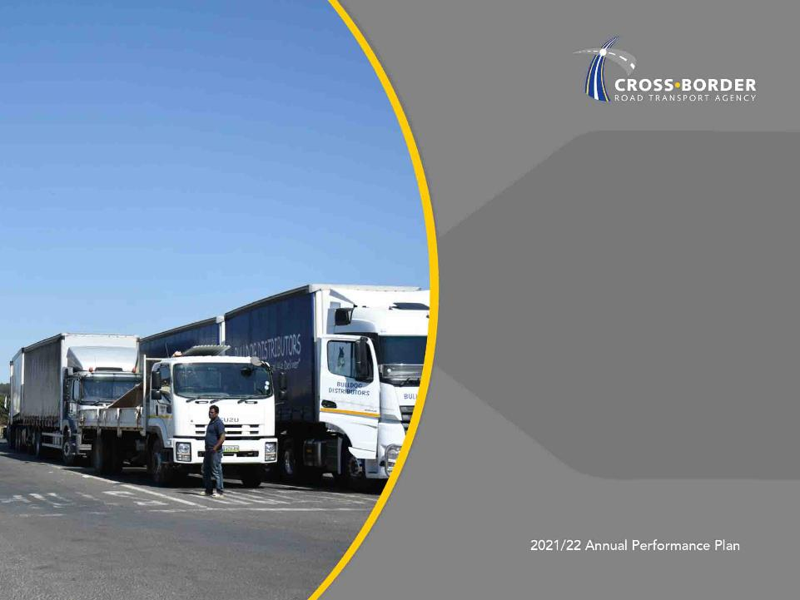
Cross Border Environment
Outcomes and Outputs per Programme
FINANCIAL INFORMATION

Slide 24
Programme 1: Regulatory Services
OUTCOME | OUTCOME INDICATOR | BASELINE | FIVE YEAR TARGET
1.1 Enhanced regulatory regime by implementing quality regulation; | 1.1.1 Developed and Implemented Operator Compliance Accreditation System(OCAS) | OCAS Registration platform development | Implemented OCAS
1.2 Enhanced regulation to facilitate market access; | 1.2.1 Balanced levels of supply and demand of cross border road transport | Developed 4 MAR implementation reports | Implemented updated MAR tool
Quality Regulation means the application of minimum standards that focuses on the operational conduct of the operator with respect to vehicle and driver fitness
26

Slide 25
Programme 1: Regulatory Services - MTEF Targets
No | Outcome | Outputs | Output Indicators | Estimated Performance 2020/21 | Annual Target 2021/22 | Annual Target 2022/23 | Annual Target 2023/24
1.1 | Enhanced regulatory regime by implementing quality regulation | Implemented quality regulation | Developed and implemented Operator Compliance Accreditation System (OCAS) | Refined OCAS registration module | Developed OCAS IT System | Piloted OCAS certification & accreditation modules | Piloted profiling and risk modules
1.2 | Enhanced regulation to facilitate market access | Regulated Market Access | Implemented market access Regulation tool | No target | No target | Implemented updated MAR tool | Implemented updated MAR tool
27

Slide 26
Programme 1: Regulatory Services – 2021/22 Annual & Quarterly Targets
No. | Output Indicator | Annual Target 2021/22 | Quarter 1 | Quarter 2 | Quarter 3 | Quarter 4
1.1.1 | Developed and implemented Operator Compliance Accreditation System (OCAS) | Developed OCAS IT System | Updated OCAS Technical Design | OCAS IT system requirements Analysis | Development of the OCAS IT System | Developed OCAS IT System
28

Slide 27
Programme 2: Law Enforcement
OUTCOME | OUTCOME INDICATOR | BASELINE | FIVE YEAR TARGET
2.1 Improved compliance to cross border road transport regulation through smart law enforcement | 2.1.1. Effective smart law enforcement | New Indicator, baseline to be established during 1st year of implementation | Implemented smart law enforcement
2.2 Safe and reliable cross border road transport | 2.2.1 Developed and Implemented C-BRTA road safety strategy | New Indicator, baseline to be established during 1st year of implementation | Implemented cross border road safety strategy
29

Slide 28
Programme 2: Law Enforcement - MTEF Targets
No | Outcome | Outputs | Output Indicators | Estimated Performance 2020/21 | Annual Target 2021/22 | Annual Target 2022/23 | Annual Target 2023/24
2.1 | Improved compliance to cross border road transport regulation through smart law enforcement | Implemented smart Law enforcement | Efficient smart law enforcement | Piloted smart law enforcement vehicle | Implemented smart law enforcement tools | Efficient law enforcement operations | Assessment on the efficiency of law enforcement operations
2.2 | Safe and reliable cross border road transport | Implemented C-BRTA road safety strategy | Developed and implemented C-BRTA road safety strategy | Approved C-BRTA road safety strategy | Implemented C-BRTA Road Safety Strategy | Implemented C-BRTA road safety strategy | Assessment the impact of the C-BRTA road safety strategy
30

Slide 29
Programme 2: Law Enforcement – 2021/22 Annual & Quarterly Targets
No. | Output Indicator | Annual Target 2021/22 | Quarter 1 | Quarter 2 | Quarter 3 | Quarter 4
2.1 | Efficient smart law enforcement | Implemented smart law enforcement tools | Deployed smart law enforcement vehicle at three border posts | Deployed smart law enforcement vehicle at five border posts | Deployed of smart law enforcement vehicle at seven border posts | Conducted Impact assessment of use of smart law enforcement vehicle at borders
2.2. | Developed and implemented C-BRTA road safety strategy | Implemented C-BRTA road safety strategy | Launched Cross Border Road Safety Awareness Programme | Conducted two (2) domestic Joint Law Enforcement Operations | Launched Cross-border road transport driver fatigue management programme | Conducted Regional Seminar for Assessment of Road Safety Programmes
31

Slide 30
Programme 3: Facilitation
OUTCOME | OUTCOME INDICATOR | BASELINE | FIVE YEAR TARGET
3.1 Harmonised economic regulations; | 3.1.1. Percentage compliance to harmonised cross border road transport policies | New Indicator, baseline to be established after 1st year of implementation | 90% compliance to harmonised cross border road transport policies
3.2 Increased participation by historically disadvantaged individuals | 3.2.1. Percentage increase of participating target group in the freight and tourism cross border road transport industry | New Indicator, baseline to be established after 1st year of implementation | 5% increase in the number of participating target group in the freight & tourism cross border road transport industry Women = 3% Youth = 2% People with disability = 1% (will either be women and or youth)
32

Slide 31
Programme 3: Facilitation
OUTCOME | OUTCOME INDICATOR | BASELINE | FIVE YEAR TARGET
3.3 Fair operating environment for cross border road transport operators; | 3.3.1. Implemented strategies to neutralise restrictive measures | New Indicator, baseline to be established after 1st year of implementation | Implemented cross border road transport charges
33

Slide 32
Programme 3: Facilitation - MTEF Targets
No | Outcome | Outputs | Output Indicators | Estimated Performance 2020/21 | Annual Target 2021/22 | Annual Target 2022/23 | Annual Target 2023/24
3.1 | Harmonised economic regulations | Harmonised cross border road transport policies | Percentage implementation of harmonised cross road transport policies | Implemented 20% of the SADC Protocol and other agreements on cross border related matters | Implemented 30% of the SADC Protocol and other agreements on cross border related matters | Implemented 40% of the SADC Protocol and other agreements on cross border related matters | Implemented 50% of the SADC Protocol and other agreements on cross border related matters
3.2 | Increased participation by historical disadvantaged individuals | Growing participation of target groups in the freight and tourism cross border road transport industry | Percentage increase in the number of participating target groups in the freight and tourism cross border road transport industry | Established baseline of participating target groups in the freight and tourism cross border road transport industry | 0,5% increase in the number of participating women, youth and people with disabilities in the freight cross border road transport industry | 1,5% increase in the number of participating women, youth and people with disabilities in the freight cross border road transport industry | 1.5% increase in the number of participating women, youth and people with disabilities in the freight cross border road transport industry
34

Slide 33
Programme 3: Facilitation - MTEF Targets (cont.)
No. | Outcome | Outputs | Output Indicators | Estimated Performance 2020/21 | Annual Target 2021/22 | Annual Target 2022/23 | Annual Target 2023/24
3.3 | Fair operating environment for cross border road transport operators | Cross border road transport charges | Developed and implemented cross border road transport charges model | Developed cross border road transport charges pricing model | Developed Cross-Border Charges Implementation Strategy | Implemented cross border charges | Implemented cross border charges
35

Slide 34
Programme 3: Facilitation – 2021/22 Annual & Quarterly Targets
No. | Output Indicator | Annual Target 2021/22 | Quarter 1 | Quarter 2 | Quarter 3 | Quarter 4
3.1.1 | Percentage implementation of harmonised cross road transport policies | Implemented 30% of the SADC Protocol and other agreements on cross border related matters | Implemented 5% of the approved C-BRTA linked activities of the SADC Protocol and other agreements | Implemented 10% of the approved C-BRTA linked activities of the SADC Protocol and other agreements | Implemented 5% of the approved C-BRTA linked activities of the SADC Protocol and other agreements | Implemented 10% of the approved C-BRTA linked activities of the SADC Protocol and other agreements
3.2.1 | Percentage increase in the number of participating target groups in the freight and tourism cross border road transport industry | 0.5% increase in the number of participating women, youth and people with disabilities in the freight cross border road transport industry | Updated baseline of participating target groups in freight and tourism cross border road transport industry | Refined baseline of participating target groups in freight and tourism cross border road transport industry | 0.25% increase in the number of participating women, youth and people with disabilities in the freight cross border road transport industry | 0,25% increase in the number of participating women, youth and people with disabilities in the freight cross border road transport industry
36

Slide 35
Programme 3: Facilitation – 2021/22 Annual & Quarterly Targets (cont.)
No. | Output Indicator | Annual Target 2021/22 | Quarter 1 | Quarter 2 | Quarter 3 | Quarter 4
3.3.1 | Developed and implemented cross border road transport charges model | Developed Cross-Border Charges Implementation Strategy | Assessment of Cross-border charges collection infrastructure | Drafted cross-border charges Implementation Strategy | Drafted final cross-border charges implementation strategy | Approved Cross Border Charges Implementation strategy
37

Slide 36
Programme 4: Research & Advisory Services
OUTCOME | OUTCOME INDICATOR | BASELINE | FIVE YEAR TARGET
4.1 Functional and reliable cross border road transport trade facilitation information; | Developed and implemented cross border road transport trade | ASCBOR Country Profiles Cross border calculator | Functional cross border road transport trade facilitation platform
38

Slide 37
Programme 4: Research & Advisory Services – MTEF Targets
No | Outcome | Outputs | Output Indicators | Estimated Performance 2020/21 | Annual Target 2021/22 | Annual Target 2022/23 | Annual Target 2023/24
4.1 | Functional and reliable cross border road transport trade facilitation information | Functional Cross border road transport and trade facilitation information platform | Developed and implemented cross border road transport trade facilitation platform | Established information platform | Updated cross-border road transport and trade facilitation information platform | Updated information platform | Updated information platform
39

Slide 38
Programme 4: Research & Advisory Services – Annual & Quarterly Targets
No | Output Indicator | Annual Target 2021/22 | Quarter 1 | Quarter 2 | Quarter 3 | Quarter 4
4.1.1 | Developed and implemented cross border road transport and trade facilitation information platform | Updated cross-border road transport and trade facilitation information platform | Developed Information platform | Tested and piloted information platform | Implemented Information Platform | Updated cross-border road transport and trade facilitation information platform
40

Slide 39
Programme 5: Administration
OUTCOME | OUTCOME INDICATOR | BASELINE | FIVE YEAR TARGET
5.1 Viable cross border road transport economic regulator | Financially sustainable cross border road transport economic regulator | Business case on sale of information revenue stream | Commercialised information implemented
 | Effective permit issuance | Approved EA plan Implemented prioritised interventions | Fully functional ICBMs
 | High performance culture | New Indicator | Fully implemented organisational practice and culture strategy
 | Effective communication strategy | New Indicator | 80% implementation of Integrated Communication Strategy
41

Slide 40
Programme 5: Administration
OUTCOME | OUTCOME INDICATOR | BASELINE | FIVE YEAR TARGET
5.2 Improved governance and strengthened control environment | Percentage responses to Parliamentary questions within stipulated timelines | 100% responses to Parliamentary questions | 100% responses to Parliamentary questions
 | Percentage resolution of reported incidents of corruption | No baseline | 95% resolution of reported incidents of corruption
 | Ethics committees operationalised | Ethics Committee established | Ethics Committees operationalised
 | Percentage implementation of action plans to address audit findings | No baseline | 100% implementation of action plans to address audit findings
 | Regulatory Audit Outcome by the Auditor-General of South Africa (AGSA) | Clean audit outcomes | Clean audit outcomes
 | Percentage compliance to 30-day payment requirement | No baseline | 100% compliant to valid invoices
42

Slide 41
Programme 5: Administration - MTEF Targets
No. | Outcome | Outputs | Output Indicators | Estimated Performance 2020/21 | Annual Target 2021/22 | Annual Target 2022/23 | Annual Target 2023/24
5.1 | Viable cross border road transport economic regulator | Commerciali sed information | Implemented strategy on commercialised information | Approved Curriculum | Developed and submitted prioritised cross-border training curriculum for accreditation | Commercialised training of identified regional Law Enforcement candidates | Commercialised training of identified regional Law Enforcement candidates
 |  | Effective permit issuance system | Implemented cross border management system | Operational iCBMS (Online and front office permits issued via new iCBMS) and integrated platform implemented | Integrated the new iCBMS with external or third-party systems | Implemented Digital and Mobile Permit Platform | Enhanced and optimised iCBMS
43

Slide 42
Programme 5: Administration – 2021/22 Annual & Quarterly Targets
No. | Outcome | Outputs | Output Indicators | Estimated Performance 2020/21 | Annual Target 2021/22 | Annual Target 2022/23 | Annual Target 2023/24
5.1 | Viable cross border road transport economic regulator | Enhanced organisational culture | Implemented culture enhancements initiatives | Implemented prioritised culture initiatives in the revised enhancement Implementation Plan | Implemented prioritised culture enhancement initiatives as per 2021/22 Implementation Plan | Implemented prioritised culture initiatives in the revised enhancement Implementation Plan | Implemented prioritised culture initiatives in the revised enhancement Implementation Plan
 |  | Improved brand and visibility | Developed and implemented Integrated Communication Strategy | Implemented approved Integrated Communication Strategy | Implemented Integrated Communication Strategy | Implemented Integrated Communication Strategy | Implemented Integrated Communication Strategy
44

Slide 43
Programme 5: Administration – 2021/22 Annual & Quarterly Targets
No. | Outcome | Outputs | Output Indicators | Estimated Performance 2020/21 | Annual Target 2021/22 | Annual Target 2022/23 | Annual Target 2023/24
5.1 | Viable cross border road transport economic regulator | COVID 19 Regulations Compliant | Implemented COVID 19 response plan initiatives | Monitored implementation of COVID 19 response plan | Implemented COVID 19 response plan | Implemented COVID 19 response plan | Implemented COVID 19 response plan
5.2 | Improved governance and strengthened control environment | Adequacy of responses to Parliamentary questions | Percentage responses to Parliamentary questions within stipulated timelines | - | 100% responses to Parliamentary questions | 100% responses to Parliamentary questions | 100% responses to Parliamentary questions
45

Slide 44
Programme 5: Administration – 2021/22 Annual & Quarterly Targets
No. | Outcome | Outputs | Output Indicators | Estimated Performance 2020/21 | Annual Target 2021/22 | Annual Target 2022/23 | Annual Target 2023/24
5.2 | Improved governance and strengthened control environment | Resolution of reported incidents of corruption | Percentage resolution of reported incidents of corruption | - | 95% resolution of reported incidents of corruption | 95% resolution of reported incidents of corruption | 95% resolution of reported incidents of corruption
 |  | Functionality of ethics structures and adequate capacity | Ethics committees established and operationalised | - | Ethics Committees operationalised | Ethics Committees operationalised | Ethics Committees operationalised
46

Slide 45
Programme 5: Administration – 2021/22 Annual & Quarterly Targets
No. | Outcome | Outputs | Output Indicators | Estimated Performance 2020/21 | Annual Target 2021/22 | Annual Target 2022/23 | Annual Target 2023/24
5.2 | Improved governance and strengthened control environment | Implementation of action plan to address audit findings | Percentage implementation of action plans to address audit findings | - | 100% implementation of action plans to address audit findings | 100% implementation of action plans to address audit findings | 100% implementation of action plans to address audit findings
 |  | Maintenance of unqualified audit outcomes | Regulatory Audit Outcome by the Auditor-General of South Africa (AGSA) | - | Unqualified Audit Report with no significant findings | Unqualified Audit Report with no significant findings | Unqualified Audit Report with no significant findings
 |  | Compliance to 30-day payment requirement | Percentage compliance to 30-day payment requirement | - | 100% compliance | 100% compliance | 100% compliance
47

Slide 46
Programme 5: Administration – 2021/22 Annual & Quarterly Targets (cont.)
No. | Output Indicators | Annual Target 2021/22 | Q1 | Q2 | Q3 | Q4
5.1.1 | Implemented strategy on commercialised information | Developed and submitted prioritised cross border training curriculum for accreditation | Identified content(scope) for cross border qualification curriculum | Development of prioritised curriculum | Submitted prioritised curriculum for accreditation | Conducted internal training using developed learning material
5.1.2 | Implemented cross border management system | Integrated the new iCBMS with external or third-party systems | Development of iCBMS Phase 1 | ‘Launched’(Go-live) the new iCBMS | One system integrated with iCBMS | One system integrated with iCBMS
48

Slide 47
Programme 5: Administration – 2021/22 Annual & Quarterly Targets (cont.)
No. | Output Indicators | Annual Target 2021/22 | Q1 | Q2 | Q3 | Q4
5.1.3 | Implemented culture enhancements initiatives | Implemented prioritised culture enhancement initiatives as per 2021/22 Implementation Plan | Initiated mentorship, coaching and leadership programs | Conducted change management workshops that support organisational redesign project | Rolled out organisational value campaign | Rolled out talent management program to support succession planning
5.1.4 | Developed and implemented Integrated Communication Strategy | Implemented initiatives in the integrated communication strategy | Conducted media awareness on the Agency inclusive of its flagship projects | Created and posted an informative video on permit application process | Hosted two (2) stakeholder seminar/roundtables/webinars | Conducted media campaign on iCBMS
5.1.5 | Implemented COVID 19 response plan initiatives | Implemented COVID 19 response plan | Implemented COVID 19 response plan | Implemented COVID 19 response plan | Implemented COVID 19 response plan | Implemented COVID 19 response plan
49

Slide 48
Programme 5: Administration – 2021/22 Annual & Quarterly Targets (cont.)
No. | Output Indicators | Annual Target 2021/22 | Q1 | Q2 | Q3 | Q4
5.1.6 | Percentage responses to Parliament questions within stipulated timelines | 100% responses to Parliament questions | 100% response to Parliamentary questions received - | 100% response to Parliamentary questions received | 100% response to Parliamentary questions received - | 100% response to Parliamentary questions received
5.1.7 | Percentage resolution of reported incidents of corruption | 95% resolution of reported incidents of corruption | 95% of reported incidents resolved | 95% of reported incidents resolved | 95% of reported incidents resolved | 95% of reported incidents resolved
5.1.8 | Established and operationalised ethics committees | Monitored operations of ethics committees | - | Monitored operations of ethics committees | - | Monitored operations of ethics committees
5.1.9 | Percentage implementation of action plans to address audit findings | 100% implementation of action plans to address audit findings | 100% implementation of action plans to address audit findings | 100% implementation of action plans to address audit findings | 100% implementation of action plans to address audit findings | 100% implementation of action plans to address audit findings
50

Slide 49
Programme 5: Administration – 2021/22 Annual & Quarterly Targets (cont.)
No. | Output Indicators | Annual Target 2021/22 | Q1 | Q2 | Q3 | Q4
5.1.10 | Regulatory Audit Outcome by the Auditor-General of South Africa (AGSA) | Unqualified Audit Report with no significant findings | - | Unqualified Audit Report with no significant findings | - | -
5.1.11 | Percentage compliance to 30-day payment requirement | 100% of valid invoices paid within 30 days | 100% of valid invoices paid within 30 days | 100% of valid invoices paid within 30 days | 100% of valid invoices paid within 30 days | 100% of valid invoices paid within 30 days
51

Slide 50

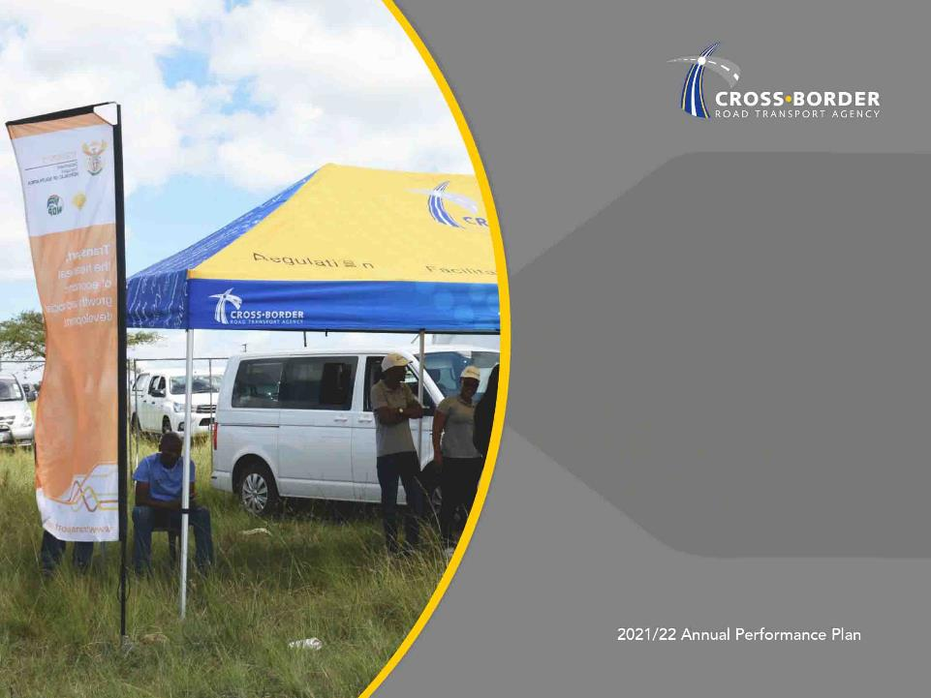
Cross Border Environment
Financial Information
Financial Information
C-BRTA OUTCOMES ALIGNED TO GOVERNMENT PRIORITIES

Slide 51
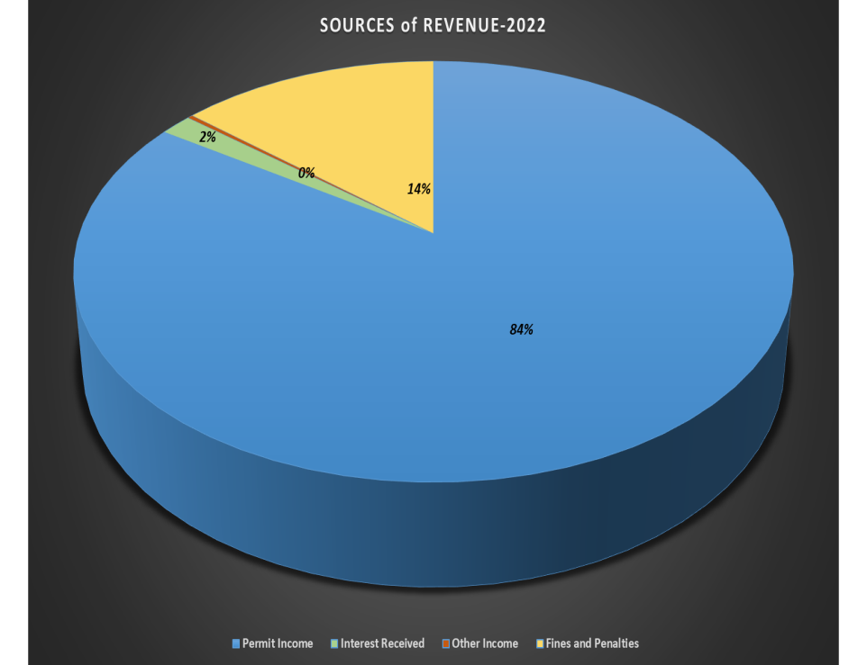
Revenue Budget: 2022 - 2025
Key Budget assumptions relating to Revenue:
Revenue is expected to increase by CPI which is 3.3% in 2022 and thereafter by 4.8% in the medium terms due to increase envisaged from revision of permit fee regulations.
Penalty Income is recorded in C-BRTA and payable to RTMC as part of funding Road Transport Inspectorate – governed by Principal/Agency relationship.
Fines and penalties expected to reduce in 2022 due to closure of borders for passengers as a result of COVID 19 and thereafter increase by inflation.
53

Slide 52
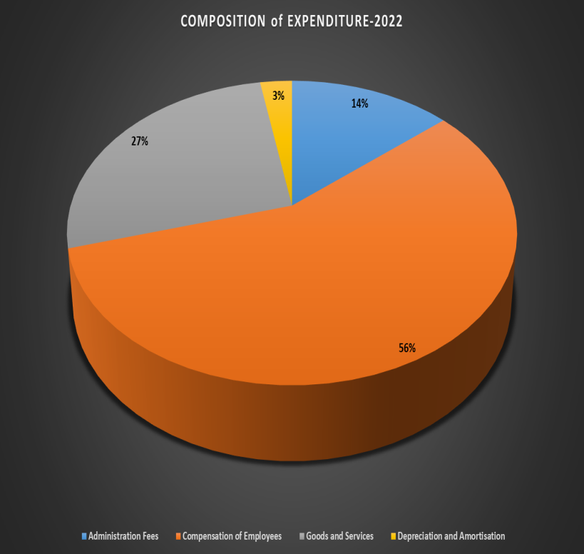
Expenditure Budget Per Economic Classification: 2022 - 2025
Key Assumptions relating to Expenditure:
Compensation of employees to increase in 2022 due to:
  Annual salary inflation.
  Filling of few key vacant positions necessary to achieve APP targets
Goods and services to increase due to the following:
  4.8% inflation over the medium and short
  Additional cost of implementing new projects
Depreciation and amortisation to increase with increase in IT capabilities
54

Slide 53
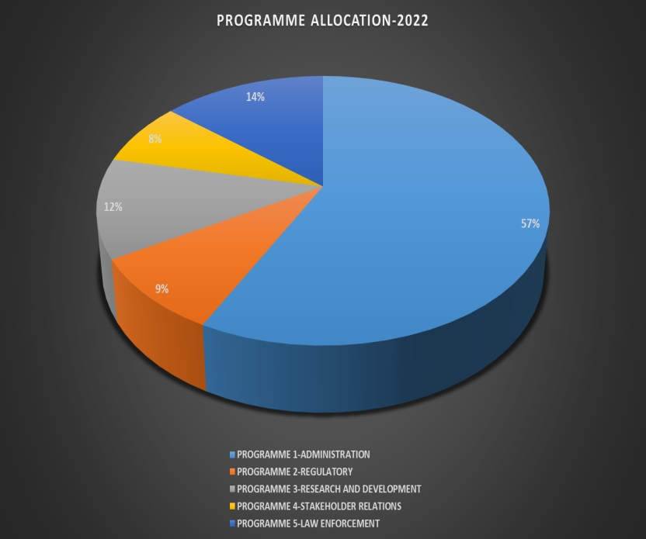
Expenditure Budget Per Economic Classification: 2022 - 2025
Key Assumptions relating to Expenditure:
Expenditure on administration is expected to increase by 14% in 2022 due to envisaged implementation iCBMS system and other systems aimed at creating a COVID 19 friendly working environment.
Expenditure on Regulatory Services is expected to decrease by 7.0% in 2022 due to cost containment measures necessitated by COVID 19 and thereafter increase by 4.8% which include annual inflationary increase. This includes human resources capacitation of Regulatory services to facilitate the harmonisation of regional regulatory regime.
Expenditure on research and development is expected to decrease by 5% due to cost containment measures and thereafter increase by 4.8% per annum in the medium to long term.
Expenditure on stakeholder relations is expected to increase by inflation over the medium term.
Expenditure in law enforcement is expected to decrease in 2022 due to closure of borders necessitated by COVID 19 response measures. Thereafter the general law enforcement expenditure is expected to increase with levels of inflation.
55

Slide 54
Cross Border Environment
Audit Outcomes
Financial Information
C-BRTA OUTCOMES ALIGNED TO GOVERNMENT PRIORITIES

Slide 55
Audit Outcomes Over the Past Five (5) years
The Agency has achieved a Clean Audit for five consecutive years
2015/16 Clean Audit
2016-17
Clean Audit
2017-18
Clean Audit
2018-19 Clean Audit
2019/20 Clean Audit
57

Slide 56
Audit Outcomes 2019/20
CONCLUSION | SUMMARY
Annual Financial Statements | AFS present fairly, in all material respects, the financial position of the entity, its financial performance and cash flows for the year ended
Pre-determined objectives | There were no material findings on the usefulness and reliability of reported performance information
Compliance with legislation | No material findings on non-compliance with applicable key legislation No significant deficiencies identified in internal controls
Other Matters | Investigation being conducted by the Accounting Authority relating to the alleged conduct of the Chief Executive Officer
58

Slide 57
Cross Border Environment
Governance Matters
FINANCIAL INFORMATION

Slide 58
Governance & Financial Sustainability Matters
GOVERNANCE CHALLENGE | DESCRIPTION | PROPOSED SOLUTION
Current Board not properly constituted | The C-BRT Act requires two freight transport specialists and two passenger transport specialists | DoT to consider the requirements of the C-BRT Act in finalizing the process for the appointment of the Board
Financial sustainability issues | C-BRTA operations currently funded primarily from permit fees | Pursuing the levying of cross-border charges on foreign vehicles a harmonization project and an alternative revenue stream
60

Slide 59

