Slide 1
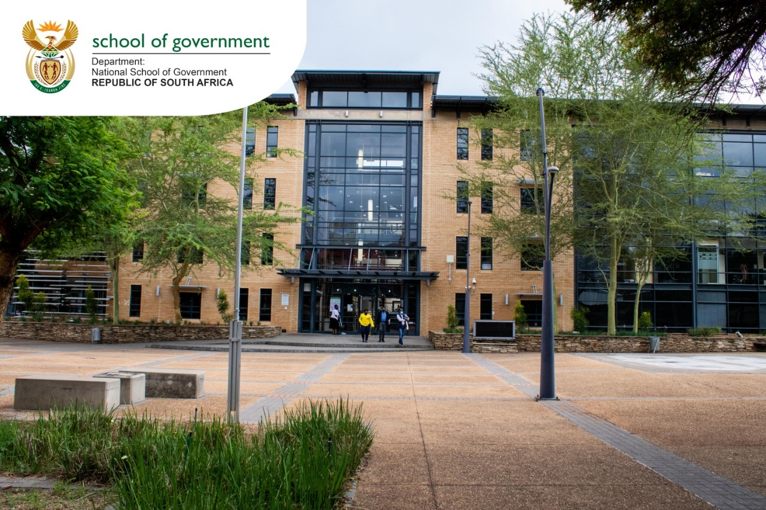
Annual Performance Plan 2021/22
Presentation to the Portfolio Committee on Public Service and Administration
Mr Busani Ngcaweni
Principal: The NSG
5 May 2021

Slide 2
Purpose of the presentation
The purpose of the presentation to the Portfolio Committee is to present the Annual Performance Plan (APP) for the 2021/22 financial year. This APP represents the second year of implementation of the five-year strategy (2020-2025)
For this purpose, the presentation will contextualise the work of the National School of Government (the NSG) within the priority strengthening state capacity and building an efficient, capable, ethical and developmental state
The presentation will provide a recap of the five-year strategy and the key interventions for this period. It is also important to reflect on the performance of the past financial year – being the first year of implementation of the new strategy - in the face of challenges posed by the global COVID-19 pandemic and the response interventions
The presentation will provide the performance priorities and the financial position for the 2021/22 financial year
Finally, we will present a status update on the professionalisation of the public service, and the interventions planned in this financial year

Slide 3
Introduction and Context

Slide 4
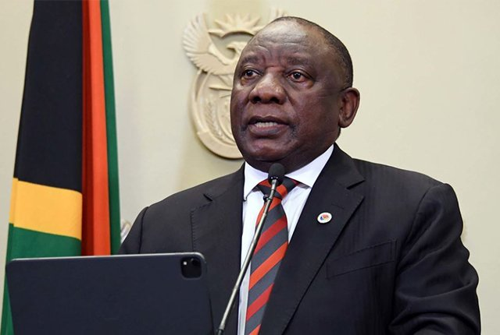
Introduction and Context
“When I was elected to the position of President of South Africa, I said that building an efficient, capable and ethical state free from corruption was among my foremost priorities.
Only a capable, efficient, ethical and development-oriented state can deliver on the commitment to improve the lives of the people of this country.
This means that the public service must be staffed by men and women who are professional, skilled, selfless and honest” – President Cyril Ramaphosa, 1st March 2021

Slide 5
Introduction and Context
CAPABLE STATE
A capable state has the
required human capabilities,
institutional capacity, service
processes and technological
platforms to deliver on the NDP through a social contract
with the people.
ETHICAL STATE
An ethical state is driven by
the constitutional values and
principles of public administration and the rule of law, focused on the progressive realisation of socio-economic rights and social justice as outlined in the Bill of Rights.
DEVELOPMENTAL STATE
A developmental state aims to meet people’s needs through interventionist, developmental, participatory public administration. Building an autonomous developmental state driven by the public interest and not individual or sectional interests; embedded in South African society leading an active citizenry through partnerships with all sectors of society.

Slide 6
Introduction and Context
A capable, ethical and developmental state must fulfil the following:
Improved leadership, governance and accountability
Functional, efficient and integrated government
Professional, meritocratic and ethical public administration
Social compact and engagement with key stakeholders
Mainstreaming of gender, empowerment of youth and people with disabilities

Slide 7
Introduction and Context
10 key elements of what should characterise SA’s developmental capable state in action
Strong, resilient and institutions across all spheres
Professional and ethical public administration
Execution diligence and accountability
People oriented (inclusive growth)
Capacity to plan (evidence based) short, medium to long term
Strong centre (coherence, coordination and line of sight)
Prudent use of resources
Effective governance and transparent government
Compacts with social partners
Quality of decisions

Slide 8
Introduction and Context

Slide 9
Five-year Strategy (2020-2025)

Slide 10
Background to the NSG 5-year strategy
Vision
Build an Ethical and Capable Public Sector in Service of the People
Mission
To Empower Public Servants to be Responsive to Citizen Needs and Government Priorities through Education, Training and Development interventions.

Slide 11
Background to the NSG 5-year strategy
Five Strategic Outcomes
A functional integrated institution (NSG) supporting the delivery of ETD interventions
Competent public servants who are empowered to do their jobs
Sustainable partnerships and collaboration to support ETD interventions
Quality ETD practitioners
Responsive ETD Interventions

Slide 12
Background to the NSG 5-year strategy:
Key interventions
Leadership development:
Senior & executive leadership in three spheres of government, legislative sector, state-owned entities and focus on the institution of traditional leadership
Thought Leadership seminars/ webinars, Master Classes, Spring School on Economic Governance
Implementation capabilities of public servants:
Focus of an entry-to-exit approach of public service career management (4 occupational bands to deliver)
Compulsory programmes to address systemic challenges and demand-led programmes
Opportunities for online and virtual learning
Professionalisation:
Partnerships with professional bodies to professionalise certain categories of employees
Partnerships with Schools of Public Administration – endorsements to programmes
Empowerment:
Cadet programme for interns and higher education students
Art of facilitating engagement in communities
Gender mainstreaming

Slide 13
Background to the NSG 5-year strategy
Key interventions
Quality Management:
Quality assurance and accreditation of programmes
Trainer professionalisation
Quality management in delivery of ETD
Curriculum:
Develop full graduate qualification for rollout in partnership with HEIs
Post-graduate qualification on Governance in Africa through the AMDIN
Introduce peer review mechanism to improve the quality and competitiveness of our curriculum
Determine and introduce pre-requisite training and/or examinations for specified appointments, transfers and compulsory development needs
Institutional matters:
Organizational structure aligned to new strategy
Digital transformation and efficient operations management
Address funding options for the NSG Trade Account to be more sustainable

Slide 14
Our performance in the first year of implementation (2020/21)

Slide 15
Status of organisational performance for 2020/21
The NSG revised its APP for the 2020/21 financial year in view of the COVID19 pandemic and national lockdown. Key revisions were the reduction for generating revenue from R132million to R75milion, and the training numbers from 43 600 to 26 040
As at the end of the financial year (subject to audit process), the NSG can report the following:
Number of learners trained is 37 009 against an annual projected target of 26 040 (142% achievement) but the revenue generated to the amount of R21,3 million (28,4%)
The Nyukela programme is now entrenched as one of our bespoke programmes, with a total of 11 668 public servants enrolled for the course and 6893 successfully completing
The Ethics course had a total enrolment of 15 834, with 15 473 completing the course (98% achievement)
Six master classes were successfully held, including one held with members of the executive

Slide 16
Status of organisational performance for 2020/21
Online Course | Enrolment
Nyukela Public Service SMS Pre-entry Programme | 11507
Ethics in the Public Service | 19074
Ethics for Internal Auditors | 1480
Compulsory Induction Programme for Levels 6-12 | 2575
Know and live our Constitution | 3158
Introduction to Strategic Planning and Management | 3396
Introduction to Financial Management and Budgeting | 2913
Introduction to Leading Change | 1936
Introduction to Strategic Human Resource Management | 755
Introduction to Policy Formulation and Implementation | 655
Writing for Government: Basic Writing Skills | 2504
Financial Management Delegations of Authority in the Public Sector | 21
Generally Recognised Accounting Practice (GRAP) | 1385
Managing Performance in the Public Service | 22
Operations Management Framework | 813
Policy and Procedure on Incapacity Leave and Ill-health Retirement (PILIR) | 1340
Ethics in the FSCA | 28
COVID-19 Resource Repository (not a course, but a collection of resources on Covid-19) | 1054
TOTAL | 54616

Slide 18
Status of organisational performance for 2020/21

Slide 19
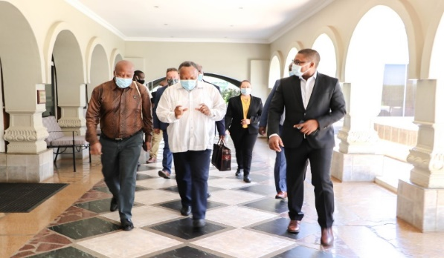
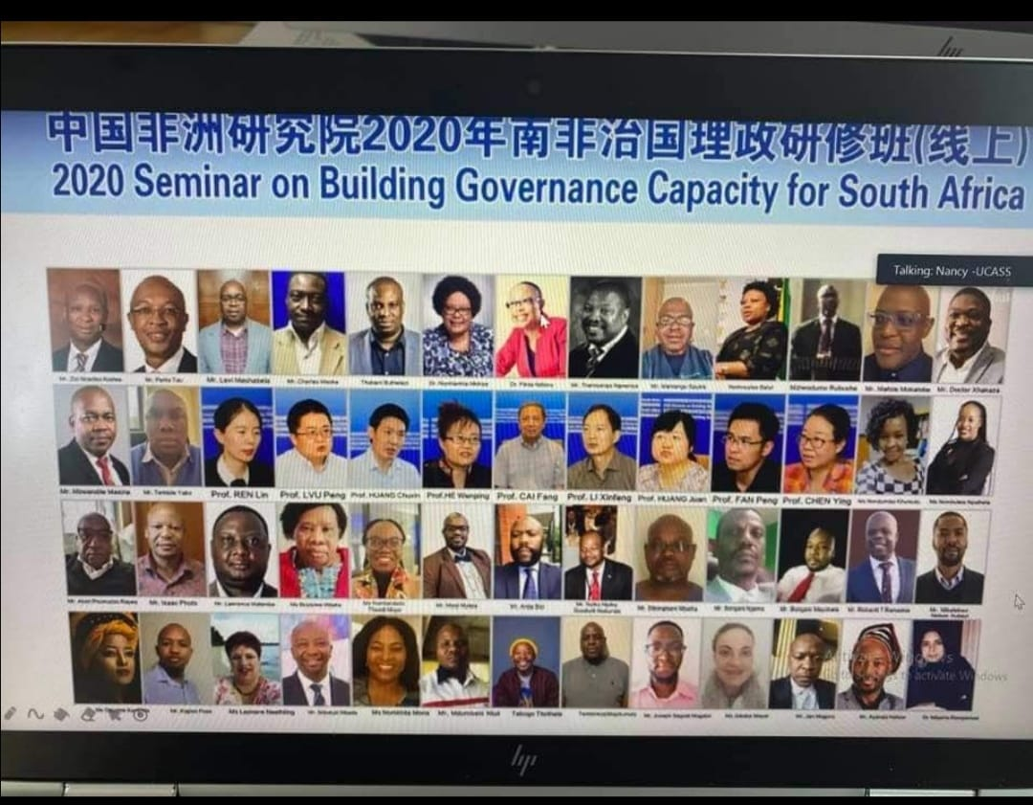
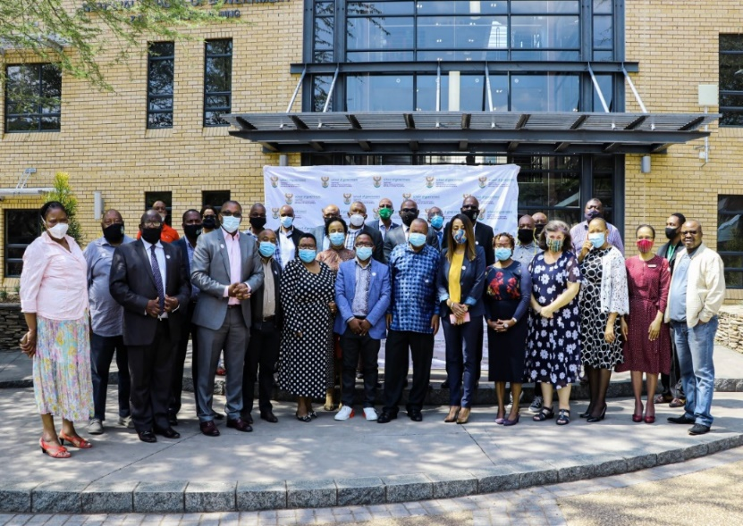
Status of organisational performance for 2020/21

Slide 20
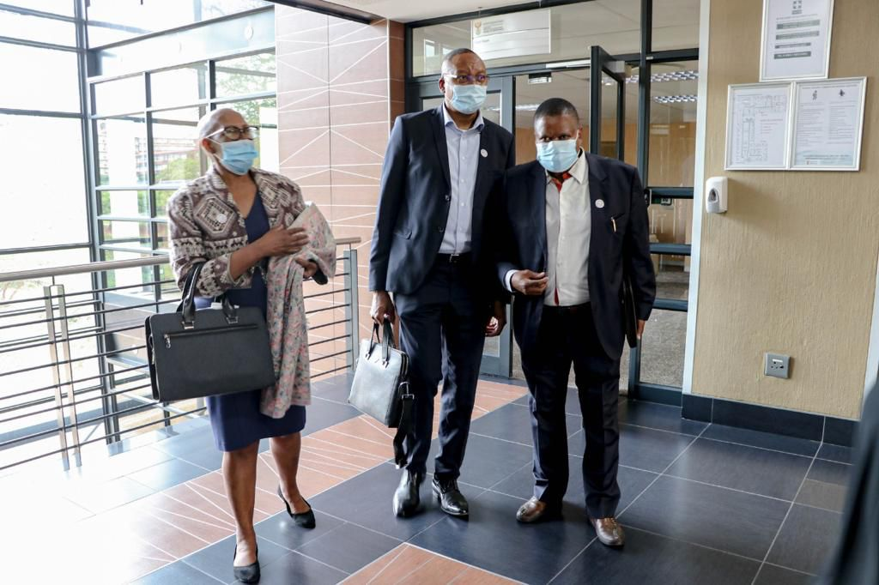
NSG Fellowship Programme

Slide 21
Partnerships are the Future

Slide 22
Financial Performance

Slide 23
Vote Financial Preliminary Report – 31 March 2021
 | Annual Budget 2020/21 | Adjusted Budget | April toMarch Pro-rata budget 2020/21 | April to March Actual Expenditure | April to March Variance budget compared to actual (over)/under | April to March Expenditure as % of pro-rata budget
 | R'000 | R'000 | R'000 | R'000 | R'000 | %
Administration | 112,925 | 101,863 | 101,863 | 96,051 | 5,812 | 94%
Public Sector Organisational and Staff Development | 93,703 | 125,579 | 125,579 | 125,579 | - | 100%
Total Vote Expenditure | 206,628 | 227,442 | 227,442 | 221,630 | 5,812 | 97%
Compensation of Employees | 62,420 | 58,644 | 58,644 | 55,595 | 3,049 | 95%
Goods and services | 47,073 | 39,787 | 39,787 | 38,586 | 1,201 | 97%
Households | - | - | - | 305 | (305) | 0%
Payments for capital assets | 3,432 | 3,432 | 3,432 | 1,564 | 1,868 | 46%
Transfers NSG | 93,703 | 125,579 | 125,579 | 125,579 | - | 100%
Total Vote Expenditure | 206,628 | 227,442 | 227,442 | 221,630 | 5,812 | 97%
Donor EU | 11,391 | 11,391 | 11,391 | 4,403 | 6,988 | 39%
Grand Total | 218,019 | 238,833 | 238,833 | 226,033 | 12,800 | 95%

Slide 24
Trade Preliminary Financial Report – 31 March 2021
 | Annual Budget 2020/21 | Adjusted Budget | April toMarch Pro-rata budget 2020/21 | April to March Actual Expenditure | April to March Variance budget compared to actual (over)/under | April to March Expenditure as % of pro-rata budget
 |  | R'000 | R'000 | R'000 | R'000 | %
Training related revenue (course Fees) | 132,728 | 75,262 | 75,262 | 21,333 | (53,929) | 28%
Transfers NSG | 93,703 | 125,579 | 125,579 | 125,579 | - | 100%
Other Reveneue (Interest) | 3,300 | 3,300 | 3,300 | 2,422 | (878) | 73%
Total Revenue | 229,731 | 204,141 | 204,141 | 149,334 | (54,807) | 73%
Compensation of Employees | (107,992) | (104,528) | (104,528) | (91,601) | 12,927 | 88%
Goods and services | (121,739) | (99,613) | (99,613) | (42,935) | 56,678 | 43%
Payments for capital assets | - | - | - | - | - | 0%
Total Trade Expenditure | (229,731) | (204,141) | (204,141) | (134,536) | 69,605 | 66%
Suplus/(Deficit) | - | - | - | 14,798 | 14,798

Slide 25
Performance priorities for 2021/22

Slide 26
Performance Priorities for 2021/22
The NSG is different from many other learning institutions due to its location in the state and its emphasis on vocational related interventions to improve public sector individual and institutional performance
The ETD interventions and initiatives are constantly evolving to ensure relevance, applicability, and quality and to improve access for learners at different levels of the public sector, as well as the institutions of traditional leadership
The ETD interventions are offered across all levels on the public sector, and clustered according to the following bands: Cadet and Foundational Development; Middle Management Development; Senior Management and Professionalisation; and Executive Management and Leadership
The last band will also focus on political office bearers, traditional leaderships, boards and the executive of state-owned entities

Slide 27
New generation of public sector employees and leaders
Committed to the course of national development and transformation
Diligent in the execution of national priorities
Prudent in the deployment of public funds
Masterful and know what they are doing
Ethical and Accountable to the people
Innovative, always seeking new ways of doing things with precision

Slide 28
Performance Priorities for 2021/22
Whilst the COVID 19 pandemic has proven to be disruptive to the NSG business model, we turned this crisis into an opportunity to refocus on increased online and virtual learning offerings
For this purpose, the School secured licencing for virtual tools and trained its employees to deliver virtually. This is proven by the fact that there has been an unprecedented number of online enrolments for eLearning courses
In addition, we focused on stringent social distancing measures for contact training, enhanced social media presence, and securing licencing for virtual tools
New innovative features such as webinars are gaining popularity among public servants as well as the Master Classes. For the first time, a sitting President accompanied by his executive attended a master class held by the NSG. This event was also televised on live national TV

Slide 29
Performance Priorities for 2021/22
Supporting the MPSA under the social cohesion cluster programme of action (training of all SMS on how to deal with all forms of discrimination; and support to Basic Education on training teachers and SMTs on handling diversity and how to deal with infusing the classroom with a culture of human Rights; classroom diversity; multi culturalism and multilingualism; and dealing with signs of racism and discrimination)
Curriculum framework of 129 accredited and non-accredited courses and programmes. The following courses will be added in this financial year:
Rapid Evaluation
Writing for Government (Advanced)
Legal Writing for Government
Socio Economic Impact Assessment System (SEIAS)
Ethical Leadership and Oversight for Members of the Executive
Evidence Based Policy Making and Implementation (Reviewed)
Art of facilitating Socio-Economic Development for Traditional Communities
Chief Information Officer (Reviewed)
Covid-19 and the SA Economy
Ethics for Educators
Assessor Training

Slide 30
Performance priorities for 2021/22
Performance priority | Performance target
Delivery of ETD programmes and courses | 38 460 learners in compulsory and demand-led programmes and courses
 | Develop/ review 10 programmes and courses
 | 36 active online courses available
 | R118,5 million in revenue generation towards the TTA
Quality ETD practitioners | Recruitment of ETD practitioners
 | Concept of Framework for performance management system for ETD practitioners
 | Standards for trainers, assessors, moderators, mentors and coaches
Responsive ETD interventions | 6 impact evaluation studies
 | 10 skills assessment reports
 | Perception survey at national and provincial government
Partnerships | 20% of signed partnerships contributing to ETD interventions

Slide 31
Performance priorities for 2021/22
Performance priority | Performance target
Learner Administration and Finance | NSG Training Calendar
 | Fully automated and functional Training Management System
Functional integrated institution | Quality Management policy and implementation plan
 | Operations Management implementation plan (mapping business processes)
 | Unqualified or clean audit outcome
 | Integrated communications, marketing and branding (NSG website revamp)
 | Implement approved organizational structure

Slide 32
SONA priorities for 2021/22
SONA Priority | NSG Response
Defeat the corona virus pandemic | NSG will provide learners with opportunities to better understand the digital era (international partnerships)
 | The NSG will prioritise its programme, Khaedu, in order to build capacity among public servants on issues relating to efficient business processes and operations management
 | Prioritise our human resource management and development programmes to support departments in how to manage employees during this pandemic
Accelerate our economic recovery | Economic Governance School for members of the executive and the Etella programme for executive leadership
 | Webinars and master classes to support public servants in accelerating economic recovery
Implement economic reforms to create sustainable jobs and drive inclusive growth | Implement programmes to support economic reform, including financial and SCM Partnerships with economic-related institutions
Fight corruption and strengthen the State | Prioritise programmes on ethics and anti-corruption Partnerships with key institutions (e.g. NPA)

Slide 33
Financial Budget for 2021/22
 | Annual Budget 2021/22
 | R'000
Administration | 109,107
Public Sector Organisational and Staff Development | 101,019
Total Vote Expenditure | 210,126
Compensation of Employees | 58,057
Goods and services | 47,492
Households | -
Payments for capital assets | 3,621
Transfers NSG | 101,019
Total Vote Expenditure | 210,189
Donor EU | 11,391
Grand Total | 221,580

Slide 34
Financial Budget for 2021/22
 | Annual Budget 2021/22
 | R’000
Augmentation
Training related revenue (course Fees) | 118,588
Transfers NSG | 101,019
Other Reveneue (Interest) | 3,400
Total Revenue | 223,007
Compensation of Employees | (104,219)
Goods and services | (118,788)
Payments for capital assets | -
Total Trade Expenditure | (223,007)
Suplus/(Deficit) | -

Slide 35
Professionalisation of the Public Service

Slide 36
Professionalisation of the Public Service
Cabinet approved the publication of the draft national implementation framework towards the professionalisation of the Public Service - 18 November 2020
The publication follows consultations and engagements within FOSAD MANCO, GSCID Cluster and Cabinet Committee
MPSA media statement in January 2021 outlined a two-week public consultation process clustered in 10 functional groups, for the period 15-26 February 2021

Slide 37
Professionalisation of the Public Service
Pre-entry, Recruitment & Selection
Introduce Integrity Tests & Extend Pre-entry Exams
Induction & Onboarding
Make Induction compulsory across levels & link to probation & PMDS & revitalize onboarding for serving public servants
HR Planning & Performance Management
Introduce rules to regulate succession planning & take corrective measures against poor performance & promote/rotate staff
Continuing Learning & Professional Development
Fully implement PAMA provisions on continuing learning for all public servants & progressively phase-in Professional Registration/ Recognition for Legal, Finance, Supply Chain, HR & Build Environment Practitioners
Career Progression & Career Incidents
DG in the Presidency to manage career incidence of DGs, extend tenure of DGs/HoDs to 7 years & rotate after 2 terms. Introduce special dispensation to progress women into senior management positions. Implement revolving door policy to bring expertise to government
Phase-in interventions with a clear set of implementation modalities

Slide 38
Public Consultation Process
Functional Group | Date | Organisation Invited | Number of Actual Attendees
Civil society organisations, institutions of higher learning, think tanks | 15/02/21 | 21 | 115
Regulators, policy government departments, oversight institutions and quality councils | 16/02/21 | 19 | 98
Professional bodies and organisations in the built environment - planning, implementation and project management | 17/02/21 | 18 | 91
Professional bodies and organisations in the Finance and Audit fields, including supply chain management and contracts management | 18/02/21 | 28 | 118
Professional bodies and organisations in the human resource management and development and organisational development | 19/02/21 | 14 | 59

Slide 39
Public Consultation Process
Functional Group | Date | Organisation Invited | Number of Actual Attendees
Professional bodies and organisations responsible for legal, governance and compliance functions | 22/02/2021 | 12 | 69
Professional bodies and organisations in local government | 24/02/21 | 12 | 61
Professional bodies, organisations and government institutions responsible for state-owned entities | 25/02/21 | 8 | 84
All recognised professional bodies (statutory and non-statutory) | 26/02/21 | 27 | 76
Total of organisations and attendees | 15 – 26 Feb 2021 | 159 | 771

Slide 40
Professionalisation of the Public Service
Key issues emerging:
The Framework must strongly advocate for ethical issues across the Public Service
Internship programme needs to be ramped and allow skills created or imparted to be used with the government (creation of permanent opportunities for internship programmers)
Training (reskilling and upskilling) becomes important pillars to ensure professionalisation of public service
The framework to recognize Recognition of Prior Learning (RPL) and ensure preservation of organisational memory
Emphasize and ensure promotion of Constitutional values and principles
Way-forward:
Targeted consultations continue: May 2021
Appointment of Ministerial Task Team: May 2021
Finalization of Framework and Cabinet tabling: October 2021

Slide 41
Key issues for discussion and consideration

Slide 42
Key issues for discussion and consideration
NSG funding model and revenue sustainability continues to remain a crisis for the NSG, and does require executive intervention to adequately fund the School in order to strengthen state capacity
Heads of all public sector institutions have a responsibility to ensure that their employees have the requisite tools of trade to perform and learn within a context of the fast-paced digital transformation that is unfolding in our public sector
Data service providers must ensure that where programmes being offered by the NSG to public servants, there must be a zero-rating for data costs. This allows all public servants, especially our front-line workers the ability to learn without data concerns, and at a time that is suitable for them to learn
Partnerships are the future for the NSG, and we will continue to endeavour to provide opportunities (especially international opportunities) for our public servants

Slide 43
The NSG:
Learn: expanding learning opportunities for public servants to master state craft
Serve: building the capacity (and culture) of public servants to serve society effectively
Grow: helping public servants to combine learning and service (experience) to grow professionally

