Slide 1
PRASA Corporate Plan 2021 – 2024
Parliamentary Committee on Transport
4 May 2021

Slide 2
PRASA Mandate per LSA (1989), as amended.
OUR PRIMARY MANDATE
To ensure that, at the request of the National Department of Transport, rail commuter services are provided within, to & from the Republic in the public interest & provide, in consultation with the National Department of Transport, long haul passenger rail & bus services within, to & from the Republic in terms of the principles set out in section 4 of the National Land Transport Act (2000) (Act no 22 of 2000, as amended)
OUR SECONDARY MANDATE
The second objective & secondary business of PRASA is that it shall generate income from the exploitation of assets acquired by it.
PRASA is a Schedule 3B Government Enterprise as per PFMA

Slide 3
Vision & Mission & Alignment with DOT
PRASA MISSION
  Provide safe, reliable, affordable commuter rail, long-haul passenger rail and long-haul intercity bus services.
DoT VISION
  Transport, the Heartbeat of Economic Growth and Social Development
PRASA VISION
  Be a recognised provider and manufacturer of safe and reliable public passenger services and products.
DoT MISSION
  Lead development of efficient and integrated transport systems by creating a framework of sustainable policies, regulations and implementable models to support government strategies for economic and social development”

Slide 4
Shareholder Imperatives
Apex Priorities of the 6th Administration
Building A Capable, Ethical And Developmental State
Economic Transformation and Job Creation
Education, Skills and Health
Consolidating the Social Wage through Reliable and Quality Basic Services
Spatial Integration, Human Settlements and Local Government
Social Cohesion and Community Safety
A Better Africa and World
Minister’s Priorities of 5 Strategic Thrusts
  Safety (including security) as an enabler of service delivery;
  Public transport that enables social emancipation and an economy that works;
  Infrastructure build that stimulates economic growth and job creation;
  Building a maritime nation, elevating the oceans economy; and
  Accelerating transformation towards greater economic participation

Slide 5
Shareholder Compact Performance Plan

Slide 6
Performance Plan aligned to Indicators of Minister
Outcome of Minister | Pillar | Output | Performance indicator
Affordable, safe and reliable public transport | Pillar 7: Modernise Rail through manufacturing, Infrastructure development and maintenance | New rolling stock deployed to priority corridors | Number of new train sets provisionally accepted per annum
 | Pillar 8: Restructure and improve performance of the secondary mandate. | Stations revitalised and modernised | National station improvement and upgrade projects completed per annum
 | Pillar 2: Recover Rail and Autopax performance | Return of passengers to rail and Autopax | Number of Metrorail passenger trips per annum
 | Pillar 2: Recover Rail and Autopax performance |  | Number of MLPS passengers per annum
 |  |  | Number of Autopax passengers per annum

Slide 7
Performance Plan aligned to Indicators of Minister
Outcome of Minister | Pillar | Output | Performance indicator
Improved transport safety and security | Pillar 3: Improve operational safety, security, and compliance. | Improved rail safety environment | Number of safety occurrences for specified categories reported per annum (open line collisions & derailments, level crossing occurrences, signals passed at danger, people struck by train, platform train interchange occurrences)
 | Pillar 3: Improve operational safety, security, and compliance. | Improved rail security environment | Number of security occurrences per RSR categories 1-9 reported per annum
Affordable, safe and reliable public transport (Infrastructure Projects) | Pillar 7: Modernise Rail through manufacturing, Infrastructure development, and maintenance. | Signalling programme: Completion of installations (commissioning of interlockings) | Number of Gauteng interlockings commissioned
 |  |  | Number of Western Cape interlockings commissioned
 |  |  | Number of KwaZulu-Natal interlockings commissioned
 |  | Depot modernisation (EMU capacity completed) | EMU capacity in depots completed per annum
 |  |  | Depot fencing for depots and yards completed

Slide 8
Performance Plan aligned to Indicators of Minister
Outcome of Minister | Pillar | Output | Performance indicator
Affordable, safe and reliable public transport (Infrastructure Projects) | Pillar 2: Recover Rail and Autopax performance | Recovery of Mabopane corridor electrical train services | Full electrical train service reintroduced between Mabopane and Pretoria
 | Pillar 2: Recover Rail and Autopax performance | Recovery of Central Line electrical train services | Full Electrical train service reintroduced between Cape Town, Kapteinsklip and Chris Hani
 | Pillar 7: Modernise Rail through manufacturing, Infrastructure development and maintenance. | Refurbished and repaired Rolling Stock through General Overhaul program | Number of Metrorail coaches overhauled per annum
 |  |  | Number of MLPS Coaches refurbished per annum
 |  | Improved availability of trains | Train sets in service

Slide 9


Status of PRASA and actions of management
3 determinants of successful railways
Capital investment to achieve quality & attractiveness

Slide 10
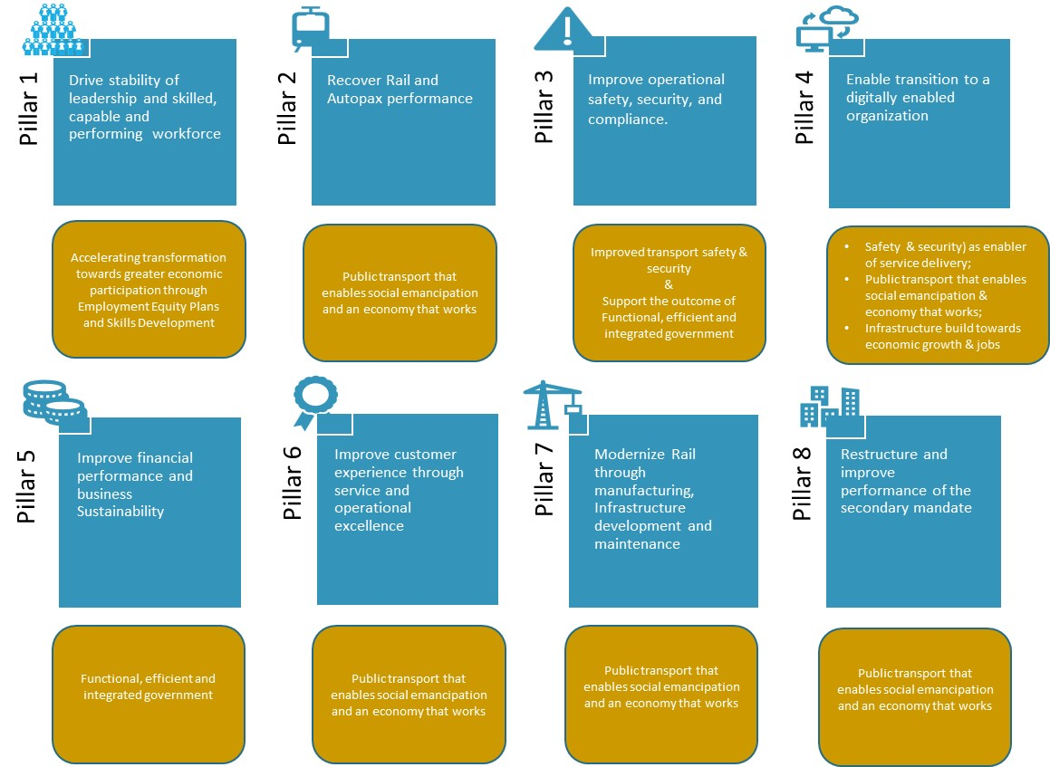
PRASA’s Objectives
PRASA’s strategic intent is to be recognised as a provider and manufacturer of safe and reliable public transport services and products. The pillars are the high-level objectives that define the areas of activities and initiatives that will direct PRASA in the pursuit of its long-term goals.

Slide 11
PRASA: Key Performance Measure improvements in 5 years
Measure | Baseline 2019/20 | 2021/22 | 2022/23 | 2023/24 | 2024/25 | 2025/26
R63.5 billion capital investment spend | R2.4bn | R9.7bn | R12.6bn | R12.9bn | R13.7bn | R14.5bn
R15.3 billion revenue generated from operations | R1.8bn | R2bn | R2.8bn | R3.3bn | R3.5bn | R3.7bn
85% network availability by 2025/26 | New indicator | 60% | 65% | 75% | 80% | 85%
Fleet availability (old fleet) – 260 train sets available for service by 2025/26 | 110 | 193 | 210 | 230 | 250 | 260
15% reduction in personnel costs (non-core skills) | 52% of Opex | 47% of Opex | 44% of Opex | 41% of Opex | 39% of Opex | 37% of Opex
350 million Metrorail passenger trips by 2025/26 | 132.7 million | 69 million | 238 million | 311 million | 330 million | 350 million
468 000 MLPS passengers by 2025/26 | 206 000 | 183 000 | 387 000 | 417 000 | 442 000 | 468 000
2.6 million Autopax passengers by 2025/26 | 1.5 million | 2 million | 2.4 million | 2.5 million | 2.5 million | 2.6 million
R969 million Autopax revenue by 2025/26 | R425.6m | R565.8m | R783.8m | R830.8m | R889m | R969m

Slide 12
PRASA Pillar Choices
Core Service Choices
Stabilize Service Choices
Sustain Service Choices
Phase 1: Fix the Core Plan
(8 – 12 Months)
2021 FY
Phase 2: Stabilization
(12 -24 Months)
2022-2023
Phase 3:Sustainability
36-48 Months
2023-2026
Ensures that indicators are developed that will give effect to the long-term financial sustainability of the PRASA.
Focuses primarily on cash & restoring the cash position of PRASA
Expands on the financial indicators to be monitored & emphasizes key governance & institutional issues which must simultaneously be addressed & finally,
The approach is designed to ensure that financial recovery is not only achieved, but more importantly, that progress is institutionalized & sustained.

Slide 13
Pillar 1:
Drive stability of leadership and skilled, capable and performing workforce
Accelerating transformation towards greater economic participation through Employment Equity Plans and Skills Development

Slide 14
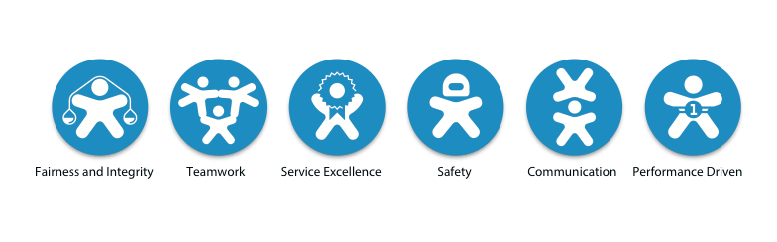
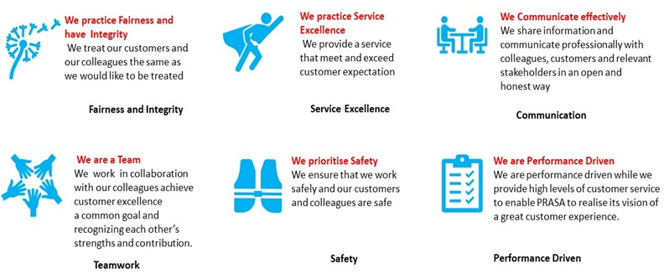
PRASA Values & Behaviour Descriptors

Slide 15
Our People Choices
GETTING HCM BASIC RIGHT FIRST
Core Service Choices
Stabilize Service Choices
Sustain Service Choices
Phase 1: 2021-2022
Organisational culture – Change Management
HCM Governance , Compliance & Performance Improvement
Business Focused Skills development
Employee Relations Climate Improvement
Building Agile & Resilient workforce
Organisational Structures Review in line with Business Operating Model
Phase 2: 2022-2023
Driving culture change agenda
HCM Governance , Compliance & Performance Improvement
Integrated Talent Management
Improved Employee Relations Climate
Organisational Structures Review in line with Business Operating Model
Employee Recognition & Reward
Phase 3:2023-2026
Driving culture change agenda
HCM Governance , Compliance & Performance Improvement
Integrated Talent Management
Improved Employee Relations Climate
Building Resilient workforce
Lean Organisational Structures
Employee Recognition & Reward

Slide 16
Labour Costs reduction strategies over 5 years
Automation of Time & attendance (payroll) linked to biometrics
Strategic use of Overtime in line with approved work schedules
Review of conditions of service
Review the 5-day worker & 6-day worker – Move to a 24hr & 7-day operations
HCM Administration automation
Continuous improvement program (Productivity vs Efficiency using 6 sigma)
Identify & eliminate redundancies & duplications in line with operating model
Cross train employees (Multitasking, Cross functional projects etc.)

Slide 17
Pillar 2:
Recover Performance of Rail and Autopax
Public transport that enables social emancipation and an economy that works

Slide 18
Metrorail: Top 10 Priority Corridors Resumption
Priority Line Selection:
Corridors normally carrying the majority of rail commuters
Covering stations with highest volumes of commuters (Super-core stations and Core Stations
In line with the recovery schedule for Infrastructure, Stations, Rolling Stock and Security)

Slide 19
Our Metrorail Choices
Core Service Choices
Stabilise Service Choices
Sustain Service Choices
PHASE 1: 2021 - 2022
Mabopane – Pretoria
Leralla – Daveyton – Germiston
Daveyton – Germiston
Johannesburg – Naledi
Pienaarspoort – Pretoria
Saulsville – Pretoria
Pretoria – Kaalfontein
Cape Town – Khayelitsha/Kaapteinsklip
Cape Town – Simonstown (WNB & ATL)
Cape Town – Strand
Umlazi – KwaMashu (Including Bridge City)
PHASE 2: 2022 - 2023
Residensia – New Canada
Kwesine – Germiston
Cape Town – Stellenbosch
Belville – Wellington
Keslo – Reunion
Randfontein – Johannesburg
Springs – Dunswart
Crossmoor - Durban
Pinetown – Durban
  PHASE 3: 2023 - 2026
  Future expansion
Hammanskraal – Pretoria
Siyabuswa - Pretoria
Motherwell – Gqeberha
Umdantsane-East London
Lanseria – Johannesburg
Facilities management (cleaning, horticulture & maintenance)
CIP- Capital Intervention Program - Repair stations quickly by restoration of ablutions, lighting & electricity, ticket offices & general building repairs
ABT- Alternative Building Technology - Using repurposed containers to provide ticketing offices, ablutions & services to 41 stations that have been totally vandalised. Q1 2021/22
***Key KPI’s :
1. Train Schedule & Time-Keeping
2. Passenger Numbers & Fare Revenue – supported by new ticketing systems
3. Operating Safety and Security Incidents

Slide 20
Central Line
Core Service Choices
Stabilize Service Choices
Phase 1: 2021-2022
Follow up & ensure that the illegal settlements on the Central Line are removed so that assets can be reinstated, & trains can run
Walling design & construction
Roll-out added security interventions for infrastructure protection (RPAS, E-Guarding & Response vehicles)
Rehabilitation of Perway System
Rehabilitation of the Power Supply System (Substations & OHTE)
Rehabilitation of train stations
Central Line Resignalling completed
Resourcing of the Programme Management Office
Phase 2: 2022-2023)
6 Pedestrian bridges required on Central Line completed
Project | Sub-project | Outputs | Start date | End Date
Central line corridor | Encroachments | Relocation of illegal settlements | Feb 2021 | Mar 2021
 | Walling (height 3m with strength of 30-40MPa) | Structural engineering designs and project management | Feb 2021 | Dec 2021
 |  | Construction of 160km (2 x 80km) of concrete wall | Jun 2021 | Dec 2021
 | Street-to-street pedestrian bridges | 6 new pedestrian bridges | Sep 2021 | Jun 2022
 | Perway material replacement | Perway rehabilitation | May 2021 | Jul 2021
 | Heavy on-track machines | Perway rehabilitation | Jul 2021 | Sep 2021
 | OHSE agent | OHSE consultant | Apr 2021 | Apr 2022
 | Restoration of 33kV network | Reinstatement of 33kV transmission line | Apr 2021 | Aug 2021
 | Restoration of 11kV network and substations | Reinstatement of 11kV transmission line and substations | Apr 2021 | Oct 2021
 | Restoration of 3kV and OHTE network | Reinstatement of 3kV traction distribution lines | Apr 2021 | Oct 2021
 | Restoration of 11kV and 3kV substations | Recovery of substations | May 2021 | Nov 2021

Slide 21
Mabopane Corridor
Core Service Choices
Stabilize Service Choices
Phase 1: 2021-2022
Rehabilitation of the Power Supply System (Substations & OHTE)
Walling design & construction
Rehabilitation of train stations
Roll-out added security interventions for infrastructure protection (RPAS, E-Guarding & Response vehicles)
Complete Re-signalling programme across the corridor.
Resourcing of the Programme Management office
Phase 2: 2022-2023
Completion of 8 pedestrian bridges along the corridor.
Project | Sub-project | Outputs | Start date | End date
Mabopane corridor | Walling (height 3m with strength of 30-40MPa) | Structural engineering designs and project management | Feb 2021 | Dec 2021
 |  | Construction of 90km (2 x 45km) concrete wall | Jun 2021 | Dec 2021
 | Street-to-street pedestrian bridges | 8 new pedestrian bridges | May 2021 | May 2022
 | Resignalling system | Upgrading of old, vandalised signalling system with the electronic signalling system | Jan 2021 | Nov 2021
 | OHSE agent | OHSE consultant | Apr 2021 | May 2022
 | 3kV DC substation rehabilitation | Reinstatement of 3kV DC power supply network | Apr 2021 | Oct 2021
 | Rehabilitation of OHTE system | Reinstatement of 3kV DC power supply network | Apr 2021 | Oct 2021
 | Rehabilitation of train stations | Reinstatement of train stations for revenue collection | May 2021 | Sep 2021

Slide 22
Our Mainline Passenger Services Choices
Core Service Choices
Stabilize Service Choices
Sustain Service Choices
Phase 1: 2021-2022
Johannesburg – Cape Town
Johannesburg – Port Elizabeth
Johannesburg – East London
Johannesburg – Komatipoort
Johannesburg – Musina
Cape Town – East London
Johannesburg -Durban (dependent on availability of reliable 18E loco’s)
Collaboration with Transnet on Infrastructure and priority of passenger trains
Phase 2: 2022-2023
Johannesburg – Cape Town
Johannesburg – Port Elizabeth
Johannesburg – East London
Johannesburg – Komatipoort
Johannesburg – Musina
Cape Town – East London
Johannesburg -Durban
Introduce charter trains
Phase 3:2023-2026
Johannesburg – Moria (Moria Train Precinct with accommodation)
Johannesburg- Emalahleni
Botshabelo – Thabanchu - Bloemfontein
QwaQwa – Bloemfontein
Johannesburg- Mafikeng
Cross border services (Mozambique & Zimbabwe)
PPP’s and partner with tourism market
Re-introduce Premier Classe
Rebrand MLPS products to compete with other luxury trains
Maintain current frequencies
Improve safety Performance
Increase passenger numbers and revenue.
Improve on time performance
Increase frequency
Increase passengers & revenue
Improve safety Performance
Expansion – Grow the Market
Recovery based on the lease of locomotives for 3 years with a maintenance contract that will be replaced by PRASA owned locomotives suitable for long-distance rail (Stadler as well as additional locomotives). Maintenance insourcing in year 3 with upgraded maintenance depots for MLPS

Slide 23
AUTOPAX Choices
AUTOPAX Choices
Core Service Choices
Stabilize Service Choices
Sustain Service Choices
Phase 1: 2021-2022
Divisionalise Autopax
Implement revised operating model to become financially self sustainable focusing on the product offering, fit for purpose structure and the go to market strategy.
Identify and operate high demand long distance routes which revenue contribute to fixed cost recovery.
Diversify Autopax revenue streams.
Rebuild Brand Trust and customer confidence
Replace old and redundant buses to improve bus availability. All new coaches to have bolt on full maintenance contracts.
Adherence to service schedule (on time departures and arrivals)
Phase 2: 2022-2023
Integrate and co-ordinate Autopax services with that of MLPS and Metro Rail
Each route to be a profit Centre
Integrated and electronic ticketing system
Integrated ICT systems between the different functions
Electronic monitoring of drivers and buses
Scheduling of services to meet changing passenger demand
Accessibility to Autopax service offering and passenger communication.
Phase 3:2023-2026
Clean audit with minor emphasis of matter items
Expand services to SADC countries
Maintain financial sustainability and increase net asset value.
Participate in the multimodal transport network.
Value added services offered as part of tickets sold.

Slide 24
Pillar 3:
Improve operational safety, security, and compliance.
Improved transport safety & security and
Support the outcome of
Functional, efficient and integrated government

Slide 25
Our Safety Choices
Core Service Choices
Stabilize Service Choices
Sustain Service Choices
Phase 1: 2021-2022
Implement Safety Culture Programme/Intervention focusing on Visible & Felt Safety Leadership
Enforce Compliance to the Occupational Health & Safety Legislation [OHS Act & RSR Act], SANS 3000-1 series & related Standards through the implemented Safety Management System (SMS) and Safety Risk Control Model.
Promote Employees , Passengers & Communities’ awareness & knowledge of Railway Safety.
Build Human Factor Management Capacity to reduce the human error related occurrences.
Establish & capacitate the Inspectorate function to enforce Safety Compliance
Develop a compelling safety case including railway infrastructure, station rehabilitation modernisation programme & security strategy implementation plan for a three-year safety permit.
Phase 2: 2022-2023
Graduate to a three-year safety regime.
Embed & maintain safety culture (training, reward & recognition)
Evaluate & monitor the performance of all the SMS components
Move to level 3 Safety Maturity Level where safety risks are fully defined & understood and controlled organisation wide.
Strengthen and empower the Safety Inspectorate Function to monitor the condition of assets regularly and proactively minimise safety & reliability risk levels of assets conditions.
Phase 3:2023-2026
Fully matured Safety culture & robust Safety Management System incorporated into the PRASA Integrated Management System.
Continued optimisation of the Integrated/Safety Management System focusing on ways to continue reducing frequency of accidents through Technology interventions (Predict and Prevent)

Slide 26
Our Security Choices
Core Service Choices
Stabilize Service Choices
Sustain Service Choices
Phase 1: 2021-2022
Improved Visibility & Presence:
Establish National & Integrated Regional Security Control Centres with regional command and control
Physical Security (permanent & contract staff) deployed
Visible Patrols (“Boots on the Ground” & Policing)
Visible & noticeable Cameras as deterrents
Commence implementation of Technology interventions including walling.
Phase 2: 2022-2023
Coordinate Special Security Operations:
National Joint Operation Committee), SAPS NPA, SSA, Security Companies, Communities, PR2P, Eskom, Transnet, & Telkom
Technology Integration
Implement Physical Security Information Management System
Enable e-Guards & Armed Response
Deployment of RPAS (Remotely Piloted Aircraft Systems)
Enable Information Gathering Capability (Investigations, forensic laboratory support, Vetting & Screening)
Implement Aerostat at strategic assets & Operational Hotspots for Cable Infrastructure
Plan to migrate specific key assets for accreditation as National Key Points
Phase 3:2023-2026
“Proactive Alerts” – Tracking & Analysis through Threat Intelligence), Cyber Forensics & Business Intelligence
Collaborate with Technology Systems of SAPS, SSA, Communities & Private Security for real-time communication
Implement Geographical Information Systems reporting & Business Intelligence & Analytics Platforms
Peace Officers status training for guards

Slide 27
Our Risk & Compliance Choices
Core Service Choices
Stabilize Service Choices
Sustain Service Choices
Phase 1: 2021-2022
Re-establish & capacitate risk management structure.
Review risk & business continuity management policies & frameworks
Implement risk management strategy & fraud & corruption prevention plan.
Embed integrated risk management for PRASA Group .
Initiate implementation of Quality Management System (QMS)
Facilitate addressing of external audit findings by the AGSA
Embed the Group Wide Compliance Function & training on Compliance Discipline & Policies
Develop Policies Repository
Embed Remediation of Audit Findings related to Compliance with Laws, especially SCM Regulations
Training on PFMA & SCM Regulations
Phase 2: 2022-2023
Improve risk management culture & embed risk management in decision making
Implement Combined Assurance on key risks
Expand implementation of the QMS
Reduce audit findings by the AGSA by a minimum of 50% from the previous year.
Facilitate the Combined Assurance Model
Embed & maintain Compliance & Corporate Governance culture through training
Professionalise Compliance Function as a Discipline i.e. recruitment of professional compliance practitioners, training of current compliance practitioners & membership of accredited Governance & Compliance professional bodies
Phase 3:2023-2026
ISO 9001: 2015 Certification
Towards a clean audit outcome from the AGSA
Fully integrated Centralized Compliance Function reporting to Group
Compliance Practitioners seconded to Business
Review of the Compliance Manual

Slide 28
Pillar 4:
Enable transition to a digitally enabled organization
Support all thrusts except Maritime.

Slide 29
Rail Industry Digitisation
PRASA DIGITAL MODERNISATION STRATEGY
Prasa ICT Strategic Plan 2020 - 2026
Goals
1. Stabilise and ensure adequacy of ICT infrastructure
2. Innovate for Digital Future
3. Optimise for Efficiencies, Improved Capability, Governance and Compliance
4. Evolve Cybersecurity and Risk Management
5. Build a High performance Digital Ready Talent Pool

Slide 30
Our Digital Choices
Core Service Choices
Stabilize Service Choices
Sustain Service Choices
Focuses primarily on rebuilding the ICT Base/Foundation Infrastructure & Capacity
Support business by building newer applications more especially Revenue Support systems
Ensures that indicators are developed that will give effect to the long- term financial sustainability of the PRASA.
Phase 1: 2021-2022
Phase 2: 2022-2023
Phase 3:2023-2026
Modernise IT Systems Network Infrastructure & Optimise Network Services Deliver a Hybrid Cloud Environment to leverage commercial innovation Build Digital Capabilities to empower PRASA Workforce Modernise / Replace Legacy Systems with Open Systems Digitise Content as a Strategic Asset Create Command, Control Nerve Centre systems & environment Revamp Data Centres Deploy Identity & Access Management Systems Strengthen & secure Information, Document & Records Management
Enable Information Sharing to Mobile (for Commuters, Customers & Employees) Drive Standardisation on all IT Systems Adoption & Integration 4IR Components Shift to ICT as a Shared Service Enable Office Through Tools of Trade Digitisation & Automation of Processes Build Data Repository & Engine Strengthen IT Governance Management, Decision Making & Accountability Build Mobile Apps & Online Application Capabilities & Platform Build Business Intelligence Capability – Data Driven Prasa
Build Solution Crafting Capability Enhance Digital Workforce Recruiting, Retention, Education & Training & Professional Development Build partnership with Human Capital

Slide 31
MTEF Operational Expenditure

Slide 32
MTEF 2021 Budget (Income Statement)

Slide 33
    BUSINESS RECOVERY PACKAGE (Current and Capital)
In the short to medium term, sue to the extent of theft and vandalism (especially) during lockdown, PRASA will require significant investment in infrastructure and stations to ensure service recovery.
The most affected component of capital allocation is Other Capital which has significantly reduced over the years.
Unavailability of infrastructure and stations will have significant impact on PRASA’s ability to generate fare revenue (which was already on the decline) increasing its reliance on Government support.

Slide 34
Pillar 5:
Improve financial performance and business sustainability
Support the outcome of
Functional, efficient and integrated government

Slide 35
Our Financial Sustainability Choices :
Prioritise services based on cash available
Core Service Choices
Stabilize Service Choices
Sustain Service Choices
Phase 1: 2021-2022
Set-off of Transnet & PRASA Debt
On charge utility costs to BUs with SLA’s
Review fare structure with higher frequencies, predictability and service improvements
Activity Based Costing (ABC) to identify redundancy & inefficiencies
Review SCM Policy to allow OEM spares & components
Execute rapid procurement with transaction advisors’ panel
Improved controls, record & document management
Procurement Governance
Strengthen the control environment, Tender Administration offices for bid security, contract management & administration
Proficient Practitioners
Regular training to bid committees on SCM prescripts and processes
SCM Control framework for standarisation
Vendor Management and configuration of transformation reports (BBBEE)
Phase 2: 2022-2023
Corridor costing model
Automated ticketing, remission & accounting to reduce personnel requirements, printing costs & effective revenue collection.
Different fare structure with limited discounted fares, simplified communication to commuters, fare increases to cover shortfalls (Funding Model NT & DOT)
Procurement
Institutionalising SCM Controls
Strengthen Supplier Development capability and supplier management
Establish a Specification Registry
Improve Material Planning & Replenishment to drive Commodity grouping
Automation and e-tendering
Vendor managed Inventory & consignment stock for material availability and reduced procurement
Phase 3:2023-2026
Move to Schedule 2 for borrowing capability subject to high costs coverage high & identified assets transferred to ring fenced SPV
Diversified Revenue streams:
Strategic partnerships to develop properties around rail
New corridors i& build in high-density areas
Procurement.
Optimising Long-Term Contracts
Inventory / Stock Disposal part of SAP
Warehouse process re-engineering and optimization
Establish Integrated Business Planning for procurement planning

Slide 36
Pillar 6:
Improve customer experience through service and operational excellence
Public transport that enables social emancipation and an economy that works

Slide 37
Customer Service Charter
The plans are founded on the PRASA’s Passenger Service Charter. The Passenger Service Charter is a declaration of PRASA’s commitment to deliver acceptable service quality to all our customers.
Customers will at any time know how the service is performing relative to the minimum service levels.

Slide 38
Our Service & Operational Excellence Choices
Core Service Choices
Stabilize Service Choices
Sustain Service Choices
Phase 1: 2021-2022
Back To Basics Strategy focusing on customers & employees
Implement Passenger Service Charter & Condition of Carriage including Covid-19 compliance
Uniform for staff to instill a sense of pride & professionalism.
Migration to a single fully operational PRASA Contact Centre with a single contact number
Card payments – roll out speed points
Marketing, Communications and Stakeholder Management – Restore confidence
Showcase state of Rail- As is now
Public support for journey to restoration & recovery and publicise services as recovered
Capital projects
MLPS- recovered routes
Bus services- new fleet
Brand Architecture incl. corporate Identity, train, bus & station branding
Phase 2: 2022-2023
Continue service delivery priorities, improve the CSI & extending services to other routes/lines
Roll-out of the automated ticketing system
Launch the customer mobile app
Marketing, Communications and Stakeholder Management –
Regain passengers
Showcase Progress/ wins- recovery programme
Market services of Metrorail, Autopax and MLPS to grow passenger numbers and revenue
Market CRES opportunities
Market Capital programmes, modernisation & other investments
Phase 3:2023-2026
Ensure a modernized service through the implementation of the following:
  Self Service Machines – pilot super-core stations
  Travel card
  Loyalty Program
Marketing, Communications and Stakeholder Management –
Grow market
Grow number of passengers & attract new passengers to all services (Metrorail, MLPS and Autopax)
Introduce loyalty programmes
Market Capital programmes, modernisation & other investments
Monitor Rebranding processes & adherence to policies & guidelines
The approach is designed to ensure that customer experience & the Customer Satisfaction Index (CSI) is continuously improved

Slide 39
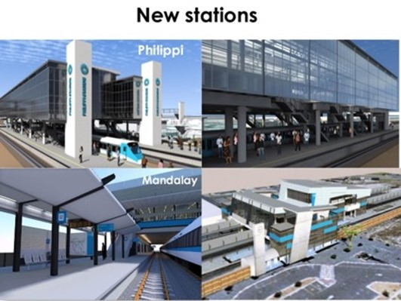
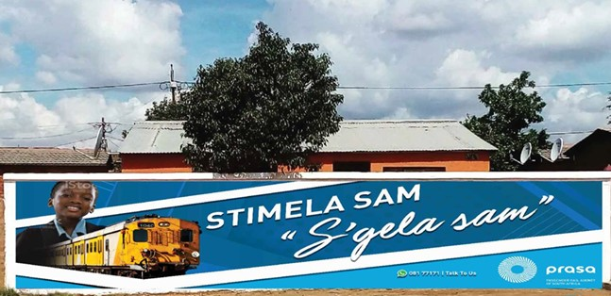
Stakeholder Management
Capital Projects
Vibrant & upbeat drawings showing the progress of PRASA stations, & the picture of the final product. This is to give audiences hope, & ability to look forward to something beautiful & progressive.

Slide 40
Pillar 7:
Modernise Rail through manufacturing, infrastructure development and maintenance
Public transport that enables social emancipation and an economy that works

Slide 41
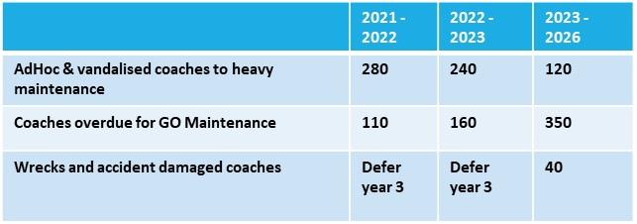
Our Rolling Stock (RS) Choices
Fleet Renewal Program
General Overhaul Program
Core Service Choices
Phase 1: 2021-2022
Delivery of 44 new trains from Factory
Commence with the supplier park development
Strategy for taking over Gibela factory at end of contract.
Stabilize Service Choices
RS Maintenance Program
Phase 2: 2022-2023
Delivery of 51 new trains from factory
Completion of supplier park
Finalise long term contracts for components, spares and maintenance material in Qrt 1.
Capacitate structures in depots and upskill
2021/22: 193 sets in operation;
2022 /23 210 train sets in operation;
2023/24 230 train sets in operation
Sustain Service Choices
MLPS Locomotive Program
Phase 3:2023-2026
Delivery of 62 new trains in 2024 & potentially 70 train set following p.a.
3-year lease of 18 loco’s with maintenance whilst procurement of locomotives (Stadler & additional is completed.)
Upgraded maintenance depots by 2023/24 to insource maintenance.

Slide 42
Our Depot Modernisation Choices
Core Service Choices
Stabilize Service Choices
Sustain Service Choices
Phase 1: 2021-2022
Wolmerton turnkey contractor - phase 3
Springfield, Durban Yard & Salt River designs accelerated work package 3 (KZN) & 4
Paarden Eiland turnkey completion 21/22
7 Depot Fencing Projects
Phase 2: 2022-2023
Benrose & Wolmerton completed
Phased completion for Salt River & Springfield: extension of existing maintenance depot facilities & construction of new facilities
Phase 3:2023-2026
Springfield, Durban Yard & Salt River complete 2023
Braamfontein Complete 2024
PE & East London Complete 2025
 | 2021/22 |  |  |  | 2022/23 |  |  |  | 2023/24
Depot | Train set capacity |  |  |  | Train set capacity |  |  |  | Train set capacity
 | Q1 | Q2 | Q3 | Q4 | Q1 | Q2 | Q3 | Q4 | Q1 | Q2 | Q3 | Q4
Wolmerton Phase 3 | 40 |  |  | 46 |  |  |  | 45
Springfield/Durban | 2 | 8 |  | 30 |  |  | 40 | 52 |  |  | 53
Paarden Eiland | 10 |  |  | 50 |  |  |  | 52
Salt River |  |  |  |  | 30 |  | 40 |  |  |  |  | 43
Depot modernisation programme depot capacity (cumulative) | 52 | 60 | 60 | 186 | 216 | 216 | 296 | 393 | 393 | 393 | 446 | 489
Gibela contractual delivery | 40 |  |  |  |  | 12 | 12 | 13 | 13 | 17 | 17 | 14
Gibela delivery (COVID-19 impact) | 8 | 9 | 9 | 8 | 9
Gibela delivery (programme cumulative) | 48 | 57 | 66 | 74 | 83 | 95 | 107 | 120 | 133 | 150 | 167 | 181
Capacity utilisation (Gibela/depot modernisation programme) | 92% | 95% | 110% | 40% | 38% | 44% | 36% | 31% | 34% | 38% | 37% | 37%

Slide 43
Our Infrastructure Maintenance Choices
Fix the Core Service Choices
Stabilize Service Choices
Perway
Supply and deliver rails, Replace sleepers and rail fasteners
On-track machines for rehabilitation of track geometry, rail grinding, ballast tamping;
Rehabilitate drainage & formation, bridges and structures,
Electrical
Supply of electrical, OHTE and substation tools and materials;
Rehabilitation & Upgrades 18 substations (10 GP, 4 KZN, 4 Western Cape (WC));
Replace and refurbish transmission lines of 226km. (160.9km GP; 26.2km KZN and 38.4km Western Cape)
Signals
Rehabilitation, vandal proofing and train detection systems between
Leralla – JHB – Naledi; Pienaarspoort – PTA;
Umlazi-Durban-KwaMashu; Reunion – Kelso; Crossmoor – Merebank;
Cape Town – Newlands – Simon’s Town; Cape Town – Mutual – Bellville; Cape Town- Athlone – Retreat.
Telecoms:
Restoration of 10M & 5M2A Train Driver Simulator in GP, KZN and WC
Rehabilitate aerial, underground optic fibre network, public address (PA) systems & display boards, Telecontrol systems; GSM-R system & data logger firmware (GP) plus procure Telecoms tools & equipment
Phase 2: 2022-2023
Continue with projects started in 2021
Rehabilitation of track through ontrack machines on a 3 years contract
Procurement of Perway material nationally: Sleepers & fastenings, turnouts, 57 kg/m & 48 g/m rails, rails & turnout components.
As & When replacement of Substation Equipment & Power supply equipment
Upgrade data Logger firmware & recovery for Traction controller unit in KZN & WC
Implement a train collision avoidance system
Maintenance audits re-instated & conducted
All maintenance plans, processes & procedures reviewed & updated.
Adhere to annual maintenance schedule to reduce/eliminate the backlog.
Maintain material & components stock levels
Sustain Service Choices
Phase 3:2023-2026
Ensure succession within grades of all technical personnel is in place to support long term maintenance requirements.

Slide 44
Our Infrastructure Project Choices
Core Service Choices
Stabilize Service Choices
Sustain Service Choices
Phase 1: 2021-2022
Level Crossings and Footbridges
Planning for construction of footbridges at Perseverance & Fort Jackson (Eastern Cape) and at Umbilo, Congella & Renishaw (KZN)l
Complete designs for the elimination of the level crossing at Berwyn Road (KZN)
Appointment of a turnkey contractor for the construction of temporary footbridges in Mamelodi
Platform Rectification
Construction commencement Atteridgeville station
Appoint turnkey contractors for 21 stations in Gauteng North
Complete Planning for 29 stations for national programme
Electrical
Complete Substation designs (Nyanga / Langa / Paarden-Eiland), refurbishment designs (Booth / Northdene / Springfield)
Turnkey Service providers for replacement of (National)
Complete replacement of foundations, structures & small part steel in Gauteng North
Phase 2: 2022-2023
Level Crossings and Footbridges
Construction of footbridges Perseverance & Fort Jackson (Eastern Cape) Umbilo, Congella & Renishaw (KZN)
Commence construction for elimination of the level crossing at Berwyn Road (KZN)
Construction of temporary footbridges in Mamelodi in Gauteng North
Platform Rectification
Construction commencement for Platform Rectification - Turnkey
Bosman to Saulsville – 8 stations
Pretoria to Pienaarspoort – 10 stations
Electrical
Installation & commissioning for substations Western Cape (Nyanga / Langa / Paarden-Eiland)
Appointment of service providers for Substation Refurbishment Programme in KZN (Booth/Northdene/Springfield)
Commence with installation for the High Circuit Breakers replacement programme
Phase 3:2023-2026
Commissioning of footbridges at Perseverance, Fort Jackson, Umbilo, Congella, Renishaw & Mamelodi
Commissioning of level crossing at Berwyn Road
Platform Rectification Continuation
Electrical Substations
Construction commencement for Substation Refurbishment KZN (Booth / Northdene / Springfield)
Continuation of the roll-out plan for the national High Circuit Breakers replacement replacement programme

Slide 45
Our Signalling Choices
Core Service Choices
Stabilize Service Choices
Sustain Service Choices
Phase 1: 2021-2022
Gauteng:
Finalise 26 Interlockings,
Western Cape
Finalise 20 interlockings
KZN:
Interim solution rehabilitate current system (covered under Transnet projects)
Phase 2: 2022-2023
Gauteng and Western Cape
Central Traffic Control fully operational e
Complete fibre network
Finalise contracts
KZN
Commence roll-out modern Signalling programme
Phase 3:2023-2026
KZN:
Finalise signalling & telecoms design
Complete fibre network & commission 20 interlockings
  2023: 3 interlockings
  2024: 6 interlockings
  2025: 11 interlockings
New Projects:
KZN PRASA Train Control System Design & Construct (KZN PTCS D&C) – 9 years including Maintenance & Defect Liability
Gauteng & Western Cape Optical Transmission Network Design & Construct (GP&WC OTN D&C) - 3 years
National GSM-R Operational Portable Handheld Radios Supply & Maintain (National GSM-R OPHR S&M)
Gauteng & Western Cape PRASA Train Control System Design & Construct (GP&WC PTCS D&C) (ATP) - 7 years including Maintenance & Defect Liability
National GSM-R Redundancy Network Design & Construct (National GSM-R RN D&C) - 7 years including Maintenance & Defect Liability (Digital radio communication)
National Electronic Authorisation System Design & Construct (National EAS D&C) - 4 years (Eliminate Manual Train Authorisation)

Slide 46
Pillar 8:
Restructure and improve performance of the secondary mandate
Public transport that enables social emancipation and an economy that works

Slide 47
Our Real Estate Choices
Core Service Choices
Stabilize Service Choices
Sustain Service Choices
Phase 1: 2021-2022
Phase 2: 2022-2023
Phase 3:2023-2026
Revitalise and modernize stations (ABT, CIP, NSIP, NSUP)
Delivered FM services, in line with prioritised rail corridors
Execute Corridor densification program
Optimise diversified income (commercialise leases, advertising, scrap sales, renewable energy, telecoms)
Real estate systems to optimize the performance of the Division
Finalise the consolidation of Intersite and CRES
Provide capital investment to Intersite projects
Develop long-term funding strategy with approvals
Agree on financial for performance of secondary mandate
Deliver WPIP, in line with internal dustomer demand
Consolidate Station Modernisation Programmes under Real Estate Entity (e.g. Greenview, Phillipi, Oakmoor)
Land use management plans, aligned to Rail Master Plans (DOT)
Plan use management plans are signed off to inform acquisition strategy for parcels of land / servitudes.
Stabilize project management capacity
Continue corridor densification Program execution
Private Sector Optimisation to take advantage of Intersite Opportunities with external investment
Provide capital investment to Intersite projects

Slide 48
Increasing Commercial Revenue Through Diversified Streams
Key Focus Areas:
A. Strategic Partnerships
Department of Housing & SHRA
SASSA/Post Office/Gov Entities
B. Request for Proposals
Development Leases
1.Densification of the Rail Corridor
Social Housing
Affordable Residential Housing
Mixed use development
Student accommodation
How ?
2.Revenue Growth
3rd Party Developments
Telecoms
Re-engineering of Advertising portfolio
Commercialisation & space optimisation
C. Capital Allocations
Execution of commercial projects

Slide 49
Capital Program

Slide 50
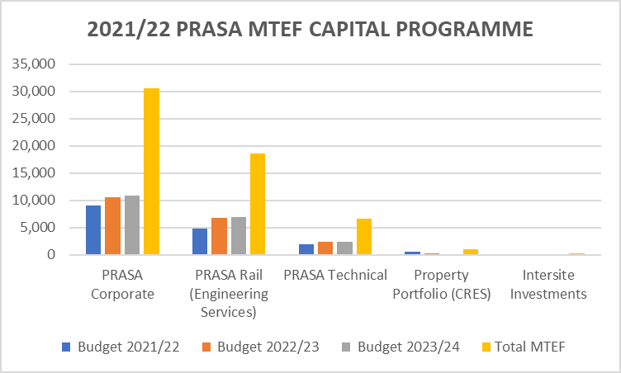
MTEF 2021 CAPITAL PROGRAMME
Case for the CAPEX Budget
High CAPEX in Corporate due to earmarked funds for:
  Rolling stock revatilisation programme
  Signaling programme
  PRASA Rail and Technical for recovery of infrastructure and security measures.
  Property Portfolio (CRES) and Intersite Investment for facilities management to improve service and Investment to increase revenue through diversification.

Slide 51
MTEF 2021 Budget (Income Statement)
Starting from low revenue base due to COVID-19 impact and inefficient service prior to COVID-19
High fixed cost structure, mainly personnel cost (i.e., not influenced by the reduction/low service)
Budget deficit over MTEF (unfunded budget)
Detailed income statement attached as Appendix 2 to the presentation

Slide 52
MTEF 2021 Budget (Income Statement)
Case for increased revenue over MTEF
Fare Revenue: Pillar 2 Recover performance of Rail and Autopax
Top 10 corridors identified based on high volume of commuters
Leasing of locomotives to support MLPS
Leased locomotives to be replaced by owned locomotives from Stadler
Repurposing Autopax business model to ensure is sustainable
Invest in Autopax infrastructure to support the new business model

Slide 53
MTEF 2021 Budget (Income Statement)
Rental Income: Pillar 8 Restructure and improve performance of the secondary mandate
Densification of the Rail Corridor
  Social Housing
  Affordable Residential Housing
  Student accommodation
Diversification of revenue stream
  3rd Party Developments
  Telecoms, Advertising portfolio, commercialisation & space optimisation

Slide 54
MTEF 2021 Budget (Income Statement)
Analysis of Key Expenditure
Personnel Costs
Increase relates to 5% salary increase of bargaining unit staff (unfunded).
Engagement to be held with the shareholder on the matter.
Security
Front loading expenditure due to immediate security initiatives required.
Y2 focusing on monitoring, evaluation and strengthening.
Outer years level of maturity is expected, and the focus will be efficiencies.

Slide 55
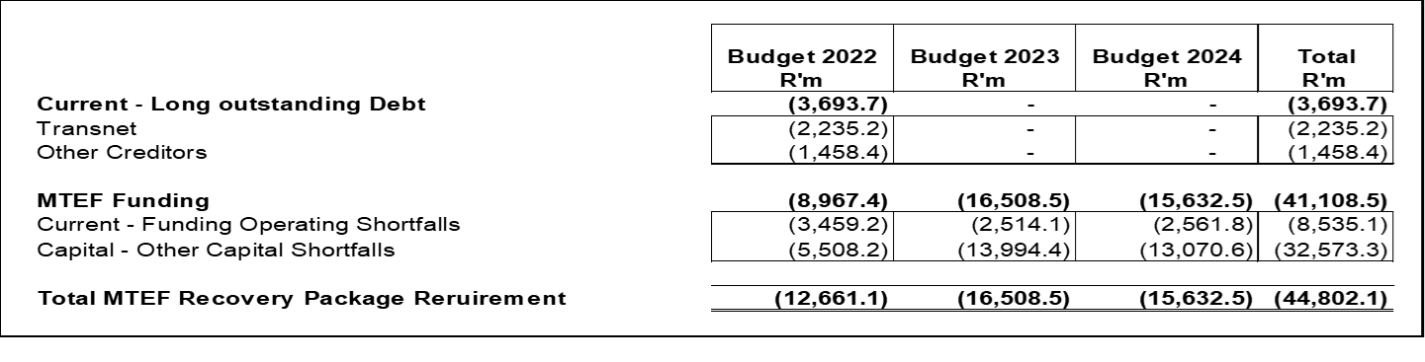
2021/22 MTEF Overall
Short fall on CAPEX Other Programme ( Unearmarked items).
Short fall on OPEX Budget.
No budget allocation to meet the existing liabilities.
Additional cash injection will be required over MTEF

Slide 56
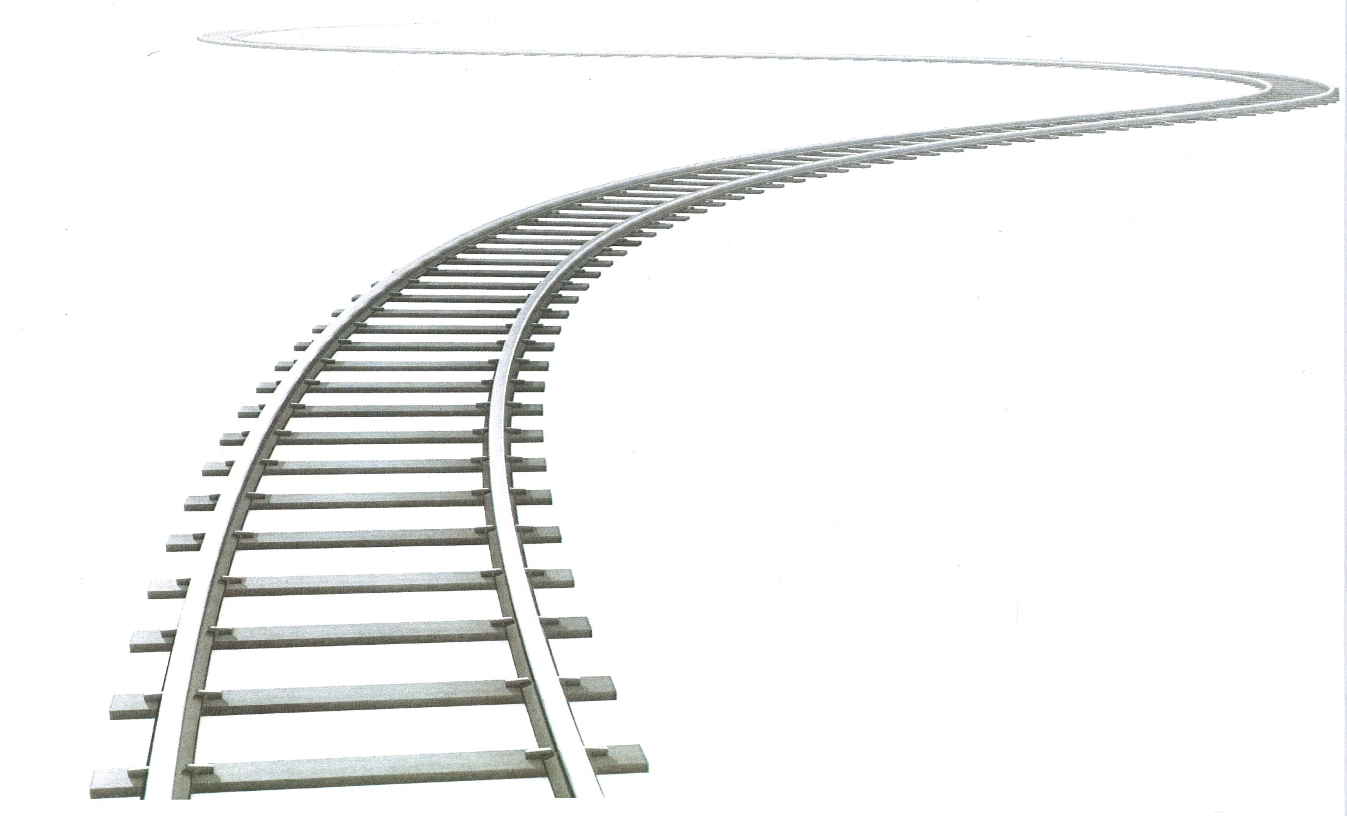
THANK YOU

