Slide 1
The Compensation Commissioner for Occupational Diseases (CCOD)
Presentation to Portfolio Committee on Health
Annual Performance Plan (2021/22)
6 May 2021
Slide 1

Slide 2
What do we do?
Provide medical assessments (benefit medical examinations) for eligible current & ex-mineworkers for occupational lung diseases
Certification of claims by medical panels
Payments of pensions and claims
Collect revenue (levies on risk shifts in controlled mines and works)

Slide 3
Highlights for 2020/21
Annual Reports for 2014/15, 2015/16 and 2016/17 submitted to parliament
2017/18 (almost finalised by Auditor-General); 2018/19 (submitted to Auditor-General)
Business process (as at 31 March 2021)
111 Benefit Medical Examinations per month ~ 718 (2019/20)
1 090 certifications per month ~ 1 482 (2019/20)
446 claims finalised per month ~ 608 (2019/20)
Total Paid – R172m to 5354 claims ~ R211m to 7291 claims (2019/20)
Neighbouring countries – R58m to 2 058 claims ~ R73m to 2 832 claims (2019/20)
During the 2020/21 year the Covid-19 pandemic affected operations

Slide 4
Personnel (31 December 2020)
Designation | Level | No. of Posts | Filled | Vacant
Commissioner | 14 | 1 | 1 | 0
Director | 13 | 2 | 2 | 0
Deputy Directors | 12 | 3 | 3 | 0
Assistant Directors | 10 | 3 | 2 | 1
Senior State Accountant (Finance) | 8 | 1 | 0 | 1
Senior State Accountant (Inspector) | 8 | 2 | 2 | 0
Senior Administration Officer | 8 | 1 | 1 | 0
Administration Officer | 7 | 2 | 2 | 0
Senior Administration Clerks | 7 | 1 | 1 | 0
Personal Assistant | 6 | 2 | 1 | 1
Senior Administration Clerk | 6 | 4 | 3 | 1
Administration / Finance Clerk | 5 | 22 | 21 | 1
Switchboard operator | 4 | 1 | 1 | 0
Cleaner | 3 | 1 | 0 | 1
Messenger | 3 | 1 | 1 | 0
Total |  | 47 | 41 | 6
Slide 4

Slide 5
Personnel (31 December 2020)
Level | African |  |  |  | Coloured |  |  |  | Indian |  |  |  | White |  |  |  | Total
 | M | D | F | D | M | D | F | D | M | D | F | D | M | D | F | D | M | D | F | D
14 |  |  |  |  |  |  |  |  | 1 |  |  |  |  |  |  |  | 1
13 | 2 | 1 |  |  |  |  |  |  |  |  |  |  |  |  |  |  | 2 | 1
12 |  |  | 3 |  |  |  |  |  |  |  |  |  |  |  |  |  |  |  | 3
10 | 1 |  | 1 |  |  |  |  |  |  |  |  |  |  |  |  |  | 1 |  | 1
8 | 2 |  | 1 |  |  |  |  |  |  |  |  |  |  |  |  |  | 2 |  | 1
7 | 3 |  |  |  |  |  |  |  |  |  |  |  |  |  |  |  | 3
6 | 2 |  |  |  |  |  |  |  |  |  |  |  |  |  | 2 |  | 2 |  | 2
5 | 6 |  | 15 |  |  |  |  |  |  |  |  |  |  |  |  |  | 6 |  | 15
4 |  |  | 1 |  |  |  |  |  |  |  |  |  |  |  |  |  |  |  | 1
3 | 1 |  |  |  |  |  |  |  |  |  |  |  |  |  |  |  | 1
Total | 17 | 1 | 21 |  |  |  |  |  | 1 |  |  |  |  |  | 2 |  | 18 | 1 | 23
Slide 5

Slide 6
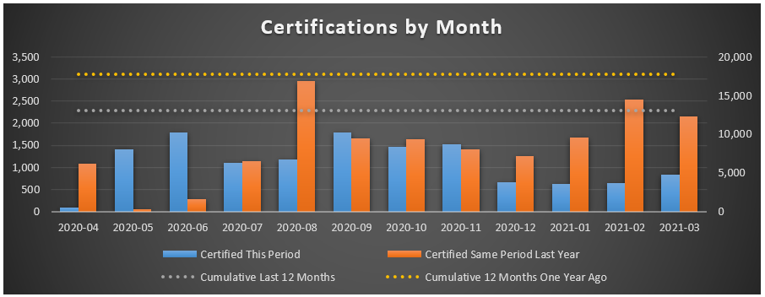
Certifications (2019/20 & 2020/21)
Slide 6

Slide 7
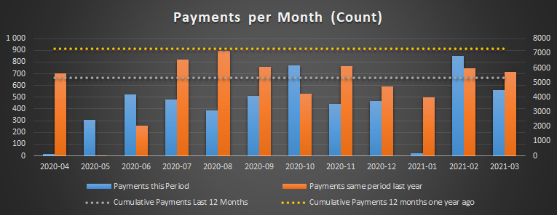
Payments (2019/20 & 2020/21)
Slide 7

Slide 8
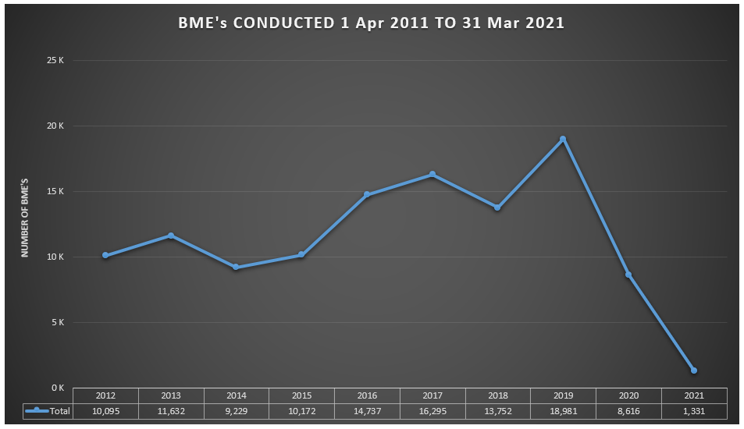
BME’s performed 2011/12 to 2020/21
Slide 8

Slide 9
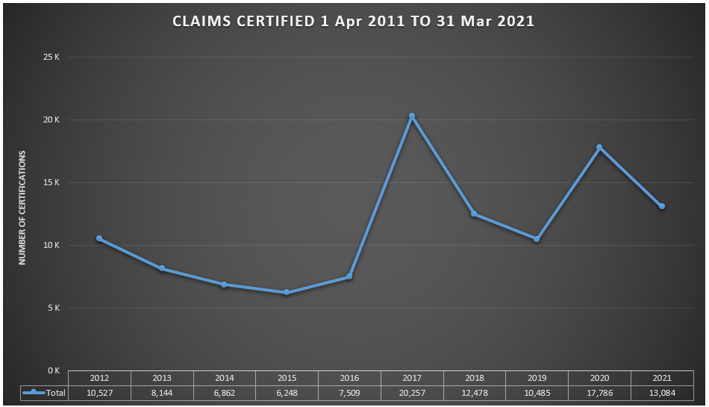
Claims certified 2011/12 to 2020/21
Slide 9

Slide 10
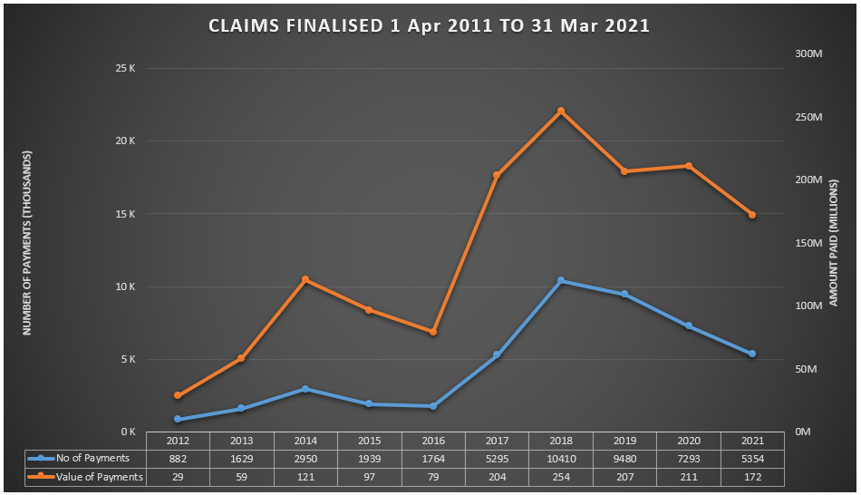
Claims finalised 2011/12 to 2020/21
Slide 10

Slide 11
Focus Areas - 2021/22
Submission of amendments to Occupational Diseases in Mines & Works Act, 1973
Maintenance of the database of controlled mines and works
Enhancing the claims management system
Submission of annual reports & financial statements (2019/20 and 2020/21) for audit by the Auditor-General

Slide 12
Annual Reports / Financial Statements
Confirmed legal status of the Mines and Works Compensation Fund (MWCF) by National Treasury
Application made to list the MWCF as a Schedule 3A entity (under Public Finance Management Act, 1 of 1999)
2017/18 FY submitted to the Auditor-General in June 2020 (audit being finalised)
2018/19 FY submitted to Auditor-General in February 2021 (audit being finalised)

Slide 13
Annual Reports / Financial Statements
2019/20 FY to be submitted to Auditor-General of South Africa in May 2021
2020/21 FY in preparation and actuarial valuation being conducted

Slide 14
Controlled Mines & Works
857 controlled mines and works
Updated register with gazettes
Need to link with Department of Mineral Resources and Energy for mine closures
Special effort for completeness of revenue & completeness of register

Slide 15
Objectives
Objective | Indicator | Performance (2020/21) | Target (2021/22)
Submission of amendments to ODMWA to the Director-General of the National Department of Health | Report on the submission of amendments to the Director-General of the National Department of Health | Legal team began drafting of amendments to ODMWA and one virtual consultative workshop was held with mining companies and trade unions | Submission of amendments to ODMWA to the Director-General of the National Department of Health
Ensure the effective and efficient management of the CCOD | Report on updates of database of claims at the CCOD in terms of claims, payments, certifications and data exchange updates and/or additions | Updates were made to the master database for payments made, new claims and new certifications. External data exchanges to the master database were done once a quarter. | Master database updated for payments made, new claims and new certifications for the month before the 7th of the next month. External data exchange updates and/or additions to the master database once a quarter

Slide 16
Objectives
Objective | Indicator | Performance (2020/21) | Target (2021/22) (2020/21)
Ensure the effective and efficient management of the CCOD (Continued) | Report on the number of certifications finalised on the Mineworkers Compensation System per year | 13 084 (31 Dec 20 : 12 400) | 12 000 (12 000)
 | Report on the number of benefit payments made by the CCOD (other than pension payments) | 4 212 (31 Dec 20 : 3 476) | 7 000 (7 000)

Slide 17
Objectives
Objective | Indicator | Performance (2020/21) | Target (2021/22) (2020/21)
Ensure the effective and efficient management of the CCOD (Continued) | Report on the number of claims finalised by the CCOD (other than pensioners) | 5 354 (31 Dec 20 : 3 923) | 7 700 (7 700)
 | Of all claims finalised in the period, what percentage were finalised within 90 days of receipt of all completed claim documents | 81.6% (31 Dec 20 : 80%) | 60% (50%)

Slide 18
Objectives
Objective | Indicator | Performance (2020/21) | Target (2021/22) (2020/21)
Ensure the effective and efficient management of the Compensation Fund (Continued) | Percentage of controlled mines and works liable for payment of levies per the financial system paying levies to the CCOD | 65% (31 Dec 20 : 65%) | 80% of controlled mines and works paying levies to the CCOD (80%)
 | Report on the submission of annual reports of the CCOD to the Auditor General of South Africa | The 2017/18 and 2018/19 annual reports were submitted to the Auditor-General of South Africa | Submission of the 2019/20 and 2020/21 annual reports to the Auditor-General of South Africa (2017/18 and 2018/19 submitted)

Slide 19
Objectives
Objective | Indicator | Performance (2020/21) | Target (2021/22) (2020/21)
Ensure the effective and efficient management of the Compensation Fund (Continued) | Report on the number of controlled mines and works inspected | 41 (31 Dec 20 : 17) | 77 (77)

Slide 20
Financial Performance* (31 March 2021)
R’ 000 | 2017/18 | 2018/19 | 2019/20 | 2020/21
Tax (levy) | 315 850 | 305 000 | 311 000 | 305 000
Non-tax (interest) | 265 000 | 270 000 | 246 000 | 235 000
Transfers | 3 718 | 3 836 | 4 050 | 4 272
Total Revenue | 584 568 | 578 836 | 561 050 | 544 272
Expenses | 194 570 | 200 294 | 211 314 | 231 512
Surplus | 389 998 | 378 542 | 349 736 | 312 760
*Unaudited

Slide 21
Financial Performance* (31 March 2021)
R’ 000 | 2017/18 | 2018/19 | 2019/20 | 2020/21
Investments | 4 167 944 | 4 365 700 | 4 524 362 | 4 581 418
Receivables | 5 070 | 13 500 | 15 470 | 17 017
Cash and cash equivalents | 80 000 | 82 000 | 65 000 | 42 250
Total assets | 4 253 014 | 4 461 200 | 4 604 832 | 4 640 685
Accumulated surplus/(deficit) | 594 091 | 959 595 | 1 322 369 | 1 635 129
Trade and other payables | 3 800 | 15 250 | 13 147 | 14 462
Provisions | 3 655 123 | 3 486 355 | 3 269 316 | 2 991 094
Total equity and liabilities | 4 253 014 | 4 461 200 | 4 604 832 | 4 640 685
*Unaudited

Slide 22
Financial Performance (MTEF) (31 March 2021)
R’ 000 | 2020/21 | 2021/22 | 2022/23 | 2023/24
Tax (levy) | 305 000 | 321 470 | 310 000 | 323 950
Non-tax (interest) | 235 000 | 247 690 | 265 028 | 276 954
Transfers | 4 272 | 1 437 | 1 544 | 1 735
Total Revenue | 544 272 | 570 597 | 576 572 | 602 639
Expenses | 231 512 | 244 009 | 255 422 | 266 916
Surplus | 312 760 | 326 588 | 321 150 | 335 723

Slide 23
Financial Performance (MTEF) (31 March 2021)
R’ 000 | 2020/21 | 2021/22 | 2022/23 | 2023/24
Investments | 4 581 418 | 4 828 815 | 4 813 980 | 5 030 609
Receivables | 17 017 | 17 936 | 26 000 | 27 170
Cash and cash equivalents | 42 250 | 44 532 | 26 000 | 27 170
Total assets | 4 640 685 | 4 891 282 | 4 865 980 | 5 084 949
Accumulated surplus/(deficit) | 1 635 129 | 1 964 787 | 2 047 852 | 2 140 005
Trade and other payables | 14 462 | 15 243 | 24 000 | 25 080
Provisions | 2 991 094 | 2 911 252 | 2 794 128 | 2 919 864
Total equity and liabilities | 4 640 685 | 4 891 282 | 4 865 980 | 5 084 949

Slide 24
Compensation Fund - Budget (MTEF) (31 March 2021)
R’ 000 | 2020/21 | 2021/22 | 2022/23 | 2023/24
Administration | 8 910 | 9 391 | 8 748 | 9 142
Pensioners | 4 272 | 4 507 | 4 674 | 4 884
Miners and Ex-miners | 175 750 | 185 241 | 216 000 | 225 720
Tuberculosis | 42 572 | 44 871 | 26 000 | 27 170
Eastern Cape | 8 | - | - | -
Total | 231 512 | 244 010 | 255 422 | 266 916

Slide 25
Explanation of planned performance of the medium-term period
Stabilise number of claims through interactions with government departments and social partners
Provision of Benefit Medical Examinations at One Stop Service Centres; use of mobile clinics and limited outreach activities – working with Tshiamiso Trust
Enhance revenue collection through inspections of controlled mines and works
Proposed amendments to ODMWA to cover costs of administration, medical examinations & health care
Actuarial valuation as at 31 March 2021

Slide 26
Voted Funds – Actual Vs Budget 2020/21 (Dept of Health) (31 March 2021)
 | Budget R’ 000 | Actual R’ 000 | Available R’ 000 | % Spent
Compensation of Employees | 39 298 | 34 702 | 4 596 | 88%
Goods and Services | 15 389 | 19 391 | (4 002) | 126%
Transfers | 4 058 | 4 058 | - | 100%
Capital | 2 893 | 2 742 | 151 | 95%
Total | 61 638 | 60 893 | 745 | 99%

Slide 27
Voted Funds - Budget (MTEF) (Dept of Health)(31 March 2021)
R’ 000 | 2020/21 | 2021/22 | 2022/23 | 2023/24
Compensation of Employees | 39 298 | 38 871 | 36 161 | 41 572
Goods and Services | 15 389 | 19 429 | 21 923 | 20 947
Transfers | 4 058 | 1 437 | 1 544 | 1 735
Capital | 2 893 | 3 415 | 3 620 | 4 160
Total | 61 638 | 63 152 | 63 248 | 68 414

Slide 28
Resource Considerations
Inadequacy of voted funds
Working with mining companies, trade unions and social partners to enhance business reforms and services
Register of controlled mines & inspections to ensure accuracy of revenue collection working with Dept of Mineral Resources & Energy
New model for governance, management and service delivery
Criteria and timing of benefit medical examinations
Training of health professionals

Slide 29
Thank You
Dr Barry Kistnasamy Compensation Commissioner Department of Health barry.kistnasamy@health.gov.za 011-356 5602 0722200247
Slide 29

