Slide 1


NATIONAL HOUSING FINANCE CORPORATION
STRATEGIC PLAN 2020-2025 &
APP 2020/21
Presentation to the Portfolio Committee on Human Settlements, Water and Sanitation
29th APRIL 2021
LAYING STRONG FOUNDATIONS FOR TOMORROW’S SUCCESS

Slide 2
PURPOSE OF THE PRESENTATION
To present to the Portfolio Committee on Human Settlements,
Water and Sanitation:
Strategic Plan for the period 2020/21 – 2024/25; and
2. Annual Performance Plan for the 2021/22 financial year and related
  budget

Slide 3
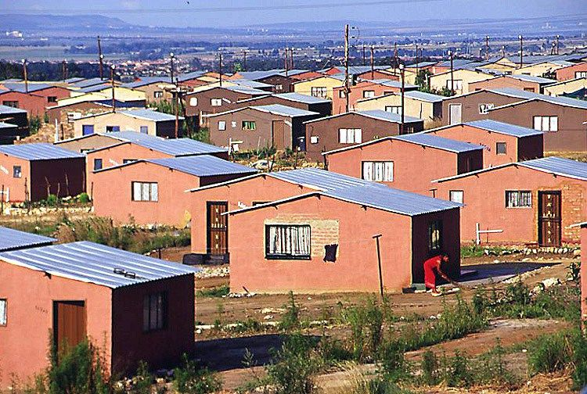
CONTENTS
NHFC’s key risks and mitigations
Purpose of the presentation
Mandate and Overview of the NHFC
Impact statement of the NHFC
Strategy (SP) Review and Development:
  Highlight Outcomes?
  Outcome Indicators?
  Baseline for 5year targets?
  Performance Projections over 5years
  & MTSF contributions?
Annual Performance Plan (APP)
Budget
NHFC’s key risks and mitigations
NHFC’s priority initiatives to achieve its aspirations

Slide 4

MANDATE AND OVERVIEW
Mandate Broadening & deepening market access to affordable housing finance for rural, low
              and middle income households in SA
Established: 1996 in Terms of the Companies Act
Merged with RHLF & NURCHA: 2018 [ Aim: Establishment of a “Human Settlements Development Bank” in support of the entire human settlements delivery value-chain]
Type of Organisation: Development Finance Institution
Ownership: 100% State Owned Company
Total Assets: R 6,2 billion (Including R 1,3 billion from HIP Trusts)
Total Liabilities: R 1,5 billion (Including R 1.1 billion from HIP Trusts)
Funding Status: Self-sustaining
Geographic activities: National
Headcount: 130

Slide 5

About Us
The National Housing Finance Corporation SOC Ltd (NHFC) is a Schedule 3A Public Entity, supporting housing delivery through the provision of affordable housing finance.
Target Market : low- to middle-income housing market with regular monthly income of between R800 and R22 000
Effective from 1 October 2018, the Rural Housing Loan Fund NPC (RHLF) and the National Urban Reconstruction and Housing Agency NPC (NURCHA) merged into the NHFC.
This merger was a crucial step towards the formation of the Human Settlements Development Bank (HSDB)
HSDB aims to deliver sustained, equitable and accessible value creation by effectively and efficiently providing quality funding and financial support for the development of integrated human settlements in South Africa.
1996
2018
2021
Establishment of the NHFC
RHLF & NURCHA merged into NHFC
Establishment of HSDB

Slide 6
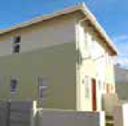

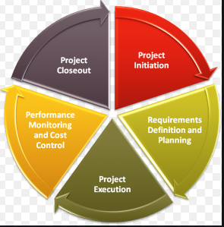
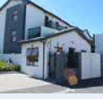
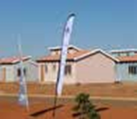
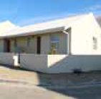

Our Value Proposition
SOCIAL HOUSING FINANCE – SUBSIDISED RENTAL ACCOMODATION
We provide long-term finance to Social Housing Institutions to develop affordable rental accommodation for HH earning R1 500 to R15 000.
STRATEGIC PARTNERSHIPS AND INVESTMENTS
We work closely with private investors, developers and housing development agencies and funds to leverage private sector and development funders to finance and create affordable housing that caters to the market that we serve..
PROGRAMME & FUND MANAGEMENT
Programme management and project implementation services are offered, under this programme, to provincial and local authorities to support the development of project and programme management capacity and enhance service delivery in the human settlement sector.
PRIVATELY - OWNED RENTAL HOUSING AND STUDENT ACCOMODATION FINANCE
We provide long-term finance to develop or refurbish affordable privately-owned rental (un-subsidised) accommodation.
INCREMENTAL HOUSING FINANCE
We provide funding to non-banking intermediaries who on-lend funding to home-owners for incremental housing improvements (Rural & Urban)
SUBSIDY & AFFORDABLE HOUSING
FINANCE
We provide bridging and development finance to contractors and developers involved in the development of fully subsidised (BNG) and affordable housing (GAP & FLISP).
FINANCE LINKED INDIVIDUAL SUBSIDY PROGRAMME (FLISP)
We are the implementing agent for FLISP nationally. FLISP enables qualifying beneficiaries to reduce the initial home loan amount or augment the shortfall between the qualifying loan and the total house price.

Slide 7
NHFC VALUES WILL BE FUNDAMENTAL TO HSDB ACHIEVING ITS OVERALL VISION OF BEING THE
APEX HUMAN SETTLEMENTS FINANCING INSTITUTION IN SOUTH AFRICA
Serving the households evolving needs of access and affordability to adequate housing, in support of developing quality living environment
01
Vision
To prioritise the development impact through Transformation and Sustainability
02
Purpose
03
Values

Slide 8
NHFC will offer a variety of products and services to its primary customers operating in different markets
Product and services
Commentary
NHFC will offer 4 main categories:
  Finance
  Fund management
  Guarantees
  Other services
Advisory and advocacy will be overarching service offerings that will be provided along with the instruments (debt, equity and both)
The offering will continually be determined by assessing the demand in the market from each primary customer and the ability for the NHFC to meet that demand and remain sustainable
Guarantees require input from financial institutions, however a feasibility assessment would need to be conducted to assess viability
PRODUCTS AND SERVICES
Finance
Guarantees
Debt, equity and quasi-equity tailor-made products
Mortgage default insurance (MDI)
Guarantees
Other
Fund Management
Other Services
Coordination
Promotion
Advocacy
FLISP Administration
Programme management
Independent management of mutual funds
Others to be added as HSDB evolves

Slide 9
NHFC IMPACT STATEMENT:
SUSTAINABLE HUMAN SETTLEMENTS AND IMPROVED QUALITY OF HOUSEHOLD LIFE
Outcome | Outcome Indicator | Baseline ( 1 Year) | 5 Year Target
Functional, Efficient and Integrated Governance | Unqualified audit opinion with no matters of emphasis (including audit of the performance report) | Unqualified audit opinion with matters of emphasis on predetermined objectives | Unqualified audit opinion with no matters of emphasis
2. Improved delivery of affordable housing | Number of Housing Opportunities facilitated through the disbursements (No.):
 | Social Housing Units (No.) | 775 | 4 529
 |  | 352 | 2 536
 | Private Rental Units (No.) | 202 | 6 235
 | Bridging Affordable – Units (No.) | 432 | 3 300
 | Bridging Affordable – Serviced Stands (No.) | New indicator | 3 275
 | Bridging Subsidy – Units (No.) | 1 368 | 21 066
 | Incremental Loans (No.) | 37 183 | 144 325
 | Number of housing units facilitated through FLISP Grant Disbursements | 1 900 | 30 523
3. Increased access to affordable finance to enable end-users to have appropriate, spatially just and adequate housing | Value of leveraged funds in strategic partnerships (R’m) | New indicator | 3 500
 | Value of leveraged funds from the Private sector - Excluding FLISP (R'm) | 705 | 2 218
 | Value of leveraged funds from FLISP (R’m) | 882 | 17 606
 | Number of Leveraged Units - Private Rental and Affordable (Strategic Investments) | 1 965 | 1 512
 | Number of Provinces Covered by RFIs | New indicator | 9
4.Increased penetration and participation of low-to middle income households and businesses owned by PDIs in the housing market | Percentage of portfolio comprised of PDIs Percentage of disbursements to PDI on managed programmes | 35% 30% | 50% 50%

Slide 10
PERFORMANCE MTSF CONTRIBUTION

Slide 11
Annual Performance Plan (APP)
2020/21
Overview of the situational analysis:
    The external environment: PESTEL model
    The internal environment
The institutional Performance:
    Outcomes, Outputs, Performance Indicators and Targets
    Budget
The key risks and mitigations

Slide 12







NHFC IN TRANSITION TO BECOME HSDB: CURRENT REALITIES
The housing market is still very fractured, despite the efforts and progress made, with citizens having inequitable access to the benefits, resulting in an affordability problem
There are 16,7m households across SA, 81,1% are considered formal dwellings
13,1% of households are still considered informal, being slums or backyard dwellings
There is an estimated housing backlog of between 2,3m and 3,7m households, growing at 178 000 a year
7,7m households (46,3%) earn less than R3 500 a month, qualifying for Government Subsidy (RDP)
7,2m households (37,1%) earn between R3 501 and R20 000 a month, making them ineligible for RDP but unable to afford to participate in the private property market
0,8m households (4,3%) earn between R15 000 and R20 000 a month

Slide 13







From a macro-economic perspective, economic, political and social factors create barriers in catalyzing impact in the low cost housing market
PESTEL ANALYSIS PORTRAIT
Legal Factors
Political Factors
Policy uncertainty : The prevalent issues related to land reform and expropriation looms in the distance and casts a shadow within the market as it seeks clarity
Legislation approval processes hamper efficiencies
Rental agreements and payment conditions will be negatively impacted by COVID-19 as businesses and households push back on payment agreements
The newly formed democracy inherited a flawed system which has isolated most of the population away from economic activities
High levels of fraud and corruption have reduced investor confidence resulting in a decline in the property market
L
P
Economical Factors
Economic effects of the crisis caused by the Covid-19 pandemic have been extensive and a recovery to pre-pandemic levels will take several years
DGP expected to contract, interest rates expected to remain the same, unemployment increased due to pandemic thereby reducing household disposable income and access to credit
Financial sector continues to serve the middle-higher end of the market
Environmental Factors
Increased awareness of enterprise ecological footprint has provided the market with new considerations to ensure that their needs are met in a sustainable manner.
E
E
PESTEL Analysis
Technological Factors
T
S
The advent of the 4th industrial revolution has brought new technologies and innovation into the market enabling lower income households ability to access affordable finance
Innovation in housing materials have led to cheaper raw materials required to build better quality housing
Sociological Factors
Rapid urbanization and population growth has increased migration to metropolitan areas as the market seeks to address spatial issues constructed by the previous regime
The limited exposure, education and awareness of financial planning, savings and wealth generation limits the lower end of the market from participating in property markets
Negative impact
Neutral impact
Positive impact

Slide 14
THE INTERNAL SITUATIONAL ANALYSIS LOOKS AT THE CURRENT STRUCTURE, OPERATING MODEL,
FINANCIAL PERFORMANCE AND OVERALL STRENGTHS, WEAKNESSES, OPPORTUNITIES AND THREATS
Financial Analysis
Structure
Operating Model
SWOT Analysis
The operating model is aligned to ensure maximum development impact
The current governance structure is appropriate
The Memorandum of Incorporation provides for a minimum of 8 non executive directors and 1 executive director. A balanced mix of gender, race and age, 5 males and 3 females
The executive management committee consists of 10 members, 3 females and 7 males
The company has strong geographical footprint across South Africa and needs to continue to maintain those touch points nationally
Strategic partnerships are imperative to the success and sustainability of the company and the NHFC aims to achieve developmental impact through targeted strategic partnerships
Partnership Strategy would further enhance their ability to achieve their objectives
NHFC has knowledge and existing partnerships and stakeholder relationships which will stand it in good stead to achieve its objectives and maximize development impact
However, there are numerous weaknesses in terms of its processes and operations which have been highly manual and are in the process of being automated in order to achieve sustainability and continuity
Change management is still critical as the entity is in its infancy post consolidation. Procedures for change management are being reviewed to ensure a cohesive entity
The weaknesses and the economic situation present many opportunities for NHFC to play a pivotal role in the human settlements value chain and maximize its development impact whilst remaining sustainable, if addressed and target appropriately
The Group's balance sheet shows capacity to leverage with a low debt to equity ratio.
There is clearly demand for the product offerings as the loans and advances balances continue increasing
The entity continues to monitor its cost to income ratio which needs to be addressed to ensure financial sustainability
14

Slide 15
PERFORMANCE CONTRIBUTION AT PROGRAMME LEVEL
Programme 1: Administration – Functional & Efficient Governance
Programme 2: Integrated Human Settlements Planning and Development Programme
Programme 4: Rental and Social Housing Programme
Programme 5: Affordable Housing Programme
Programme 6: Sector Transformation

Slide 16
PROGRAMME 1 – ADMINISTRATION

Slide 17
PROGRAMME 2a – INTEGRATED HS PLANNING AND DEVELOPMENT PROGRAMME

Slide 18
PROGRAMME 2b – INTEGRATED HS PLANNING AND DEVELOPMENT PROGRAMME

Slide 19
PROGRAMME 4- RENTAL AND SOCIAL HOUSING PROGRAMME

Slide 20
PROGRAMME 5a – AFFORDABLE HOUSING PROGRAMME

Slide 21
PROGRAMME 5b – AFFORDABLE HOUSING PROGRAMME

Slide 22
PROGRAMME 6 – SECTOR TRANSFORMATION

Slide 23
PERFORMANCE CONTRIBUTION
BUDGET

Slide 24


KEY VALUE DRIVERS
Loan Pricing/ Interest Margin
Loan Book
Growth & Quality (growth & credit loss ratio etc.)
Operational Efficiency
(cost to income)
Capital Allocation
- Loan/Portfolio
Mix
(portfolio mix)
Capital Structure
- Debt to Equity
- Cost Of Funding
Business
Environment
Business
Strategy
24

Slide 25
BUDGET ASSUMPTIONS FY2018-FY2024

Slide 26
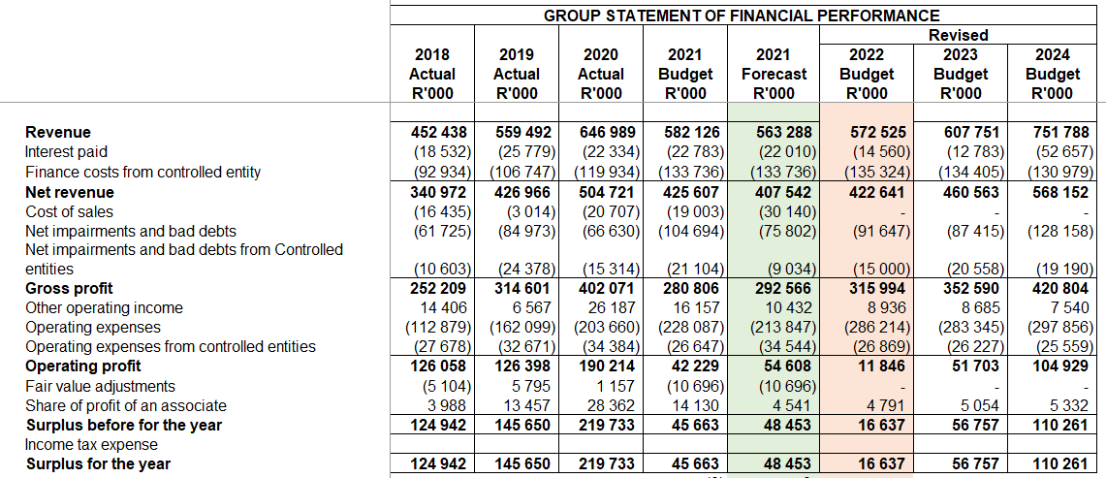
GROUP FINANCIAL PERFORMANCE FY2018-FY2024

Slide 27
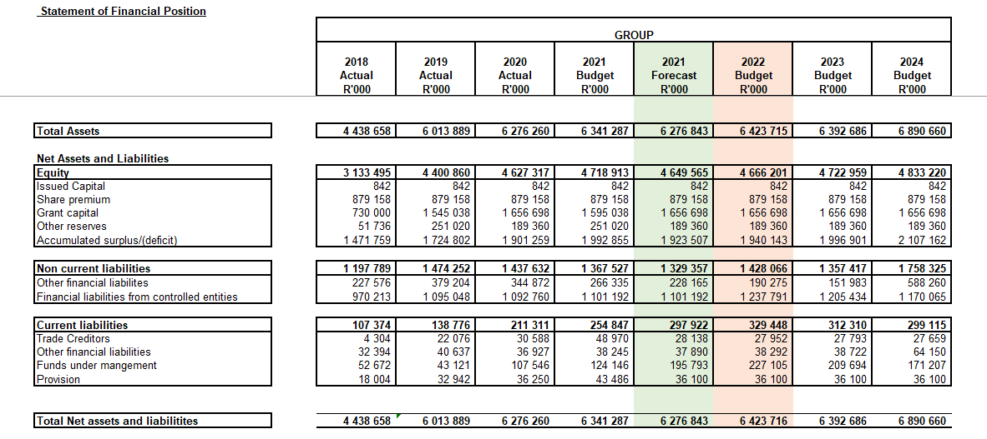
GROUP FINANCIAL POSITION FY2018-FY2024

Slide 28
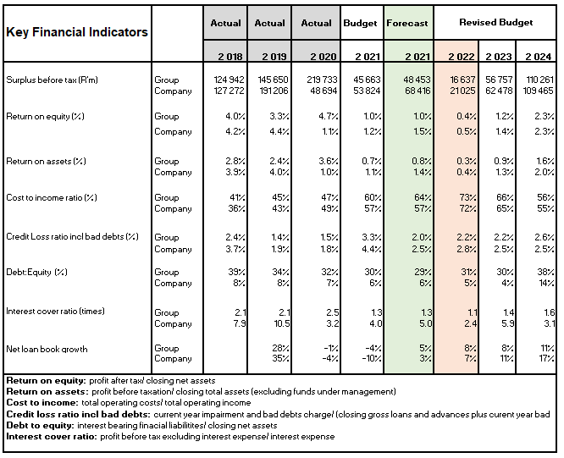
KEY PEFORMANCE INDICATORS

Slide 29
NHFC’s KEY RISKS AND MITIGATIONS
Outcome | Key Risk | Risk Mitigation
Functional, Efficient and Integrated Government | Qualified audit opinion | Compliance with all applicable regulatory legislation; prescripts, guidelines and practises.
 | Delayed establishment of HSDB | Robust engagement with NDoHS
 | Challenge in balancing developmental mandate with financial sustainability | Revise financial model Develop and implement Business Continuity Plan PoPI framework , IT strategy & Governance Framework Review and implement Risk Appetite statement, Product Pricing policy and strategy
2. Improved delivery of affordable housing | Failure to deliver on the targets in the shareholder's mandate | Semi-annual engagements with shareholder on the mandate and their expectations as per shareholder compact
3. Increased access to affordable finance that is spatially just to enable social cohesion | Inability to attract or establish suitable developers, retail intermediaries and funding partners | Update and implement targeted marketing, stakeholder engagement and communications strategy Sign partnership agreement with research company Develop and implement strategic partnership strategy and framework
4. Increased penetration and participation of low-to middle income market | Inability to increase participation due to limited knowledge and awareness of NHFC’s product offering | Update and implement targeted marketing and communications strategy Develop and implement Consumer education strategy

Slide 30
RECOMMENDATION
The Portfolio Committee on Human Settlements, Water and Sanitation is requested to note the briefing by the NHFC on the:
2020/25 Strategic Plan for the period 2020/21 to 2024/25, and
2. Annual Performance Plan for the 2021/22
financial year and budget.

Slide 31
THANK YOU

