Slide 1
Parliamentary Portfolio Committee Employment and Labour
Comments on
the COIDA Amendment Bill, 2018
By WCA Workers Compensation Assistance cc
28 April 2021

Slide 2
Contents
Introductions and Overview
General Comments on Proposed Amendments
Items of Concern, by Degree of Seriousness
Conclusions and Questions

Slide 3
Introductions and Overview
WCA Workers Compensation Assistance:
Serves:
1,000 employers and their workforce of ~500,000;
Members of legal insurance;
With COIDA administration and compliance.
Employs 30 staff;
Was established in 2002;

Slide 4
Introductions and Overview
Senior WCA Team:
Mr Brian Pivo. Managing Member
Ms Celia Coetzer. Executive Member (Assessments)
Ms Corrie Corte-Real. Executive Member (Claims)
Mr Johan de Bruyn. Manager (Claims)
Ms Ravishni Mahadeo. Manager (Assessments)

Slide 5
General Comments on Proposed Amendments
Positive:
Enfolds domestic workers in private households
Modernises the principal Act
Restores the role of the Compensation Commissioner
Emphasises rehabilitation / reintegration
Simplifies and improves the no-fault principle
Brings the Act in line with prevailing law

Slide 6
General Comments on Proposed Amendments
Negative:
Misses the opportunity to clarify “employer” vs “exempted employer” vs “employer individually liable”
Introduces some items of deep concern (dealt with individually below) mainly in areas of:
Penalties
Institutional capacity and
Regulation.
Typographic / grammatical errors

Slide 7
Items of Concern, in order of Seriousness
Section 16 (which amends section 39 of the principal Act):
"(6) An employer, who fails to comply with subsection 1 shall be liable to a penalty of 10% of the declared annual earnings
Section 43(a) (amends s83)
"(5) If the earnings actually paid by an employer in respect of a particular period differ from the current estimated earnings shown
Section 17(c ) (amends s40)
Issue: This and all penalties should be stated as a maximum.
Section 14(b) (amends s30)
[Mutual associations] License to carry out Business of Compensation Fund
Section 36 (amends s73)
(4) Cession or relinquishment of medical claim void -
Section 34(b) (adds s70A)
70A. the Compensation Fund may provide facilities, services and benefits aimed at rehabilitating employees suffering from occupational injuries
Section 44(b) (amends s85)
(3) If the employer is participating in the rehabilitation of employees as prescribed, the Commissioner may give such employer a rebate.
Section 1(k) (amends s1)
"'employer individually liable' means an employer who in terms of section 84(1)(a) and b is exempt from paying assessments to the compensation fund

Slide 8
Items of Concern, by Degree of Seriousness
Section 16 (which amends section 39 of the principal Act):
"(6) An employer, excluding an employer referred to in section 84 subsection (1)(a)(i), (ii) and (iii) who fails to comply with subsection 1 shall be [guilty of an offence] liable to a penalty of 10% of the declared annual earnings of that particular year.
Issue 1: “declared”
An employer declares earnings in the annual return of earnings (for all employees);
An employer reports earnings of the individual employee in the Employer’s Report of Accident / Occupational Disease;
10% of declared earnings is typically 7 times the annual assessment that an employer pays and cannot be sustained.

Slide 9
Items of Concern, by Degree of Seriousness Section 16 (amends s39)
The word “declared” should be replaced with the word “employee’s”;
Because the employer “shall” be liable for the penalty it will result in destructive harm to most employers in RSA.
Issue 2: “The prescribed manner”
Since 2014 (dawn of on-line accident reporting), it is not possible to report accidents in the “prescribed manner” (Employer’s Report of Accident / Occupational Disease);
The current CompEasy system prevents or delays reporting until / unless all aspects (and more) of the accident / disease are known (eg COVID-9 questionnaire) and

Slide 10
Items of Concern, by Degree of Seriousness Section 16 (amends s39)
Issue 3: Employer-based reporting vs Employee claiming
South Africa law requires employers and doctors to report accidents;
Many other jurisdictions require injured Employees to submit claims;
Employer-based accident reporting is a remnant of a paternal past;
Summary: section 16 of the amendment bill
The institutional hurdles placed before employers render compliance impossible and the resultant fines that “shall” be imposed will potentially put employers out of business.

Slide 11
Items of Concern, by Degree of Seriousness Section 16 (amends s39)
(8) If an employer, excluding an employer referred to in section 84 (1)(a)(i), (ii) and (iii), fail to report in the prescribed manner an accident which has happened to an employee in his, her or its service within seven days after having received notice thereof or having learnt thereof in some other manner, the [Director -General] Commissioner may impose a [fine] penalty equal to the full amount of compensation payable plus interest from the date of the accident
Issue 1: Double Penalty
The revised section 39(6) replaces an “offence” with a “penalty” that “shall” be imposed;
A further penalty under the revised section 39(8) “may” be imposed, equal to the value of the compensation (including the capitalised pension which could be millions of rands).

Slide 12
Items of Concern, by Degree of Seriousness Section 16 (amends s39)
Issue 2: “The prescribed manner”
As in the point above, institutional impediments practically guarantee that employers will fail to report accidents.
Issue 3: Employer-based reporting vs Employee claiming
As in the point above, the Compensation Fund’s processes should recognise the capacity of employees to institute claims on their own behalf;

Slide 13
Items of Concern, by Degree of Seriousness Section 43(a) (amends s83)
43(a). Section 83 of the principal Act is hereby amended - by the substitution for subsection (5) of the following subsection:
"(5) If the earnings actually paid by an employer in respect of a particular period differ from the current estimated earnings shown in respect of that period in the return concerned, the [Director -General] Commissioner shall adjust his assessment accordingly.
The original wording in the principal act is reproduced below:
(5) If the earnings actually paid by an employer in respect of a particular period differ from the earnings shown in respect of that period in the return concerned, the Director-General shall adjust his assessment accordingly
Issue: The section must apply to all earnings incorrectly shown, not only to earnings “currently estimated” (whatever that means).

Slide 14
Items of Concern, by Degree of Seriousness Section 43(a) (amends s83)
Practical considerations:
It is all too easy, with the CF on-line systems, for an Employer to make an error in reporting “earnings”.
A simple error such as skipping a decimal point could lead to assessments that are a hundred times over-stated.
Similarly, an Employer may under-state earnings.
Therefore, no limitation should be imposed to the Commissioner’s right to correct an assessment to bring it line with the actual earnings.
Specifically, the time at which the error is discovered or made might not be in respect of the earnings “currently estimated”.

Slide 15
Items of Concern, by Degree of Seriousness Section 17(c ) (amends s40)
17. Section 40 of the principal Act is hereby amended -
(c) by the substitution for subsections (3) and (4), of the following subsections respectively:
(4) An employer who fails to comply with the provisions of this section shall be [guilty of an offense] liable to a penalty equal to the full amount of compensation payable plus interest."
Issue: This and all penalties should be stated as a maximum. Thus, the wording would be “An employer who fails to comply with the provisions of this section shall be liable for a penalty not exceeding the full value of the compensation payable plus interest.”

Slide 16
Items of Concern, by Degree of Seriousness Section 14(b) (amends s30)
14. Section 30 of the principal Act is hereby amended-
(a) by the substitution for the heading of the following heading:
"[Mutual associations] License to carry out Business of Compensation Fund ";
(b) by the substitution for subsection 1 of the following subsection:
(1) The Minister may, for such period and subject to such conditions as he or she may determine, issue a licence to carry on the business of insurance of employers against their liabilities to employees in terms of this Act to a [mutual association which was licensed on the date of commencement of this Act in terms of section 95 (1) of the Workmen's Compensation Act] licensee: Provided that the Minister may, from time to time, order that, [in addition to any securities deposited in terms of the Insurance Act, 1943 (Act No. 27 of 1943), and the Workmen's Compensation Act,] the licensee deposit securities considered by the Director -General to be sufficient to cover the liabilities of the [mutual association] licensee in terms of this Act [be deposited with the Director -General 1or (sic) his or her nominee].

Slide 17
Items of Concern, by Degree of Seriousness Section 14(b) (amends s30)
Issue: Regulatory framework required
Bases and criteria for awarding licenses (including existing licensees);
Arbitration of disputes against awards and similar issues;
Sight to be kept of the objective of the amendment – i.e. to avoid “preferential procurement” (contravention of s217 of the Constitution);
Risk of “capture”;

Slide 18
Items of Concern, by Degree of Seriousness Section 14(b) (amends s30)

Slide 19
Items of Concern, by Degree of Seriousness Section 14(b) (amends s30)

Slide 20
Items of Concern, by Degree of Seriousness Section 36 (amends s73)
36. Section 73 of the principal Act is hereby amended -
(a) by the addition of the following subsections:
(4) Cession or relinquishment of medical claim void - any provision of an agreement existing at the commencement of this Act or concluded there after in terms of which a service provider cedes or purports to cede or relinquishes or purports to relinquish any rights to medical claim in terms of this Act shall be void."
Issues 1: Unlawfulness
Much has been written in other submissions based on the unlawfulness of this proposed new subsection. Nothing further will be added here regarding the unlawfulness.

Slide 21
Items of Concern, by Degree of Seriousness Section 36 (amends s73)
Issue 2: Impracticality for Employers, Employees and the CF:
Currently, Employees do not easily obtain medical services of their choice due to admin. burden on providers who treat COIDA patients;
If providers cannot choose how to recover their COIDA fees, Employers and their injured Employees will have even greater difficulty obtaining medical services;
Ultimately, Employees will be treated in public facilities or their medical aid will pay. The CF will find it near impossible to obtain medical reports and Claims will languish unresolved.

Slide 22
Items of Concern, by Degree of Seriousness Section 34(b) (adds s70A)
REHABILITATION AND RE- INTEGRATION
Compensation Fund to provide rehabilitation
70A. 1 Subject to the provisions of this Act the Compensation Fund may provide as the case may be facilities, services and benefits aimed at rehabilitating employees suffering from occupational injuries or diseases to return to their work and to reduce any disability resulting from their injuries or diseases.
Issue: Rehabilitation benefits are inadequate / poorly supported
Examples:
The CF does not pay for the services of biokineticists and dieticians despite their interventions being crucial in rehab.
Physiotherapists often struggle to obtain payment for services
The CF must urgently review the regulatory framework for rehab.

Slide 23
Items of Concern, by Degree of Seriousness Section 44(b) (amends s85)
44. Section 85 of the principal Act is hereby amended -
(a) by the substitution for subsection (3) of the following subsection:
"(3) If the accident record of an employer during a particular period is in the opinion of the [Director -General] Commissioner more favourable than those of employers in comparable businesses, or if the employer is participating in the rehabilitation of employees as prescribed, the [Director -General] Commissioner may give such employer a rebate on any assessment paid or payable by him."
Issue: The CF requires a framework for rebates
Since 2011 the CF has been inconsistent in applying section 85 discounts, loadings and rebates;
To avoid uncertainty and abuse, strict guides are required for all aspects of section 85 (see notice suspending the effect of s85(1) on next page)

Slide 24
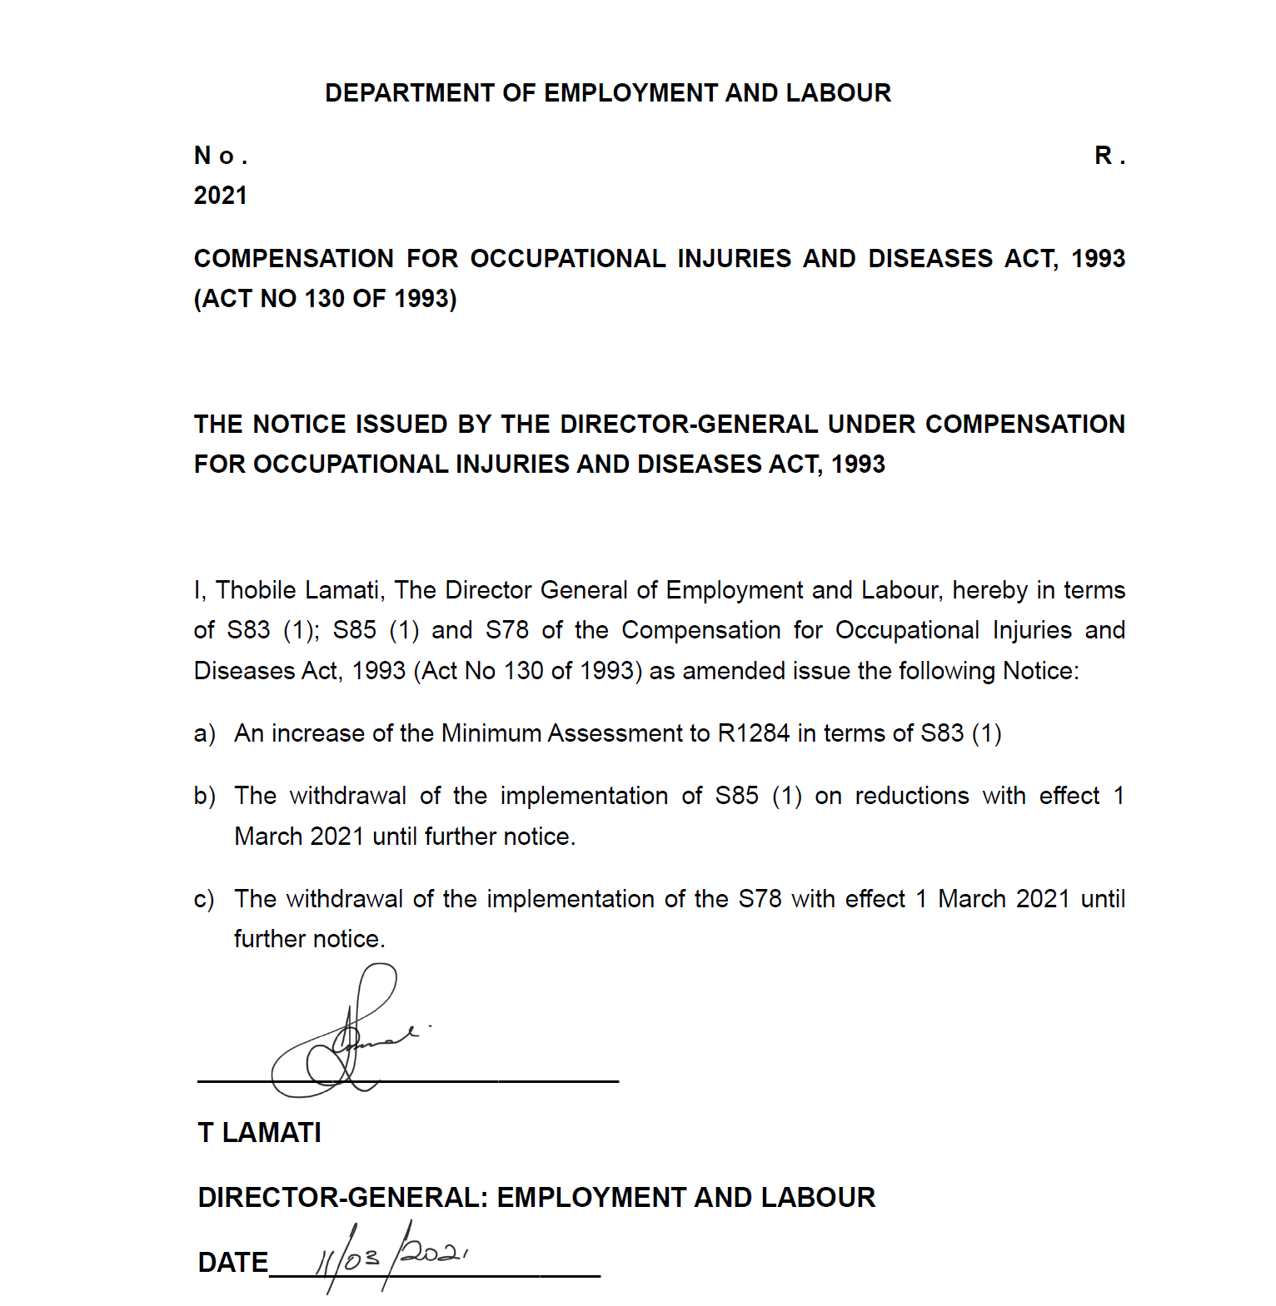
Items of Concern, by Degree of Seriousness Section 44(b) (amends s85)

Slide 25
Items of Concern, by Degree of Seriousness Section 1(k) (amends s1)
by the substitution for the definition of "employer individually liable" of the following definition:
"'employer individually liable' means an employer who in terms of section 84(1)(a) and b is exempt from paying assessments to the compensation fund";
Section 84(1)(a) and (b) of the principle Act read as follows:
84. Certain employers exempt from assessment
(1) No assessment in favour of the compensation fund shall be payable in respect of employees-
(a) in the employ of-
(i) the national and provincial spheres of government, including Parliament and provincial legislatures;

Slide 26
Items of Concern, by Degree of Seriousness Section 1(k) (amends s1)
(ii) a local authority which has obtained a certificate of exemption in terms of section 70(1)(a)(ii) of the Workmen's Compensation Act and has notified the Director-General in writing within 30 days after the commencement of this Act that it desires to continue with the arrangements according to the said certificate of exemption;
(iii) a municipality contemplated in section 10B of the Local Government transition Act, 1993 (Act No. 209 0f 1993), to which exemption has been granted in terms of subsection 2;
whose employer has with the approval of the Director-General obtained from a mutual association a policy of insurance for the full extent of his potential liability in terms of this Act to all employees employed by him, for so long as he maintains such policy in force.
(3) Notwithstanding the provisions of this section, the Director-General may on application by an employer referred to in subsection (1) permit such employer to pay assessments to the compensation fund in respect of his employees, and thereafter the provisions of this section shall cease to apply to such an employer.

Slide 27
Items of Concern, by Degree of Seriousness Section 1(k) (amends s1)
Issue 1: An exemption to pay the CF is not the same as “individual liability”
Clearly, a member of a Mutual Association is not individually liable. Liability lies with the Mutual Association.
Conversely, a provincial department is individually liable and MUST pay COIDA benefits from its own budget.
It is therefore incorrect to group these two classes of employers together under the banner of Employers “individually liable”.

Slide 28
Items of Concern, by Degree of Seriousness Section 1(k) (amends s1)
Issue 2: An anomaly has been created by the Ministerial notice published 3 October 2014 which mandated the move of all Class 13 (steel manufacturing) businesses to the RM:
Although these employers have a theoretical right under s84(3) to move their registration to the CF, the notice prevents them from doing so;
By an interpretation of s84(3) such employers after they have moved back to the CF may never again be insured by a mutual association / licensee.

Slide 29
Conclusion and Questions
Deepest thanks to the Chair and Honourable Members for taking the time to hear our concerns.

