Slide 1
Strategic Plan and Annual Performance Plan MTEF 2021/22
Presentation to the Portfolio Committee on Human Settlements,
Water and Sanitation.
28 April 2021

Slide 2
PURPOSE
To Brief the Portfolio Committee on Human Settlements, Water and Sanitation on the:
1. 2021/25 -2024-2025 Strategic plan and
2. 2021/22 Annual Performance Plan of the HDA

Slide 3
TABLE OF CONTENTS
Item | Content | Slide no
1. | Purpose of Presentation | 4
2. | HDA Strategic Plan 2021-2022 to 2024-2025 | 5-13
3. | HDA Vision, Mission and Values | 5
4. | Revised Strategy | 6-8
6. | Medium to Long Term Operating Model | 9
7. | Measuring Strategic Plan Outcomes | 11-12
8. | 21/22 FY Transition – 5 Strategic Projects | 13
9. | HDA Annual Performance Plan 2021-2022 | 14-
10. | Programme Structure | 15
11. | External Environmental Analysis | 16-17

Slide 4
TABLE OF CONTENTS...continued
Item | Content | Slide no
12. | Internal Environmental Analysis | 18
13 | Programme Performance Information | 19-32
14. | Budget | 33-37
15. | Key Risks and Mitigating Actions | 38-40
16. | Recommendations | 39
17. | End Of Presentation | 42

Slide 5
HDA 2021/25 -2024-2025 Strategic Plan

Slide 6
HDA Vision, Mission and Values
Vision | Mission | Values
The public sector Developer of Choice providing integrated, sustainable human settlements and security of tenure. | Accelerated delivery of spatially transformed integrated and sustainable human settlements. Providing security of tenure and asset wealth. Transforming the human settlements sector to be inclusive of the country’s demographic profile with a special focus on the marginalized sectors of women, youth and persons with disabilities. | Performance-oriented, Excellence, Accountability, Teamwork, Integrity.

Slide 7
The Revised Strategy…
Allows the Agency to:
Fulfil its mandate in terms of the entirety of the HDA Act,
realise July 2014 announcement of the Minister that the HDA serves as “a fully-fledged property development agency”, and
activate March 2016 Board approved Business Case in support of the Minister’s 2014 statement.
At the same time the Agency will continue to completion all the support and assistance programmes it is implementing on behalf of and in partnership with the NDHS, provinces and municipalities.

Slide 8
The Revised Strategy…continued
Does not duplicate the work of other human settlement agencies e.g. SHRA
Does not replace the constitutional responsibilities of provincial and municipal departments of human settlements.
Ensures focused application of limited resources to gain maximum outcomes and impact.
Enables the Agency to build on its strengths and successes to date.
Addresses gaps and weaknesses in the public sector’s capacity to effectively implement its human settlement programmes and services.
Enables the Agency to implement projects within the PHSHDAs and that are aligned to national, provincial and/or municipal HS Master Plans or other Spatial Development Plans.

Slide 9
The Revised Strategy…continued
Shifts the Agency from the current support, facilitative dependencies model of IP’s signed with Provinces, MTOPs signed with municipalities and delegated responsibilities/interventions from the NDHS – to a focused implementation role.
Requires the Agency to acquire and develop land for its own HS projects that will be implemented in partnership with strategic private sector partners that will share project and financial risks.
Strengthens the HDA’s own balance sheet thus reducing its dependency on the fiscus.
Positions the Agency to be responsible for the full value chain of property developer services and thus to be fully accountable for the achievement of tangible outputs therefrom.

Slide 10
Medium to Long-Term Operating Model

Slide 11
Measuring Strategic Plan Outcomes
MTSF PRIORITY 1 | A CAPABLE, ETHICAL AND DEVELOPMENTAL STATE
HDA OUTCOME 1 | OUTCOME INDICATOR | BASELINE | FIVE-YEAR TARGET
Effective and Efficient Management and Good Governance of the HDA. | Number of Unqualified audit report for each financial year | Qualified audit 2019/2020 | Unqualified audit report for each financial year
MTSF PRIORITY 4 | SPATIAL INTEGRATION, HUMAN SETTLEMENTS AND LOCAL GOVERNMENT
HDA OUTCOME 2 | OUTCOME INDICATOR | BASELINE | FIVE-YEAR TARGET
Integrated and sustainable human settlements and Security of Tenure | Number of hectares of well-located land acquired within PHSHDAs, for each financial year | New Indicator | 6 000 hectares acquired in PHSHDA’s 4 000 hectares acquired
 | % of the 2841 ha of land acquired during 2014 – 2019 falling within PHSHDAs rezoned, for each financial year | New Indicator | 100% hectares rezoned
 | Number of Housing Units Delivered | 23 526 housing units delivered | 25 420 housing units delivered by HDA Comprising of- from year 2021/22 to 23/24 Strategic projects = 2340 Region A = 8364 Region B = 5074
 | Number of serviced sites delivered | 23 948 serviced sites delivered | 23 586 serviced sites delivered by HDA Comprising of- from year 2021/22 to 23/24 Region A= 7539 Region B= 5405 Region C= 1500
 | Number of title deeds Registered | New Indicator | 35 499 Title deeds Registered

Slide 12
Measuring Strategic Plan Outcomes
MTSF PRIORITY 4 | SPATIAL INTEGRATION, HUMAN SETTLEMENTS AND LOCAL GOVERNMENT
HDA OUTCOME 2 | OUTCOME INDICATOR | BASELINE | FIVE-YEAR TARGET
Integrated and sustainable human settlements and Security of Tenure | Number of PHSHDA’s with new development plans completed, per financial year | New Indicator | 94 Development Plans in PHSHDA’s completed
 | Number of Informal settlements supported for upgrading to phase 3 each financial year per MTSF targets through packaging and inclusion in the upgrading pipeline2 aligned to the Provincial and Municipal Business plans | New Indicator | 1500 Informal settlements supported for upgrading to phase 3
 | Number of Catalytic Projects provided with Implementation support, per financial year as per MTSF targets | 57 national and/or provincial priority human settlements catalytic projects provided with implementation support | 50 national and/or provincial priority human settlements catalytic projects provided with implementation support
 | Number of municipalities provided with technical and implementation support for distressed mining communities, each financial year | 22 municipalities provided with technical implementation support for distressed mining communities, each financial year | 23 municipalities provided with technical implementation support

Slide 13
21/22 FY Transition – 5 Strategic Projects
PROJECT NAME | PROVINCE AND LOCALITY | LAND: HECTARES & OWNERSHIP | EXPECTED HOUSING YIELD ON COMPLETION | STAGE OF IMPLEMENTATION FOR 21/22 FY
Savannah City | Gauteng, Midvaal | Hectares to be confirmed Privately owned – land already acquired | 240 units | 240 units
Sicelo Shiceka | Gauteng, Midvaal | 6.0704 ha GPG owned – land already acquired | 540 units | 540 units
Ellofspark | Gauteng, Intersection of Franzina, Mansfield and R101 in Ellofsdal | 19.36 ha HDA owned | 2976 High Density Mixed Use Development | Land Assembly and Preparation. Project preparation and packaging.
Queenstown | Eastern Cape, Along Louis Botha Street in Queenindustria, Opposite Queenstown Mall | 5, 1924 ha HDA owned | 833 High Density Mixed Use Development | Land Assembly and Preparation. Project preparation and packaging.
Hartebeesfontein | Gauteng/North West??, South of Stormvoel Road and west of Derdepoort Road | 18.75 ha HDA owned | 2207 High Density Mixed Use Development | Land Assembly and Preparation. Project preparation and packaging.

Slide 14
HDA Annual Performance Plan
2021-2022 FY

Slide 15
Programme Structure
Programme 1
Administration
Audit and Risk
Finance
Programme 2
Land Management and Priority Humans Settlements Development Areas
Land Management
Priority Human Settlements Housing Development Areas (PHSHDAs)
Programme 3
Programme Planning and Design, Regional Coordination and Human Settlements Implementation Support Services
Programme Planning Design (Informa Settlements Upgrading , Catalytic Projects and Revitalisation of Distressed Mining Towns)
Regional Coordination and Human Settlements Implementation support services
Corporate support services
Strategy & Organisational Performance
Communications & Marketing
Programme 4
Planning, Monitoring, Evaluation and IGR
Monitoring & Evaluation
Geographic Information Systems (GIS)
Intergovernmental and Stakeholder Relations (IGR)

Slide 16
External Environmental Analysis
Pestel Analysis
Political | Insufficient alignment in the human settlement plans of the three spheres of government. Lack of alignment in terms of bulk infrastructure and human settlements planning and budgeting. The political impact of the Covid-19 pandemic. The political and socio-economic priorities set for the 6th administration as outlined in the MTSF and the NDHS Strategic Plan for the same period.
Economic | Fragmented funding framework of government. Reduced budgets for human settlement projects. The economic impact of the COVID-19 pandemic. High levels of unemployment coupled with slow economic growth.
Social | Protest actions and work stoppages at human development project sites. Expectations of communities not being met, and the poor achievement of human settlement outcomes as defined in the NDP Vision 2030 and the MTSF for the 6thadministration. Slow or inadequate spatial transformation and delivery of integrated human settlements close to or inclusive of socio-economic amenities. The social impact of the Covid-19 pandemic

Slide 17
External Environmental Analysis
Pestel Analysis
Technological | Slow uptake of, and utilisation of alternative building technologies that speed up delivery and ensures long-term environmental sustainability, in the delivery of human settlements. Opportunity for 4th industrial revolution innovations to improve the quality and standards of human settlement developments. Insufficient funding and infrastructure to ensure broadband connectivity in integrated human settlements.
Legal | Impact of litigation and court judgements in respect of the NDHS and provincial departments of human settlements. Impact of legislation e.g. the Expropriation Bill. Unlawful occupation of land.

Slide 18
Internal Environmental Analysis
Strengths | Project management and implementation experience Appropriately skilled human capital Established partnerships with provincial departments of human settlements and municipalities Single Shareholder (NDHS) Established governance structures Established partnerships with private sector developers
Weaknesses | Lack of direct capex budget for projects An appropriate organisational structure/operating model to deliver onthe adopted strategic approach Leadership interruptions in the organisation Passive and reactive role in implementation support services
Opportunities | Section 7(1)(g) and (h) of the HDA Act which provides for the HDA to pay a proactive property developer role Realign the operating model, organisational structure and the budget progamme structure to deliver on the property developer role Successful speedy delivery of TRU's in response to the Covid 19 pandemic Successful delivery of ABT housing units
Threats | HDA's appointment as project manager and implementor based on the "goodwill" ofprovinces and municipalities Partnership dependencies in terms of existing IPs and MTOPs negatively impacts achievement of HDA delivery targets Dependency on strategic IGR partners to address lack of or slow delivery by service providers/developers

Slide 19
Programme 1: Administration
Outcome | Outputs | Output Indicators |  |  | Annual Targets
 |  |  | Audited / Actual Performance |  |  |  | Estimated Performance | MTEF Period
 |  |  | 2017/18 | 2018/19 | 2018/19 | 2019/20 | 2020/21 | 2021/22 | 2022/23 | 2023/24
Functional, Efficient and Integrated Government | Unqualified audit reports | 1.1.1 Unqualified audit report for each financial year | Unqualified audit report for the 2016/17 | Unqualified audit report for the 2017/2018 | New Indicator | Qualified audit opinion for the 2018/ 19 financial year | Unqualified audit report for 2019/20 | Unqualified audit report for 2020/21 | Unqualified audit report for 2021/22 | Unqualified audit report for 2022/23
 | Transformation and Empowerment of designated groups | 1.1.2 Percentage of annual HDA procurement spend, targeted at businesses owned by BB BEE Levels 1 - 4 | New Indicator | 61.7% of annual HDA procurement spend, targeted at Businesses owned by BB BEE Levels 1 - 4 |  | 50% of annual HDA procurement spend, targeted at businesses owned by BB BEE Levels 1 - 4 | 50% of annual HDA Procurement spend, targeted at businesses owned by BB BEE Levels 1 - 4 | 60% of annual HDA procurement spend, targeted at businesses owned by BB BEE Levels 1 - 4 | 65% of annual HDA procurement spend, targeted at businesses owned by BB BEE levels1 – 4 | 70% of annual HDA procurement spend, targeted at businesses owned by BB BEE Levels 1 – 4
 |  | 1.1.3 Percentage of annual HDA procurement spend targeted at businesses owned by Women | New Indicator | 34.72% of annual HDA procurement spend, targeted at businesses owned by Women |  | 35% of annual HDA procurement spend, targeted at businesses owned by Women | 35% of annual HDA procurement spend, targeted at businesses owned by Women | 35% of annual HDA procurement spend, targeted at businesses owned by Women | 35% of annual HDA procurement spend, targeted at businesses owned by Women | 35% of annual HDA procurement spend, targeted at businesses owned by Women

Slide 20
Programme 1: Administration
Outcome | Outputs | Output Indicators |  |  | Annual Targets
 |  |  | Audited / Actual Performance |  |  |  | Estimated Performance | MTEF Period
 |  |  | 2017/18 | 2018/19 | 2018/19 | 2019/20 | 2020/21 | 2021/22 | 2022/23 | 2023/24
Functional, Efficient and Integrated Government | Transformation and Empowerment of designated groups | 1.1.4 Percentage of annual HDA Procurement spend targeted at businesses owned by Youth | New Indicator | 2.5% of annual HDA procurement spend, targeted at businesses owned by Youth | New Indicator | 46% of annual HDA procurement spend, targeted at businesses owned by Youth | 15% of annual HDA procurement spend, targeted at businesses owned by Youth | 15% of annual HDA Procurement spend, targeted at businesses owned by Youth | 15% of annual HDA procurement spend, targeted at businesses owned by Youth | 15% of annual HDA procurement spend, targeted at businesses owned by Youth
 |  | 1.1.5 Percentage of annual HDA procurement spend targeted at businesses owned by Persons with disabilities | New Indicator | 1.25% of annual HDA procurement spend, targeted at businesses owned by Persons with disabilities |  | 0 of annual HDA Procurement spend, targeted at businesses owned by Persons with disabilities | 5% of annual HDA Procurement spend, targeted at businesses owned by Persons with disabilities | 5% of annual HDA procurement spend, targeted at businesses owned by Persons with disabilities | 5% of annual HDA procurement spend, targeted at businesses owned by Persons with disabilities | 5% of annual HDA procurement spend, targeted at businesses owned by Persons with disabilities
 |  | 1.1.6 Percentage of annual HDA procurement spend targeted at businesses owned by Military Veterans | New Indicator | 0.5% of annual HDA procurement spend, targeted at businesses owned by Military Veterans |  | 0.56% of annual HDA procurement spend, targeted at businesses owned by Military Veterans | 5% of annual HDA procurement spend, targeted at businesses owned by Military Veterans | 5% of annual HDA procurement spend, targeted at businesses owned by Military Veterans | 5% of annual HDA procurement spend, targeted at businesses owned by Military Veterans | 5% of annual HDA procurement spend, targeted at businesses owned by Military Veterans

Slide 21
Programme 2: Land Assembly and PHSHDAs
Outcome | Outputs | Output Indicators |  | Annual Targets
 |  |  | Audited / Actual Performance |  |  |  | Estimated Performance | MTEF Period
 |  |  | 2017/18 | 2018/19 | 2018/19 | 2019/20 | 2020/21 | 2021/22 | 2022/23 | 2023/24
Integrated and Sustainable human Settlements and Security of Tenure | Integrated implementation Programmes for PDAs prepared | 2.1.1. Number of integrated implementation programmes for PDAs prepared | New Indicator | New Indicator | New Indicator | New Indicator | New Indicator | 47 Integrated implementation programmes for PDAs prepared | 40 Integrated implementation programmes for PDAs prepared | 30 Integrated implementation programmes for PDAs prepared
 | Well-located land acquired within PHSHDAs | 2.1.2 Number of hectares of well-located land acquired within PHSHDAs | New Indicator |  | New Indicator | New Indicator | 1500 hectares of well located acquired within PHSHDAs | 1500 hectares of well located acquired within PHSHDAs | 1500 hectares of well located acquired within PHSHDAs | 1500 hectares of well located acquired within PHSHDAs
 | Land rezoned, townships established, and all related development approvals acquired | 2.1.3 Percentage of the 1884.6870ha of land acquired during 2014 – 2019 falling within PHSHDAs rezoned | New Indicator |  | New Indicator | New Indicator | 10% of the land acquired during 2014 – 2019 falling within PHSHDAs rezoned | 30% of the 1884.6870ha of land acquired during 2014 – 2019 falling within PHSHDAs | 50% of the 1884.6870ha of land acquired During 2014 – 2019 falling within PHSHDAs rezoned | 100% of the 1884.6870ha of land acquired during 2014 – 2019 falling within PHSHDAs rezoned

Slide 22
Programme 2: Land Assembly and PHSHDAs
Outcome | Outputs | Output Indicators |  |  | Annual Targets
 |  |  | Audited / Actual Performance |  |  |  | Estimated Performance | MTEF Period
 |  |  | 2017/18 | 2018/19 | 2018/19 | 2019/20 | 2020/21 | 2021/22 | 2022/23 | 2023/24
Integrated and Sustainable human Settlements and Security of Tenure | Land rezoned, townships established, and all related development approvals acquired | 2.14 Number of hectares of land rezoned for Human Settlements development | 1564.129 hectares of land rezoned for Human Settlements development | 1330. 6885 hectares of land rezoned for Human Settlements development | New Indicator | 5 parcels of land facilitated for rezoning | 1000 hectares of land rezoned for Human Settlements development | 1000 hectares of land rezoned for Human Settlements development | 1000 hectares of land rezoned for Human Settlements development | 1000 hectares of land rezoned for Human Settlements development
 | Well-located land acquired or released for human settlement development | 2.1.5 Number of hectares of well-located land acquired or released for human Settlements development | 3329.446 ha of Land acquired or released for Human Settlements | 3124. 8773 ha of Land acquired or released for Human Settlements |  | 3514, 5428 hectares of Land acquired or released for Human Settlements | 1500 of hectares of well-located land acquired or released for human settlements development | 750 of hectares of well-located land acquired or released for human settlements development | 500 of hectares of well-located land acquired or released for human settlements development | 250 of hectares of well-located land acquired or released for human settlements development

Slide 23
Programme 3.1: Informal Settlements Upgrading
Outcome | Outputs | Output Indicators |  | Annual Targets
 |  |  | Audited / Actual Performance |  |  | Estimated Performance | MTEF Period
 |  |  | 2017/18 | 2018/19 | 2019/20 | 2020/21 | 2021/22 | 2022/23 | 2023/24
Integrated and Sustainable Human settlements and Security of Tenure | Adequate housing and improved living conditions in informal settlements | 3.1.1 Number of Informal settlements supported for upgrading to phase 3 |  | New Indicator | 369 Informal settlements assessed and categorized | 143 of Informal settlements supported for upgrading to phase 3 | 375 of Informal settlements supported for upgrading to phase 3 | 464 of Informal settlements supported for upgrading to phase 3 | 300 of Informal settlements supported for upgrading to phase 3
 |  | 3.1.2 Number of Informal Settlements upgraded to phase 3 (end to end) | New Indicator | New Indicator | New Indicator | New Indicator | 4 of Informal Settlements upgraded to phase 3 (end to end) | 5 of Informal Settlements upgraded to phase 3 (end to end) | 6 of Informal Settlements upgraded to phase 3 (end to end)
 | Adequate housing and improved living conditions in Emergency housing areas Selected Inner cities Selected catalytic/mega projects | 3.1.3 Number of Informal settlements assisted with relocation and emergency interventions | New Indicator | New Indicator | New Indicator | New Indicator | 2 of Informal settlements assisted with relocation and emergency interventions | 3 of Informal settlements assisted with relocation and emergency interventions | 3 of Informal settlements assisted with relocation and emergency interventions

Slide 24
Programme 3.2: Catalytic Projects and Revitalisation of Destressed Mining Towns
Outcome | Outputs | Output Indicators |  | Annual Targets
 |  |  | Audited / Actual Performance |  |  | Estimated Performance | MTEF Period
 |  |  | 2017/18 | 2018/19 | 2019/20 | 2020/21 | 2021/22 | 2022/23 | 2023/24
Integrated and sustainable human Settlements and Security of Tenure | Adequate housing and improved living Conditions in selected catalytic/mega projects | 3.2.1 Number of catalytic projects provided with implementation support | 58 Catalytic Projects provided with Implementation support | 57 Catalytic Projects provided with Implementation support | 50 Catalytic Projects provided with Implementation support | 50 Catalytic Projects provided with Implementation support | 50 Catalytic Projects provided with Implementation support | 50 Catalytic Projects provided with Implementation support | 50 Catalytic Projects provided with Implementation support
 |  | 3.2.2 Number of Catalytic projects assisted to raise capital for the infrastructure required for the projects | New Indicator | New Indicator | New Indicator | New Indicator | 6 of Catalytic projects assisted to raise capital for the infrastructure required for the projects | 8 of Catalytic projects assisted to raise capital for the infrastructure required for the projects | 6 of Catalytic projects assisted to raise capital for the infrastructure required for the projects

Slide 25
Programme 3.2: Catalytic Projects and Revitalisation of Destressed Mining Towns
Outcome | Outputs | Output Indicators |  | Annual Targets
 |  |  | Audited / Actual Performance |  |  | Estimated Performance | MTEF Period
 |  |  | 2017/18 | 2018/19 | 2019/20 | 2020/21 | 2021/22 | 2022/23 | 2023/24
Integrated and sustainable human Settlements and Security of Tenure | Adequate housing and improved living conditions in distressed mining communities | 3.2.3 Number of municipalities provided with technical and implementation support for distressed mining communities | 22 of municipalities provided with technical and implementation support for distressed mining communities | 22 of municipalities provided with technical and implementation support for distressed mining communities | 22 of municipalities provided with technical and implementation support for distressed mining communities | 23 of municipalities provided with technical and implementation support for distressed mining communities | 23 of Municipalities provided with technical and implementation support for distressed mining communities, | 23 of municipalities provided with technical and implementation support for distressed mining communities | 23 of municipalities provided with technical and implementation support for distressed mining communities

Slide 26
Summary of Housing Units and Serviced sites for 2021/22
Housing Units | Serviced sited
5030 | 4420

Slide 27
Programme 3.3: Regional Coordination and Human Settlements Implementation Support Services
Outcome | Outputs | Output Indicators |  | Annual Targets
 |  |  | Audited / Actual Performance |  |  | Estimated Performance | MTEF Period
 |  |  | 2017/18 | 2018/19 | 2019/20 | 2020/21 | 2021/22 | 2022/23 | 2023/24
Integrated and sustainable human Settlements and Security of Tenure | Housing Units delivered by HDA | 3.3.1 HDA Strategic Projects: Number of units completed | New Indicator | New Indicator | New Indicator | New Indicator | 780 of units completed | 780 of units completed | 780 of units completed
 |  | 3.3.2 Region A: Number of IBT housing units delivered i.r.o. projects implemented by the HDA | 2872 of IBT housing units delivered i.r.o. projects implemented by the HDA | 2397 of IBT housing units delivered i.r.o. projects implemented by the HDA | 4356 of IBT housing units delivered i.r.o. projects implemented by the HDA | 2283 of IBT housing units delivered i.r.o. projects implemented by the HDA | 2787 of IBT housing units delivered i.r.o. Projects implemented by the HDA | 2787 of IBT housing units delivered i.r.o. projects implemented by the HDA | 2787 of IBT housing units delivered i.r.o. projects implemented by the HDA
 |  | 3.3.3 Region B: Number of Housing Units Delivered i.r.o. projects implemented by HDA 17 | 2320 of Housing Units Delivered i.r.o. projects implemented by HDA | 4973 of Housing Units Delivered i.r.o. projects implemented by HDA | 1191 of Housing Units Delivered i.r.o. projects implemented by HDA | 1138 of Housing Units Delivered i.r.o. projects implemented by HDA | 1463 of Housing Units Delivered i.r.o. projects implemented by HDA | 1781 of Housing Units Delivered i.r.o. projects implemented by HDA | 1830 of Housing Units Delivered i.r.o. projects implemented by HDA

Slide 28
Programme 3.3: Regional Coordination and Human Settlements Implementation Support Services
Outcome | Outputs | Output Indicators |  | Annual Targets
 |  |  | Audited / Actual Performance |  |  | Estimated Performance | MTEF Period
 |  |  | 2017/18 | 2018/19 | 2019/20 | 2020/21 | 2021/22 | 2022/23 | 2023/24
Integrated and sustainable human Settlements and Security of Tenure | Serviced sites delivered | 3.3.4 REGION A: Number of serviced sites delivered i.r.o. projects implemented by HDA | 4004 of serviced sites delivered i.r.o. projects implemented by HDA | 5374 of serviced sites delivered i.r.o. projects implemented by HDA | 2440 of serviced sites delivered i.r.o. projects implemented by HDA | 3872 of serviced sites delivered i.r.o. projects implemented by HDA | 2513 of serviced sites delivered i.r.o. projects implemented by HDA | 2513 of serviced sites delivered i.r.o. projects implemented by HDA | 2513 of serviced sites delivered i.r.o. projects implemented by HDA
 |  | 3.3.5 Region B: Number of serviced sites delivered i.r.o. projects implemented by HDA | 4142 of serviced sites delivered i.r.o. projects implemented by HDA | 5156 of serviced sites delivered i.r.o. projects implemented by HDA | 1400 of serviced sites delivered i.r.o. projects implemented by HDA | 884 of serviced sites delivered i.r.o. project implemented by HDA | 1389 of serviced sites delivered i.r.o. projects implemented by HDA | 2252 of serviced sites delivered i.r.o. projects implemented by HDA | 1764 of serviced sites delivered i.r.o. projects implemented by HDA

Slide 29
Programme 3.3Regional Coordination and Human Settlements Implementation Support Services
Outcome | Outputs | Output Indicators |  | Annual Targets
 |  |  | Audited / Actual Performance |  |  |  | Estimated Performance | MTEF Period
 |  |  | 2017/18 | 2018/19 | 2018/19 | 2019/20 | 2020/21 | 2021/22 | 2022/23 | 2023/24
Integrated and Sustainable human Settlements and Security of Tenure | Serviced sites delivered | 3.3.6 Region C: Number of serviced sites delivered i.r.o. projects implemented by HDA | New Indicator | New Indicator | New Indicator | New Indicator | New Indicator | 500 serviced sites delivered i.r.o. projects implemented by HDA | 500 serviced sites delivered i.r.o. projects implemented by HDA | 500 serviced sites delivered i.r.o. projects implemented by HDA
 | TRU’s delivered as requested | 3.3.7 Region B: Number of temporary residential units delivered | New Indicator | New Indicator | New Indicator | New Indicator | New Indicator | 1554 of temporary residential units delivered | 0 of temporary residential units delivered | 0 of temporary residential units delivered
 | Projects managed by HDA delivered against all milestones, as per signed IPs and MTOPs | 3.3.8 Region A: Number of HS Projects managed by the HDA | New Indicator | New Indicator | New Indicator | New Indicator | New Indicator | 40 HS Projects managed by the HDA | 40 HS Projects managed by the HDA | 40 HS Projects managed by the HDA

Slide 30
Programme 3.3:Regional Coordination and Human Settlements Implementation Support Services
Outcome | Outputs | Output Indicators |  |  | Annual Targets
 |  |  | Audited / Actual Performance |  |  |  | Estimated Performance | MTEF Period
 |  |  | 2017/18 | 2018/19 | 2018/19 | 2019/20 | 2020/21 | 2021/22 | 2022/23 | 2023/24
Integrated and Sustainable human settlements and Security of Tenure | Projects managed by HDA delivered against all milestones, as er signed IPs and MTOPs | 3.3.9 Region A: Percentage completion of milestones of all projects managed by the HDA | New Indicator | New Indicator |  | New Indicator | New Indicator | 100% completion of milestones of all projects managed by the HDA | 100% completion of milestones of all projects managed by the HDA | 100% completion of milestones of all projects managed by the HDA
 |  | 3.3.10 Region C: Number of HS Projects managed by the HDA | New Indicator | New Indicator |  | New Indicator | New Indicator | 62 HS Projects managed by the HDA | 45 HS Projects managed by the HDA | 40 HS Projects managed by the HDA
 |  | 3.3.11 Region C: Percentage completion of bucket eradication project implemented by the HDA | New Indicator | New Indicator |  | New Indicator | New Indicator | 100% completion of bucket eradication projects implemented by the HDA | 100% completion of bucket eradication projects implemented by the HDA | 100% completion of bucket eradication projects implemented by the HDA

Slide 31
Programme 3.3:Regional Coordination and Human Settlements Implementation Support Services
Outcome | Outputs | Output Indicators |  |  | Annual Targets
 |  |  | Audited / Actual Performance |  |  |  | Estimated Performance | MTEF Period
 |  |  | 2017/18 | 2018/19 | 2018/19 | 2019/20 | 2020/21 | 2021/22 | 2022/23 | 2023/24
Integrated and Sustainable human settlements and Security of Tenure | HDA Projects packaged for implementation | 3.3.12 Number of HDA strategic Projects packaged for development | New Indicator | New Indicator |  | New Indicator | New Indicator | 3 projects (Ellofspark, Queenstown and Hartebeesfontein) strategic Projects packaged for development | 1 HDA Strategic Projects packaged for development | 1 HDA Strategic Projects packaged for development
 | Title Deeds Registered | 3.3.13 Number of Title deeds registered | New Indicator | 0 Title Deeds Registered |  | 403 Title Deeds Registered | 7058 Title Deeds Registered | 1456 Title Deeds Registered | 1528 Title Deeds Registered | 1604 Title Deeds Registered

Slide 32
Programme 4: Planning, Monitoring and Evaluation and
Inter-Governmental Relations
Outcome | Outputs | Output Indicators |  |  | Annual Targets
 |  |  | Audited / Actual Performance |  |  |  | Estimated Performance | MTEF Period
 |  |  | 2017/18 | 2018/19 | 2018/19 | 2019/20 | 2020/21 | 2021/22 | 2022/23 | 2023/24
Integrated and sustainable human settlements and Security of Tenure | HS Projects managed or developed by HDA reflects spatial transformation principles | 4.1.1 Percentage of spatial transformation planning, analysis and implementation support provided on projects / programs within 10 working days | New Indicator | New Indicator |  | New Indicator | New Indicator | 100% of spatial transformation planning, analysis and implementation support provided on projects / programs within 10 working days | 100% of spatial transformation planning, analysis and implementation support provided on projects / programs within 10 working days | 100% of spatial transformation planning, analysis and implementation support provided on projects / programs within 10 working days

Slide 33
BUDGET
The HDA has received the following allocation from the NDHS for the Medium Term Expenditure Framework period:
The consolidated budget is based on confirmed grant funding from the Department of Human Settlements and funds received from provinces for operational expenditure in the respective offices based on agreed Medium-Term Operational Plans (MTOPs). Total projected consolidated budget for the financial year is R436m, a reduction compared to prior year budget of R475m.
The reduced budget is driven by a reduction in MTOP funding from R211m to R197m based on signed funding agreements.

Slide 34
DRAFT QUARTERLY BUDGET 2021/22
Statement of performance | Annual Budget | Q1 | Q2 | Q3 | Q4
Revenue | 436 119 725 | 109 029 931 | 109 029 931 | 109 029 931 | 109 029 931
Revenue from non-exchange transactions | 235 379 000 | 58 844 750 | 58 844 750 | 58 844 750 | 58 844 750
Operational grant funding | 235 379 000 | 58 844 750 | 58 844 750 | 58 844 750 | 58 844 750
Revenue from exchange transactions | 200 740 725 | 50 185 181 | 50 185 181 | 50 185 181 | 50 185 181
Medium Term Operation Plans (MTOP) | 197 740 725 | 49 435 181 | 49 435 181 | 49 435 181 | 49 435 181
Other income | 3 000 000 | 750 000 | 750 000 | 750 000 | 750 000
Expenditure | (436 119 725) | (109 029 931) | (109 029 931) | (109 029 931) | (109 029 931)
Operational expenditure | (210 176 991) | (52 544 248) | (52 544 248) | (52 544 248) | (52 544 248)
Payroll costs | (225 942 734) | (56 485 684) | (56 485 684) | (56 485 684) | (56 485 684)
Budget | - | - | - | - | -

Slide 35
BUDGET PER PROGRAMMES
Total Expenditure | 436 119 725 | 109 029 931 | 109 029 931 | 109 029 931 | 109 029 931
Administration - Programme 1 | 131 942 853 | 32 985 713 | 32 985 713 | 32 985 713 | 32 985 713
CFO | 44 032 260 | 11 008 065 | 11 008 065 | 11 008 065 | 11 008 065
CEO | 10 416 049 | 2 604 012 | 2 604 012 | 2 604 012 | 2 604 012
Audit and Risk | 1 045 000 | 261 250 | 261 250 | 261 250 | 261 250
Board | 5 203 576 | 1 300 894 | 1 300 894 | 1 300 894 | 1 300 894
CS | 44 986 134 | 11 246 534 | 11 246 534 | 11 246 534 | 11 246 534
Strategic Support | 26 259 834 | 6 564 959 | 6 564 959 | 6 564 959 | 6 564 959
Land Management and Priority Housing Development Areas - Programme 2 | 27 488 172 | 6 872 043 | 6 872 043 | 6 872 043 | 6 872 043
Land Management | 24 473 172 | 6 118 293 | 6 118 293 | 6 118 293 | 6 118 293
Priority Housing Development Areas | 3 015 000 | 753 750 | 753 750 | 753 750 | 753 750
Programme Planning, Design and Regional Coordination - Programme 3 | 254 116 875 | 63 529 219 | 63 529 219 | 63 529 219 | 63 529 219
Planning Programme Design(PPD) | 9 479 888 | 2 369 972 | 2 369 972 | 2 369 972 | 2 369 972
Chief operating office (COO) | 38 118 152 | 9 529 538 | 9 529 538 | 9 529 538 | 9 529 538
Region A | 2 421 640 | 605 410 | 605 410 | 605 410 | 605 410
RegionB | 2 872 484 | 718 121 | 718 121 | 718 121 | 718 121
Region C | 3 483 986 | 870 997 | 870 997 | 870 997 | 870 997
Limpopo | 23 924 325 | 5 981 081 | 5 981 081 | 5 981 081 | 5 981 081
Free State | 25 583 903 | 6 395 976 | 6 395 976 | 6 395 976 | 6 395 976
Kwa-Zulu Natal | 26 495 387 | 6 623 847 | 6 623 847 | 6 623 847 | 6 623 847
Northern Cape | 9 538 969 | 2 384 742 | 2 384 742 | 2 384 742 | 2 384 742
North West | 35 701 519 | 8 925 380 | 8 925 380 | 8 925 380 | 8 925 380
Western Cape | 32 757 842 | 8 189 461 | 8 189 461 | 8 189 461 | 8 189 461
Eastern Cape | 22 442 842 | 5 610 711 | 5 610 711 | 5 610 711 | 5 610 711
Gauteng | 21 295 938 | 5 323 985 | 5 323 985 | 5 323 985 | 5 323 985
Planning and Monitoring - Programme 4 | 22 571 825 | 5 642 956 | 5 642 956 | 5 642 956 | 5 642 956
Spatial Information Management Planning | 22 571 825 | 5 642 956 | 5 642 956 | 5 642 956 | 5 642 956

Slide 36
STATEMENT OF FINANCIAL PERFORMANCE | 2021/22 Budget estimate | 2022/223 | 2023/24
Rand thousand | Budget estimate | Budget estimate | Planning budget estimate
Objective/Activity
Administration | 105 683 | 110 967 | 115 406
Strategic support | 48 832 | 51 274 | 53 325
Development management operation | 47 598 | 49 978 | 51 977
Built enviroment and operation | 234 007 | 241 275 | 244 258
 | - | - | -
Total | 436 120 | 453 494 | 464 966
Economic classification
Current payments | 436 120 | 453 494 | 464 966
Compensation of employees | 225 205 | 236 465 | 232 114
Salaries and wages | 215 696 | 226 481 | 221 645
Social contributions | 9 509 | 9 984 | 10 469
Goods and services | 210 915 | 217 029 | 232 852
Of which
Administrative fees | 242 | 254 | 266
Advertising | 1 812 | 1 903 | 1 998
Minor assets | 485 | 509 | 534
Audit costs: External | 2 500 | 2 625 | 2 756
Bursaries: Employees | 1 764 | 1 852 | 1 945
Catering: Internal activities | 657 | 690 | 723
Communication (G&S) | 5 900 | 6 195 | 6 505
Computer services | 4 368 | 4 181 | 4 382
Consultants: Business and advisory services | 122 038 | 128 339 | 135 695
Legal services (G&S) | 9 000 | 4 468 | 4 691
Science and technological services | - | - | -
Contractors
Maintenance and repairs of other fixed structures | 651 | 684 | 718
Agency and support/outsourced services | 4 009 | 4 212 | 4 419
Entertainment | - | - | -
Consumables: Stationery, printing and office supplies | 1 143 | 1 201 | 1 260
Operating leases | 2 043 | 2 145 | 2 251
Rental and hiring | - | - | -
Property payments | 20 358 | 21 376 | 22 376
Transport provided: Internal activities | - | - | -
Travel and subsistence | 10 919 | 11 465 | 11 986
Training and development | 3 728 | 3 914 | 4 097
Operating payments | 15 992 | 16 792 | 21 827
Venues and facilities | 344 | 1 114 | 1 164
Depreciation | 2 962 | 3 111 | 3 259
Losses from | - | - | -
Outside shareholders Interest | - | - | -
Total Expenditure | 436 120 | 453 494 | 464 966
Objective less Expenditure | 0 | 0 | -

Slide 37
REVENUE | 2021/22 | 2022/23 | 2023/24
Revenue | Budget estimate | Budget estimate | Planning budget estimate
R Thousand
Revenue
Tax revenue | - | - | -
Entity revenue | 200 741 | 210 778 | 221 317
Sale of goods and services other than capital assets | 200 741 | 210 778 | 221 317
Of which:
Administration fees | 3 000 | 3 150 | 3 308
Management Fees | - | - | -
Other Income | 1 000 | 1 050 | 1 103
Investment Income | 2 000 | 2 100 | 2 205
Please specify
Sales by market establishments | 197 741 | 207 628 | 218 009
Provincial Projects | 197 741 | 207 628 | 218 009
Transfers received | 235 379 | 242 716 | 243 649
Other government units | 235 379 | 242 716 | 243 649
National government | 235 379 | 242 716 | 243 649
Departmental transfers | 235 379 | 242 716 | 243 649
Tax benefit | - | - | -
Outside shareholders interest | - | - | -
Total revenue | 436 120 | 453 494 | 464 966
Check
Total revenue | 436 120 | 453 494 | 464 966
Total expenses | 436 120 | 453 494 | 464 966
Surplus / (Deficit) | – | 0 | 0
Annual report Surplus / (Deficit)
Differences

Slide 38
STATEMENT OF FINANCIAL POSITION |  | 2021/22 | 2022/23 | 2023/24
Statement of Financial Position | Notes | Budget estimate | Budget estimate | Planning budget estimate
ASSETS
Current assets |  | 1 339 548 | 1 406 525 | 1 465 882
Inventory |  | 368 953 | 387 401 | 404 834
Trade and other receivables from exchange transactions |  | 220 659 | 231 691 | 242 118
Cash and cash equivalents |  | 749 936 | 787 433 | 818 930
Non-current assets |  | 39 799 | 41 640 | 43 514
Property, plant and equipment |  | 8 892 | 9 337 | 9 757
Intangible assets |  | 142 | - | -
Investment property |  | 30 765 | 32 303 | 33 757
Total assets |  | 1 379 347 | 1 448 166 | 1 509 396
LIABILITIES
Current liabilities |  | 1 276 201 | 1 339 862 | 1 396 220
Payments received in advance |  | - | - | -
Trade and other payables from exchange transactions |  | 32 752 | 34 389 | 35 937
Current provisions |  | 17 888 | 16 334 | 17 069
Provisions for operational liabilities |  | 17 888 | 16 334 | 17 069
Deferred income |  | 1 225 562 | 1 289 139 | 1 343 214
Derivatives financial instruments |  | - | - | -
Non-current liabilities |  | 588 | 617 | 645
Finance lease liability |  | 588 | 617 | 645
Operating Lease Liability |  |  | - | -
Total liabilities |  | 1 276 789 | 1 340 480 | 1 396 865
NET ASSETS |  | 102 558 | 107 686 | 112 532
Accumulated surplus / (deficit) |  | 102 435 | 107 557 | 112 397
Reserves |  | 123 | 129 | 135
Cash reserves |  | - | - | -
Non_cash reserves |  | 123 | 129 | 135
Capital fund/ Deferred government grant |  | - | - | -
Total net assets and liabilities |  | 1 379 347 | 1 448 166 | 1 509 397
Contingent liabilities |  | - | - | -

Slide 39
CASH FLOW DATA | 2021/22 | 2022/23 | 2023/24
Cash flow data | Budget estimate | Budget estimate | Planning budget estimate
R Thousand
Cash flow from operating activities | 21 680 | 18 332 | 24 685
Cash receipts from stakeholders | 436 120 | 453 494 | 464 966
Tax receipts | - | - | -
Sales of goods and services other than capital assets | 200 741 | 210 778 | 221 317
Sales of goods and services produced by department (excl. capital assets) | 200 741 | 210 778 | 221 317
Administrative fees | 3 000 | 3 150 | 3 308
Management Fees | - | - | -
Other Income | 1 000 | 1 050 | 1 103
Investment Income | 2 000 | 2 100 | 2 205
Sales by market establishments | 197 741 | 207 628 | 218 009
Provincial Projects | 197 741 | 207 628 | 218 009
 |  |  | -
Other sales | - | - | -
Transfers received | 235 379 | 242 716 | 243 649
Other goverment units | 235 379 | 242 716 | 243 649
National government | 235 379 | 242 716 | 243 649
Departmental transfers | 235 379 | 242 716 | 243 649
Other national departments | - | - | -
Departmental agencies and accounts | - | - | -
Provincial governments | - | - | -
Cash paid to stakeholders | 414 440 | 435 162 | 440 281
Current payments | 414 440 | 435 162 | 440 281
Compensation of employees | 225 205 | 236 465 | 232 114
Salaries and wages | 215 696 | 226 481 | 221 631
Social contributions | 9 509 | 9 984 | 10 483
Goods and services | 189 235 | 198 697 | 208 167
Administrative fees | 242 | 253,575 | 265
Advertising | 1 812 | 1 903 | 1 987
Minor assets | 485 | 509 | 532
Audit costs: External | 2 500 | 2 625 | 2 756
Bursaries: Employees | 1 764 | 1 852 | 1 934
Catering: Internal activities | 657 | 690 | 721
Communication (G&S) | 5 900 | 6 195 | 6 505
Computer services | 4 368 | 4 181 | 4 382
Consultants: Business and advisory services | 93 968 | 98 667 | 103 600
Infrastructure and planning services | - | - | -
Legal services (G&S) | 9 000 | 4 468 | 4 691
Science and technological services | - | - | -
Contractors | 9 716 | 10 202 | 10 712

Slide 40
CASH FLOW DATA….Continued | 2021/22 | 2022/23 | 2023/24
Cash flow data | Budget estimate | Budget estimate | Planning budget estimate
R Thousand
Maintenance and repairs of other fixed structures | 9 212 | 9 796 | 5 859
Agency and support/outsourced services | 3 200 | 4 212 | 4 419
Entertainment | - | - | -
Consumables: Stationery, printing and office supplies | 1 143 | 1 201 | 1 260
Operating leases | 2 043 | 2 145 | 2 251
Property payments | 20 358 | 21 376 | 22 376
Travel and subsistence | 10 919 | 16 934 | 17 679
Training and development | 3 728 | 3 914 | 4 097
Operating payments | 16 999 | 16 792 | 21 827
Venues and facilities | - | - | -
Interest and rent on land | 937 | 937 | 937
Interest | 937 | 984 | 1 027
Rent on land | - | - | -
Tax payment | - | - | -
Outside shareholders interest | - | - | -
Cash flow from investing activities | (2 831) | (2 967) | (3 101)
Acquisition of property, plant, equipment | (2 831) | (2 967) | (3 101)
Buildings: residential | - | - | -
Furniture and office equipment | (2 831) | (2 967) | (3 101)
Other machinery and equipment | - | - | -
Heritage assets | - | - | -
Outside shareholders interest | - | - | -
Cash flow from financing activities | 89 863 | 94 356 | 98 130
Deferred Income | - | - | -
Departmental transfer | - | - | -
Other Revenue | - | - | -
Repayment of finance leases | - | - | -
Other (e.g. issuance of shares, revaluations) | 89 863 | 94 356 | 98 130
Interest | - | - | -
Dividends | - | - | -
Net increase / (decrease) in cash and cash equivalents | 111 543 | 112 689 | 122 815

Slide 41
Key Risks
Outcome | Risk Key | Risk Mitigation
Effective and Efficient Management and Good Governance of the HDA | Tender irregularities Increase in Irregular Expenditure and fruitless and wasteful expenditure | Strengthen SCM internal controls: On-the job training for all SCM Staff Continuously monitoring of the Procurement Plan to reduce emergency procurements. Review all tender files before proceeding to BEC & BAC. Review outdated SCM Policy and align with NT Regulations. Strengthen SCM processes and internal controls to detect and prevent irregular expenditure: & Fruitless & wasteful expenditure Detection of expired contracts Non- payment of irregular or expired contracts. Maintain and review an Irregular Expenditure Register monthly basis Instituting disciplinary action against persons liable for fruitless & wasteful expenditure
 | Fraud & Corruption | All Whistleblowing Reports will be investigated and tabled at the Audit & Risk Committee on a quarterly basis. Fraud & Corruption Awareness & training to be conducted on an annual basis
 | Non -Compliance of statutory requirements & missed deadlines | Develop and maintain a Compliance Calendar to ensure that the Agency complies with required statutory deliverables timeously.
 | Old & outdated Policies & Procedures | Embark on a Policy Drive to update all policies with applicable legislations and regulations

Slide 42
Key Risks
Outcome | Risk Key | Risk Mitigation
Effective and Efficient Management and Good Governance of the HDA | Failure to discharge the HDA legislative mandate within the approved operational budget | New Strategy approved by board that is in line with HDA’s legislated mandate, awaiting National approval
 |  | HDA to be developer of choice as per the Act.
 | Failure to meet HDA transformation and empowerment targets | Review and update existing role-specific and generic indicators to make transformation and targets more impactful Establish HDA’s BBBEE level Set targets for the preferential procurement, enterprise and supplier developments pillars Develop an implementation plan
Integrated and sustainable human settlements and Security of Tenure | Lack of funding to acquire land for human settlement due to current fiscal arrangements. | Obtained Cabinet approval for the release of 14 000 hectares of public land. Preparation of multiyear land acquisition pipeline
 | Potential land price collusion | Review of controls/processes on land acquisition Land valuation processes conducted by independent values
 | Delays in the acquisition of land through expropriation | Expedite the process through meaningfully engagements with the expropriation authorities (Minister, MECs, Local Authority, Courts)

Slide 43
Key Risks
Outcome | Risk Key | Risk Mitigation
Integrated and sustainable human settlements and Security of Tenure | Programs and projects not delivered on time within budget and according to scope | Participate in the business planning processes of the Provinces Implementation of proper project management processes Accept fully funded mandates with implementation controls
 | Misalignment between National Priority Programmes and the priorities of Provinces, Municipalities and Sector Departments | Review of Planning Regime Fiscal alignment and coordinated budgeting between Provinces/Municipality and HDA The signing of Implementation Protocols
 | Inability to provide supporting and spatial information for decision making | Develop GIS Strategy for new MTSF period and communicate it to stakeholders to address time frames, resource limitations, data governance, data quality and security.
 | The unwillingness of stakeholders (Project manager’s/development managers/municipalities and contractors) to provide land, project information and source documents to measure spatial transformation. | Development of Spatial Transformation Scoring Tool A framework developed for M&E Formulated appropriate M&E indicators in consultation with stakeholders Secured baseline data

Slide 44
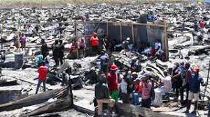
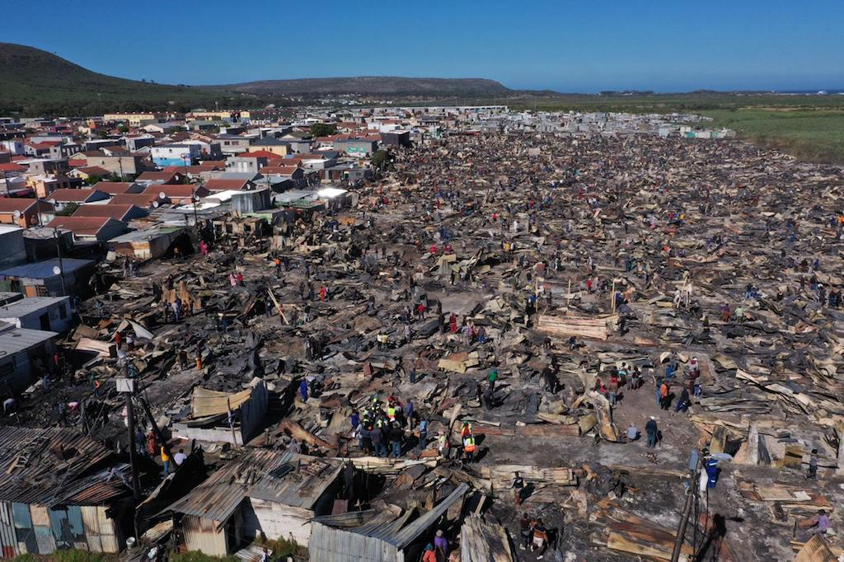
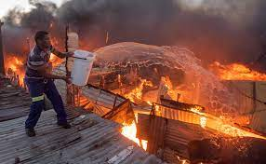
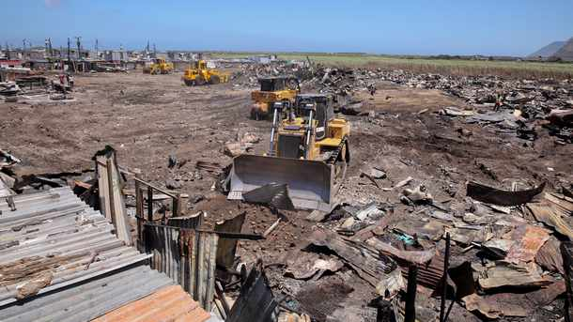
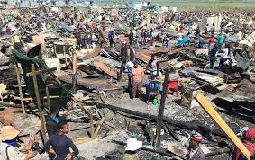
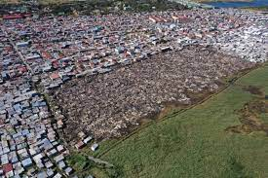
1.c Masiphumelele Before The Intervention

Slide 45
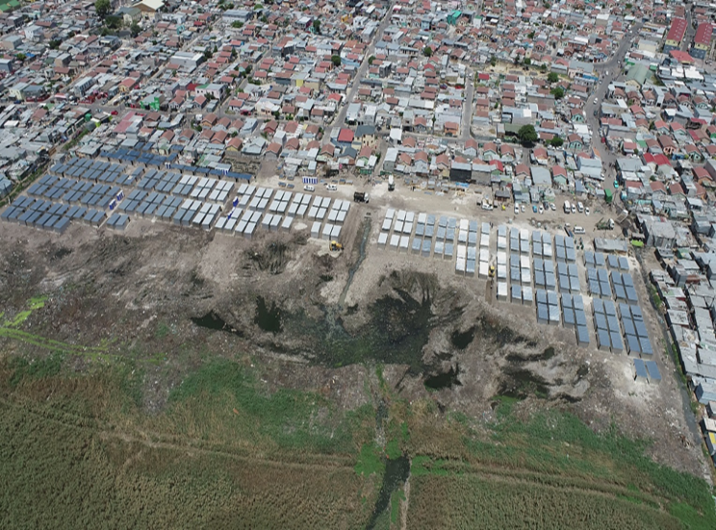
2.3 Precinct 1 (Phase 1) – Burnt Site, Planned 401 units of 18m²- Completed
Planned Start Date: 07 January 2021
Actual Start Date: 13 January 2021
Planned completion Date: 08 February 2021
Revised completion date: 17 February 2021
Planned layout: 656 units
Revised layout: 401 units (occupied)
Due to spacing and wetland approaching on dry land, this had led to capacity of the land to reduce significantly and over areas originally intended for re-settlement of fire victims. The number of structures to be provided for was reduced from 650 to 401.
Local employment: 46 EPWP & 4 CLOs
Interim services: 15 x water standpipes at ratio of 1:25 & 25 chemical toilets at a ratio of 1:5. CoCT in progress with the installing the outstanding services

Slide 46
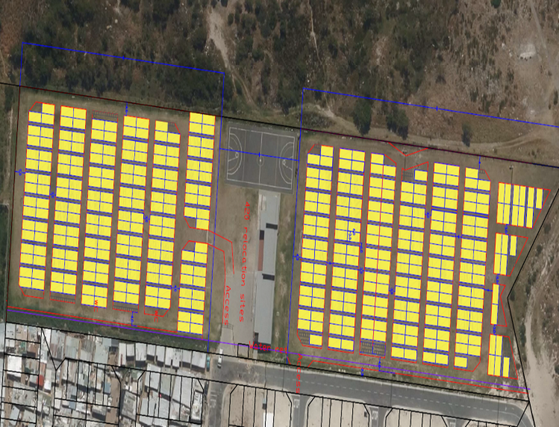
2.4 Precinct 1 (Phase 2) – Sport field, planned 420 units of 18m² – Implementation Stage.
Planned Start Date: 09 February 2021
Actual Start Date: 09 March 2021
Planned completion Date: 20 February 2021
Revised completion date: 15 April 2021
Planned layout: 420 units
Constructed: 499 units on site
499 allocated
499 units occupied
39 with no numbers/boarders to be resolved
Interim services: Under construction

Slide 47
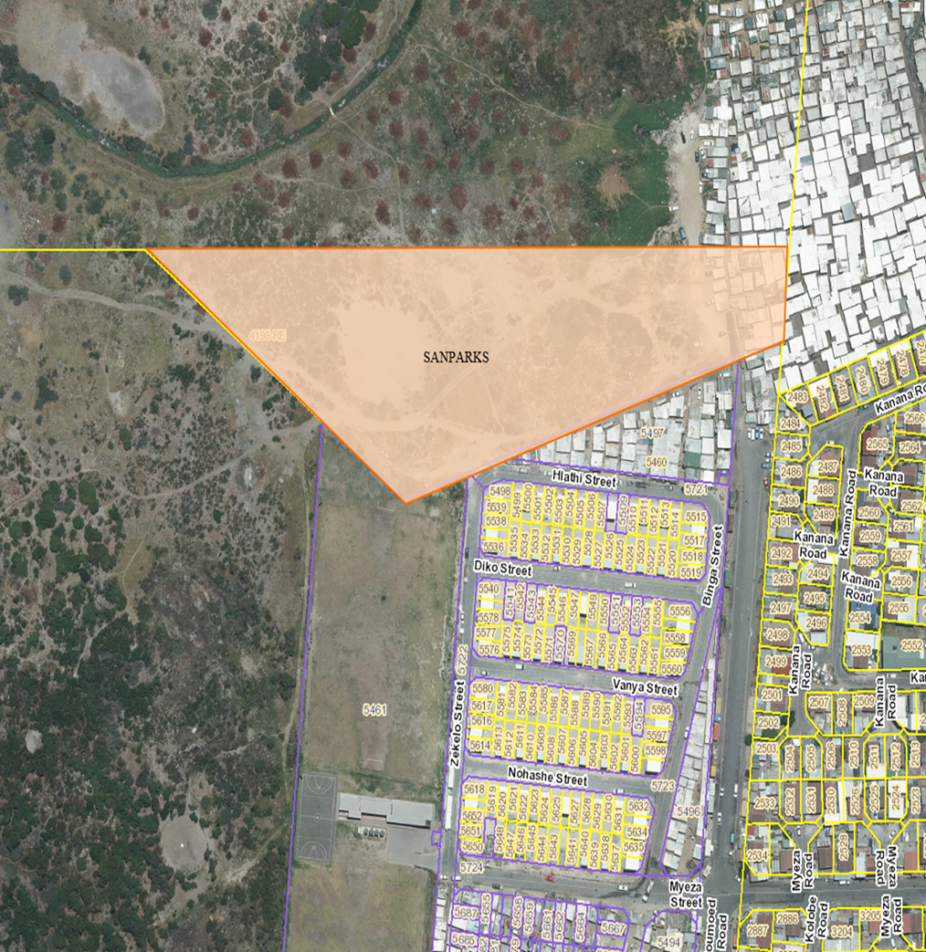
2.5 Precinct 3 – Precinct 2 (Medium – Long term solution) – Erf 5131, Planned 2748 units Double @ 26m² (Extended)
Town planning approval application were submitted on the 21st of February 2021 and the advertisement is schedule for the 24 April 2021. According to the current programme, it is envisaged that the EIA approval will be granted on the 21st of October 2021.
A formal request for the donation of 1.8ha of the remainder of erf 4198, Kommetjie for the purpose of Human Settlement development, was submitted to SANPARKS on the 10th of February 2021 by the Housing Development Agency.
Street names finalized by Steering Committee and submitted as part of the planning process.

Slide 48
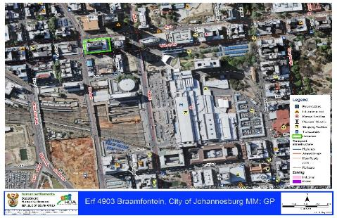
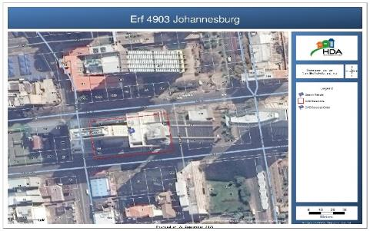
Braamfontein Site Details
Erf 4903 Johannesburg
Province | Gaunteng
Municipality | City of Joburg
Suburb | Braamfontein
Size | 0.3721 hactares
Zoning | Business 1
Development Status | Block of offices
Land Use | Unoccupied building
Municipal Value | R127,800,000
Market Value
Access To Basic Services | Fully serviced
Site Specifications | The building consists of 16 floors and 200 parking bays. The super structure and the interior of the building is of acceptable and usable standard. The building is within the Braamfontein area close to all amenities and surrounded with educational facilities.
Proposed development | Social Housing

Slide 49
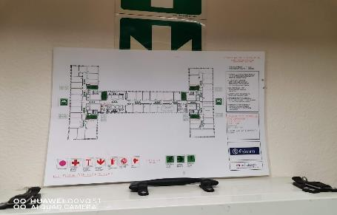
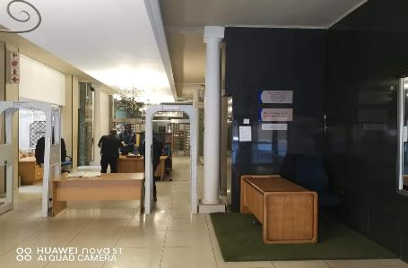
Braamfontein Site Pictures

Slide 50
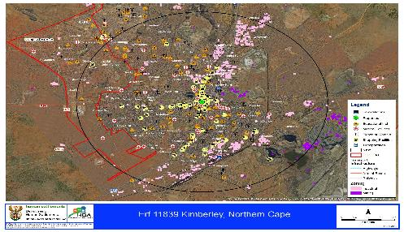
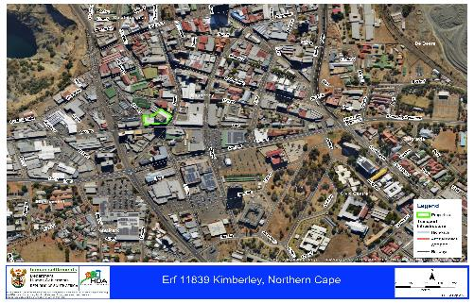
Kimberley Site Details
Erf 11839 Kimberley
Province | Northern Cape
Municipality | Sol Plaatje LM
Suburb | Kimberley
Size | 0.2891 hactares
Zoning | Business 1
Development Status | High-rise office building
Land Use | Unoccupied building
Municipal Value | R48,500,000
Market Value
Access To Basic Services | Fully serviced
Site Specifications | The building consists of 12 floors. The super structure and the interior of the building is of acceptable and usable standard. The building is within the Kimberley CBD area close to all amenities and 650 metres from the University.
Proposed development | Student Accommodation /CRU

Slide 51
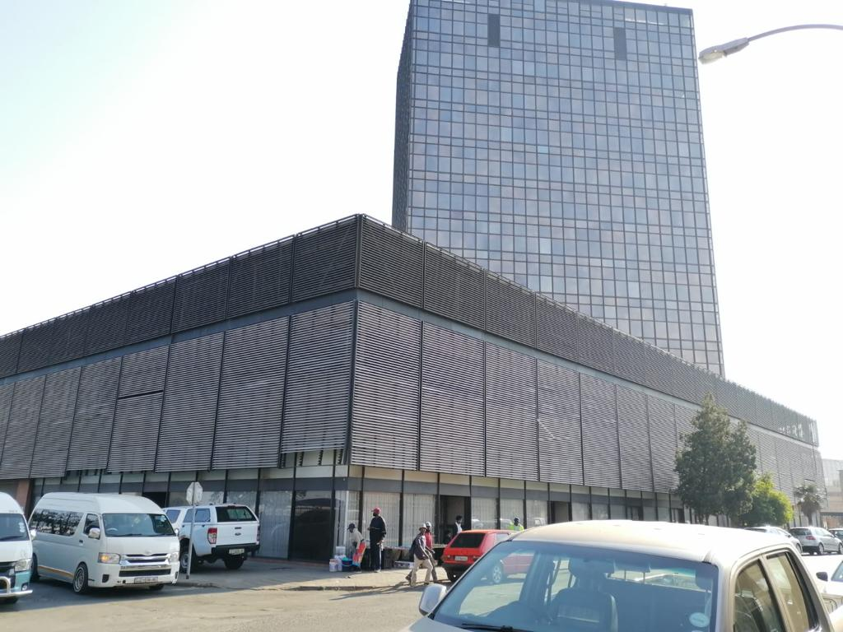
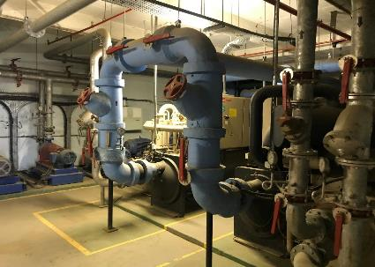
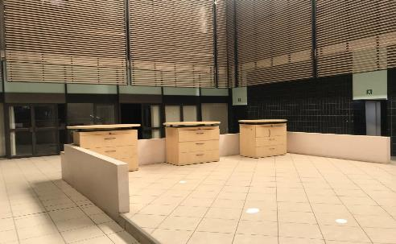
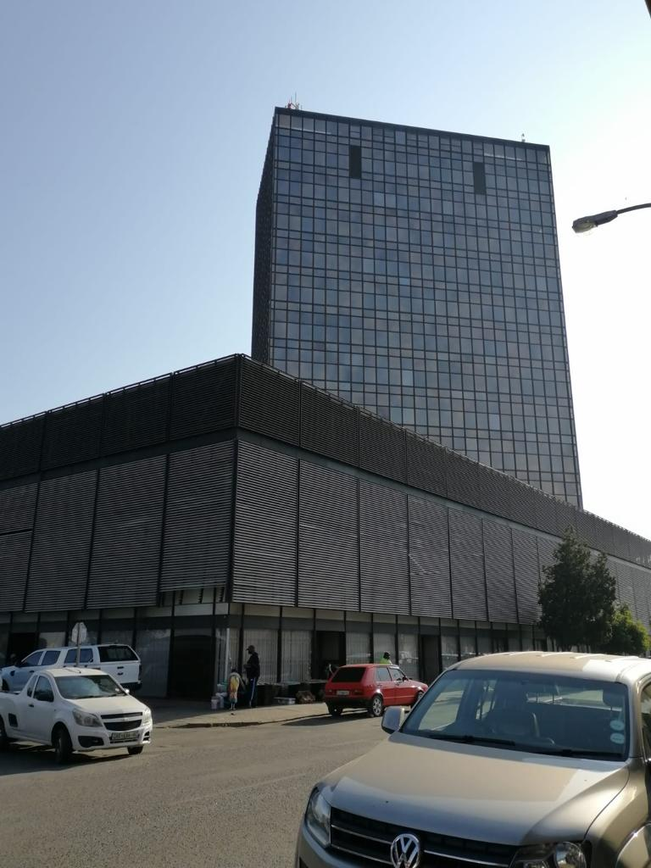
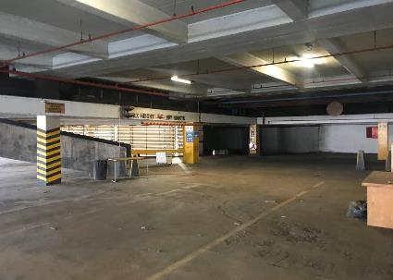
Kimberley Site Pictures

Slide 52
the Portfolio Committee on Human Settlements, Water and Sanitation to note the 1. 2021/22 Strategic Plan and 2. 2021/22 Annual Performance Plan of the HDA.
RECOMMENDATIONS
Portfolio Committee on Human Settlements, Water and Sanitation to note the following:
1. The 2021/22- 2024-2025 Strategic Plan of the HDA
2. The 2021/22 Annual Performance Plan of the HDA.

