Slide 2
PRESENTATION TO PORTFOLIO COMMITTEE: MINERAL RESOURCES AND ENERGY
BASIC FUEL PRICE (BFP)
12 APRIL 2021

Slide 3
PRESENTATION OUTLINE
Introduction
Policy position and key pricing mechanism
The Basic Fuel Price (BFP) for liquid fuels – International Factors
Local Factors included in the Prices of Fuel Prices
Fuel Price Breakdown Structure
Regulatory Accounting System (RAS)
Recap
Frequently asked questions
End

Slide 4
INTRODUCTION
Three basic forms of fuel pricing globally
Ad hoc pricing - Prices set irregularly, No transparency – common in countries that have own oil (highly subsidized)
{It is an illusion – keeping the prices constant even when the markets are bullish, hoping that the prices will go down e.g. Bolivia.}
Formula based / automatic pricing adjustments – Prices are published (but not the formulas in some countries) e.g. RSA publish both prices and the formula
Liberalised pricing system – the market set the prices (depoliticized) but there is a formula e.g. Australia.
{The Australian Competition and Consumer Commission (ACCC) act as a watchdog to ensure that there is no price collusion}

Slide 5
POLICY POSITION AND KEY PRICING MECHANISM
Regulation of liquid fuels prices
Petrol, diesel and illuminating paraffin (IP)
Liquefied Petroleum Gas (LPGas) for households since 14 July 2010
Import parity principle (IPP) applies
Dfn: IPP is the price an importer has to pay to purchase a product in the world market and have it delivered for domestic sale.
Deemed pricing
Zonal pricing – magisterial district zones (MDZ)
Transport modes – based on least cost mode
Cost recovery - Pass through cost

Slide 6
POLICY POSITION AND KEY PRICING MECHANISM…
Regulatory Mandate
Energy White Paper on Energy Policy of November 1998
Petroleum Products Act, 1977 (Act No.120 of 1977);
Central Energy Fund Act, 1977 (Act No. 38 of 1977);
Gas Act, 2001 (Act No. 48 of 2001);
Petroleum Pipelines Act, 2003 (Act No.60 of 2003);
Gas Regulator Levies Act, 2002 (Act No. 75 of 2002);
Petroleum Pipelines Levies Act, 2004 (Act No. 28 of 2004);
National Energy Regulator Act, 2004 (Act No. 40 of 2004); and
National Energy Act, 2008 (Act No. 34 of 2008)

Slide 7
THE BASIC FUEL PRICE (BFP) FOR LIQUID FUELS
The Basic Fuel Price (BFP) is based on the import parity pricing principle i.e. what is would cost a South African importer of petrol to buy the petrol from an international refinery, transport the product from that refinery, insure the product against losses at sea and land the product on South African shores.
NB: The Central Energy Fund (CEF) (Pty) Ltd was appointed by Cabinet in 1994 as an impartial body to determine BFP (prevent manipulation by any interested party)
Daily and average monthly BFP for price regulated fuels are calculated by (CEF) in terms of the Working Rules to administer the BFP
Monthly BFP calculations, price changes to be effected and monthly Fuel Price Media Statement audited by independent auditors appointed by the DMRE

Slide 8
THE BASIC FUEL PRICE (BFP) FOR LIQUID FUELS …
Basic Fuel Price Working Rules
Make provision for all grades of petrol, all grades of diesel and illuminating paraffin (IP)
BFP is adjusted on the first Wednesday of a month
Over/under recoveries incurred in a fuel price review period are cleared in the next one
Important months
April – transport tariffs, fuel levy and RAF adjustments
September – Forecourts attendants wage adjustments
December – wholesale and retail margins adjustments including secondary storage and transport
Quarterly – Octane differential adjustments

Slide 9
THE BASIC FUEL PRICE (BFP) FOR LIQUID FUELS …
Elements of the BFP
Free-on-Board (FOB) - value
Freight and Average Freight Rate
Insurance
Ocean loss
Demurrage
Cargo Dues
Coastal Storage
Stock Financing costs

Slide 10
THE BASIC FUEL PRICE (BFP) FOR LIQUID FUELS …
Elements of the BFP
Free-on-Board (FOB)
Platts: A price reporting agency. Mean quoted FOB-values used
Petrol: 50% MED (USD/ton)+50% Singapore (USD/bbl)
Diesel: 50% MED (USD/ton)+50% AG (USD/bbl)
IP: 50% MED (USD/ton)+50% Singapore (USD/bbl)
NB: Argus and Bloomberg are other agencies

Slide 11
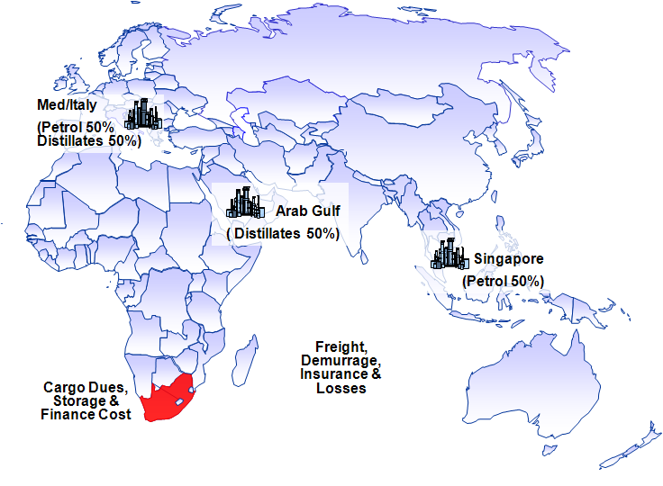
THE BASIC FUEL PRICE (BFP) FOR LIQUID FUELS … REFERENCE MARKETS

Slide 12
THE BASIC FUEL PRICE (BFP) FOR LIQUID FUELS …
Elements of BFP
Freight and Average Freight Rate
London Tanker Brokers Panel
MR Vessel: 35,000 to 39,999 tons
Average of 37,499.5 tons used in calculation
Freight costs:
Petrol: 50% Med+50% Singapore
Diesel: 50% Singapore+50% AG
IP: 50% MED+50% AG
NB: 15% premium to supply RSA

Slide 13
THE BASIC FUEL PRICE (BFP) FOR LIQUID FUELS …
Elements of BFP
Insurance Ocean Loss and Cargo Dues
Insurance=0.15% of (FOB-value+ Freight)
CIF-value=[Costs(FOB)+Insurance]+Freight
Ocean Loss= 0.3% of CIF-value
Cargo dues= Tariff set by the National Ports Authority

Slide 14
THE BASIC FUEL PRICE (BFP) FOR LIQUID FUELS …
Elements of BFP
Demurrage
Demurrage is the time spent in a harbour to load and discharge a cargo - hourly rent of vessel, but not operating
Demurrage rate: World Freight Rate Association
Rate for petrol:50%MED+50% Singapore
Rate for diesel and IP: 50% Singapore+50% AG
Days allowed: 3 days in total

Slide 15
THE BASIC FUEL PRICE (BFP) FOR LIQUID FUELS …
Elements of BFP
Coastal Storage and Financing
Assessed at $3/bbl or 2.5 SA c/l per month
25 days allowed for storage =2.038 SA c/l
Adjusted annually in line with the movement in the Producer Price Index (PPI)
{CS=PPIn/PPIb*2.083 c/l}
Interest rate: Standard Bank’s prime interest rate less 2%
SFC= [LCV*(PR-2)*25/365]
LCV: Landed Cost Value
PR: Prime Interest Rate

Slide 16
OTHER INTERNATIONAL FACTORS THAT INFLUENCE THE BFP
International crude oil prices
International product supply/demand balances
Product inventory levels
Geo-politics
Rand/US Dollar exchange rate
International refining margins
Weather patterns in the Northern Hemisphere
NB: CEF website: www.cefgroup.co.za

Slide 17
SUMMARY OF INTERNATIONAL FACTORS
Average exchange rate: USD1=R14.98
Average FOB: 630.146 c/l
Freight rate and AFRA: 23.316 c/l
Demurrage: 0.853 c/l
Insurance: 1.017 c/l
Ocean Leakage: 2.036 c/l
Cargo dues: 3.244 c/l
Coastal Storage: 5.673 c/l
Stock financing costs: 3.749 c/l
International conversion factors used

Slide 18
LOCAL FACTORS INCLUDED IN THE FUEL PRICES
Fuel Levies (1)
Petroleum products levy: to reimburse the pipeline users for the applicable NERSA tariff on transporting fuel through the pipeline - levy set by the Ministers of Energy and of Finance in line with the expenditure budget of NERSA
IP Tracer dye levy: to reimburse the oil industry for buying IP tracer dye and to inject it into IP to curtail the mixing of IP and diesel (loss to the Fiscus)
Slate levy: to finance the cumulative under recovery of the industry. Only applicable when the cumulative Slate balance exceeds R250 million (under recovery)

Slide 19
LOCAL FACTORS INCLUDED IN THE FUEL PRICES…
Fuel Levies (2)
Fuel levy: Tax levied by Government (Minister of Finance)
Custom and Exercise levy: a duty collected in terms of the Customs Union Agreement
Road Accident Fund (RAF) levy: To compensate for people involved in vehicle accidents.
Demand Side Management levy (DSML): Introduced in 2006 to curtail the use of ULP 95 in the inland market.

Slide 20
FUEL PRICE BREAKDOWN STRUCTURE – PETROL & DIESEL
 | Petrol 95 ULP (c/l) | Petrol 93 ULP (c/l) | Diesel 0.05% S (c/l) | Diesel 0.005% S (c/l) | IP (c/l)
Wholesale margin | 40,500 | 40,500 | 77,660 | 77,660 | 77,660
Secondary Storage | 27,200 | 27,200 | 27,200 | 27,200 | 27,200
Secondary Distribution | 15,800 | 15,800 | 15,800 | 15,800 | 15,800
Router Differential | 0,000 | 0,000 | 0,000 | 0,000 | 7,400
Retail margin | 221,600 | 221,600 | 0,000 | 0,000 | 0,000
Zone differential in Gauteng | 64,900 | 64,900 | 64,900 | 64,900 | 85,300
IP Tracer levy | 0,000 | 0,000 | 0,100 | 0,100 | 0,000
Fuel levy | 393,000 | 393,000 | 379,000 | 379,000 | 0,000
Customs & excise duty | 4,000 | 4,000 | 4,000 | 4,000 | 0,000
RAF levy | 218,000 | 218,000 | 218,000 | 218,000 | 0,000
Petroleum Products levy | 0,330 | 0,330 | 0,330 | 0,330 | 0,000
Slate levy | 0,000 | 0,000 | 0,000 | 0,000 | 0,000
DSML | 10,000 | 0,000 | 0,000 | 0,000 | 0,000
Pump Rounding | 0,500 | 0,500
Sub-total | 995,830 | 985,830 | 786,990 | 786,990 | 213,360
Basic Fuel Price Contribution | 636,170 | 629,170 | 625,430 | 629,830 | 632,328
Retail Price | 1 632,00 | 1 615,00
Wholesale price |  |  | 1 412,420 | 1 416,820 | 845,688

Slide 21
FUEL PRICE BREAKDOWN STRUCTURE - ILLUMINATING PARAFFIN (IP)
Price Component | Cents per litre
Basic Fuel Price | 632.33
Wholesale Margin | 77.66
Service Differential | 43.00
Router Differential | 7.40
Transport costs | 85.30
Sub-Total | 845.69
Retail Margin (33.3% of Sub-Total) | 281.62
SMNRP | 1127.31

Slide 22
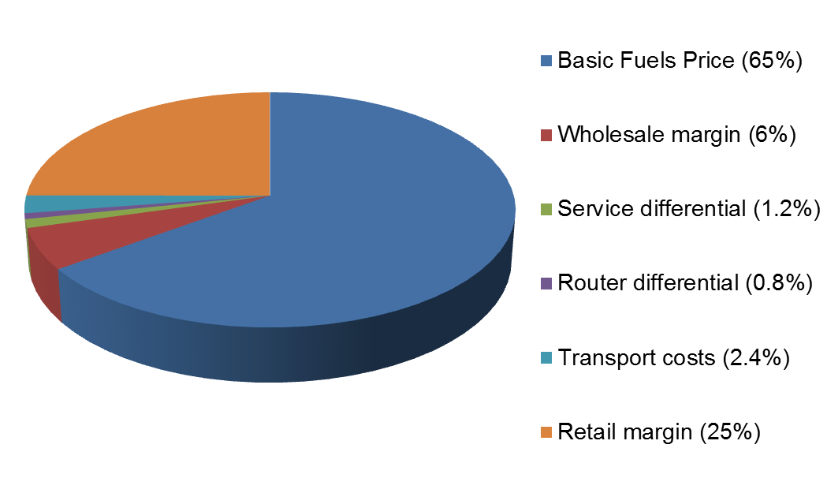
FUEL PRICE BREAKDOWN STRUCTURE - ILLUMINATING PARAFFIN … Illuminating Paraffin Pie Diagram

Slide 23
FUEL PRICE BREAKDOWN STRUCTURE - MAXIMUM RETAIL PRICE OF LIQUEFIED PETROLEUM GAS (LPGAS)
 | Coast | Inland
Price Element | Zone 1A | Zone 9C
Maximum refinery gate price | 1 137,895 | 1 137,895
Primary transport costs | 47,588 | 225,582
Operating expenses | 464,757 | 464,757
Working capital | 35,228 | 35,228
Depreciation | 173,648 | 173,648
Gross margin: Cylinder –filling plant | 221,883 | 221,883
Subtotal (1) | 2 080,999 | 2 258,993
Retail Margin: (15% of Subtotal (1)) | 312,150 | 338,849
Subtotal (2) | 2 393,149 | 2 597,842
Value Added Tax (15% Subtotal (2)) | 358,972 | 389,676
Maximum Retail Price (Rounded to full cents | 2 752,000 | 2 988,000

Slide 24
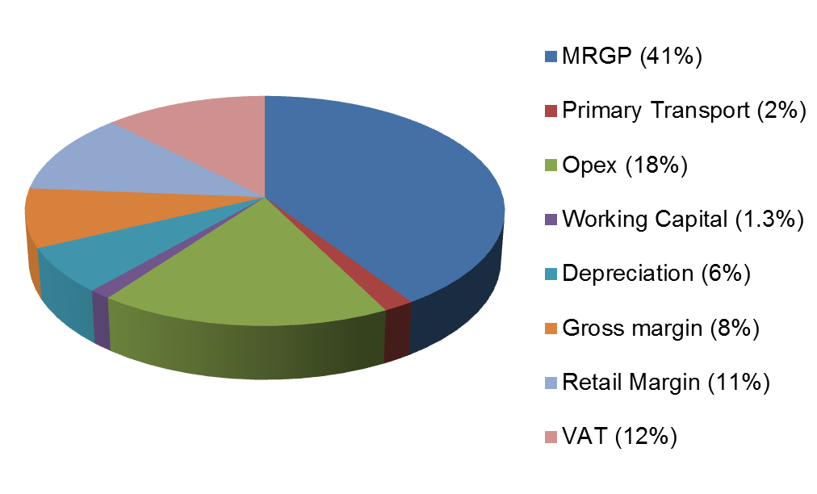
FUEL PRICE BREAKDOWN STRUCTURE - MAXIMUM RETAIL PRICE OF LIQUEFIED PETROLEUM GAS (LPGAS) LPGas Pie Diagram

Slide 25
REGULATORY ACCOUNTING SYSTEM (RAS)
Margins on activities are based on Regulatory Accounts
Activities post-refinery gate are ring-fenced
Assets, costs and ROA are ring-fenced to that activity – ABC methodology
CAPM and WACC are applied to determine the ROA of each activity
Identified activities were:
Wholesale activities
Secondary storage
Secondary distribution
Service station retail activities (BSS)

Slide 26
RECAP
Petrol is regulated at retail level
Diesel is not regulated, the Department publishes the wholesale reference price
Illuminating Paraffin is regulated at retail level (SMNRP)
LPGas is regulated at Retail level and the MRGP is determined by government
Industry margins are determined by using the Regulatory Accounting System (RAS) methodology

Slide 27
FREQUENTLY ASKED QUESTIONS (FAQS)
Why are the fuel prices changing every month?
What is over (under) recovery?
Why is petrol cheaper in neighboring countries and yet they purchase it from RSA?
Why is SASOL not selling petrol at lower prices because they produce it from coal?
Why is the government not deregulating fuel prices?
Why is ULP95 more expensive than ULP93 in GP, but the cost the same price in coastal areas?
7. Why is the government not buying oil from African countries at lower prices?

Slide 28
THANK YOU

