Slide 1
STATE OF READINESS FOR THE
2021 LOCAL GOVERNMENT ELECTIONS
PRESENTED TO:
PORTFOLIO COMMITTEE ON
COOPERATIVE GOVERNANCE AND TRADITIONAL AFFAIRS
DR KEVIN NAIDOO: 6 APRIL 2021

Slide 2
PRESENTATION OUTLINE
CONTENTS
Background Formulae for Number of Councillors Establishment of IMCoME MDB Activities IEC Activities (Dealt with by the IEC) Calling and Setting the Date for the Elections Legislative Amendments Guidance to Municipalities and Provinces (Pre- and Post- LGE) Recommendations

Slide 3
BACKGROUND;
FORMULAE;
IMCoME

Slide 4
BACKGROUND
Prior LGE held on –
  5 December 2000
  1 March 2006
  18 May 2011
  3 August 2016
  Next LGE must be held within 90 days of this date.
During June and July 2019, CoGTA approached Cabinet –
  Formulae for number of Councillors
  Establishment of the IMCoME and Technical IMCoME
Formulae for number of Councillors published by Minister in Gazette on 5 July 2019.

Slide 5
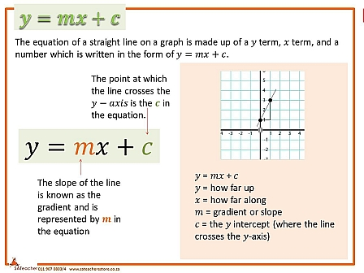
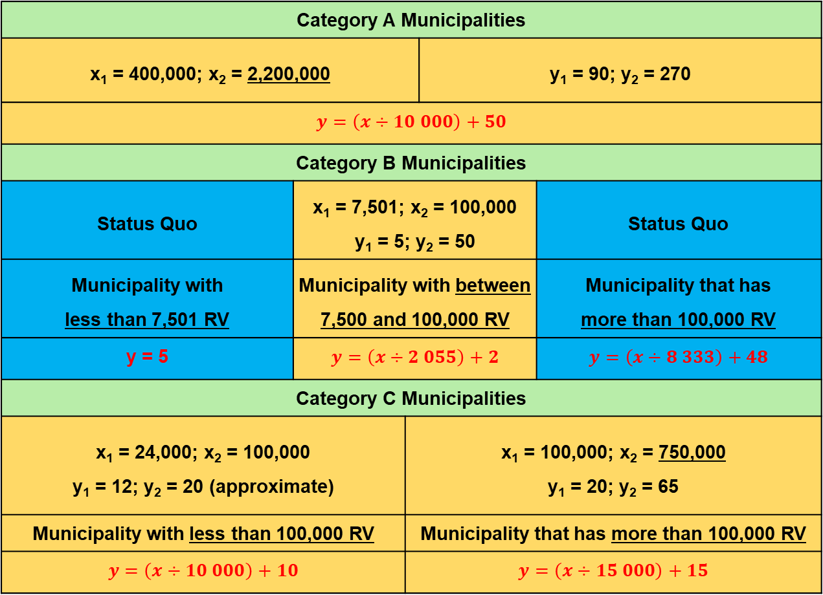
Formulae FOR NUMBER OF COUNCILLORS
Category A Municipalities
x₁ = 400,000; x₂ = 2,200,000 |  |  | y₁ = 90; y₂ = 270
$$y=\left(x÷10 000\right)+50$$
Category B Municipalities
Status Quo | x₁ = 7,501; x₂ = 100,000 y₁ = 5; y₂ = 50 |  |  | Status Quo
Municipality with less than 7,501 RV | Municipality with between 7,500 and 100,000 RV |  |  | Municipality that has more than 100,000 RV
y = 5 | $$y=\left(x÷2 055\right)+2$$ |  |  | $$y=\left(x÷8 333\right)+48$$
Category C Municipalities
x₁ = 24,000; x₂ = 100,000 y₁ = 12; y₂ = 20 (approximate) |  | x₁ = 100,000; x₂ = 750,000 y₁ = 20; y₂ = 65
Municipality with less than 100,000 RV |  | Municipality that has more than 100,000 RV
$$y=\left(x÷10 000\right)+10$$ |  | $$y=\left(x÷15 000\right)+15$$

Slide 6
FORMULAE FOR NUMBER Of COUNCILLORS
Pursuant to the publication of the formulae by the Minister, MECs published the number of councillors as follows:
NO. | PROVINCE | DATE PUBLISHED | COMMENTS
1. | Mpumalanga | 19 July 2019
2. | Limpopo | 28 July 2019
3. | North West | 28 July 2019 19 August 2019 | Rustenburg was gazetted with 91 Councillors. In terms of Structures Act, number must not be more 90 councillors, if it is a local or district municipality. Province re-gazetted on 19 August 2019.
4. | KwaZulu-Natal | 13 September 2019
5. | Gauteng | 13 September 2019
6. | Northern Cape | 20 September 2019
7. | Free State | 30 August 2019 14 February 2020 | Revised Notice published on 14 February 2020.
8. | Western Cape | 7 August 2019
9. | Eastern Cape | 21 August 2019

Slide 7
FORMULAE FOR NUMBER Of COUNCILLORS: results (2000 to 2021)
Category | Seat Type | 2006 | 2011 | 2016 | 2021 | % increase: 2016 to 2021
A | Ward | 538 | 709 | 740 | 742 | 0.3%
A | PR | 536 | 706 | 738 | 740 | 0.3%
B | Ward | 3,357 | 3,568 | 3,652 | 3,727 | 2.1%
B | PR | 3,289 | 3,451 | 3,516 | 3,586 | 2.0%
C | Direct (40%) | 640 | 654 | 655 | 674 | 2.9%
C | Appointed (60%) | 917 | 967 | 984 | 1,010 | 2.6%
C: DMA | DMA Seats | 20 | - | - | - | -
 | Total Seats | 9,297 | 10,055 | 10,285 | 10,479 | 1.9%
 | Total Councillors | 8,380 | 9,088 | 9,301 | 9,469 | 1.8%

Slide 8
ESTABLISHMENT OF IMCoME
Cabinet approved that the IMCoME, and the Technical IMCoME structures be established to oversee the arrangements for the preparations of the 2021 LGEs.
IMCoME is convened by the Minister of CoGTA and consists of the following Ministries:
  Ministry of Home Affairs
  Ministry of Justice and Correctional Services
  Ministry of Finance
  Ministry of Police
  Ministry of State Security
  Ministry of Defence
  Ministry of Communications
Chairperson of the IEC; President of SALGA; and Chairperson of MDB are also part of the IMCoME.
IMCoME met on 18 September 2020 and 25 March 2021.

Slide 9
ESTABLISHMENT OF TECHNICAL IMCoME
Technical IMCoME is convened by the Director-General of DCoG, and consists of the following organisations:
Technical IMCoME meetings were held on 17 June; 17 August; 23 November 2020; 15 February 2021 – next meeting on 10 May 2021.
Progress reports from the various work-streams towards preparations for 2021 LGE, were considered.
The following matters were discussed:
Update on the MDB and IEC Preparations for the 2021 LGEs
Report on Safety and Security Matters relating to 2021 LGEs
Communication Strategy for the 2021 LGEs
Department of Home Affairs Department of Justice and Constitutional Development National Treasury Department of State Security Department of Police | GCIS Statistics South Africa SALGA IEC MDB

Slide 10
PREPARATIONS BY THE MDB

Slide 11
PREPARATIONS BY THE MDB: WARD DELIMITATION
MDB undertakes ward delimitation prior to every LGE.
Process began in August 2019 to prepare draft boundaries.
Before end of March 2020, consultations on the draft boundaries were initiated in
5 Provinces (KZN, Limpopo, Eastern Cape, Western Cape and Gauteng).
Due to COVID-19, the engagement plans were reassessed - approach was separated into two batches.
  BATCH 1: entailed finalising most boundaries for those municipalities where the engagements (contact sessions) were to be held before end March 2020.
  BATCH 2: entailed finalising boundaries for the remaining municipalities, through virtual platforms.

Slide 12
PREPARATIONS BY THE MDB: WARD DELIMITATION
PROVINCE | DATE / PLANNED ENGAGEMENTS | NO. OF MUNICS | BATCH 1 | BATCH 2
Eastern Cape | 3 February to 18 March 2020 | 33 | 30 | 3
Free State | 1 to 30 April 2020 | 19 | 0 | 19
Gauteng | 12 to 31 March 2020 | 9 | 1 | 8
KwaZulu-Natal | 4 February to 25 March 2020 | 44 | 37 | 7
Limpopo | 1 to 23 April 2020 | 22 | 0 | 22
Mpumalanga | 4 February to 11 March 2020 | 17 | 17 | 0
Northern Cape | 1 to 28 April 2020 | 26 | 0 | 26
North West | 1 to 30 April 2020 | 18 | 0 | 18
Western Cape | 4 February to 17 March 2020 | 25 | 24 | 1
 | TOTAL | 213 | 109 | 104

Slide 13
PREPARATIONS BY THE MDB: WARD DELIMITATION (BATCH 1)
ACTIVITIES | TIMELINES
Board meeting to approve publication for objections | 22 July 2020
Publication for objections | 29 July to 12 August 2020
Closing date for objections | 12 to 26 August 2020
Ward delimitation committee meeting | 31 August 2020
Board meeting to consider objections and approval for final publication | 22 September 2020
Final publication | 25 to 30 September 2020
Handover of final wards to IEC | 30 September 2020

Slide 14
PREPARATIONS BY THE MDB: WARD DELIMITATION (BATCH 2)
ACTIVITIES | TIMELINES
Closing date for submissions | 30 July 2020
Board meeting to approve publication for objections | 22 September 2020
Publication for objections | 1 to 7 October 2020
Closing date for objections | 14 to 21 October 2020
Publish final ward boundaries | 30 November 2020
Media communication for publication of final ward boundaries | 1 December 2020
Handover of final wards to IEC | 1 December 2020

Slide 15
PREPARATIONS BY THE MDB: WARD DELIMITATION (BATCH 1 AND 2)
MDB provided draft wards to solicit views and submissions from communities and stakeholders.
There were two closing dates for this process:
  31 May 2020 for all Batch 1 municipalities; and
  31 July 2020 for all Batch 2 municipalities.
Submissions were received from individuals, community members, traditional leaders, political parties and other stakeholders.
MDB received 1,206 submissions at the end of the periods of submissions. Of the 1,206 submissions received, 368 (30,5%) were rejected and 838 (69,5%) were accepted and published for objections.
Publication of Gazettes for Batch 1 municipalities took place between 3 and 12 August 2020, and publications for Batch 2 municipalities took place between 1 and 7 October 2020.
MDB received a total of 1,465 objections - all objections were considered by the Board.
For all 4,468 wards published, 469 wards (10,5%) were re-configured / varied as a result of objections received, whilst 3,999 wards (89,5%) were confirmed as published.

Slide 16
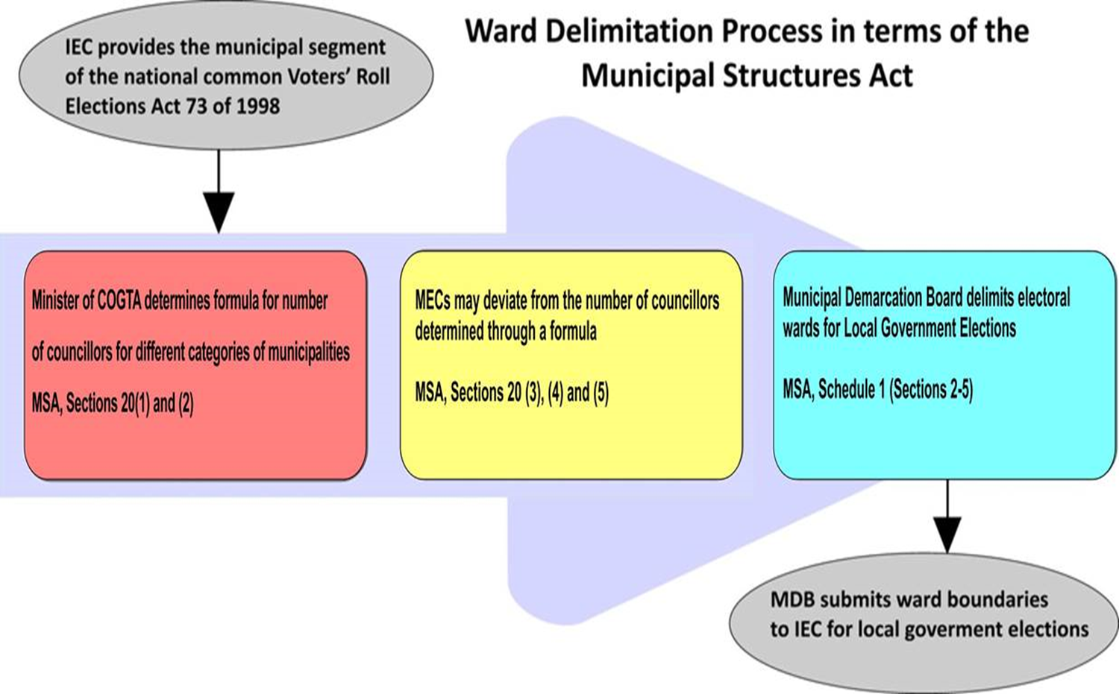
TO RECAP WARD DELIMITATION process …

Slide 17
CALLING / SETTING DATE FOR 2021 LGE

Slide 18
CALLING AND SETTING THE DATE FOR THE 2021 LGE
Section 24 of the Structures Act requires, the Minister, after consulting IEC, to call and set a date for an election of all municipal councils within 90 days of the expiry of the term of municipal councils.
Since last LGE was held on 3 August 2016, next LGE must be held between 3 August 2020 and
1 November 2021 – taking into consideration the 90 days period.
The following factors, amongst others, are considered when determining the date of the LGE:
  Voting day should occur on a Wednesday
  Avoid holding elections on school holidays/recess (Inland and Coastal Provinces)
  MDB hand over of final ward boundaries to the IEC
  Targeted voter registrations ahead of LGE
  Publication of the Election Timetable
  Registration of political parties at municipal level
  Constituting Political Party Liaison Committee
  Candidate nomination
Consultations have begun with the IEC.

Slide 19
LEGISLATIVE AMENDMENTS

Slide 20
LEGISLATIVE AMENDMENTS
Local Government: Municipal Structures Amendment Bill, 2021 was referred by the NCOP on
2 December 2020 to the National Assembly.
  Processed by the Portfolio Committee on CoGTA on 10 February 2021 (amendments unanimously agreed-to); report adopted by the Committee on 23 February 2021 – referred to the National Assembly. Was considered by the National Assembly on 16 March 2021.
  Amendments deal with various governance and electoral-related amendments.
  Has implications for 4 municipalities that have determined less than 10 Councillors – Laingsburg, Prince Albert, Kannaland, Renosterberg.
Local Government: Municipal Systems Amendment Bill, 2021 was referred to the NCOP on
2 December 2020.
  Bill was considered by the Select Committee on 16 February 2021 – referred to the Provincial Legislatures.
  Gauteng Provincial Legislature considered the Bill on 24 February 2021.
Bills, once enacted, will ensure that the new term of local government commences with legal certainty on various matters.
DCoG will also issue a Circular / Guideline to assist municipalities on various transition-related matters.

Slide 21
GUIDANCE / circular TO ASSIST MUNICIPALITIES
PRE-ELECTION MATTERS | POST-ELECTION MATTERS
Participation of staff members in the LGE; Non-returning councillors; Salaries, benefits and allowances; Municipal assets; Outstanding debts owed by councillors; Councillor pension benefits; Procurement-related matters; Preparation of hand-over reports; Preparations for the first council meeting: Preparation of information packs; Capacity building for municipal managers. | Integrated councillor induction programme; Code of Conduct for Councillors: ▪ Disclosure of interests; ▪ Personal gain; ▪ Declaration of interests; Salaries, allowances and benefits for newly-elected councillors; Employment contracts; Political rights of municipal managers and managers directly accountable to municipal managers; Employment of dismissed staff; Extension and renewal of existing employment contracts of senior managers; Performance management; Management of discipline; Premature termination of contracts; Development of staff establishments; Establishment of ward committees; Cost containment measures; and Offences and penalties.

Slide 22
COALITIONS / TYPES OF MUNICIPALITIES

Slide 23
COLLECTIVE EXECuTIVE TYPE OF MUNICIPALITY
“Another wild-card option is that the MEC in a province is permitted by section 16 of the Act to change the executive mayoral system to an executive committee system.
This would require the MEC for local government first at the commencement of the process to amend the system, to give written notice of the proposed amendment to organised local government in the province and any existing municipalities that may be affected by the amendment. The MEC would also have to consult organised local government in the province; and the existing municipalities affected by the amendment before doing so.
A change to an executive committee system is significant as it provides for a forced power sharing agreement between all parties represented in a municipal council in an executive committee in proportion to the seats held by each party in the council. To simplify slightly, this executive committee, comprising the parties in council in proportion to the number of seats they hold in council, will wield power in a similar manner than an executive mayor would otherwise wield power in an executive mayoral system.”
[Pierre de Vos, 8 August 2016] – Constitutionally Speaking

Slide 24
COLLECTIVE EXECutIVE TYPE OF MUNICIPALITY
“Under a collective executive system the mayor plays more of a ceremonial role, with the real executive power residing in the collective executive committee. That executive committee is elected by the full council and is a multi-party committee broadly reflecting party interests within the council.”
“The collective executive system has inherent in its structure the necessary checks and balances to ensure that it is more difficult for the majority party to ride roughshod over the views of minority parties and interests. Important policy issues are more thoroughly debated and meetings are inherently transparent. Public participation is enhanced. This does not remove the potential for cronyism and corruption, but certainly makes it more difficult for miscreants to flourish.”
“Alternatively, if there is not the necessary will on the part of the main political parties, the Municipal Structures Act could be amended to remove the executive mayoral option and make the collective executive system mandatory.”
“An outcome would be far less volatile municipalities and a more efficient and effective local governance system. The ultimate beneficiaries of such a shift would be the communities and residents served by our municipalities.”
Michael Evans of Webber Wentzel [Daily Maverick, 25 June 2018]

Slide 25
COALITIONS: post the 2016 lge

Slide 26
COLLECTIVE EXECutiVE TYPE OF MUNICIPALITY
Section 43 (of the LG: Municipal Structures, as amended):
Composition of executive committees (EXCO)
Section 43(1) be amended as follows by:­
“elect” replaced with the word “determine”.
an insertion after the words “20 per cent of the councillors” with “(fractions to be disregarded)”.
Section 43(2) and (3) be replaced with a NEW subsection 43(2):
  The award of seats on the EXCO to political parties or political interests must be determined in the following manner-
  The number of seats won by a political party or political interest divided by the total number of councillors determined for that municipality in terms of Section 12(e) and multiplied by the number of seats on the EXCO;
  If the calculation in subparagraph (a) gives a surplus, that surplus must compete with other similar surpluses, and be awarded to the highest surplus;
  If there is an equality of the surpluses, the result must be determined by lot;
  The political party or political interest to which seats are allocated to on the EXCO must nominate their representatives to occupy such seats;
  Nothing precludes a political party or political interest from nominating a councillor from another political party or political interest to one or more of its allocated seats; and
  In the event of a vacancy arising on the EXCO, the political party or political interest to which the seat was allocated to will nominate a councillor to fill that vacancy.

Slide 27


COLLECTIVE EXECutiVE TYPE OF MUNICIPALITY
Municipality XYZ has 61 Cllrs, distributed as follows amongst three Political Parties: Party A – 52; Party B – 3; Party C – 2; Other Parties – 4. Size of EXCO: 20% or ≤ 10 – in this case, EXCO is 10.
OPTION 1: |  |  | OPTION 2: |  |  | PROPOSED AMENDMENT
Allocation: [Seats ÷ Quota] Quota (Q) = [Seats ÷ Size of EXCO] + 1 Q = [61 ÷ 10) + 1 Q = 6.1 + 1 Q = 7.1 (Rounded-off to 7) Q = 7 |  |  | Allocation: [Seats ÷ Quota] Quota = [Seats ÷ Size of EXCO] Q = [61 ÷ 10) Q = 6.1 (Rounded-off to 6) Q = 6 |  |  | NO QUOTA! Allocation: [Seats ÷ Total # of Cllrs] X Size of EXCO
ALLOCATION OF SEATS |  |  | ALLOCATION OF SEATS |  |  | ALLOCATION OF SEATS
A: (52 ÷ 7) | 7.42 | 8 | A: (52 ÷ 6) | 8.6 | 9 | A: (52 ÷ 61) X 10 | 8.52 | 9
B: (3 ÷ 7) | 0.42 | 1 | B: (3 ÷ 6) | 0.5 | 1 | B: (3 ÷ 61) X 10 | 0.49 | 1
C: (2 ÷ 7) | 0.28 | 1 | C: (2 ÷ 6) | 0.3 | 0 | C: (2 ÷ 61) X 10 | 0.32 | 0
TOTAL |  | 10 | TOTAL |  | 10 | TOTAL |  | 10

Slide 28
COLLECTIVE EXECuTIVE TYPE OF MUNICIPALITY
Section 155(2) of the Constitution states that national legislation must define the different types of municipality that may be established within each category (that is, A, B or C) – LG: Municipal Structures Act.
Section 155(5) of the Constitution provides that provincial legislation must determine the different types of municipality to be established in the province.
Original Section 13 of the LG: Municipal Structures Act – Constitutional Court declared inconsistent with the Constitution, and invalid (October 1999).

Slide 29
RECOMMENDATIONS

Slide 30
recommendations
  It is recommended that the Portfolio Committee:
  Notes the preparations being made for the 2021 LGE;
  Notes that DCoG, Provincial CoGTAs and SALGA, through various structures and forums, are engaging and preparing for the 2021 LGE.

Slide 31
119
DAYS TO THE END OF TERM 4!

