Slide 1

UPDATE ON THE WARD DELIMITATION PROCESS
06 APRIL 2021
PORTFOLIO COMMITTEE OF COGTA
WARD DELIMITATION 2019-2020
Mr Thabo Manyoni
Chairperson: Municipal Demarcation Board

Slide 2
presentation LAYOUT
  MANDATE
  INTRODUCTION AND BACKGROUND
  WARD DELIMITATION PROCESS
  STATUS OF WARD DELIMITATION PROCESS
  ANALYSIS OF 2021 WARDS
  IMPACT OF MUNICIPAL STRUCTURES AMENDMENT BILL ON THE MDB.
  CONCLUSION
2

Slide 3
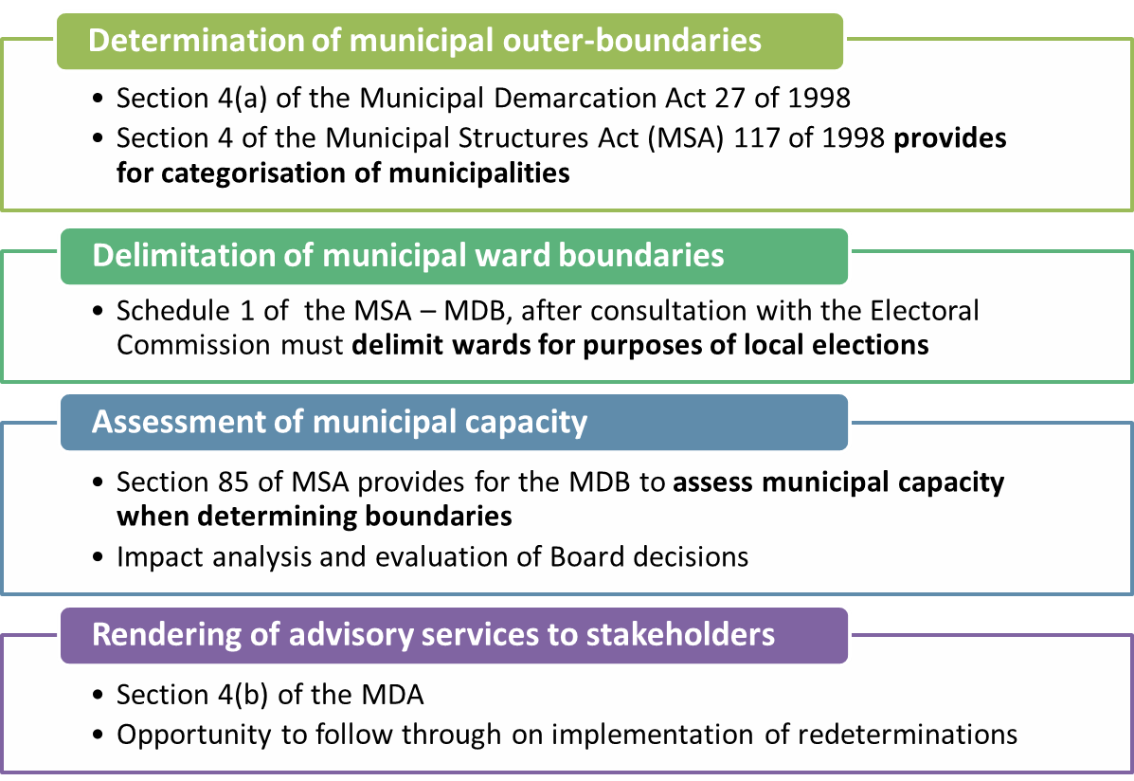
MANDATE AND LEGISLATIVE FRAMEWORK

Slide 4
INTRODUCTION AND Background
The Municipal Demarcation Board (MDB) delimits wards in metropolitan and local municipalities for electoral purposes.
The MDB commenced the process in 2019. Although the project was interrupted in 2020 after the outbreak of Covid 19, the process was completed in November 2020.
The wards were handed over to the IEC to start preparing for the Local government elections.

Slide 5
INTRODUCTION AND Background (Cont..)
When the Minister declared the Covid-19 disaster, the Board had the public engagement completed in 5 Provinces.
These were in the following provinces: Mpumalanga (in all munics), KwaZulu Natal (in all LMs except 7), Eastern Cape ( in all LMs except 3), Western Cape (in all LMs except 1) and Gauteng (in one LM except 8 ie. Ekurhuleni).
The programme was amended by postponing the final handover of wards to the IEC from August as initially planned to November 2020.
That allowed remaining municipalities, mainly in Four Provinces (including outstanding municipalities not consulted as noted in par. 5 above), more time to provide inputs to the draft sets of wards already shared with municipalities in November 2019.

Slide 6
ENGAGEMENT WITH CRITICAL STAKEHOLDERs
The MDB engaged and consulted with the following stakeholders :
  Portfolio Committees of COGTA;
  MuniMECs;
  National House of Traditional Leaders, Provincial Houses of Traditional Leaders;
  Several SALGA structures;
  IEC Party Liaison structures;
  NCOP in Limpopo and Northern Cape visits;
  Conducted awareness and education campaign in municipalities;
  Some communities and political parties;
  Technical consultations with municipal officials to prepare draft wards in municipalities;
  Portfolio Committee on Home Affairs (12 November 2020);
  Public consultations in EC, GT, KZN, MP and WC;
  Virtual meetings with Local Municipalities (Batch 2)

Slide 7
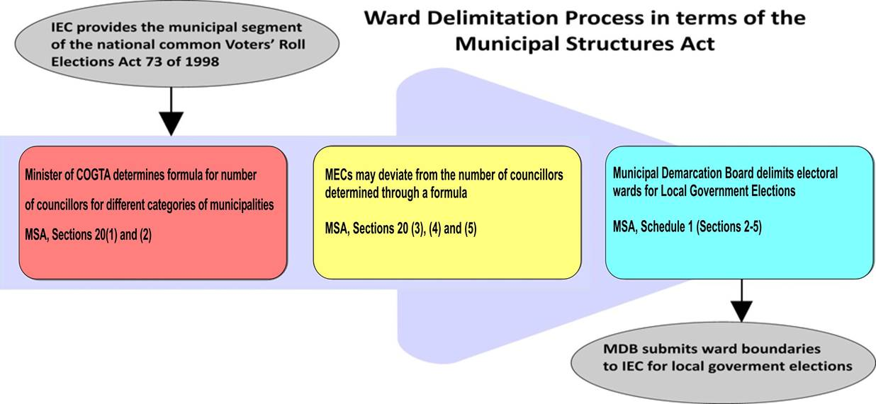
Ward delimitation process
The key legal requirements and milestones for the ward delimitation process are summarised as follows:

Slide 8
WARD DELIMITATION PROCESS (CONT..)
The IEC published the certified voters roll in March 2019, the Minister for COGTA determined and published the formula for determining the number of Cllrs.
Thereafter, MEC’s responsible for local government determined and published the number of councillors for municipalities in their respective provinces.
Utilising the number of councillors, as published by MECs, MDB calculated the norms for each municipality together with their variances, i.e. 15% below the norm (minimum) and 15% above the norm (maximum) allowable number of voters in each municipal ward.
That allowed the MDB in October 2019 to prepare draft wards to facilitate consultation with members of the public.

Slide 9
STATUS for THE ward delimitation PROCESS
PUBLIC CONSULTATIONS
In February 2020, public consultations began in Eastern Cape, Gauteng, Kwazulu Natal, Mpumalanga and Western Cape.
These were meant to be completed by the end of March 2020 with consultations in Northern Cape, Free State, North West and Limpopo scheduled for April 2020.
  Due to the lockdown, the MDB reviewed the ward delimitation programme to try allow more time to complete all outstanding public consultations. In view of the uncertainty of the circumstances regarding the spread of the Corona virus in the country, the MDB divided the municipalities into two groups i.e. Batch 1 and Batch 2:
    BATCH 1: where public meetings were completed (all municipalities in MP, majority in EC, KZN, WC, 1 in GT); and
    BATCH 2: municipalities where public meetings were cancelled (all municipalities in NW, LIM, NC, FS, 8 GT municipalities, a few in 7 KZN, 3 EC and 1 in WC)
A total 109 (Batch 1) public meetings were conducted before the programme was suspended and 104 (Batch 2) public meetings could not be carried out as reflected in the next slide.

Slide 10
STATUS for THE ward delimitation PROCESS (cont..)
Public Consultations AND IMPACT OF COVID 19
PROVINCE | DATE | STATUS
 |  | PLANNED MEETINGS | COMPLETED MEETINGS | DISCONTINUED MEETINGS
Eastern Cape | 03 FEB – 18 MAR 2020 | 33 | 30 | 3
Free State | 01 – 30 APR 2020 | 19 | 0 | 19
Gauteng | 12 – 31 MAR 2020 | 9 | 1 | 8
KwaZulu-Natal | 04 FEB – 25 MAR 2020 | 44 | 37 | 7
Limpopo | 01 – 23 APR 2020 | 22 | 0 | 22
Mpumalanga | 04 FEB – 11 MAR 2020 | 17 | 17 | 0
Northern Cape | 01 – 28 APR 2020 | 26 | 0 | 26
North West | 01 – 30 APR 2020 | 18 | 0 | 18
Western Cape | 04 FEB – 17 MAR 2020 | 25 | 24 | 1
 | TOTAL | 213 | 109 | 104

Slide 11
status for THE ward delimitation PROCESS (cont..)
Public Consultations AND IMPACT OF COVID 19
The MDB arranged virtual meetings for all outstanding 104 municipalities (Batch 2).
Municipalities took up the opportunity to arrange virtual meetings under difficult and uncertain conditions.

Slide 12
STATUS FOR THE ward delimitation PROCESS (cont..)
The MDB provided draft wards to solicit views and submissions from communities and stakeholders.
There were two closing dates for this process, one was the 31st May 2020 for all municipalities consulted before Covid-19 and 31st July 2020 for the municipalities that were consulted virtually.
Submissions were received from individuals, community members, traditional leaders, political parties and other stakeholders.
Overall the MDB received 1206 submissions as at the end of the periods of submissions.
Of the 1206 submissions received, 368 (30,5%) were rejected and 838 (69,5%) were accepted and thus taken to the publication for objections.

Slide 13
STATUS FOR THE ward delimitation PROCESS (cont..)
Publication for objections
Publication of Gazettes for municipalities where face to face consultation was done (Batch 1) took place between 03 and 12 August 2020 and publications for municipalities that were virtually consulted (Batch 2) took place between 01 and 07 October 2020.
The MDB received a total of 1465 objections. All objections were considered by the Board.
On average for all 4468 wards published, 469 (10,5%) wards were configured and were accordingly varied as a result of objections received, whilst 3999 (89,5%) wards were confirmed as published.

Slide 14
STATUS FOR THE ward delimitation PROCESS (cont..)
OUTCOMES OF CONSIDERATION OF OBJECTIONS PER PROVINCE
PROVINCE | TOTAL NO. OF OBJECTIONS RECEIVED | PERCENTAGE TO THE TOTAL
EASTERN CAPE | 275 | 18,8%
FREE STATE | 68 | 4,6%
GAUTENG | 51 | 3,5%
KWAZULU NATAL | 193 | 13,2%
LIMPOPO | 132 | 9,0%
MPUMALANGA | 540 | 36,9%
NORTH WEST | 90 | 6,1%
NORTHERN CAPE | 2 | 0,1%
WESTERN CAPE | 114 | 7,8%
TOTAL | 1465 | 100%

Slide 15
STATUS FOR THE ward delimitation PROCESS (cont..)
OUTCOMES OF CONSIDERATION OF OBJECTIONS PER PROVINCE
Province | Total Number of Wards | Published Wards confirmed | Wards varied | Percentage of Wards reconfigured or to be varied
Eastern Cape | 710 | 687 | 23 | 3%
Free State | 319 | 293 | 26 | 8%
Gauteng | 529 | 492 | 37 | 7%
KwaZulu-Natal | 901 | 731 | 170 | 19%
Limpopo | 568 | 535 | 33 | 6%
Mpumalanga | 400 | 339 | 61 | 15%
North West | 403 | 330 | 73 | 18%
Northern Cape | 232 | 222 | 10 | 4%
Western Cape | 406 | 370 | 36 | 9%
Total | 4468 | 3999 (90%) | 469 (10%)

Slide 16
STATUS FOR THE ward delimitation PROCESS (cont..)
OUTCOMES OF CONSIDERATION OF SUBMISSIONS/OBJECTIONS
Some submissions/Objections were rejected on the basis of, amongst others, the following:
Did not comply to the norm;
Created unnecessary split in voting districts;
Did not align or no consideration to physical features, where it is more feasible to do so to allow for a more visible boundary (e.g. rivers, valleys, roads etc.;
Proposing none contiguous wards;
Unnecessary split of communities (when a ward boundary can be located where it will not split a community and the ward is compliant to the norm, but an objection proposes a change that would result in a split of a community); and
Others e.g. affecting municipal boundaries, configurations with more wards than those determined.

Slide 17
STATUS for OVERALL WARD DELIMITATION plan
ACTIVITIES | TIMELINES | RESPONSIBILITY | STATUS
Publication for objections: Batch 1 | 29 July 2020 – 12 August 2020 | GPW | DONE
Batch 2 | 01 – 07 October 2020 | GPW | DONE
Board meeting to consider objections and approve final publication: Batch 1 | 23 September 2020 | MDB | DONE
Batch 2 | 24 November 2020 | MDB | DONE
Final Publication: Batch 1 | 01 – 07 October 2020 | GPW | DONE
Batch 2 | 27 November – 09 December 2020 | GPW | DONE
Handover of data for final wards to IEC: Batch 1 | 30 September 2020 | MDB | DONE
Batch 2 | 24-27 November 2020 | MDB | DONE
Official handover of final wards to IEC | 01 December 2020 | MDB | DONE

Slide 18
POTENTIAL RISK AREAS EMANATING FROM DEMARCATION PROCESSES
Before and during the process the MDB identified several potential risk areas.
The issues causing the concern range from, amongst others:
  Community dissatisfaction with municipal boundaries;
  Unresolved provincial boundary matters; and
  General dissatisfaction with MDB ward delimitation process and objections to final outcomes. The nature of these can be summarized as follows:
  communities who are unhappy with their areas not delimited into one ward, even though the number of registered voters in the area does not allow;
  unhappy that after their proposal was accommodated by the Board in publication for objections, the MDB changed the wards after considering the objections to what they do not want;
  complaints that they were not consulted before their final wards were delimited;
  Demand that their ward should be the same as it was in 2016, etc.

Slide 19
POTENTIAL RISK Areas emanating from demarcation process (CONT..)
PROV | MUNIC | DESCRIPTION OF MATTER | COMMENTS
EC | Ntabankulu Local Municipality | Community proposing Municipal Boundary affecting Ward 17 residents requesting to be moved to uMzimbvubu | The applicant has been notified that these will be dealt with after the LGE
EC | Buffalo City municipality | Ward boundary matter: Unhappy about the outcomes of ward delimitation (especially that their objections and related proposals for several wards e.g. ward 4, 8, 16, 37, 43 and a few more in Buffalo city were not accepted as they were non compliant to the criteria) | The MDB has responded to the complainants and provided them with information on the process that ensued including the rationale for the decisions thereof.
EC | Sakhisizwe Local Municipality | Cala University Students Association want to know if public engagements are still to take place in ward 6. | Details of the process and outcomes have been provided to the applicants
KZN | Msinga Local Municipality | Ward boundary matter: Dissatisfaction with the final ward 13 in Msinga municipality. | Details of the process and outcomes have been provided to the applicants and those aggrieved met with the Chairperson of the Board on 20 October 2021.
KZN | Ndwedwe Local Municipality | Ward boundary matter: Dissatisfaction with the consideration of objection and final ward boundaries for ward 3 and 11. | Details of the process and outcomes have been provided to the applicants and those aggrieved met with the Chairperson of the Board on 12 March 2021.
KZN | eThekwini Metropolitan Municipality | Complaint by hostel dwellers in ward 39 Kwa Mashu, They want to retain the ward as it was in 2016. However, their objection was submitted late | Details of the process and outcomes have been provided to the applicants and those aggrieved will be meeting with the Board on the 09 April 2021.

Slide 20
POTENTIAL RISK Areas emanating from demarcation process (CONT..)
PROV | MUNIC | DESCRIPTION OF MATTER | COMMENTS
KZN | eThekwini Metropolitan Municipality | Complaint by Mr DM Pillay of ward 68 in Merebank, Ethekwini. They want Merebank to be delimited into one ward. | MDB has responded and provided details of the process and outcomes including the rationale for the decisions thereof.
GT | Merafong Local Municipality | Complaints that they were not consulted before completion of ward 10. | The MDB responded detailing the process and a formal response was sent to the complainant to that effect.
LIM | Fetakgomo Tubatse Local Municipality | Municipal boundary matter: A demand for MDB to reverse amalgamation that took effect in 2016. | The applicant has been notified that these will be dealt with after the LGE
LIM | Makhado/Musina, Thulamela/Sollins Chabane Local Municipalities | Municipal boundary matter: A demand for MDB to reverse amalgamation, and disestablishment of Mutale that took effect in 2016. | The applicant has been notified that these will be dealt with after the LGE
NW | JB Marks Local Municipality | Municipal boundary matter: A demand for MDB to reverse amalgamation that took effect in 2016. | The applicant has been notified that these will be dealt with after the LGE
NW | Mafikeng Local Municipality | Complaint about considering objection and varying ward 6 and 28 | MDB has responded and provided details of the process and outcomes.
MP | City of Mbombela Local Municipality | Municipal boundary matter. Community demanding the reversal of an amalgamation of Mbombela and Umjindi municipality | The applicant has been notified that these will be dealt with after the LGE
MP | Thembisile Hani Local Municipality | A member of the community complaining that they were never consulted before ward 22 was finalised. | The MDB responded detailing the process and a formal response was sent to the complainant to that effect.
NC | Phokwane Local Municipality | Provincial boundary matter: The inclusion of Baga Mothibi area into NC | The matter is currently one of those under consideration by COGTA.

Slide 21
Analysis of 2021 Wards against 2016 Wards (CONT…)
Some of the assumptions made at the beginning of the process, were that the revised formula and a retention of the number wards as in the 2016 LGE could assist with retaining boundaries or spatial configuration for a higher number of wards, however the results demonstrates a different outcome:
Gauteng and Mpumalanga did not change the number of wards from 2016 LGE but were only able to retain boundaries for 37% and 23% respectively;
Limpopo only increased by 2 wards from 2016 and was able to retain 48% of its wards;
Eastern Cape and the North West had changes in some municipalities and were able to retain boundaries for 46% and 38% of their wards respectively;
KwaZulu-Natal, Free State and Western Cape had changes in some municipalities and were able to retain between 31% and 35% boundaries of their wards;
The Northern Cape had changes in 18 of the 26 municipalities and retained boundaries for only 10% of its wards.
Nationally, boundaries were retained for 1 605 (36%) of the 4 468 of wards.
This simply means that retaining the boundaries of the wards is almost impossible due to constant changes and variations in voter registration across the country.

Slide 22
Analysis of 2021 Wards against 2016 Wards
In an attempt to retain the wards for 2021:
The Minister revised the formulae and advised MEC to as far as possible maintain the 2016 Cllrs
Two provinces (MP and GP) retained the number of Cllrs as in 2016
MDB is usually accused of destabilising municipalities when delimiting wards. These are factors which amongst others influence the configuration of wards:
The formulae published by the Minister to determine the number of councillors;
The determination of councillors by the MEC’s;
The patterns of voter registration;
The norm provided as part of the ward delimitation criteria; and
Inputs from stakeholders and members of the public during the delimitation process.

Slide 23
Analysis of 2021 Wards against 2016 Wards (CONT…)
Province | Number of Wards 2016 | Number of Wards 2021 | Number of Wards that retained their 2016 boundaries | Percentage of Wards that retained their 2016 boundaries per Province | Percentage of Wards that maintained their 2016 boundaries Nationally
Eastern Cape | 705 | 710 | 327 | 46% | 7%
Free State | 309 | 319 | 105 | 33% | 2%
Gauteng | 529 | 529 | 196 | 37% | 4%
KwaZulu-Natal | 870 | 901 | 306 | 35% | 7%
Limpopo | 566 | 568 | 274 | 48% | 6%
Mpumalanga | 400 | 400 | 94 | 24% | 2%
North West | 407 | 403 | 154 | 38% | 3%
Northern Cape | 204 | 232 | 23 | 10% | 1%
Western Cape | 402 | 406 | 126 | 31% | 3%
Total | 4392 | 4468 | 1605 |  | 36%

Slide 24
Analysis of 2021 Wards against 2016 Wards (CONT…)
In trying to accommodate proposals from members of the community, the MDB at the end split a total of 1122 voting districts out of 22924 affecting a total of 1636 wards as reflected below:
Province | Number of Voting Districts | Number of Split Voting Districts | Number of Wards Affected by Split Voting Districts
Eastern Cape | 4791 | 63 | 103
Free State | 1529 | 86 | 132
Gauteng | 2771 | 159 | 246
KwaZulu-Natal | 4885 | 162 | 254
Limpopo | 3157 | 45 | 84
Mpumalanga | 1772 | 247 | 285
North West | 1733 | 117 | 197
Northern Cape | 707 | 72 | 118
Western Cape | 1579 | 171 | 217
Total | 22924 | 1122 (5%) | 1636

Slide 25
Analysis of 2021 Wards against 2016 Wards (CONT…)
The 2021 ward 12 in Nyandeni Local Municipality is retained as it was in 2016

Slide 26
Analysis of 2021 Wards against 2016 Wards (CONT…)
Nkakabidi Secondary School
Voting District split between ward 25 and 30 of Mogalakwena Local Municipality

Slide 27
Analysis of 2021 Wards against 2016 Wards (CONT…)
It is noted that several municipalities e.g. City of Johannesburg, Polokwane, Mbombela, Emfuleni and Rustenburg local municipalities have reached the maximum number of councillors.
The rise in the number of registered voters in these municipalities will not increase the number of councillors; but will increase the average number of voters (norm) in the municipality.
This brings the issue of the formula to a sharp scrutiny.

Slide 28
IMPACT OF MUNICIPAL STRUCTURES ACT AMENDMENT BILL ON MDB PROCESSES
On 16 March 2021, the National Assembly has passed the Municipal Structures Amendment Bill.
Section 7(a) of the Bill provides for an amendment to section 20 of the Municipal Structures, i.e. no local or district municipality will have less than 10 councillors or more than 90 councillors.
Currently there are 4 local municipalities in the country with less than 10 councillors, 3 in the Western Cape and 1 in the Northern Cape.
Province | Municipality | Category | Councillors2021 | Wards2021
Northern Cape | Renosterberg Local Municipality | Category B (LC) | 9 | 5
Western Cape | Kannaland Local Municipality | Category B (LC) | 7 | 4
Western Cape | Laingsburg Local Municipality | Category B (LC) | 7 | 4
Western Cape | Prince Albert Local Municipality | Category B (LC) | 7 | 4

Slide 29
IMPACT OF MUNICIPAL STRUCTURES ACT AMENDMENT BILL ON MDB PROCESSES
If the new provision is to take effect before or on the date of the next Local Government Elections (2021), the MDB will have to re-delimit wards for the three Western Cape Municipalities.
Renosterberg municipality (NC) wards will not be affected as it already has 9 councillors and even if one councillor was to be added it will not affect the number of wards.
However, the three Western Cape municipalities will most likely have three extra councillors as they each currently have 7 councillors which means three additional councillors to get to a new minimum. That will translate into one extra ward for each one of them.
The MDB will then, after the determination of the new number of councillors by MEC in the Western Cape, restart the ward delimitation process for those municipalities.

Slide 30
IMPACT OF MUNICIPAL STRUCTURES ACT AMENDMENT BILL ON MDB PROCESSES
To comply to the amendment, the following steps will have to be taken:
The MEC must publish a correction of the number of Councillors;
The MDB must calculate the number of wards, the norms, the variances and then configure draft wards.
In terms of the normal MDB process (Option 1) the draft wards are to be made available to the public and allow citizens or stakeholders to make inputs or submit alternate proposals.
  Anyone aggrieved by the published wards must lodge their objections within 14 days from the publication date.
  The MDB must consider all objections received, confirm or vary wards and publish final wards in the provincial gazette.
  The MDB may consider a shorter timeframe to comply with the amendment (if the Amendment Act is to be proclaimed later than end of April). The MDB might opt not to conduct “prel-legal public consultation process” and opt to proceed straight with the legal process (Option 2)
  The two options are reflected in the tables in the next slide.

Slide 31
IMPACT OF MUNICIPAL STRUCTURES ACT AMENDMENT BILL ON MDB PROCESSES: OPTION 1
ACTIVITIES | DATES | RESPONSIBILITY
PUBLICATION OF NUMBER OF COUNCILLORS BY MECs | MAY 2021 | PROVINCIAL MEC’S
CONFIGURATION OF DRAFT WARDS | MAY 2021 | MDB
PROVIDE DRAFT WARDS TO THE PUBLIC AND REQUEST INPUTS | JUNE 2021 | MDB
RECEIVE AND ANALYSE SUBMISSIONS | JUNE 2021 | MDB
BOARD TO CONSIDER INPUTS AND DETERMINE WARDS | JULY 2021 | MDB
PUBLICATION OF WARDS FOR OBJECTIONS | JULY 2021 | MDB
PROCESS OBJECTIONS RECEIVED | JULY 2021 | MDB
BOARD TO CONSIDER OBJECTIONS AND DETERMINE FINAL WARDS | AUGUST 2021 | MDB
PUBLISH FINAL WARDS | AUGUST 2021 | MDB
WARD HANDOVER TO IEC – PRESS RELEASE | AUGUST 2021 | MDB

Slide 32
IMPACT OF MUNICIPAL STRUCTURES ACT AMENDMENT BILL ON MDB PROCESSES: OPTION 2
ACTIVITIES | DATES | RESPONSIBILITY
PUBLICATION OF NUMBER OF COUNCILLORS | MAY 2021 | PROVINCIAL MEC’S
CONFIGURATION OF DRAFT WARDS | MAY 2021 | MDB
BOARD DETERMINE WARDS | MAY 2021 | MDB
PUBLICATION OF WARDS FOR OBJECTIONS FOR 14 DAYS | MAY 2021 | MDB
PROCESS OBJECTIONS RECEIVED | JUNE 2021 | MDB
BOARD CONSIDERS OBJECTIONS AND DETERMINE FINAL WARDS | JULY 2021 | MDB
PUBLISH FINAL WARDS | JULY 2021 | MDB
WARD HANDOVER TO IEC | JULY 2021 | MDB

Slide 33
IMPACT OF MUNICIPAL STRUCTURES ACT AMENDMENT BILL ON MDB PROCESSES: OPTION 2
Some matters which may require resolution:
That the Bill will be accented to into law by the President in April.
That the LG election will still be at the outer end of the period around November 2021
The MEC LG in western Cape publish a correction notice as early as possible considering that the IEC still has to finalise the registration process in various VDs and communicating the changes thereof
The elections in these three municipalities be held in January 2022 which is not desirable
The Act’s date of effect i.r.o section 20 be in 2026 LG elections

Slide 34
CONCLUSION
The support of all its stakeholders enabled the MDB to complete wards on time as agreed with the IEC;
We appreciate the support given by the Portfolio committee and all stakeholders including COGTA, provincial departments responsible for local government, SALGA, Houses of Traditional Leaders; law enforcement agencies, IEC and all municipalities
The MDB will continue to work with everyone including law enforcement agencies and the IEC in resolving any dissatisfaction from the communities related to demarcation in the period towards the elections, and in this regard, we continue to engage and respond to queries from aggrieved individual as indicated in slide 19 and 20 above.

