Slide 1
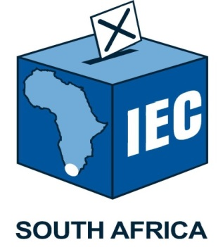
Preparations for the 2021 Local Government Elections March 2021

Slide 2
Contents
Election Planning Date
The Road to LGE 2021
Provisional Timelines
Cessation of By-Elections
Electoral System
Status of Legislative Amendments
Total Municipalities, Seats, Councillors
Ward Demarcation
Voting District Delimitation
Status of Voters’ Roll
Stakeholder Management
Communication and Voter Education
Recruitment and Training
Key Innovations for LGE 2021
COVID-19 Measures

Slide 3
Election Planning Date
Section 159 of the Constitution read with section 24(1) of the Local Government: Municipal Structures Act provides that a term of a municipal council is 5 years
Elections must take place within 90 days of expiry of the term
For the 2021 Local Government Elections that 90 day window starts on
4 August and ends on 1 November 2021
General elections are traditionally held on a Wednesday with special votes being cast on the two preceding days
Minister of COGTA responsible for determination of the date after consultation with the Commission
Consultation has commenced but not concluded

Slide 4
The Road to LGE 2021
2018
MDB completed municipal outer boundary re-determination process
2019 - 2020
1 December 2020
The IEC provided the municipal segment of the national common voters’ roll based on final registration as at NPE 2019
Handover of final ward boundaries to IEC
February – November 2020
Public consultations on ward boundaries
Minister of COGTA determines the formulae for determining the number of councillors for different categories of municipalities
The MECs responsible for local government use the formulae to determine and publish the number of councillors
The MDB commenced with the ward delimitation process in 2019

Slide 5
Provisional Timelines for LGE 2021
October 2020 – March 2021
Alignment of voting districts to new ward boundaries
April – May 2021
July – August 2021
Targeted voter registration and communications (new and split VDs)
Candidate nominations
May – June 2021
General voter registration and education campaign
August – November 2021
1-2 days before elections: Special votes (home visits and at voting stations)
+/- 7 days after elections: Announcement of results
+/- 14 days after elections: Election of local municipal representatives to district councils

Slide 6
Cessation of By-elections
In terms of the present Structures Act provisions, by elections may not be held for vacancies arising from 1 May 2021
However, by-elections may still be held beyond this date if the vacancy arose before 1 May 2021
The MEC for local government has to determine that the by-election must stand over until the general elections
In terms of the amended version of the Structures Act, by-elections may not held for vacancies that arise from 1 February 2021 (9 months to the general elections)
The law cant be applied retrospectively, therefore the effective date for by-elections in terms of the new provisions of the Structures Act will be the date of commencement of the act as determined by the President
The are 15 wards for the by-elections on 21 April 2021
There are 40 wards for the by-elections on 19 May 2021

Slide 7
Electoral System
The current electoral system for local government is Mixed-Member Proportional
Ward councillors: 50 percent of council
Proportional councillors: 50 percent of council
Voters in metropolitan municipalities will receive two ballot papers (ward and PR)
Voters in local municipalities will receive three ballot papers (ward, PR for local council; PR for district council)

Slide 8
Status on Legislative Amendments
The Municipal Structures Amendment Bill has now been passed by both houses of Parliament
Cessation of by-elections
MEC’s proclaiming by-elections
MM must inform the MEC and Commission of vacancies
Councillors removed by MC in terms code of conduct providing two year cooling period
Following an election list of candidates may only be amended after the inaugural council meeting
Excessive seats
Placing time limits of 48 hours to supplement list, candidates elected on multiple lists

Slide 9
Status on Legislative Amendments
The Electoral Laws Amendment Bill has also been passed by both houses of Parliament
Increasing the registration levels of political parties
Providing for a varied voting procedure for voters without addresses
Clarifying the effective date of the electoral code of conduct
Balancing the right to privacy of personal information and the right of freedom of expression in the publication of the voters’ roll
Rationalizing the need for submission of an acceptance of nomination form
Removing the ballot paper statement from the Act. To be revised in the regulations

Slide 10
Total Municipalities
Number of municipalities remains unchanged from LGE 2016
8 metropolitan municipalities
205 local municipalities
44 district municipalities

Slide 11
Total Seats & Councillors
The number of councillors to be elected will increase slightly from 2016 to 2021
Seat Type | 2006 | 2011 | 2016 | 2021* | % Increase: 2016 to 2021
Metro Ward Seats | 538 | 709 | 740 | 742 | 0.3%
Metro PR Seats | 536 | 706 | 738 | 740 | 0.3%
Local Ward Seats | 3 357 | 3 568 | 3 652 | 3727 | 2.1%
Local PR Seats | 3 289 | 3 451 | 3 516 | 3586 | 2.0%
Disctrict Council Seats (40%) | 640 | 654 | 655 | 674 | 2.9%
Disctrict Council Seats (60%) | 917 | 967 | 984 | 1010 | 2.6%
DMA Seats | 20 | - | - | -
Total Seats | 9 297 | 10 055 | 10 285 | 10479 | 1.9%
Total Councillors | 8 380 | 9 088 | 9 301

Slide 12
Available Seats and Councillors

Slide 13
Ward Delimitation
Following the handover of the list of ward boundaries by MDB in September and December 2020, the Electoral Commission is currently updating the VD delimitation in preparation for voter registration
This phase of work includes:
update the delimitation of voting districts in accordance with recent population changes since NPE 2019
to adjust VDs that have been split by ward boundaries
to identify venues to be used as voting stations and
to consult with members of MPLCs on VD boundaries and choice of venues to be used as voting stations for LGE 2021
This work is scheduled for completion by end of March 2021

Slide 14
Final wards received from MDB
by province
Province | Municipalities | MDB ward count 2021 | Split voting districts
Eastern Cape | 33 | 710 | 63
Free State | 19 | 319 | 87
Gauteng | 9 | 529 | 159
KwaZulu-Natal | 44 | 901 | 162
Limpopo | 22 | 568 | 45
Mpumalanga | 17 | 400 | 247
North West | 18 | 403 | 117
Northern Cape | 26 | 232 | 72
Western Cape | 25 | 406 | 171
Total | 213 | 4 468 | 1 123

Slide 15
Number of Wards 2000 – 2021
Election | Number of wards | % Increase between elections
2000 | 3 794 | -
2006 | 3 895 | 2.7%
2011 | 4 277 | 9.8%
2016 | 4 392 | 2.7%
2021* | 4 468 | 1.8%
* Total number of wards for LGE 2021 may still vary

Slide 16
Number of Wards
3.4%
% Increase
2.7%
9.8%
2.7%

Slide 17
Voting District Delimitation
PROVINCE | NUMBER MUNICS (LCs & MCs) | 2016 WARDS | 2021 WARDS | VDs SPLIT BY WARDS
Eastern Cape | 33 | 705 | 710 | 63
Free State | 19 | 309 | 319 | 87
Gauteng | 9 | 529 | 529 | 159
KwaZulu Natal | 44 | 870 | 901 | 162
Mpumalanga | 17 | 400 | 400 | 247
Northern Cape | 26 | 204 | 232 | 72
Limpopo | 22 | 566 | 568 | 45
North West | 18 | 407 | 403 | 117
Western Cape | 25 | 402 | 406 | 171
TOTAL | 213 | 4 392 | 4 468 | 1 123

Slide 18
Voting District Delimitation
PROVINCE | MUNICS (LCs & MCs) | MUNICS COMPLETED | % MUNICS COMPLETED | PROVISIONAL NEW VD COUNT | PROVISIONAL MERGED VD COUNT
Eastern Cape | 33 | 33 | 100% | 23 | 5
Free State | 19 | 3 | 17% | 7 | 1
Gauteng | 9 | 9 | 100% | 38 | 8
KwaZulu Natal | 44 | 44 | 100% | 46 | 2
Mpumalanga | 17 | 17 | 100% | 15 | 1
Northern Cape | 26 | 0 | 0% | 0 | 0
Limpopo | 22 | 21 | 95% | 33 | 5
North West | 18 | 17 | 94% | 13 | 7
Western Cape | 25 | 25 | 100% | 17 | 19
TOTAL | 213 | 169 | 80% | 192 | 48

Slide 19
Voters’ Roll Growth: 1999 - 2020
Election Year | Registered Voters (in millions)
1999 | 18.17
2000 | 18.47
2004 | 20.67
2006 | 21.05
2009 | 23.18
2011 | 23.33
2014 | 25.39
2016 | 26.33
2019 | 26.76
2021* (Mar) | 26.21
+47%
* The number of registered voters declines between general elections at an average rate of +/- 30 000 per month due to deaths. A nationwide voter registration campaign is planned ahead of LGE 2021

Slide 20
Voters’ Roll Growth: 1999 - 2020

Slide 21
Voters’ Roll by Gender March 2021
Province | Female | Male | Total
Eastern Cape | 1 867 581 | 1 404 337 | 3 271 918
Free State | 791 153 | 640 468 | 1 431 621
Gauteng | 3 257 080 | 2 992 619 | 6 249 699
KwaZulu-Natal | 3 065 735 | 2 364 527 | 5 430 262
Limpopo | 1 512 556 | 1 035 765 | 2 548 321
Mpumalanga | 1 047 486 | 860 510 | 1 907 996
North West | 884 258 | 788 872 | 1 673 130
Northern Cape | 331 460 | 285 548 | 617 008
Western Cape | 1 695 673 | 1 387 876 | 3 083 549
Total | 14 452 982 | 11 760 522 | 26 213 504
Percentage | 55% | 45% | 100%

Slide 22
Voters’ Roll by Gender March 2021

Slide 23
Voters’ Roll by Age March 2021
 | Age Band
Province | 18-19 | 20-29 | 30-39 | 40-49 | 50-59 | 60-69 | 70-79 | 80+ | Total
Eastern Cape | 6 106 | 572 966 | 759 743 | 630 136 | 530 263 | 411 194 | 215 628 | 145 882 | 3 271 918
Free State | 2 466 | 222 974 | 368 178 | 303 793 | 247 169 | 167 276 | 81 173 | 38 592 | 1 431 621
Gauteng | 8 588 | 903 720 | 1 628 246 | 1 491 845 | 1 124 832 | 675 638 | 293 652 | 123 178 | 6 249 699
KwaZulu-Natal | 12 664 | 1 164 299 | 1 472 227 | 1 061 990 | 778 657 | 523 306 | 276 730 | 140 389 | 5 430 262
Limpopo | 8 046 | 451 935 | 641 636 | 515 372 | 395 890 | 266 707 | 155 174 | 113 561 | 2 548 321
Mpumalanga | 4 714 | 342 991 | 535 860 | 398 985 | 300 844 | 189 423 | 86 756 | 48 423 | 1 907 996
North West | 5 330 | 244 950 | 424 244 | 368 122 | 290 456 | 196 941 | 96 332 | 46 755 | 1 673 130
Northern Cape | 1 604 | 100 219 | 155 367 | 135 525 | 107 122 | 69 756 | 32 698 | 14 717 | 617 008
Western Cape | 4 596 | 414 029 | 722 357 | 712 996 | 584 923 | 372 189 | 187 384 | 85 075 | 3 083 549
Total | 54 114 | 4 418 083 | 6 707 858 | 5 618 764 | 4 360 156 | 2 872 430 | 1 425 527 | 756 572 | 26 213 504
Percentage | 0.2% | 16.9% | 25.6% | 21.4% | 16.6% | 11.0% | 5.4% | 2.9% | 100%

Slide 24
Age Band Distribution March 2021
* The age band for 18 – 19 is excluded due to the fact that it cannot be compared to the 10 year bands.

Slide 25
Status of Voters’ Roll Addresses
Address Category | 1 March 2016 | % | 3 March 2021 | %
Complete Addresses | 8 468 119 | 34% | 24 667 998 | 94.1%
Potentially Incomplete Addresses | 8 601 195 | 35% | 252 862 | 1.0%
No Recorded Addresses | 7 857 156 | 32% | 1 227 907 | 4.7%
"REC AS" Addresses | - | - | 64 737 | 0.2%
Total Registered Voters | 24 926 470 | 100% | 26 213 504 | 100%

Slide 26
Voters’ Roll Address Progress 2016 - 2021
94.2%
34%
35%
32%
0.9%
4.7%

Slide 27
Voters’ Roll Addresses by Province 3 March 2021
Province | Complete Addresses | Potentially Incomplete Addresses | "REC-AS" Addresses | No Recorded Addresses | Total
Eastern Cape | 3 054 532 | 51 311 | 17 630 | 148 445 | 3 271 918
Free State | 1 323 252 | 10 760 | 3 589 | 94 020 | 1 431 621
Gauteng | 5 784 418 | 42 103 | 9 806 | 413 372 | 6 249 699
KwaZulu-Natal | 5 162 822 | 62 121 | 14 842 | 190 477 | 5 430 262
Limpopo | 2 436 736 | 3 911 | 4 918 | 102 756 | 2 548 321
Mpumalanga | 1 753 873 | 17 229 | 6 552 | 130 342 | 1 907 996
North West | 1 579 772 | 13 321 | 2 336 | 77 701 | 1 673 130
Northern Cape | 581 311 | 12 777 | 1 376 | 21 544 | 617 008
Western Cape | 2 991 282 | 39 329 | 3 688 | 49 250 | 3 083 549
Total | 24 667 998 | 252 862 | 64 737 | 1 227 907 | 26 213 504
Percentage | 94.1% | 1.0% | 0.2% | 4.7% | 100%

Slide 28
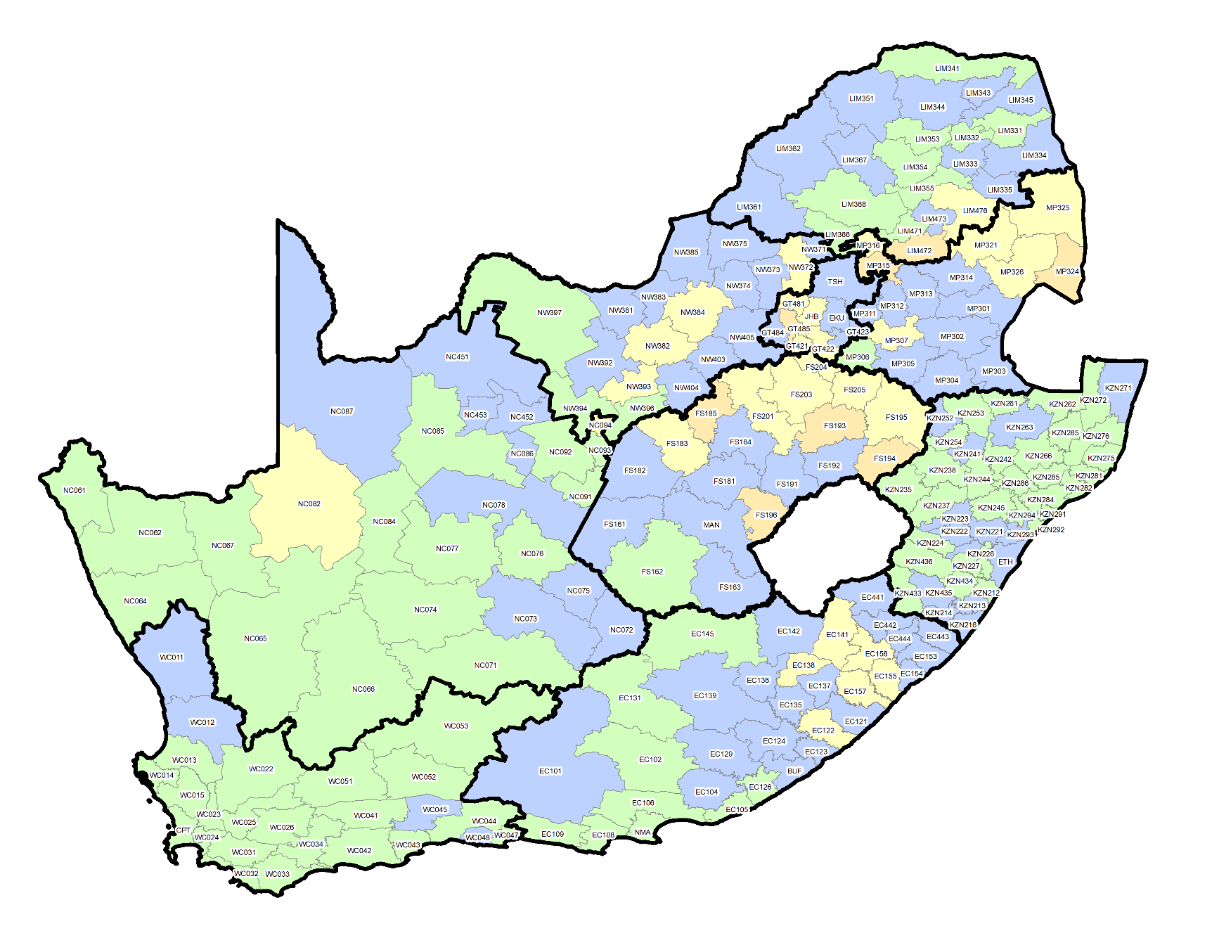
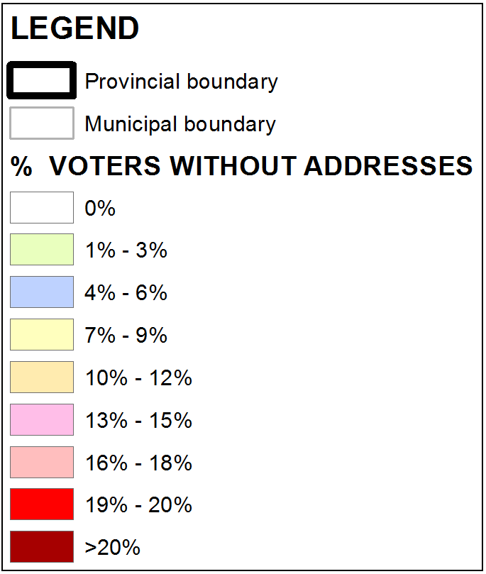
No Recorded Addresses
by Municipality 3 March 2021

Slide 29
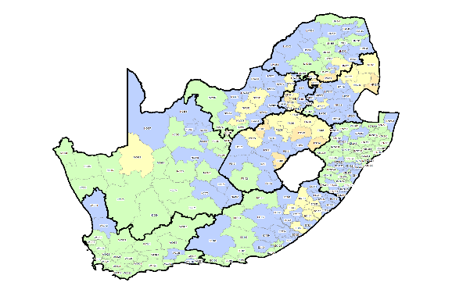
No Recorded Addresses
by Municipality 3 March 2021

Slide 30
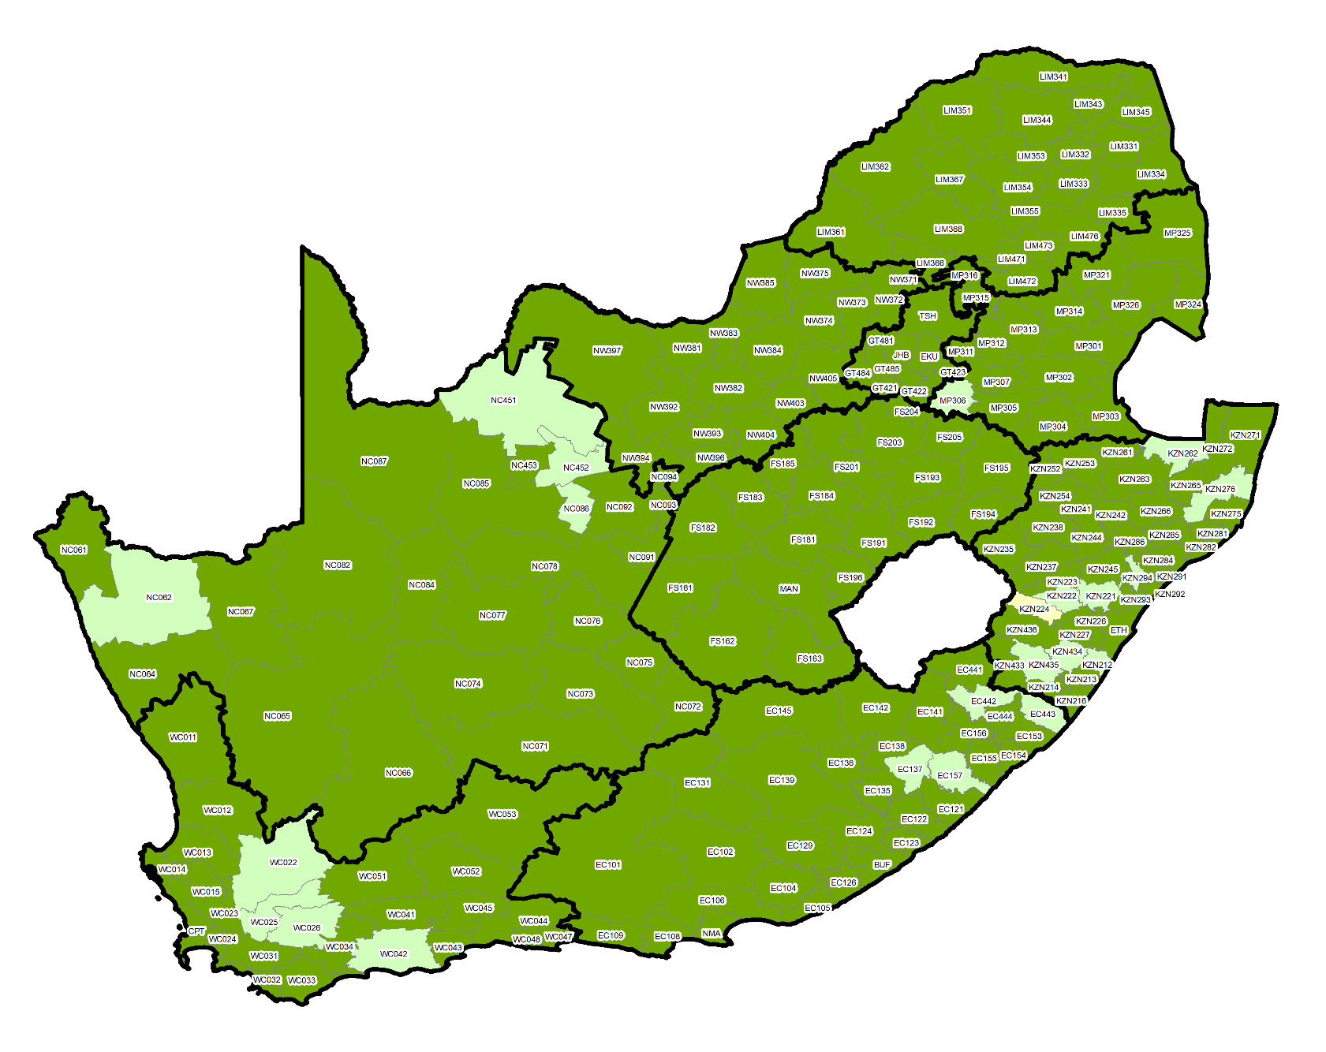
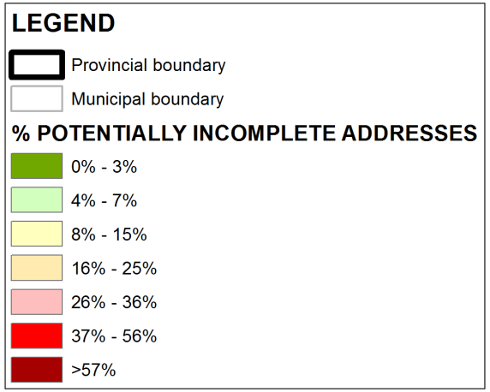
Potentially Incomplete Addresses
by Municipality 3 March 2021

Slide 31
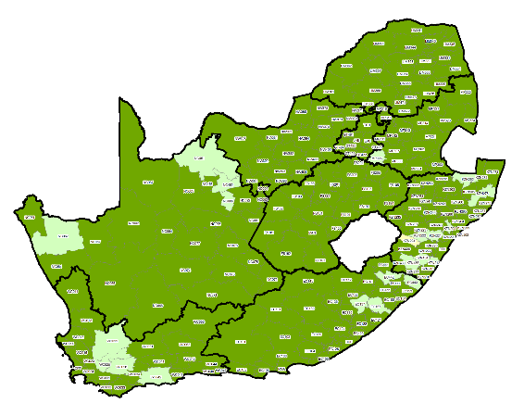
Potentially Incomplete Addresses
by Municipality 3 March 2021

Slide 32
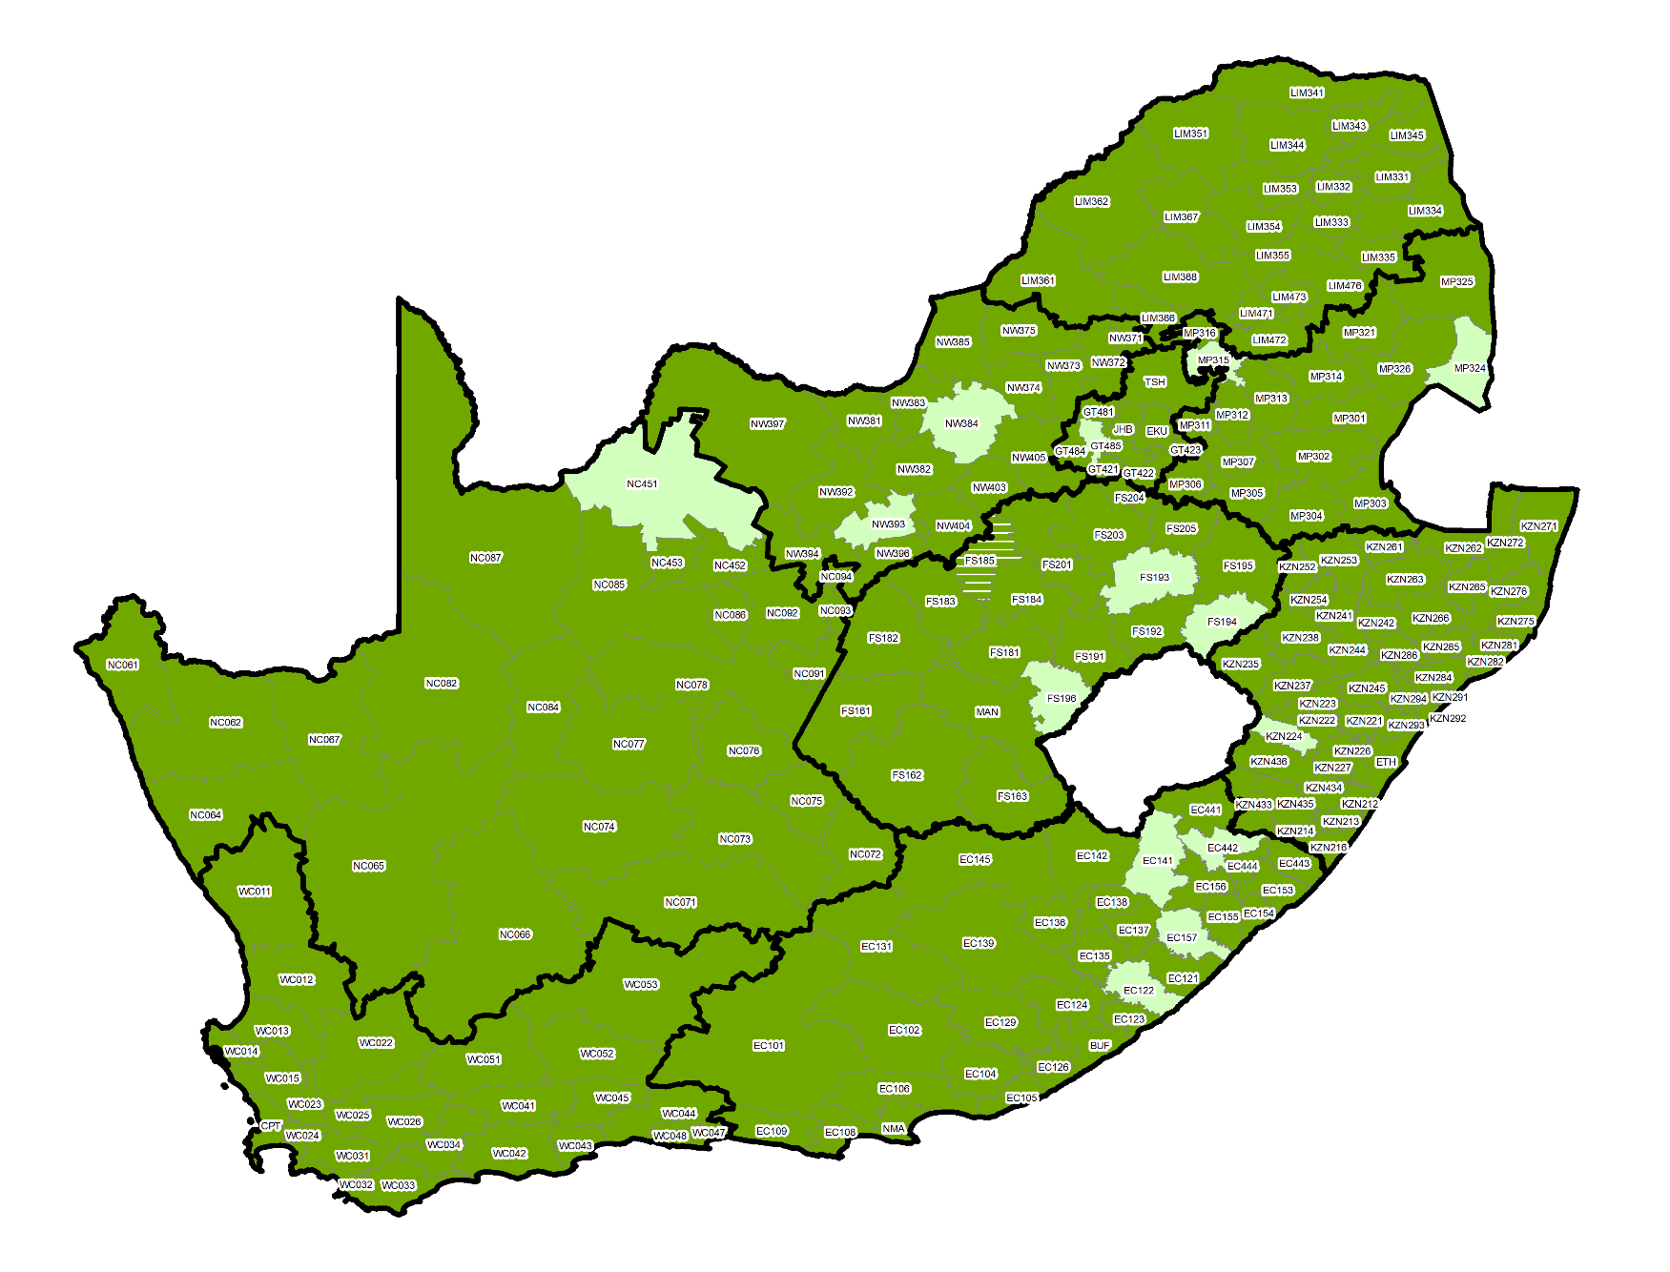
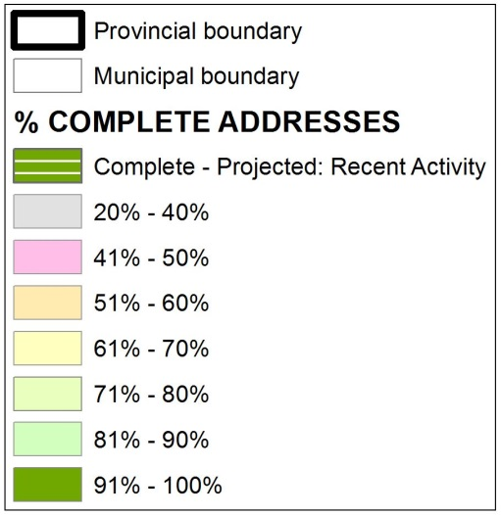
Complete Addresses
by Municipality 3 March 2021

Slide 33
Complete Addresses
by Municipality 3 March 2021

Slide 34
Stakeholder Engagement
Free, fair and credible elections require the cooperation of and participation by a wide range of stakeholders including:
State departments and structures (COGTA, Inter-ministerial Committee on Elections, NATJoints, SAPS etc)
Other agencies (Municipal Demarcation Board, ICASA)
Municipalities
Political parties (primarily via NPLC, PPLC and MPLC)
Media
Civil society (including NGOs, faith-based organisations)
Business and labour
Traditional leaders
Observers
International community (including diplomatic corps)
The Electoral Commission began with an extensive stakeholder engagement programme in the third quarter of 2020 to provide information regarding election preparations and areas of mutual cooperation
This engagement will continue throughout 2021

Slide 35
Communication and Voter Education
An informed electorate is a key success factor for free and fair elections
The Electoral Commission embarks on heightened communication and voter education programmes ahead of elections to ensure the electorate is empowered with information relating to participation in elections including:
The importance of participation by each citizen
How to register and update voter registration information
Where and how to vote
Other key areas of communications in the upcoming LGE 2021 will include:
COVID-19: Explaining the new COVID-19 protocols and how these will keep voters, election staff, observers, party agents and others safe
Disinformation: The rise of social media has also seen a rise in disinformation which has the potential to undermine the freeness and fairness of elections. Educating voters on the dangers of disinformation and how to spot it/report it.

Slide 36
Recruitment and Training
The criteria for the recruitment of electoral staff developed in consultation with the NPLC
Key consideration being to exclude persons that may be partisan (no-one who has held office in a political party may serve as an election official)
Names of proposed presiding officers and deputies are presented to MPLCs for objection before they are confirmed.
Approximately 58 000 electoral staff are recruited and trained for the registration events and +/- 207 000 for voting day
Recruitment and training is scheduled to commence from January 2021

Slide 37
Key Innovations for LGE 2021
1. New Voter Management Devices are being procured ahead of LGE 2021 to replace “zip-zips”
New generation technology will allow for enhanced voter registration and monitoring of voter participation in real time. This includes:
The ability to capture an address or place of residence during registration and to verify the address against ward boundaries
To serve as online real-time voters’ roll on election day to further prevent multiple voting and to provide further demographic details of voter participation
2. A revamped public website and app for improved navigation and communications
3. A public reporting app for disinformation on social media
4. Introduction of e-learning modules for training of election staff

Slide 38
COVID-19 Protocols for Elections
In order to prevent the elections posing a risk to all participants, the Electoral Commission introduced a range of special COVID-19 prevention measures for by-elections in 2020
These included:
Strict social distancing practices both outside and inside voting stations
The mandatory wearing of masks over nose and mouth of all persons within the boundaries of the voting station
The application of hand sanitisers to all persons entering and exiting the voting station
The replacement of the traditional indelible ink marker pens with an indelible ink liquid which will be applied from a bottle to the thumb of voters using cotton buds which will be disposed after each use
Protective equipment including masks, gloves and face shields was procured for election staff for voting stations and for conducting home visits for those voters who are physically disabled, infirm or pregnant

Slide 40
Key Challenges for LGE 2021
1. Voter registration and turnout
Turnout in any election is an important part of the credibility of the elections and legitimacy of elected representatives
Turnout of the past two municipal elections in 2011 and 2016 showed encouraging growth over previous elections
Turnout for by-elections held in November and December 2020 was largely in-line with by-election trends since 2016
But the trend of voter turnout around the world is declining and SA saw a 8% decline in turnout in NPE from 2014 to 2019
Funding: Only one registration weekend budgeted for ahead of LGE 2021 (see next slide)
Local Government Elections | Turnout |  | National and Provincial Elections | Turnout
2000 | 48% |  | 1999 | 88%
2006 | 48% |  | 2004 | 76%
2011 | 57% |  | 2009 | 77%
2016 | 58% |  | 2014 | 74%
2021 | ?? |  | 2019 | 66%

Slide 41
Key Challenges cont.
2. Reduced resources
The COVID-19 pandemic has further decimated resources available to government
At the same time responding to the pandemic requires additional resources – including additional PPE equipment for election staff, sanitizing products for voters, e-learning modules for training
Electoral Commission has been requested to make budget cuts of R109 million in the current financial year
Additionally, over the next three years the Electoral Commission is required to cut R744 million from its budget
These cuts will impact every aspect of the Electoral Commission including people, processes and projects
Among the direct implications for LGE 2021 is that currently two voter registration weekends are not fully funded – only one voter registration weekend budgeted for
E-voting pilot cancelled owing to lack of funding
Limited funding will also severely curtail the ability of the Commission to respond proactively to conflict prevention and resolution including the roll-out of conflict monitoring and mediation programmes in high risk areas

Slide 42
Key Challenges cont.
3. Heightened political contestation and litigation
Ever-more robust contestation between more and more political parties
In the previous Local Government Elections we have seen the number of political parties contesting grow from 79 in 2000 to over 200 in 2016
And the number of contesting candidates has grown over the same period from 30 000 to over 63 000 in 2016
More candidates = more losers (increase in dissatisfaction over outcome by contestants and their supporters)
Increasing rhetoric and taunting between parties and their supporters (in both physical and digital spheres)
Alongside this rise has been an increase in scrutiny of each and every aspect of elections, which has also given rise to increased objections and litigation

Slide 43
Key Challenges cont.
4. Demarcation disputes
The Municipal Demarcation Board has finalized the list of ward boundaries for next year’s elections
While no outer boundaries have changed, there is always the potential for some communities to remain aggrieved and to use the high profile of elections to raise the profile of their grievances
This can pose risks to election events including voter registration, civic education, campaigning by parties, turnout and access to voting stations
The Electoral Commission fully supports the right of citizens to voice their grievances through peaceful protest but this cannot be at the cost of the rights of other citizens to vote

Slide 44
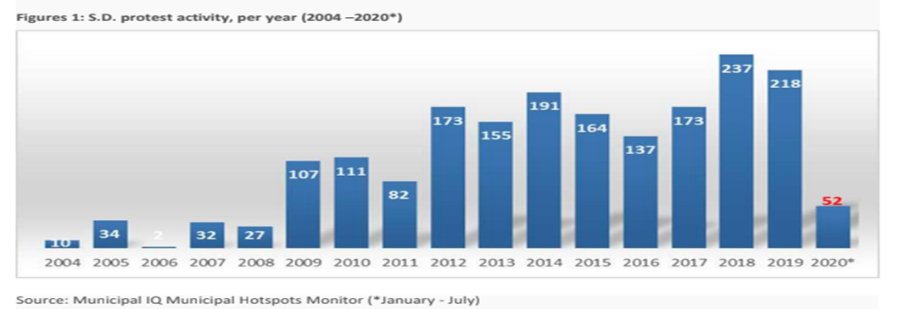
Key Challenges cont.
5. Social unrest
Incidents of social unrest – including service delivery protests – also pose risks to the smooth conduct of elections
Frequently these prevent access to communities and key areas which may hamper electoral preparations and the conducting of elections
These protests also often target municipal facilities where many of our local offices are located
Statistics from Municipal IQ show a steady rise in such protests over the past decade – with over 450 incidents reported in 2018 and 2019

Slide 45
Key Challenges cont.
6. Political violence/ intra-party conflict
The process of candidate selection by political parties for local government has also emerged as a source of conflict and violence in some parts of our country
According to researcher Mary De Haas, around 90 municipal councillors, political party officials and senior municipal officials, have been murdered in KwaZulu-Natal since 2015
The Eastern Cape, Limpopo, Mpumalanga and North West have not recorded the same numbers of politically-linked attacks but have certainly not been immune to these tragic incidents
As we approach the Local Government Elections, the Electoral Commission appeals to all contestants, parties and voters to respect human life and the sanctity of the electoral process to ensure free, fair and peaceful elections

Slide 46
Thank you

