Slide 1
LOCAL GOVERNMENT SUPPORT PROGRAMMES
1 April 2021

Slide 2
PRESENTATION OUTLINE
Local Government Context
Programme Objectives, Implementation Initiatives, Successes and Lessons learned:
  Project Liquidity, Viability and Masakhane
  ISRDP and URP
  Project Consolidate
  Siyenza Manje
  LG Strategic Agenda
  LG Turnaround Strategy
    Technical Support
    Operation Clean Audit
    Clean Cities and Towns
  Back-to-Basics
District Development Model (DDM)
  Background
  Progress
  Lessons learned from the Pilots

Slide 3
LOCAL GOVERNMENT CONTEXT
The transformation of local government took almost a decade to complete (1993 – 2000). The overall objectives were:
• Abolishing local governance based on race;
• Integrating previously divided communities under one municipal authority and tax base;
• Establishing democratically elected local government throughout the country; and
• Extending service delivery to the majority of the population and the poor in particular who had been deprived of access to services and infrastructure under apartheid.
Post-apartheid local government functions with a radical new mandate. The mandate of local government is located in the Constitution’s definition of local government as a sphere of government. Together with this new status, the Constitution gave local government a new development mandate, namely that a municipality must “structure and manage its administration; budgeting and planning processes to give priority to the basic needs of the community and to promote the social and economic development of the community.

Slide 4
History of local government’s transformation

Slide 5
Consolidation of local government
Huge consolidation of local government structures took place, firstly with newly amalgamated municipalities in 1995/96, and then with re-demarcated municipalities in final phase of LG transition
Year | Category A (Metros) | Category B (LMs) | Category C (Districts) | TOTAL
Pre 1994 | Separate white & black local authorities, management committees, R293 admins |  |  | 1 262
1995/6 | Transitional amalgamated local authorities |  |  | 843
2000 | 6 | 231 | 47 | 284
2006 | 6 | 231 | 46 | 283
2011 | 8 | 226 | 44 | 278
2016 | 8 | 205 | 44 | 257

Slide 6
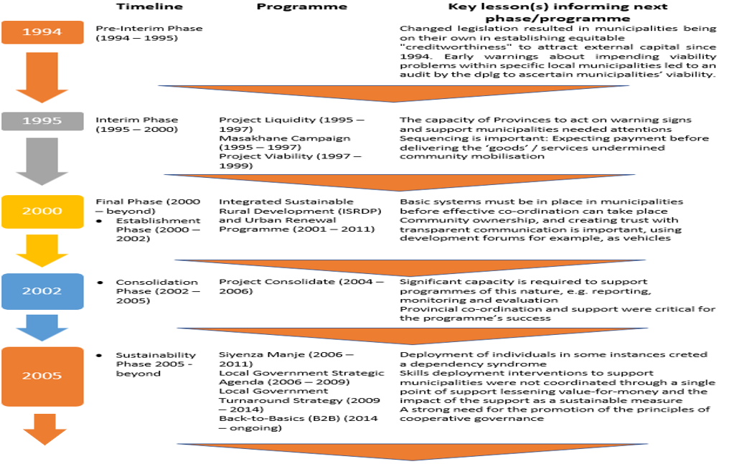
LG SUPPORT PROGRAMME TIMELINE

Slide 7
Pre- and Interim Phases(1994 – 2000) (Liquidity, Viability, Masakhane)
Programme Objectives
Determine municipal liquidity/viability
Early warning of impending problems
Promote a culture of payment
Implementation Initiatives
Monitoring
Establishing provincial task teams
Support Programmes
Successes
Some success in reducing municipal insolvency
Lessons Learned
Inadequate provincial capacity to act on warning signs

Slide 8


Establishment Phase(2000 - 2002) (Integrated Sustainable Rural Development & Urban Renewal) (2001 – 2011)
Programme Objectives
  To alleviate poverty through:
    Micro and local economic development imperatives
    Improved coordination and integration of service delivery across government
    Decentralisation of decision making
    Demand driven approaches
    Fostering partnerships; and
    A participatory approach to development
Implementation Initiatives
  Strengthened Intergovernmental Coordination
  Resource Mobilisation
  Technical Support
  Political Support

Slide 9
Establishment Phase(2000 - 2002) (Integrated Sustainable Rural Development & Urban Renewal) (cont.)
Successes
Detailed economic profiles were compiled for each node
An element was introduced to the Local Government Equitable Share (LGES) formula to allow for the prioritization of development in the nodes
Significant progress in the provision of basic services
Poverty levels in the urban nodes (except for Kwa Mashu, where demarcation impacted on the data) dropped significantly
A significant contribution made by the National Treasury through the Neighbourhood Development Grant (NDPG) to crowd in public sector investment
‘Anchor Projects’ e.g. Khayelitsha rail extension, Alexandra London Road linkage
Community Investment Programme (economic development in Maruleng and Bushbuckridge

Slide 10

Establishment Phase(2000 - 2002) (Integrated Sustainable Rural Development & Urban Renewal) (cont.)
Lessons Learned
  Basic systems in municipalities should be in place, e.g. if there are key vacancies at the municipal level, it is often not that useful to deploy a co-ordinator. Basic systems must be in place for effective co-ordination can take place.
  Involvement of Political Champions in the Programme was diverse, and their impact varied. A challenge that was never clearly addressed was the implementation of the approach in a context of multi-party democracy, and the need for co-operation when different parties hold leadership positions.
  Some of the sharpest lessons were learnt about the challenge of enterprise development in poor areas. First, unlike many developing countries, small South African enterprises must compete with established firms in tightly integrated markets. Second, they must get over the threshold of what social grants can provide before entrepreneurs are motivated to risk resources and energy. And third, they are often trapped in areas with few local resources and even fewer linkages to the regional or national economy.

Slide 11
Consolidation Phase(2002 - 2005) (Project Consolidate)
Programme Objectives
  Rally the local government sphere in discharging its service delivery and development mandate;
  Realise the peoples’ contract and mobilize social partners around this programme;
  Entrench a people-centred orientation in the entire public sector and a new approach to local government’s mode of operation;
  Establish a new and practical benchmark for local government performance excellence; and
  Have successful local government elections in 2005/6.
Implementation Initiatives
  Deployment of Technical Experts
  Service Delivery Facilitators
  Training Programmes (Jipsa/Ilima/SAMDI)
  Financing for Infrastructure

Slide 12
Sustainability Phase(2005 - beyond) (Siyenza Manje)
Programme Objectives
To provide short term specialist skills to implement infrastructure projects
Implementation Interventions
Hands-on expertise was identified, recruited, and deployed to distressed and capacity challenged municipalities for extended periods of time, depending on the situation and changing circumstances of the municipality, with the primary purpose of creating well functioning municipalities
To facilitate the development of policies, systems and processes to enhance infrastructure delivery and financial management
To support the development of municipal in-house capacity through training and mentoring of relevant staff
To contribute to the development of skills by providing opportunities for young professionals and internships
To contribute to the further refinement of a framework for capacity building and the associated tools to be used in providing support to municipalities
The planning cluster provided support on all planning issues towards the compilation of statutory systems and procedures required for planning purposes. These included, master planning, the compilation of valuation rolls, development or refinement of spatial development frameworks and land use management schemes
Capacity Building and Training: Young professionals programme, Artisan Programme, Vulindlela Academy

Slide 13
Sustainability Phase(2005 - beyond) (Siyenza Manje)(CONT.)
Successes
The number of projects that have been facilitated showed an upward trend with around 1 000 new projects facilitated each year by 2010. Municipalities indicated that technical deployees have unlocked infrastructure projects, often by assisting in setting up systems and policies for supply chain management, by doing project business plans and budgets and by project managing projects.
Lessons Learned
The programme was to an extent centred around individual deployees, creating a dependency syndrome within some municipalities.
As the Siyenza Manje was better paying, it attracted skilled and experienced people from municipalities, thus creating vacancy rates

Slide 14
Sustainability Phase(2005 - beyond) (Local Government Strategic Agenda)
Programme Objectives
Mainstreaming hands-on support to Local Government to improve municipal governance, performance and accountability.
Implementation Interventions
The Five-Year Local Government Strategic Agenda pursued 5 key performance areas to contribute to good governance. The five key performance areas were:
Addressing the structure and governance arrangements of the State in order to better strengthen, support and monitor Local Government.
Refining and strengthening the policy, regulatory and fiscal environment for Local Government, and giving greater attention to enforcement measures.
Municipal Transformation and Organisational Development
Basic Service Delivery
Local Economic Development
Municipal Financial Viability and Management
Good Governance and Public Participation
There were also cross-cutting issues designed to focus on coordination issues, such as capacity-building support initiatives across government, intergovernmental relations, inter-sphere planning, and communications.

Slide 15
Sustainability Phase(2005 - beyond) (Local Government Strategic Agenda) (cont.)
Successes
The National Capacity Building Framework (NCBF) was introduced in 2006 as capacity support for the implementation of the LGSA.
Lessons Learned
Skills deployment interventions to support municipalities were not coordinated through a single point of support lessening value-for-money and the impact of the support as a sustainable measure
During 2007, CoGTA developed the Local Government Anti-Corruption Strategy (LGACS) in order to promote good governance and accountability. The strategy was developed as part of the national strategy to curb nepotism, kickbacks and other corrupt practices that damage the image of local government.
LG ICT Fora were established in all provinces. As part of an overall ICT framework, SITA developed an ICT blueprint for municipalities and are running pilots in some municipalities. On 30 November 2007, the Minister of Communications launched the Municipal Websites Portal.
Varying reports were received on the effectiveness of the Provincial Departments of Local Government and the provincial sector departments, indicating the degree to which inter-sphere fragmentation was occurring

Slide 16
Sustainability Phase(2005 - beyond) (Local Government Turnaround Strategy)
Programme Objectives
Restore the confidence of most of our people in our municipalities, as the primary delivery machine of the developmental state at a local level;
Implementation Interventions
Municipal Turnaround Strategies
Re-build and improve the basic requirements for a functional, responsive, effective, and efficient developmental local government;
Municipalities to become the nation’s pride; and
To ensure that public representatives are truly accountable to the people.
Improved Collaboration
Financial Management Support, e.g. NT Municipal Financial Management Improvement Programme
Clean Cities and Towns Campaign
Introducing the Municipal Support Agent for technical assistance
Technical Support Units in the Provinces
Operation Clean Audit
Refined ward committee model
Minimum Competency Framework
Community Work Programme

Slide 17
Sustainability Phase(2005 - beyond) (Local Government Turnaround Strategy) (cont.)
Successes
Intergovernmental Collaboration: The Department of Water Affairs (DWA) adopted the Enhanced Local Government Support Approach (ELGSA)
Lessons Learned
The need for an interactive approach to improve the maturity of municipalities’ performance information;
Significant progress was shown by the Municipal Infrastructure Agent (MISA). By the end of June 2013, a total number of 77 technical experts had been placed in over 100 municipalities across the country.
The successful development of the Ward Committee Operational Plans was a major achievement in ensuring that communities participate in the needs analysis, planning and implementation of the Integrated Development Plans regarding the provision of targeted basic services in ward areas, such as gravel roads, high mast lighting, sanitation, waste disposal, etc.
The importance of extensive consultation and engagement with the sector;
The need to undertake a review of reporting requirements imposed on municipalities by other government departments, particularly when it comes to other sectors imposing reporting requirements on municipalities;
A strong need for the promotion of the principles of cooperative governance; and
The need to recognise and address the significant challenges that disparate municipal council objectives and priorities pose to developing common and meaningful outcome measures

Slide 18
Sustainability Phase(2005 - beyond) (Back-to-Basics)
Programme Objectives
The B2B approach’s initial aim at its conception was to specifically focus on the challenges in the local government sphere, in the short and medium term particularly, in order to get the basics in municipal services right.
Implementation Interventions
A provincial verification process for the identification of under-performing municipalities was approved by the Local Government MINMec.
5 Key Results areas were agreed on:
Putting People First
Service Delivery
Good Governance
Sound Financial Management
Institutional Capability

Slide 19
Sustainability Phase(2005 - beyond) (Back-to-Basics) (cont.)
Successes
The mobilisation of fundamental stakeholders, namely the various PCCs, MINMec, SALGA, the different municipal troika’s, and the relevant Parliamentary Committees
Lessons Learned
While B2B has had significant successes, it has not yet had sufficient impact in terms of citizens’ experience of local government resulting in increasing protests.
Provincial Task Teams were established in all 9 provinces.
Support and good governance packages were developed and implemented
Municipalities were supported to institutionalise community complaints management processes as part of improving service delivery
Anti-corruption strategies were rolled-out in 18 district municipalities;
Municipalities were monitored for compliance with the MSA regulations in relation to the appointment of senior managers
The uneven participation in provincial task teams, and the lack of central coordination and standardization of work of the provincial task teams resulted in problems with quality of information and in the quality of B2B action plans.
Certain B2B actions plans did not address specific key underlying causes of problems in municipalities.
Some of the B2B action plans were incomplete (e.g. they are missing timeframes and responsibilities allocations).
There was insufficient mobilisation of social partnerships, such as traditional leaders, business, and civil society.

Slide 20
GOVERNMENT’S INVESTMENT IN CAPACITY BUILDING
National government invests over R2 billion every year in capacity building for local government
In contrast to this substantial investment in S154 support, very little is invested in ensuring the success of government’s S139 responsibilities
Support and capacity building interventions remain uncoordinated and fragmented
20

Slide 21
ACCEPTABLE LEVEL OF PERFORMANCE (IDEAL MUNICIPALITY
Strong political and administrative leadership;
Characterised by political stability;
Councils meeting regularly as legislated;
Functional council and oversight structures;
Regular report back to communities;
Low vacancy rates;
Collection rates above 80% on average;
Spending on capital budgets above 80%;
Continuity in the administration;
Consistent spending of capital budgets;
Consistent unqualified audit outcomes;
Responsive to service delivery needs;
Evidence of good administrative and financial management; and
Performance driven by Integrated Development Plans, Budgets Compliance and Innovation

Slide 22
WHAT CHARACTERISES DISTRESSED AND DYSFUNCTIONAL MUNICIPALITIES
Political and Administrative instability;
Unstable coalitions and their impact on functionality;
Vacancies in critical senior management positions;
Extremely low levels of capital budget spending (MIG);
Unfunded budgets and poor revenue collections;
Cash flow/ Liquidity challenges and high levels of debtors;
Disclaimers and adverse Audit opinions;
Overall disregard for financial and supply chain management regulations;
Fraud and Corruption;
Compromised service delivery;
High level of community dissatisfaction resulting in protests;

Slide 23
High level lessons Conclusion
Building strategic and ethical leadership that is both visible and strong;
Focusing on the building of strong, resilient local economies;
Enforce regulatory and legislative compliance;
Accountability and consequence management
Address the continuity of leadership;
Address vacancies and key skills gaps;
Strengthen public participation processes; and
Address bulk infrastructure demand gaps and maintenance.

Slide 24
DISTRICT DEVELOPMENT MODEL IMPLEMENTATION LESSONS

Slide 25
DDM BACKGROUND
Cabinet approved the DDM as a government approach to improve integrated planning and delivery across the three spheres of government with district and metropolitan spaces as focal points of government and private sector investment.
The envisaged integrated planning and delivery in the district and metropolitan sites will be enabled by joint planning, budgeting and implementation process.
The DDM is anchored on the development of the “One Plan”. The One Plan is an intergovernmental plan setting out a long-term strategic framework to guide investment and delivery in the 52 district and metropolitan space.
This plan is meant to be jointly developed and agreed to by all spheres of government.

Slide 26
THE PILOTING PHASE
The piloting phase comprised mainly of five areas of work. The piloting phase comprised of the following areas of work:
The development of profiles for the three pilots,
Soliciting government (national, province and local) and parastatal projects, programmes and expenditure in the three pilots,
Soliciting private sector investment where possible,
Hosting an event where the pilot is launched,
Implementing post launch programmes such as, conducting a skills gap analysis, establishing district and metro hubs, developing the one,
Establishing district hubs, and
Development of the One Plan

Slide 27
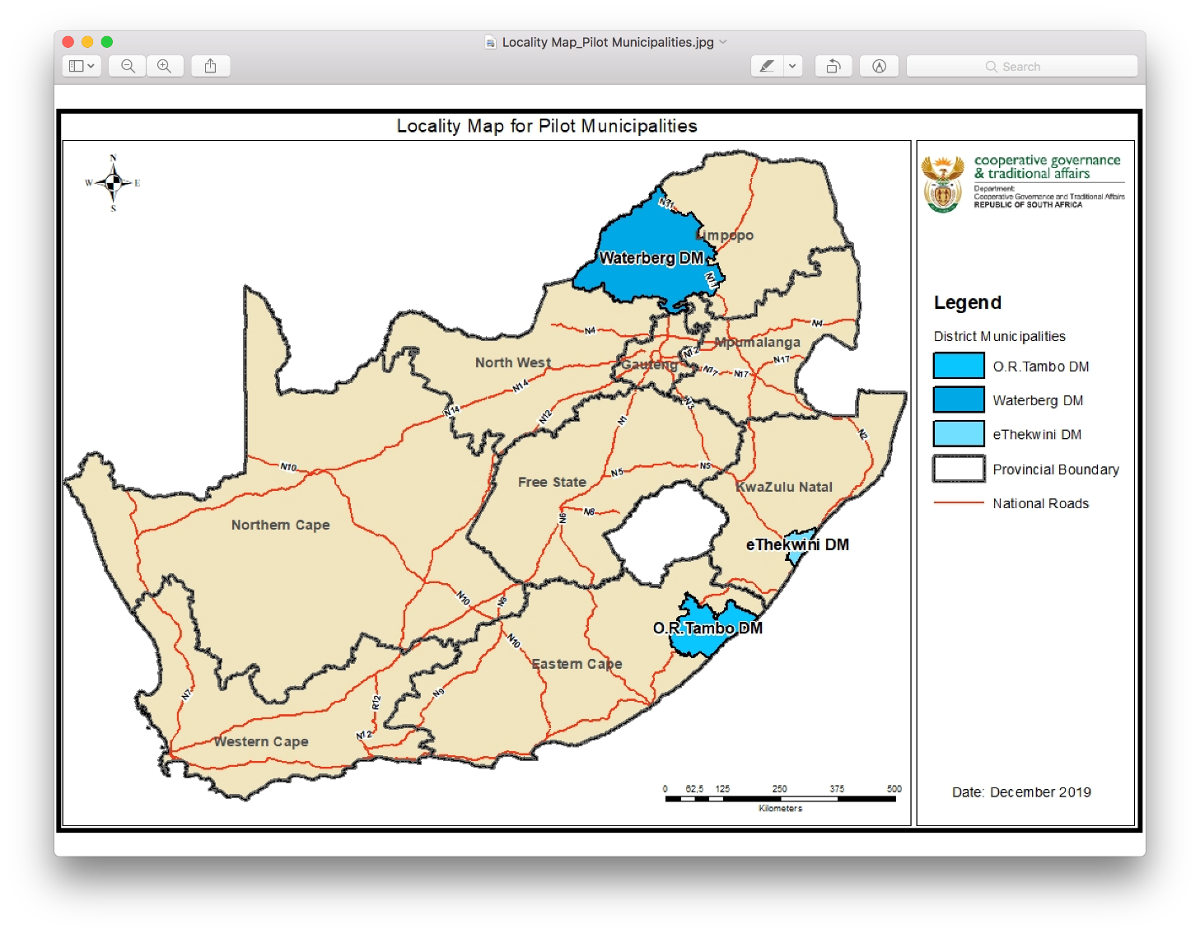
DDM pilots

Slide 28
PROGRESS
After the launches of the pilots, work still continued. The main areas include:
conducting a skills gap analysis: this process entails an assessment of the required skills that would be critical to implement the DDM in the districts,
establishing district and metro hubs: to assist with the coordination of government planning, budgeting and implementation within the district/regional space.
development of the One Plan: which is a long-term intergovernmental plan of government in the district that is compiled by the three spheres of government through a collaborative process.
implementation of any urgent programmes that would address challenges in the pilots.

Slide 29
PROGRESS
START
3 DDM Hubs launched
One Plan process guidelines
Approved by Cabinet
Aug 2019O
Ethekwini, Waterberg & OR Tambo
to direct all govt depts & entities
52 District Profiles completed
Political champions appointed
Covering situational analysis
Ministers, Deputy Ministers & MECs
FINISH
DDM Information Management System
Development of One Plans underway
The development of the DDM Information System currently underway
Waterberg, R Tambo, eThekwini and the 49 districts

Slide 30
Progress
DDM Implementation Framework outlining key aspects for the institutionalization of the DDM concluded.
Guidelines for the development of One Plans have been developed.
Circular on the implementation of the DDM has been issued to provinces and municipalities.
DDM Political Champions appointed.
Guidelines for DDM Political Champions developed.
Draft Section 47(1)(b) Regulations Framework for the Intergovernmental Relations Framework Act (IGRFA) developed for discussion.
IDP Guidelines and Circular aimed to link with the One Plan has been developed.
DDM launches in KZN and Limpopo provinces.
On going support and guidance on how to mainstream DDM national sector departments provided.
Strategic partnerships to implement the DDM currently underway.

Slide 31
LESSONS LEARNED FROM THE PILOTING PHASE
The lessons from the piloting phase can be this be categories into three key areas; namely:
Intergovernmental coordination and institutional arrangements lessons
  During the pilot phase, it became clear that the partnership between the provincial Departments of Cooperative Governance and Traditional Affairs, the Offices of the Premier and Provincial Treasures are critical to any intergovernmental programme of government.
  The establishment of intergovernmental task teams led by national COGTA resulted in an efficient and effective process to manage the implementation of the pilot process.
  Coordination took place through the Inter-Ministerial Committee (IMC) on Integrated Service Delivery. The Minister for DCOG played a very active role to personally ensure that national sector departments cooperated and provided information that was required.
  Intergovernmental planning and coordination is informed by a set planning and budgeting processes across the three spheres. During the pilot phase, we learned that in order for national and provincial sector departments to speedily/immediately respond to pertinent challenges on the ground, the current cycle of planning does not always permits this to be done. Where the synchronization process is incorrect and budgets are already committed to specific projects, there is little room in the system to reprioritize.
    This lesson is important because in some instances there was no link between the challenges that communities have in districts and the programmes that national and provincial sector departments are implementing.

Slide 32
LESSONS LEARNED FROM THE PILOTING PHASE (Cont.)
The lessons from the piloting phase can be this be categories into three key areas; namely:
Content lessons
  Most of the trends that regarding content issues from the three pilots were similar, however, the eThekwini metropolitan municipality was slightly different. The metropolitan municipality was able to provide additional content information based on research and studies that they had conducted, i.e. human settlement, tourism, etc. The fact that the metropolitan municipality is part of the City Support Programme (CSP) in the National Treasury, contributed to setting the metro apart, especially with the development of the Built Environment Performance Plan (BEPP) that metros were required to prepare. This lesson lay a good foundation for a differentiated approach on how some aspects of the DDM roll out would need to be approached.
  In the collation of all national, provincial and local projects and budgets to cost government investment in each pilot site, it was found that leadership, starting with the political head, accompanied by persistence, and dedication, enables the achievement such challenging tasks. Given the scale of this exercise and the fact that it was being done for the first time at this scale within such as short period of time, it was encouraging to see the overwhelming response, especially from national sector departments.

Slide 33
LESSONS LEARNED FROM THE PILOTING PHASE (Cont.)
The lessons from the piloting phase can be this be categories into three key areas; namely:
Content lessons (cont.)
  One of the main concerns on content issues was access to and the reliability of some of the statistical data. There were instances where some of this data and information was outdated.
  It was also found that there is weak integration and coordination of programmes and projects both vertically and horizontally potentially because some sector departments do not collaborate when developing and implementing their projects and programmes leading to potential duplication and diluted impact at district level. In some instances, it was challenging to determine a rationale of the projects that government was implemented in the districts, e.g., schools built in villages with no enrolment of learners
  During the pilot phase, there were some national projects that were not spatially mapped. While this is also a fairly new practice in government, it became clear that spatial mapping of national and government projects is critical and would need to be enhanced as the DDM is rolled out.
  For the first time, the whole of government was able to jointly agree and obtain an appreciation of the challenges facing local communities. This step of the DDM laid a solid foundation and proved to be a valuable lesson to anchor an intergovernmental approach to planning, budgeting and implementation

Slide 34
LESSONS LEARNED FROM THE PILOTING PHASE (Cont.)
The lessons from the piloting phase can be this be categories into three key areas; namely:
Lessons learned from stakeholder engagement
  Engagement sessions demonstrated the willingness of all stakeholders to collaborate with and support government and in particular the DDM roll our process. While there were concerns raised, most stakeholders were eager to provide support and partner with government as it implements the DDM.
In conclusion,
The majority lessons learnt from the piloting process points to a greater need for collaboration across the three spheres of government. The lessons from the piloting process exposes faultiness of how government plans, budgets and implements. The lessons also demonstrate challenges on some of the tools that are critical to enable the roll out of the DDM.
The leadership provided by the President and the Minister for Cooperative Government and Traditional Affairs was one of the areas that set the piloting of the DDM apart from previous programmes. This leadership was critical in mobilizing all of government and all of society towards a journey that will improve the lives of poor communities, especially women, children and young people.

