Slide 1
SAFETY PRIORITY BRIEFING
Department of Community Safety
Standing Committee on Community Safety, Cultural Affairs and Sport
31 March 2021

Slide 2

Overview
Key elements of the approach
  Rationale for the Safety Priority
  Approach for the Safety Priority
  Collaborative Governance
  Area-based interventions & LEAP deployments
  Way forward
COMSAFE Standing Committee
2

Slide 3
Rationale for the Safety Priority

Slide 4
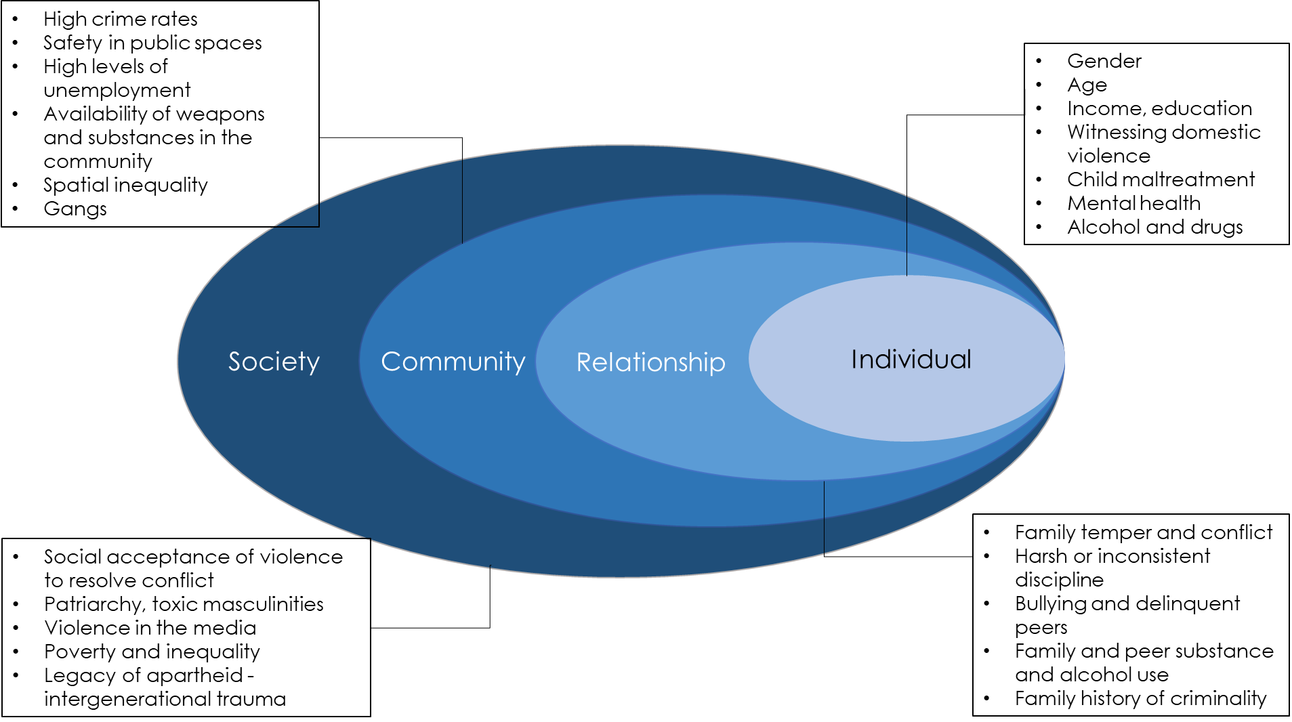
PSP Safety Plan - Violence Prevention Shift
COMSAFE Standing Committee
Notes:
Previously in the Province, crime and violence reduction were approached from a nationally mandated enforcement approach.
The provincial response to crime and violence reduction shifted dramatically under the PSP Safety Plan.
The social-ecological model of crime and violence reduction was used as the basis for development of the Safety Plan and is in line with global best practice, such as the WHO and CDC models of violence prevention. It is also in line with developing international trends, such as the defunding the police concept, that emphasises the use of violence prevention avenues over enforcement to reduce violence and crime in society.

Slide 5
Western Cape Government - Strategic Approach to Safety: Provincial Strategic Plan
Levers
Reducing gang violence
Safe and Cohesive Communities
Increased safety of public spaces (urban design)
Enhanced capacity and effectiveness of policing and law enforcement
Strengthened individual, relational and societal social cohesion against violence
Reducing gender-based violence.
Notes:
The interconnectedness of socio-economic factors in relation to violent crime was recognized and a whole-of-government approach was proposed to address risk factors of violent crime.
Violence prevention interventions that tackled individual-, relationship-, community- and societal level risk factors drivers were identified for implementation under the safe and cohesive communities priority, however many of the primary interventions were embedded in other VIPs, for example in VIP 2: Growth and Jobs and VIP 3: Empowering People.
All the initiatives would work in concert to create safe and cohesive communities, and together their implementation comprises the Province’s Safety Plan.

Slide 6



Safety Priority - Key considerations
Broader context for Safety Recovery Priority
Pre-COVID 1st surge
“PSP – VIPs”
During COVID
“Recalibration”
COVID
“Recovery”
Safety Plan:
Reduce violent crime (Murder 50%)
11 City Priority
Areas – LEAP officers
Data-led
Apex priorities all WCG Depts
PDIA problem statement
Key Learnings:
Hotspot geographic focus – shared purpose
Evidence-informed interventions
Data-led; innovations; agility
Multi-sectoral relationships matter
Impact of lockdown on homicide and trauma
Re-aligned Intent:
Align violence prevention and law enforcement
Evidence informed & data-led approach
Implement in local geographic areas
2020 MTBPC Engagement: VIP 1
Notes:
Unemployment, anxiety, food insecurity, financial insecurity, family tensions in the household, education and health accessibility and quality, strains on social welfare provision, such as a safety net, counselling and protection services, will all likely exacerbate the likelihood of violence as they are all systemic issues that underlie crime and violence risk factors.
Often, risk factors are interconnected and exposure to one risk factor might lead the heightened risk of exposure to another risk factor. Therefore, a sustainable and effective approach to strategies aimed at reducing violence should ideally consider all risk factors together, and the interlinkages between them.
Key learnigs from COVID-19 were included in the Recovery Plan

Slide 7
Approach for the Safety Priority

Slide 8
Recovery Plan Safety Priority Approach
Governance
Collaborative governance
Facilitative leadership
Formalised/ mandated
Evidence-based interventions:
International and local evidence
Evidence for violence prevention and law enforcement
Surveillance/ data-led approach:
Track the size and trends of the consequences of the problem
Track the impact of the interventions
Inter-personal violence
Jobs
Well-being
Area-based implementation:
All hotspot geographic areas
Testing/ prototyping in specific geographic areas with rapid scaling
Notes:
Safety definition
Safety is an aspiration. It is the state of being free from crime and violence. Being free from inter-personal violence will be the key driver to safety in the Western Cape.
Reducing inter-personal violence requires a evidence-informed, data-led, area-based public health approach to law enforcement and violence prevention.

Slide 9


Process Going Forward – Data Surveillance Strategy
1:Define data parameters from revised ToC
2:Integrate data from multiple
Depts.
3:Define markers for impact with ABTs
4:Dashboards to track markers for
impact
Integrated data surveillance system implementation
Practical
approach to “evidence translation”
Data
Surveillance strategy
Area-based intervention
strategy
COMSAFE Standing Committee
8
Notes:
Sharing information through partnerships with communities can help create provincial and local solutions for preventing injuries from violence in public spaces.

Slide 10
Process Going Forward – Area-based Interventions
1:Confirm priority geographic areas
2: Establish & mandate area-based teams.
3: Implement and learn collaboratively
4: Monitor impact and refine approach
Integrated area-based interventions
Practical
approach to “evidence translation”
Data
Surveillance strategy
Area-based intervention
strategy
COMSAFE Standing Committee
9
Notes:
5 prioritised areas for current LEAP officer deployment:
Klipfontein/ Mitchells Plain – Hanover Park, Nyanga
Tygerberg/ Northern – Delft, Bishop Lavis
Khayelitsha/ Eastern - Khayelitsha
5 additional geographic areas (for additional LEAP officer deployment):
Areas that have been proposed are Mfuleni, Harare, Gugulethu, Kraaifontein & Mitchells Plain
Area-based teams:
Establish local area-based team, with WCG, City and SAPS officials
Implement evidence-informed and data-led interventions for law enforcement and violence prevention – process is underway

Slide 11
Approach for Evidence-based Interventions
2: ID key priorities from evidence base
1: TOC mapping & evidence
3: Evidence translation for impact
4: Area-based teams implement
Evidence & Knowledge translation
Practical
approach to “evidence translation”
Data
Surveillance strategy
Area-based intervention
strategy
COMSAFE Standing Committee
10
Notes:
1. Theory of Change mapping exercise
2. Identify key potential entry-points from the list of programmes offered across the various Departments
3. Design evidence-informed interventions”
4. Implement via the “local area-based teams
Underpinned by evidence and knowledge translation practitioners converting evidence into practical tools to assist practitioners with successful implementation
Need to bring three processes together over the next 2-3 weeks: (a) Practical approach to “evidence translation” – Gwen and Veeral; (b) Data Surveillance strategy – Melvin, Zeenat and Amanda; b) Area-based intervention strategy – Louis Brown, Yashina and I will confirm the specific priority geographic areas with SAPS, City and District Municipalities, and we will introduce the need to confirm a uniform approach at PTM next Monday.

Slide 12
Three-pronged Approach
Safety
Social cohesion
Urban design
Law enforcement
Area-based intervention

Slide 13

Murder trend/pattern in the Province
There have been 515 homicides recorded in the province in the first 9 weeks of 2021 (weeks 2-9). This is a 3.19% reduction from the 532 homicides in the same period in 2020, and a 4.09% reduction from the 537 homicides in 2019.
There were 86 homicides in week 9 of 2021. This is a 13.15% increase from the 76 homicides in the previous week. Homicides have continued to increase since the adjusted Alert level 3c where alcohol was made available for sale and consumption

Slide 14

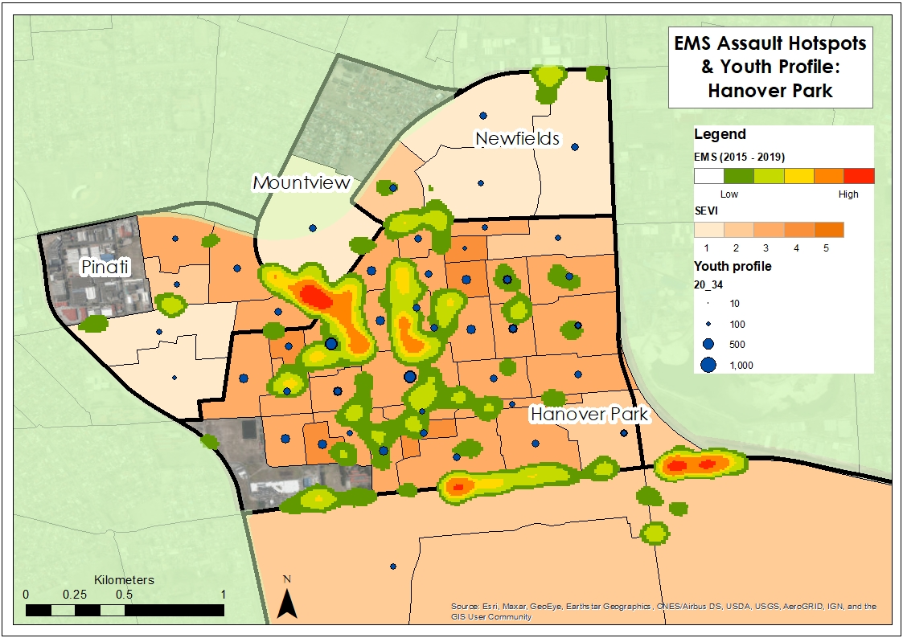
Area-based Profile Data
Mapping
Population Profile
Government Services
Transport
Sub-place population data
Socio-Economic vulnerability index
Movement patterns
Crime statistics
EMS assault hotspots
Violence and vulnerability index
Community Safety information

Slide 15

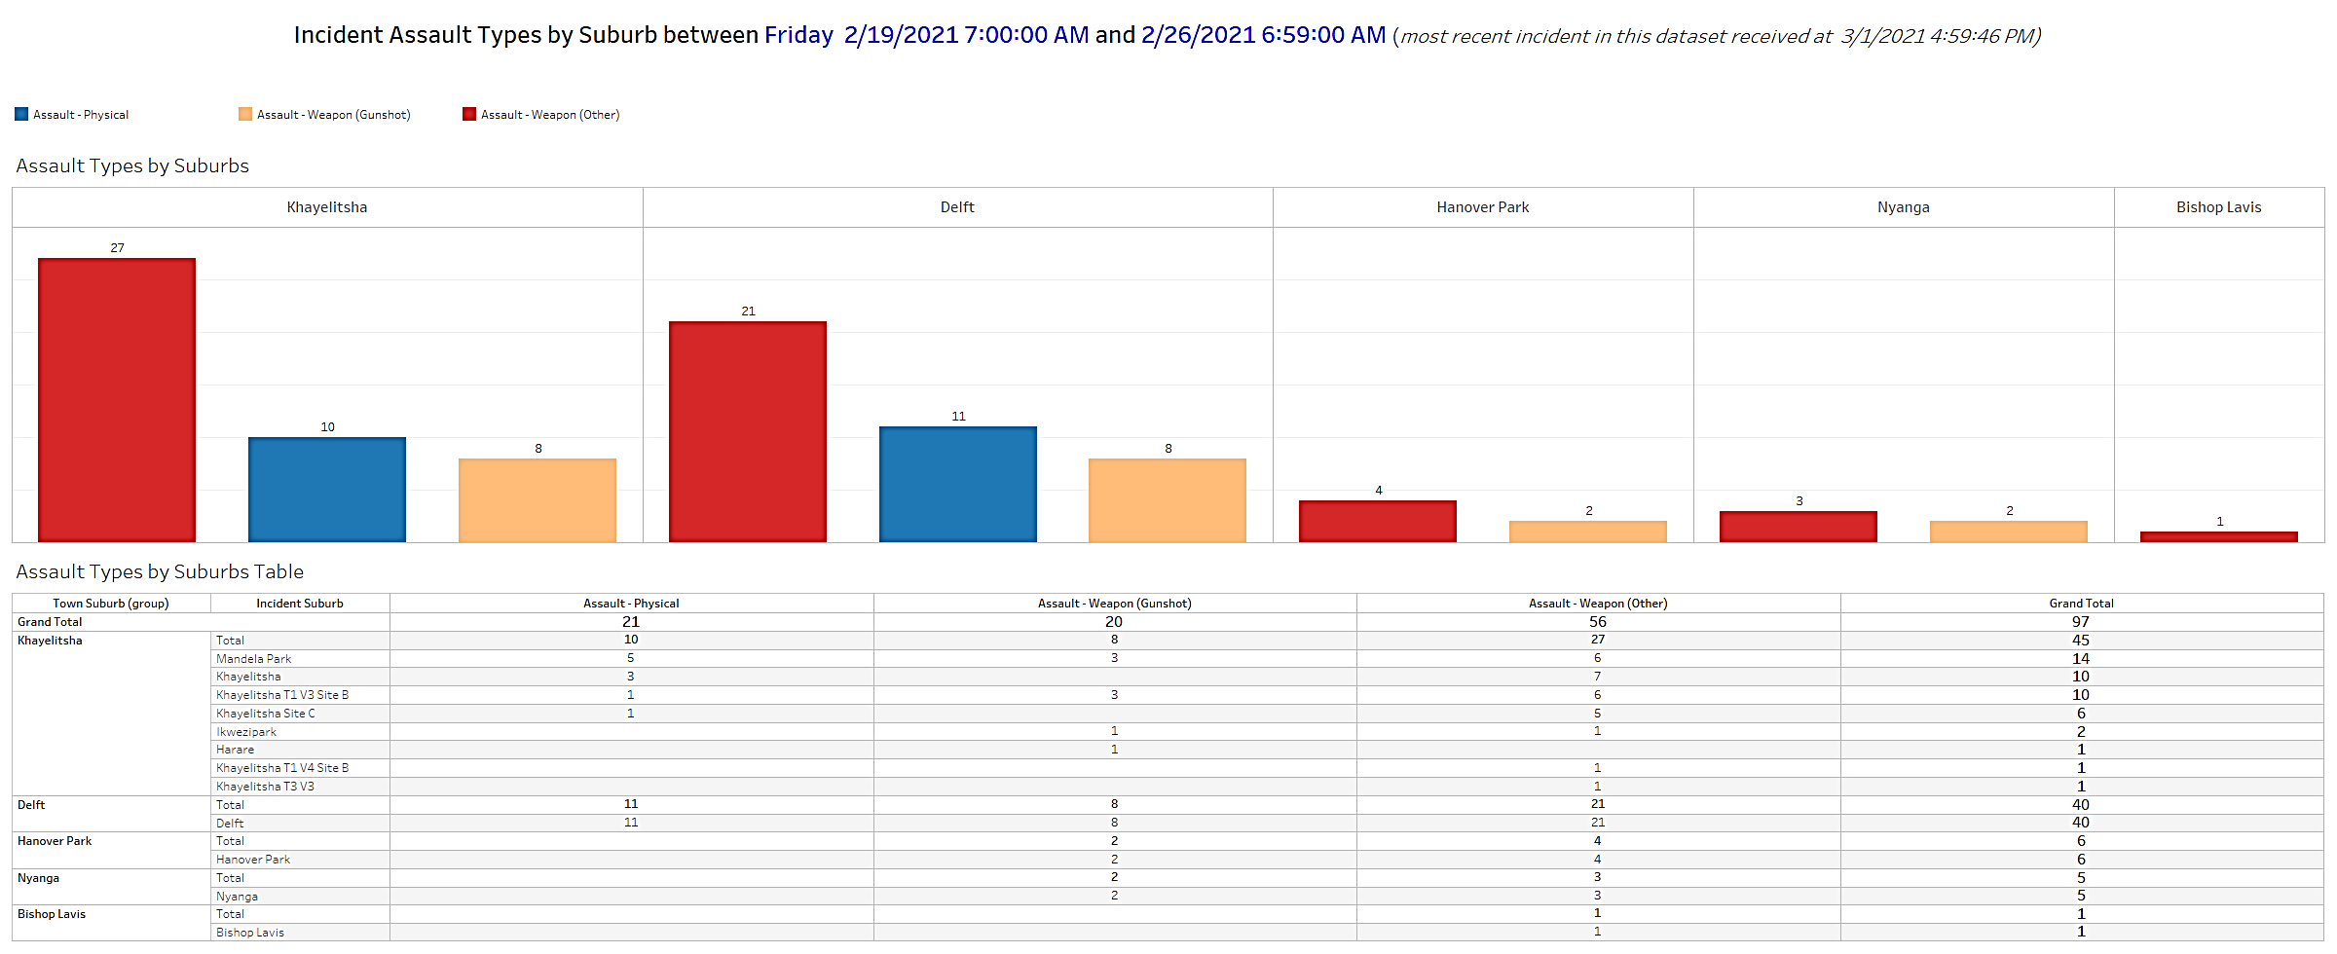
Emergency Medical Services (EMS) has developed reports for each priority area.
These reports include detailed information on time of injury, type of injury and place of injury, aligning perfectly with the Cardiff Model.
These reports will be drawn weekly and made available to all stakeholders.

Slide 16
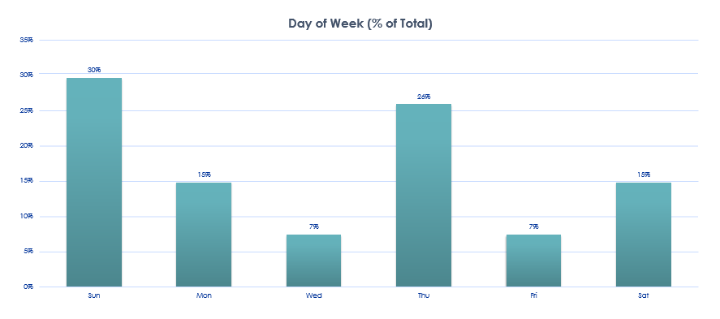

EMS Data- All Assaults August-October 2020- Day of the week- Hanover Park
Hanover Park
Over the 3-month period, we see that the majority of EMS cases occurred on a Sunday or a Thursday.
This is an interesting contrast to Delft, Khayelitsha and Nyanga, which all showed more assaults attended by EMS on Saturday and Sundays.

Slide 17
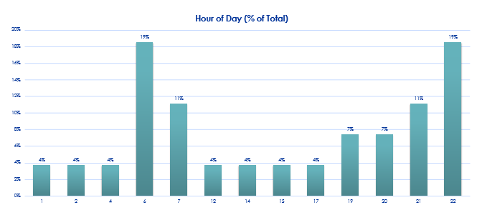
EMS Data- All Assaults August-October 2020- Day of the week- Hanover Park
These data show that 30% of assault cases attended to by EMS occurred between 21h00-22h00.
The increase in EMS cases at 06H00 to 07h00 may be attributed to people seeking assistance in the morning after the assault.
Understanding the time pattern of assaults will help guide resource deployment.

Slide 18
Collaborative Governance

Slide 19
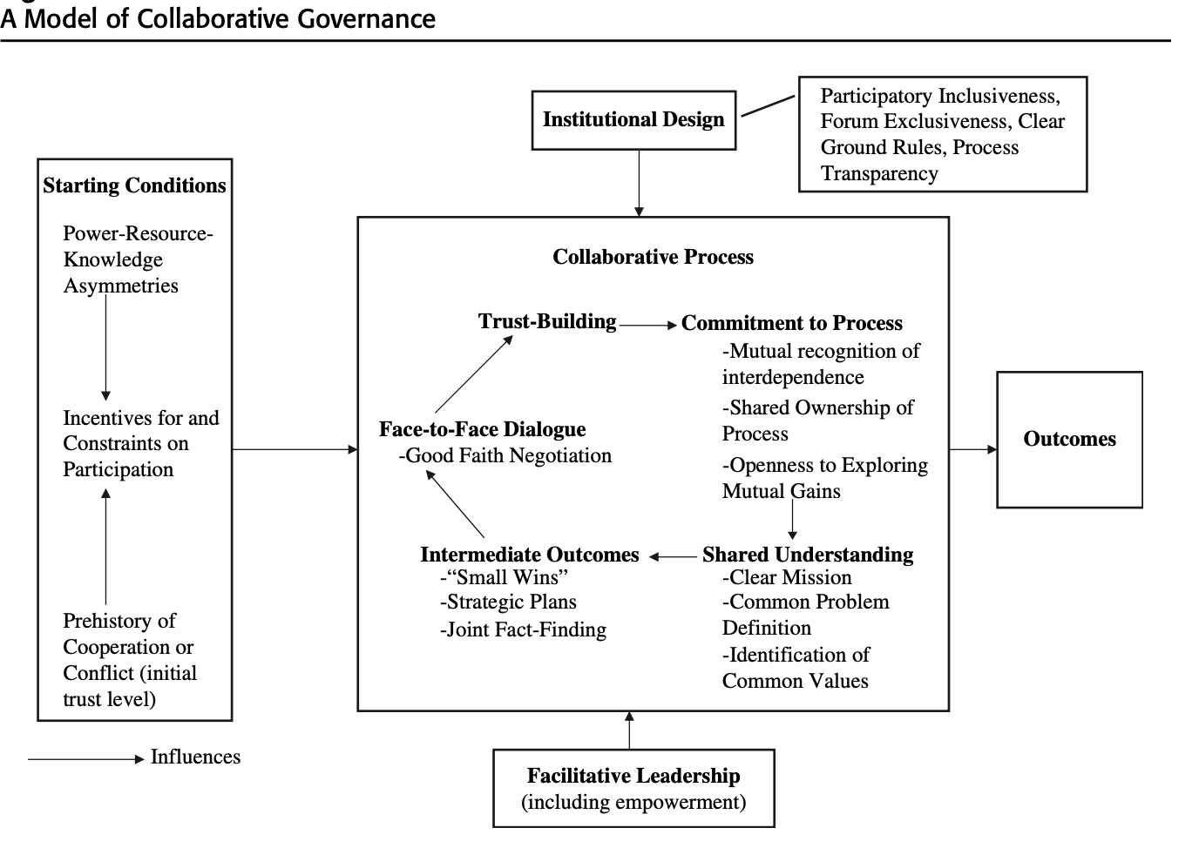
A Model of Collaborative Governance

Slide 20





Evidence Stream
Advisory Board
Steering Committee
Interim Tech
Steering Committee
Data surveillance Stream
Evidence-based Initiatives
Law Enforcement Technical Work Group
Social Cohesion Technical Work Group
Urban Design Technical Work Group
Data Surveillance
Hanover Park Nyanga Khayelitsha Delft Bishop Lavis Mitchells Plain
Police station, hospitals/clinics, schools, social workers, libraries, sanitation, cleansing, urban management, area economic development

Slide 21
Evidence Stream
Advisory Board
Steering Committee
Interim Tech
Steering Committee
Data surveillance Stream
Evidence-based Initiatives
Law Enforcement Technical Work Group
Social Cohesion Technical Work Group
Urban Design Technical Work Group
Data Surveillance
LE
LE
LE
LE
LE
Area-based Technical Workgroups?
Technical Area Teams
Who will function in these circles and what will they do?
Hanover Park Nyanga Khayelitsha Delft Bishop Lavis Mitchells Plain
Police station, hospitals/clinics, schools, social workers, libraries, sanitation, cleansing, urban management, area economic development

Slide 22
Evidence Stream
Advisory Board
Steering Committee
Interim Tech
Steering Committee
Data surveillance Stream
?
Evidence-based Initiatives
Law Enforce-ment Work Group
Social Cohesion Technical Work Group
Urban Design & Management Technical Work Group
SC
LE
+
+
=
UDM
Data Surveillance
?
LE
?
SC
LE
SC
LE
SC
?
UDM
?
UDM
?
?
?
UDM
?
3+ Technical Area Teams
Dashboards
Area-based Team (ABT)
6 Initial Metro Sites 5 Additional Metro Sites 5 Rural Sites
Police station, hospitals/clinics, schools, social workers, libraries, sanitation, cleansing, urban management, area economic development
What’s missing?
14
Notes:
We will have to figure out interactions with the eventual Steering Committee, the Technical Working Groups and the Area Based Teams
Is this governance or more than that?
This is where a Learning Network is important to understand and compare the different experiences across the 16 sites

Slide 23
Area Based Interventions & LEAP Deployments

Slide 24
Area-based interventions – City of Cape Town
Prioritised geographic areas in Cape Town
6 prioritised areas for initial LEAP officer deployment:
  Klipfontein/ Mitchells Plain – Hanover Park, Mitchells Plain & Nyanga
  Tygerberg/ Northern – Delft, Bishop Lavis
  Khayelitsha/ Eastern - Khayelitsha
5 additional geographic areas (for additional LEAP officer deployment):
  Klipfontein/ Mitchells Plain – Gugulethu
  Tygerberg/ Northern – Kraaifontein & Mfuleni
  Khayelitsha/ Eastern – Harare
  Southern/ Western - Atlantis
Area-based teams:
  The ABT methodology will be based on data-led evidence to guide interventions. The ABT will ensure coordination and monitoring of all interventions and operationalises service delivery interventions
  The local “Area-Based Teams” (ABTs) will bring law enforcement and violence prevention together & is well placed to incorporate the other priorities of the recovery strategy.

Slide 25
Area-based Interventions – City of Cape Town
First 6 prioritized geographic areas
Bishop Lavis
Mitchells Plain
Nyanga
Khayelitsha
Delft
Philippi

Slide 26
Law Enforcement Technical Work Group
Achievements to date
  Established with DOCS, SAPS, EDP, City & ISS
  Partnership created with SAPS & LEAP in establishing area-based law enforcement interventions
  Station Commander leads
  Identified following quick wins:
  Firearms
  Substance abuse (alcohol & drugs)
  Persons of interest

Slide 27
Law Enforcement Technical Work Group
Functions
Monitoring of deployments
Monitoring of actions
Operational indicators (mandate)
Mapping and design
Actual vs allocated
Weekend vs week
Data driven (linked to homicide pattern)
Optimal utilization
Arrests executed
Confiscations
Fines issued
Monitoring of homicides
Ensure collaboration
Province
Priority areas
Instruments used
Forming
Storming
Norming
Performing
Operational coordination
Improve cooperation
Monitoring & Evaluation
Mentoring

Slide 28
Area-based interventions – Rural Municipalities
Area-based teams: Progress on implementation
      District and Local Municipalities have been engaged via the development and funding of District Safety Plans over the years.
      District and Local Municipalities have been consulted on the adoption of the area-based approach of the safety priority for the 2021/22 financial year.
      District and Local Municipalities have agreed to identify one local area within a local municipality (5) to implement the area-based safety priority approach, as from April 2021.
      The input of SAPS and other role-players are important to establish similar governance arrangements to that of the City of Cape Town, in each of the 5 non-metro districts.

Slide 29
Way forward

Slide 30

Concluding remarks & next steps
Steering Committee established – weekly meetings are held
Evidence Advisory Committee established and meets monthly
Law Enforcement Technical Working Group meets weekly and have undertaken the following:
  Evidence-based policing model workshopped with Hanover Park SAPS officers
  Identification of LE teams in the 6 initial sites
Law Enforcement Area Tactical Teams to be launched in the 6 sites
Presentation made to the SAPS PC & his top management – 8 March 2021 PCCF. Further engagements with Cluster Commanders and Station Commanders to take place
Municipalities confirming areas for the establishment of 5 ABTs
Further roll-out of LEAP in the additional 4 areas – Gugulethu, Mfuleni, Harare & Kraaifontein to take place from April 2021
Promulgation of quick win liquor amendments underway
On-boarding of violence prevention pillar in the ABTs – establishment of Urban Design & Social Cohesion Technical Committees
Addressing quick win spatial & urban design interventions

