Slide 1
BREEDE-GOURITZ CMA 2019-2020
ANNUAL REPORT PRESENTATION
Jan van Staden
Chief Executive Officer (Acting)
30 March 2021

Slide 2
CONTENT OF THE PRESENTATION
Institutional arrangements
The Breede-Gouritz Water Management Area
Vision
Mission
Values
Strategic objectives
Annual performance information
BGCMA Employment Equity Statistics
Gender statistics in the BGCMA
Annual Financial Statements for the year ended 31 March 2020
Audit outcomes for the 2019/20 financial year

Slide 3
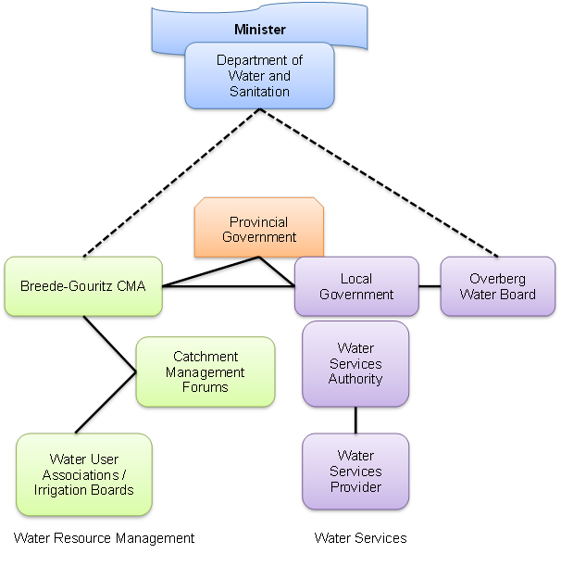
Institutional arrangements of the Breede-Gouritz Water Management Area

Slide 4
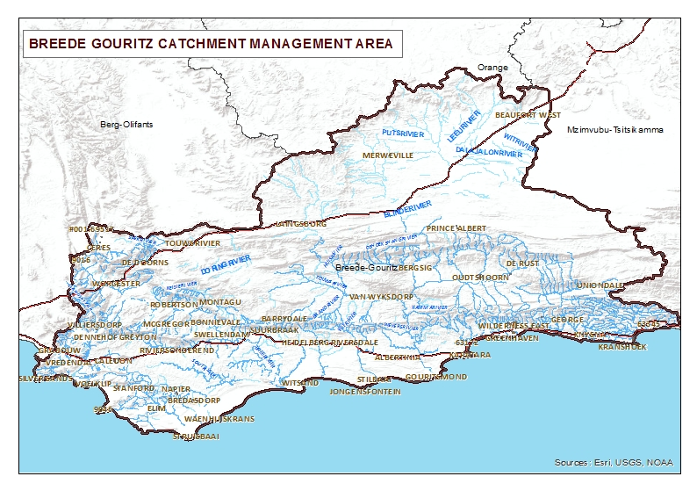
The Breede-Gouritz Catchment Management Area

Slide 5
VISION
The Breede-Gouritz Catchment Management Agency (BGCMA) has a vision of:
Quality water for all, forever

Slide 6
MISSION
The Breede-Gouritz Catchment Management Agency exists to:
manage water resources responsibly, through continuous engagement with all stakeholders and to devolve decision making to the lowest level for the benefit of all water users in the Breede-Gouritz Water Management Area, including the environment.

Slide 7
VALUES
Integrity
Accountability
Empowerment
Approachability
Equity

Slide 8
STRATEGIC OBJECTIVES
Water Resources planning
Water Use Management
Institutional Engagement
Water Allocation Reform
Strategic Support
Management and Governance
Resources Protection

Slide 9
ANNUAL PERFORMANCE INFORMATION
1. Water Resources Planning
Indicators | Planned Targets | Achieved Targets
% of land use planning rezoning applications | 90% | 95%
2. Water Use Management
% of water registrations finalised | 85% | 73%
% of licences captured | 100% | 84.6%
% of licences recommended as per regulation | 85% | 75.76%

Slide 10
ANNUAL PERFORMANCE INFORMATION
2. Water Use Management contin……
Indicators | Planned Targets | Achieved Targets
% of general authorisations confirmed | 100% | 100%
Number of audit reports completed for water use compliance | 80 | 88
Number of confirmation letters sent | 200 | 93

Slide 11
ANNUAL PERFORMANCE INFORMATION
3. Institutional and Stakeholder Relations
Indicators | Planned Targets | Achieved Targets
Number of learners and stakeholders capacitated and awareness in WRM | 5000 | 9793
Number of Intergovernmental Cooperation initiatives facilitated to enhance WRM | 4 | 6
Number of newsletters compiled and printed | 4 | 4
% of approved grant projects funded | 100% | 100%
Number Forums supported in WRM | 30 | 46

Slide 12
ANNUAL PERFORMANCE INFORMATION
4. Water Allocation Reform
Indicators | Planned Targets | Achieved Targets
% of HDIs and RPFs technically supported on water use | 100% | 100%
% of RPFs assisted with completing financial applications for government subsidies | 100% | N/A
Number of workshops held to capacitate and empower RPFs in WRM | 2 | 9
Number of Rain Water Harvesting Tanks installed | 400 | 400
Notes:
N/A – Due to DWS funding constraints.

Slide 13
ANNUAL PERFORMANCE INFORMATION
5. Water Resource Protection
Indicators | Planned Targets | Achieved Targets
Number of DWS Water Quality Monitoring projects sampled (NEMP) | 1 | Included in BGCMA monitoring program
Number of BGCMA water resource points monitored | 80 | 146
Number of river rehabilitation projects funded and technically supported | 3 | 5
% of reported non-compliant cases resolved | 100% | 100%

Slide 14
ANNUAL PERFORMANCE INFORMATION
6. Strategic support
Indicators | Planned Targets | Achieved Targets
% of reports complying with listed financial reporting prescripts | 100% | 100%
Number of proposed tariff reports submitted to DWS complying with pricing strategy | 1 | 1
Number of risk assessment reports | 1 | 1
Percentage of compliance to audit recommendation | 100% | 100%
% of targeted procurement budget spent on BBBEE (9.2 m, which is 30% of the procurement budget) | 100% (R9 200 00) | 163% (R15 006 533)

Slide 15
ANNUAL PERFORMANCE INFORMATION
6. Strategic support contin………
Indicators | Planned Targets | Achieved Targets
% of WRM charges collected | 65% | 78%
% of outstanding debt recovered | 10% | 15%
% of occupancy rate of approved and funded posts on the organogram | 75% | 72%

Slide 16
ANNUAL PERFORMANCE INFORMATION
7. Management & Governance
Indicators | Planned Targets | Achieved Targets
% of Corporate Compliance reports and non-financial reporting scripts produced | 100% | 100%
Number of shareholder compacts signed | 1 | 1
Number of agreements signed | 1 | 1

Slide 17
EMPLOYMENT EQUITY STATISTICS 2019-2020

Slide 18
GENDER STATISTICS IN THE BGCMA

Slide 19
FINANCIAL REPORT
AS AT 31 MARCH 2020
Presentation by: Zanele Mngoma
Chief Financial Officer
4 February 2021

Slide 20
Breede-Gouritz Catchment Management Agency
Annual Financial Statements for the year ended March 31, 2020
Statement of Financial Position as at 31 March 2020

Slide 21
Breede-Gouritz Catchment Management Agency
Annual Financial Statements for the year ended March 31, 2020

Slide 22
Breede-Gouritz Catchment Management Agency
Annual Financial Statements for the year ended March 31, 2020

Slide 23
Breede-Gouritz Catchment Management Agency
Annual Financial Statements for the year ended March 31, 2020

Slide 24

Breede-Gouritz Catchment Management Agency
Annual Financial Statements for the year ended March 31, 2020
AUDIT OUTCOMES FOR THE 2019/20 FINANCIAL YEAR:
Clean Audit with no findings for the 2019/20 financial year !!!!!!!!!

Slide 25
THANK YOU
ENKOSI
DANKIE

