Slide 1
Caro Smit:
Psychiatric Social Worker; Alcohol & Drug Educator & Counsellor Director & Founder SADD - 2006
Internationally trained Road Safety Expert
Member of
Awards
FedEx International Road Safety Award- 2017
Prince Michael of Kent International Road Safety Award - 2012
C.A.R.S- Road Safety Award - 2006
“SADC Road Safety NGO’s”
Member of “Africa Chapter of the Global Alliance of NGOs for Road Safety.”

Slide 3
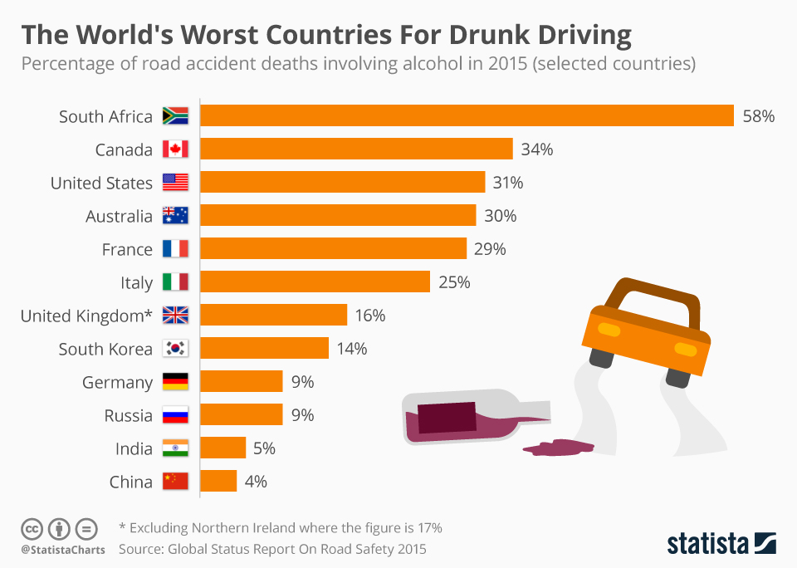

Slide 4
It is the alcohol that affects the driving- not whether the person is “drunk” or not, & that is why it is now called “Drink Driving”
Because even 1 Unit affects driving skills
NB. SAFEST DRIVING RULE =
ZERO
ALCOHOL!!

Slide 5
Alcohol is a Drug
Alcohol is the Number ONE drug problem in South Africa
DRINK DRIVING IS A SERIOUS CRIME
ROAD CRASHES ARE A PUBLIC HEALTH ISSUE

Slide 6
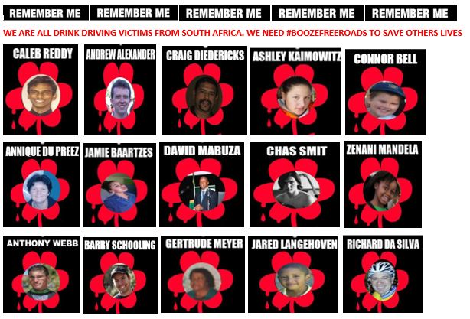
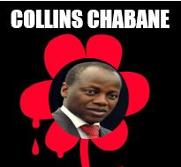
Deaths throw families into poverty/further into poverty as well as eternal grief

Slide 7
Health
Social Development
Transport
Finance
Justice
DUI affects S.A.’s GDP, Parliament & many Government Departments including…….

Slide 8
Education, units & elimination rates of alcohol is very important.
1 x 25ml tot of 45% whiskey/brandy etc = 1 unit
1u = 0.02g BAC
It takes 1 hour to eliminate 1 u
So <0.02g effectively means one cannot drive after 1 tot

Slide 9
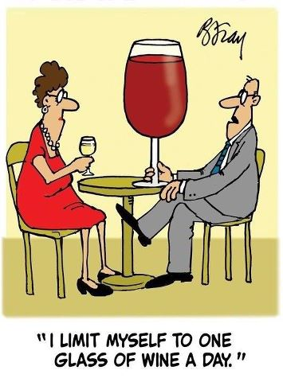
Which is 1 glass of wine?
That is why you should not talk about a “drink”. This is very inaccurate! Talk about units!
Small 90ml glass white wine 12%
= 1 unit = 0,02g
Large 250ml glass red wine 14% = 3,5units
= 0,07g. OLL

Slide 10
SA used to have BAC of 0.08g. This was changed to 0.05g… and yet the drink driving rate & deaths still went up. Our present <0.05 & <0.02 for professional drivers is W.H.O.’s Best Practice. We only need to change Novice drivers limits to Zero or <0.02g.

Slide 11
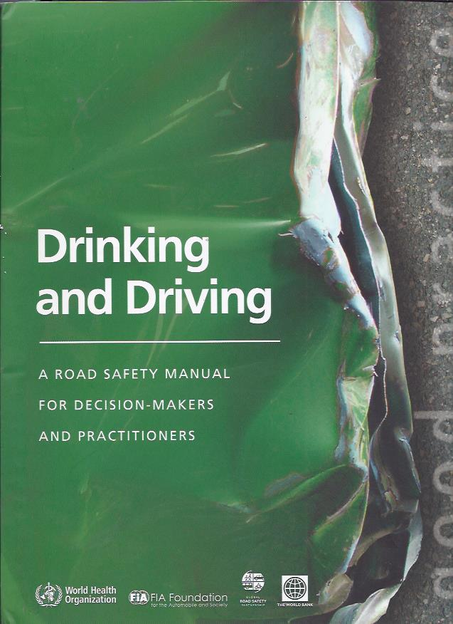

Slide 12
Drinking and driving reduction: W.H.O. WHOW.H.OProgrammes
ELEMENT | EFFECTIVENESS
Road safety/ crash data assessment
High
Laws on BAC or BrAC levels
High
Strong enforcement of drink-driving laws
High
Strict and swift punishment for those who break drinking and driving laws
High
Public information and education
High (when combined with enforcement)
Monitoring and evaluation
High

Slide 13
Changing driving behaviour
N.B. Behaviour only changes because people are afraid of the legal and financial repercussions of their actions.

Slide 14
SADDs Recommendation: Keep BAC’s at same level, but change BAC of Novice drivers. If changes MUST be taken then use BAC of <0.02g which effectively means ZERO alcohol. Zero BAC for Novice drivers of all ages, for 1st year after getting licence.
Suggested PENALTIES
At 0.02 ->0.049 g. Warning, Diversion Program and Fine of R20,000 which goes into a Special Victims Fund
0.05g + Criminal record. Automatic suspension of licence
At any BAC, causing severe injuries or death - imprisonment for up to 6 years, suspension of licence, and large Fine – up to R120 000 allowed (which goes into a Special Victims Fund)

Slide 15
- ketones/residual alcohol in body - small amounts of mouth alcohol - alcohol in medicines - At <0.02g drivers are not dangerous at this level- have more fender benders than killing/injuring - Lawyers will create doubt/ difficult to get convictions /they make money
but …. It’s Hard to test Zero because of -

Slide 16
BAC | EFFECTS ON DRIVING SKILLS | CHANCE OF CRASH
0.02 W.H.O Best Practice Novice/ Professional drivers
Slight impairment of judgement
2x Chance
0.05
W.H.O:
Best Practice
Very acceptable
Decrease in various brain centre functions
Inconsistent effects on behavioral task performances
Decrease in judgement and inhibitions
4x Chance
0.14
Impairment of balance and movement
Impairment of visual functions
Slurred speech
Vomiting, especially if this BAC is reached rapidly
18x Chance
Most deaths occur at these levels
Severe sensory impairment, including reduced awareness of external stimulation
Severe motor of impairment, e.g. frequently staggering or falling
80x Chance
0.20
0.40
Non responsive stupor
Loss of consciousness
Anaesthesia comparable to that of surgery
Death (for many) but not for “alcoholics”
150x Chance

Slide 17
Brand | %Alcohol | Volume | Pure Alcohol | Units | BAC
Vicks Acta Plus | 10 | 10 | 1 | 0.1 | 0.002
Benylyn Wet Cough | 9.5 | 10 | 0.95 | 0.095 | 0.0019
Benylyn Wet Cough | 9.5 | 20 | 1.9 | 0.19 | 0.0038
Linctogan | 12 | 5 | 0.6 | 0.06 | 0.0012
Linctogan | 12 | 10 | 1.2 | 0.12 | 0.0024
Prospan | 0 |  | 0 | 0 | 0
Vicks Ginger Honey | 5 | 15 | 0.75 | 0.075 | 0.0015
Herbal Cough | 13 | 5 | 0.65 | 0.065 | 0.0013
Vicks Medinite Syrup | 18 | 30 | 5.4 | 0.54 | 0.0108

Slide 18
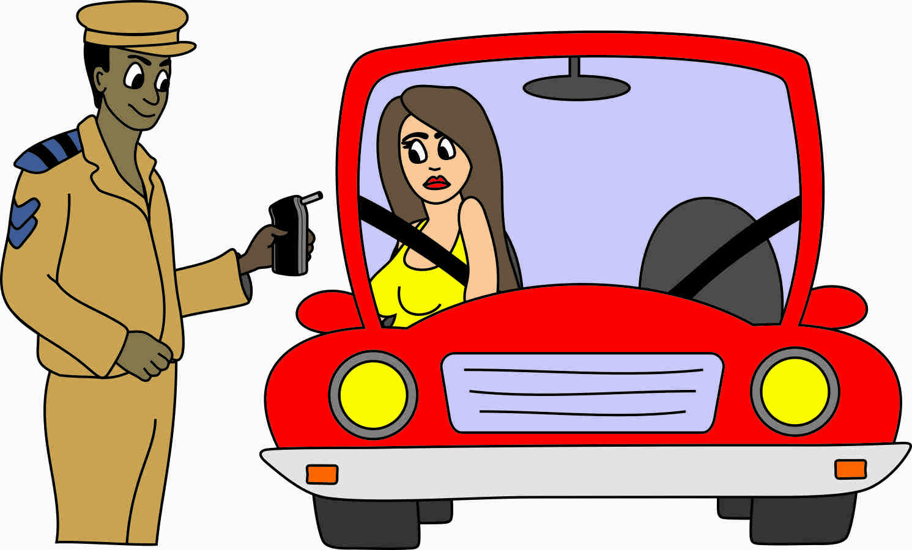
We need Screening devices in all SAPs & Traffic Offices vehicles. Spend money to save money.
Screening devices can give the result as Br.A.C., or converted to BAC

Slide 19
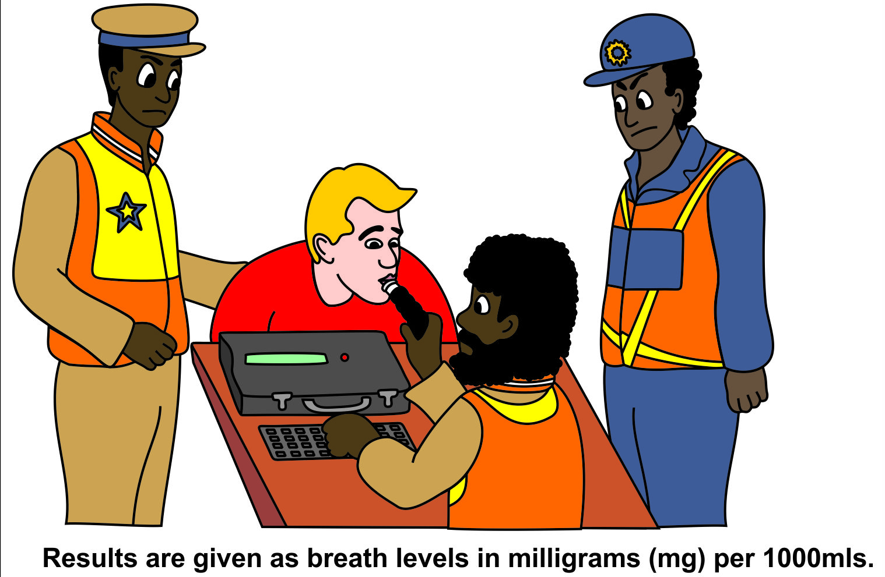
We need Evidential breathalysers as opposed to blood tests. Spend money to save money

Slide 20
We need to get commitment from Parliament - all Ministers from different Sectors in SA Government trained to take DUI seriously
Political Will & Road Safety Officials being committed to testing & harsher sentences will:
Bring down DUI
Protect the rights of victims
Help convict the offenders - not feel sympathy for them
Create awareness of the emotional and financial costs of DUI to the economy and families

Slide 21
.….NOT GUILTY VERDICTS ARE GIVEN DUE TO……..
Lack of evidence
Lack of forms filled in correctly/Lack of documentation
SAPS often don’t see drink driving as a crime. “No one was killed”
Need lots of paperwork there Poor Police work
Inadequate training of investigators
No, or bad post crash investigation
At crash scenes: No automatic testing for alcohol/drugs
Lack of understanding of seriousness of road crimes
Political indifference
Records missing. Bribery…….
This is very different to proving a drivers innocence!

Slide 22
What works to reduce drink-driving? (W.H.O)
Setting BAC limits. 0.05 & 0.02 for professional & novice drivers= Best practice!
Enforcement of BAC levels. Police &Traffic Officers to have BREATHALYZERS IN CARS. Test when checking speeding, tyres, License disc- i.e. all time!
Random and selective breath testing. Need many tests.
Severity of punishment. Need suspension of licenses, high fines/penalties/ Imprisonment (for causing death/severe injuries)
Swiftness of punishment. Breath alcohol testers accurate & preferred.
Consistency swift sentencing Special Drink Driving Courts/Traffic Courts. Eg: USA
TEST both drivers for alcohol at all crash scenes. Make this a Mandatory Law.
Treatment of repeat offenders. Alcohol ignition interlocks. Introduce esp. for convicted DD’s. Eg:US, Australia. Alcohol Training schools. (Diversion programs or community service not very effective. )
Restriction on young or inexperienced drivers/Graduated drivers licensing.
0% ALC Designated driver and ride service programs. Eg: Australia/NZ

Slide 23
Education, Engineering, Enforcement, & Evaluation Of the 4 “E’s”…
Enforcement is the most important element
Good Political Will & Road Safety Officials being committed to testing & harsher sentences will help deter people from DUI
Enforcing the seatbelt laws will bring down deaths & injuries significantly

Slide 24
Thank You. Any questions ? Please contact me if you would like to order manuals/education manuals!
South Africans Against Drunk Driving
NPO 055 255
www.sadd.org.za
+27 8282 13673
carosmit@sadd.org.za
Twitter SADD_SA

