Slide 1
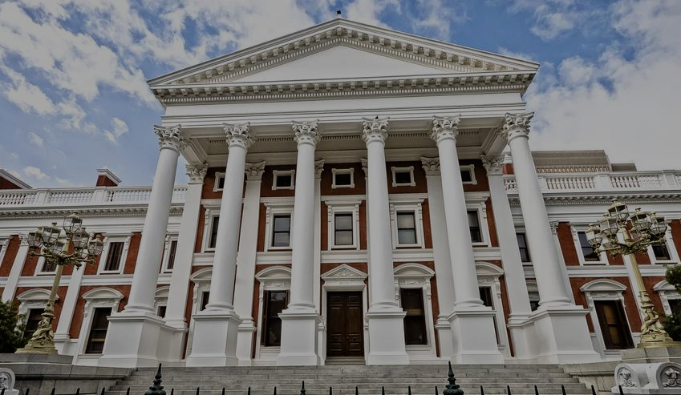
INDEPENDENT MEDIA
PRESENTATION TO PARLIAMENT
STANDING COMMITTEE ON FINANCE (SCOF)
WEDNESDAY 17 MARCH 2021
PRESENTED BY:
DR IQBAL SURVE (EXECUTIVE CHAIRMAN)
TAKUDZWA HOVE (CHIEF OPERATING OFFICER)
ANEEZ SALIE (EDITOR IN CHIEF)
SIFISO MAHLANGU (EDITOR, THE STAR)

Slide 2
BACKGROUND TO PRESENTATION
Honourable Minister of Finance Tito Mboweni suggested that Independent Media and the PIC/ GEPF present the status of the company to Parliament.
Independent Media and SIM (Sekunjalo Independent Media) together with their 1,500 employees welcome this opportunity to present to SCOF.
* Point of clarification for SCOF:
The Minister referred to Sekunjalo whereas he meant the Special Purpose Vehicle called Sekunjalo Independent Media Consortium (SIM) currently renamed Independent Media Consortium;
This reference to Sekunjalo was something which arose from the PIC presentation to SCOF where they kept referring to Sekunjalo as opposed to the Consortium.
Sekunjalo has written numerous times to the PIC to stop referring to the SIM consortium as Sekunjalo as the PIC has at no stage advanced any funding to Sekunjalo Investment Holdings.

Slide 3
OUR TITLES

Slide 4
OUTLINE OF THE INDEPENDENT MEDIA PRESENTATION
Section 1 - MEDIA BEFORE 1994 & SIM ACQUISITION
Media before 1994 & Independent Media Consortium (SIM) Sale
PIC’s investment in Independent Media - Rationale
Transformation of the media industry
The PIC investment: Facts as opposed to misinformation
Attempts to derail the transaction before acquisition
Section 2 - POST ACQUISITION
The Early Years : Resistance to a black competitor
The later years: Transformation drive & Excellence in diversity
Section 3 - UNLOCKING VALUE FOR THE PIC
Unlocking value for the PIC
2019 Post Sagarmatha conversation
Section 4 - CONCLUSION & OUR FUTURE
Conclusion
Our Future: Media Freedom & Diversity

Slide 5
SECTION 1:
MEDIA BEFORE 1994
&
SIM ACQUISITION

Slide 6
MEDIA BEFORE 1994: THE AFRIKAANS MEDIA
Prior to 1994 the print media landscape was largely controlled by four major media groupings
The Afrikaans media which today includes Naspers/Media24, Caxton CTP arose directly from the belly of two major Afrikaans aligned political parties and businesses.
The Nasionale pers (Naspers) arose from the ruling National Party :
Naspers/Media24 was dominated from the Western Cape and was close to PW Botha and their editors sat in on the cabinet meetings
Hendrik Verwoed, the architect of apartheid, was the editor of the Transvaaler incorporated into Naspers
Naspers’ major publications include Die Burger, Die Beeld and Rapport and City Press which was launched for the black market
They also have the largest online site in South Africa-News24
A Chairman of Naspers famously wrote to PW Botha and vice versa pledging support for the National Party in exchange for printing textbooks contract
Caxton funding and support arose from another Afrikaner media group based in Transvaal (Gauteng) funded by the government. Established The Citizen which still exists today.
Rembrandt controlled by Johan Rupert and the Rupert family is a significant shareholder in Caxton as well as other media in South Africa such as eTV, ENCA and provides support for the Daily Maverick.

Slide 7
MEDIA BEFORE 1994: THE ENGLISH MEDIA
Prior to 1994 the English media was for all intents and purposes controlled by the Oppenheimer family through Anglo American and its subsidiaries
This eventually resulted in two major media groupings, - The Times Media Group (Arena-Sunday Times & Business Day) and The Argus Group (Independent Media)
The Oppenheimer family decided to sell their shares in the Times Media business, which was listed, to a consortium led by President Cyril Ramaphosa through the NEC, which eventually became the Johnnic Consortium.
This changed over time to be known as Johnnic Holdings and Avusa which had a shareholder from Tokyo Sexwale’s Mvelaphanda Group.
In both above cases because it was a listed company, they were never able to have control and shape the transformation and narrative of these titles. The management and editorial remained largely untransformed.
Just prior to 1994 Oppenheimer did not want The Argus Group to fall into the hands of the ANC and sold this group to Tony O’Reilly’s Independent Media from Ireland. Hence the name changed from The Argus Group to Independent News and Media now being owned by the Irish
From 1993 to 2013, Independent Media was owned by the listed Irish Independent Media Group in which control had changed from Tony O’Reilly to Dennis O’Brien, the telecoms entrepreneur. The Irish Independent was in serious financial difficulty having made acquisitions globally and was forced to sell its businesses overseas in South Africa and Australia

Slide 8
THE SALE OF INDEPENDENT MEDIA
In 2012 the Irish announced that they would be selling their SA media assets and appointed corporate advisors to effect the sale.
There was a bid process with 30 bidders and eventually a short list of 5 bidders
Dennis O’Brien, the major shareholder of the Irish Independent indicated publicly that they would accept nothing less than 280 million Euros for the South African assets, roughly translating into R3,2 billion.
However, as time went on a number of factors forced the Irish to sell Independent for a lower amount. These factors included: the debt which the Irish had to Banks in Ireland, the impact of the rand/dollar exchange rate and most importantly the Marikana massacre which created a confidence crisis in the South African economy
The 5 shortlisted bidders included prominent South African businessman from prominent families and some holding political positions.
The Gupta Family also tried to bid but failed to make the short list.
The Sekunjalo Consortium was the successful bidder with a bid just over R2 billion which was negotiated down from an original R2,6 billion to just over R2 billion.

Slide 9
INDEPENDENT MEDIA CONSORTIUM (SIM)
The Sekunjalo Independent Media Consortium (SIM) was set up with Sekunjalo Investment Holdings being the anchor shareholder to provide the necessary capital support, technical and corporate transaction experience.
The broad-based consortium which was negotiated with the PIC included labour union investment companies, women’s groupings, community groupings, representatives of the Black Business Council and various NGO’s.
Importantly employees of Independent Media through an employee trust were given an opportunity to become shareholders and remain shareholders today.
Initially the PIC had made a non binding commitment of over R2 billion when the Irish were demanding close to R3.2 billion.
Sekunjalo appointed the London division of global investment bank CitiBank as its corporate advisor to the transaction. This unit had strong media M&A experience.
CitiBank was retained by Sekunjalo (at its own risk) as its advisor even though the transaction might not be successful
The SIM consortium also engaged with former senior black editors to advise on the purchase of Independent Media.

Slide 10
SEKUNJALO INDEPENDENT MEDIA CONSORTIUM
Anchor Shareholder
Sekunjalo Investment Holdings (SIH)
LABOUR FEDERATIONS
BEE BUSINESSES & COMMUNITY GROUPINGS
The South Africa Clothing and Textile Workers’ Union (SACTWU)
Food Allied Workers Union (FAWU)
Kopano Ke Matla Investment Company (Pty)Ltd.
EMPLOYEES
VALUE ADD STRATEGIC PARTNERS
RURAL & WOMEN
GROUPINGS

Slide 11
PIC INVESTMENT IN INDEPENDENT MEDIA: RATIONALE
The PIC was already a significant investor in media.
It had invested in Naspers (when it was almost bankrupt before it changed to a technology/internet company - very successful);
It had invested in Times Media/Tiso Black Star/Avusa/Arena and Caxton CTP where it has lost billions in equity value of its investment.
Many of the above investments of the PIC where there was massive loss in value are a result of the structural shifts in media caused by the rapid shift of audiences to digital and social media platforms.
The PIC supported the Independent Media transaction because:
Firstly, on a purely commercial basis in that the EBITDA based valuation of 7,5 X was in line with global valuations.
Secondly, the PIC saw an opportunity to create a new Naspers or as its then CEO when presenting to Parliament comment - “a black Naspers”.
Thirdly, it was important to bring this important media asset back in South African hands.
Lastly it was an opportunity to enable media diversity in terms of ownership and to transform the media landscape in South Africa by having one of the largest print media groupings owned by black people.

Slide 12
VISION FOR INDEPENDENT MEDIA
Lead the transformation agenda in the media landscape;
Give a voice to previously marginalised communities through ownership and representation (Trade unions, Women, Rural communities, Black investors);
Drive a new media agenda centred on transformation;
Present duality of storytelling (two sides of the same story);
Tell stories about the lived reality of black South Africans with nuance ;
Use media to power growth and development;
Grow vernacular media to ensure access for ALL South Africans;
Transform the decision-making structures to ensure inclusivity and representation for all South Africans; and
Do Media for Social Good and have a meaningful impact on society.

Slide 13
THE PIC INVESTMENT TRANSACTION WITH INDEPENDENT MEDIA: MYTH V REALITY
The Myth
The urban myth is that the PIC has invested R2 billion in Independent Media.
Deliberately propagated by detractors of Independent Media.
Create impression that only the PIC funded the transaction.
The reality
The PIC has invested, for its own account, in Independent Media an amount of
R167 million for an equity stake of 25%
R133 million to acquire an existing portion of a shareholders loan
R285m Bridging loan (prior to preference shares conversation) as part of the leveraged buyout (funds all to the seller)
It provided R215m of the R365m required to fund Independent Media Consortium (SIM) 55% equity into Independent Media
The total PIC exposure across to Independent Media and SIM at the time was R850 million in total, all of which was paid over to the Irish as part of the purchase consideration. (Initial commitment was R2 billion)
Sekunjalo invited other investors to co invest in Independent Media which provided the remaining capital with approximately R1,15 billion.
Since 2013, the PIC has not supported Independent Media with a single cent.
Only the Sekunjalo Group is providing Independent Media financial support to grow its business and compete in the marketplace. To date, directly and indirectly from the Sekunjalo Group, almost R500 million has been provided, allowing the PIC to benefit as a shareholder without providing any additional funds.
It is important to note that the Sekunjalo Group negotiated the Irish down from R2,6 billion to just over R2 billion, saving hundreds of millions in value for its shareholders including the PIC.

Slide 14
THE ATTEMPTS TO DERAIL THE TRANSACTION
At the beginning of 2013, Independent Media Consortium (SIM) announced as the preferred bidder.
Immediately vigorous attempts was made by SANEF Chair Nic Dawes, to stop the transaction by threatening that:
competition commission intervene to break up the Independent Media Group’s 18 regional and national titles (the hypocrisy was that whilst Independent Media was under the Argus Group and the Irish, there was no call to break up the group).
It is important to note that this attempt happened before Sekunjalo even owned Independent Media.
Simultaneously, a consortium led by Mail and Guardian funders, USA based Media Investment Fund at the time, approached Sekunjalo to acquire 3 major titles, The Pretoria News, The Cape Times and the Natal Mercury as a condition for SANEF dropping its objection to the sale of Independent Media to SIM.
SIM refused to be threatened and in the end Dawes had to apologise. SANEF continues to play a partisan role against Independent Media as seen by its most recent conduct.
On the eve of the transaction, Sekunjalo was approached to walk away from the Independent Media transaction for a payment of R500 million to a consortium that was linked to a Democratic Alliance (DA) funder.
This informal offer was made on the basis that Sekunjalo would be R500 million richer without any costs and cede its acquisition to the corporate entity that would acquire the transaction that was aligned to the DA.
This was not unusual as Independent Media under the Irish was fully influenced by the DA and its leadership who would often dictate to senior editors what they wanted to have written in the newspapers.

Slide 15
ALL ATTEMPTS TO STOP THE TRANSACTION FAILED
Notwithstanding all of the challenges that the SIM consortium encountered, it was successfully able to acquire the Independent Media group from the Irish
In summary the financial constraints included:
the PIC reneged on its support for the transaction by reducing its support from R2 billion to R850 million
Aggressive and public posturing by Sanef and its Chair Nic Dawes to stop the transaction
Intensive smear campaign by competitive media such as the Times Media Group and Naspers who feared the commercial competition of a black owned enterprise as well as a competitor and diverse narrative now in the public space.
Attempts to influence the Irish by some senior privileged editorial staff at Independent Media who also attempted to put in a their own bid and retain editorial control.

Slide 16
SECTION 2:
POST ACQUISITION

Slide 17
THE EARLY YEARS : RESISTANCE TO A BLACK COMPETITOR
The first few years Independent Media was faced with a hostile media environment.
The detractors especially competitor media houses (and former Indy journalist) launched an aggressive campaign to undermine Independent Media and its public reputation by targeting the Executive Chairman.
One of the media groups had a project which was well funded and intended to deliver maximum damage on Independent Media and its chairman in order to reduce its influence in the media landscape.
Privileged positions held by executives were changed to a merit based system which resulted in huge internal resistance to transformation and change to the extent that many of the privileged left to join other media houses.
No bank facilities were made available to Independent Media and up to today Independent Media has zero banking facilities and has to pay mostly cash for its working capital needs which includes purchasing paper, printing and logistics costs of more than R700 million annually.
Other media houses decided to withdraw from partners which included SAPA as well as distribution JVs.
The Irish had locked Independent Media into long term onerous printing, distribution and lease agreements. Some still remain and continue to affect our sustainability.
The perfect storm arose almost over night rapid shift globally of revenue from print to digital with Google and Facebook now dominating the advertising revenue landscape.
Real GDP growth during this period was also negative.

Slide 18
THE LATER YEARS: TRANSFORMATIVE DRIVE
Notwithstanding the challenging environment which was sketched earlier, SIM was committed to the success of Independent Media and its transformation.
Employees: The first point of transformation was to ensure our 1,500 employees are selected on merit and there is no special privilege based on race.
Development of young executives and editorial staff :
For example: in the 150 year history of the Cape Times it has its first African editor in Siyavuya Mzantsi, age 28. As much of his appointment was criticised by our detractors he has recently been awarded the INMA Rising Star Award validating his appointment. Similarly we have young editors such as Sifiso Mahlangu at The Star, Ayanda Mdluli at the Daily News and Philani Makhanya at the Mercury.
The transformation is not only at editorial level but at executive and management level:
Independent Media can claim that it is the only fully transformed Media company in South Africa. This is a far cry from the Independent Media of the past which was rooted in privilege where the senior editorial and executive base did not reflect the diversity of the country.
Independent Media is a non racial organization and mirrors the diversity of the country in its leadership.
Independent Media has one of the highest representation of women in its leadership positions.

Slide 19
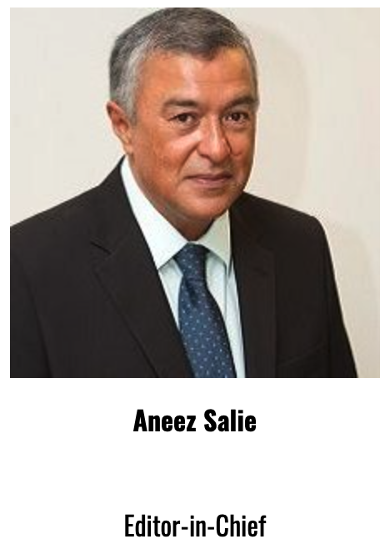
WE GIVE MEDIA FREEDOM A VOICE

Slide 20
EXCELLENCE IN DIVERSITY
Independent Media diversity of its editorial and executive, since the ownership of SIM has made it the most awarded media company on the African continent.
It has been the top media company in Africa despite its limited resources by winning the global awards in video, in digital, community media, in social justice media, in innovation and mobile.
It is regarded as a highly innovative media company with its innovation sought after by global media partners
The next slide is an indication of the awards given to Independent Media since 2015
Campaigns launched by Independent Media “Media for Social Change” reflect the demographic reality and diversity of the communities that we serve and our editorial narrative.

Slide 21
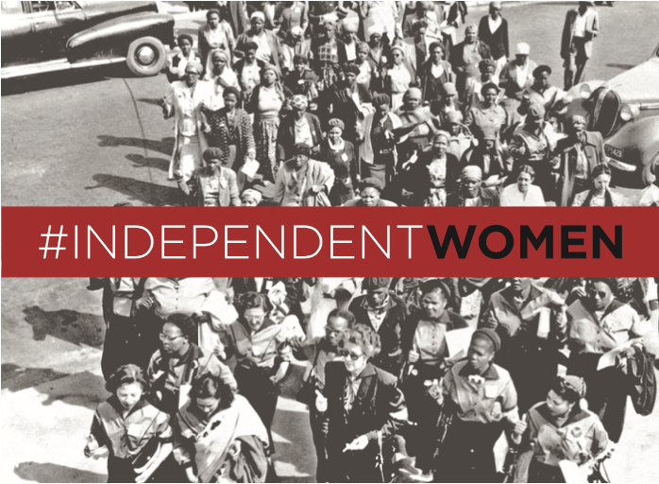
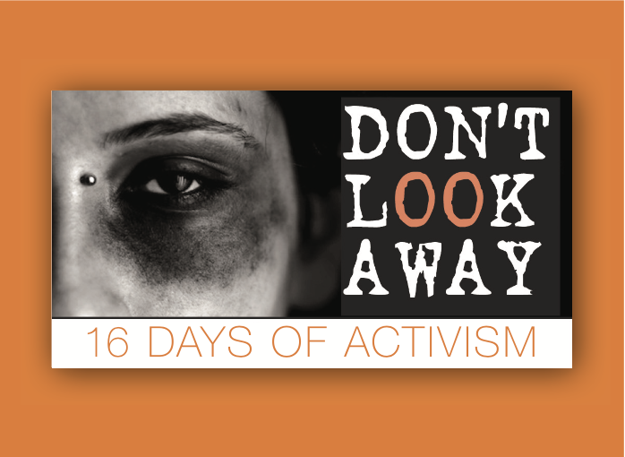
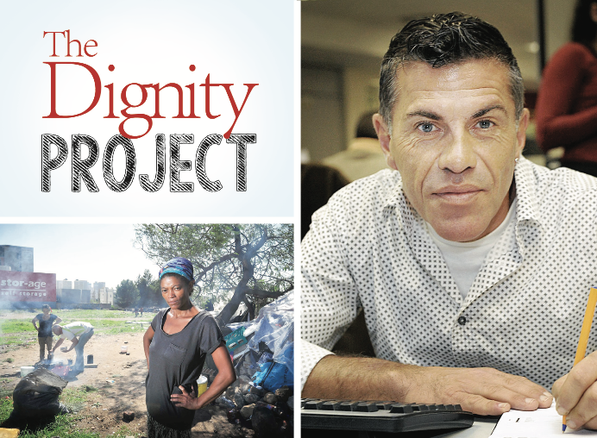
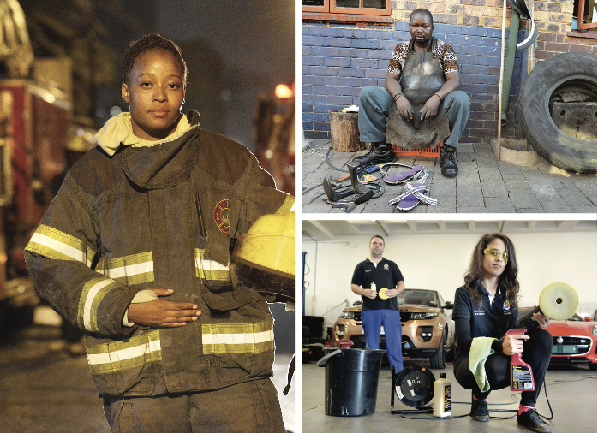
THE POWER TO BRING CHANGE

Slide 22
DIGITAL MEDIA & JOURNALISM AWARDS 2015-2021
2021
Independent Media finalists in INMA 2021 Global Media Awards for Best Brand Awareness Campaign and Best Idea to Encourage Reader Engagement.
Several journalists have received top SA journalism awards such as Standard Bank Sikuvile Journalism Awards and Vodacom
2020
Siyavuya Mzansi received the INMA 30 Under 30’s award for rising stars in the global news media industry.
2019
Best Use Of An Event To Build A News Brand' for its Regional and National High School Quiz which involved creating a platform for teenagers across the country to compete against one another.
Global Media Award for 'Best In Africa' where judges selected the best of six world regions from the finalists.
Senior executive, Sandy Naudé scooped the Silver Shovel Award alongside Pit Gottschalk of Fever Pit’ch in Germany for their lifetime service to the news industry and to INMA events.
2017
INMA GLOBAL MEDIA AWARDS
Best in Africa-Racism Stops with me
Best Community Service Campaign-Racism Stops with me
Best Use of Video-2nd place-Don’t Look Away
Best New Print Product-2nd place-Independent Home Magazine
2016
WAN-IFRA DIGITAL MEDIA AFRICA AWARDS
Best Use of Online Video-What would you take a bullet for?
Best Tablet Publishing-IOL Tablet App
Best News Website-2nd place-IOL
Best Entertainment Lifestyle Website-2nd place Condé Nast House & Garden
Best Entertainment Lifestyle Mobile Service-2nd place-Condé Nast House & Garden App
Best New Product-2nd place-Loot/Isolezwe
2015
INMA GLOBAL MEDIA AWARDS
Global Innovation Award for Africa-Independent Media
Global Innovation Award-2nd place #FeesMustFall
Best Idea Encourage Print Readership-3rd Place -Isolezwe
Best Use of Mobile-3rd Place-Asidlale
Best Use of Social Media-3rd place-MOJO (Mobile Journalism)
Newspaper Category-2nd place-Independent Media

Slide 23
SECTION 3:
UNLOCKING VALUE FOR THE PIC-SAGARMATHA

Slide 24
UNLOCKING THE VALUE FOR PIC: NASPERS SUCCESS STORY
The former CEO of the PIC informed parliament that due to the success with Naspers, they want to replicate that effort and create a new “ black Naspers”.
Naspers which was financially struggling in 2001, was saved by it’s investment in Tencent in China and became one of the most successful PIC investments of all time.
Simultaneous to this the Sekunjalo Group had invested significantly in eCommerce, digital media, syndication services, application software and various other tech/media investments and aggregated these separate investments into a company called Sagarmatha Technologies.
Sagarmatha Technologies has applied to SARB to list on an International Stock Exchange as a primary listing.
Sagarmatha applied to the Reserve Bank in November 2018 for a primary listing for New York and Hong Kong which would result in more than R4 billion coming back to South Africa and the development of young black software engineers who would grow the ecommerce and digital media footprint on the African continent.
Despite the SARB having initially indicating that approval would take at most a few months, Sagarmatha still awaits approval two years later.
SARB has now indicated that a new application has to be made which will be forwarded to Treasury for approval.
This delay has prejudiced Sagarmatha, Independent Media and the PIC and is indicative of a hidden hand stopping the progress of the listing and the unlocking of value for the PIC.

Slide 25
SAGARMATHA: A MSP TECH MEDIA COMPANY
The Sagarmatha is a multi sided platform company with ecommerce and digital content.
The Sagarmatha listing is important:
for the development of internet and technology industry to compete with Naspers ( which dominates the market)
The PIC should be working with Sagarmatha and Independent Media to ensure the success of an international listing and unlocking value for its pensioners.
Perhaps SCOF can assist in understanding why SARB hasn’t given Sagarmatha the go ahead to list overseas when it qualifies for media/technology companies to be allowed to have primary listing overseas in terms of the new SARB policy.
The SARB changed their primary listing policy to accommodate the Naspers subsidiary Prosus on the Dax exchange in Amsterdam and we still don't know why Sagarmatha is still not able to list/havent got approval for the listing.

Slide 26
THE SAGARMATHA OPPORTUNITY: A QUICK OVERVIEW
Africa:
400 Million Middle class African by 2030, 50% under 35 years
eCommerce sector in Africa generated $16,5 billion in revenue in 2017 and forecasts of $29 million by 2022
435 million Africans accessed the internet in 2018, 191 million are active social media users and just over 1 BILLION have mobile connections
Sagarmatha:
Experience and specialisation in content, commerce and technology
Strong African footprint and partnerships on the continent
Use technology to drive African ambitions
Content and Tech:
Reach 350 million middle class African via our content and commerce businesses, driving 100 million towards the Sagarmatha Peak membership program

Slide 27
SAGARMATHA PLATFORM ECOSYSTEM
DATA PLATFORMS
DATA SETS/DATA SYSTEMS/DATA ANALYSIS
INVESTMENT REPORTS/MARKET INTELLIGENCE
DATA JOURNALISM VIA ANA TO AFRICAN AND GLOBAL MARKETS
DATA & ARTIFICIAL INTELLIGENCE
CONTENT SYNDICATION PLATFORMS NEWS WIRE
PR WIRE
INVESTOR REPORTS CUSTOM PUBLISHING
NICHE CONTENT PLUG-INS MEDIA PARTNERSHIPS ACROSS AFRICA HYPERLOCAL SOCIAL MEDIA PLATFORM
VIDEO PLATFORMS
VIDEO CONTENT SYNDICATION VIDEO PRODUCTION
DIGITAL VIDEO PLAYER
VIDEO AD INVENTORY
COMMERCE
CONTENT SYNDICATION
VIDEO & ENTERTAINMENT
PREMIUM DIGITAL CONTENT PLATFORMS
BRANDED MEDIA
COMMUNITY MEDIA SPECIALISED CONTENT
CLASSIFIED PLATFORMS MOTORING, PROPERTY, SERVICES LISTINGS REPUTATION MANAGEMENT SOCIAL MEDIA REACH & ENGAGEMENT
LEAD GENERATION
CUSTOM CONTENT
SECTOR SALES/ SPECIALISED SALES
PRIME AUDIENCES
CONTENT
B2C, B2B and SCB2B ECOMMERCE
CLASSIFIEDS MARKETPLACE
DIGITAL MEDIA
ECOMMERCE PLATFORMS
B2B2C MARKETPLACE
DAILY DEALS
GENERAL MERCHANDISE

Slide 28
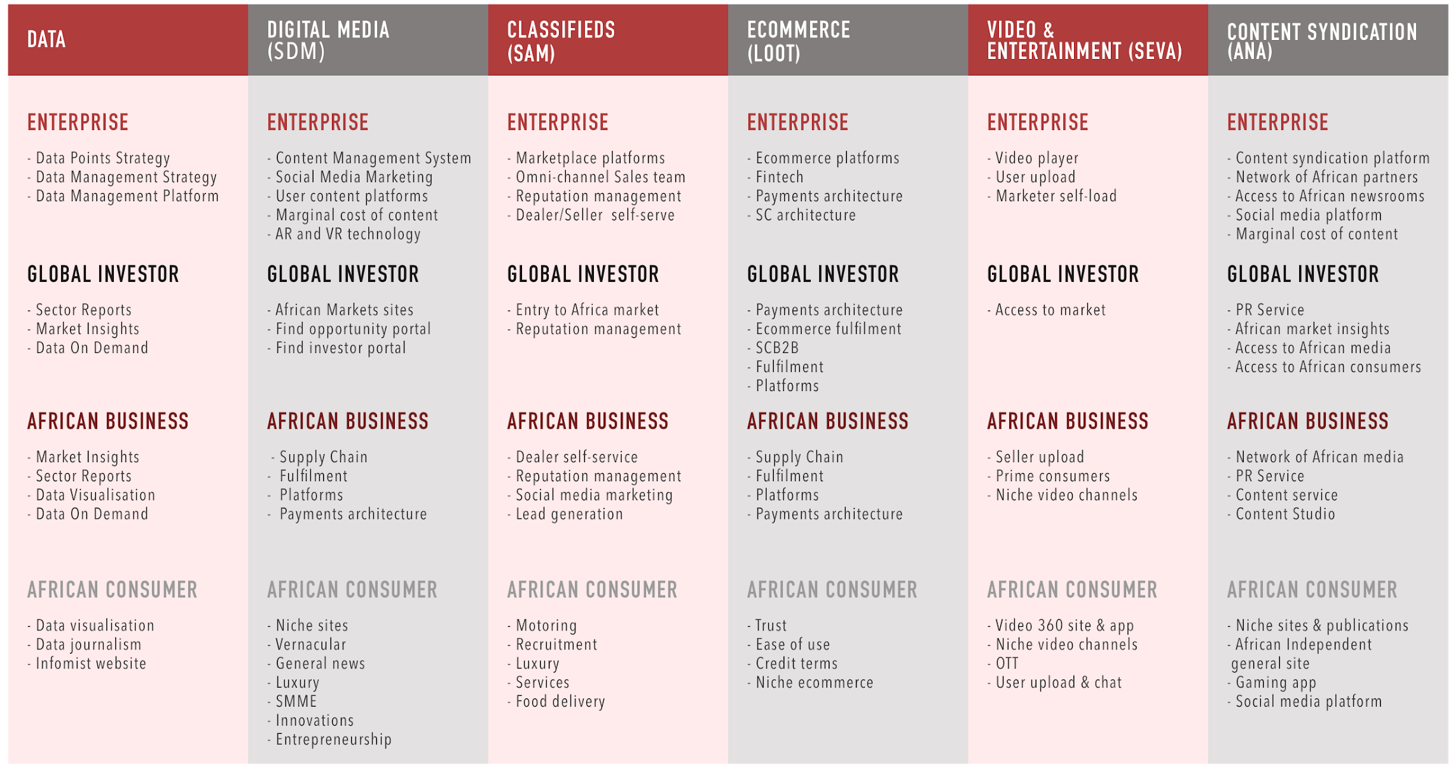
SAGARMATHA PEAK - 100 MILLION
ANNUITY INCOME THIRD PARTY ACCESS

Slide 29
10 POINT PLAN
AI-enabled digital media application footprint with an audience base of 350 million consumers and monthly usage of 100 million consumers
Multiple ecommerce sites in Africa, 17 hubs over 5 years
Continent-wide classifieds business in high growth sectors – property, motoring, education and SMEs
Scale African News Agency (ANA), only African syndication content business
Africa’s first integrated social media application, Junxion, to reach 400M Africans in 5 years and 1BN Africans within a decade
Niche Content verticals in business, lifestyle, food, motoring and travel
B2B2C and SCB2B marketplaces
African video streaming platform to scale up the current Video360 business and the Studio360 business (branded content)
Africa’s premier membership program, Sagarmatha Peak, with 100 MILLION members in 5 years
Become the technology content group most needed in Africa

Slide 30
SAGARMATHA AFRICAN FOOTPRINT
African logistics partner in 35 countries
ANA Syndication with 20 African media partners
ANA Publishing
African Community Media with 22 SA titles
Sekunjalo Group of companies in Africa
Condé Nast SA magazine business
Independent Media online and print 10 million reach
The Young Independent Youth Content platform
Loot.co.za eCommerce platform with 2,2 Million users
Successful Vernacular newspapers in SA

Slide 31
SECTION 4:
CONCLUSION: MEDIA FREEDOM & OUR FUTURE

Slide 32
THE PIC, INDEPENDENT MEDIA & MEDIA FREEDOM
The PIC under new leadership has taken a hostile approach to Independent Media and Sagarmatha.
It is clear that Independent Media is an important voice in media diversity and its narrative of factual based news, truth and diversity has ruffled many feathers.
There is now a desperate attempt to either launch a hostile assault on Independent Media for a takeover of the business or failing that destroy the business completely so that there is no competitor narrative to the other mainstream media.
This is a direct attack on media freedom and undermines our constitution and it is not fathomable how the PIC has targeted Independent Media and has left all other media alone in its public utterances and legal inquisitions.
It is odd that the PIC claiming to act for pensioners has instituted summons against SIM, Independent Media and has not offered any support to defend media freedom and journalisms and seems to be operating with an NGO like Sanef (which does not does represent the media) in undermining Independent Media. Not a single Independent Media editor is a member of Sanef and yet we are the largest print media group in the country.
SCOF can be provided with all of the relevant letters received by Independent Media SIM from the PIC and the gross misrepresentation of Independent Media position.

Slide 33
MEDIA FREEDOM & OUR FUTURE
We are thankful to Minister Tito Mboweni that we present to SCOF our side of the story.
Our country needs media diversity and media freedom and we should together with parliament resist all attempts to hinder the diversity of media ownership and transformation.
We should work together for the future of our stakeholders which includes the GEPF pensioners and our 1,500 employees, journalists and others to ensure that media is sustainable and journalism continues in our country.
We know that we have exposed uncomfortable truths including most recently PPE corruption which robbed our health care workers of valuable equipment. We know in doing so and in exposing powerful individuals and their associates we anger powerful people to shut us down and use the PIC as a blunt instrument against us.
The country will be poorer if all media has a singular narrative and if there is no diversity. We have to prevent our country and those in power from exercising authoritarianism since the consequence of that can be seen by many countries around the world, including north of our border, where media freedom is a rare commodity.

Slide 34
IN SUMMARY
We have explained the media landscape from before 1994 to current
The acquisition of Independent Media from the Irish and the resistance to change of media ownership and diversity.
We have explained the transformation journey of Independent Media and its excellence in awards
We have shown that the PIC did not invest R2 billion. The Sekunjalo Consortium and its partners had invested more than R1,15 billion.
We have shown that it is only Sekunjalo through the Sekunjalo group companies that have funded Independent Media since the acquisition for the benefit of the PIC.
We have shown that the PIC conversion of its shares and loans into Sagarmatha is a positive exit strategy which unlocks value for the PIC and its pensioners.
We await the SARB permission to list Sagarmatha on an International Stock Exchange in line with the content to commerce strategy and unlock value for the PIC.

Slide 35
CONCLUSION
LET’S WORK TOGETHER TO HAVE A DIVERSITY OF VIEWS
“Let a hundred flowers bloom and let a hundred schools of thought contend” (Mao Zedong)
“Tell no lies, claim no easy victories.” (Amilcar Cabral)
We thank you.

