Slide 1

Briefing on NRSO: Criminal Law (Sexual Offences and Related Matters) Amendment Act Amendment Bill
17 Mar 2021

Slide 2
Purpose of the Presentation
Address Parliament on:
Background of the Establishment of the NRSO
The powers, duties and functions of the Registrar
The goals of the NRSO
How the NRSO functions
Successes and Challenges in the management of the NRSO
Plans to secure resources, as required by the Bill
Notes:
A

Slide 3

Background of the NRSO
Section 42 of the Act establishes provides for the establishment of the NRSO:
(1)“A National Register for Sex Offenders containing particulars of persons convicted of any sexual offence against a child or a person who is mentally disabled or are alleged to have committed a sexual offence against a child or a person who is mentally disabled and who have been dealt with in terms of section 77(6) or 78(6) of the Criminal Procedure Act, 1977, whether committed before or after the commencement of this Chapter and whether committed in or outside the Republic, must, within six months after the commencement of this Chapter, and, in accordance with the provisions of this Chapter and the regulations made there-under, be established and maintained by the Minister.

Slide 4
Key Powers, Duties and Functions of Registrar
Receives Data
SAPS
Vetting
Processes applications for clearance from:
Employees; Employers;
Removes Registered Sex Offenders
Processes applications for removal of particulars of sex offenders in terms of the eligibility requirements set by the Act
Executes court orders for disclosure of data to persons not falling under the categories listed by the Act
DCS
DoH
Courts
Licensing authorities/ Applicants for licence to operate business involving children/ persons with mental disabilities
Applicants: Foster care parents, kinship, care-givers, adoptive parents, curator
Maintains data integrity and confidentiality
Contributes in the reduction of sex crimes and prevention of recidivism

Slide 5

Goals of the NRSO
Provides national repository of
convicted SEX OFFENDERS
Protects children and persons
with mental disabilities from
PAEDOPHILIA
Prevents recidivism
Reduces sex crimes against the
limited targeted person

Slide 6
Functioning of the NRSO
NRSO is the National Repository for convicted Sex Offenders convicted of sex crimes involving children and persons with disabilities
It is an Electronic Register (Integrated Case Management System (ICMS NRSO)) established in 2009
(i) NRSO receives data from courts and other sources;
(ii) Analyses data for compliance with the requirements of the Act
Provides national statistics of sex offenders in the country and can used for sex offender profiling
Serves as a data source for consideration of applications for expungements made by convicted sex offenders in terms of the CPA
Provided data to SAPS as part of the DNA database in terms of the Criminal Law (Forensic Procedures) Amendment Act, 2013
Regulates data confidentiality and criminalises the disclosure thereof that is contrary to the Act
Provides vetting of certain persons, entities and businesses
Permits removal of certain registered sex offenders after the expiry of certain periods of time

Slide 7
Successes Achieved Since the Establishment of NRSO in 2009

Slide 8
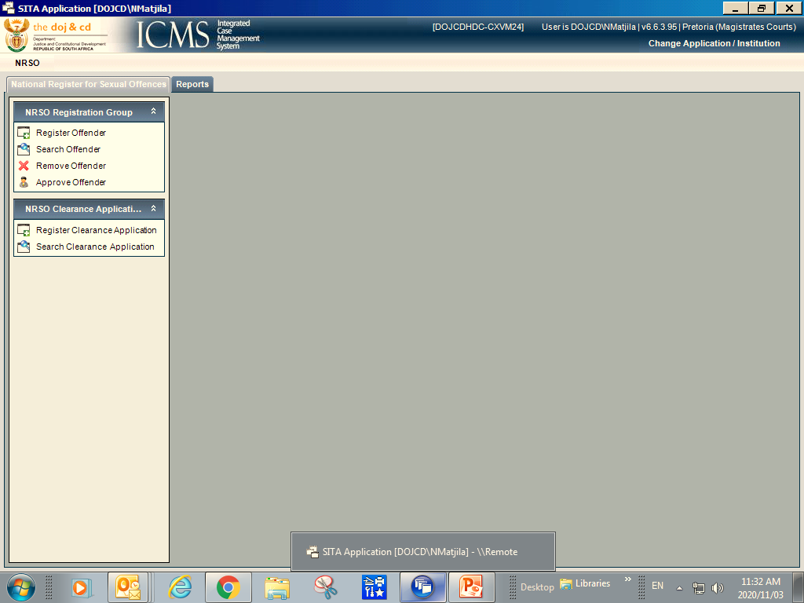

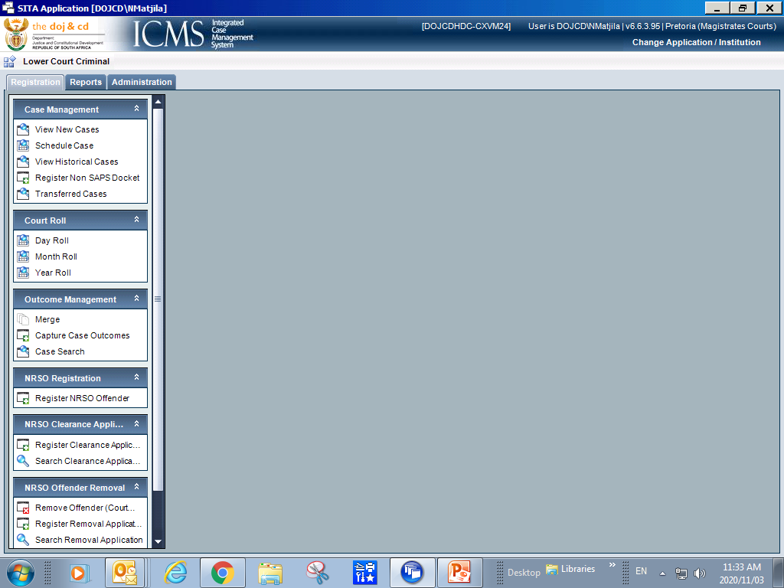
PROGRESSIVE
UPGRADES OF THE ELECTRONIC NRSO
LATEST FINALISED IN 2019

Slide 9
Current Successes of the NRSO
In 2018, finalised data clean-up, the overhaul of NRSO and achieved data integrity
Has registered historic convictions
Issues clearance certificates: DoJ&CD, NPA (TCCs), SAPS FCS, Educators, etc.
Removes particulars of qualifying registered sex offenders
Registers current convictions

Slide 10
Remaining Challenges on the Management of NRSO
Inadequate human capital
Centralisation of the functions of the NRSO

Slide 11
Required Resources to Implement the Extended Scope of the NRSO

Slide 12
Resource Plan for the Implementation of the Extended Scope of NRSO
Establishment of the Office of the Sexual Offences Register within the National Office, which will be progressively rolled out to all nine Provinces
Provision of additional human capital and tools of trade
Resource costing already done.
Current office space is adequate. No Funding is therefore required for office accommodation.

Slide 13
Resource Plan to Implement the Extended Scope of NRSO
What is Required? | Current Status | Resources | Timelines
Upgraded Electronic Register for Sex Offenders to accommodate new changes introduced by the Bill | The latest upgrade of the electronic NRSO to include more variables was finalised in 2019 IJS will commence with the next system’s upgrade in April 2021 | Already budgeted for by IJS | 12 months
Technical resources: Computers, scanners, printers, network cables | Recently approved a tender for laptops and desktops | Budget available | 30 days
Additional human resources for NRSO and the Decentralisation of NRSO services; | Work study investigation for NRSO permanent structure already conducted Macro structure will be submitted to MPSA for concurrence HR has started to shift personnel from over-populated branches to NRSO | Budget reserved | 12 mths
Training on the new provisions and the new NRSO system | Training is annually offered Module will be amended to incorporate changes introduced by the Bill | Budget reserved | Ongoing

Slide 14
Resource Costing for the implementation of the new NRSO

Slide 15
If the NRSO Remains at DoJ&CD…

Slide 16
If DoJ&CD RETAINS THE MANAGEMENT OF THE NRSO…
DoJ&CD has already overcome many hurdles of starting and managing the NRSO and gathered a lot of experience in the process
The NRSO is already established and kept in an electronic format as part of the electronic infrastructure of the DoJ&CD – which connects directly to courts which are the biggest data sources for the NRSO
DoJ&CD has already invested millions of Rands in the periodical upgrades of the NRSO system. The last upgrade was done in 2019 and the next is scheduled for April 2021.
DoJ&CD has already established procedures and policies for the administration and management of the NRSO.
The issuing of Clearance Certificates in respect of particulars is a FREE service with DoJ&CD
A provision where one can apply on behalf of another without many hurdles in place
The primary purpose and objective of the NRSO is victim centric (to protect children and persons with mental disabilities against convicted sex offenders)

Slide 17
If DoJ&CD RETAINS THE MANAGEMENT OF THE NRSO…
The NRSO is intended to protect children and persons with mental disabilities from paedophilia, convicted sex offenders. It is a national repository that can be used to profile sex offenders and assist the country to introduced more responsive and impacful programmes to address the pandemic of sexual violence in the country.
DoJ&CD is the primary data source for the NRSO.
The NRSO carries an indicator on the Gender-based Violence and Femicide (GBVF) National Strategy Plan and is reporting performance to the Presidency on monthly basis.
NRSO system would require an update to include newly proposed crimes and other data variables in the system. IJS has already planned to upgrade this system in 2021/2022. Budget reserved.
The fact that the Bill extends the scope of protection to all victims of sex crimes, irrespective of age, will make the process of data entries easy since all convictions of sex crimes will be eligible for entry into Register

Slide 18
Thank you

