Slide 1
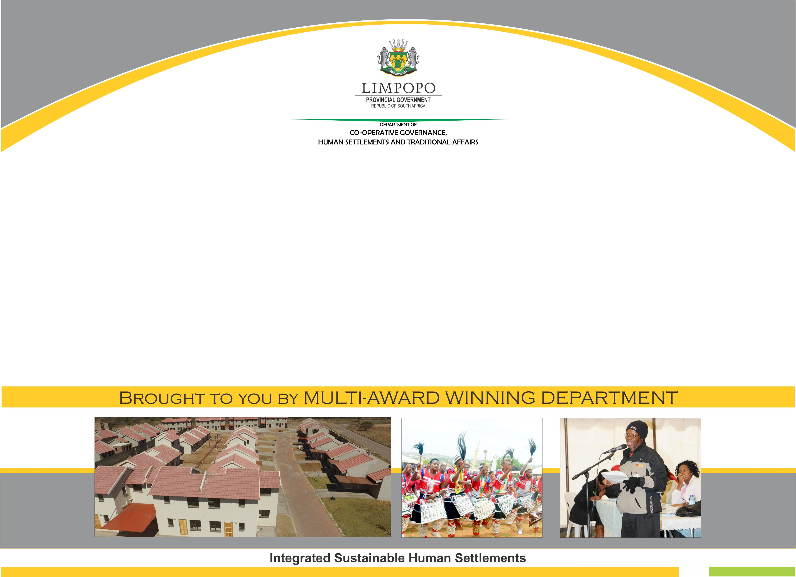
PORTFOLIO COMMITTEE PRESENTATION
SUPPORT PROVIDED TO MUNICIPALITIES IN SEKHUKHUNE DISTRICT
17 MARCH 2021

Slide 2

PURPOSE
The purpose of this presentation is to provide the Portfolio Committee with progress on the support provided to the municipalities in the Sekhukhune District.

Slide 3
INTRODUCTION
Section 154 of the Constitution enjoins the national and provincial departments to support municipalities.
In response to this legislative mandate, various branches in the Department provide support to municipalities as follows:
  Cooperative Governance and Traditional Affairs: Provides support in areas such as development planning, financial management, economic development, infrastructure management, capacity building, performance management, disaster management, etc.
  Corporate Services Branch: Information technology, organizational development,

Slide 4
INTRODUCTION
The presentation will focus on the following:-
Infrastructure management support
Intuitional capacity support
Financial management support
Council support
Spatial Planning and LED

Slide 5
Sekhukhune District Munic: 2016/2017 – 2019/2020 MIG implementation
Municipality was allocated R 1,725,357 billion over four financial years.
R 1,592,342 billion was spent within the financial years with R 133,014 million unspent.
The Municipality spent 100% in 2016/17 financial year.
In 2016/17 the allocation of the municipality was reduced by R126,800 million, reducing the allocation from R457,984 to R331,184). In 2017/18 the allocation of the municipality was reduced by 20 million, reducing the allocation from R484,042 to R464,042. Again in 2019/20 the municipality surrendered R10 million to National Treasury, reducing the allocation from R475,195 to R465,195)
Financial Year | Allocation R’000 | Expenditure R’000 | % Expenditure | Unspent amount R’000
2016/2017 | 331,184 | 331,184 | 100.0 | 0.00
2017/2018 | 464,042 | 418,994 | 90.3 | 45,047
2018/2019 | 464,936 | 451,938 | 97.2 | 12,998
2019/2020 | 465,195 | 390,226 | 83.9 | 74,969
TOTAL | 1,725,357 | 1,592,342 | 92.8 | 133,014

Slide 6
The municipality has shown improvement in the past 2 financial years and is currently (2020/2021) spending above the provincial average.

Slide 7
Fetakgomo Tubatse LM : 2016/2017 – 2019/2020 MIG implementation
Municipality was allocated R 330,529 million over four financial years.
R 262,148 million was spent within the financial years with R 68,379 million unspent.
Further more, the total amount of R 30,000 million was re-allocated to the municipality in 2016/17 financial year due to good performance and R 33,226 was re-allocated to other municipalities in 2018/19 financial year due to poor spending. The original allocation in 2018/19 was R82,638 million and was reduced by R33,226 million to R49,412 million
The spending of the municipality regressed since 2017/18 and was worse off in 2019/2020
COGHSTA will continue to support the new management of the municipality.
Financial Year | Allocation R’000 | Expenditure R’000 | % expenditure | unspent amount R’000
2016/2017 | 110,885 | 98,125 | 88.5 | 12,759
2017/2018 | 85,863 | 70,194 | 81.7 | 15,668
2018/2019 | 49,412 | 47,814 | 96.8 | 1,598
2019/2020 | 84,369 | 46,015 | 54.5 | 38,354
TOTAL | 330,529 | 262,148 | 80.4 | 68,379

Slide 8
The municipality continues to perform badly, spending below the provincial average mainly due to late appointment of service providers.

Slide 9
Makhuduthamaga LM: 2016/2017 – 2019/2020 MIG
Municipality was allocated R 290,978 million over four financial years.
R 284,969 million was spent within the financial years with R 6,008 million unspent.
The roll-over of R 6,000 of 2016/17 of the municipality was approved and was spent 100% in 2017/18, again Municipality spend 100% consecutively over three years, from 2017/18 to 2019/20.
This is a high performing Municipality in Sekhukhune, getting additional funding for three consecutive years: In the Financial Year 2016/17 additional funding of 28 million, raising the allocation from R59.210 million to R 87.210 million. In the Financial Year 2017/18 additional funding of R 5.450 million, raising the allocation from R63.196 million to R68.646 million and in the Financial Year 2018/19 additional funding of R7 million, raising the allocation from R 66 million R73 million.
Financial Year | Allocation R’000 | Expenditure R’000 | % expenditure | unspent amount R’000
2016/2017 | 87,210 | 81,201 | 93.1 | 6,008
2017/2018 | 68,646 | 68,646 | 100.0 | 0.00
2018/2019 | 73,000 | 73,000 | 100.0 | 0.00
2019/2020 | 62,122 | 62,122 | 100.0 | 0.00
TOTAL | 290978 | 284969 | 98.3 | 6,008

Slide 10
The municipality has consistently spent above the provincial average and is on course to spend 100% in the current 2020/2021 financial year.

Slide 11
Elias Motsoaledi LM: 2016/2017 – 2019/2020 MIG implementation
Municipality was allocated R 256,032 million over four financial years.
R 216,131 million was spent within the financial years with R 39,899 million unspent.
The roll-over of R16.768 million of 2016/17 of the municipality was approved and was spent 100% in 2017/18
Again the roll-over of R1.500 million of 2018/19 of the municipality was approved and was spent 100% in 2019/20
This is a good performing municipality , getting additional funding for three consecutive years: In the Financial Year 2016/17 additional funding of R20 million, Financial Year 2017/18 additional funding of R11 million and Financial Year 2018/19 additional funding of R8 million.
Financial Year | Allocation R’000 | Expenditure R’000 | % expenditure | unspent amount R’000
2016/2017 | 72,419 | 47,016 | 64.9 | 25,402
2017/2018 | 66,860 | 60,763 | 90.9 | 6,096
2018/2019 | 61,832 | 58,800 | 95.1 | 3,032
2019/2020 | 54,921 | 49,552 | 90.2 | 5,369
TOTAL | 256,032 | 216131 | 85.3 | 39,899

Slide 13
Ephraim Mogale LM: 2016/2017 – 2019/2020 MIG implementation
Municipality was allocated R 140,389 million over four financial years.
R 127,165 million was spent within the financial years with R 13,222 million unspent.
The roll-over of the municipality was approved for 2015/16 which was spent 100% in 2016/17
Furthermore, the total amount of R 2,604 was re-allocated to other municipalities in 2016/17 financial year due to poor performance.
Financial Year | Allocation R’000 | Expenditure R’000 | % expenditure | unspent amount R’000
2016/2017 | 29,313 | 23,026 | 78,5 | 6,286
2017/2018 | 44,810 | 43,019 | 96.0 | 1,790
2018/2019 | 32,823 | 32,679 | 99.6 | 144
2019/2020 | 33,443 | 28,441 | 85.0 | 5,002
TOTAL | 140,389 | 127,165 | 89.8 | 13,222

Slide 14
The municipality is on course to spend 100% in the current 2020/2021 financial year.

Slide 15
INFRASTRUCTURE SUPPORT
Municipalities supported in their service delivery provision through:
Regular meetings (monthly at district & provincial level) and one-on-one intervention meetings
  During these meetings, municipalities get an opportunity to provide progress on the implementation of their service delivery projects, indicate any challenges and areas where they need support from provincial COGHSTA, MISA and other sector departments.
  COGHSTA coordinates these support measures.
Training / workshops on project implementation value chain (feasibility studies, design reviews, contract management, asset management, management of consultants, etc.)
Assessment of projects for funding through conditional grants to ensure they meet grant conditions and monitoring the implementation thereof.
Assist municipalities in developing turn around plans in areas where there are challenges in project implementation.

Slide 16
2019/20 AFS SUBMISSION TREND
Late submissions: 2016/17: Fetakgomo Tubatse late submission was due to the delay in submission of the asset information.
Support was provided to the municipalities during preparation of AFS plans, assessed and provided inputs on the draft AFS and attendance of Audit Steering Committee.

Slide 17
Reliance on consultants for preparation of AFS has increased from 20% in 2018/19 to 40% in 2019/20 and this is due to a lack of specialized skills in municipalities.
It should however be noted that there are areas that require specialized skills in the preparation AFS, i.e. valuation of post retirement benefits, compilation of GRAP compliant asset register and valuation of landfill sites
Municipalities were trained on AFS preparation, GRAP interpretation, and further supported on the review of AFS.

Slide 18
AUDIT OUTCOME TREND
Municipality | 2016/17 | 2017/18 | 2018/19
Makhuduthamaga | Unqualified | Qualified | Unqualified | Improved
Fetakgomo Tubatse | Qualified | Qualified | Qualified | Stagnant
Ephraim Mogale | Qualified | Unqualified | Qualified | Regressed
Elias Motsoaledi | Qualified | Unqualified | Qualified | Regressed
Sekhukhune | Unqualified | Unqualified | Qualified | Regressed
There has been one audit outcome improvement in the District, i.e. (Makhuduthamaga), one municipality (Fetakgomo Tubatse) remained stagnant while three municipalities regressed from unqualified to qualified, namely: Ephraim Mogale, Elias Motsoaledi and Sekhukhune
Commitments, Revenue, Distribution losses, Non-compliance with Supply Chain Management Regulations, Prior Period Errors are some of the negative audit findings that affected the audit outcomes.
Implementation of audit action plans remains a challenge, hence a significant number of recurring findings
The 2019/20 audit is in progress.

Slide 19
FINANCIAL MANAGEMENT SUPPORT
Monitor and support the four local municipalities with compliance on Municipal Property Rates Act. All municipalities are complying with the MPRA.
Makhuduthamaga LM and Fetakgomo Tubatse LM were supported on the development of the new valuation roll to be implemented on the 1st of July 2021.
Supported the four local municipalities on promulgation of resolution of the levy property rates.
Held engagements with all 5 municipalities in the District on the AFS Readiness
Reviewed and provided inputs on the AFS Process Plans and the draft 2019/20 Annual Financial Statements
Assessed and monitored the audit action plan for 2018/19 and provided inputs
Attended audit committee meetings and audit steering committee meetings as part monitoring compliance with MFMA
Conducted verification on the outstanding Government Debts for all four local municipalities
Facilitated Technical and Provincial Debt Forum
Facilitated Technical and Provincial MPAC Forum
Provided assistance with the interview process for Audit Committee members in Sekhukhune DM, Ephraim Mogale LM and FetakgomoTubatse LM

Slide 20
COUNCIL SUPPORT
Conducted one-day workshop with ward committee members on minutes writing and reports, communication conflict management, and Ward Operational Plans.
Conducted capacity building programme for Speakers on their roles and responsibilities as leaders of municipal council, development and implementation of the rules of order of municipal council, code of conduct for Councilors.
Conducted District Roadshows to strengthen IGR coordination between the District and its Local Municipalities.
Developed District IGR internal rules to guide operations and activities of the District IGR Forum.
Supported District Speakers Forums and Public participation forums on ward delimitation processes, development of policies that guide public participation and functionality of ward committees.

Slide 21
INSTITUTIONAL CAPACITY BUILDING
CoGHSTA LP and the DBSA entered into an MOA in January 2020 to support municipalities with lending and non-lending products for a period of five (5) years. DBSA has appointed a technical resource to provide municipalities support on the DBSA application process.
The following applications were received from municipalities in Sekhukhune District:-
Year | Municipality | Project | Status
Year 1 | Sekhukhune DM | Revenue Enhancement Programme (REP) | Completed
 |  | Project Preparation Support (Bull Water Supply) (Waste Water Plant) | DBSA contracting stage
 | Elias Motsoaledi LM | Revenue Enhancement Programme (REP) | DBSA application stage
The department held sessions with all municipalities in February 2021 on the non-lending products available from DBSA. The session also provided guidance to municipalities on the application requirements and process for Year 2 projects.

Slide 22
MISA SUPPORT
The department in collaboration with MISA established a pilot programme with the objective of building capacity in seven (7) identified municipalities in the province.
Two municipalities namely Elias Motsoaledi and Ephraim Mogale are part of the beneficiaries that signed off the Municipal Capacity Development Plans as a requirement to be part of the MCDP.
The two municipalities receive technical support on institutional, service delivery and financial management.
The District is allocated one Engineer supporting the district and its local on all technical aspects.

Slide 23
TRAINING PROGRAMMES
GTAC and MISA provided virtual training to all municipalities in the province on the following key aspects:-
  Asset Management
  the utilization of Framework Contracts
  Introduction to IDMS and
  SIPDM (now FIPDM)
The training is meant to improve project planning and implementation capabilities in municipalities.
The department through the LGSETA Grant conducted skills training programmes i.e. MPAC and Monitoring and Evaluation (M&E)

Slide 24
HUMAN RESOURCE CAPACITY SUPPORT
CoGHSTA is part of the District Job Evaluation Committee responsible for all the job evaluation of posts in all five municipalities in the Sekhukhune District. The Department is also providing support on the development of job description which are critical for the success of Job Evaluation.
Following financial management challenges in Sekhukhune District Municipality, the Department conducted an IT Assessment to identify technology gaps. The assessment identified several shortcomings in the mainly systems and governance. The Department will support the municipality to develop and implement a remedial plan.
The department is on continuous basis delegating senior officials to serve as panel members for recruitment process in municipalities. This is based on invitations from municipalities.
The department supported municipalities on the implementation of performance management system and is part of the panel for individual performance assessments/evaluation.
Quarterly B2B district sessions are convened and presided upon by the department.

Slide 25
SPLUMA By-laws, Municipal Planning Tribunals & Land Use Management
SPLUMA By-Laws:
All municipalities under Sekhukhune district municipalities were supported in the development of SPLUMA By-laws. The by-laws have been adopted and gazetted and currently being implemented
Municipal Planning Tribunals(MPTs):
The department has nominated officials (at least two Town and Regional Planners) in support of Sekhukhune District Municipal Planning Tribunal (Ephraim Mogale, Elias Motsoaledi, Makhuduthamaga and Fetakgomo-Tubatse) to provide technical expertise and advisory role during the sitting of the Municipal Planning Tribunal.
Two additional departmental officials (Town and Regional Planners) have been nominated to form part of Fetakgomo Tubatse Appeal Authority in a bid to strengthen capacity and ensure functionality of MPT
The department conducted training for MPT members, in collaboration with DALRRD in a bid to capacitate members to execute assignments as mandated .

Slide 26
SPLUMA By-laws, Municipal Planning Tribunals & Land Use Management
Land Use Schemes (LUSs):
Supported Ephraim Mogale in the development of Land Use Schemes and to date the municipality has a credible Land Use Scheme aligned to SPLUMA Guidelines.
Currently support is being provided to Fetakgomo Tubatse , Elias Motsoaledi and Makhuduthamaga with development/ review of their respective Land Use Schemes.
Emanating from support provided by the department, draft land Use Schemes of Elias Motsoaledi and Makhuduthamaga are in place and undergoing public participation process respectively, whilst Fetakgomo-Tubatse awaits adoption by council and gazetting of the LUS.
The department supported all local municipalities in the land development applications including security of tenure rights.

Slide 27
Spatial planning and Spatial Development Frameworks (SDFs)
Spatial Development Frameworks (SDFs)
  The Department assisted both the district and local municipalities in development / review of the SDFs. Continuous support is provided to ensure effective implementation of the SDFs in terms of managing and directing development growth in the district and respective municipalities.
Spatial planning
  Supported Elias Motsoaledi with conditions of establishments for all townships within the municipality.
  The department also supported Ephraim Mogale with site inspection at Elandskraal A on erf 645 and 646 to clarify the boundary line.
  Fetakgomo-Tubatse, supported with the development of the Steelpoort Precinct Plan and the Burgersfort Precinct Plan. The municipality was also supported with re-identification of erf 116 in Orighstad, erf 996 at Tubatse A, and demarcation of a farm portion within the farm Goedverwacht 763 KS
  Makhuduthamaga supported with continuous participation in the relocation of government offices from Lebowakgomo to Jane Furse project.

Slide 28
ECONOMIC DEVELOPMENT & IDP SUPPORT
Integrated Development Plan Support
Sekhukhune and its local municipalities adopted their IDPs by end of June 2020. The department provides support to the District its local municipalities in the development and review of the IDPs. The support entails among others:
  Analyzing the District Draft IDP/Budget documents.
  Assessment of Final IDP documents
  Participation in IDP Steering Committee meetings, Rep Fora sessions.
Supported the development of the Socio-Economic profile in line with the DDM .
The departmental team supported in the preparations inaugural meeting of the Sekhukhune District Development Model.

Slide 29
LOCAL ECONOMIC DEVELOPMENT & IDP SUPPORT
Local Economic Development
  Supported the District municipality in compiling the District Economic Recovery Plan. The department ensured that all the local municipalities contribute to the development of District Economic Recovery Plan.
  Provided technical support for the review of LED Strategies for Elias Motsoaledi; Ephraim Mogale, Makhuduthamaga and Sekhukhune District. Fetakgomo Tubatse LED Strategy is due for development after amalgamation;
  The department supported the district and its local municipalities on local economic development through the structures provincial LED forums which also serves a platform for municipalities learning each other.
  Supported the District in implementing Community Work Programme (CWP) through CWP Local Reference Committees.

Slide 30
STRATEGIC CHALLENGES AND INTERVENTIONS
STRATEGIC CHALLENGES | INTERVENTIONS
Insufficient capacity in key units such finance, internal audit and supply chain management (e.g. no Manager Revenue in Ephraim Mogale, Makhuduthamaga and Elias Motsoaledi and Fetakgomo Tubatse) | Municipalities are encouraged to fill key vacancies. CoGHSTA and Provincial Treasury have developed a collaboration framework to align and integrate support initiatives to improve financial sustainability.
Escalation of unwanted expenditures (UIFW) that affects all 5 municipalities in the District | Continuous training of MPACs on the investigation of UIF&W process
High financial sustainability risk in municipalities | Facilitation and participation in the Technical and Provincial Debt Forum to ensure that monies owed to municipalities by government departments are recovered

Slide 31
STRATEGIC CHALLENGES AND INTERVENTIONS
STRATEGIC CHALLENGES | INTERVENTIONS
Under resourced and insufficient capacity of MPACs to play oversight role (i.e. not able to finalise investigation reports) | Capacity building workshops were carried out on key municipal performance areas for the Speakers, MPAC Chairpersons and Mayors of municipalities in the main to enhance their skills and improve municipal performance. Treasury, COGHSTA and SALGA to scale up support initiatives for Councilors and MPACs . Municipality should provide resources for MPACs
Low revenue collection and slow registration of government properties built on communal land | Support is provided thorough the DBSA Partnership through non-lending assistance on various areas such as master plans, spatial planning instruments, project preparation, asset care, revenue enhancement, and any other future lending products of the DBSA. Depts of Public Works and Agriculture, Land Reform and Rural Development to fast-track the registration of state domestic facilities built on communal land.

Slide 32
Recommendations
It is hereby recommended that:
The Portfolio Committee notes the report
The Portfolio Committee engages the departments Depts of Public Works and Agriculture, Land Reform and Rural Development to fast-track the registration of state domestic facilities built on communal land to improve financial viability in municipalities.

Slide 33
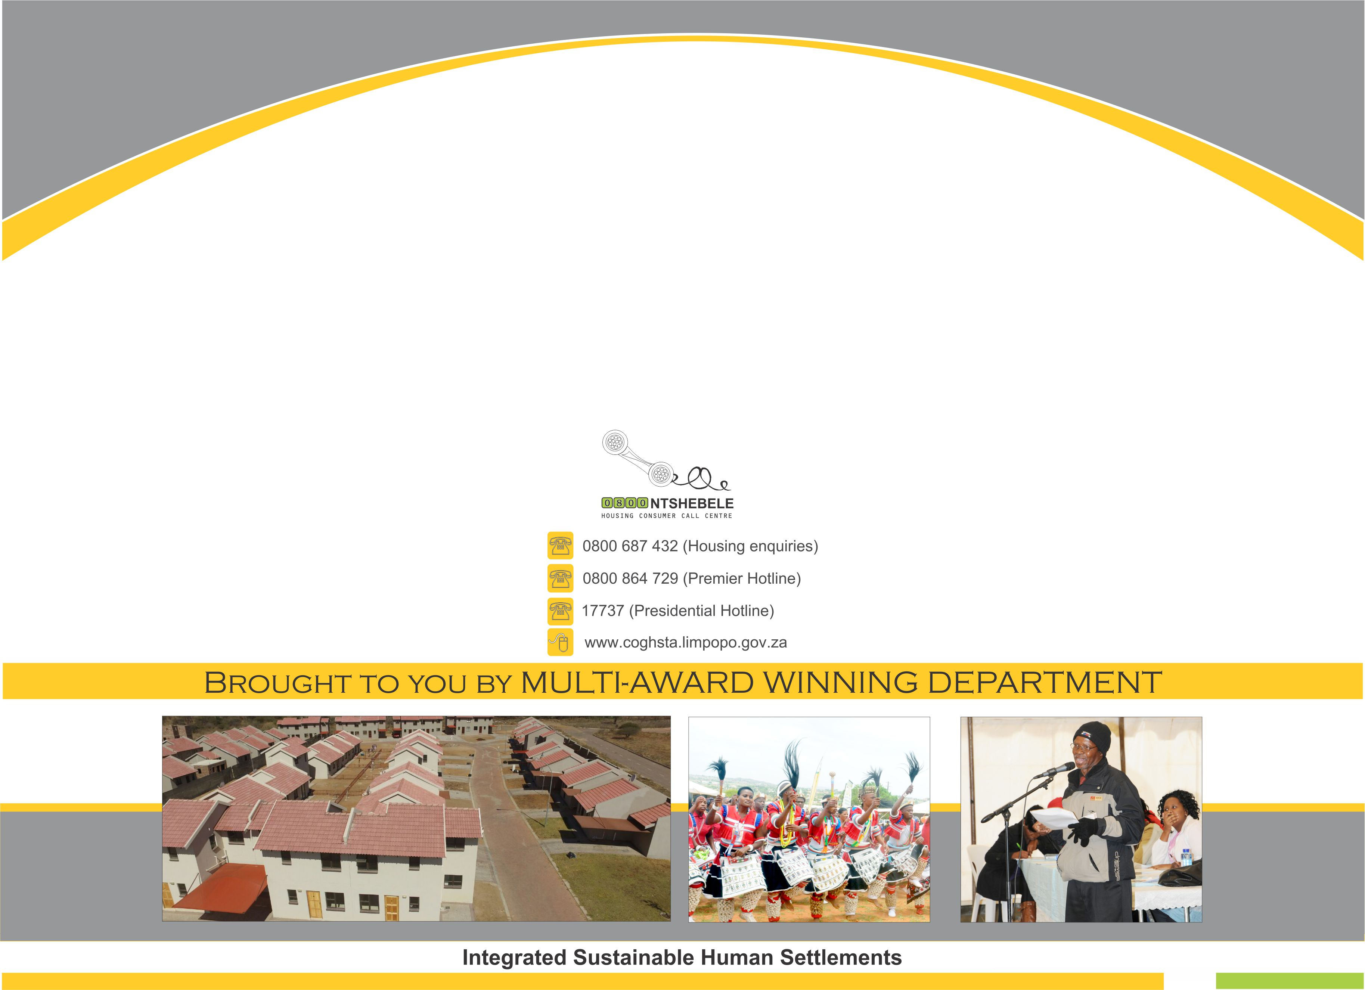
THANK YOU

