Slide 1
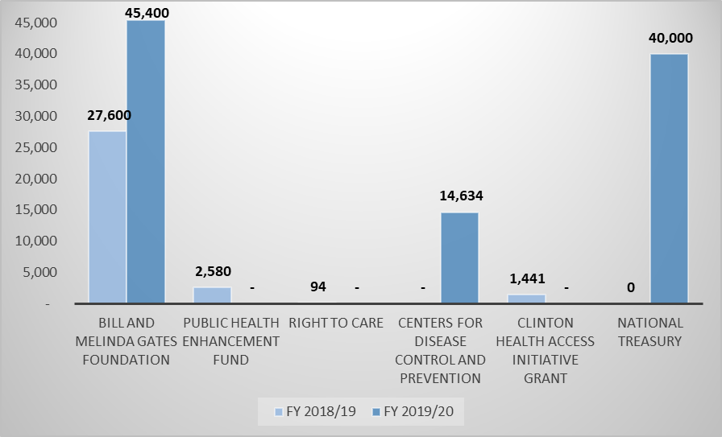
External Funding (R’000)
External funding received is mainly to fund the backlog project.
BMGF, PHEF and Right to Care support were received in the form of services in kind where services were paid directly to evaluators and or suppliers

Slide 2
External Funding
Description | Clinton Health Access Innitiative | Centers for Disease Control | Public Health Enhancement Fund | Right to care | Bill and Melinda Gates Foundation | National Treasury
1. Type of Fund | Direct Donation | Direct Donation through NDOH | Services in Kind | Services in Kind (Office Accommodation) | Services in Kind | Conditional Grant
2. Purpose of Fund | Backlog reduction project | Backlog reduction project | Crisis support during strike | Backlog reduction project | Backlog reduction project | Backlog reduction project
3. Period Received | Jan-19 | April '19 - Nov '20 | Sep '18 - Feb '19 | Nov '18 - Dec '18 | April '18 - current | April '19 - March '21
4. FY 2018-19 | R1 441 170 | - | R2 580 000 | R94 204 | R27 600 000 | R0
5. FY 2019-20 | - | R14 634 131 | - | - | R45 400 000 | R40 000 000
6. FY 2020-21 | - | R2 104 925 |  | - | R5 398 623 | R20 000 000
7.Total Funds/Services received to date | R1 441 170 | R16 739 056 | R2 580 000 | R94 204 | R78 398 623 | R60 000 000
8. Total Funds/Services used FY 2019/20 | R1 441 170 | R14 634 131 | R2 580 000 | R94 204 | R73 000 000 | R17 409 082
9. Total Funds/Services used to date | R1 441 170 | R16 739 056 | R2 580 000 | R94 204 | R78 398 623 | R42 325 077
Clinton Health Access Initiative – Direct funding received for utilization for the back log project
CDC – Direct funding received through the Department of Health for clearing applications relating to specifically relating to HIV and TB drugs
PHEF – Support received by providing crises project management support paid directly by PHEF
Right to Care – Support received by providing accommodation to the Backlog Reduction Project Team
BMGF – Support received by providing Wits University funding to project manage and pay for international evaluators and the development of guidelines and procedures in support of the Backlog Reduction Programme
National Treasury – Additional funding obtained for the Backlog Reduction Programme

