Slide 1
PORTFOLIO COMMITTEE 2021 PRESENTATION Chairperson of Council, Ms Nomarashiya Caluza and UNIZULU Executive Management 16 March 2021

Slide 2
PRESENTATION OVERVIEW
Governance and Management
Teaching and Learning During Lockdown
Student Performance Statistics and Success Rates
Infrastructure Development Projects
Finances and Audit Outcomes
NSFAS Disbursement
Readiness of 2021

Slide 3
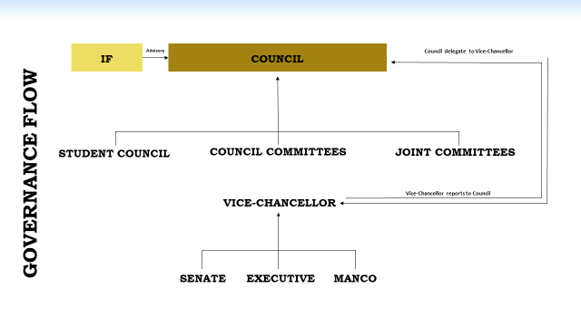
1. GOVERNANCE AND MANAGEMENT OVERVIEW

Slide 4
GOVERNANCE AND MANAGEMENT OVERVIEW (Continued)
COUNCIL & COMMITTEES
Statutory Compliance
Duly Constituted Council (60/40) and Committees (23 positions, 3 vacancies)
Independent and skilled Chairpersons to Chair all Committees
Charters in place (Council and Committees)
ARCC – Comprising only external members – internal/external auditors' invitation
Code of Ethics – monitored by ARCC
Inductions ongoing
Continuous Assessment – DHET Scorecard
Delegations and Oversight
Delegations Policies (Council to Committees; Council to VC; VC to Senior Management)
Vice-Chancellor and Management in place
Accountability and monitoring conducted by ARCC
Strategic Plan, Annual Performance Plan and Mid-Year reporting in place and monitored
Performance Management in place – reporting on organizational achievement

Slide 5
GOVERNANCE AND MANAGEMENT OVERVIEW (Continued
Risk Governance
Compliance with laws, codes, rules and Standards
Leadership, Ethics &
Corporate Citizenship
Decisions, actions and deliberations were conducted with sensitivity to the legitimate interests and expectations of all shareholders.
Council understands the triple context in which the University operates – economy, society and environment
Strategic Plan, and operational planning - aimed at ensuring that UNIZULU remains sustainable and promotes transformation
Transformation - integral part of Strategy
Decisions, actions and deliberations were conducted with sensitivity to the legitimate interests and expectations of all shareholders.
Council understands the triple context in which the University operates – economy, society and environment
Strategic Plan, and operational planning - aimed at ensuring that UNIZULU remains sustainable and promotes transformation
Transformation - integral part of Strategy
An Enterprise-wide approach to risk management is applied and a Risk Management Framework, Strategy and Policy is in place.
Internal Risk Management Committee and MANCO monitors divisional risk registers.
Strategic Risk Register in place – monitored by ARCC and Council
Anti-fraud Initiatives – Whistleblowing Hotline
The University is fully compliant with all laws, codes, rules and standards applicable to higher education and its operations in general
No refusals to information made - Promotion of Access to Information Act, 2000
Compliance with POPI
Incorporating IFRS Standards
Council leads ethically, effectively and governs the University in a manner that supports the establishment of an ethical culture.
Council is not aware of any key risk current, imminent or forecasted that may threaten the sustainability of the University.
No material or immaterial but often repeated regulatory penalties, sanctions or fines for contraventions or non-compliance with statutory obligations were imposed on the Institution during the year under review.

Slide 6
GOVERNANCE AND MANAGEMENT OVERVIEW (Continued)
Business Continuity and Information & Technology Governance
ICT strategy, framework and policies are actively implemented and monitored.
Business Continuity Plan (BCP) and Disaster Recovery Plan (DRP) implemented.
Enterprise Resource Planning (ERP) system in place - aimed at paperless transactions
Service Management software (HEAT) was implemented to manage the IT Service delivery
Moodle upgrades enables the university to track student’s performance through automated learning analytics procedures;
Higher Degrees Management System (HDMS) implemented
Online requisition implemented on ITS Finance iEnabler
ITS Integrator 4.1 upgrading enabling online registration
Partitioning of new ODI Server - mitigate some cybersecurity risks
Full implementation online Residence booking system.
50% of the ICT HDI Grant committed to Infrastructure Management System.
Staff capacity development as student training conducted.
CCTV monitoring system reviewed – tender for integrated surveillance system
UNIZULU has made significant strides in its commitment to maintaining systems of internal control over financial reporting and the safeguarding of assets against the unauthorised acquisition, use or disposal thereof.
Accepted standards are applied to protect privacy and ensure control over all data, including disaster recovery and ‘back up’ procedures.
Despite this, inherent limitations to the effectiveness of any system of internal control, including the possibility of human error and the circumvention or overriding of controls, exists.
Accordingly, even an effective internal control system can provide only reasonable assurance with respect to financial statement preparation and the safeguarding of assets. Furthermore, the effectiveness of an internal control system can change according to circumstances.

Slide 7
REPORTING OUTCOME
GOVERNANCE AND MANAGEMENT OVERVIEW (Continued)
EVIDENCE OF ACHIEVEMENT
Good Governance
Show that Council has fulfilled its agreements with DHET.
Accountable
Corporate Citizenship
Evidence of stable governance, good internal controls, quality, sustainability and achievement of Strategic Goals.
Balanced Student Life
Annual Report
Sustainable and Viable
Quality Academic Offerings
Strategic Direction - Performance
Internal Controls and Quality

Slide 8
2. TEACHING AND LEARNING DURING LOCKDOWN
INSTITUTIONAL READINESS FOR MULTIMODAL APPROACH
COMPLETION OF THE 2020 ACADEMIC YEAR
University Readiness For Online Teaching And Learning:
LMS: Moodle Upgrade from version 2.4 to version 3.9, with 4 different instances (one for each faculty).
Including features such as learner analytics, Interactive content, plagiarism detection, learner collaboration
Revision of the academic calendar to ensure that activities were not compromised

Slide 9
TEACHING AND LEARNING (Continued)
STAFF READINESS FOR MULTIMODAL APPROACH
Faculties received extensive support for dynamic educational experience:
Converting face-to-face courses into online materials : instructional design resources and workshops/webinars.
1. Instructional Design (Beginner and Interim)
2. Educational Technologies (Beginner)
These are some of the training that academics participated in:
Instructional Design and Educational Technology Training – 6 April 2020
Phase One –Basic Moodle Training (facilitated by TLC – 29 April 2020)
Phase Two – Big BlueButton Training (facilitated by TLC – 6 May 2020)
AAU Emergency Remote Teaching Webinar 1-4 (April and May)
UNIZULU Virtual Learning –Henley Business School -13 May 2020
Faculty support groups and LMS champions: LMS, Google Docs, Dropbox, OneDrive, Office 365
Web-conferencing: Zoom, MsTeams
E-Learning Committee chaired by the Director of Information and Communication Technology (ICT) where lecturers who are champions of online teaching and learning represent all Faculties.
Workshop for support staff to assist during multimodal teaching and learning

Slide 10
TEACHING AND LEARNING (Continued)
STUDENT READINESS FOR MULTIMODAL APPROACH
Analytics:
Student Usage of LMS:
1. Since the nationwide lockdown 88% of students have accessed the LMS.
Student usage during the first week two weeks of July has dropped to 83%
During the last term of 2020 participation on Moodle increased
Provision of laptops and data: 10G Day and 10G Night data
Preparation and printing of hard copy study material, packing and sorting of study material, Delivery of study material
Material delivered to 59 different delivery points on predetermined dates
WhatsApp groups per delivery site, bulk sms, phone call before delivery

Slide 11
TEACHING AND LEARNING (Continued)
STUDENTS RETURN TO CAMPUS: PHASED-IN PROCESS
Level 3: in a staggered way
Return of 94 Nursing students from Faculty of Science on 29 June 2020
The 40 final year BCom (MIS) students, returned due to their need for specialized software and a practical online assignment and assessments;
20 Postgraduate students in FCAL who require specialized software packages only available on campus, including econometric software and big data sets
7 SAICA Interns in the FCAL to assist Accounting and Auditing students
Level 2: September 2020
14 BSC Honours in Biokinetics students:
38 MSc and PhD students
Conditions and obligations attached to their return:
Letter of invitation
Permit
Covid-19 Indemnity and Code of Conduct
Teaching and Learning and Social orientation.

Slide 12
TEACHING AND LEARNING (Continued)
ASSESSMENT STRATEGIES AND UNDERPINNING PRINCIPLES
Types:
Fully Online Examinations
Take Home/Open Book exams
Formative Assessments
Portfolios (long essays, critical reflection, etc.)
Laboratory based examinations
Principles:
Quality – not to be compromised. Question papers were moderated to ensure that they were of good standard
Flexibility - to accommodate different learning styles
Student access to and participation in exams - 80% - 100% participation rates across faculties
Adequate support to staff and students throughout the exam period
Assessment types: Test-Based, Task-Based, and to some extent Self-, peer- and group assessment, recorded presentations, artifacts, voice notes, portfolios, slideshows, reflective video responses, written responses, data interpretation and analysis

Slide 13
TEACHING AND LEARNING (Continued)
MANAGEMENT OF EXAMS
Support to staff and students w.r.t. Online exams
ICT Helpdesk was set up to provide support to students
LMS and server upgrade was done by TLC
Support to academics was provided by faculty champions and TLC
Server monitoring was done by TLC and consultant
Monitoring of University network was done by ICT
Daily submission of examination reports by Faculty Deans to the DVC and Registrar to monitor and address student challenges
Exams successfully completed on 5 February 2021

Slide 14
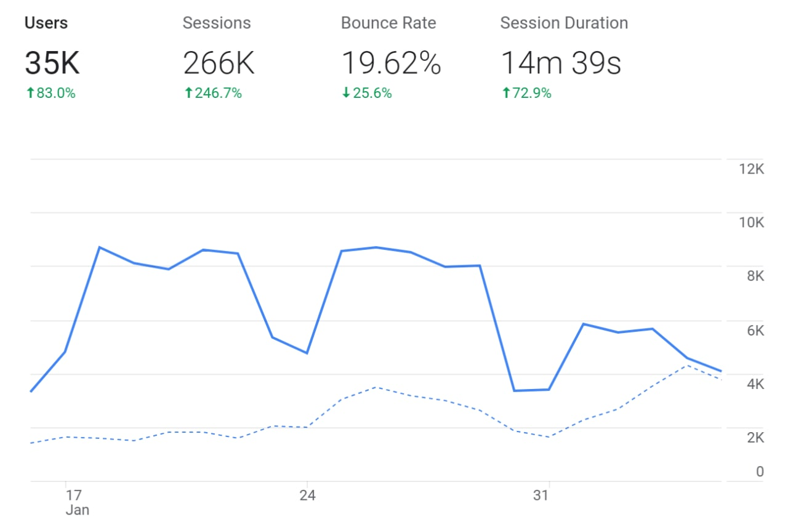
TEACHING AND LEARNING (Continued)
EXAMINATIONS
Successful online examination conducted on the Moodle LMS Platform
Unprecedented participation by students on online examinations
Improved pass rates noted

Slide 15
3. STUDENT ENROLMENT AND SUCCESS STATISTICS 2020
ACCESS - HEADCOUNT TOTALS 2020

Slide 16
ENROLMENT AND SUCCESS STATISTICS (Continued)
MAJOR FIELD OF STUDY 2020

Slide 17
ENROLMENT AND SUCCESS STATISTICS (Continued)
STUDENT DEREGISTRATION 2020
 | 2020
Number of headcount undergraduate students registered in 2020 | 15,709
Number of headcount undergraduate students that deregistered in 2020 (cumulative) | 161
Number of remaining undergraduate headcount registered students | 15,548
Number of headcount postgraduate students registered in 2020 | 1,618
Number of headcount postgraduate students that deregistered in 2020 (cumulative) | 55
Number of remaining postgraduate headcount registered students | 1,563

Slide 18
ENROLMENT AND SUCCESS STATISTICS (Continued)
SUCCESS RATES / PASS RATES

Slide 19
ENROLMENT AND SUCCESS STATISTICS (Continued)
SUCCESS RATES / PASS RATES BY CESM FACULTY

Slide 20
ENROLMENT AND SUCCESS STATISTICS (Continued)
GRADUATION TRENDS 2014 - 2020

Slide 21
4. READINESS FOR 2021 ACADEMIC YEAR (Continued)
REGISTRATION
1- 19 March Registration of FTENs and returning students
Registration period has been extended
FIRST YEAR STUDENT ORIENTATION
23 – 27 March (focusing on Multimodal learning skills)
COMMENCEMENT OF TEACHING AND LEARNING
29 March for FTENs
15 March for returning students
University has provided data for teaching and learning
Faculty online-seminars for research progress presentations – to support postgraduate students

Slide 22
5. INFRASTRUCTURE DEVELOPMENT PROJECTS
UniZulu’s Spatial Development Framework is the main point of reference in regard to infrastructure planning and development
Master project list of refurbishments and new construction projects made up of 2021 priorities
Implementation Plan and List of Priority Projects
Procurement Strategy is in place
First Implementation Target Date: July 2020, revised severally to September 2020, November 2020, January 2021, and finally March 2021.

Slide 23
INFRASTRUCTURE DEVELOPMENT PROJECTS (Continued)
PROJECT IMPLEMENTATION TIMELINE (AS AT DECEMBER 2020)
CONSTRUCTION WORK PACKAGE STAGES AT 11 DEC 2020 | READINESS FOR CONSTRUCTION
Packages 1, 2, 3, 8.1: Student Accommodation | March 2021
Package 4.1: Student Centre | May 2021
Package 6: Richards Bay Engineering Building | August 2021
Package 7.1: Multi-purpose Conference Facilities | August 2021
Package 7.2 : University Main Entrance Upgrade and Modernisation | May 2021

Slide 24
INFRASTRUCTURE DEVELOPMENT PROJECTS
CONSTRUCTION WORK PACKAGE STAGES AT 11 DEC 2020 | READINESS FOR CONSTRUCTION
Package 8.2: Refurbishment of the Main Administration Building | May 2021
Package 9.1: Implementation of projects linked to the Water & Sewer Masterplan | March 2021
Package 9.2: Implementation of projects linked to the Roads & Storm water Masterplan | Due to the potential damages caused by Construction vehicles on the roads, the implementation will be done later.
Package 10.1: Implementation of projects linked to the Hot Water Masterplan | March 2021
Package 10.2 Implementation of projects linked to the Electrical | May 2021 – Subject to Availability of Funding.

Slide 25
INFRASTRUCTURE DEVELOPMENT PROJECTS
(Continued)
RISKS CAN ACKNOWLEDGED
Extended Lockdown (implications of availability of human resources, construction materials, equipment, and cost implications)
Procurement (longer periods than anticipated)
Disruptions: Community and student protests
Bulk infrastructure and services from the municipality a key success factor in the rollout of implementation plan – integration in plans between the university and uMhlathuze municipality is essential.

Slide 26
6. FINANCES AND AUDIT OUTCOME 2020
TUITION FEES 2020
Historically University of Zululand tuition fees have been very low when compared to other universities.
The University did an analysis which illustrates the material difference in tuition fees between University of Zululand and comparable universities in the public higher education sector.
For the University to fulfil its responsibilities towards its stakeholders and to remain financially sustainable there is a need to review the fee baseline of the University of Zululand.

Slide 27
FINANCES AND AUDIT OUTCOME 2020 (Continued)
TUITION FEES 2020

Slide 28
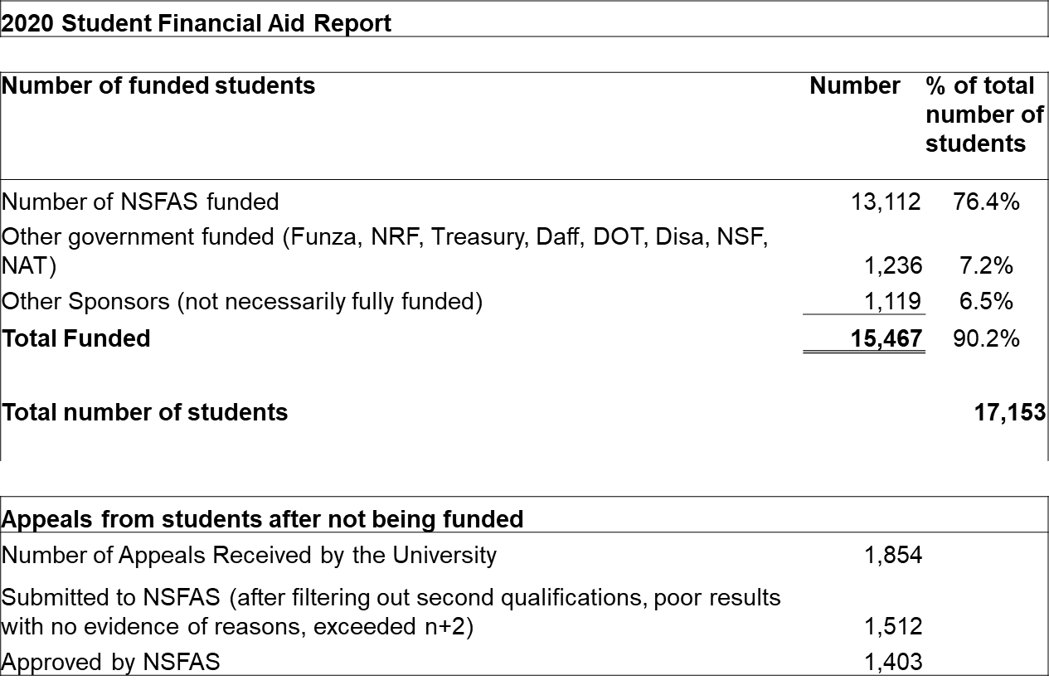
FINANCES AND AUDIT OUTCOME 2020 (Continued)
NSFAS 2020

Slide 29
FINANCES AND AUDIT OUTCOME 2020 (Continued)
AUDIT AND FINANCES 2020
The 2019 audit was an unqualified audit opinion
The audit for the 2020 financial year is still being performed, scheduled for reporting on 30 June 2021 as per Reporting Regulations.
Budget vs actual 2020
Income R1 173 million (budget) vs R1 198 million (actual)
Recurrent expenditure R1 153 million (budget) vs R1 040 million (actual)
The University Council approved a breakeven budget for 2021 which included a downward operational budget adjustment (cut)
The University is in a sound financial position but there is the risk of the influence of the Covid-19 related impact on income and expenditure

Slide 30
FINANCES AND AUDIT OUTCOME 2020 (Continued)
REGISTRATION 2021
Students are not required to make a minimum initial payment to register
All 2021 funded students register regardless of outstanding debt
As per Council resolution payment plan arrangements are made for unfunded students with outstanding debt and this has been implemented very successfully in the past ensuring access for students
As part of the multimodal approach to teaching and learning, the University has also made provision for laptops for all first years

Slide 31
THE END

