Slide 1
Select Committee on Health and Social Services:
Annual Performance Plan 2021/22
16 March 2021
Dr SSS Buthelezi
Director-General
National Department of Health

Slide 2
Outline
Background and Introduction
  Health sector’s priorities
  Emperical evidence / additional diagnostic reports
Strategic Plan 2020/21 – 2024/25
Annual Performance Plan 2021/22
  Performance Information (Outputs, Output Indicators and Targets)
  Financial Information
    Equitable Share
    Conditional Grants

Slide 3
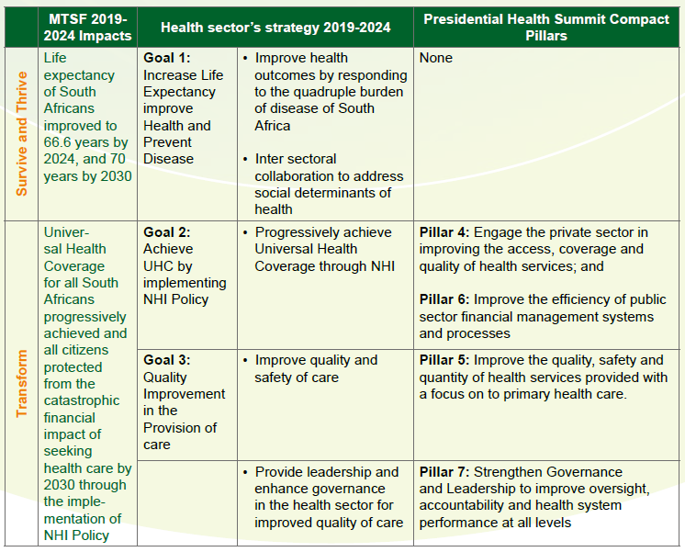
Health sector’s response to MTSF 2019-2024 and Presidential Health Compact

Slide 4
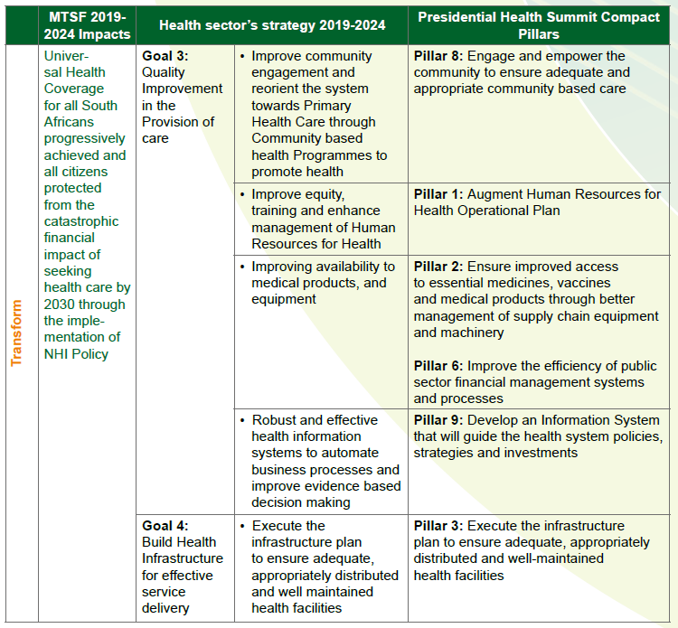
Health sector’s response to MTSF 2019-2024 and Presidential Health Compact (cont)

Slide 5




Additional diagnostics …
Private sector
(mostly)
Health Status of
South Africans
Public sector (mostly)
High Level Findings and Recs: Dec 2018
Detailed Report: May, 2019
Summit: Oct 2018
Summit Report: Feb, 2019
Compact: July, 2019
Started in 2014
Prelim findings: 2018
Final Report: Sep, 2019
Key Findings 2017
Final Report: Jan 2019
Notes:
Context is important.
This diagnostics provide national (macro-level) challenge. The national health system is faced with challenges but not all Districts are challenged in a same way.

Slide 6

National DoH Strategic Plan 2020/21-2024/25

Slide 7
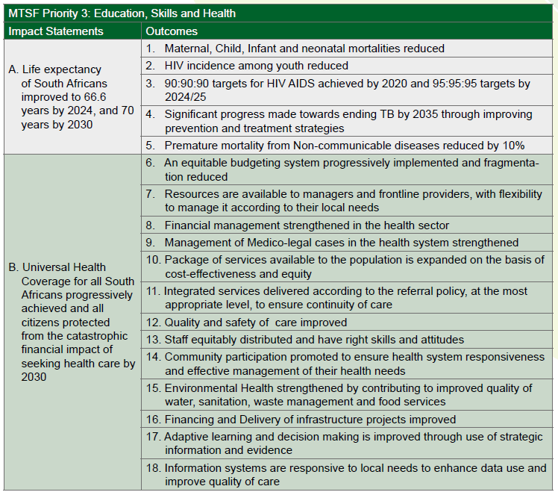
Strategic Plan 2020/21-2024/25
2 Impact statements of the National DoH plans derived from the MTSF 2019-2024
18 Outcomes mapped against 2 Impact statements
5 outcomes for quadruple Burden of Disease
13 Outcomes for health system strengthening and NHI
Added an extra outcome for Covid-19 – “Morbidity and Mortality due to Covid-19 reduced”
(Note: National DoH will review its Strategic Plan when undertaking a mid-term review, and also incorporate the to be revised MTSF 2019-2024)

Slide 8

Annual Performance Plan 2021/22

Slide 9
PROGRAMME 1 - ADMINISTRATION
The purpose of the Administration Programme is to provide support services to the National Department of Health. These include: Human Resources Development and Management, Labour Relations Services, Information Communication Technology Services, Property Management Services, Security Services, Legal Services, Supply Chain Management and Financial Management Services

Slide 10
Programme 1: Administration
Outcome | Output | Output Indicator | Estimated Performance | MTEF Targets
 |  |  | 2020/21 | 2021/22 | 2022/23 | 2023/24
Financial Management strengthened in the health sector | Audit outcome of National DoH | Audit outcome of National DoH | Unqualified audit opinion for 2019/20 FY received | Unqualified audit opinion for 2020/21 FY received | Unqualified audit opinion for 2021/22 FY received | Unqualified audit opinion for 2022/23 FY received
Management of Medico-legal cases in the health system strengthened | A policy and legal framework to manage medico-legal claims in South Africa | A policy and legal framework to manage medico-legal claims in South Africa developed | A policy and legal framework developed to manage medico-legal claims in South Africa drafted A policy framework was adopted in 2015, under the former Minister, anchored on three pillars. The State Liability Amendment Act is being processed through Parliament by the Department of Justice. | A policy and legal framework gazette to manage medico-legal claims in South Africa | A policy and legal framework developed to manage medico-legal claims in South Africa implemented and monitored | A policy and legal framework to manage medico-legal claims in South Africa implemented and monitored

Slide 11
Programme 1: Administration
Outcome | Output | Output Indicator | Estimated Performance | MTEF Targets
 |  |  | 2020/21 | 2021/22 | 2022/23 | 2023/24
Contingent liability reduced to under 60% of the backlog in value | A secure case management system developed and implemented to streamline case management and reduce contingent liability | A secure case management system developed and implemented to streamline case management | Case Management system developed and implemented in 3 provinces | Case Management System used to manage new medico legal claims in 7 provinces | Not Applicable | Not Applicable
Premature mortality due to NCDs reduced to 26% (10% reduction) | 100 Health Promotion messages actively marketed through social media | Number of Health promotion messages broadcasted on Social Media to supplement other channels of communication | 100 health promotion messages broadcasted on social media | 100 health promotion messages broadcasted on social media | 100 health promotion messages broadcasted on social media | 100 health promotion messages broadcasted on social media

Slide 12
PROGRAMME 2 - NATIONAL HEALTH INSURANCE
The purpose of National Health Insurance Programme is to improve access to quality health services through the development and implementation of policies to achieve universal health coverage and health financing reform

Slide 13
Programme 2: National Health Insurance
Outcome | Output | Output Indicator | Estimated Performance | MTEF Targets
 |  |  | 2020/21 | 2021/22 | 2022/23 | 2023/24
Package of services available to the population is expanded on the basis of cost-effectiveness and equity | NHI Bill purchasing Health Services by 2023/24 | NHI Fund purchasing health services by 2023/24 | Portfolio Committee public hearings on the NHI Bill in Parliament attended | Portfolio Committee and NCOP public hearings on the NHI Bill in Parliament attended | NHI Fund established as a public entity | NHI Bill purchasing Health service
 | Medical Aid Beneficiaries registered on HPRS | Medical Aid Beneficiaries registered on HPRS | Medical Aid Beneficiaries registered on HPRS | a Project plan in partnership with Council for Medical Schemes (CMS) developed | None | None
 | Technical Working Group appointed to draft the Service benefit framework for PHC | Technical Working Group appointed to draft the Service benefit framework for PHC | Technical Working Group appointed to draft the Service benefit framework for PHC | Service benefits framework for PHC completed | Service benefit framework for Regional and Specialist Hospitals developed | Service benefit framework for District, Central and Tertiary Hospitals developed
 | 4.5 million Patients registered to receive medicines through the centralised chronic medicine dispensing and distribution (CCMDD) system | Total number of patients registered to receive medicines through the CCMDD system | 4 million | 4.5 million | 5 million | 5.5 million

Slide 14
Programme 2: National Health Insurance
Outcome | Output | Output Indicator | Estimated Performance | MTEF Targets
 |  |  | 2020/21 | 2021/22 | 2022/23 | 2023/24
Resources are available to managers and frontline providers, with flexibility to manage it according to their local needs | 3830 health facilities reporting stock availability at national surveillance centre | Total number of health facilities reporting stock availability at national surveillance centre | 3 788 (3310 Clinics/CHC/CDC, 379 Hospitals, 99 Other medicine storage sites) | 3830 | 3850 | 3860

Slide 15
Programme 3 - Communicable and Non-Communicable Diseases
The programme develops and supports the implementation of national policies, guidelines, norms and standards, and achievement of targets for the national response needed to decrease morbidity and mortality associated with communicable diseases (HIV, Tuberculosis, Malaria, Influenza and others) and non-communicable diseases (mental health; cancer, hypertension, diabetes and others). It is also responsible to develop strategies and implement programmes that reduces Maternal and Child Mortality.

Slide 16
Programme 3: Communicable and non-communicable diseases
Outcome | Output | Output Indicator | Estimated Performance | MTEF Targets
 |  |  | 2020/21 | 2021/22 | 2022/23 | 2023/24
Morbidity and Mortality due to Covid-19 reduced | 16.6 million persons vaccinated against Covid-19 | Number of persons vaccinated against Covid-19 | New Indicator | 16.6 million persons vaccinated against covid-19 | 25 million persons vaccinated against Covid-19 | 40 million persons vaccinated against Covid-19
Quality and Safety of Care Improved | 98 hospitals obtain 75% and above on the food service policy assessment tool | Number of hospitals compliant with the food service policy | Not Applicable | 98 hospitals obtain 75% and above on the food service policy assessment tool | 196 hospitals obtain 75% and above on the food service policy assessment | 296 hospitals obtain 75% and above on the food service policy assessment tool
HIV incidence among youth reduced | 800 additional PHC facilities with youth zones | Number of PHC facilities with youth zones | 800 PHC facilities with youth zones | 1600 PHC facilities with youth zones | 2400 PHC facilities with youth zones | 3200 PHC facilities with youth zones
Premature mortality due to NCDs reduced to 26% (10% reduction) | National Strategic Plan (NSP) for Non-Communicable Diseases (NCDs) developed and published | NSP for NCDs developed and published | NSP for NCDs developed | NSP for NCDs developed and published | NSP for NCDs implementation monitored; and 4 quarterly reports produced | NSP for NCDs implementation monitored; and 4 quarterly reports produced

Slide 17
Programme 3: Communicable and non-communicable diseases
Outcome | Output | Output Indicator | Estimated Performance | MTEF Targets
 |  |  | 2020/21 | 2021/22 | 2022/23 | 2023/24
Premature mortality due to NCDs reduced to 26% (10% reduction) | Multi-sectoral strategy to guide implementation of National strategy for tobacco control intervention | National strategy for tobacco control developed | Not Applicable | Draft Multi-sectoral strategy to guide implementation of National tobacco control interventions | Approval and partial implementation of the multi-sectoral strategy | Continue with implementation of the strategy
 | 75 State patients *admitted into designated psychiatric hospitals | Number of State patients admitted into designated psychiatric hospitals | Not applicable | 75 State patients admitted into designated psychiatric hospitals | 100 State patients admitted into designated psychiatric hospitals | 125 State patients admitted into designated psychiatric hospitals
Improve quality and safety of care | 500 medical officers and professional nurses trained ** to improve their skills in clinical management of mental disorders | Number of medical officers and professional nurses trained to improve their skills in clinical management of mental disorders | Not applicable | 500 medical officers and professional nurses trained to improve their skills in clinical management of mental disorders | 500 medical officers and professional nurses trained to improve their skills in clinical management of mental disorders | Not Applicable
* State patients are defined as persons who allegedly committed a criminal offence due to mental illness and declared by the Court.
** working in units that are listed to conduct 72 hours assessment and psychiatric units attached to general hospitals

Slide 18
Programme 3: Communicable and non-communicable diseases
Outcome | Output | Output Indicator | Estimated Performance | MTEF Targets
 |  |  | 2020/21 | 2021/22 | 2022/23 | 2023/24
Maternal, Child, Infant and neonatal mortalities reduced | Maternity care guidelines | Maternity care guidelines approved | Not Applicable | Maternity care guidelines approved | Maternity care guidelines monitored for implementation | Maternity care guidelines monitored for implementation
 | Neonatal care guidelines | Neonatal care guidelines approved | Not Applicable | Neonatal care guidelines approved | Neonatal care guidelines monitored for implementation | Neonatal care guidelines monitored for implementation

Slide 19
Programme 4: Primary Health Care
To develop and oversee the implementation of legislation, policies, systems, and norms and standards for a uniform well-functioning District Health System, including Emergency and Environmental Health Services.

Slide 20
Programme 4: Primary Health Care
Outcome | Output | Output Indicator | Estimated Performance | MTEF Targets
 |  |  | 2020/21 | 2021/22 | 2022/23 | 2023/24
Quality and Safety of Care Improved | 100 PHC Facilities and 80 Hospitals implementing the National Quality Improvement Programme | Number of health facilities implementing the National Quality Improvement Programme | 350 PHC Facilities and 50 Hospitals implementing the National Quality Improvement Programme | 100 PHC Facilities and 80 Hospitals implementing the National Quality Improvement Programme | 25% of public facilities implementing Quality Improvement Plan | 50% of public facilities implementing Quality Improvement Plan
 | 2100 PHC facilities that qualify as Ideal Clinics | Number of primary health care facilities that qualify as ideal clinics | 1908 PHC facilities qualify as Ideal Clinics | 2100 PHC facilities qualify as Ideal Clinics | 2200 PHC facilities that qualify as Ideal Clinics | 2250 PHC facilities that qualify as Ideal Clinics

Slide 21
Programme 4: Primary Health Care
Outcome | Output | Output Indicator | Estimated Performance | MTEF Targets
 |  |  | 2020/21 | 2021/22 | 2022/23 | 2023/24
Quality and Safety of Care Improved | Policy on Traditional Medicine approved and implementation commenced | Policy on Traditional Medicine approved and implementation commenced | Draft Policy and implementation guidelines on Traditional Medicine presented to the Interim traditional practitioners council for consultation | Policy and implementation guidelines on Traditional Medicine approved and implementation commenced | Policy on Traditional Medicine Implemented and Monitored | Policy on Traditional Medicine Implemented and Monitored
 | 18 Ports of entry services compliant with international health regulations per year | Number of ports of entry compliant with international health regulations based on self-assessments | 9 ports of entry compliant with international health regulations | 18 ports of entry compliant with international health regulations based on self-assessments | 25 ports of entry complaint with international health regulations based on self-assessments | 30 ports of entry compliant with international health regulations based on self-assessments

Slide 22
Programme 4: Primary Health Care
Outcome | Output | Output Indicator | Estimated Performance | MTEF Targets
 |  |  | 2020/21 | 2021/22 | 2022/23 | 2023/24
Community participation promoted to ensure health system responsiveness and effective management of their health needs | Monitoring system for measuring effectiveness of clinic committees tested in 200 clinics | Number of clinics testing the guidelines for measuring effectiveness of clinic committees | Guidelines for monitoring effectiveness of clinic committees piloted. | 200 clinics testing the guideline for measuring effectiveness of clinic committees | 500 clinic committees compliant to measurement guidelines | Not Applicable
 | 250 000 clients lost to follow up for treatment traced by CHWs | Number of clients lost to follow up for treatment traced by CHWs | 250 000 | 250 000 | 400,000 | 200,000
 | 1250 PHC Facilities with Ward Based Outreach teams | Number of PHC Facilities with Ward Based Outreach Teams | 1250 | 1250 | 3,000 | 3,467

Slide 23
Programme 4: Primary Health Care
Outcome | Output | Output Indicator | Estimated Performance | MTEF Targets
 |  |  | 2020/21 | 2021/22 | 2022/23 | 2023/24
Quality and Safety of Care Improved | 11 districts and metropolitan municipalities compliant with National Environmental Health Norms and Standards. | Number of Metropolitan and District Municipalities that performed below 65% assessed for compliance to National Environmental Health Norms and Standards | Not Applicable | 11 Metropolitan and District Municipalities that performed below 65% assessed for compliance to National Environmental Health Norms and Standards | 21 Metropolitan and District Municipalities assessed for compliance to National Environmental Health Norms and Standards | 20 Metropolitan and District Municipalities assessed for compliance to National Environmental Health Norms and Standards
 | 9 Provinces assessed for compliance with Emergency Medical Services Regulations | Number of provinces assessed for compliance with Emergency Medical Services Regulations | 9 Provinces assessed for compliance with Emergency Medical Services Regulations | 9 Provinces assessed for compliance with Emergency Medical Services Regulations | Quality improvement plans of 9 Provincial DoH monitored | Quality improvement plans of 9 Provincial DoH monitored

Slide 24
PROGRAMME 5: HOSPITAL SYSTEMS
Develops national policy on hospital services and responsibilities by level of care; providing clear guidelines for referral and improved communication; developing detailed hospital plans; and facilitating quality improvement for hospitals.
The programme is further responsible for the management of the national tertiary services grant and ensures that planning of health infrastructure meets the health needs of the country.

Slide 25
Programme 5: Hospital Systems
Outcome | Output | Output Indicator | Estimated Performance | MTEF Targets
 |  |  | 2020/21 | 2021/22 | 2022/23 | 2023/24
Financing and Delivery of infrastructure projects improved | 40 PHC facilities constructed or revitalised | Number of PHC facilities constructed or revitalised | 38 PHC facilities constructed or revitalised | 40 PHC facilities constructed or revitalised | 40 PHC facilities constructed or revitalised | 45 PHC facilities constructed or revitalised
 | 21 Hospitals constructed or revitalised | Number of Hospitals constructed or revitalised | 21 Hospitals constructed or revitalised | 21 Hospitals constructed or revitalised | 30 Hospitals constructed or revitalised | 50 Hospitals constructed or revitalised
 | 120 public health Facilities (Clinics, Hospitals, nursing colleges, EMS base stations) maintained, repaired and/or refurbished | Number of public health Facilities (Clinics, Hospitals, nursing colleges, EMS base stations) maintained, repaired and/or refurbished | 115 public health Facilities (Clinics, Hospitals, nursing colleges, EMS base stations) maintained, repaired and/or refurbished | 120 public health Facilities (Clinics, Hospitals, nursing colleges, EMS base stations) maintained, repaired and/or refurbished | 150 public health Facilities (Clinics, Hospitals, nursing colleges, EMS base stations) maintained, repaired and/or refurbished | 200 public health Facilities (Clinics, Hospitals, nursing colleges, EMS base stations) maintained, repaired and/or refurbished

Slide 26
PROGRAMME 6 – HEALTH SYSTEM GOVERNANCE AND HUMAN RESOURCES
The purpose of the programme is threefold:
to achieve integrated health systems planning, monitoring and evaluation, health information systems and research.
Develops and monitors the implementation of health workforce policies and ensures effective health workforce planning, development and management in the national health system, as well as alignment of academic medical centres with health workforce programmes and training of health professionals. It assists the government to achieve the population health goals of the country through nursing and midwifery, through the provision of expert policy and technical advice and recommendations on the role of nurses in attainment of desired health outputs.
Lastly, the programme also has the responsibility for oversight over public entities and statutory health professional councils, and ensuring compliance by with applicable legislative prescripts.
.

Slide 27
Programme 6: Health System Governance and Human Resources
Outcome | Output | Output Indicator | Estimated Performance | MTEF Targets
 |  |  | 2020/21 | 2021/22 | 2022/23 | 2023/24
Quality and safety of care improved | All 9 Public nursing colleges supported to achieve accreditation for rbasic and specialist nursing and midwifery programmes | Number of Public nursing colleges supported to achieve accreditation for r basic and specialist nursing and midwifery programmes | 9 Public nursing colleges accredited and registered to offer basic nursing and midwifery programmes | 9 Public nursing colleges supported to achieve accreditation for basic and specialist nursing and midwifery programmes | Not applicable | Not applicable
 | 9 Provinces supported to develop implementation plans for strengthening clinical governance | Number of Provinces supported to develop implementation plans for strengthening clinical governance | Clinical governance system assessed, and 3 provinces supported to develop implementation plans | 9 Provinces supported to develop implementation plans for strengthening clinical governance | Not Applicable | Not Applicable

Slide 28
Programme 6: Health System Governance and Human Resources
Outcome | Output | Output Indicator | Estimated Performance | MTEF Targets
 |  |  | 2020/21 | 2021/22 | 2022/23 | 2023/24
Staff equitably distributed and have right skills and attitudes | Community service policy published | Community service policy published; | Community service policy reviewed | Community Service Policy Published | Community service policy implemented and monitored | Not applicable
 | 90% eligible students allocated to a health facility for community service | Percentage of eligible students allocated to a health facility for community service | Not Applicable | 90% eligible students allocated to a health facility for community service | 90% eligible students allocated to a health facility for community service | 90% eligible students allocated to a health facility for community service

Slide 29
Programme 6: Health System Governance and Human Resources
Outcome | Output | Output Indicator | Estimated Performance | MTEF Targets
 |  |  | 2020/21 | 2021/22 | 2022/23 | 2023/24
Information systems are responsive to local needs to enhance data use and improve quality of care | 500 Covid-19 vaccination sites registered on the EVDS to use the Electronic Vaccination Data System (EVDS) | Number of Covid-19 vaccination sites registered to use the Electronic Vaccination Data System (EVDS) | Not Applicable | 500 Covid-19 vaccination sites registered to use the Electronic Vaccination Data System (EVDS) | 1500 Covid-19 vaccination sites registered to use Electronic Vaccination Data System (EVDS) | 2000 Covid-19 vaccination sites registered to use the Electronic Vaccination Data System (EVDS)
Adaptive learning and decision making is improved through use of strategic information and evidence | National Health Research Priorities identified to generate the required knowledge for the South African health system | Revised set of Health research priorities produced | National Health Research Priorities identified | Revised set of Health research priorities produced | National Health Research priorities implemented | Not applicable
Information systems are responsive to local needs to enhance data use and improve quality of care | Alpha version of networked TB/HIV Plus Information System developed | Alpha version of networked TB/HIV Plus Information System developed | Prototype of networked TB/HIV Plus Information System developed | Alpha version of networked TB/HIV Plus Information System developed | Networked TB/HIV Plus Information System tested and implemented | Not applicable

Slide 30
Financial Information

Slide 31
31
Summary per Programme

Slide 32
32
Summary per
Economic Classification

Slide 33
REASONS FOR DEVIATIONS
The baseline has been decreased across all the economic classifications due to economic pressures as a result of the Covid-19 pandemic.
Compensation of employees:
The COE ceiling was reduced with 12%, resulting in reductions across all the programmes.
Goods & services:
R4.35 billion was allocated for the procurement of Covid-19 vaccines.
The allocation for indirect NHI grants under Programmes 2 and 5 has been materially decreased.
Additional funds have been allocated under Programme 1 to fund the related expenditure due to the relocation of the Department to another building.
33

Slide 34
REASONS FOR DEVIATIONS
Transfers & subsidies:
The allocations for conditional grants and transfers to non-profit institutions were reduced with 3% and 13% respectively, across all the applicable programmes.
SANAC received a once-off increase of R10 million, while allocations for the other Departmental Agencies have been decreased.
Purchase of capital assets:
The NHI Indirect grant for the construction and refurbishment of health facilities under Programme 5, have been reduced with R107 million.
The allocation for the procurement of machinery & equipment of the indirect NHI grants under Programmes 2 and 5 has been decreased.
The capital allocations of all the units across all the programmes has been increased once-off to make provision for procurement of computer equipment and / or furniture due possible damage because of the relocation to another building.
34

Slide 35
INDIRECT GRANTS SUMMARY (01)
35

Slide 36
[INDIRECT GRANTS SUMMARY (02)]
The overall reduction on indirect grants for 2021/22 is 16,3% (this is without the new Covid allocation for vaccines); this means that the 21% increase is artificial due to new Covid – 19 funding for vaccines.
The major reduction is under Infrastructure indirect grant with 19,6% followed by Non-Personal Services with 15,6%.
The reduction will have a negative impact on nationally managed programmes especially infrastructure projects. Some planned projects will need to be postponed due to limited funding. The current infrastructure backlog will continue to grow.
The department is in the process of establishing oncology services in underserved provinces however this process will be delayed due to budget cuts.
36

Slide 37
DIRECT GRANTS SUMMARY (01)
37

Slide 38
38
DIRECT GRANTS SUMMARY (02)
The overall reduction on direct grants for 2021/22 is 3,4% or R1,8 billion and this is growing over MTEF period.
The major reduction is under NTSG R1 billion and HIV component R1,6 billion.
This will have serious service delivery implications as this will require
  rationalisation of services,
  Maintainance of current services eg it will be difficult to initiate new patients on ART programme.
  All the current initiatives to modernise the tertiary services and establishment of new services will have to be postponed.
  Cross-border referrals will continue which will have a direct effect on patients.
However, the department will continue to put measures in place to ensure current services are not tempered with.

Slide 39
39
NDoH & PDoH Reprioritisation towards COVID-19

Slide 40

THANK YOU

