Slide 1
Presentation to the Portfolio Committee Home Affairs 25 June 2020

Slide 2
Presentation Outline
Background
Purpose of the Presentation
Order of Court
Three Judgements
Building Blocks of the Court’s Reasoning
Parliament’s Regulation
Jafta Judgement
Froneman’s Dissent
High-Level Operational Implications
Timelines

Slide 3
Purpose of the Presentation
To provide a succinct analysis of the Constitutional Court Judgement
To identify the responsibilities of Parliament
To provide high-level operational implications for the Electoral Commission
Timelines Implications
The presentation is not about options on electoral systems

Slide 4
Background
New Nation Movement first sought the declaration of constitutional invalidity of the Electoral Act in the Western Cape High Court
The Presidency and Parliament abided the decision of the Court
Minister of Home Affairs opposed the application
The application in the High Court was dismissed
The applicant directly appealed to the Concourt
A hearing on urgency was heard on 2 May 2019
Matter was postponed to 15 August 2019
Judgement was delivered on 11 June 2020

Slide 5
Background
Its position was that it was “agnostic as to what electoral system is chosen for South Africa. That is ultimately a matter for Parliament”
However, the Electoral Commission sought to make submissions to the Court on the correct legal principles applicable
It did so on the basis that the Court had previously held that “it is undesirable that matters involving the conduct of elections should be decided without the benefit of the views of the Commission.”

Slide 6
Order of Court
It is declared that the Electoral Act 73 of 1998 is unconstitutional to the extent that it requires that adult citizens may be elected to the National Assembly and Provincial Legislatures only through their membership of political parties.
The declaration of unconstitutionality referred to in paragraph 4 of the judgement is prospective with effect from the date of this order, but its operation is suspended for 24 months to afford Parliament an opportunity to remedy the defect giving rise to the unconstitutionality.
The Minister of Home Affairs must pay the applicants’ costs in the High Court and this Court, such costs to include the costs of two counsel

Slide 7
Court Delivered Three Judgments
The majority judgment of Madlanga J commanded the support of eight judges
The concurring judgment of Jafta J also commanded the support of eight judges
This is potentially significant, because it means the principles laid down in the judgment of Jafta J are as much part of law as those in the judgment of Madlanga J
There was a lone dissent by Froneman J

Slide 8
Building Blocks of Court’s Reasoning
The political rights conferred under section 19 must be read together – “[s]ection 19(3)(b) is part of closely related rights that the Constitution deliberately groups together as “political rights”. They are so interconnected that they have to be read together.”
The proper understanding of the rights conferred under section 19 must start with the appreciation that section 19(1) confers the freedom to make political choices – which includes a choice not to join or form a political party

Slide 9
Building Blocks of Court’s Reasoning
To appreciate the full extent of the rights conferred by section 19(3)(b), it has to be read together with the right to freedom of association under section 18 - “[i]t seems to me that in the context of this matter the freedom of association challenge is inextricably linked to what the content of the section 19(3)(b) right really is.”

Slide 10
Building Blocks of Court’s Reasoning
Section 18 protects both the right to form associations as well as the right not to associate – “Section 18 of the Constitution provides that “[e]veryone has the right to freedom of association”. In its traditional sense this right is associated more with the positive than the negative element. The positive element is about the right of an individual to be free to form an association with whomsoever she or he wishes for whatever purpose. Of course, the purpose must be one that is worthy of protection under section 18. The negative element is about the freedom not to associate at all, if that be the individual’s choice.”

Slide 11
Building Blocks of Court’s Reasoning
Reading section 19(3)(b) to limit the exercise of the right to stand for political office to having to do so through a political party would result in the infringement of other rights in the Bill of Rights – “It is axiomatic then that if the state compels an individual to associate when she or he does not want to, that limits the right to freedom of association. That must mean the reading of section 19(3)(b) contended for by the respondents results in a denial of the right to freedom of association.”
“Also, this reading creates tension between the section 19(3)(b) right and the section 10 right to dignity.

Slide 12
Parliament's Regulation
The Court’s interpretation gives primacy to the Bill of Rights in defining the scope and extent of the political rights that are protected.
This limits the choices that Parliament can make under sections 46 and 105 to an electoral system that gives effect to the rights conferred under the Bill of Rights.
In relation to sections 46(1)(d) and 105(1)(d) the Court held that:
“The focus of the sections is on the “result”: whoever the participants may be, the system must be one that “results, in general, in proportional representation,” and that “proportionality does not equal exclusive party proportional representation.”

Slide 13
Other Constitutional Provisions
Reference to political parties in sections 57(2), 116 178(1)(h), 193(5), 236 and Schedule 3B must be viewed in light of the founding values one of which implicitly denounces one party governance for South Africa and expressly decrees that the Republic is founded on the value of a multi-party system of democratic government
However, these provisions do not mean that the Constitution envisages an exclusive party proportional representation system to the total exclusion of independent candidates

Slide 14
Other Constitutional Provisions
“Section 157(2)(a) imposes a requirement that entails a “discrete and narrow limitation” on the rights protected by sections 18 and 19” and only does so in the local government sphere.
“It makes sense that – for whatever reason – the framers of the Constitution (which post-dates the mentioned negotiations) may have seen a need to introduce in the Constitution a discrete, internal limit applicable only to the system of election of members of Municipal Councils. The problems uniquely attendant to municipalities – involving as they did – the intractable problem of racially based spatial distribution of the South African population could not have ended overnight.”

Slide 15
Other Constitutional Provisions
The normative force of section 19 continues to apply in every instance where the Constitution has not specified a system of representation different to what section 19 requires. Therefore, in the election of members of the National Assembly and Provincial Legislatures, the normative system the Bill of Rights itself creates in section 19 must apply

Slide 16
Jafta J Judgement
In unequivocal terms, section 19(3)(b) confers upon every adult South African the right “to stand for public office and, if elected, to hold office”. Whilst Parliament has the power to pass legislation that regulates the exercise of the right, it cannot enact legislation that prevents the exercise of the right. In its present form, the Electoral Act does not allow every adult South African to exercise the right to contest elections on their own

Slide 17
Froneman J Dissent
He concludes that “[b]ased on these constitutional values and norms it seems fair to conclude that the right to stand and hold elective office in terms of section 19(3)(b) is an individual right to represent the people in a multi-party system through the medium of political parties that results, in general, in proportional representation.”

Slide 18
High-Level Operational Implications
ICT Business Applications
Candidate Nomination’s System
Results Systems
Result capturing
Seat calculation
Seat assignment
Logistics Information system
Number and Size of Ballot Papers
Possible Delimitation of Constituencies
Re-training of Staff
Possible Re-Configuration of Local Offices
Counting and Declaration of Results
Modalities of Voting
Increased Costs of Elections

Slide 19
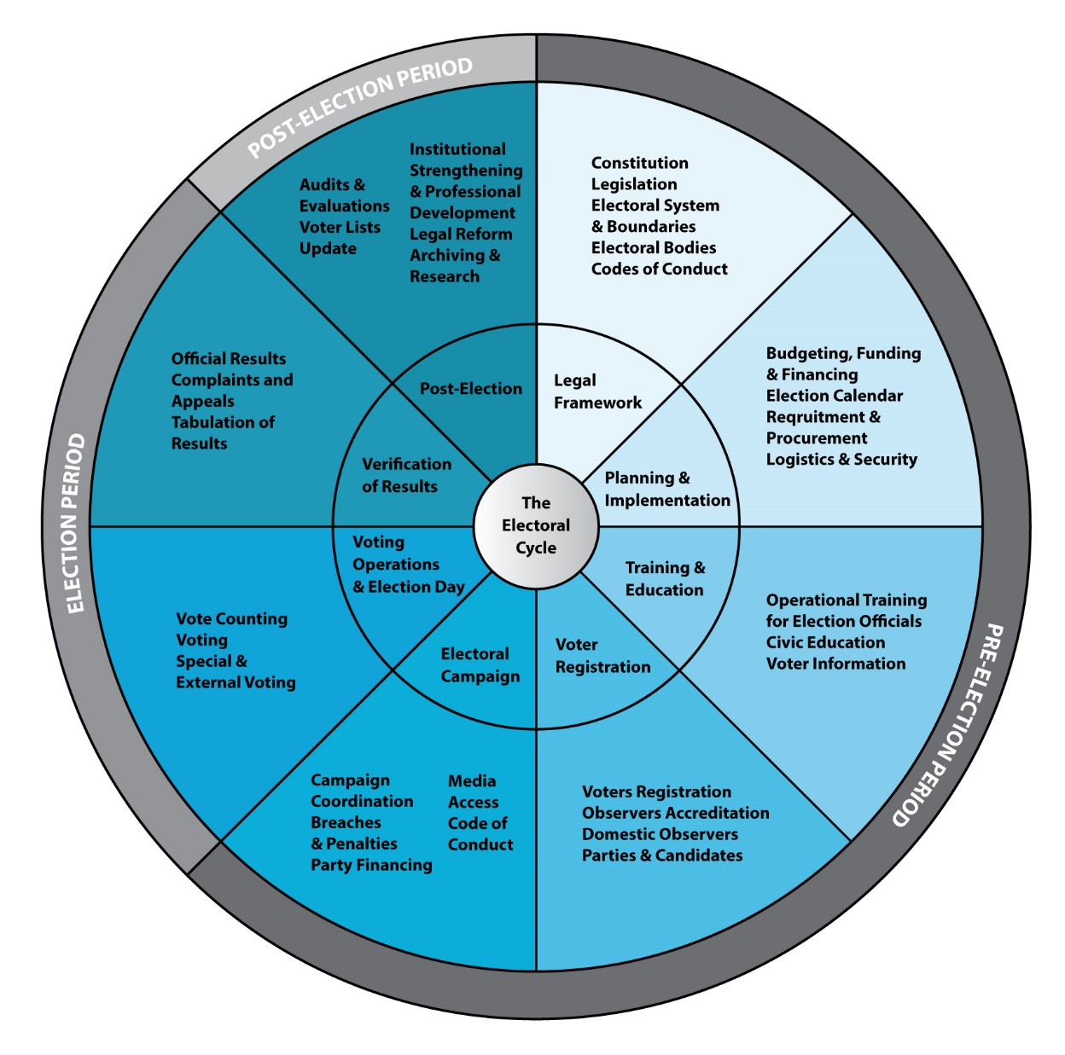
Impact on Electoral Cycle

Slide 20
Timelines
Parliaments have 24 months to remedy the defects in the Electoral Act
However, this period is not enough
MDB requires 24 months to draw municipal wards
Delimitation of “New Constituencies” is likely to take a lot more time
Consultation
Objections
New electoral system means re-constructing the whole electoral edifice
Re-writing ICT business applications will take at least a year
Parliamentary process should commence

Slide 21
Closure
The Commission stands ready to assist Parliament in the process of reviewing the electoral system

