Slide 1
MUSEUMS ORDINANCE AMENDMENT BILL
Standing Committee: Community Safety, Cultural Affairs and Sport
Michael Janse van Rensburg
Deputy Director: Museum Service
Department of Cultural Affairs and Sport
15 March 2021

Slide 2
LEGISLATION
The Museums Ordinance No. Ordinance 8 of 1975 was assigned to the Western Cape Province in 1994 under Proclamation 115 of 1994.
Broadly, the Museums Ordinance governs:
The establishment of museums,
the governance of museums,
(5) Provincial Museums (Management Committee)
(20) Province-aided Museums (Board of Trustees)
(6) Local Museums (Control Board)
the granting of subsidies/grants to museums, and
the appointment of staff at museums

Slide 3
MOTIVATION
The Museums Ordinance predates the Constitution of the Republic of South Africa, 1996 and so contains language that is not aligned with the Constitution.
It also predates the Public Finance Management Act, 1999 (Act 1 of 1999), and so is not aligned with that Act.
Province-aided museums are funded through subsidies that are paid to them in terms of section 29 of the Ordinance. These museums face a huge challenge because section 32 of Ordinance requires them to be audited by the Auditor-General.
The collective Auditor-General fees for 19 province-aided museums in the Province was R2,3 million for 2018/19 and R2,5 million for 2019/2020.
The collective result is that province-aided museums are unable to allocate sufficient resources towards their core functions to conserve, exhibit and educate communities about the Province’s collective heritage

Slide 4
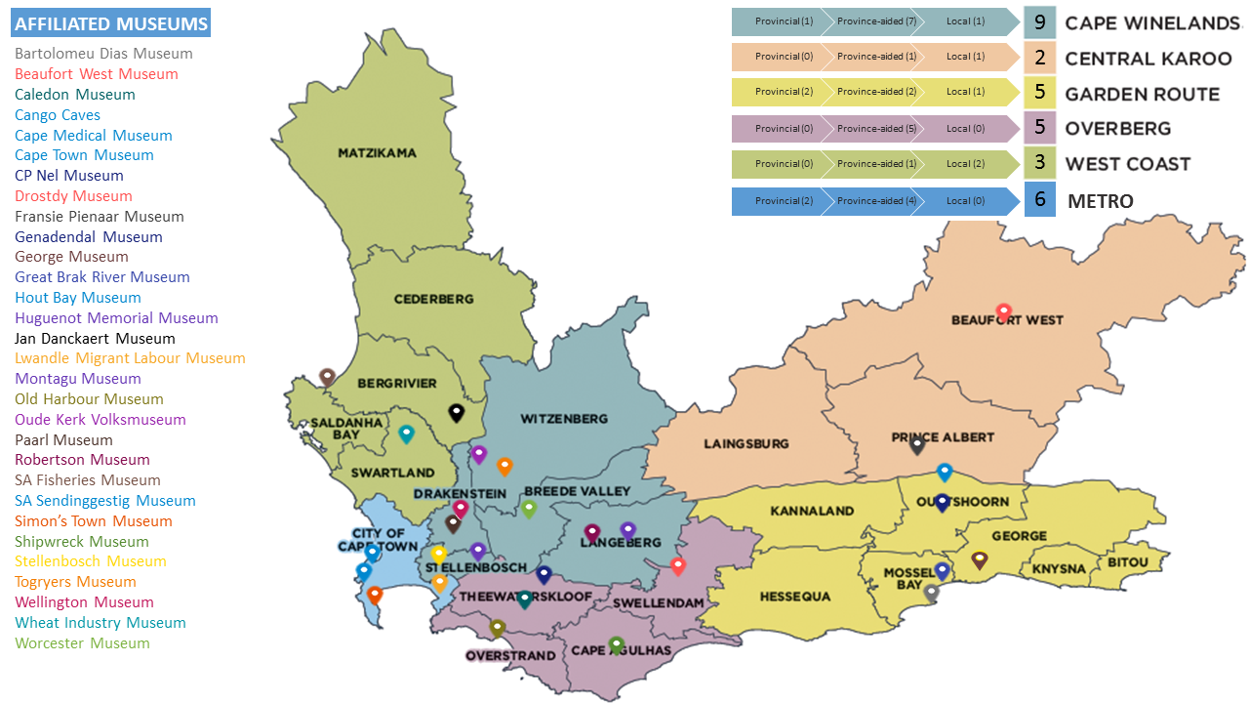
Museums

Slide 5
OBJECTS OF THE BILL
The Museums Ordinance Amendment Bill seeks to amend provisions to align the principal Ordinance with the Constitution, other relevant legislation such as the Public Finance Management Act, 1999, and good practice within the museum governance environment.
Furthermore, the Museums Ordinance Amendment Bill seeks to align the principal Ordinance with current terminology and government structures, and to alleviate the financial burden of annual financial audits by the Auditor-General on province-aided museums.
AMENDMENTS LEGEND
Legislative Alignment
(LA)
Terminology Alignment
(TA)
Auditor General Alternative
(AG)
Good Practise Alignment

Slide 6
AMENDMENTS
Clause 1 TA | amends section 1 of the principal Ordinance by substituting, deleting and inserting certain definitions for standardisation purposes and alignment with current provincial government structures.
Clause 2 GP | amends section 2 of the principal Ordinance to provide guidance for the exercise of the discretion of the Provincial Minister to establish a provincial museum.
Clause 3 TA | amends section 3 of the principal Ordinance and is a consequential amendment to the substitution of the expressions “Administrator” and “officer” and the deletion of the definition of “official” in clause 1.
Clause 4 LA | amends section 4 of the principal Ordinance to extend the term of office of an appointed member from two to three years. The clause sets out the circumstances that give rise to a vacancy in a management committee. It provides that the allowances that are paid to members are as determined by the Provincial Minister in consultation with the provincial minister responsible for finance in the Province.

Slide 7
AMENDMENTS (CONT.)
Clause 5 GP | inserts section 4A in the principal Ordinance to provide for the disqualification for membership of a management committee.
Clause 6 GP | amends section 5 of the principal Ordinance to provide that the Provincial Minister must designate a chairperson of a management committee when he or she appoints the appointed members or if the chairperson vacates his or her office. This is to strengthen the governance of provincial museums.
Clause 7 GP | substitutes section 6 of the principal Ordinance to make different provision for the quorum and decision-making at meetings of a management committee. The clause provides that a quorum for a meeting is fifty per cent plus one of the total number of members of such a committee and further provides for decisions, under certain circumstances, to be taken by vote. This is to ensure good governance at provincial museums.
Clause 8 LA | amends section 7 of the principal Ordinance to provide for a different manner by which a committee may determine and charge admission fees to increase potential revenue. The clause deletes discriminatory language in the principal Ordinance.

Slide 8
AMENDMENTS (CONT.)
Clause 9 TA | amends section 8 of the principal Ordinance. The clause substitutes the expression “Administrator” for the expression “Head of the Department” and the expression “Provincial Service” for the expression “Public Service”.
Clause 10 LA | substitutes section 9 of the principal Ordinance to align the acceptance of donations and bequests with the Public Finance Management Act, 1999.
Clause 11 LA | substitutes section 10 of the principal Ordinance to provide that moneys collected by a provincial museum or management committee of a provincial museum must be paid into the Provincial Revenue Fund for use by the management committee of the provincial museum concerned subject to the Head of the Department’s approval.
Clause 12 LA | repeals section 10A of the principal Ordinance.

Slide 9
AMENDMENTS (CONT.)
Clause 13 GP | substitutes section 11 of the principal Ordinance to provide guidance for the exercise of the discretion of the Provincial Minister to abolish a provincial museum and provides for a public participation process.
Clause 14 GP | amends section 12 of the principal Ordinance to further guide the discretion of the Provincial Minister to declare a museum to be a province-aided museum.
Clause 15 GP | substitutes section 15 of the principal Ordinance to reconfigure the constitution of a board to ensure good governance at province-aided museums. The whole of the principal Ordinance was assigned to the Province to the extent that it applied in the Province. The museums listed in section 15(2) of the principal Ordinance do not fall within the geographical area of the Province. For this reason, section 15(2) of the principal Ordinance is not applicable in the Province and hence was not assigned to the Province.
Clause 16 GP | substitutes section 16 of the principal Ordinance and comprehensively sets out the tenure of office of the various categories of members that constitute a board.

Slide 10
AMENDMENTS (CONT.)
Clause 17 GP | substitutes section 17 of the principal Ordinance and is a consequential amendment to amendments in clause 4 and 15
Clause 18 GP | substitutes section 18 of the principal Ordinance and provides for a change in the criteria for disqualification for membership of a board
Clause 19 GP | inserts section 18A in the principal Ordinance to provide for the designation of a chairperson of a board by the Provincial Minister.
Clause 20 GP | substitutes section 19 of the principal Ordinance to make different provision for the quorum and decision-making at meetings of a board. By the inclusion of a reference to section 6 the clause provides that a quorum for a meeting of a board is fifty per cent plus one and makes further provision for decisions, under certain circumstances, to be taken by vote. This is to ensure good governance at province-aided museums.
Clause 21 TA | amends section 20 of the principal Ordinance and is a textual improvement of the principal Ordinance.

Slide 11
AMENDMENTS (CONT.)
Clause 22 GP | amends section 21 of the principal Ordinance to make different provision for when an annual report by a board must be submitted. The revised timeline is to ensure sufficient accountability to the Department.
Clause 23 GP | substitutes section 24 of the principal Ordinance to provide that the Head of the Department must determine the staff establishment of a province-aided museum. The clause further prohibits a board from appointing staff in addition to the staff establishment so determined without the prior written consent of the Head of the Department. This is to ensure that the Department retains sufficient oversight of staff that are appointed in addition to the staff establishment
Clause 24 GP | substitutes section 25 of the principal Ordinance to delete the approvals that a board required under the principal Ordinance to appoint staff to the staff establishment. It provides further for the manner in which a board must apply for consent to appoint staff in addition to the staff establishment determined by the Head of the Department and the criteria that the Head of the Department must consider in such applications.

Slide 12
AMENDMENTS (CONT.)
Clause 25 GP | inserts section 26(2) in the principal Ordinance and provides a board with the power to retain staff beyond their retirement age with the approval of the Head of the Department.
Clause 26 GP | repeals section 27 of the principal Ordinance so that boards have sufficient decision-making power to determine the salaries of the staff it appoints. This is because the context and financial means of different province-aided museums differ widely. The clause further repeals section 28 of the principal Ordinance. This is a consequential amendment to the amendment in clause 25.
Clause 27 GP | substitutes section 29 of the principal Ordinance to clarify the procedure to be followed when subsidies are paid to boards and, in the event that the board of the Cango Cave Museum intends to request payment of a subsidy, to provide for a process setting out the circumstances in which a request can be made and the process to be followed to make the request.

Slide 13
AMENDMENTS (CONT.)
Clause 28 LA | inserts section 29A in the principal Ordinance to make provision for the payment of additional funds to a board. The clause sets out the procedure to be followed when a board applies for additional funds or when the Head of the Department, on his or her own accord, considers that a board may require additional funds.
Clause 29 LA | substitutes section 30 of the principal Ordinance to provide that a board may raise short-term loans.
Clause 30 LA | substitutes section 31 of the principal Ordinance to provide that funds received by a board through the payment of a subsidy or additional funds and that are not immediately required by the board in the exercise and performance of its powers, duties and functions must be invested in a bank finally registered in terms of the Banks Act, 1990 (Act 94 of 1990), or in government stock.
Clause 31 AG | substitutes section 32 of the principal Ordinance to provide that a board must appoint an auditor to audit the financial statements of the board. This is to ensure that the financial burden of annual audits, currently conducted by the Auditor-General, on province-aided museums are reduced, while still ensuring effective financial accountability

Slide 14
AMENDMENTS (CONT.)
Clause 32 AG | inserts section 32A in the principal Ordinance to regulate financial misconduct by a board. This is to ensure proper financial accountability of boards.
Clause 33 GP | amends section 34 of the principal Ordinance to provide guidance for the exercise of the discretion of the Provincial Minister to declare a museum to be a local museum.
Clause 34 GP | substitutes section 35 of the principal Ordinance to reconfigure the constitution of a control board. This is to ensure good governance at local museums.
Clause 35 GP | substitutes section 37 of the principal Ordinance and comprehensively sets out the tenure of office of the various categories of members that constitute a control board
Clause 36 GP | substitutes section 38 of the principal Ordinance and is a consequential amendment to amendments in clause 4.

Slide 15
AMENDMENTS (CONT.)
Clause 37 GP | inserts clause 38A in the principal Ordinance to provide for the designation of a chairperson of a control board. The clause inserts clause 38B in the principal Ordinance to provide for the quorum and decision-making at a meeting of a control board. Clause 38B, by the inclusion of a reference to section 6, provides that a quorum for a meeting of a control board is fifty per cent plus one of the total number of members of a control board and further provides for decisions, in certain circumstances, to be taken by vote. This is to ensure good governance at local museums.
Clause 38 LA | substitutes section 39 of the principal Ordinance to provide guidance for the exercise of the discretion of the Head of the Department to pay grants to control boards. The clause sets out the procedure to be followed when a control board applies for a grant.
Clause 39 TA | amends section 40 of the principal Ordinance to substitute the expression “Administrator” with the expression “Provincial Minister”. The clause improves the text of the principal Ordinance and makes a consequential amendment following the deletion of the definition of ‘official” in clause 1.

Slide 16
AMENDMENTS (CONT.)
Clause 40 TA | amends section 41 of the principal Ordinance to improve the text of the principal Ordinance and makes consequential amendments following the amendments in clause 37.
Clause 41 GP | substitutes section 42 of the principal Ordinance to provide guidance for the exercise of the discretion of the Provincial Minister to establish a province-aided or local museum as a provincial museum.
Clause 42 TA | amends section 43 of the principal Ordinance and is a consequential amendment to the substitution of the expression “Administrator” with the expression “Provincial Minister”.
Clause 43 LA | substitutes section 44 of the principal Ordinance to provide guidance for the exercise of the discretion of the Provincial Minister to abolish a province-aided or local museum and to provide for a public participation process.

Slide 17
AMENDMENTS (CONT.)
Clause 44 TA | substitutes section 45 of the principal Ordinance. The clause is a consequential amendment following the deletion of the definition of “official” and “employee” in clause 1.
Clause 45 TA | substitutes certain expressions in the principal Ordinance.
Clause 46 TA | amends the long title of the principal Ordinance.
Clause 47 AG | provides for savings and transitional arrangements. The purpose of clause 47(12) is to avoid confusion with regard to references relating to section 15(2) in this Draft Bill and the principal Ordinance.
Clause 48 TA | makes provision for the short title of the Act and its commencement.

Slide 18
OTHER IMPLICATIONS
No additional financial implications because current budget resources will be used.
No direct personnel implications.

Slide 19
Contact Details
Michael Janse van Rensburg
Deputy Director: Museum Service
Department of Cultural Affairs and Sport
Phone: 021 483 9678
Email: Michael.JanseVanRensburg@westerncape.gov.za

