Slide 1
1. PROJECT HOEFYSTER (New Generation Infantry Combat Vehicle) Presentation to Joint Standing Committee 11 March 2021

Slide 2
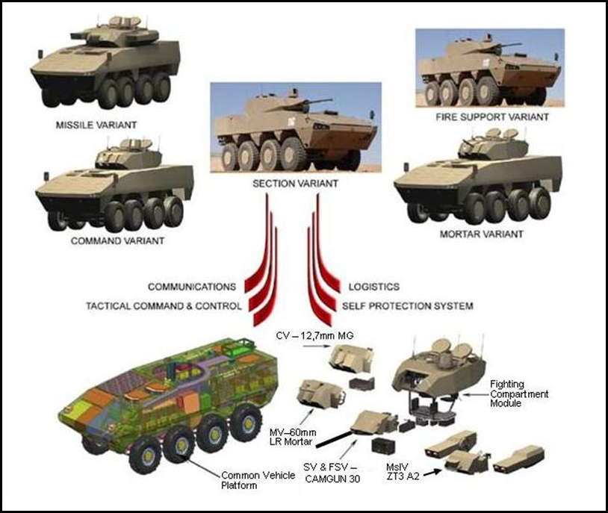
Background
Project Hoefyster provides for the development and production of a total of 264 New Generation Infantry Combat Vehicles (ICV) to replace the current Ratel ICV.
Originally comprising 5 different variants.
Subsequently, 5 additional variants were introduced.
Vehicle based on :
Hull from Patria (Finland)
Turret developed by DLS
Initial Hulls obtained from Patria,
with transfer of technology for
subsequent local production.

Slide 3
Background (2)
Project Development Plan approved during 2006
Schedule: Design and development of 5 variants to be completed by Nov 2011.
A phased acquisition contract to be negotiated with Denel Land Systems, (DLS) for the complete level 5 products system.
Contract 1161 between Armscor and Denel was signed on 21 May 2007 after approval by the Armscor Board of Directors on 02 May 2007.
Original contracted delivery period was over a 66 month period (from May 2007 to May 2012).
Contract provided for activation of Phase 2 (industrialisation and production of 238 vehicles) once predefined suspensive conditions were met. (Achievement of Product Baseline A)
The Acquisition Plan (AP) to activate Phase 2 of Project HOEFYSTER was approved by the AAC on the 13 February 2013.
To proceed with Phase 2 of Project HOEFYSTER, the Industrialisation and Production of 238 vehicles:
Schedule : Production to be completed by March 2023.

Slide 4
Background (3)
The Armscor Board of Directors approved activation of Phase 2 on the 14 August 2013 :
Contracted Denel for Industrialisation and production of 238 vehicles comprising :
5 Original variants (section, missile, mortar, fire support and command)
5 new variants (Artillery BAOS, Art TCP, Art EAOS, Signal and Ambulance)
Number of vehicles subsequently increased to 243 in exchange for advance payments made.
Contract completion date : 30 November 2023 (First battalion of 88 vehicles to be completed by May 2019)

Slide 5
Project Status
Current Contract execution delays :
Phase 1 completion delayed by approximately 9 years from original date of 2012 as was foreseen in 2007
Phase 2 behind schedule in excess of 40 months with contractual production completion date of 30 November 2023
Development (Phase 1) not completed , and very little progress is being shown at present. Due to :
Financial constraints of Denel
Technical challenges to meet contracted performance
Significant loss of capability to complete development and industrialisation.
The status at present of completion of development is as follows :
Common Product System (Hull and Turret items common to all variants) : 72,7%
Section Variant : 83,9%
Fire Support Variant : 83.09%
Command Variant : 72.6%
Mortar Variant : 44.5%
Missile Variant : 53.61%
All work on new 5 new variants put on hold

Slide 6
Denel Challenges
Technical :
Development
Section Variant EDM has not been qualified and failed several functionality and performance tests at Alkantpan Test Range in February 2018, and recently at Overberg Test Range in November 2019.
Other combat variants are further delayed.
Industrialisation
The delivery of the Phase 2, Section Variant Pre-Production Model (PPM) (Gun and Vehicle) Level 5 system is behind schedule and continues to slip.
The industrialisation of Vehicle Platform Hulls (and Turret Hulls) at Denel Vehicle Systems must be redone due to VR Laser liquidation.
The industrialisation is on hold, due to parts shortages due to non-payment of Suppliers.
Landmine protection of vehicle still to be verified on a RSA built vehicle platform
Production
The delivery of the first Battalion consisting of eighty eight (88) Badger vehicles was supposed to be completed by May 2019.
DLS is not in the position to even start this phase.
The Phase 2 contract is currently behind schedule by more than 40 months.

Slide 7
Denel Challenges (2)
Financial :
During December 2018, Denel indicated in writing that they cannot complete the contract in terms of
Specification
Cost
Timescales
Denel further indicated that :
The contract will be loss-making
They cannot fully fund the completion of Phase1
Do not have operating funds to execute Phase 2
Unable to pay current suppliers and subcontractors
Denel will not be able to absorb the penalties for late deliveries.
DLS would have the cover the warranty costs of the major components that were bought and kept in stock beyond the 2 year OEM warranty period.
Requested that the contract be reset, and for Armscor and the DOD to absorb escalation costs beyond the delivery dates, and waive the penalties.

Slide 8
Conclusion
During several previous presentations to Parliamentary Portfolio Committee and others, Denel maintained that the Development of the Section Variant had been completed (Product Baseline achieved)
Armscor disagreed with this statement, as there are a significant number of technical non-compliances not resolved.
During August 2020, Consensus was reached between Armscor and Denel regarding the number of non-compliances to specification.
Denel was requested to review the technical non-compliances and provide Armscor with :
Non-compliances which can be rectified by Denel
Non-compliances which can not be rectified – Denel to request Change Requests using the official process.
Denel to provide new dates and implications for completing the Development Phase
To date, Denel has not responded with any further information.

Slide 9
2. Intellectual Property (IP)

Slide 10
ARMSCOR IP MANAGEMENT
Armscor is a custodian of the Department of Defence (DOD) Intellectual Property (IP) and is responsible to manage this IP in the effective and efficient manner.
Armscor must ensure that DOD IP is identified, protected and exploited for the benefit of the DOD and the country at large.
In order to achieve the above, Armscor has developed an IP Strategy that speaks to the following:
How Armscor aims to use IP to drive technology development;
How IP is leveraged to promote transformation in the South African Defence Industry (SADI);
Importance of proper IP control and protection; and
IP exploitation governance.

Slide 11
TECHNOLOGY DEVELOPMENT
Armscor undertakes research and development initiatives in order to maintain the existing defence technologies and foster innovation within the SADI.
In this regard, Armscor aims to collaborate with both local and international stakeholders to promote technology transfer between the parties and cooperative research and development efforts.
Armscor also aims to transfer technology to Exempted Micro Enterprises (EMEs) and Qualifying Small Enterprises (QSEs) to enable them to source funding to research and develop new technologies and/or maintain existing technologies.

Slide 12
LEVERAGE IP FOR TRANSFORMATION
The IP Strategy speaks to Armscor leveraging IP to promote transformation within SADI and thereby supporting the objectives of the Defence Sector Code.
Armscor will transfer the IP to QSEs and EMEs in order for them to participate meaningfully in Defence Acquisition, Research and Development programmes.
The QSEs and EMEs will be able to bid for Armscor orders and use the transferred IP to execute these orders.

Slide 13
IP CONTROL AND PROTECTION
The SADI submits IP exploitation requests to Armscor for approval thereof by the Armscor and DOD.
These requests are taken through the IP exploitation process to ensure control and protection of the DOD IP, and are considered on a case by case basis.
When assessing the IP exploitation requests, due consideration is given to the financial benefit to the DOD in the form of a royalty payment, the strategic and/or sovereign nature of the IP and issues of national security.

Slide 14
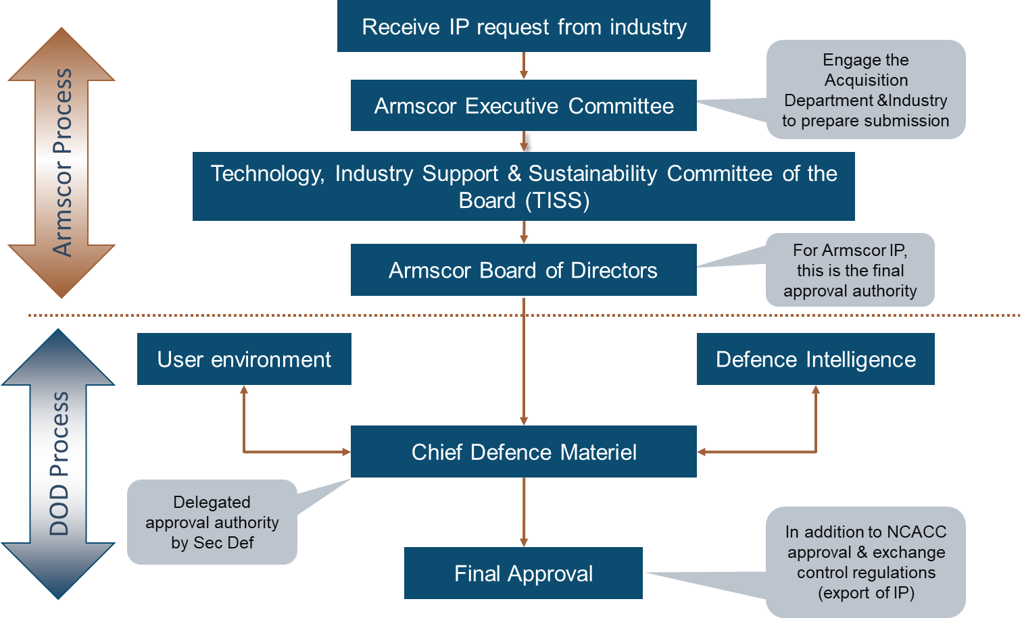
IP EXPLOITATION GOVERNANCE PROCESS

Slide 15
IP MANAGEMENT PRACTICE
The Armscor IP management practice is similar to countries such as Canada, China, United Kingdom, United States of America and Iran.
The government of these countries cooperate with their defence industry to leverage the defence IP for further innovation and economic growth.
Armscor’s practice or approach is also informed by the current circumstances of budget cuts and the need to maintain defence strategic and sovereign capabilities.

Slide 16
Arms Control Asset Tracking System (ACATS)

Slide 17
Background
ACATS - Arms Control Assets Tracking System
Developed on iDempiere Open Source ERP platform
The system is Customised to suit ARSCMOR’s Business Requirements
Accurate Reporting (For Reconciliation of EUC and Permits)
Real Time Feeds, and integration with core business systems
Types of Permits
Armaments Development Manufacturing and/or Services (ADMS) permit
Marketing Permit (MKP)
Contracting Permit (CP)
Import Permit (IMP)
Export Permit (EXP)
Temporary Two-Way Permit (TTWP)
Disposal documents:
Domestic Transfer Authorisation (DTA)
Destruction Authorisation (DA)

Slide 18
ACATS Reporting
The Report details the status of all issued EUC/EUU and also provide details of the permit linked to the end-user certificates/undertaking. The user is able to choose search parameters such as, the type of document, Country or even use the part numbers and/or item description. Below is a list of information that can be obtained from the report.
Document type – The report clearly distinguish the type of report whether it is an EUC/EUU.
Country – This provide information about the Countries that we have entered into commitments with.
Document No. – The system assigns unique numbers to each application which assists with the tracking and tracing of document trails.
Dates – To reflect timelines during processing of the EUC/EUU
Permit No and Application reference number – Provides information about all permits that were issued against the EUC/EUU. This is one of the most important and critical features of ACATS which seeks to assist with the reconciliation of EUC/EUU and to make a determination, of which ones have been exhausted, partially used as well as those that have not been used. The user is able to draw out this information as often as is needed in order to gauge the status quo.
Part description – the system gives information about the items that were imported and this should correspond with those on the EUC.

Slide 19
High Level Activities
Project Phase | High-Level Activities
Planning | Project Kick Off Meeting Develop Project Charter Develop Project Schedule
Analysis | Confirm Business Requirements Assess the level of fit between the business requirements and ACATS Functionality. All the functionality not covered by the of ACATS will be identified and documented.
Design and Build | ACATS is configured as per the functional requirements defined in the analysis phase. Perform unit testing of all newly developed components
Data Management / Migration | Extract data from the source system, transformed, cleansed, and loaded into the target system.
Testing and Evaluation | Perform User Acceptance Testing Perform Stress Testing Perform Load Testing Perform Regression Testing
Change Management | Develop Change Management Strategy Conduct Readiness Assessment Develop Communication Management Plan
Training | Provide training to the End Users and Power Users: - Technical support - Power users - System Administrators - End - Users
Go-live | Deploy solution in the production environment
Support and Maintenance | Provide ongoing support to DOD for the remaining life of the system.

Slide 20
Indicative Timelines
Project timelines are dependent on the Project Scope.

