Slide 1
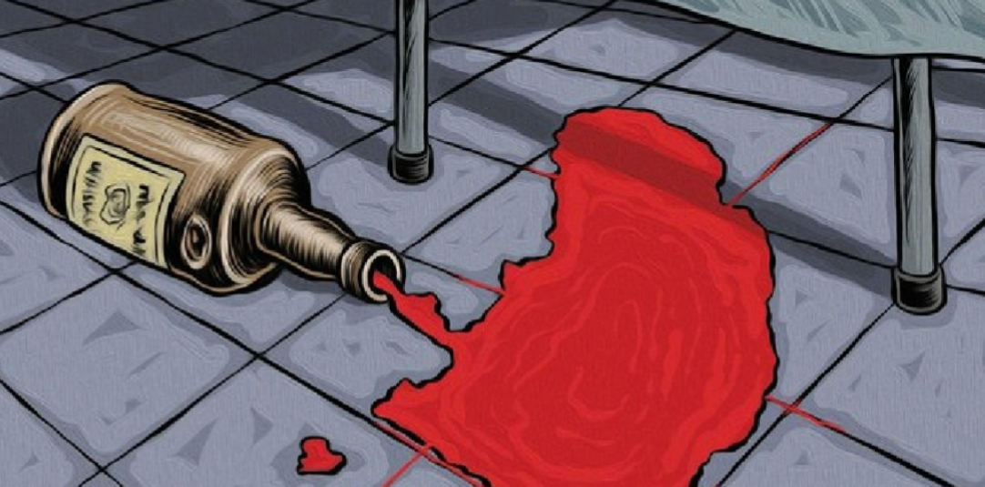
Public hearings on the National Road Traffic Amendment Bill
Prof Charles Parry
South African Medical Research Council, Cape Town
10 March 2021

Slide 2
outline
01
Background
02
Effect of alcohol on drivers & collateral damage
Policy options, support for reducing BAC levels & evidence for effectiveness
03
04
Monitoring & evaluation

Slide 3
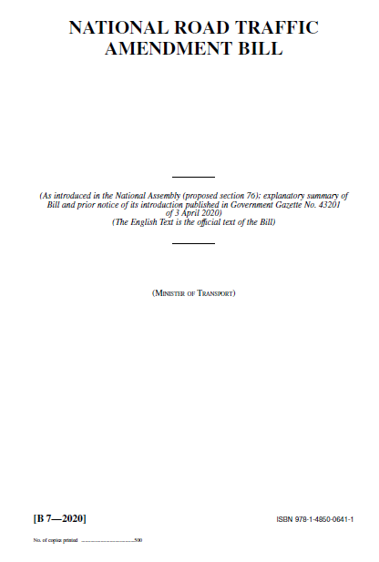
background
Section 65 of the principal Act (93 of 1996) is amended to basically say no person may be on a public road or drive a vehicle or occupy the driver’s seat of a vehicle where the engine is running while there is any concentration of alcohol in their body

Slide 4
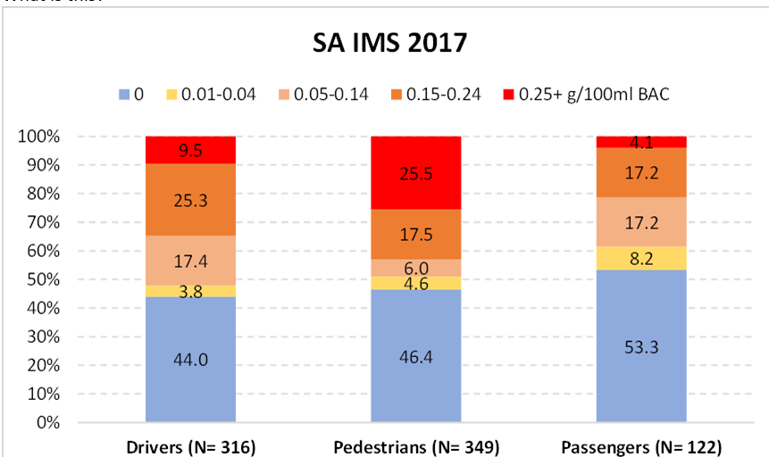
SA: road traffic death rate (39.7 per 100 000 each year) double the global rate (WHO, 2018)
Injury Mortality Survey, 2017

Slide 5
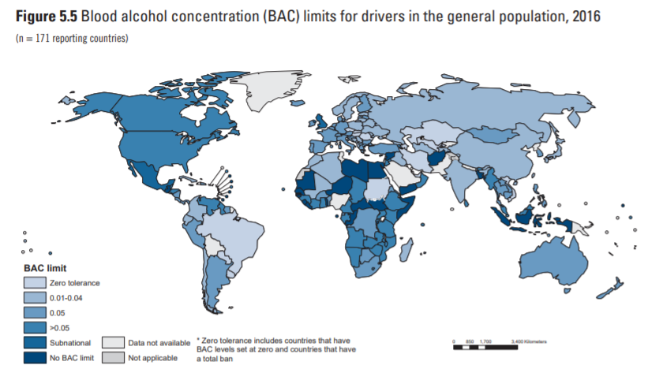
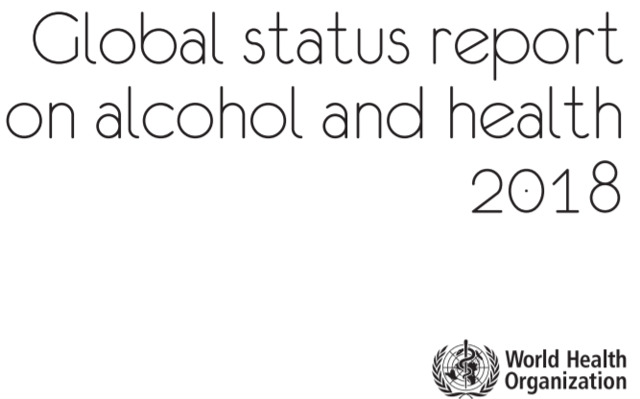
15 have 0 BAC & 31 BAC between 0.01 & 0.05 (27% <0.05)
0.02 or 0.03: Brazil, Norway, Sweden, Israel, Poland, China. Hungary, India, Japan, Russia, Uruguay

Slide 6
Effect of alcohol on drivers/collateral damage
Alcohol effects drivers’ vision, balance & reaction time
Drivers with a BAC 0.02-0.05 have >3x greater risk of dying in vehicle crash as compared to persons with 0.00 BAC. Risk increases to >6x with BAC 0.05-0.08, & to 11x for BAC 0.08-0.10 (NICE, 2010)
Younger drivers are particularly at risk of crashing whatever their BAC level because they are less experienced drivers & have lower tolerance to alcohol (NICE, 2010)
Unfortunately, drunk drivers don’t just kill and injure themselves or damage their own property, they kill/injure other road users and damage others’ property as well (cars, traffic lights, buildings, walls, etc.)
Tax payers have to fork out millions each year to pay for many drunk drivers & persons injured by them to be treated and rehabilitated & to mend public property

Slide 7
Policy options
SAMRC supports idea of having zero tolerance for any drinking & driving, separate out the 2 events: drinking & driving
Would do away with need for drivers to have to calculate whether they were over limit
Propose:
Maximum of 0.02 g of AA/100 ml of blood – this disallows testing positive because of certain medications & reduces false positives from small traces from as far back as 12 hours previously
(perhaps have zero BAC limit but only prosecute if ≥0.02)
Administrative fine between 0.02-0.05 as with speeding so s not to overburden criminal justice system and criminalise people for small amounts of alcohol in their systems
Criminal prosecution BAC ≥ 0.05

Slide 8
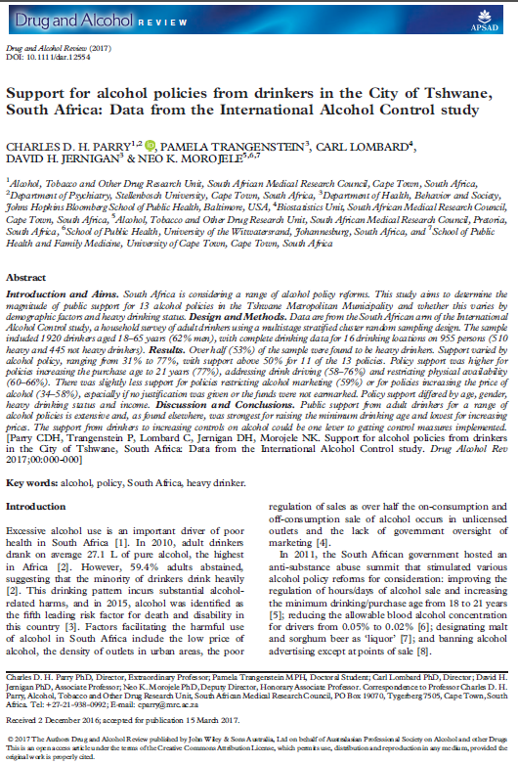
Policy support
A representative household survey of 1,957 adult drinkers in Tshwane conducted by my unit in 2014:
55% supported or strongly supported lower allowable blood alcohol concentrations for drivers
A further 17% indicated that they were neutral on this issue.
Only 28% were opposed to lowering BAC levels for drivers

Slide 9
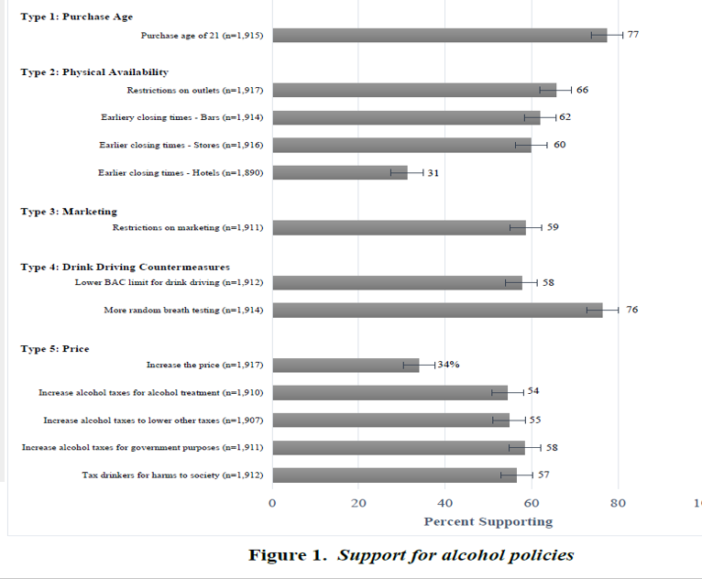

Slide 10
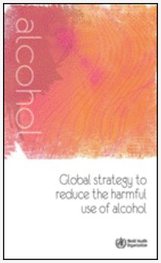
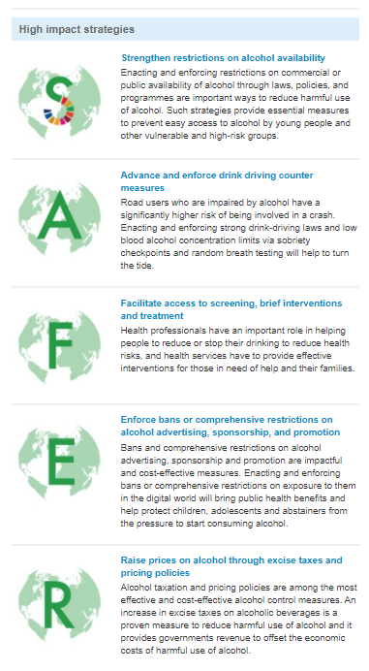
Evidence for effectiveness
WHO Global Strategy (2010) cites strong evidence in support of a low BAC limit (btw 0.02 & 0.05) as does WHO’s 2018 SAFER initiative
In Brazil new traffic law (2008) led to reductions in traffic injury & fatalities in the State and capital of Sao Paulo (7% and 16% respectively–difference due enforcement) (Andreuccetti et al., 2011)
Implementation of 0.02 BAC law in Sweden in 1990 reduced fatal crashes by 6% (Norström, 1997)
In Japan, BAC level changed to 0.03 in 2002 & increased penalties. Rate of alcohol-related traffic fatalities per billion kilometers driven decreased by 38% in the post-law period. (Nagata et al., 2008)

Slide 11
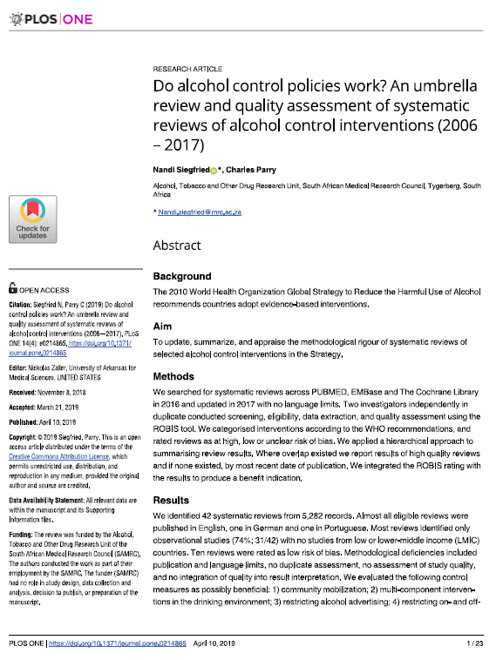
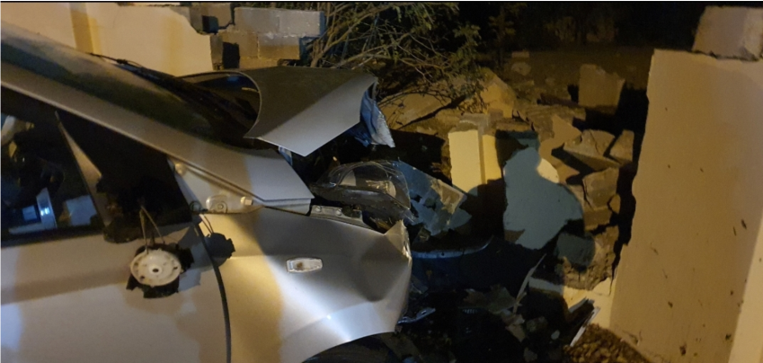
Other / related strategies
Our 2019 umbrella review of systematic reviews of alcohol control interventions suggests that reducing BAC limits alone is unlikely to be successful if not combined with other interventions:
increasing police controls
mandating ignition locks be installed in the vehicles of persons convicted alcohol-impaired driving requiring them to blow into a device which checks the driver’s alcohol level before the vehicle will start.
Increase random breath testing (as opposed to sobriety checkpoints)
Mandatory testing of drivers at all crash sites where someone killed or seriously injured or serious damage to property (will need to improve our testing capability)
Plus legal liability for outlets/persons serving to obviously intoxicated persons who go on to cause a motor vehicle accident - see WC AHR White Paper & 2017 DTIC Liquor Amendment Bill (supplying to unlicensed outlets)
Improve public transport. This bill may also create new jobs in e-hailing businesses

Slide 12
Monitoring & evaluation
Reporting on mandatory testing for alcohol at crash sites
Reporting on roadside testing: % positive & consequences for those testing positive
Alcohol testing of transport-related injury trauma at hospitals (clinical assessment and biomarkers)

