Slide 1
01
KZN Operations
What has been achieved per portfolio
02
Support rendered per portfolio
03

Slide 2
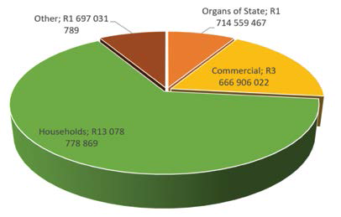
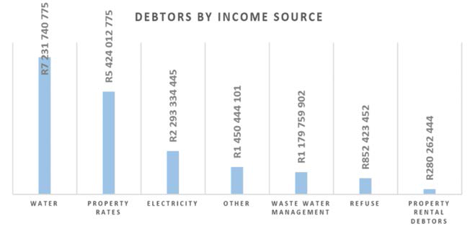
The KZN municipal consumer debt
amounted to R 20.1 billion for the 4th
quarter (compare to R 18.4 billion for
the 4th quarter last year, 2018), this shows
increase of R 1.7 billion in 12 months.
Revenue raised from Water Services still proving to be most difficult to collect followed by Property Rates.

Slide 3
CHALLENGES IN UTHUKELA DM
Ageing Infrastructure –
provision for depreciation
Lack of Operations and Maintenance;
Tariffs below water board tariffs;
Vandalism/thefts illegal connections, on water and sanitation infrastructure.
Increase in Indigency levels decrease in payment level

Slide 4
AG Basis for qualified opinion
Cash and cash equivalents
The control procedures for cash management not effective
Receivable from exchange transactions
There is still no reliance on water revenue due to high meter estimation on billing
Consumer debtors
The credit policy has not been implemented effectively
Payables from exchange transactions
The municipality is unable to meet creditors as they fall due
Water losses
The municipality is still challenged by the inadequate systems and processes for the recording and monitoring of these water losses

Slide 5
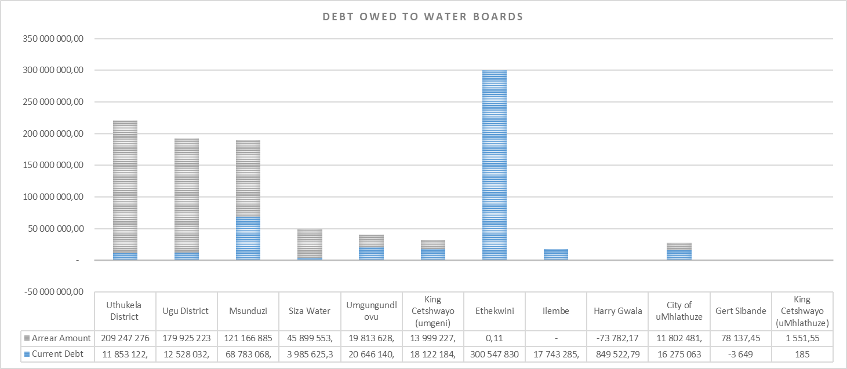

Slide 6
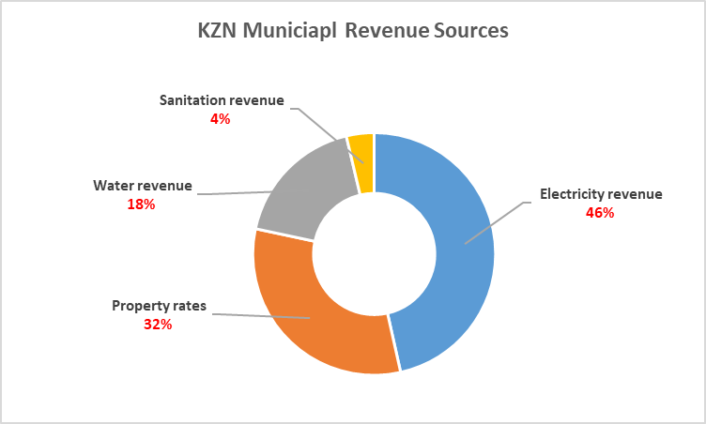
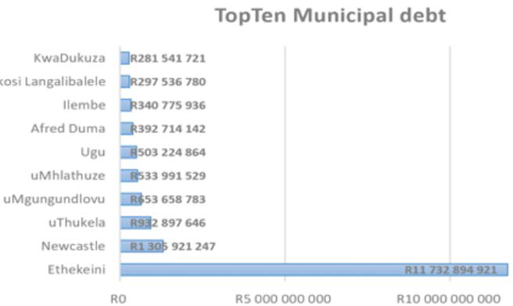

Slide 7
On 12 November 2020, Umgeni Water proposed a bulk water tariff increase of 9% for the period of 2021/22.
This was to offset the 0% imposed by the Minister the previous year
Even though Umgeni had made a profit the year of the 0%
After SALGA mediation and municipal objections, Umgeni eventually moved from 9% to 7%.
Municipalities in KZN object to the 7% and indicated such to the DWA
Municipalities face less than 70% collections rates resulting Covid 19.
Non-Revenue water is still a challenge.
Umgeni did not fully spend its maintenance budget in the previous year
the water board was able to record a profitable year despite the 0% change last year.

Slide 8
Currently, KZN municipalities are struggling to keep up with a total Water Board debt of R 1 073 190
594,18 as at December 2020. This amount includes an amount of R 394 944 378,21 older than 120
days and the concern is that any increase, at the peak of the pandemic, would only increase this
debt.

Slide 9
The idea that WSA can switch off in case of non-payment is not realist:
A flat rate, which, may range between R50 – R100 paid on a monthly basis by indigent households must be implemented by all WSA’s.
A local municipality with an electricity licence is not obligated to assist a district with credit control for the same customer and properties can be transferred without a district clearance certificate.
Water tariff setting requires a regulator as water boards are able to make profits while WSA struggle.

Slide 10
Labour Relations

Slide 11
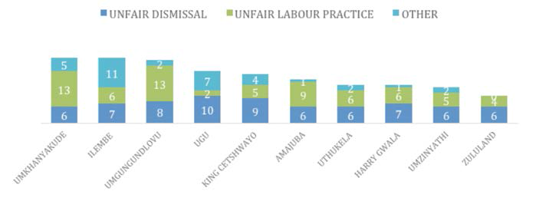
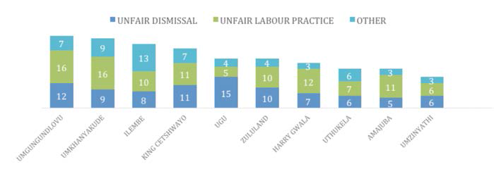

Slide 12
Trainings that Uthukela has directly benefitted from in the past 18 months
Webinar: Covid 19 - A New Approach to HR & LR
Training on the Interpretation & Application of Collective Agreements: Conditions of Service
Training on the Interpretation & Application of Collective Agreements: Main Collective Agreement
Powers & Functions of the LLF (Employer Body)
Peer Learning & Knowledge Sharing - OHS Compliance in the Era of Covid 19
Labour Relations Webinar-Accountability and Consequence Management in the Labour Relations Context.”
Peer Learning & Knowledge Sharing towards the cascading of PMS to other levels
Integrated Councillor Induction Programme Level 2 (NQF 5)
Strike Guidelines Training
Powers & Functions of the LLF (Employer Body)
HR Symposium- HR in a Changing World
Arbitration & Conciliation Training

Slide 13
The idea that all districts can play a coordinating and capacity building role, within the district, is not realistic:
In the area of HR/LR very often each municipality is on its own.
Interventions such a Job Evaluation and PMS are often polluted by adhoc approaches and infighting.
Cases that go to the bargaining council are dependent on the mandate prosecutors receive. In a climate of intimidation, mandates are weak and witnesses are reluctant.
Cases that go to the bargaining council are dependent on the evidence available. In a climate of poor record keeping, evidence is weak.

Slide 14
Human Resources :Areas that is addressed :Cascading of performance management ,development of human resources strategies ,sharing of best practises
Cascading of performance management through peer learning sessions but junior officials attending with no authority to resolve and to implement the programmes
Generic HR policies developed by SALGA and available to municipalities but not further developed for adoption by council
The non attendance of peer learning and knowledge sharing sessions presented by SALGA result in HR remaining at transactional level and not developmental

Slide 15
The Portfolio committee has to satisfy itself that:
The treatment used (s139 (1) (a)/(b)/(c) is appreciate and will yield the resulted so desired
The defect is an executive function
There are results following the treatment
Reason | Comment
Financial distress, governance and organisational challenges which are negatively impacting service delivery; | The municipality is still Financial distress, this has resulted in failure to settle Utility Bill..
council failure to exercise oversight | Lack of oversight of council cannot be arrested by an administrator as an administrator does not have powers over council.
The weak financial management controls | The lack of controls is still persist as the number of qualifying matters from AG report are based on weak financial controls
water service function is not | Water service delivery is a challenge and the municipality has not come up with a strategy managed it.
Current liabilities exceeded its current assets by R92,37 m; | The status has not been changed, the Water Board invoice has made it look worse
Unspent conditional grants of R69,71 m | Not an executive function
The municipality has used conditional grants for operational expenses; | Not an executive function
Water losses amounted to R153,48m mainly due to the distribution losses as a result of the ageing infrastructure and theft through illegal connections as reported by the AG; | The water loss were R246.15 million , the municipality is still challenged by the inadequate systems and processes for recording and monitoring of water losses.
The municipality incurred irregular expenditure and fruitless & wasteful expenditure of R136.0 million and R64, 581 respectively for the period ending in May 2018; and | The last years irregular was R232,64m and the wasteful expenditure was R1,99 million, the increase was due to lack of oversight by Council.
Frequent labour and community protests and the municipality’s failure to have concrete plans to avoid service delivery disruptions in this regard. | Not an executive function

