Slide 1
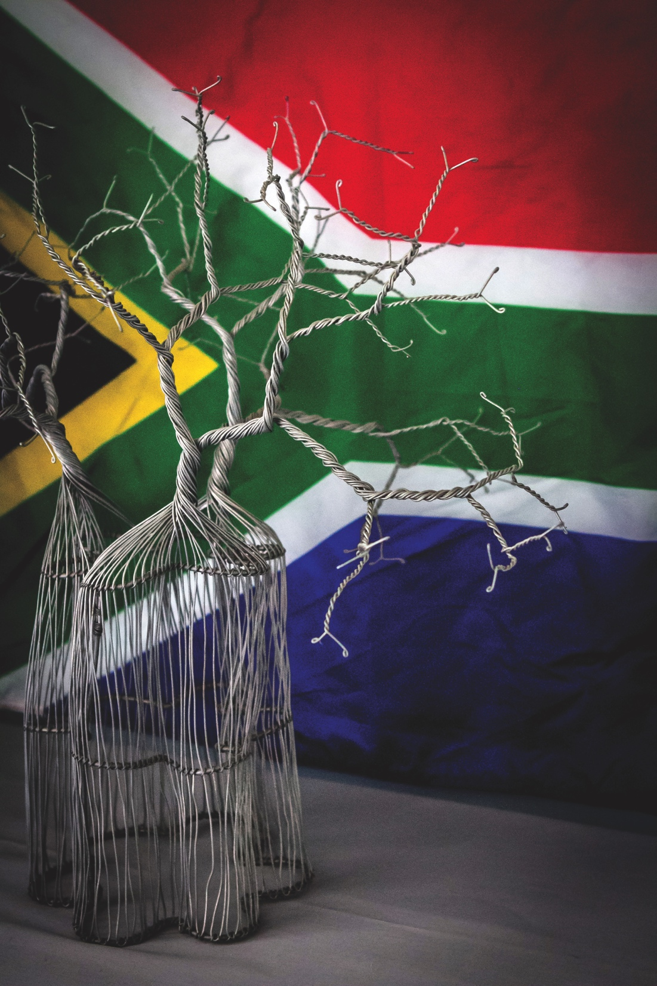
BRAND SOUTH AFRICA
BRIEFING BY THE BOARD OF BRAND SOUTH AFRICA TO THE PORTFOLIO COMMITTEE ON THE UPDATE REGARDING THE FINALIZATION OF THE SUSPENDED CHIEF EXECUTIVE OFFICER AND OUTLINE THE PLAN TO STABILISE THE INSTITUTION AT THE LEADERSHIP POSITIONS
DATE: WEDNESDAY 10 MARCH 2021
TIME: 09H30 – 13H00
VENUE: ONLINE VIA ZOOM

Slide 2
Agenda of presentation
The finalization of the suspended Chief Executive Officer.
The plan to stabilize the institution at the leadership positions:
Current posts
Extension of contracts
Intern fixed term contracts
Stakeholder engagements
Closing remarks

Slide 3
1. THE FINALIZATION OF THE SUSPENDED CHIEF EXECUTIVE OFFICER
Due process was followed in terms of the Disciplinary Code and Procedure in line with the Labour Relations Act.
The Executive Authority was regularly briefed by the Board of Trustees on the status of the disciplinary process.
The Board of Trustees concurred with the finding of the disciplinary hearing and submitted the same to the Executive Authority for concurrence. The matter was pending a response from the Executive Authority at the time of the contract of the Chief Executive Officer ending on 31 July 2020.
Brand South Africa immediately commenced with the process to advertise the Chief Executive Officer post.
On 9 October 2020, the Executive Authority imposed a moratorium on the filling of posts in view of the reconfiguration process between SA Tourism, Brand South Africa and Invest SA.
The Board of Trustees has submitted a formal request to the Executive Authority to extend the period of secondment of the current Acting Chief Executive Officer beyond 31 March 2021, in view of the moratorium. The response from the Executive Authority is currently awaited.

Slide 4
2. THE PLAN TO STABILIZE THE INSTITUTION AT THE LEADERSHIP POSITIONS
Current posts
At the executive level, the Chief Executive Officer, Chief Marketing Officer and Chief Financial Officer posts are currently vacant.
The moratorium that is in place since 9 October 2020 by the Executive Authority prevents Brand South Africa from filling the vacant posts permanently.
The Chief Executive Officer – the Board of Trustees has requested the Executive Officer to extend the secondment of the current Acting Chief Executive Officer beyond 31 March 2021. The response from the Executive Authority is currently pending.
The Chief Marketing Officer – the acting appointments are rotating between the General Managers at Brand South Africa every six (6) months.
The Chief Financial Officer – the disciplinary matter of the former Chief Financial Officer, on appeal by the Board of Trustees, is pending at the Labour Court. The acting Chief Financial Officer appointment is extended during this period.

Slide 5
2. THE PLAN TO STABILIZE THE INSTITUTION AT THE LEADERSHIP POSITIONS
Extension of contracts
Fixed term contracts have been extended in critical service delivery units including but not limited to Supply Chain Management and the Country Heads of USA and UK.
Intern fixed term contracts
The interns at Brand South Africa were in 2-year internships. Their internships have translated into 12-month fixed term contracts from 1 March 2021.

Slide 6
2. THE PLAN TO STABILIZE THE INSTITUTION AT THE LEADERSHIP POSITIONS
4. Stakeholder engagements
Brand South Africa’s stakeholders are identified as people or organisations that are affected by Brand South Africa’s work; those who have influence and power to champion the Brand South Africa cause; and those who have a direct interest in the success of the Nation Brand.
Brand South Africa consistently monitors stakeholder sentiments with regards to perceptions of the entity.
As such, the institution keeps track of and engages with stakeholders who have issued informal queries about organizational stability and/or requested face-to-face interactions with the entity.
Although questions were raised in the past, organisations continue to work with Brand South Africa in the fulfillment of its mandate.
Brand South Africa also intends to leverage the Office of the Executive Authority – through Deputy Minister Siweya and Acting Minister Ntshavheni - in contributing to the management of perceptions of stability at the organisation.

Slide 7
3. CLOSING REMARKS
The moratorium that is in place since 9 October 2020, in view of the pending reconfiguration process, prevents Brand South Africa from filling permanent vacant posts. Brand South Africa appealed to the Executive Authority to uplift the moratorium. The outcome of the appeal was that the entity may fill permanent vacant posts with 12-month contract appointments.
The vacancy rate was 12.3% at the time of the moratorium. As at 1 March 2021, the vacancy rate has increased to 14.04%. The vacancy rate is likely to increase as Brand South Africa is perceived to be unstable in view of the uncertain timelines surrounding the reconfiguration process.
Capacity-related needs were to be addressed in the review of the structure, which was advertised by way of tender in March 2020. The bid committee process was in progress when the Executive Authority imposed a hold on the review of the structure in view of the reconfiguration process.

