Slide 1
(DC18) LEJWELEPUTSWA DISTRICT MUNICIPALITY
state of the municipality report
9 March 2021

Slide 2
TABLE OF CONTENTS
Auditor General Report – 2018/19
Audit Action Plan
Unauthorized, Irregular and Fruitless and wasteful expenditure
MPAC progress - Investigations.
Disciplinary Board - Consequence management
Going concern
Municipal Viability

Slide 3
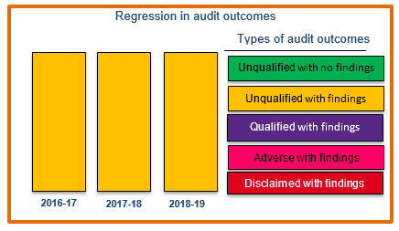
1. Auditor General Report – 2018/19
Municipal audit opinion for the three previous years

Slide 4
2. Audit Action Plan
The action plan was tabled in the council on the 30th January 2020
AREA | ACTION PLAN
Predetermined Objectives | Implement systems and processes that will enable reliable reporting of the achievement against target
Annual Financial Statements, Performance report and Annual Report | To submit 2019/20 Financial statements that are free from material misstatements
Expenditure Management | To take reasonable steps to prevent irregular expenditure to the annual financial statements
Strategic planning and performance management | To ensure that the performance management system and related controls are maintained and they describe in detail how the performance monitoring and reporting processes should be conducted and managed
Procurement and Contract Management | To ensure that quotations are awarded to bidders that score the highest points in the evaluation process

Slide 5
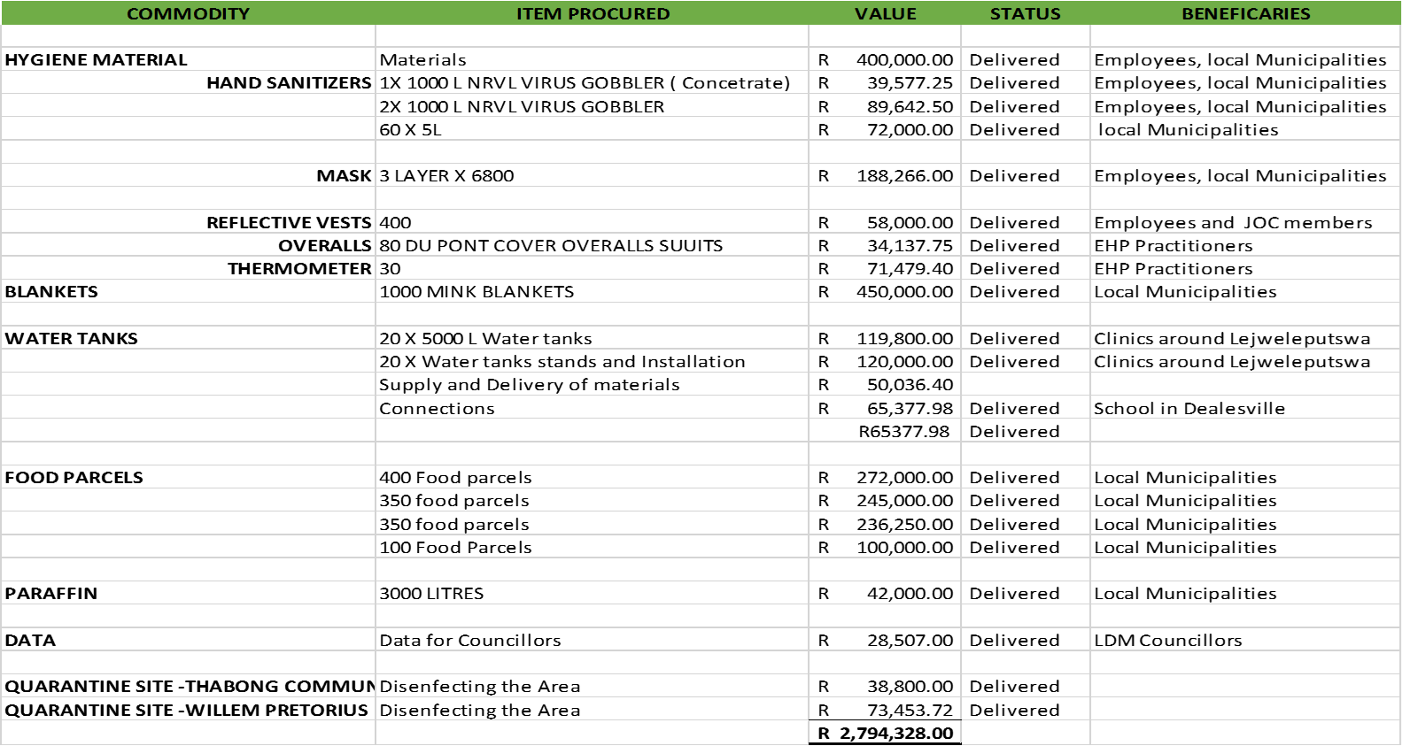
3. Covid-19 related expenditures

Slide 6
4. Covid-19 related expenditures
Municipal Disaster Relief Grant - R149 000.00

Slide 7
5 . Unauthorized, Irregular and Fruitless and wasteful expenditure (UIFW)
The municipality incurred Irregular expenditure amounting to R 583 280
The table below summarizes the UIFW as disclosed in the Annual Financial Statement

Slide 8
6. Irregular Expenditure 2018/19

Slide 9
7. MPAC PROGRESS – INVESTIGATIONS
Investigations into the irregular expenditure incurred by the municipality still in progress.
Investigations will be finalized before financial year end.

Slide 10
8. Disciplinary Board - Consequence management
The board is fully functional
No cases referred to the DC Board during 2019/20.

Slide 11
9. GOING-CONCERN
The annual financial statements of LDM are being prepared on the basis of accounting policies applicable to a going concern.
This basis presumes that funds will be available to finance future operations and that the realisation of assets and settlement of liabilities, contingent obligations and commitments will occur in the ordinary course of business.
The ability of the municipality to continue as a going concern is dependent on a number of factors.
The most significant of these is that the accounting officer continue to source funding for the ongoing operations for the municipality.

Slide 12
10. MUNICIPAL VIABILITY
Currently, the municipality is of sound financial viability
The municipality is able to sustainably meet its expenditure commitments from its own revenues and transfers
Debt Impairment of Councillors Remuneration Overpayment of R29 Million

Slide 13
11. Key positions
All Key positions were filled except for Manager Environmental Health and Disaster Management

