Slide 1
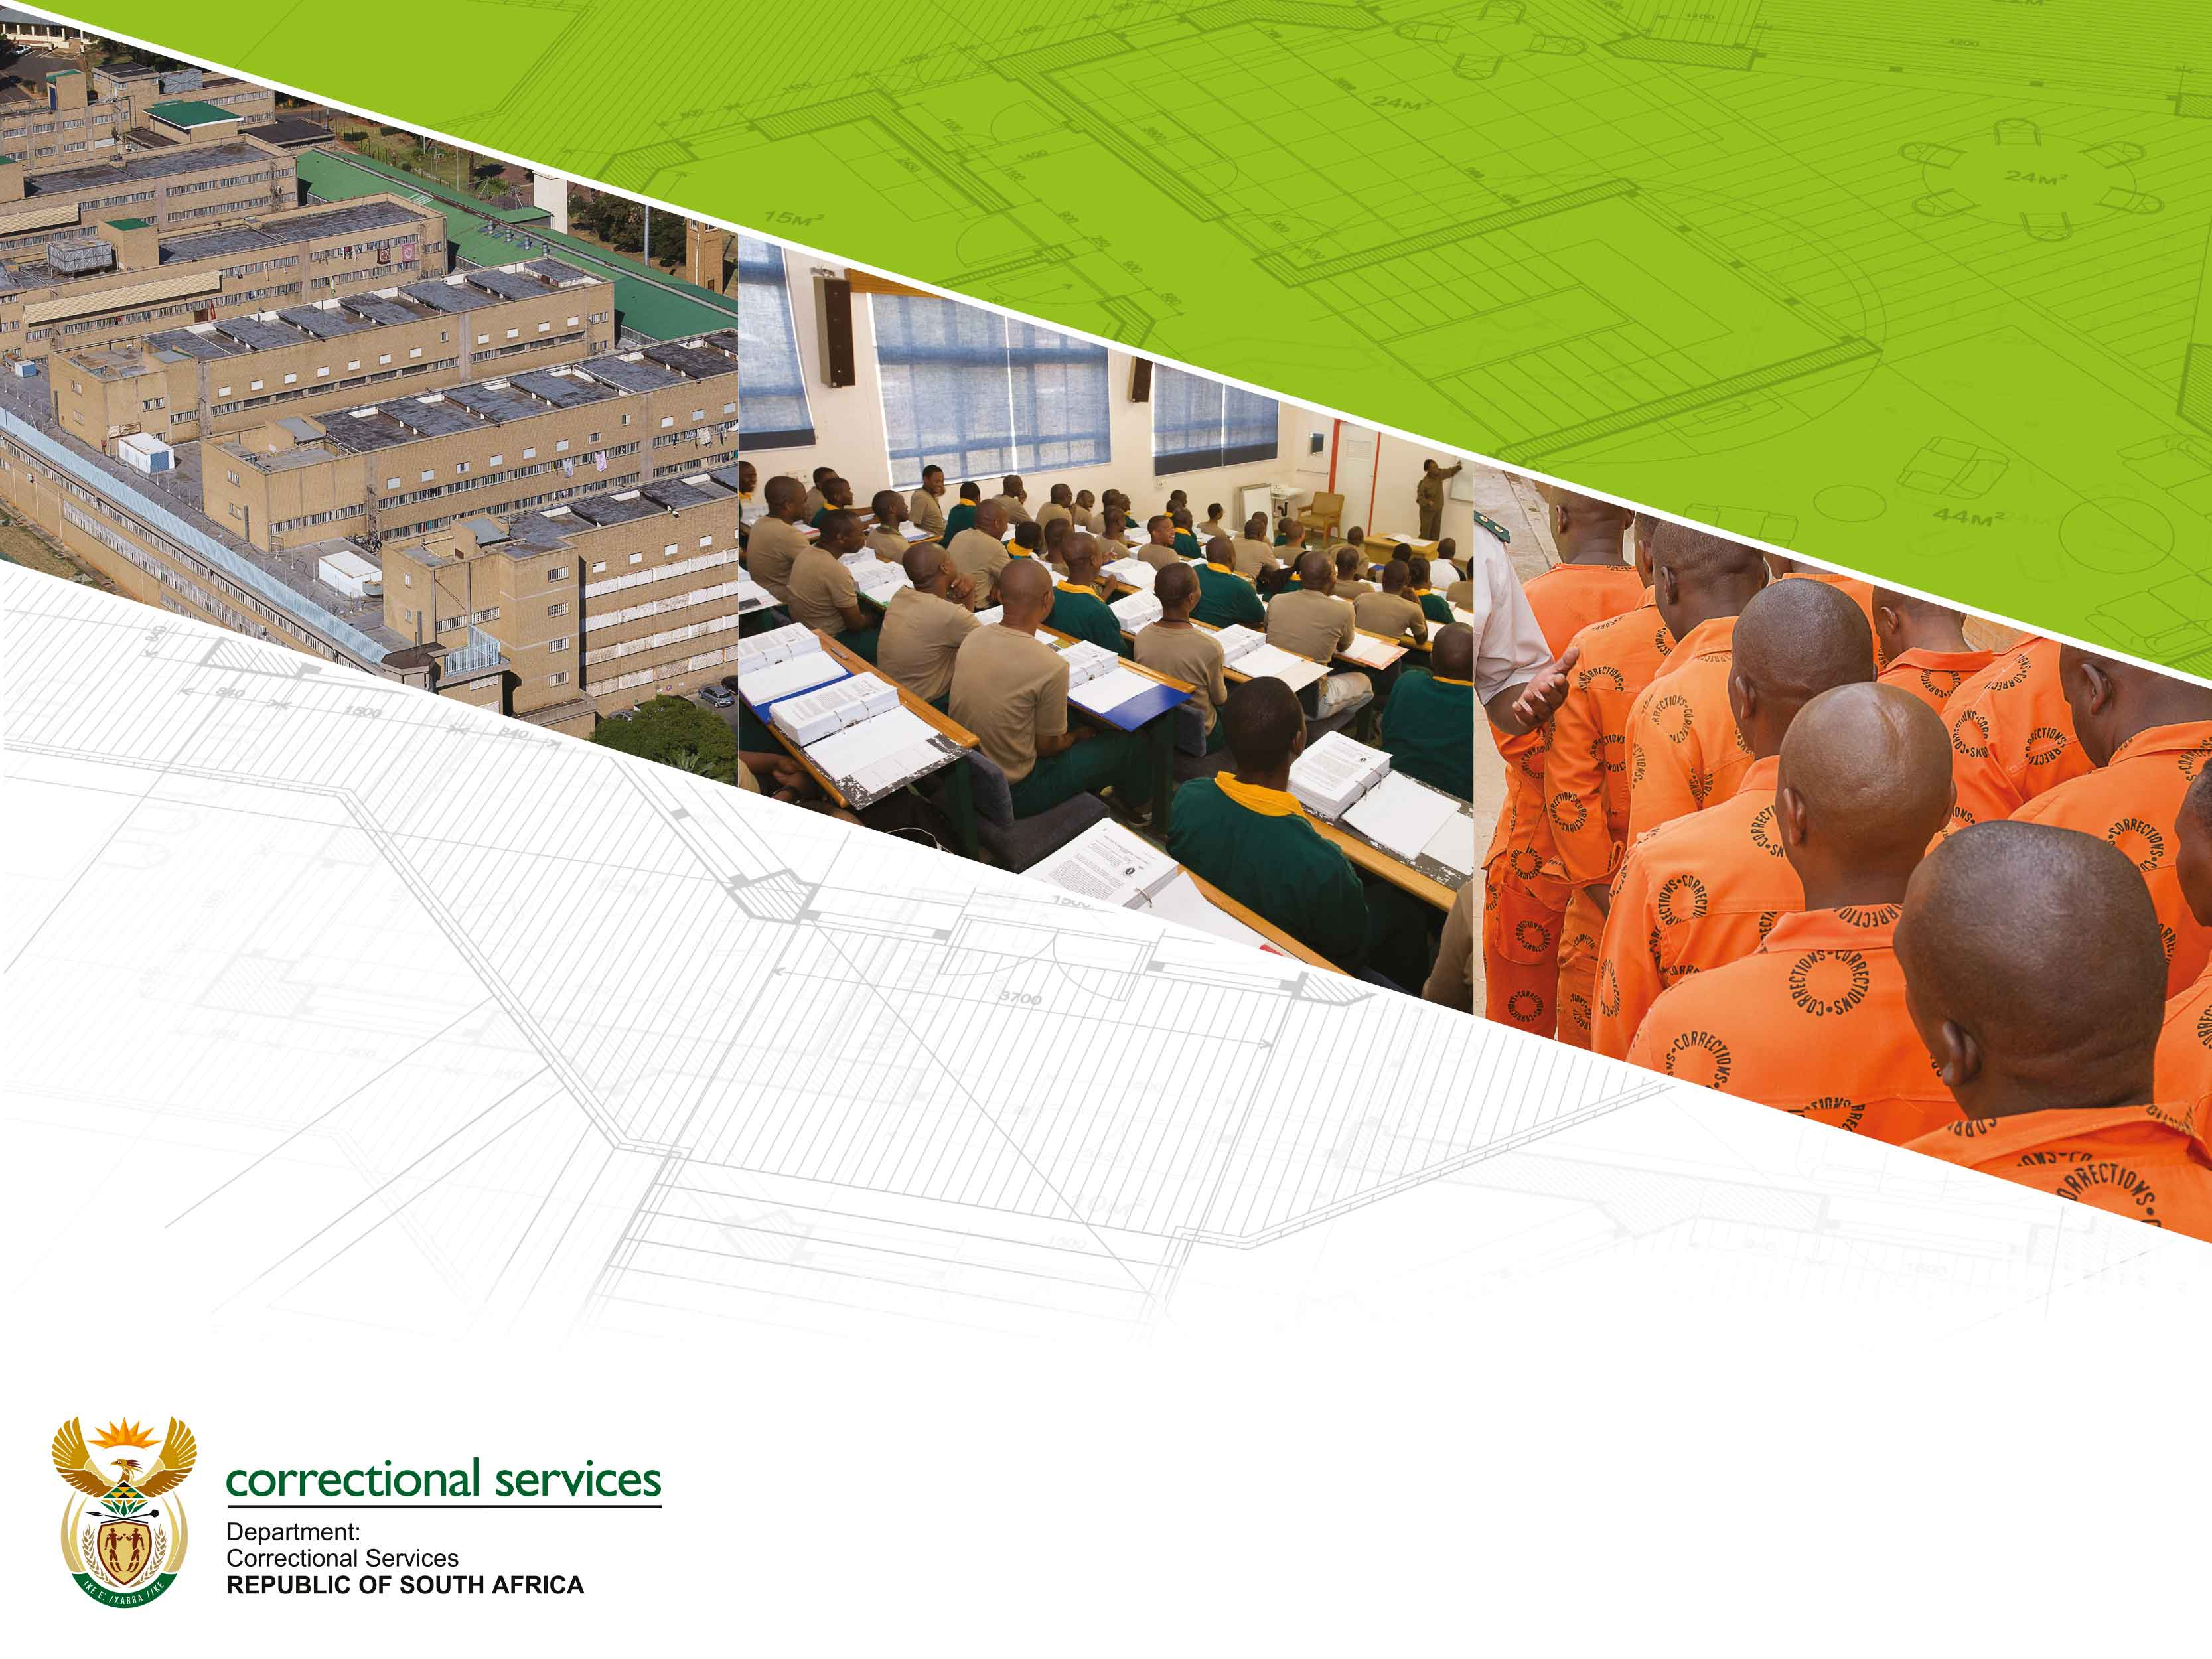
05 MARCH 2021
PRESENTATION ON FACILITIES INFRASTRUCTURE: PORTFOLIO COMMITTEE

Slide 2
Table of Contents
Purpose of Presentation
Introduction
Property Portfolio
Overview on Correctional Centres
Construction, Refurbishment and Upgrade
Outmoded Structures
New Generation Correctional Centres
Self-Sufficiency
Financial Capacity
Revised Infrastructure Strategy
Conclusion

Slide 3
1. Purpose of Presentation
The purpose of this presentation is to apprise the Portfolio Committee regarding DCS Facilities Infrastructure, with special reference to key fundamentals for the achievement of the revised infrastructure strategic objectives.

Slide 4
2. Introduction
The property portfolio of the Department consists of 243 correctional facilities and 218 community corrections offices, office accommodation, living quarters, agricultural facilities and production workshops. The property portfolio includes a total of 15 new generation correctional centres, which constitute 6,2% of correctional facilities.
The problem statement reads: “The poor condition of facilities impact on all aspects of rehabilitation and correctional activities and therefore hampers effective corrections in South Africa, due to the fact that only 6,2% (15/243) conform to new generation design”.

Slide 5
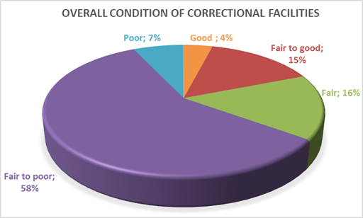
2. Introduction

Slide 6
3. Property Portfolio
The Property Portfolio can be summarised as follow;
Total number of correctional centres: 243
New Generation correctional centres: 6,2% (15/243)
Management Areas: 46
Public Private Partnership Correctional Centres: 2 (Kutama Sinthumule and Mangaung)
Community Correctional facilities: 218
Total leased office space: 185 100 m²
Total number of private leases: 134

Slide 7
4. Overview on Correctional Centres
Region | Number of Management Areas | Number of correctional centres
 |  | Number of centres temporarily closed (narrative on next slide) | Number of active centres | Total number of centres
Eastern Cape | 6 | 0 | 45 | 45
Gauteng | 8 | 1 (Emthonjeni Juvenile) | 25 | 26
Free State / Northern Cape | 7 | 0 | 47 | 47
KwaZulu-Natal | 7 | 1 (Umzimkulu) | 41 | 42
Western Cape | 10 | 2 (Brandvlei Max) & (Swellendam) | 41 | 43
Limpopo/Mpumalanga/ North West | 8 | 2 (Brits) & (Geluk) | 36 | 38
PPPs in FS/NC (1) and LMN (1) | 0 | 0 | 2 | 2
Total | 46 | 8 | 135 | 243

Slide 8
4. Overview on Correctional Centres
Closed Correctional Centres can be summarized as follow;
REGION | REASONS FOR CLOSURE/TEMPORARY CLOSURE OF CORRECTIONAL CENTRES AND STATUS
Eastern Cape | Nqamakwe closed repair and renovation: The project was finalised during July 2020 and officially opened
Gauteng | Emthonjeni Juvenile closed to repair and upgrade: The construction project is in execution and the completion is scheduled for 2022. A total of 640 bed spaces will be realised.
KwaZulu-Natal | Umzimkulu temporary closed due to upgrading. The project is under construction. The construction of the perimeter fence, kitchen and electrical work is outstanding. Glencoe: The project was completed during the current financial year at operational with 666 bed spaces.
Western Cape | Brandvlei Maximum: The project is in construction phase. Contractor on site. Swellendam closed due to dilapidation: The facility is beyond economical repair and surpassed its life expectancy. Due to condition and small infrastructure, refurbishment is not viable.
Limpopo/Mpumalanga/North West | Geluk closed due to dilapidation: The facility is beyond economical repair and surpassed its life expectancy. Due to condition and small infrastructure, refurbishment is not viable. Brits closed due to repair and upgrade project: The project is scheduled for completion during the 2021/2022 financial year. Practical completion was achieved at various sections.
FS/NC | none

Slide 9
5. Construction, Refurbishment and Upgrade
Positive progress was made during the 2019/2020/2021 financial year in finalizing various construction projects, which focused on transforming facilities from places of imprisonment to facilities of rehabilitation and care.
Estcourt: During the mentioned financial year, the replacement of a corrugated iron correctional centre at Estcourt with a new generation correctional centre was finalised during the 2019/2020 financial year. The new Estcourt correctional facility consists of state of the art technology with a capacity to accommodate 512 inmates. It also has a hospital section, training centre, maintenance workshop, logistics and other support structures.
Standerton: The upgrading of the Standerton correctional centre was also finalised which created an additional bed spaces.
C-Max: Conversion into a high security state of the art correctional centre. Construction completed and officially opened during 2019.

Slide 10
5. Construction, Refurbishment and Upgrade
Tzaneen: The construction of the Tzaneen correctional centre was finalised on the 21st of July 2020. In addition to the electronic monitoring security system the facility includes production workshops to empower inmates with skills in welding, woodwork, metal work, upholstery, panel beating and spray painting. Officially opened during November 2020.
Parys: The upgrading of the Parys correctional facility, which will provide an additional 176 bed spaces, is underway and scheduled for completion during the 2024/25 financial year, under the execution of the Development Bank of Southern Africa (DBSA).
Emthonjeni Youth Centre: The upgrade and refurbishment of the facility, which is under construction, will provide 640 bed spaces and state of the art Integrated Security Systems. Completion dates is scheduled for the 2021/2022 financial year.

Slide 11
5. Construction, Refurbishment and Upgrade
Brandvlei Max: The Department has commenced on the planning for the refurbishment and upgrade of the old Brandvlei Correctional Centre in the Western Cape Province. The upgrading and refurbishment is expected to regain 690 unused bed spaces by phasing out the currently occupied corrugated iron facility. Contractor appointed during November 2020. In construction phase.
Burgersdorp: The upgrade project is designed to construct a 500 bed space facility. The planning and design stages are finalised. Scheduled to be advertised for construction during 2021/2022.
Lichtenburg: The upgrade project is designed to construct a 500 bed space facility. The planning and design stages are finalised. Scheduled to be advertised for construction during 2021/2022.

Slide 12
6. Outmoded Structures
An urgent need exists to phase out unacceptable and unsuitable facilities in terms of the security minimum requirements. The following centres are constructed with zinc (corrugated iron) / asbestos, which emphasises the need to convert them to brick and mortar;
Region | Centres | Classification of superstructure
Western Cape | Voorberg Brandvlei Pollsmoor Med C | Zinc Structure Zinc Structure Asbestos Structure
Limpopo, Mpumalanga and North West | Zeerust Lichtenburg Tzaneen (new centre constructed) Makhado | Zinc Structure Zinc Structure Zinc Structure Part Zinc part Bricks
Freestate and Northern Cape | Groenpunt Med B | Zinc Structure
Gauteng | Leeuwkop Juvenile Atteridgeville | Zinc Structure Zinc Structure

Slide 13
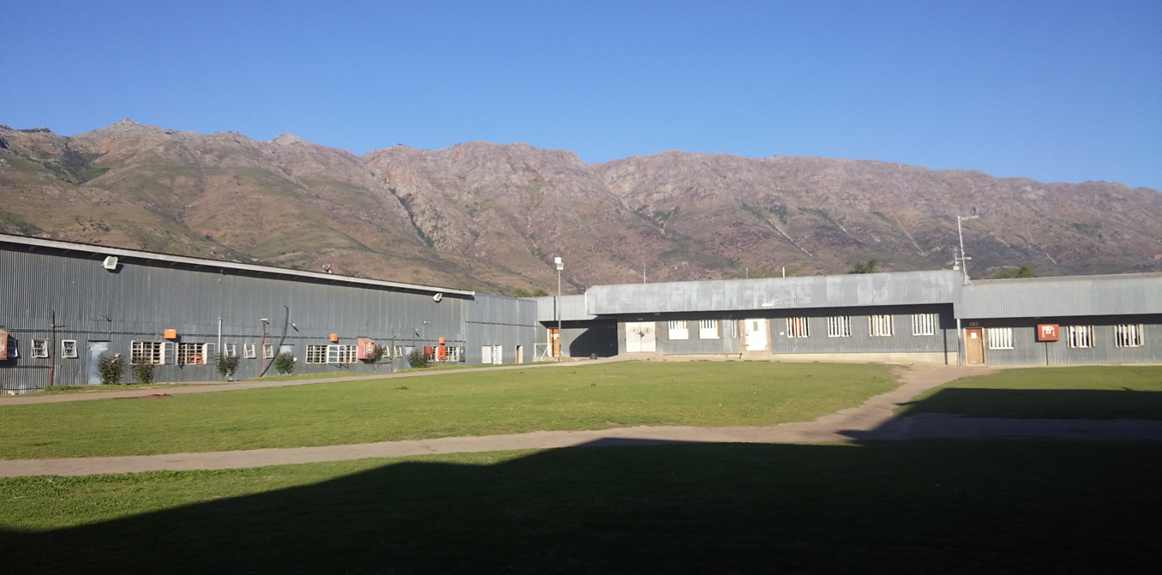
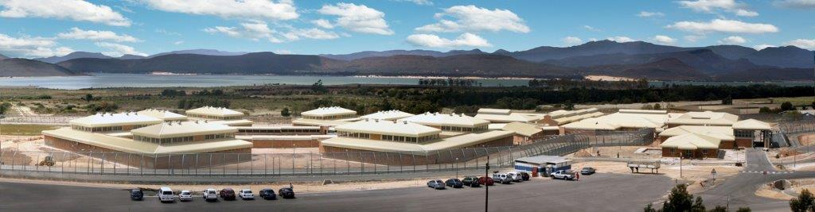
6. Outmoded Structures
Outmoded Correctional Center versus New Generation Correctional Center
Voorberg
Correctional Center
Brandvlei Medium
Correctional Center

Slide 14
7. New Generation Correctional Centres
During the 1994/1995 financial year the DCS moved towards the introduction of new generation correctional centres with emphasis on security technology systems in order to enhance the security capacity, with the strategic shift to functional unit management and through the implementation of Integrated Security Systems (ISS).
The concept of constructing new generation correctional centres are designed to promote “functional unit management”, which reduce open and direct contact with inmates, and provides for advanced technologies.

Slide 15
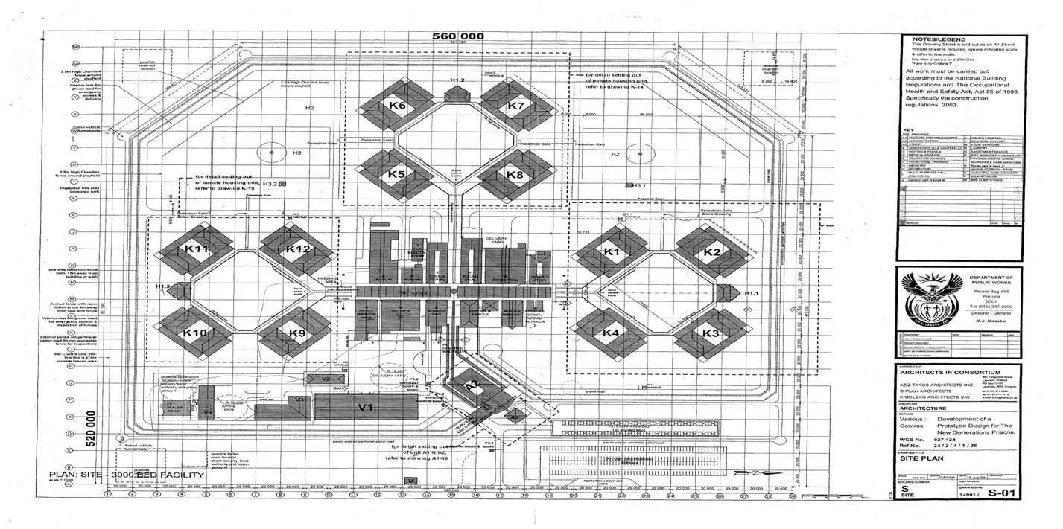
7. New Generation Correctional Centres
*K Blocks indicates units

Slide 16
7. New Generation Correctional Centres (comparison with old centres)
Conventional Correctional Centres | New Generation Correctional Centres
Centres of imprisonment | Centres of rehabilitation
Lack of new technology | Advanced technology
Sectional Management Architectural deign | Unit Management Architectural deign
Lack of support facilities such as educational and health sections | Needs-based support facilities such as educational and health sections
Hampers effective separation of different security risk profile classifications (for eg. age groups/gangs/first time offenders) | Reduced risk to offenders and staff. Effective separation of different security risk profile classifications (for eg. age groups/gangs/first time offenders)
Relatively high operating cost | Rationalised design reduce cost per capita
Requires extensive security operations. | Reduced the need for extensive security operations
Hampers operations in terms of facility layout | Designed for modern rehabilitation and housing of inmates

Slide 17
8. Self-Sufficiency
The production workshop facilities can be summarised as follow;
Type of Facility | No of Facilities | Products Range | Trades / Activities
Wood Production | 10 | Office Furniture Products, School Equipment, Wood Products, Repair to Office Furniture & Wood Products | Cabinet Making, Wood Machining, Upholstery, Furniture Polishing
Steel Production | 10 | Security Equipment, Cell Equipment, Kitchen Equipment, Repair to Steel Equipment | Welding, Plate Metal Work Fitting & Turning, Spray Painting
Textile Production | 19 | Offender Uniform, Offender Bedding, Offender Shoes (Male) | Garment Manufacturing Shoe Manufacturing
Bakeries | 09 | Bread | Craft Bread Baking

Slide 18
8. Self-Sufficiency
Farming facilities can be summarised as follow;
ACTIVITY | TOTAL NUMBER OF OPERATIONS
Vegetable production | 21 farms and 96 gardens / orchards
Fruit production | 15 farms
Milk production | 17 farms
Red meat - Beefers - Small stock | 19 farms 5 farms
Chicken-broilers | 3 farms
Chicken-Layers | 7 farms
Red meat abattoirs | 17 farms
White meat abattoirs (Chicken) | 3 farms
Piggeries | 15 farms

Slide 19
8. Self-Sufficiency
Own Resources Programme/Offender Labour:
The primary purpose of providing offenders the opportunity to perform labour is to contribute towards the following:
Fostering habits of industry;
Minimising idleness;
Encouraging positive participation in rehabilitation programmes;
Empowering offenders with work skills to break the chains of re-offending; and
Self-sufficiency after placement.
The Department of Correctional Services is in process to enhance the implementation of inmate labour on various small maintenance projects.
During the 2017/2018, 2018/2019, 2019/2020, 2020/2021 financial years the Department has engage various own resources projects.
Offender labour will be utilized during the 2021/2022 financial year to concentrate on the refurbishment of kitchens, laundries and construction of minor structures, such as entrance gates and pharmacies.

Slide 20
9. Financial Capacity
The Facilities Management budgets allocations can be summarised as follow;
Budget Description | 2018/2019 (R‘000) | 2019/2020 (R‘000) | 2020/2021 (R‘000) | 2021/2022 (R‘000)
Capital Projects | 511 830 | 540 492 | 570 219 | 337 342
Maintenance & Repairs | 168 594 | 178 036 | 187 828 | 132 159
Leasing of Buildings | 97 633 | 103 101 | 108 771 | 114 753
Municipal Services | 1 148 853 | 1 213 189 | 1 279 914 | 1 494 452
Accommodation Charges | 1 133 776 | 573 712 | 598 411 | 631 324

Slide 21
9. Financial Capacity
DCS scrutinized all allocated projects in order to reprioritize, based on the reduced allocation for capital and maintenance. The construction of a new correctional facilities at Lichtenburg and Burgersdorp will be deferred to an outer year (initially scheduled to commence with construction during the 2020/2021 financial year).
Various major capital projects have been rescheduled over the medium term to allow for appropriate planning and budget allocations.
Strategies to expand physical infrastructure and facilities are likely to be hampered by inhibiting factors related to budget constraints, which causes the inability to implement, manage and complete infrastructure development and maintenance programmes.

Slide 22
10. Revised Infrastructure Strategy
The Department of Correctional Services (DCS) has diversified the infrastructure procurement strategy and project implementation through (2021/2022);
The appointment of the additional Implementing Agents, such as the Independent Development Trust (IDT) and the Development Bank of Southern Africa (DBSA) to assist in the planning and implementation of the infrastructure programme.
The implementation of an own resources programme (offender labour) to conduct first line general maintenance and up keeping of facilities, in all six (6) regions.
The appointment of external service providers to conduct electrical and mechanical maintenance at prioritised kitchens.

Slide 23
10. Revised Infrastructure Strategy
The Department of Correctional Services (DCS) has diversified the infrastructure procurement strategy and project implementation through (2021/2022);
The finalization of in-house planning and design for the appointment of external maintenance contractors in the Eastern Cape Region, Freestate/Northern Cape Region, LMN Region and KZN Region (at various management areas).
The implementation of Total Facilities Management (TFM) projects at the newly constructed correctional centres at Standerton, Tzaneen and Estcourt.
The implementation of maintenance contracts on Integrated Security Systems at Qalakabusha, Tswelopele, Standerton, North End, Kokstad and Pietermaritzburg correctional centres.

Slide 24
11. Conclusion
Facility Management (FM) projects in the department are managed ‘reactively’ as opposed to ‘proactively’, leading to operational deficiencies across the value chain, and therefore the DCS are in process to implement Total Facilities Management projects at prioritised new generation facilities.
The majority of infrastructure projects are implemented by the National Department of Public Works and Infrastructure. Projects are often delayed during the planning and execution stages, which contributes to cost and time overruns as well as a lack of adequate accommodation to support service delivery. The Department has therefore diversified the infrastructure procurement strategy.

Slide 25
11. Conclusion
The poor condition of inherited infrastructure has created a backlog in the provision of appropriate and cost effective correctional facilities that puts rehabilitation and care at the centre of operations within the Department.
The Department embarked on a structured approach to implement own resources projects with emphasis on facilities maintenance and repair. Own resources projects utilize offender labour to address the short term maintenance requirements.
The draft Master Infrastructure Plan is aligned to support the revised infrastructure strategy.

Slide 26
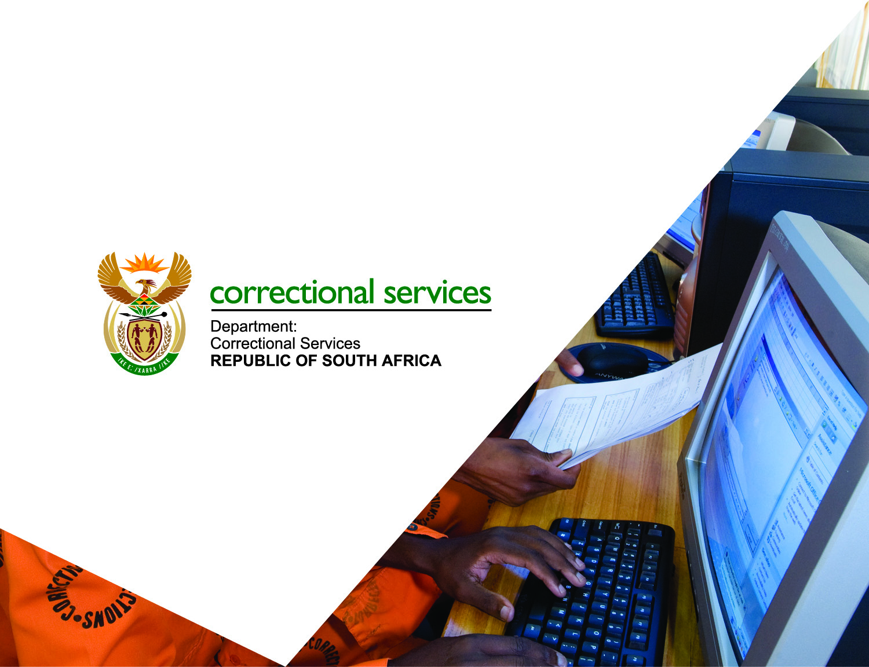
Thank You
Thank You

