Slide 1
05 MARCH 2021
INTEGRATED INMATE MANAGEMENT SYSTEM (IIMS) PROJECT REPORT

Slide 2
INTRODUCTION
Purpose
To update the Portfolio Committee on the status of the Integrated Inmate Management System (IIMS) development and roll-out project
Project Goals & Objectives
The IIMS project seeks to achieve the goal of a single view of offender through single capture of inmate and offender information (one stop shop for detained inmates, parolees, probationers and offender rehabilitation programmes)
To develop a systems development framework and platform that is easily adaptable, to infrequent changes in the South African constitution, legislation and other policy mandates and enables compliance fully
To develop capability for an integrated inmate management system
To enable business, having a single view of an inmate, to perform with ease the risk and needs profiling and an effective rehabilitation of an inmate
To improve positive inmate identity verification through the use of biometric identification technology

Slide 3
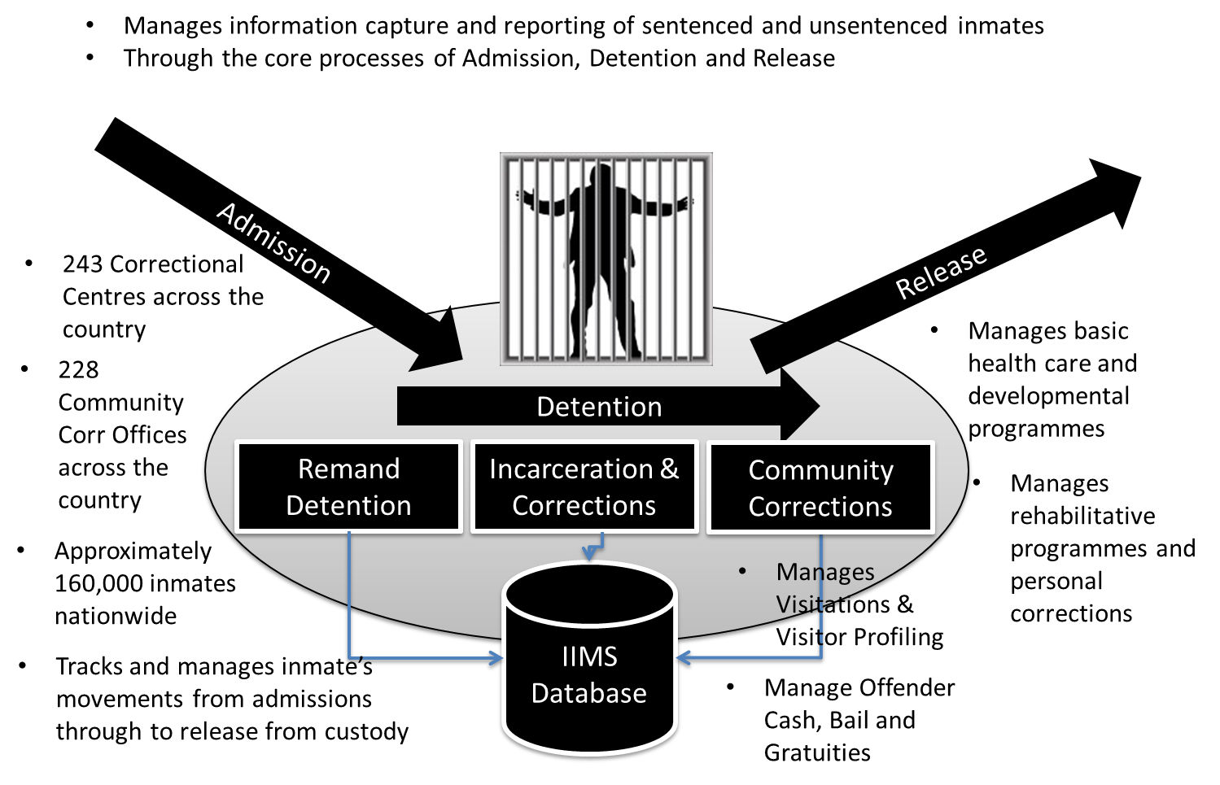
PROJECT OVERVIEW
Operational Environment
The Department of Correctional Services (DCS) operating environment comprises of National Head Office, 6 Regional offices, 48 management areas, 2 training colleges, and approximately 243 Correctional Centres, 228 community corrections offices, and 160,000 active inmates. The DCS is a critical role player in the Criminal Justice System (CJS) and participates actively in the structures and substructures of the Justice Crime Prevention and Security (JCPS) Cluster, including the Integrated Justice System programme.
ICT Strategic Alignment
To provide a reliable, integrated and secure ICT infrastructure and business applications systems, in line with Point 5 of the National Development (7-point) Plan (NDP Chapter 12): Establish an integrated and seamless information and technology database or system or both for the national criminal justice system.

Slide 4
BACKGROUND
System Acquisition and Scope
The IIMS Development Framework was acquired through and open tender, Bid HO 2/2015, and subsequently awarded to the successful bidder Integritron Integrated Solutions (IIS) in November 2015. The contract was awarded for a three-year (36 months) period, with a commencement date of 11 January 2016 thus ending initially on the 10 January 2019, later extended by an additional 12 months to 10 January 2020.
To implement a centralized and integrated inmate management system (application and database) encompassing all the department’s core business process of admission, detention (and rehabilitation) and release, intended to achieve an authoritative single view of an inmate, improve inmate identification, data accuracy, security, and integration with the Integrated Justice System.
The concept of a 360 degrees view of an inmate or offender would therefore be realized through the successful implementation of IIMS development framework and platform.
To provide the capability to develop a bespoke IIMS solution
To offer the department an increased level of productivity for building enterprise applications that are based on industry standards.
To replace the legacy A&R (Admission and Release) and Community Corrections offender management systems
To seamlessly integrate with the JCPS cluster member information systems for data exchange and information sharing i.e. through the Integrated Justice System (IJS) transversal hub.

Slide 5
PROGRESS SUMMARY
Key Achievements and Challenges
Lack of adequate IT internal resources and capacity.
Branch GITO efforts to increase internal capacity in order to prepare for an eventual handover of the project after the three years period, included several interventions, namely i) Employment of contract resources ii) GITO structure review and funding of posts iii) co-sourcing iv) IJS Intervention and v) filling of vacancies.
Of these interventions
a three year long contract appointments were made and subsequently expired in 2019/20
the GITO structure review is still not finalized
Senior and experienced vacant posts could not be fulfilled.
the co-sourcing strategy has to be re-started amid the budget cuts as announced, this strategy will assist the Branch to have extra capacity to finalize the development of the remaining module of IIMS and rollout of the completed modules.
the IJS intervention was sought, for a period of 12 months ending 31 March 2020, and
The COVID-19 and the resulting national lockdown since March 2020 to date has had the adverse effect to effecting fully the above strategies.

Slide 6
PROGRESS SUMMARY
Key Achievements and Challenges
At the end of March 2020 there had been only nine (9) sites rolled-out with IIMS. When the country moved to the Adjusted Alert Level 3 in August 2020, the Department regrouped its efforts and commenced the IIMS rollout to 11 sites by end of Quarter 2, by end of Quarter 3 rollout was to 17 sites , to date there is are twenty (21) sites rolled out with IIMS. The Department is utilizing internal resource capacity for the roll-out.
The project delivered successfully the Unsentenced portion, that is, the Remand Detention module, of the project scope to date. Nonetheless, the Remand Detention module was developed on a completed Development Framework backbone which contains in itself such common modules such as biometric identification and data centralization capabilities.
The Sentenced (Incarceration and Community Corrections) portion of the project scope was partially developed, including the development and integration of such other common modules such as Health, Pharmacy and information exchange with the Integrated Justice System (IJS) Transversal.
There were contractual disputes lodged between the Department and the Service Provider, resulting in IIS opting for the arbitration process. The arbitration preparations were still on the initiation stage, pending the appointment of an Arbitrator by the State Attorney, when the national COVID-19 lockdown was announced on or about 27 March 2020. There has been no movement in that regard and the arbitration process is still on hold.

Slide 7
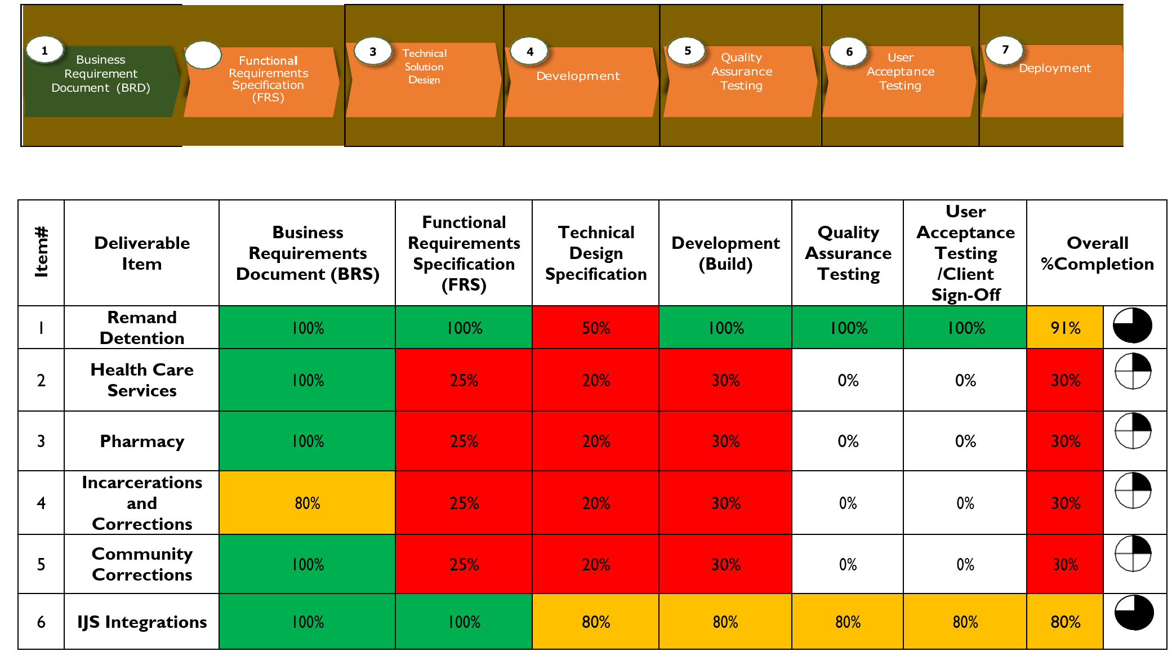
PROGRESS SUMMARY
Software (Systems) Development Life Cycle (SDLC)
The diagram below depicts the Software (Systems) Development Life Cycle (SDLC), and the Service Provider performance in terms of the contractual deliverables

Slide 8
PROGRESS SUMMARY
Rollout to all respective Remand Detention Facilities have restarted, and a cumulative total of twenty-one (21) sites has already been rolled out and the IIMS is in an effective utilization. These sites are listed as follows:
GAUTENG PROVINCE (10)
1. Pretoria Local Correctional Centre
2. Pretoria Female Correctional Centre
3. Johannesburg Medium A
4. Johannesburg Female
5. Boksburg Juvenile Correctional Centre
6. Boksburg Centre A Correctional Centre
7. Modderbee Correctional Centre
8. Heidelberg Correctional Centre
9. Nigel Male Correctional Centre
10. Krugersdorp Correctional Centre
MPUMALANGA PROVINCE (5)
1. Witbank Correctional Centre
2. Middelburg Correctional Centre
3. Carolina Correctional Centre (currently closed due to renovations)
4. Barberton Town Youth Corr Centre
5. Nelspruit Correctional Centre
NORTH-WEST PROVINCE (2)
1. Klerksdorp Correctional Centre
2. Potchefstroom Correctional Centre
KWA-ZULU NATAL PROVINCE (1)
1. Pietermaritzburg Correctional Centre
FREE STATE PROVINCE (1)
1. Grootvlei Maximum Correctional Centre
EASTERN CAPE PROVINCE (2)
1. St. Albans Medium A Correctional Centre
2. Port Elizabeth Correctional Centre

Slide 9
PROGRESS SUMMARY
Current Rollout Schedule 2020/21 Quarter 4
The next seven (7) sites targeted are planned to be completed by 31 March 2021. These sites are listed as follows:
No. | PROVINCE | Site Name (Remand Detention Facility) | Enrolment Schedule
22) | KWA-ZULU/NATAL | Durban-Westville Juvenile Correctional Centre | 22 Feb – 12 Mar, 2021
23) |  | Durban-Westville Female Correctional Centre | 22 Feb – 12 Mar, 2021
24) |  | Durban-Westville Med. A Correctional Centre | 22 Feb – 12 Mar, 2021
25) | WESTERN CAPE | Pollsmoor Female Correctional Centre | 08 Mar – 31 Mar, 2021
26) |  | Pollsmoor Med. A Correctional Centre | 08 Mar – 31 Mar, 2021
27) |  | Pollsmoor Maximum Correctional Centre | 08 Mar – 31 Mar, 2021
28) |  | Goodwood Correctional Centre | 22 Mar – 31 Mar, 2021

Slide 10
PROJECT FINANCIALS
Integritron Integrated Solutions (Pty) Ltd
The Integritron (IIS) contract price was set at R378, 084,206.08 (three hundred and seventy-eight million eighty-four thousands two hundred and six rands eight-cents), for a period of three (3) years. On April 2018, the announcement of the 15% VAT increase by the Minister of Finance resulted in an increase of the said contract by R 1 927 945.69.
A total of R 259 148 484.77 (68% of the R 380 012 151.77) was paid to Integritron Integrated Solutions (IIS), to date, made up as follows:
R 68 503 673.88 (18% of the R 380 012 151.77) – the initial outright purchase on or about June 2016 for the acquisition of the Development Framework and intellectual property rights thereto
R 42 020 457.00 (11% of the R380 012 151.77) – for the subsequent outright purchase, from March 2017 onwards in project delivery phases, of the remaining Development Framework components, including the Biometric engine software licenses.
R 32 117 860.22 (8 % of the R380 012 151.77) paid in project delivery milestones through to the end of the contract included a 2-year software license support and maintenance costs
The above constitute the cumulative mandatory Development Framework acquisition costs, totaling approximately R 142 641 991.10 (38% of the R380 012 151.77), it was unavoidable as it was a direct dependency for the performance of the service provider to automate the requisite core business processes.

Slide 11
PROJECT FINANCIALS
Integritron Integrated Solutions (Pty) Ltd
R116 506 493.67 (31% of the R380 012 151.77) would be attributable to the consulting services for the automation of the core business processes, mainly the Remand Detention module and other common modules, together with a minimal portion thereof to the rollout and deployment to two (2) production sites.
The remaining balance of R 120 863 667.00 (32% of the R380 012 151.77) has not been paid to the service provider as they didn’t complete the development of the Sentenced, Health and Pharmacy modules. This amount would therefore constitute part of the dispute resolution and the pending arbitration process.
Thank you

