Slide 1
GREAT KEI LOCAL MUNICIPALITY
STATE OF THE MUNICIPALITY REPORT - National Parliament Portfolio Committee on Cooperative Governance & Traditional Affairs
Presented by: Hon Cllr. NW Tekile
Date: 03 March 2021

Slide 2
TABLE OF CONTENTS
1. Vision & Mission
2. Background
3. Purpose
4. Implementation of Post Audit Action Plan
5. State of Finances
i) Break-down of COVID 19 Expenditure
ii) Revenue Collection
iii) Unauthorised, Irregular Fruitless and Wasteful Expenditure
6. Governance and Institutional Capacity
i) Key Positions
ii) Internal audit committee
iii) MPACs Status
iv) Service Delivery and Mid Term Performance
7. Challenges and remedial actions

Slide 3
Vision and Mission

Slide 4
Vision and Mission
Vision
To achieve a peaceful and sustainable environment, where all communities enjoy an improved quality of life through promotion of socio economic development and ensure sustainable quality service for all.
Mission
To provide sustainable/ continuous services, good governance and employment opportunities through infrastructure development, thriving agriculture, commerce, SMME’s and tourism activities.

Slide 5
2. BACKGROUND
GKM is a plenary Council where the Mayor/Speaker performs a dual role a responsibility currently assigned to Cllr Ngenisile Tekile.
We are a category B Local Municipality located within the Eastern Cape under the Jurisdiction of Amathole District Municipality with a population of 31 692 (Stats SA 2016)
Its constituted by Komga, Kei Mouth, Haga Haga, Cintsa and the villages of Mooiplaas covering a land area of 1 421 km square metre and a coastline of 42 km where major tourism centres are situated such as resorts, hotels and various get away adventures.
Standing Oversight Committees: Good Governance & Public Participation, Municipal Financial Viability and Management, Service Delivery & Infrastructure, Local Economic Development & Municipal Transformation and Institutional Arrangement.
Composition of Council: ANC 9, DA 2, EFF 1, INDEPENDENT 1: Total Council members 13
Administrative Management: Municipal Manager Mr LN Mambila, Chief Financial Officer Mr A Lwana, Director Strategic Services Mr M Mtalo and Acting Director Technical and Community Services Mr M Mapasa.
The main economic sectors are Community Services, Agriculture and tourism.
Socio economic profile attributes the unemployment rate at 28,2% with youth unemployment sitting at 39.7%.
Major Community Facilities: 28 primary schools, 4 combined schools 6 secondary schools. 4 Primary health care centres, 1 hospital, 2 libraries, 5 police stations, 26 Community Halls, 6 cemeteries & 6 Sport Fields
Number of registered voters: 18 220

Slide 6
3. PURPOSE
The purpose of this presentation is to provide an update to the National Parliament Portfolio Committee on Cooperative Governance & Traditional Affairs on the municipal progress that has been made to date with regards to the financial health status, institutional and governance matters.

Slide 7
4. IMPLEMENTATION OF POST AUDIT ACTION PLAN
The municipality has 63 findings and the status of the plan in addressing the findings is as follows:
Audit Action plan has been developed and progress on implementation is reported bi-weekly to Management
The Audit Action Plan was submitted to Provincial Treasury for review.

Slide 8
4. IMPLEMENTATION OF POST AUDIT ACTION PLAN (Cont.)
Status as at June 2020
Following is the status of the Audit Action plan as at June 2020:
Annual Performance Report to be included in the Municipality’s 2019/20 AFS work plan

Slide 9
5. STATE OF FINANCES

Slide 10
5(i) COVID-19 EXPENDITURE BREAKDOWN
The following amount has been spent in relation to COVID-19 grant of R417 000 received from National Treasury:
- The municipality has not entered into any emergency procurement with regards to the expenditure detailed above.

Slide 11
5(ii) REVENUE COLLECTION (MARCH – DEC 2020)
The municipality has a 32% average collection rate for the period of March to December 2020 and the collection analysis is as follows:

Slide 12
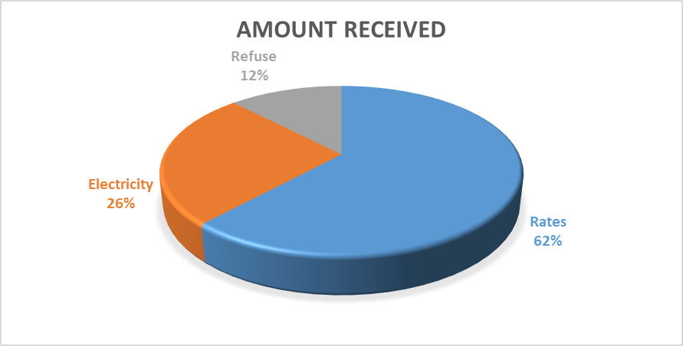
5(ii) REVENUE COLLECTION (MARCH – DEC 2020)
The municipality has intensified its revenue collection in the 3rd Quarter by implementing its credit collection policy e.g. Disconnections of electricity for long non-paying debtors.
Supplementary valuation roll 1 has been submitted in trying to respond to the data GAPS within the General Valuation Roll that was implemented in July 2020.

Slide 13
AUDITED FINANCIAL PERFORMANCE – 2019/20

Slide 14
REVENUE MANAGEMENT – 31 DECEMBER 2020
The variance was due to incorrect billing based on the GV inconsistencies and as such will be adjusted during the adjustment period.
The low billing on revenue is due to some faulty metres and electricity losses and as such it will be adjusted on adjustment budget.

Slide 15
EXPENDITURE MANAGEMENT – 31 DECEMBER 2020
  The Asset Management Module is not live on SEBATA EMS and such no depreciation allocated and manual calculations have not yet been done as the Asset Accountant post is vacant.
  Debt Impairment is showing a nil balance, due to the transactional balances back log on the EMS system and the provision will be performed as from end of February 2020.

Slide 16
EXPENDITURE MANAGEMENT – 31 DECEMBER 2020
  The following Cost Containment procedures have implemented by the municipality:
  The municipality has cut on S&T payments to employees until the municipality is financial viable. The stoppage on Acting Allowances. No booking for accommodation on meeting around the province due to financial constraints.
  Resolution was adopted by the council on non-implementation of upper limits for remuneration of councillors since 2018 financial year due to financial constraints.
  Senior management resolved on non implementation of upper limits since the 2018 financial year.

Slide 17
MUNICIPAL CREDITORS AS AT 31 DECEMBER 2020
  The following is the list and balance of creditors as at 31st December 2020:

Slide 18
MUNICIPAL GOVERNMENT DEBT AS AT 31 DECEMBER 2020
  The following is the debt owed by Government institutions as at 31st December 2020:

Slide 19
MUNICIPAL CREDITORS AS AT 31 DECEMBER 2020 (Cont.)
  The following is the list of top creditors as at 31st December 2020 :

Slide 20
PROGRESS ON CURRENT AUDIT
  Anticipated 2019/20 Audit outcome;
The municipality received a disclaimer of an audit opinion in the 2018/2019 audit and this was due to the Office of the Auditor General not being able to audit the Annual Financial Statements.
During the current year the auditors are auditing the AFS submitted for audit purposes on the 31st October 2020 and the audit is still in progress and all information requested is submitted and therefore the results could be different from prior year.
Audit Steering Committee meetings do sit bi-weekly with the Office of the Auditor General and it was confirmed that management report has been extended to be issue during mid- March.
The Audit is expected to be submitted end of March 2020 by AG.

Slide 21
5. (iii) UNAUTHORISED, IRREGULAR AND FRUITLESS EXPENDITURE
Table 11: Unauthorized, Irregular, Fruitless and Wasteful Expenditure - 31 December 2020
Nature of Expenditure
Opening
Recovered
Written off
Incurred
Balance' 30
Progress
Balance
Amount
2019/20
2019/20
June 2019
R'000
Unauthorised Expenditure
18,589,173
0
0
0
18,589,173
11,012,746
0
0
1,283,533
12,296,279
The opening balance has been reported to council and referred to
MPAC for further investigation as it was not previously properly
investigated in line with MFMA circular 68 and MFMA section 32. The
Irregular Expenditure
irregular expenditure will be reported in the next council meeting.
Council did write off UIF however upon the audit work during 2018/19 performed by AG it was confirmed that S32 of MFMA was inappropriately applied by the investigation committee. The UIFW was referred by the council to MPAC committee for further review and consideration.
2,218,940
0
0
477,834
2,696,774
Fruitless and wasteful expenditure has been reported to Standing
Fruitless & Wasteful Expenditure
Committee and Council.
Source: 2021 Municipal reports and Presentation

Slide 22
5. (iii) UNAUTHORISED, IRREGULAR AND FRUITLESS EXPENDITURE (Cont.)
Current year:
Fruitless and wasteful – Interests that has been incurred due to non payment of creditors within the prescribed period in terms of MFMA.
Unauthorised Expenditure – There is no new incurred expenditure during the first 6 months of the year.
Irregular Expenditure – This is due to irregular expenditure is a result of 3 contracts that were confirmed irregular in prior years.
The municipality has a forensic investigation report that was conducted and the recommendations were tabled MEC Cogta, the matter is under further investigations of Special Investigative Unit (Hawks).
The municipality does have registers for UIF and these are presented to council on a quarterly basis

Slide 23
6. GOVERNANCE AND INSTITUTIONAL CAPACITY

Slide 24
6. Governance and Institutional Capacity
(i) Key Positions
    MM – The position has been filled since 1 May 2019.
    CFO – position has been filled since on 14 October 2019
    Director Strategic Services – Position has been filled since November 2017
    Acting Director Technical Services
    Technical services vacancy rate that affect service delivery:
    Directorate of Technical & Community Services is vacant and the recruitment process has been initiated.
    The municipality has since appointed an acting personnel to assist with the departmental activities

Slide 25
6. Governance and Institutional Capacity
(ii) Internal Audit Unit
The internal audit unit has 5 approved positions with one funded with one position appointed.
The Unit has been co-sourced with the assistance from District Municipality (Amathole District Municipality) where they have allocated 3 officials.
The unit has been functioning and following is some of the work performed by the unit:

Slide 26
6. Governance and Institutional Capacity
(ii) Internal Audit Unit (Cont.)
Following are the top 10 audit findings that management has responded to:

Slide 27
6. Governance and Institutional Capacity ii) Audit committee (Cont.)
  Status on AC sittings & oversight, at least 4 times a year and the implementation of resolutions;
    Meeting was held on the 31st of July 2020
    Meeting was held on the 9th of October 2020
    Meeting was held on the 21st October 2020
    Meeting was held on the 27th of October 2020
    Meeting was held on 3rd December 2020
    Meeting was held on 26th of January 2021
  Resolutions Implemented
  Internal Audit Plan approved
  Provincial Treasury, Audit Committee and Internal Audit performed a joint review of the AFS
  Audit Committee and the Municipal Manager did declare the alleged fraud that took place at the Traffic Department in the AGSA fraud questionnaire
  Committee reviewed the performance report and recommendations submitted to PMS/IDP Manager through the Internal Audit Unit including the changes that have been highlighted
  Performance Management Unit and Internal Audit Unit reviewed Performance Report and ensured that the report is supported by POE.
  HR related policies submitted to the Audit Committee
  Costing for travel and overtime sent to the Audit Committee

Slide 28
6. Governance and Institutional Capacity
(iii) MPACs Functionality
  MPAC meetings are sitting as per the quarterly schedule and when the need arises.
  The MPAC is fully functional with proportional representative from all council members.
  MPAC is fairly resourced in terms of personnel and Corporate Services, is providing recordings of their proceedings
Training of the investigation committees on S32 and MFMA S32 UIFW was conducted by Provincial Treasury in order for the committee to perform its work on investigations and to review the historical UIFW.

Slide 29
6. (iv) SERVICE DELIVERY

Slide 30
MIG 2019/20 ROLLOVER PROJECTS
Form ID: Projects Name | Status of Project | Scope | % Progress | Project Duration | Contractor /Consultant Appointment
Chintsa East Internal streets | Completed | 3km | 100% | 4 Months | 14/08/19
Ward 6 Youth Centre | Construction | 290m2 | 50% | 6 Months | 23/07/19
Construction of Icwili Sportsfield | Construction | Sporstfield with netball & Combi Court | 75% | 6 Months | 23/07/19

Slide 31
MIG 2020/21 PROJECTS PROGRESS
Form ID: Projects Name | Status of Project | Scope | % Progress | Project Duration | Contractor /Consultant Appointment
Komga to Siviwe Main Street | Construction | 3,8km | 90% | 6 Months | 25/03/2020
Construction of Cefane Internal Streets | Construction | 3,5km | 70% | 6 Months | 10/11/2020
Construction of Bridge from Siviwe to Zone 10 | Construction | 1km & Culvert Crossing | 20% | 6 Months | 10/11/2020
Construction of Lusizini Community Hall | Construction | 290m² | 20% | 6 Months | 13/11/2020
Construction of Morgan Bay Internal Streets | Construction | 2,5km | 5% | 6 Months | 26/01/2021

Slide 32
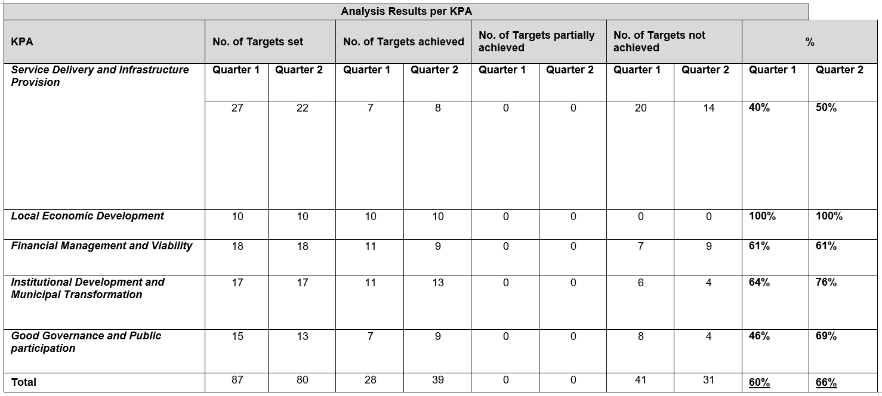
Municipal Mid- Term Performance Report – 31 December 2020
The institutional performance in the 2nd Quarter has increased by 6% compared to 60% of the 1st Quarter. Overall Performance is 63%.

Slide 33
7. Challenges faced by the municipality and remedial actions
Challenges
Increasing Salary bill versus the decreasing Equitable Share
Dilapidated electrical infrastructure
Indigent register with low numbers as compared to the social economic profile of the community.
Lack of funding for identified potential development areas
Lack of funding for bulk infrastructure for identified development areas
Litigation challenges due to financial constraints
Low Capital Grants received versus institutional service delivery backlogs identified in the IDP document.
Limited plant and machinery for roads maintenance and refuse removal due to financial constraints.
Remedial Actions
Provincial COGTA is currently reviewing the Organizational Design in response to the salary bill and establishment.
Joint registration programme has been initiated between GKM, ADM and Provincial COGTA in order to align both municipal indigent registers.
Komga Bulk infrastructure project has been earmarked as part of the Small town revitalization programme provided by Office of the Premier.
ADM is providing legal assistance on a adhoc basis and also the institution in the process of procuring a panel of legal advisors.

Slide 34
THANK YOU

