Slide 1
AMATHOLE DISTRICT MUNICIPALITY (DC12)
STATE OF GOVERNANCE REPORT
PORTFOLIO COMMITTEE ON COOPERATIVE GOVERNANCE AND TRADITIONAL AFFAIRS
3 MARCH 2021
EXECUTIVE MAYOR
CLLR. K.C. MANELI

Slide 2
CONTENT
BACKGROUND
STRATEGIC INTERVENTION
  PROGRESS TO DATE
    INSTITUTIONAL CAPACITY
    MUNICIPAL PERFORMANCE
    STATE OF SERVICE DELIVERY
    STATE OF FINANCES
SUPPORT TO LOCAL MUNICIPALITIES
RECOMMENDATIONS

Slide 3
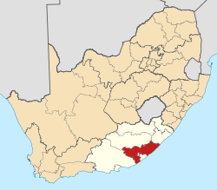
WHERE IS AMATHOLE DISTRICT?

Slide 4
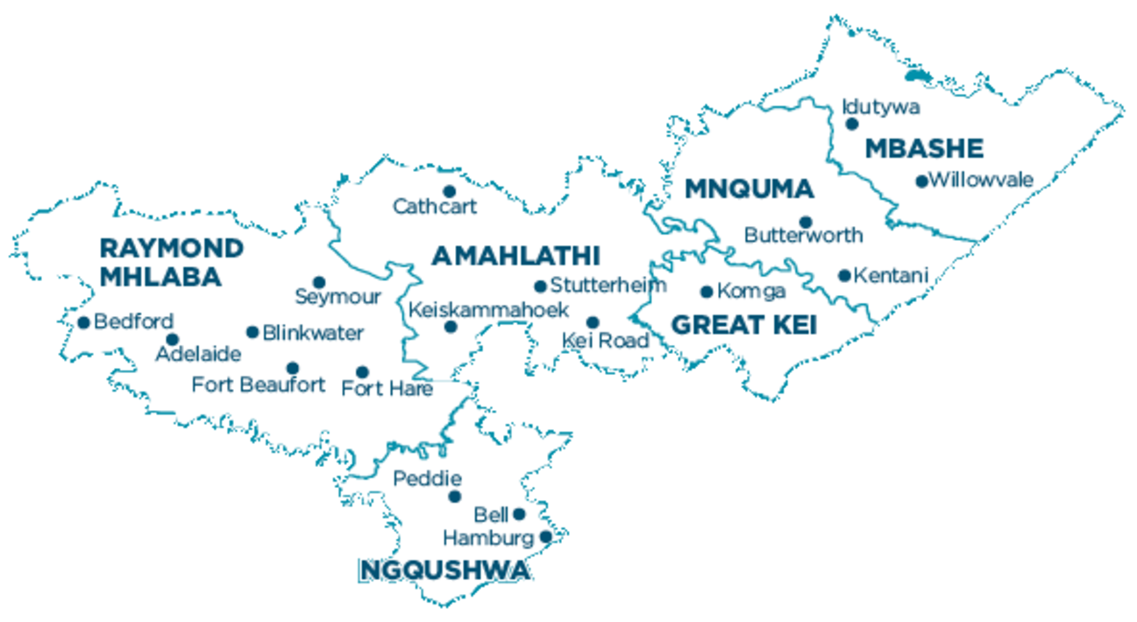
PROBLEM STATEMENT
912 000 population with 580 000 living in poverty
Majority population are children (0-14) followed for by youth (15-24)
Unemployment Rate (37,4%)
Economic Sector: Community Services (38%)
WE NEED A DIFFERENT WAY OF THINKING

Slide 5
SMART DISTRICT CONCEPTUAL FRAMEWORK
Vision 2058
OUTCOME
Contextually Aligned set of practical recommendations applicable to ADM
Global Trends
Smart District Environment
Level of Understanding
Level of implementation
Drivers for change
MTAS
IMPACT
Dynamic Rural Economy
Sustainable District
Just and Equitable
Resilient
Information and Communications Technology
Innovation
Socio Economic Development
Infrastructure Development
Nature of Progress in the ADM Context
IDP
SDBIP
What is a Smart District?
The incorporation and use of smart intelligence principles in infrastructure development and services within the 4IR in achieving the desired impact

Slide 6
AMATHOLE SMART DISTRICT TOWARDS 2058
DYNAMIC RURAL ECONOMY
OUR GROWING, THRIVING AND SMART DISTRICT WILL ENSURE TO BE ONE OF SOUTH AFRICA’S MOST DYNAMIC RURAL ECONOMY WHERE FAMILIES, BUSINESSES, LOCAL MUNICIPALITIES AND WARDS THRIVE
SUSTAINABLE DISTRICT
OUR SMART DISTRICT WILL BE THE MOST SUSTAINABLE DISTRICT IN SOUTH AFRICA AND A REGIONAL LEADER IN THE FIGHT AGAINST CLIMATE CHANGE
JUST AND EQUITABLE
OUR JUST AND EQUITABLE AMATHOLE DISTRICT MUNICIPAL AREA WILL HAVE AN INCLUSIVE, EQUITABLE ECONOMY THAT OFFERS WELL-PAYING JOBS AND OPPORTUNITY FOR ALL TO LIVE WITH DIGNITY AND SECURITY
RESILIENT DISTRICT
OUR RESILIENT DISTRICT, OUR NEIGHBOURHOODS, OUR ECONOMY, AND PUBLIC SERVICES ARE READY TO WITHSTAND AND EMERGE STRONGER FROM THE IMPACTS OF CLIMATE CHANGE AND OTHER 21ST CENTURY THREATS

Slide 7
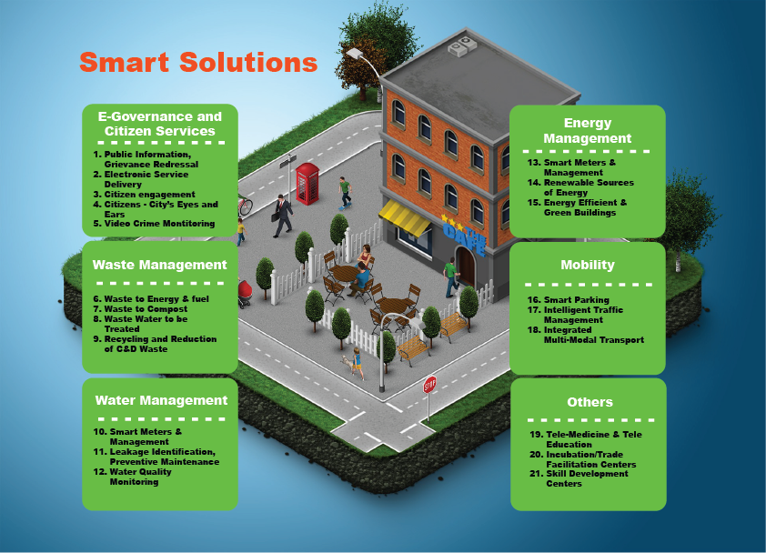
SMART DISTRICT SOLUTIONS TOWARDS 2058
  Integrated Marine Precinct and Sea Water Desalination Plant
  Integrated Transport Systems
  Broadband Connectivity
  World Class Sports Academy
  STEM Skills Academy
  Technical Training Academy
  Integrated Waste Management
  Small Towns Revitalisation
  Revitalisation of Irrigation Schemes
  Revitalisation of Crop Plantations
  World Class Disaster Management Centre

Slide 8
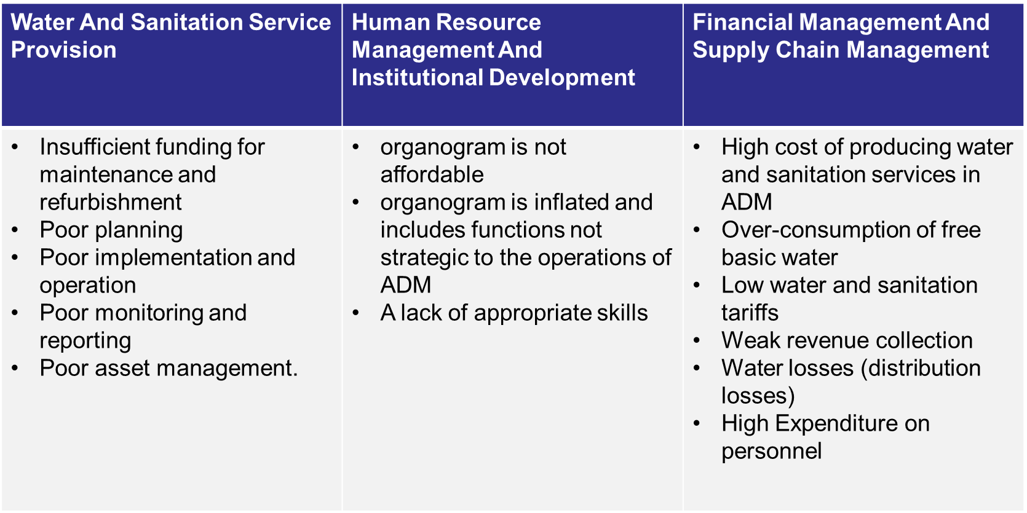
BACKGROUND: 2017 DIAGNOSTIC ANALYSIS

Slide 9
BACKGROUND:POWERS AND FUNCTION
Water and Sanitation;
Municipal Health Services;
Integrated Development Planning for the district as a whole;
Fire Fighting Services;
Solid waste disposal sites;
Regulation of passenger transport services;
Promotion of local tourism for the area of the district municipality;
Municipal public works in respect of any of the above functions.

Slide 10
BACKGROUND: CHALLENGES ROOT CAUSES
2013/14: re – categorization of the municipality from a category 6 to a 7 as per salary scales set out by the Bargaining Council
2014/15: Standardisation of salaries
2015/16: Acquisition of SAP –at a cost of R75m, which has escalated, to R111m to date;
2015/16: New Headquarters
Essential Car User Scheme
2016/17: Non-payment of Amatola Water Board
Non-payment of R50m due to Department of Water and Sanitation
2013/14-2017/2018: 936 new appointments made which inflated the organogram that included functions not strategic to the operations of ADM.
2018/19: Political Settlement Agreement post unlawful strike

Slide 11
STRATEGIC INTERVENTION

Slide 12
ADM TURNAROUND STRATEGY 2018-2023
In order ADM to be where it should, it is important to build a “Culture of Excellence” and a value based organisation through:
  Brand Repositioning - Building confidence of the ADM important Stakeholders, including local municipalities.
  Organisation Development and Design - Coupled with this culture, there is a need to revise the current organizational structure to respond to ADM’s core business.
  Financial Sustainability - There is a need to build a sound financial base to realize the service delivery goal of ADM.
  Building Public Confidence- For the community to trust and have confidence in ADM in rendering the services in an efficient and effective manner

Slide 13
ADM TURNAROUND STRATEGY 2018-2023
LEADERSHIP DEVELOPMENT
INSTITUTIONAL DEVELOPMENT
LOCAL ECONOMIC DEVELOPMENT
GOOD GOVERNANCE
QUALITY SERVICE DELIVERY
SOUND FINANCIAL MANAGEMENT
HUMAN CAPITAL DEVELOPMENT
SPATIAL PLANNING

Slide 14
ADM TURNAROUND STRATEGY 2018-2023
STRATEGIC SUPPORT PARTNERS
REGIONAL MANAGEMENT CONTRACTOR SUPPORT PROGRAM (RMSC)
        The duration of the intervention is from 2018/19 to 2019/20
        MTAS Pillars
        Institutional Development
        Quality Service Delivery
        Sound Financial Management
GOVERNANCE SUPPORT PROGRAM II
The duration of the intervention is from 2018/19 to September 2021
MTAS Pillars:
  Good Governance
  Quality Service Delivery
  Leadership Development
  Sound Financial Management
  Institutional Development
FULLY FUNCTIONAL INTEGRATED FINANCIAL MANAGEMENT SYSTEM - The duration of the intervention from June 2018- January 2019
- MTAS Pillars:
  Good Governance
  Sound Financial Management
  Institutional Development

Slide 15
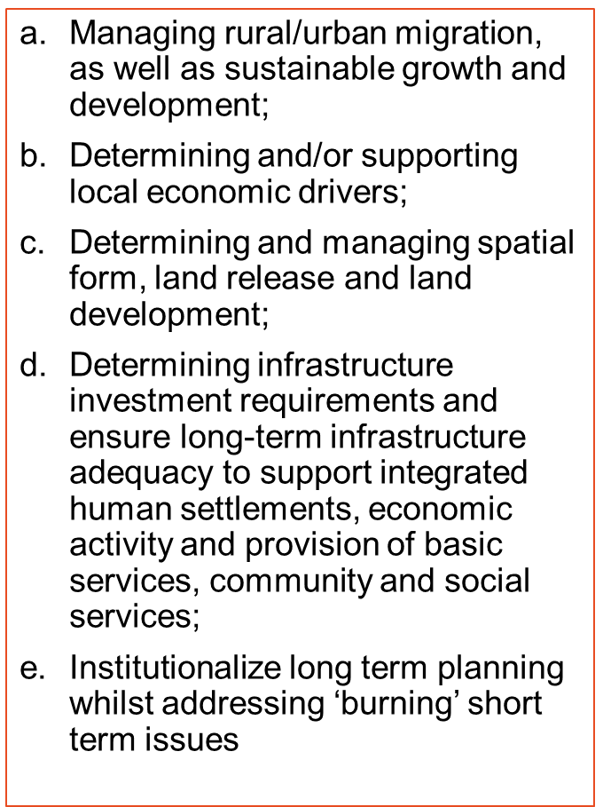
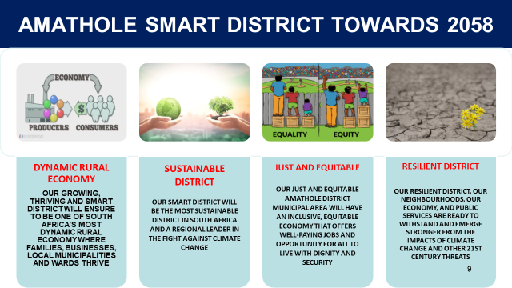
DISTRICT DEVELOPMENT MODEL
LONG TERM PLAN

Slide 16
REQUESTED FINANCIAL AND NON-FINANCIAL SUPPORT (IN LINE WITH SECTION 154)
February 2018: Diagnostic Report Tabled to ADM Institutional Strategic Planning Session
February 2018: ADM State of Governance tabled to EC COGTA Strategic Planning Session
May 2018: Request for Financial and Non Financial Support made to erstwhile Minister of National COGTA: Hon. Z. Mkhize.
August 2018: Tabling of State of Governance Report during the Eastern Cape Provincial EXCO Outreach wherein we requested immediate political and administrative financial and non financial support
Tabled ADM State of Governance requesting financial and non financial support in all IGR Structures (DIMAFO, Technical MuniMEC, Political MuniMEC).
2018
February 2019: ADM State of Governance tabled to EC COGTA Strategic Planning Session
March 2019: Request for Funding of Mutual Separation Agreement (MSA) to National Treasury
April 2019: State of Governance Report, Service Delivery Report and State of Water and Sanitation Report tabled to President Ramaphosa during the 2019 National and Provincial Government Election Campaign in Butterworth.
May 2019: Request for financial and non financial support to MISA as part of the RMSC Programme
July 2019: Engagements between National COGTA and ADM on support areas which require financial and non financial support in Human Resources and MSIG
2019

Slide 17
REQUESTED FINANCIAL AND NON FINANCIAL SUPPORT (IN LINE WITH SECTION 154)
August 2019: Follow up session between National COGTA and ADM on Financial and Non-Financial Support National COGTA
August 2019: Engagement with EC COGTA on the State of Governance and areas which require financial and non financial support
August 2019: Engagements between ADM and SALGA EC on the State of Governance in particular administration and governance, matters related to Bargaining Council and Strategic Alignment of ADM to future of District Municipalities
September 2019: Request for Financial and Non Financial Support Tabled to Minister Sisulu during the visit to the Province.
October 2019: Engagements with former Deputy Minister Tau on ADM One Plan and areas which require financial and non financial support.
Tabled ADM State of Governance requesting financial and non financial support in all IGR Structures (DIMAFO, Technical MuniMEC, Political MuniMEC).
2019

Slide 18
REQUESTED FINANCIAL AND NON FINANCIAL SUPPORT (IN LINE WITH SECTION 154)
January 2020: Follow up on Progress implementation of RMSC (through MISA) and request for Financial and non financial support of the financial recovery plan
February 2020: ADM State of Governance tabled to EC COGTA Strategic Planning Session
February 2020: Request for engagements with National Treasury on progress made thus far in implementation of MSCOA, appointment of the new SP for the implementation of SAP, submission of MSCOA Strings and request for funding of ADM Mutual Separation Agreement (MSA).
July 2020: Follow up engagements between ADM and National Treasury on Funding of Mutual Separation Agreement
August 2020: Presentation of State of Governance Report to Provincial and National Champions of ADM District Development Model requesting financial and non-financial support.
August 2020: Presentation to National Treasury on the Fact Finding Mission on Wage Bill and Organisational Structure.
September 2020: Letter from National Treasury to National COGTA on the Amathole District Municipality request for Funding on the Turnaround Strategy to reduce the wage bill
September 2020: Engagements with EC COGTA PMU to request financial and non financial support of Catalytic projects
December 2020: Engagements between ADM and EC COGTA on prevailing Labour MatterS at ADM
2020

Slide 19
PROGRESS TO DATE

Slide 20
INSTITUTIONAL CAPACITY

Slide 21
INSTITUTIONAL CAPACITY
Fully Functional Council and Committees (Section 79 & 80)
Municipal Manager post filled with Section 56 Managers.
  One vacancy, with recruitment processes underway
Functional Local Labour Forum, even though strained relations between Labour and Management
Staff Establishment reviewed and approved by Council in June 2018 in line with the powers and functions of the municipality and Category of the Municipality (Grade 6):
  Total 2084 positions
  1381 positions have been audited by the Provincial Evaluation Committee
  703 positions outstanding
Approved Mutual Separation Agreement
  Application for financial support worth R150m for MSA

Slide 22
RE-CATEGORISATION AND STANDARDISATION
PROGRESS TO DATE:
  Consultations commenced from 2017/2018 on Organisational Development and Design inclusive of Recategorisation and Standardisation:
    Local Labour Forum Consultations were unsuccessful
  Council approved to rescind the alleged unlawful administrative decision to recategorise and standardise salaries of the municipality from grade 6 to grade 7 in December 2019.
    IMATU, SAMWU and Former MM Magwangqana had filed a notice to oppose the application.
    Nevertheless, SAMWU and Former MM Magwangqana did not file opposing papers.
    Currently in court awaiting date for hearing, tentatively March 2021

Slide 23
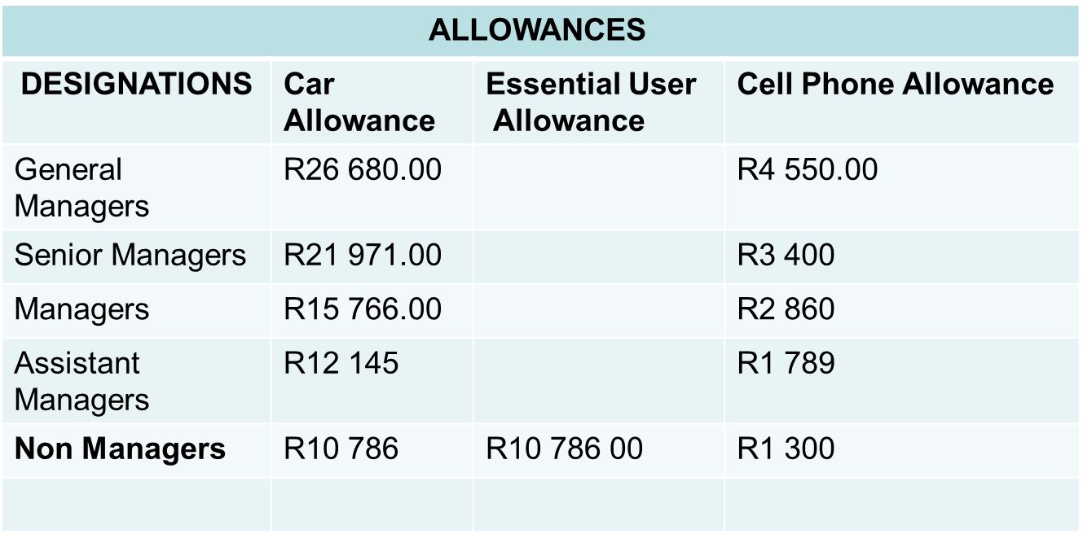
REVIEW OF EMPLOYEE BENEFIT POLICIES
As part of the Financial Recovery Plan, ADM reviewed Employee Benefit Policies which were contributing to the High Cost of Employees.
Such policies include:
  Cellphone Allowance Policy
  Essential User Scheme Policy
  Car Allowance Policy
  Subsistence and Travel Allowance policy
Overall Monthly Essential User Scheme – R945 707.00 (95 beneficiaries)
Overall Monthly Travel Allowance- R2 548 222.00 (149 beneficiaries)
Overall Monthly Cellphone Allowance- R820 054.00 (452 beneficiaries)

Slide 24
REVIEW OF EMPLOYEE BENEFIT POLICIES
Consultative Processes on the Review of the Policies was undertaken in:
  Departmental Strategic Planning Sessions
  Technical Strategic Planning Session
  Institutional Strategic Planning Session
  Local Labour Forum
  Policy Workshop for Councillors
Council Approved the reviewed policies 30 June 2020 for implementation in 2020/21
  Order of the Labour Court interdicted implementation of Council policies, ADM currently adhering to outcome:
    In short of invoking section 189, agreement must be reached with labour to review salaries and benefits

Slide 25
APPLICATION FOR EXEMPTION AT SALGBC
Application made to SALGBC in July 2020
First sitting was scheduled to take place on the 15 September 2020, which was postponed to 2 December 2020
Application for Exemption at SALGBC was unsuccessful and an appeal convened on the 14 January 2021, 9 February 2021 and 1 March 2021
Awaiting outcome of appeal in March 2021

Slide 26
UNAFFORDABLE ORGANISATIONAL STRUCTURE
Remuneration of the Municipal Manager and Senior Managers reporting directly to the Municipal Manager outside the Upper Limits of the Total Remuneration Packages as Gazetted
  the total remuneration packages of the Municipal Manager and Senior Managers reporting to the Municipal Manager as gazetted in October 2017 and November 2018 are outside the Upper Limits due to the fact that the gazetted amounts are below the package of the General Managers (with the highest being paid R1,9m per annum) who report to Directors and by implication affecting the total remuneration package of the Municipal Manager.
  Requests were made to former COGTA MEC Xasa and COGTA MEC Nqatha for the waivering the total remuneration packages of the Municipal Manager and Senior Managers reporting to the Municipal Manager as gazetted in October 2017 and November 2018, however there has been no response to date.
  A further request was made to Minister Dlamini-Zuma to consider waivering the total remuneration packages of the Municipal Manager and Senior Managers reporting to the Municipal Manager as gazetted in October 2017 and November 2018, however there has been no response to date

Slide 27
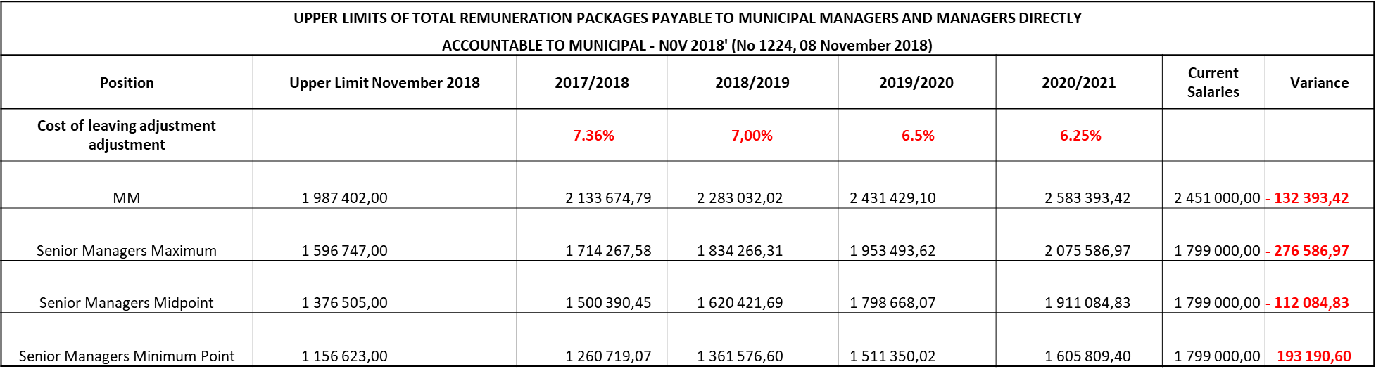
UNAFFORDABLE ORGANISATIONAL STRUCTURE
Remuneration of the Municipal Manager and Senior Managers reporting directly to the Municipal Manager outside the Upper Limits of the Total Remuneration Packages as Gazetted
  Since 2018/19 the Municipal Manager and Senior Managers reporting directly to the Municipal Manager have forfeited any salary increase and performance bonus due to them in an effort to curb the increasing of their packages, resulting in savings

Slide 28
MUNICIPAL PERFORMANCE

Slide 29
MUNICIPAL PERFORMANCE

Slide 30
SERVICE DELIVERY PERFORMANCE

Slide 31
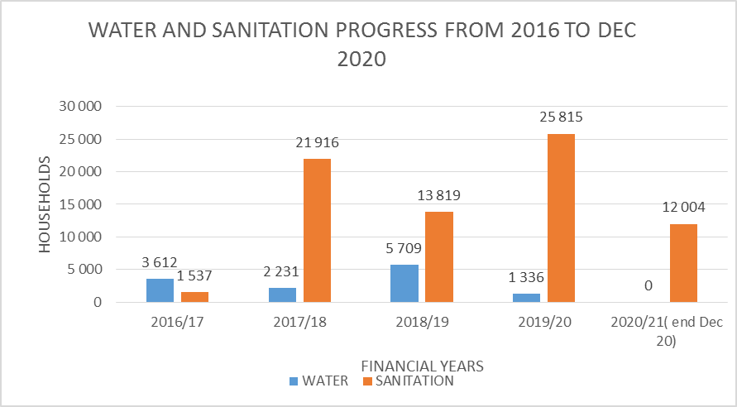

SERVICE DELIVERY PERFORMANCE
DECLARED STATE OF DISASTER
DROUGHT SINCE 2016, RE-DECLARED EVERY YEAR
SERVICES PROVIDED (NO. HOUSEHOLDS) | 2016/17 | 2017/18 | 2018/19 | 2019/20 | 2020/21( end Dec 20) | Total
WATER | 3 612 | 2 231 | 5 709 | 1 336 | 0 | 12 888
SANITATION | 1 537 | 21 916 | 13 819 | 25 815 | 12 004 | 75 091

Slide 32
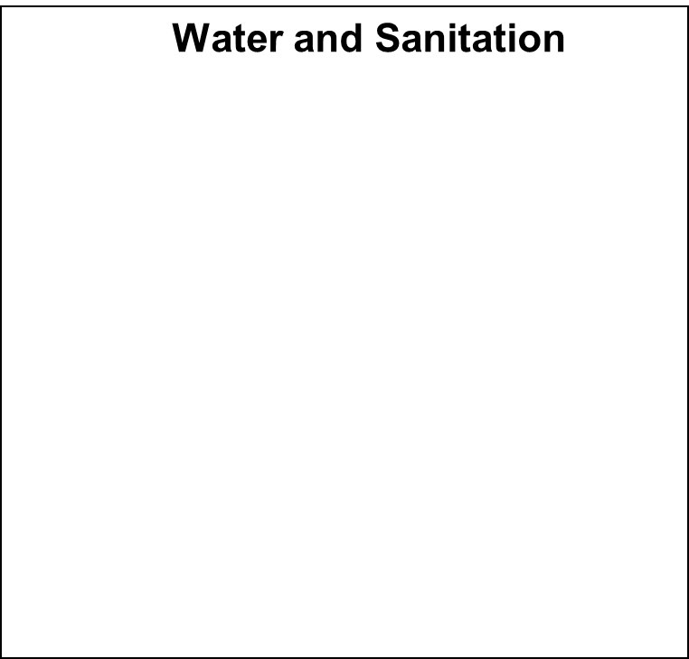
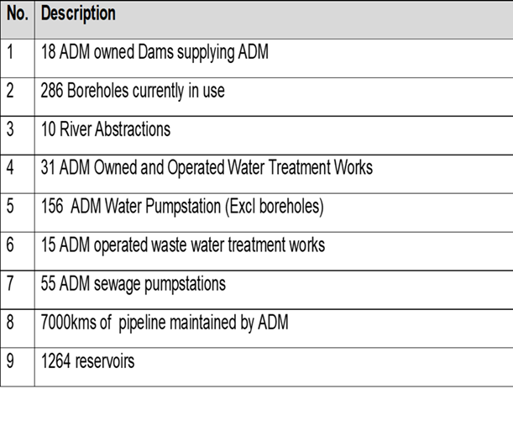
SERVICE DELIVERY PERFORMANCE
FINANCIAL YEAR | COMPLIANCE LEVEL
2017/18 | 93%
2018/19 | 93%
Declining Water Quality: <97%)
Insufficient Infrastructure Maintenance Budget (ADM should be spending R 434 027 825)

Slide 33
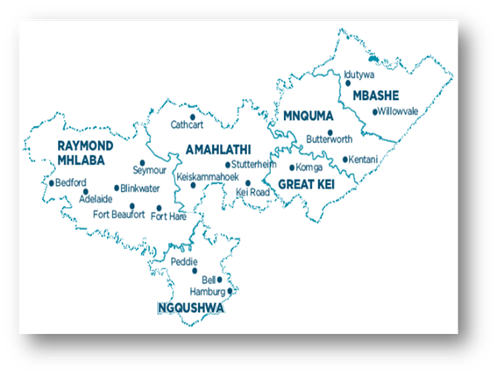
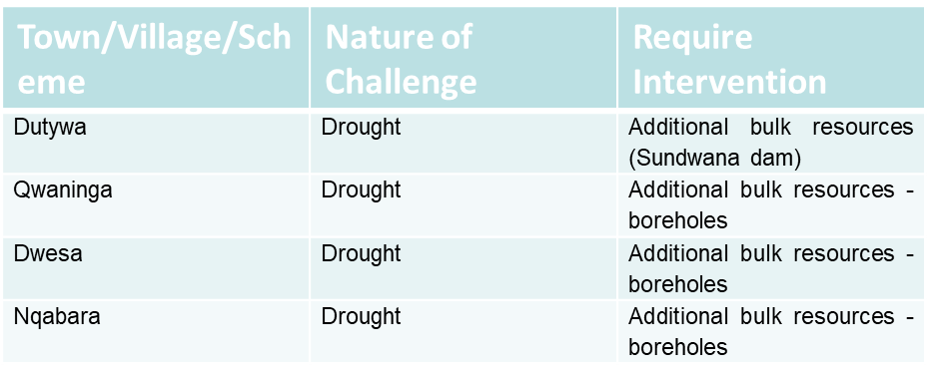
VISION 2058: SUSTAINABLE DISTRICT
MTAS PILLAR: QUALITY SERVICE DELIVERY
KPA: SERVICE DELIVERY AND INFRASTRUCTURE
MBHASHE
Challenges:
Severe drought affecting Dutywa, Dwesa, Qwaninga, Mendu, Ngqabara;
Shortage of Mechanical and Electrical artisans;
No formal sanitation systems in Willowvale and Elliotdale;
Current Interventions:
Water carting;
Ground water investigations undertaken in Dutywa & Dwesa, but boreholes not yet equipped.
Low flush toilets installed in Willowvale as an interim measure;
Medium Term Interventions:
Require approximately R70m to equip boreholes around Dutywa and convey water to Dutywa Town;
Require approximately R10m to equip boreholes at Dwesa (water quality is very poor and require further treatment)
Long Term Interventions:
Sundwana Dam and bulk water supply;
Full water borne Willowvale and Elliotdale;
WATER QUALITY
100%

Slide 34
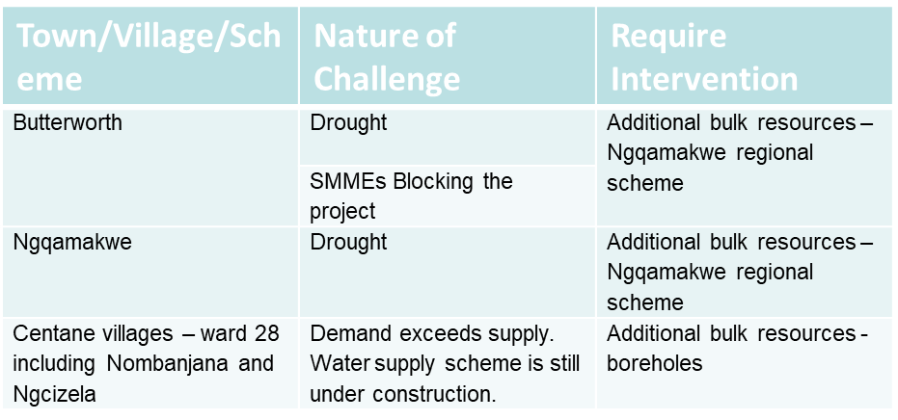
VISION 2058: SUSTAINABLE DISTRICT
MTAS PILLAR: QUALITY SERVICE DELIVERY
KPA: SERVICE DELIVERY AND INFRASTRUCTURE
MNQUMA
Challenges:
Severe drought affecting Butterworth, Ibika, Kotana, Centane areas;
No formal sanitation systems in Ngqamakwe and Centane;
Current Interventions:
Water carting;
Ground water investigations in Butterworth;
Medium Term Interventions:
Contractor appointed to equip boreholes in Teko Kona (water to be piped back to Butterworth – project due for completion 31 January 2021);
Ngqamakwe Water Supply Project which includes emergency water supply to Butterworth is being funded through DWS (R724m of R1.3b request has been allocated to date) – 36 month contract, being implemented “in-house” by DWS construction unit. Total cost of first phase is R862m, therefore shortfall of R138m);
Raising of Gcuwa weir – being implemented by DWS – currently at design stage and due for completion during 2022;
Rehabilitation of Kolifini Wetland estimated at R6.3m
Long Term Intervention:
Investigate alternative sources for Butterworth such as piping water from Xilinxa to Gcuwa to reduce stream losses;
WATER QUALITY
99%

Slide 35
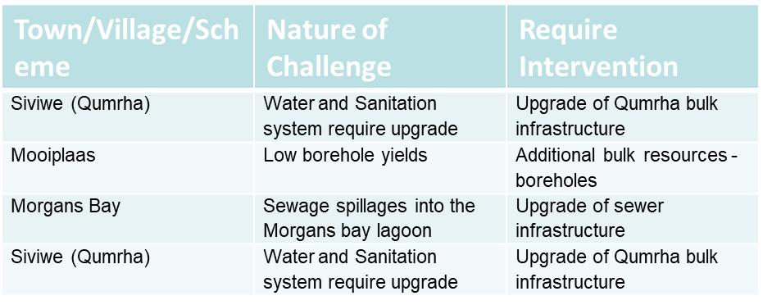
VISION 2058: SUSTAINABLE DISTRICT
MTAS PILLAR: QUALITY SERVICE DELIVERY
KPA: SERVICE DELIVERY AND INFRASTRUCTURE
GREAT KEI
Challenges:
Demand exceeds design capacity of water supply system in Qumrha, resulting in frequent water outages in Siviwe;
Kei Mouth prone to drought;
Sanitation system in Siviwe requires urgent upgrade;
Sanitation system in Morgans Bay requires urgent upgrade (frequent spillages into lagoon at a popular holiday destination);
Current Interventions:
Professional service provider appointed to upgrade Qumrha bulk water supply – tender at BSC stage;
Professional service provider appointed to upgrade Morgans Bay sanitation – refurbishment underway;
Ground water investigation conducted in Qumrha and two boreholes currently being equipped to provide emergency supply to Qumrha (one complete and operational);
Long Term Interventions:
Great Kei bulk regional scheme supplied from Wriggleswade or Nahoon;
Possible raising of Morgans Bay dam;
WATER QUALITY
100%

Slide 36
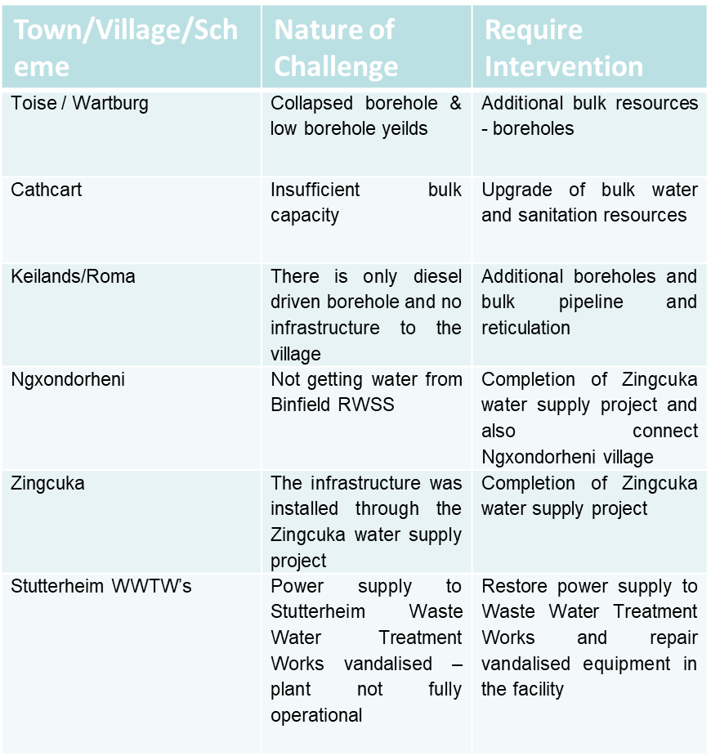
VISION 2058: SUSTAINABLE DISTRICT
MTAS PILLAR: QUALITY SERVICE DELIVERY
KPA: SERVICE DELIVERY AND INFRASTRUCTURE
AMAHLATHI
Challenges:
Drought conditions may affect Cathcart;
Drought conditions affecting Goshen and Wartburg;
Water Supply challenges at Dontsa;
Current Interventions:
Water carting;
Emergency boreholes drilled at Goshen, Wartburg and Donsta,
Goshen borehole equipped and operational, and equipping of Wartburg boreholes underway;
Contractor appointed for Cathcart Bulk Services upgrade which includes equipping and connecting additional boreholes to town supply, work currently suspended pending legal challenge to appointment;
Medium Term Interventions:
Equip boreholes;
Long Term Interventions:
Raise Sandile Dam wall;
Increase capacity of Kei Road water treatment works in order to supply Great Kei;
WATER QUALITY
95%

Slide 37
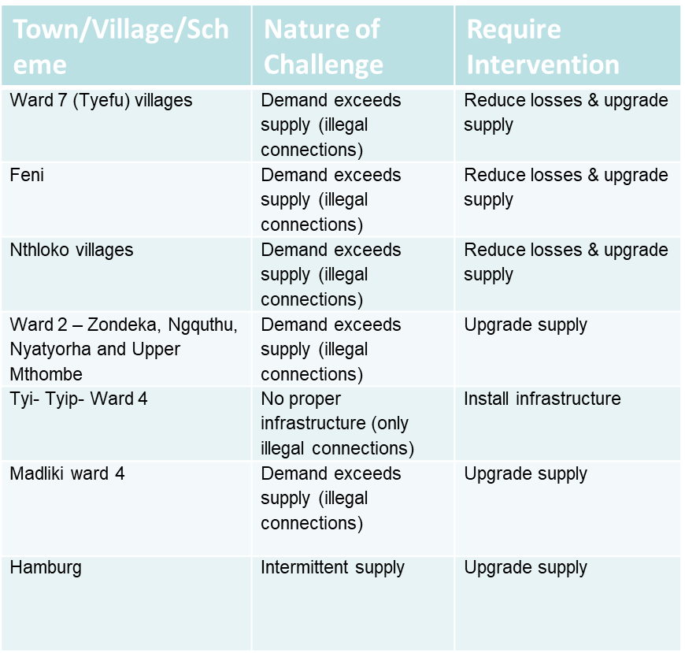
VISION 2058: SUSTAINABLE DISTRICT
MTAS PILLAR: QUALITY SERVICE DELIVERY
KPA: SERVICE DELIVERY AND INFRASTRUCTURE
NGQUSHWA
Challenges:
Water demand exceeds available supply from the Peddie Water Treatment works;
Current Interventions:
Water carting;
Water conservation and demand management iniatives;
Contractor appointed to repair and upgrade bulk pipe infrastructure;
Piloting of rural yard connection policy;
Medium Term Interventions:
Roll out rural yard connection policy;
Equip “old” boreholes to supplement supply, where possible (water quality is a challenge);
Installation of package plants at Dabi and Peddie dams;
Long Term Interventions:
Upgrade of Ngqushwa Water bulk supply system (upgrade Peddie water treatment works or install pipeline from Sandile or Laing system);
Supply Chalumna area (BCMM) from Sandile instead of Peddie Water Treatment Works;
Raising of the Sandile Dam Wall
WATER QUALITY
92%

Slide 38
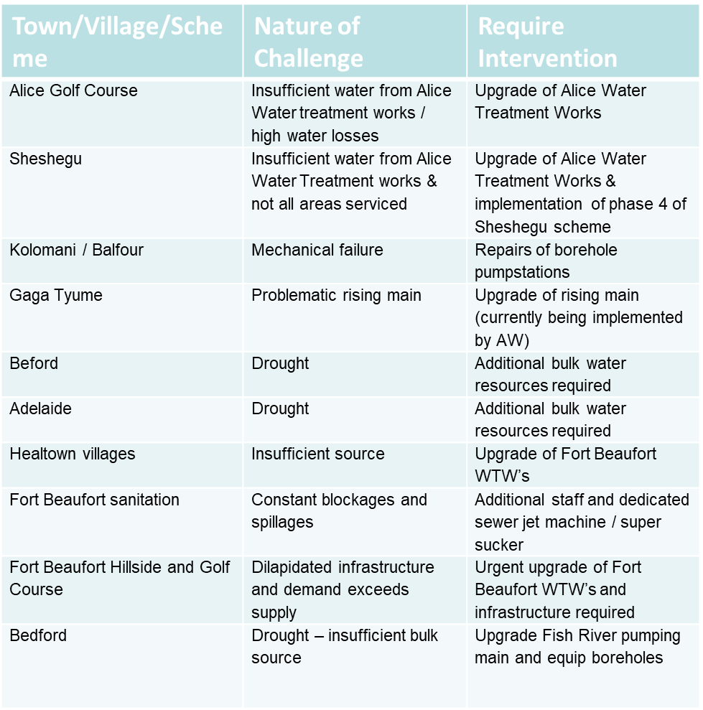
VISION 2058: SUSTAINABLE DISTRICT
MTAS PILLAR: QUALITY SERVICE DELIVERY
KPA: SERVICE DELIVERY AND INFRASTRUCTURE
RAYMOND MHLABA
Challenges:
Severe drought conditions in Bedford, Adelaide, Hogsback and Balfour areas
Sanitation challenges in Fort Beaufort, Alice and Seymour;
Current Interventions:
Water carting;
Four new pumps installed on Fish River line and minor repairs to pipeline undertaken;
Six additional boreholes drilled and equipped in Adelaide – but yield has already dropped;
Contractor on site refurbishing Waste Water Treatment works and pumpstations in Fort Beaufort;
Medium Term Interventions:
Augment source in Adelaide, Bedford and Hogsback – 7 boreholes have been drilled and are suitable for equipping, but require funding source;
Upgrade of Fort Beaufort Bulk Water Supply System – phase 1 complete, phase 2 in progress;
Require additional staff and tools in order to maintain sewer system in Fort Beaufort;
Long Term Interventions:
Foxwood dam for water supply to Adelaide and Bedford as well socio economic development (National Government Gazette No 1069)
Upgrading of Fish River rising main;
WATER QUALITY
96%

Slide 39
SUSTAINABLE WATER SOLUTIONS
MUNICIPALITY | NAME OF PROJECT | BUDGET REQUESTED | CURRENT STATUS | INTERVENTION REQUIRED
Raymond Mhlaba | Construction of Foxwood dam; Equipping of boreholes drilled during last financial year in Bedford, Adelaide and Hogsback | R2.5b R30m | Gazetted, but no funding allocated Boreholes drilled, but no funding to equip | Unlocking of funding Funding
Mnquma | Ngqamakhwe Regional Water Supply Scheme Kolofini Wetland Rehabilitation | R1.4b R6.3m | R724m gazetted and funded by DWS (total project cost R862m) No funding allocated | Balance of funding: R676m Funding
Mbhashe | Construction of Dam and Water Treatment Works for Sundwana Regional Water Supply Scheme Equipping of Dutywa boreholes | R650m R70m | R28.5m allocated from MIG for reticulation Boreholes drilled, but no funding to equip | Funding / unlocking of funding for Bulk Infrastructure Funding
Great Kei | Extension of Kei Road Water Treatment works and bulk pipeline | R1.1b | Pre-feasibility undertaken. No funding allocated | Funding required for detailed feasibility and implementation
Ngqushwa and Amahlathi | Upgrade of Water Treatment Works and construction of pipeline from Sandile Dam to Peddie | R1.5b | Feasibility undertaken, but no funding allocated | Funding required
District Wide | Aqua Solar Hybrid Power Plant and Sea Water Desalination Plant Drilling & equipping of boreholes | R4.7b R100m | Pre-feasibility undertaken No funding allocated | Funding required for detailed feasibility and implementation Funding
GRAND TOTAL: | R12.06b

Slide 40
OVERVIEW: COVID 19 RESPONSE PLAN
MULTI-SECTORAL APPROACH
National Command Council
Provincial Command Council
SECTORS
District Command Council
GOVERNANCE AND COMMUNICATION
SAFETY AND SECURITY
SOCIAL
ECONOMIC
District Joint Operations Committee
Local Municipal Joint Operations Committee

Slide 41
STATE OF FINANCES

Slide 42

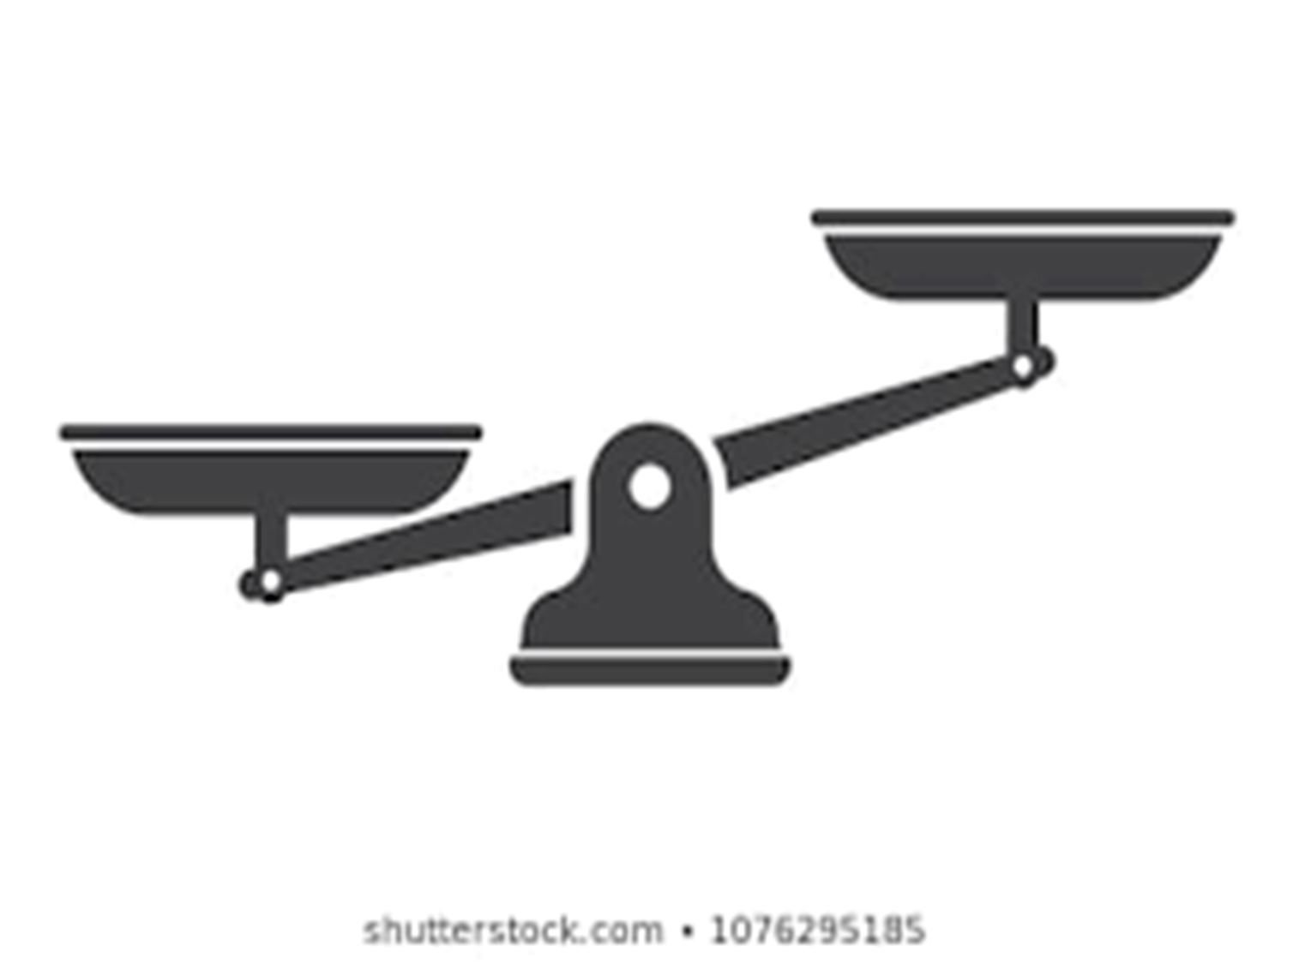

YESTERDAY WE WERE HERE…
Budget Summary 17/18
STATE OF FINANCES
Budget Summary 16/17
Revenue
R1 927 450 600
Expenditure
R1 927 450 600
Revenue
R1 872 259 578
Expenditure
R 1 872 259 578
Actual audited
R1 497 105 539
Actual audited
R1 873 909 350
Actual audited
R1 632 818 267
Actual audited
R2 071 566 1841
Budget Summary 18/19
Budget Summary 19/20
Expenditure
R2 130 694 000
Revenue
R1 825 434 592
Revenue
R2 145 724 450
Expenditure
R2 145 724 450
Actual audited
R1 862 548 318
Actual audited
R2 302 447 710
Actual
R1 980 774 523
Actual
R2 656 296 459

Slide 43
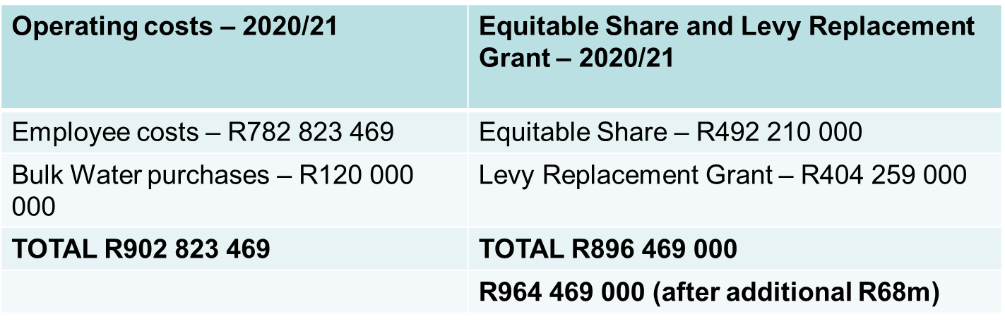
STATE OF FINANCES
Operating costs vs Equitable Share and Levy Replacement Grant
ES and LRG not sufficient to cover two of largest operating costs
Utilised to fund the budget = settle creditors

Slide 44
BUDGET SCENARIOS
Budget 2020/2021
CATEGORY | SCENARIO 1 | SCENARIO 2 | SCENARIO 3
 | 6,25% PLUS 2,5% NOTCH | 2.5% NOTCH 15% MEDICAL AID | NO INCREASE
Political Office Bearer | R14 888 925 | R14 888 925 | R14 888 925
Executive Management | R13 945 944 | R13 945 944 | R13 945 944
Other Staff | R 848 706 814 | R789 876 704 | R754 036 126
Total | R877 541 683 | R818 711 573 | R782 870 995
Notes:
This is the impact on the budget before the R68m Equitable share, which we are still not sure when it is to be received

Slide 45
FINANCIAL IMPLICATIONS
 | SCENARIO 1 | SCENARIO 2 | SCENARIO 3
 | 6,25% PLUS 2,5% NOTCH | 2.5% NOTCH 15% MEDICAL AID | NO INCREASE
COE | R877 541 683 | R818 711 573 | R782 870 995
EFFECT ON THE BUDGET | BUDGET DEFICIT (R72 776 054) | BALANCED BUDGET | BUDGET “SURPLUS” R21 894 634*
*Despite a “surplus budget”, ADM budget remains unfunded due to the amount owed to historic creditors (Top Ten Creditors: R310m)
Notes:
This is the impact on the budget before the R68m Equitable share, which we are still not sure when it is to be received

Slide 46
SALARY SCALE COMPARISION
UPPER LIMITS
 | CATERGORY 6 | CATEGORY 7
MM | R1,987m | R2,345m
DIRECTORS | R1,596m | R1,876m
 | 2018/2019 | 2019/2020 | 2020/2021
MM | R2,451 | R2,451 | R2,451
DIRECTORS | R1,799 | R1,799 | R1,799
GM | R1,722 | R1,926 | R2,046
SM | R1,479 | R1,655 | R1,758
Managers | R1,083 | R1,198 | R1,273
Increased by 6,25%
Excl 2,5%

Slide 47
BILLING AND COLLECTION TRENDS

Slide 48
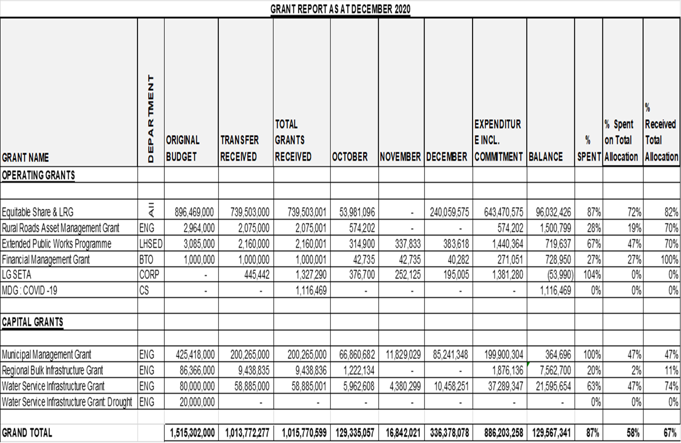
STATE OF FINANCES: GRANT PERFORMANCE

Slide 49
KEY COST DRIVERS
1. EMPLOYEE RELATED COSTS
Court application to review Recategorisation and standardisation.
Reviewed Employee Benefit Policies as part of FRP
2. SAP SYSTEM
Implementation of Forensic Investigation Outcomes as approved by Council
Final Invoice payment still in dispute (contractual obligations not met by Service Provider).
Appointed service providers to assist with SAP Business Processes Support including IT Co-Source and SAP Applications Support.
3. HEADQUARTERS AND SATELLITE OFFICE RENTALS
Identified land for construction of ADM New Office Precinct in Great Kei LM
Environmental Impact Assessment (EIA) process have been initiated.
4. FLEET
Development and Implementation of Fleet Management Strategy
Implementation of SOPs
Grounding of fleet and only use when necessary
5. AMATOLA WATER BOARD
Payment arrangements have been entered into
EMPLOYEE RELATED COSTS (Salary Bill, Essential Car User Scheme, Overtime Costs, Municipal Re categorisation, Standardisation of Posts and Fleet Maintenance) average monthly salary bill R60 m
SAP SYSTEM - acquired at R75m with total cost at R111m and R42m still owed to the service provider. Appointed new SP, R2m per month monthly support fee and R1,5m monthly fee for COE support
Headquarters and Satellite OFFICE RENTALS at R37m per annum
FLEET – monthly cost of R2m
AMATOLA WATER BOARD - R173m
PROGRESS TO DATE

Slide 50
FINANCIAL RECOVERY PLAN SUMMARY
KEY ACTIVITIES | ESTIMATED 2020/21 | MONTHY SAVING ESTIMATE JUL TO DEC | ACTUAL 2020/21 JUL TO DEC | COMMENTS
Total estimated savings | 253 003 874 | 113 338 058 | - 31 516 521
Reduction in HR Expenditure: Mutual Seperation Agreement ('MSA") | 150 053 542 | 75 026 771 | - | Funding applications made to National Treasury, National COGTA, Provincial COGTA and Provincial Treasury
Billing Improvement | 5 914 561 | 2 957 281 | - 4 213 823 | Improved number of properties billed as additional revenue source.
Collection Improvement | 9 690 955 | 4 845 477 | - 12 561 945 | Collection of revenue restrained by Drought, Illegal Industrial Action, limited implementation of debt collection and credit control policy exaggerated by COVID 19 Pandemic
Savings on HR Allowances | 78 983 276 | 26 327 759 | - 15 201 734 | Council reviewed Employee Benefit Policies for implementation in 2021/22 financial year. Unable to implement due to Labour Court interdict on
Additional Rental Generation: 40 Cambridge and other investment properties | 1 841 220 | 920 610 | - | Municipal Investment Properties Audit conducted Advertised for rental of premises

Slide 51
FINANCIAL RECOVERY PLAN SUMMARY
KEY ACTIVITIES | ESTIMATED 2020/21 | MONTHY SAVING ESTIMATE JUL TO DEC | ACTUAL 2020/21 JUL TO DEC | COMMENTS
Total estimated savings | 253 003 874 | 113 338 058 | - 31 516 521
ASPIRE | 1 224 836 | 612 418 | 1 018 918 | Relocation of ASPIRE office into ADM building Shared Services as per the SLA Reduction of Operational Grant Allocation Transfer of Investment Attraction properties from ADM to be concluded
Fuel and Repairs | 5 460 046 | 2 730 023 | - 7 734 245 | Development and Implementation of Fleet Management Strategy Implementation of SOPs Grounding of fleet and only use when necessary
Non Revenue Water Loss Reductions - leaks | 5 000 000 | 2 500 000 | 2 962 485 | Installation of Check meters on Amatola Water supply points Reconciliation of account between ADM and BCMM (R16m saved)
Reduction in Water Costs | 750 000 | 375 000 | - | Reconciliation of the ESKOM bill for WTW and WWTW (R500k) Review of the Chemical Usage by WTW and WWTW
Sale of unproductive and non-strategic assets | - | - | - | Phase 1: Municipal Investment Properties Audit conducted

Slide 52
FINANCIAL RECOVERY PLAN SUMMARY
OTHER ACTIVITIES:
  Cost of Employees was reduced from 52% in 2017/2018 to 49% in 2018/19 however the 2019 Political Settlement Agreement set back the progress and increased the Cost of Employees to 53%.
  Municipal Manager and Directors sacrificed Cost of Leaving Adjustment and Performance Bonus
UPPER LIMITS OF TOTAL REMUNERATION PACKAGES PAYABLE TO MUNICIPAL MANAGERS AND MANAGERS DIRECTLY
ACCOUNTABLE TO MUNICIPAL - N0V 2018' (No 1224, 08 November 2018)
Position | Upper Limit November 2018 | 2017/2018 | 2018/2019 | 2019/2020 | 2020/2021 | Current Salaries | Variance
Cost of leaving adjustment adjustment |  | 7.36% | 7,00% | 6.5% | 6.25%
MM | 1 987 402,00 | 2 133 674,79 | 2 283 032,02 | 2 431 429,10 | 2 583 393,42 | 2 451 000,00 | - 132 393,42
Senior Managers Maximum | 1 596 747,00 | 1 714 267,58 | 1 834 266,31 | 1 953 493,62 | 2 075 586,97 | 1 799 000,00 | - 276 586,97
Senior Managers Midpoint | 1 376 505,00 | 1 500 390,45 | 1 620 421,69 | 1 798 668,07 | 1 911 084,83 | 1 799 000,00 | - 112 084,83
Senior Managers Minimum Point | 1 156 623,00 | 1 260 719,07 | 1 361 576,60 | 1 511 350,02 | 1 605 809,40 | 1 799 000,00 | 193 190,60

Slide 53
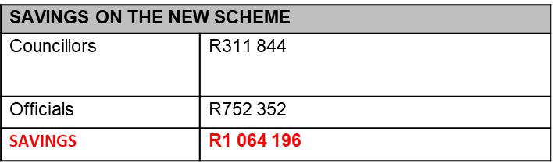
FINANCIAL RECOVERY PLAN SUMMARY
OTHER ACTIVITIES:
  Abolished dual-benefit of cellphone allowance for Councillors and Officials
  Revenue Collection Drive
    Profile indigent
    Over 31 000 indigent household register in 2019/20 compared to 5 000 indigent households registered previously
    In house debt collection Call Centre not fully operational
  Entered into payment arrangements with creditors.

Slide 54
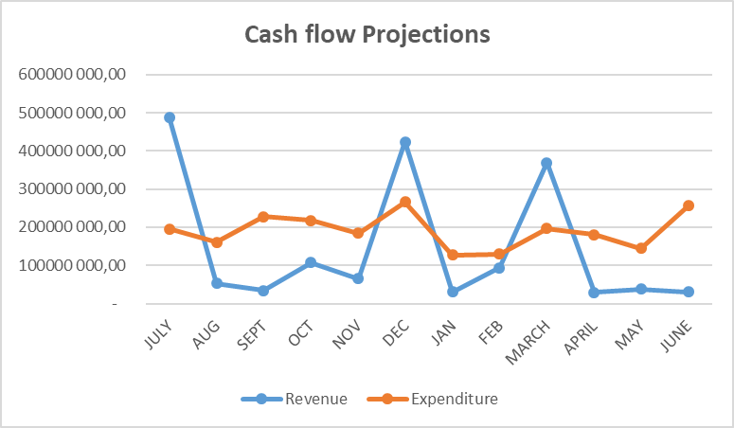
CASHFLOW PROJECTIONS
Progress on Payment of Salaries for February 2021:
Revenue Enhancement Drive intensified with highest debtors
Engagements with Government departments and Businesses
Current Cash in Hand will cover Net Salaries for the month of February 2021 and not able to cover ALL 3rd Parties

Slide 55
IMPROVEMENT OF AUDIT OUTCOME: INTERVENTIONS UNDERTAKEN
AUDIT OUTCOME 2016/17 | AUDIT OUTCOME 2017/18 | AUDIT OUTCOME 2018/19
QUALIFIED WITH FINDINGS | QUALIFIED WITH FINDINGS | DISCLAIMED WITH FINDINGS
Weekly monitoring of the audit action plan implementation – chaired by the MM
Reconciled the populations for VAT from 2016/17 being the date of migration from the legacy system
Reconciled the populations for Debtors from 2016/17 being the date of migration from the legacy system
Reconciled the service charges and interest for both 2019/20 and 2018/19. Generated reports from SAP to support the amounts
Reconstructed the WIP register from 2015/16 the year that unqualified and no material adjustments
Reconciled the VIP inventory.
Monitored the cut-off of invoices to ensure that expenditure is recorded in the correct year.
Manually reconciled leave days for both 2019/20 and 2018/19

Slide 56
DIRECT AND INDIRECT COST IMPACT OF COE INCREASE
Budget deficit estimated R40m
Unfunded budget
Unable to pay suppliers, owe creditors R322m, implications
  a) non-compliance with Sec 65(2)(e) of MFMA, which is tantamount to financial misconduct
  b) suppliers will not want to do business with ADM, hence will be unable to render services to the community
  c) interest which is fruitless and wasteful expenditure
Unable to pay statutory obligations i.e. SARS which will incur penalties.
Unable to pay salaries (R60m per month) at all
Unable to fund capital projects from Internal Funding

Slide 57

WHAT COULD CAUSE THE COLLAPSE OF ADM
Non implementation of the MTAS and the Financial Recovery plan
Inability to increase collection and revenue base of ADM
Inability to curb the increasing CoE

Slide 58
SUPPORT TO LOCAL MUNICIPALITIES

Slide 59
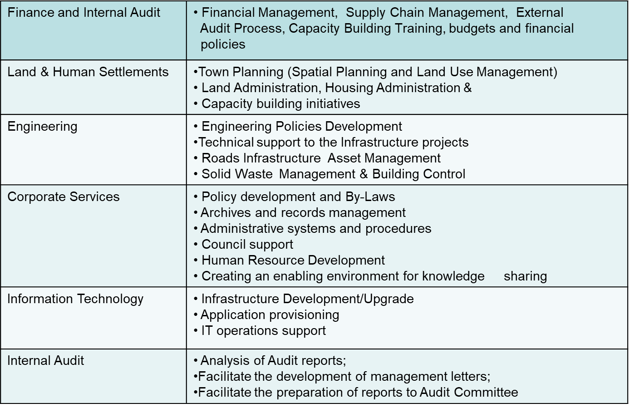
SUPPORT TO LOCAL MUNICIPALITIES
2005
Municipal Support Unit
2017
Reconfigured IGR Structures

Slide 60
SUPPORT TO LOCAL MUNICIPALITIES: ENGINNERING SERVICES
Training on road repair and resurfacing for technical staff at Local Municipalities, to reduce the outsourcing of the function and to build internal capacity;
Development infrastructure policies to provide guidelines in ensuring that the available limited resources (funds and human) for Building Control Services are utilised in an optimum;
Training on latest general condition of contracts for technical staff in the Local Municipalities, to ensure that clients are familiar with regard to the rights and obligations of all parties involved in doing business with government;
Supervisory training for technical staff in the Local Municipalities, to ensure that all the work is planned, organised and controlled properly;
Assisting engineering staff to register with ECSA, to be able to sign off some designs and be registered as professionals
Road Maintenance and resurfacing training for minor road projects to be implemented internally so as to reduce cost of outsourcing;
Infrastructure Management Plans to identify and analyse the existing Storm water and Access roads.
To set the day-to-day storm water operation and maintenance programs that are
consistent with the growth of the Local Municipality.

Slide 61
SUPPORT TO LOCAL MUNICIPALITIES: CORPORATE SERVICES
Facilitate the development of Employment Equity Plans, for submission to the department of Labor.
Worked with the Municipalities to develop and monitor a system for leasing and evaluation of Municipal properties.
Established systems and guidelines for records management (File Plans) and the plans were adopted by the the Provincial Archives.
Working with SALGA to conduct training of newly established Local Labor Forums.
Conducted Policy Development and Knowledge Management workshops for Local Municipalities;
Developed a District Corporate Services Municipal Framework.
Facilitated Training of councilors (ADM and LMs)on Governance Learnership.
Continuous Job Grading of Local municipalities championed by ADM.
Financial wellness workshop for Local Municipal Employees, development of Human Resources policies.

Slide 62
SUPPORT TO LOCAL MUNICIPALITIES: LAND AND HUMAN SETTLEMENTS
Establishment of the District Tribunal to facilitate the implementation of the Spatial Planning and Land Use Management Plans (SPLUMA);
Development of wall to wall land use schemes to align with the SPLUMA Guidelines;
Review of the District Spatial Development Framework Plan and working with Local Municipalities to ensure alignment with the Provincial and Local Municipal Plans;
Continuous review of the Human Settlements Sector Plans to adhere to the changing environment and the legislation requirements;
Development of the Land Management and disposal policy and the establishment of committees thereof;
Provide support in the processing of land use applications utilising the GIS shared services approach;

Slide 63
SUPPORT TO LOCAL MUNICIPALITIES: ICT & GIS
Assessment of the ICT Contracts for the following services:
- Internet
- VPN (Connectivity for municipal sites)
- Hosting of emails
In cases where contracts are coming to an end the Municipalities are assisted to determine the cost effective approach and offers in the market. Based on the analysis the terms of reference are developed for competitive procurement.
Support provided for the development of the IT Master Plans and other ICT policies to support the business
ADM has invested and deployed a fully functional GIS unit that also supports the local municipalities through a Shared Services model.
The cornerstone of a successful GIS implementation is in collaboration with town planning, land administration and development planning.
The major initiatives that have been completed and form a very strong base for this system are :
• Land Audit – physical land audit and verification of land parcels and ownership, including
property, was conducted and completed during the 2012/13 financial year thus covering
the whole district.
Furthermore there were corrections done on irregularities found and this meant continuous maintenance of the cadastral data that includes the ERF numbers with DEEDS data.
Property Base Workflow System – this system is a new system being rolled out to municipalities that was developed in 2014/15 financial year.

Slide 64
SUPPORT TO LOCAL MUNICIPALITIES: FINANCE, INTERNAL AUDIT AND RISK MANAGEMENT
Facilitated the Risk Champions workshop by SALGA for ADM and all local municipalities;
Assisted Municipalities with reviewing the Performance Management and SDBIP reports;
Development of the Terms of Reference for Risk Management Committees, Risk Management Plans and ensuring the sitting of the Risk Management Committees and the Internal Audit and Risk Forum;
Facilitate engagement with Provincial Treasury’s Transversal Risk Management and ADM Risk Manager to intensify support to LMs;
Supported internal audit units in preparations and conducting Audit Committee meetings
Review and Integrated of Indigent Policy and Registration
Debt Settlement arrangements between Local Municipalities and District
Integrated Collection Revenue Strategy
Debt write off of RDP Houses value of R121million

Slide 65
RECOMMENDATIONS

Slide 66
RECOMMENDATIONS (1)
IMMEDIATE POLITICAL INTERVENTIONS REQUESTED:
Department of Water and Sanitation:
  Settlement of Historical Debt of Amatola Water Board (R141m)
  Settlement of Historical Debt of DWS (R50m)
  Funding of Operations and Maintainace of Water and Sanitation Infrastructure (R434m)
  Lobbying for Funding of the Sustainable Water Solution (R12.06b ) by PICC, DBSA and NT
  Sustainable Bulk Waste Water Treatment Works Solutions, requiring R1.9b
  Waste Water Treatment Works Infrastructure Maintenance (R64.4 million)
  Waste Water Treatment Works Infrastructure Refurbishment (R26.5 million)
National/Provincial COGTA:
  Provincial support in securing the R944m for ADM Business Plans targeting Drought Relief
  Support funding application of the Mutual Separation Agreement (MSA) initiative (R150m)
  Funding the development of Ward Profiles and Ward Based plans
  Raymond Mhlaba Post Amalgamation Support
    Provision of support for ESKOM Debt

Slide 67
RECOMMENDATIONS (2)
IMMEDIATE POLITICAL INTERVENTIONS REQUESTED:
Department of Human Settlements:
  Consider the inclusion of Disaster Relief Response Backlogs into Destitute Programme
  Addressing the Housing Backlogs
Department of Roads and Transport
  Support to source funding for the surfacing of Provincial and Access Road Network
Department of Public Works
  Transfer of properties for development purposes in line with Post Covid 19 Economic Response Plans
Office of the Premier
  Consistent representation of sector departments in IGR Structures and JOCs
  Effective functioning of Ward War Rooms.
  Lobbying for Funding of the Sustainable Water Solutions (R12.06 b) and Upgrade and Surfacing of Provincial and Access Road Network (R11.8b) by PICC, DBSA and National Treasury
National/Provincial Treasury
  Implementation of MSCOA Version 6.4
  Approval of funding application for the Mutual Separation Agreement (MSA) initiative (R150m)
  Approval of funding application for surfacing of Provincial and Access Road Network through the BFI (R11.8b)

Slide 68

“Bringing ADM Back To Its Former Glory”

