Slide 1
POLICE RECORDED
CRIME STATISTICS
REPUBLIC OF SOUTH AFRICA
3RD QUARTER OF 2020/2021 FINANCIAL YEAR
(OCTOBER TO DECEMBER 2020_21)

Slide 2
RSA : Crime Situation
CRIME CATEGORY | Oct to Dec 2016_17 | Oct to Dec 2017_18 | Oct to Dec 2018_19 | Oct to Dec 2019_20 | Oct to Dec 2020_21 | Case Diff | % Change
CONTACT CRIMES ( CRIMES AGAINST THE PERSON)
Murder | 5 549 | 5 691 | 5 918 | 5 908 | 6 297 | 389 | 6,6%
Sexual Offences | 14 193 | 14 436 | 15 130 | 15 325 | 15 595 | 270 | 1,8%
Attempted murder | 4 927 | 4 826 | 5 060 | 5 014 | 5 452 | 438 | 8,7%
Assault with the intent to inflict grievous bodily harm | 50 907 | 49 154 | 50 583 | 49 428 | 50 124 | 696 | 1,4%
Common assault | 43 631 | 43 789 | 45 660 | 47 599 | 47 875 | 276 | 0,6%
Common robbery | 13 859 | 13 504 | 13 722 | 13 531 | 11 822 | -1 709 | -12,6%
Robbery with aggravating circumstances | 36 283 | 36 243 | 36 348 | 37 352 | 34 599 | -2 753 | -7,4%
Total Contact Crimes ( Crimes Against The Person) | 169 349 | 167 643 | 172 421 | 174 157 | 171 764 | -2 393 | -1,4%
TOTAL SEXUAL OFFENCES
Rape | 11 357 | 11 545 | 12 068 | 12 037 | 12 218 | 181 | 1,5%
Sexual Assault | 1 805 | 1 978 | 2 117 | 2 288 | 2 390 | 102 | 4,5%
Attempted Sexual Offences | 623 | 588 | 604 | 639 | 625 | -14 | -2,2%
Contact Sexual Offences | 408 | 325 | 341 | 361 | 362 | 1 | 0,3%
Total Sexual Offences | 14 193 | 14 436 | 15 130 | 15 325 | 15 595 | 270 | 1,8%
SOME SUBCATEGORIES OF AGGRAVATED ROBBERY
Carjacking | 4 314 | 4 153 | 3 929 | 4 462 | 4 794 | 332 | 7,4%
Robbery at residential premises | 5 935 | 5 956 | 5 970 | 5 704 | 5 781 | 77 | 1,3%
Robbery at non-residential premises | 5 219 | 5 368 | 5 314 | 5 426 | 5 052 | -374 | -6,9%
Robbery of cash in transit ** | 45 | 62 | 35 | 39 | 65 | 26
Bank robbery | 0 | 6 | 1 | 0 | 0 | 0 | 0 Cases
Truck hijacking | 324 | 339 | 312 | 325 | 436 | 111 | 34,2%
** Percentage change above 50%

Slide 3
RSA : Crime Situation per Ratios
Actual figures
CRIME CATEGORY | Oct to Dec 2016_17 | Oct to Dec 2017_18 | Oct to Dec 2018_19 | Oct to Dec 2019_20 | Oct to Dec 2020_21
CONTACT CRIMES ( CRIMES AGAINST THE PERSON)
Murder | 5 549 | 5 691 | 5 918 | 5 908 | 6 297
Rape | 11 357 | 11 545 | 12 068 | 12 037 | 12 218
Attempted murder | 4 927 | 4 826 | 5 060 | 5 014 | 5 452
Assault with the intent to inflict grievous bodily harm | 50 907 | 49 154 | 50 583 | 49 428 | 50 124
Common assault | 43 631 | 43 789 | 45 660 | 47 599 | 47 875
Common robbery | 13 859 | 13 504 | 13 722 | 13 531 | 11 822
Per capita (*Ratio per 100 000 of the population)
CRIME CATEGORY | Oct to Dec 2016_17 | Oct to Dec 2017_18 | Oct to Dec 2018_19 | Oct to Dec 2019_20 | Oct to Dec 2020_21
CONTACT CRIMES ( CRIMES AGAINST THE PERSON)
Murder | 9,9 | 10,0 | 10,2 | 10,0 | 10,5
Rape | 20,3 | 20,3 | 20,9 | 20,5 | 20,4
Attempted murder | 8,8 | 8,5 | 8,8 | 8,5 | 9,1
Assault with the intent to inflict grievous bodily harm | 91,0 | 86,4 | 87,5 | 84,1 | 83,8
Common assault | 78,0 | 77,0 | 79,0 | 80,9 | 80,0
Common robbery | 24,8 | 23,7 | 23,7 | 23,0 | 19,8
Stats SA - Population figures (2017 Series)

Slide 4
RSA : Crime Situation
CRIME CATEGORY | Oct to Dec 2016_17 | Oct to Dec 2017_18 | Oct to Dec 2018_19 | Oct to Dec 2019_20 | Oct to Dec 2020_21 | Case Diff | % Change
CONTACT-RELATED CRIMES
Arson | 1 205 | 1 047 | 1 142 | 999 | 957 | -42 | -4,2%
Malicious damage to property | 31 731 | 30 391 | 31 132 | 29 598 | 30 032 | 434 | 1,5%
Total Contact-Related Crimes | 32 936 | 31 438 | 32 274 | 30 597 | 30 989 | 392 | 1,3%
PROPERTY-RELATED CRIMES
Burglary at non-residential premises | 18 735 | 18 100 | 18 124 | 17 179 | 15 550 | -1 629 | -9,5%
Burglary at residential premises | 61 878 | 57 797 | 56 088 | 51 737 | 42 834 | -8 903 | -17,2%
Theft of motor vehicle and motorcycle | 13 150 | 12 577 | 12 115 | 11 772 | 10 099 | -1 673 | -14,2%
Theft out of or from motor vehicle | 33 636 | 32 282 | 30 735 | 28 458 | 22 697 | -5 761 | -20,2%
Stock-theft | 7 704 | 8 739 | 8 948 | 8 437 | 7 854 | -583 | -6,9%
Total Property-Related Crimes | 135 103 | 129 495 | 126 010 | 117 583 | 99 034 | -18 549 | -15,8%
OTHER SERIOUS CRIMES
All theft not mentioned elsewhere | 81 642 | 77 754 | 77 833 | 71 509 | 62 195 | -9 314 | -13,0%
Commercial crime | 18 929 | 18 665 | 20 659 | 21 725 | 23 428 | 1 703 | 7,8%
Shoplifting | 16 391 | 15 375 | 14 933 | 14 533 | 12 308 | -2 225 | -15,3%
Total Other Serious Crimes | 116 962 | 111 794 | 113 425 | 107 767 | 97 931 | -9 836 | -9,1%
Total 17 Community Reported Serious Crimes | 454 350 | 440 370 | 444 130 | 430 104 | 399 718 | -30 386 | -7,1%
CRIME DETECTED AS A RESULT OF POLICE ACTION
Illegal possession of firearms and ammunition | 4 139 | 4 621 | 3 691 | 4 114 | 3 353 | -761 | -18,5%
Drug-related crime | 72 697 | 82 680 | 34 939 | 41 520 | 37 546 | -3 974 | -9,6%
Driving under the influence of alcohol or drugs | 21 114 | 23 326 | 21 907 | 27 011 | 16 259 | -10 752 | -39,8%
Sexual Offences detected as a result of police action | 1 416 | 1 631 | 1 996 | 2 515 | 2 642 | 127 | 5,0%
Total Crime Detected As A Result Of Police Action | 99 366 | 112 258 | 62 533 | 75 160 | 59 800 | -15 360 | -20,4%

Slide 5
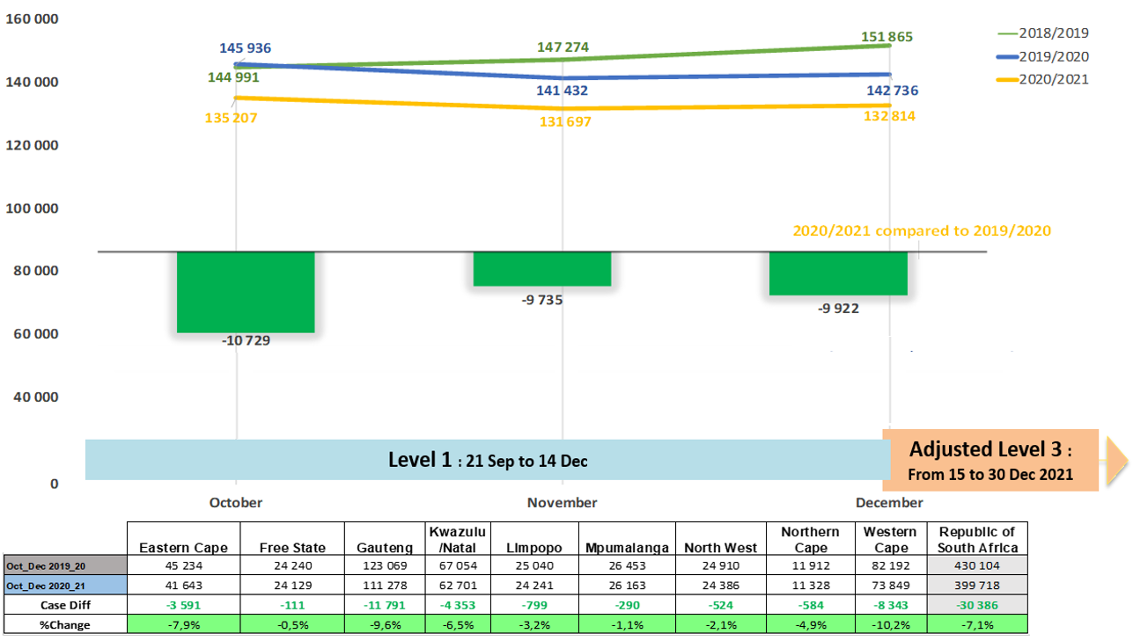
17 Community Reported Serious Crime

Slide 6
17 Community Reported Serious Crime: TOP 30 STATIONS
Position | Station | Province | October to December 2016_17 | October to December 2017_18 | October to December 2018_19 | October to December 2019_20 | October to December 2020_21 | Case Diff | % Change
1 | HONEYDEW | GAUTENG | 2 642 | 2 648 | 2 525 | 2 711 | 2 381 | -330 | -12,2%
2 | PARK ROAD | FREE STATE | 2 682 | 2 367 | 2 849 | 2 372 | 2 136 | -236 | -9,9%
3 | JHB CENTRAL | GAUTENG | 3 415 | 3 158 | 3 101 | 2 697 | 2 067 | -630 | -23,4%
4 | DURBAN CENTRAL | KWAZULU/NATAL | 2 902 | 2 671 | 2 588 | 2 396 | 1 947 | -449 | -18,7%
5 | MITCHELLS PLAIN | WESTERN CAPE | 3 220 | 2 929 | 2 936 | 2 778 | 1 918 | -860 | -31,0%
6 | WITBANK | MPUMALANGA | 2 357 | 2 354 | 2 264 | 2 062 | 1 852 | -210 | -10,2%
7 | CAPE TOWN CENTRAL | WESTERN CAPE | 4 065 | 4 052 | 3 503 | 3 328 | 1 790 | -1 538 | -46,2%
8 | KRAAIFONTEIN | WESTERN CAPE | 1 941 | 2 005 | 1 881 | 1 737 | 1 777 | 40 | 2,3%
9 | TEMBA | GAUTENG | 1 831 | 1 720 | 1 625 | 1 770 | 1 755 | -15 | -0,8%
10 | PLESSISLAER | KWAZULU/NATAL | 1 606 | 1 754 | 1 791 | 1 787 | 1 717 | -70 | -3,9%
11 | DELFT | WESTERN CAPE | 1 358 | 1 869 | 1 875 | 1 930 | 1 714 | -216 | -11,2%
12 | TEMBISA | GAUTENG | 1 345 | 1 581 | 1 523 | 1 929 | 1 714 | -215 | -11,1%
13 | PRETORIA CENTRAL | GAUTENG | 2 403 | 2 313 | 2 400 | 1 877 | 1 689 | -188 | -10,0%
14 | RUSTENBURG | NORTH WEST | 2 264 | 2 222 | 1 821 | 1 925 | 1 681 | -244 | -12,7%
15 | PINETOWN | KWAZULU/NATAL | 2 085 | 1 924 | 1 666 | 1 836 | 1 656 | -180 | -9,8%
16 | MFULENI | WESTERN CAPE | 1 382 | 1 527 | 1 631 | 1 604 | 1 656 | 52 | 3,2%
17 | BROOKLYN | GAUTENG | 1 918 | 1 597 | 1 671 | 1 712 | 1 621 | -91 | -5,3%
18 | RANDFONTEIN | GAUTENG | 1 886 | 1 710 | 1 750 | 1 688 | 1 616 | -72 | -4,3%
19 | HILLBROW | GAUTENG | 2 327 | 2 205 | 2 152 | 2 013 | 1 604 | -409 | -20,3%
20 | SUNNYSIDE | GAUTENG | 1 869 | 1 772 | 2 115 | 1 692 | 1 596 | -96 | -5,7%
21 | EMPANGENI | KWAZULU/NATAL | 1 562 | 1 619 | 1 572 | 1 517 | 1 595 | 78 | 5,1%
22 | MIDRAND | GAUTENG | 1 923 | 1 833 | 1 695 | 1 789 | 1 589 | -200 | -11,2%
23 | NYANGA | WESTERN CAPE | 2 126 | 2 261 | 2 028 | 1 516 | 1 563 | 47 | 3,1%
24 | IVORY PARK | GAUTENG | 1 722 | 1 537 | 1 497 | 1 462 | 1 560 | 98 | 6,7%
25 | AKASIA | GAUTENG | 1 658 | 1 570 | 1 552 | 1 662 | 1 536 | -126 | -7,6%
26 | NELSPRUIT | MPUMALANGA | 1 706 | 1 537 | 1 612 | 1 459 | 1 515 | 56 | 3,8%
27 | WORCESTER | WESTERN CAPE | 2 068 | 1 850 | 1 679 | 1 645 | 1 508 | -137 | -8,3%
28 | KIMBERLEY | NORTHERN CAPE | 1 873 | 1 707 | 1 889 | 1 721 | 1 497 | -224 | -13,0%
29 | KWADUKUZA | KWAZULU/NATAL | 1 540 | 1 477 | 1 400 | 1 384 | 1 486 | 102 | 7,4%
30 | MAMELODI EAST | GAUTENG | 1 333 | 1 444 | 1 609 | 1 673 | 1 470 | -203 | -12,1%

Slide 7
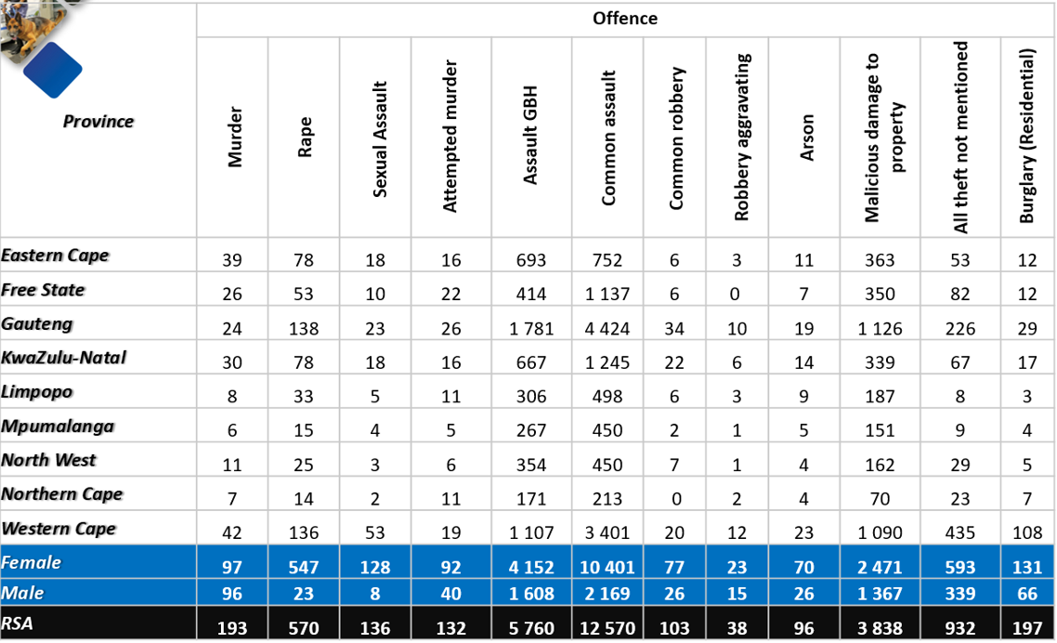
Selected Domestic Violence-related Crimes :
Oct to Dec 2020_2021
By Provincial Breakdown and Sex

Slide 8
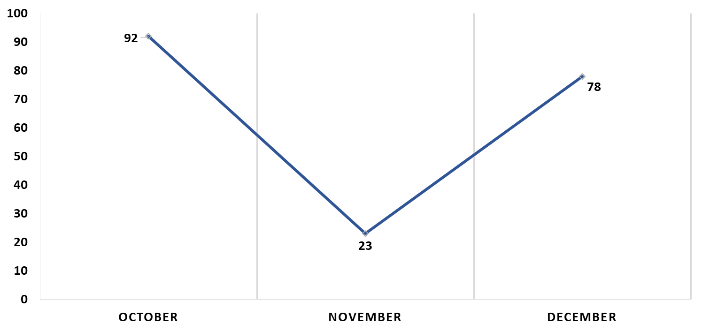
Domestic Violence-related Murders :
Oct to Dec 2020_2021
 | Eastern Cape | Free State | Gauteng | Kwazulu/Natal | Limpopo | Mpumalanga | North West | Northern Cape | Western Cape | Republic of South Africa
October | 19 | 14 | 9 | 10 | 5 | 6 | 5 | 4 | 20 | 92
November | 4 | 4 | 3 | 1 | 3 | 0 | 1 | 0 | 7 | 23
December | 16 | 8 | 12 | 19 | 0 | 0 | 5 | 3 | 15 | 78
October to December | 39 | 26 | 24 | 30 | 8 | 6 | 11 | 7 | 42 | 193

Slide 9
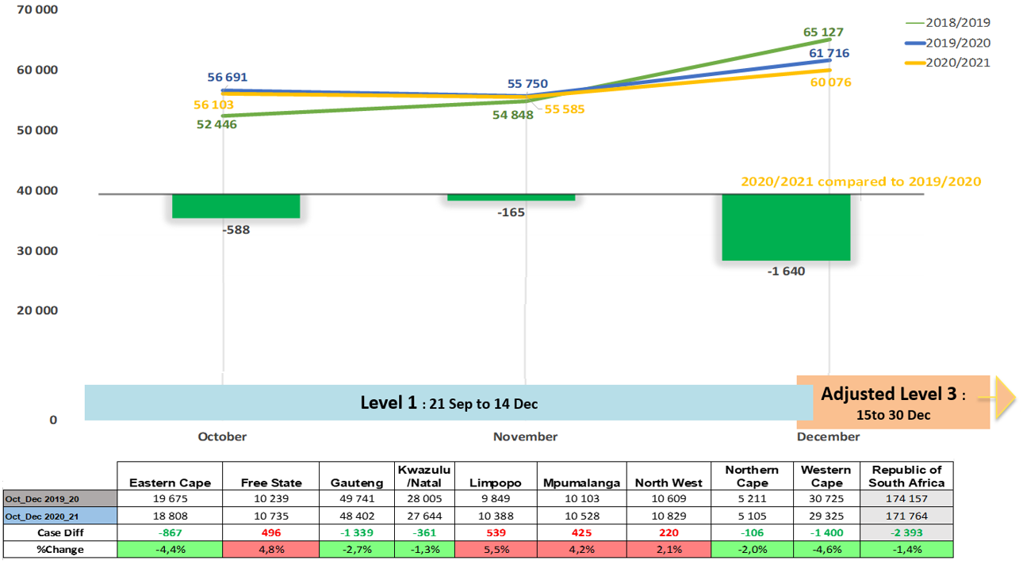
Contact Crime

Slide 10
Contact Crime: TOP 30 STATIONS
Position | Station | Province | October to December 2016_17 | October to December 2017_18 | October to December 2018_19 | October to December 2019_20 | October to December 2020_21 | Case Diff | % Change
1 | NYANGA | WESTERN CAPE | 1 331 | 1 339 | 1 190 | 926 | 1 089 | 163 | 17,6%
2 | KHAYELITSHA | WESTERN CAPE | 946 | 873 | 978 | 940 | 1 034 | 94 | 10,0%
3 | TEMBISA | GAUTENG | 636 | 769 | 715 | 1 075 | 1 033 | -42 | -3,9%
4 | HILLBROW | GAUTENG | 1 133 | 1 104 | 1 247 | 1 138 | 1 027 | -111 | -9,8%
5 | JHB CENTRAL | GAUTENG | 1 409 | 1 433 | 1 413 | 1 209 | 1 022 | -187 | -15,5%
6 | DELFT | WESTERN CAPE | 665 | 937 | 1 005 | 960 | 1 004 | 44 | 4,6%
7 | TEMBA | GAUTENG | 884 | 843 | 836 | 967 | 984 | 17 | 1,8%
8 | PLESSISLAER | KWAZULU/NATAL | 749 | 777 | 852 | 877 | 938 | 61 | 7,0%
9 | IVORY PARK | GAUTENG | 854 | 832 | 837 | 740 | 935 | 195 | 26,4%
10 | MFULENI | WESTERN CAPE | 668 | 747 | 791 | 855 | 914 | 59 | 6,9%
11 | UMLAZI | KWAZULU/NATAL | 930 | 941 | 912 | 961 | 904 | -57 | -5,9%
12 | ALEXANDRA | GAUTENG | 687 | 784 | 861 | 875 | 878 | 3 | 0,3%
13 | HONEYDEW | GAUTENG | 828 | 793 | 790 | 879 | 876 | -3 | -0,3%
14 | MAMELODI EAST | GAUTENG | 697 | 728 | 849 | 950 | 868 | -82 | -8,6%
15 | INANDA | KWAZULU/NATAL | 870 | 914 | 859 | 939 | 848 | -91 | -9,7%
16 | KRAAIFONTEIN | WESTERN CAPE | 778 | 803 | 822 | 806 | 827 | 21 | 2,6%
17 | MITCHELLS PLAIN | WESTERN CAPE | 1 219 | 1 140 | 1 175 | 1 127 | 809 | -318 | -28,2%
18 | KAGISO | GAUTENG | 1 036 | 963 | 870 | 782 | 747 | -35 | -4,5%
19 | RANDFONTEIN | GAUTENG | 712 | 709 | 741 | 787 | 728 | -59 | -7,5%
20 | HARARE | WESTERN CAPE | 652 | 637 | 654 | 696 | 728 | 32 | 4,6%
21 | JEPPE | GAUTENG | 793 | 759 | 732 | 774 | 724 | -50 | -6,5%
22 | EMPANGENI | KWAZULU/NATAL | 648 | 677 | 646 | 628 | 716 | 88 | 14,0%
23 | DIEPSLOOT | GAUTENG | 719 | 649 | 625 | 763 | 716 | -47 | -6,2%
24 | ELDORADO PARK | GAUTENG | 604 | 577 | 686 | 812 | 714 | -98 | -12,1%
25 | KWADUKUZA | KWAZULU/NATAL | 655 | 578 | 592 | 608 | 668 | 60 | 9,9%
26 | RIETGAT | GAUTENG | 618 | 642 | 673 | 855 | 667 | -188 | -22,0%
27 | DOBSONVILLE | GAUTENG | 904 | 958 | 987 | 1 056 | 666 | -390 | -36,9%
28 | AKASIA | GAUTENG | 593 | 581 | 587 | 577 | 664 | 87 | 15,1%
29 | MADADENI | KWAZULU/NATAL | 569 | 550 | 493 | 521 | 661 | 140 | 26,9%
30 | MOROKA | GAUTENG | 925 | 793 | 792 | 735 | 654 | -81 | -11,0%

Slide 11
Selected Causative Factors:
Murder, Attempted Murder and Assault GBH:
Oct to Dec 2020/2021
Causative factors | Murder | Attempted murder | Assault GBH
Arguments/Misunderstanding (not domestic-related)/Road Rage/Provocation | 991 | 1 441 | 12 831
Retaliation/Revenge | 170 | 211 | 3 748
Robbery (house/ business/street) | 293 | 675 | 731
Gang-related | 250 | 378 | 76
Vigilantism/Mob justice | 264 | 48 | 345
Law enforcement & security guards in line of duty (excl. police murder) | 8 | 228 | 149
Intervention in a fight | 10 | 28 | 471
Taxi-related | 89 | 55 | 65
Rape-related | 57 | 12 | 454
During commission of another offence - (not robbery or rape) | 18 | 111 | 83
Illicit mining | 16 | 14 | 3
Carjacking/attempted | 18 | 88 | 4
Sample size: murder = 5 773 counts, attempted murder = 4 900, assault GBH = 34 132

Slide 12
Place of Occurrence:
Some Categories of Contact Crime
Oct to Dec 2020/2021
Place of occurrence | Murder | Attempted murder | Assault GBH
Residences of perpetrator/victim (including residence known by victims/ perpetrator e.g. family/friends/neighbours) | 1 643 | 1 267 | 11 896
Public place e.g. street/open field/recreational centre/park/beach/parking area/abandoned building | 2 481 | 1 935 | 8 741
Business premises (e.g. mall/restaurants/work place/office park/entertainment centre e.g. movie theatre, gambling facility | 136 | 233 | 996
Liquor outlets e.g. shebeen /tavern/pub/night club/bottle store | 399 | 167 | 4 488
Agricultural land/farm/plot/small holding | 86 | 49 | 312
Mode of transport e.g. bus/car/plane/boat/ship/taxi | 205 | 495 | 799
Prison/holding cells | 4 | 7 | 146
Sea/river/lake/pool/dam | 36 | 7 | 151
Educational institutions (schools, universities, college, day care facilities) | 7 | 11 | 89
Petrol station | 12 | 25 | 68
Public transport premises (Bus stop/taxi rank, Railway premises e.g. track/station) | 75 | 42 | 578
Mining area | 20 | 18 | 8
Leisure premises e.g. Hotel/guest house/BnB/motel/holiday resort | 15 | 10 | 37
Dumping site | 5 | 2 | 3
Tuckshop | 27 | 21 | 31
Sample Size: Murder = 5 773 Counts, Attempted Murder = 4 900, Assault GBH = 34 132

Slide 13
Contact Crime: Liquor and Drug-related Offences: Oct to Dec 2020/2021
Confirmed incidents occurred at Liquor Outlets (Tavern/shebeen/pub/bar/night clubs etc.)
Assault GBH = 4 488
Rape = 44
Murder = 399
Attempted murder = 167

Slide 14
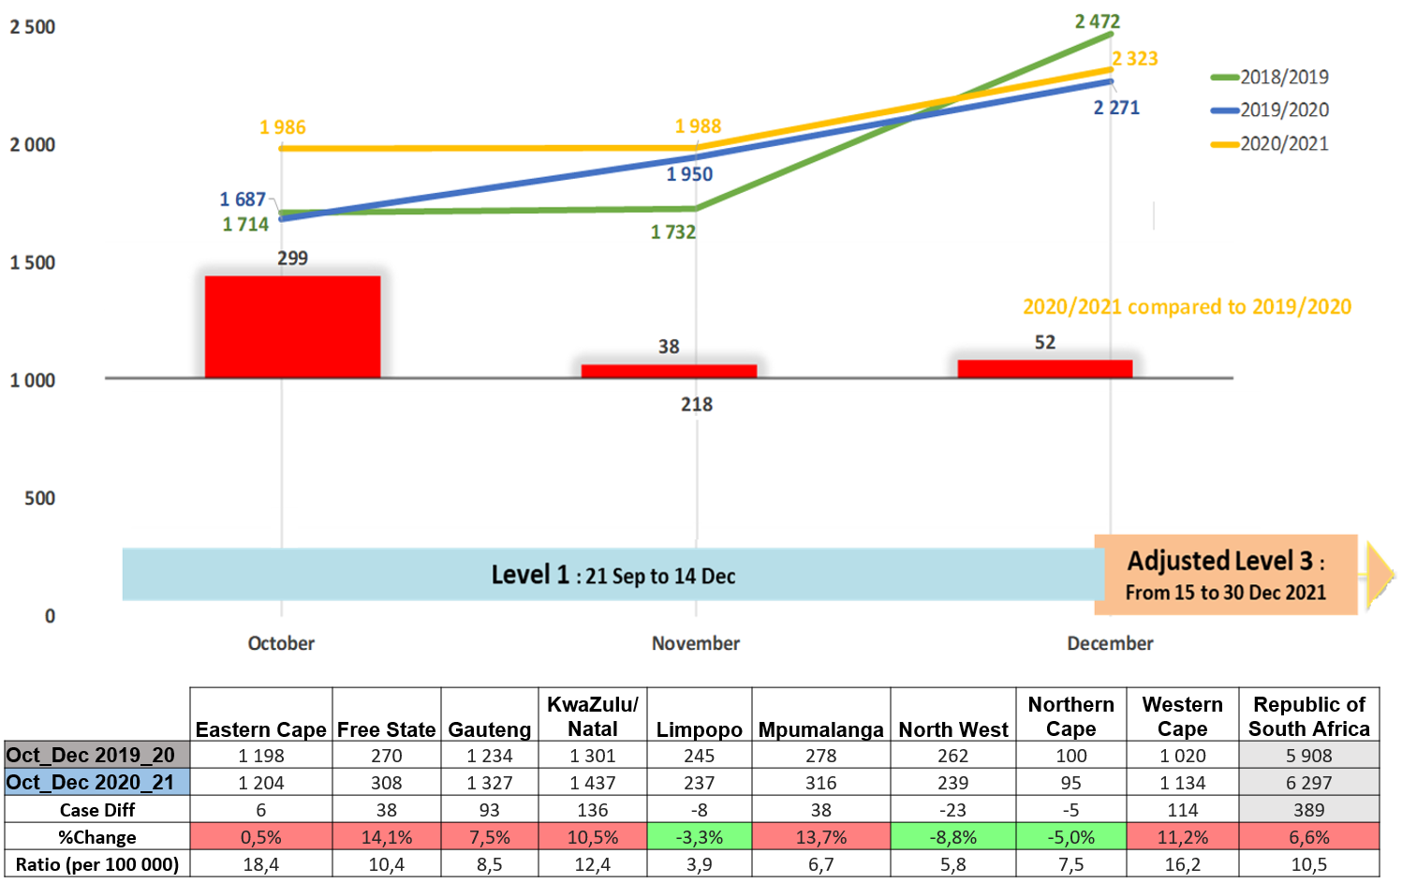
Murder

Slide 15
MURDER: TOP 30 STATIONS
Position | Station | Province | October to December 2016_17 | October to December 2017_18 | October to December 2018_19 | October to December 2019_20 | October to December 2020_21 | Case Diff
1 | KRAAIFONTEIN | WESTERN CAPE | 32 | 53 | 34 | 42 | 84 | 42
2 | DELFT | WESTERN CAPE | 36 | 62 | 65 | 77 | 80 | 3
3 | UMLAZI | KWAZULU/NATAL | 51 | 65 | 47 | 65 | 74 | 9
4 | INANDA | KWAZULU/NATAL | 55 | 61 | 56 | 70 | 66 | -4
5 | NYANGA | WESTERN CAPE | 79 | 75 | 72 | 46 | 58 | 12
6 | KHAYELITSHA | WESTERN CAPE | 51 | 56 | 70 | 47 | 57 | 10
7 | PLESSISLAER | KWAZULU/NATAL | 39 | 25 | 45 | 32 | 57 | 25
8 | HARARE | WESTERN CAPE | 46 | 35 | 53 | 25 | 55 | 30
9 | PHILIPPI EAST | WESTERN CAPE | 49 | 32 | 55 | 44 | 49 | 5
10 | MFULENI | WESTERN CAPE | 43 | 47 | 37 | 35 | 49 | 14
11 | MTHATHA | EASTERN CAPE | 36 | 42 | 58 | 50 | 48 | -2
12 | GUGULETHU | WESTERN CAPE | 35 | 41 | 35 | 53 | 47 | -6
13 | BETHELSDORP | EASTERN CAPE | 39 | 33 | 44 | 40 | 45 | 5
14 | LUSIKISIKI | EASTERN CAPE | 22 | 29 | 53 | 31 | 41 | 10
15 | MANENBERG | WESTERN CAPE | 11 | 23 | 14 | 9 | 37 | 28
16 | KAGISO | GAUTENG | 30 | 18 | 31 | 40 | 33 | -7
17 | IVORY PARK | GAUTENG | 42 | 31 | 32 | 27 | 33 | 6
18 | KWAMASHU E | KWAZULU/NATAL | 29 | 37 | 32 | 21 | 33 | 12
19 | RAVENSMEAD | WESTERN CAPE | 18 | 15 | 26 | 23 | 32 | 9
20 | SAMORA MACHEL | WESTERN CAPE | 0 | 0 | 11 | 15 | 31 | 16
21 | KWAZAKELE | EASTERN CAPE | 25 | 29 | 28 | 25 | 31 | 6
22 | ESIKHALENI | KWAZULU/NATAL | 9 | 10 | 27 | 13 | 30 | 17
23 | COFIMVABA | EASTERN CAPE | 22 | 29 | 22 | 21 | 29 | 8
24 | ELDORADO PARK | GAUTENG | 17 | 10 | 19 | 20 | 29 | 9
25 | DUTYWA | EASTERN CAPE | 16 | 21 | 26 | 14 | 29 | 15
26 | LENASIA | GAUTENG | 8 | 10 | 17 | 9 | 29 | 20
27 | NGQELENI | EASTERN CAPE | 28 | 31 | 27 | 19 | 28 | 9
28 | ATTERIDGEVILLE | GAUTENG | 16 | 17 | 12 | 16 | 28 | 12
29 | JHB CENTRAL | GAUTENG | 25 | 30 | 30 | 24 | 28 | 4
30 | WILLOWVALE | EASTERN CAPE | 36 | 19 | 25 | 27 | 28 | 1

Slide 16
Murder: Motive/Causative Factors
Oct to Dec 2020/2021
Murder causative factors | EC | FS | GP | KZN | LP | MP | NW | NC | WC | RSA
Arguments/ Misunderstanding (not related to domestic) / Road Rage / Provocation | 30 | 80 | 229 | 368 | 45 | 23 | 9 | 44 | 163 | 991
Robbery (house/ Business/ Street) | 14 | 17 | 104 | 73 | 12 | 8 | 9 | 1 | 55 | 293
Vigilantism / Mob justice | 14 | 10 | 54 | 66 | 27 | 35 | 5 | 2 | 51 | 264
Gang-related | 42 | 7 | 10 | 3 | 0 | 0 | 1 | 0 | 187 | 250
Retaliation / Revenge | 4 | 2 | 11 | 5 | 11 | 6 | 1 | 1 | 129 | 170
Taxi-related | 2 | 0 | 34 | 25 | 0 | 0 | 0 | 0 | 28 | 89
Rape-related | 39 | 0 | 4 | 8 | 2 | 1 | 0 | 0 | 3 | 57
Law enforcement & security guards in line of duty (excluding police murder) | 2 | 1 | 2 | 2 | 0 | 0 | 1 | 0 | 0 | 8
Illicit mining | 0 | 0 | 12 | 0 | 0 | 0 | 2 | 2 | 0 | 16
Carjacking | 0 | 1 | 0 | 5 | 2 | 3 | 0 | 0 | 7 | 18
During commission of other crime (Not Robbery and Rape) | 0 | 3 | 0 | 0 | 4 | 11 | 0 | 0 | 0 | 18
Intervened in argument | 0 | 0 | 0 | 3 | 1 | 0 | 0 | 0 | 6 | 10
Sample size: murder = 5 773

Slide 17
Murder of Members of the Police :
On/Off Duty: Oct to Dec 2020/2021
Over Three-year Period
2020/2021 | Eastern Cape | Free State | Gauteng | KwaZulu-Natal | Limpopo | North West | Western Cape | RSA
On duty | 0 | 0 | 1 | 2 | 1 | 1 | 0 | 5
Off duty | 2 | 3 | 1 | 2 | 0 | 0 | 4 | 12
Stationed at | Eastern Cape | Free State | Gauteng | Head Office | KwaZulu-Natal | Limpopo | Mpumalanga | North West | Western Cape | RSA
2019/2020 | 5 | 0 | 4 | 1 | 6 | 2 | 1 | 0 | 3 | 22
2020/2021 | 2 | 3 | 2 | 0 | 4 | 1 | 0 | 1 | 4 | 17
Counts difference | -3 | 3 | -2 | -1 | -2 | -1 | -1 | 1 | 1 | -5

Slide 18
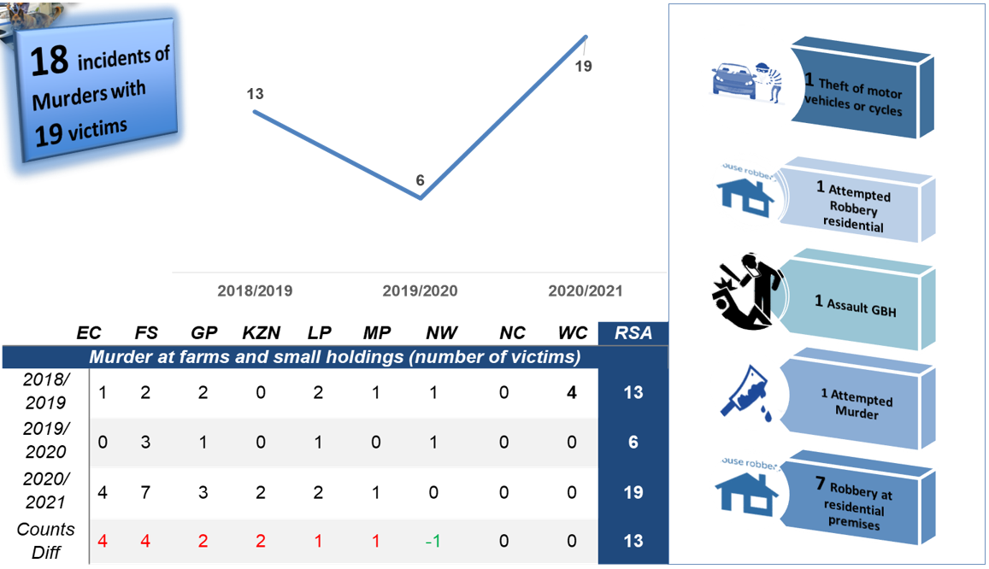
Murders of Farming Community
Oct to Dec 2020/2021
Over Three-year Period

Slide 19
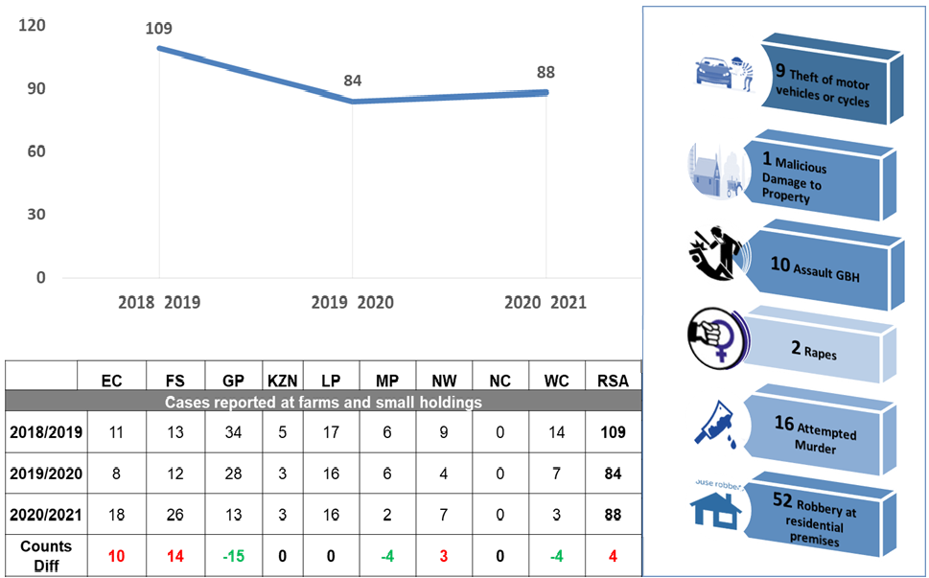
Attacks On Farms And Small Holdings:
All Incidents (Including Murder):
Oct to Dec 2020/2021
109 counts in 88 incidents

Slide 20
Farm dwellers/workers attacked by farmers/farm management: Selected Contact Crime:
Oct to Dec 2020/2021
1 Attempted Murder
17 Assault comonm
1 sexual assault
4 Assault GBH
3 Murder
Counts of offences (26)
26 Contact Crimes incidents recorded: Oct to Dec 2020
Crime committed | EC | FS | GP | KZN | LP | MP | NW | WC | Total
Assault GBH | 1 | 1 | 0 | 1 | 1 | 0 | 0 | 0 | 4
Attempted murder | 0 | 0 | 0 | 0 | 0 | 0 | 0 | 1 | 1
Common assault | 0 | 9 | 0 | 1 | 2 | 2 | 0 | 3 | 17
Murder | 0 | 1 | 0 | 0 | 0 | 0 | 2 | 0 | 3
Sexual assault | 0 | 0 | 1 | 0 | 0 | 0 | 0 | 0 | 1
Total | 1 | 11 | 1 | 2 | 3 | 2 | 2 | 4 | 26

Slide 21
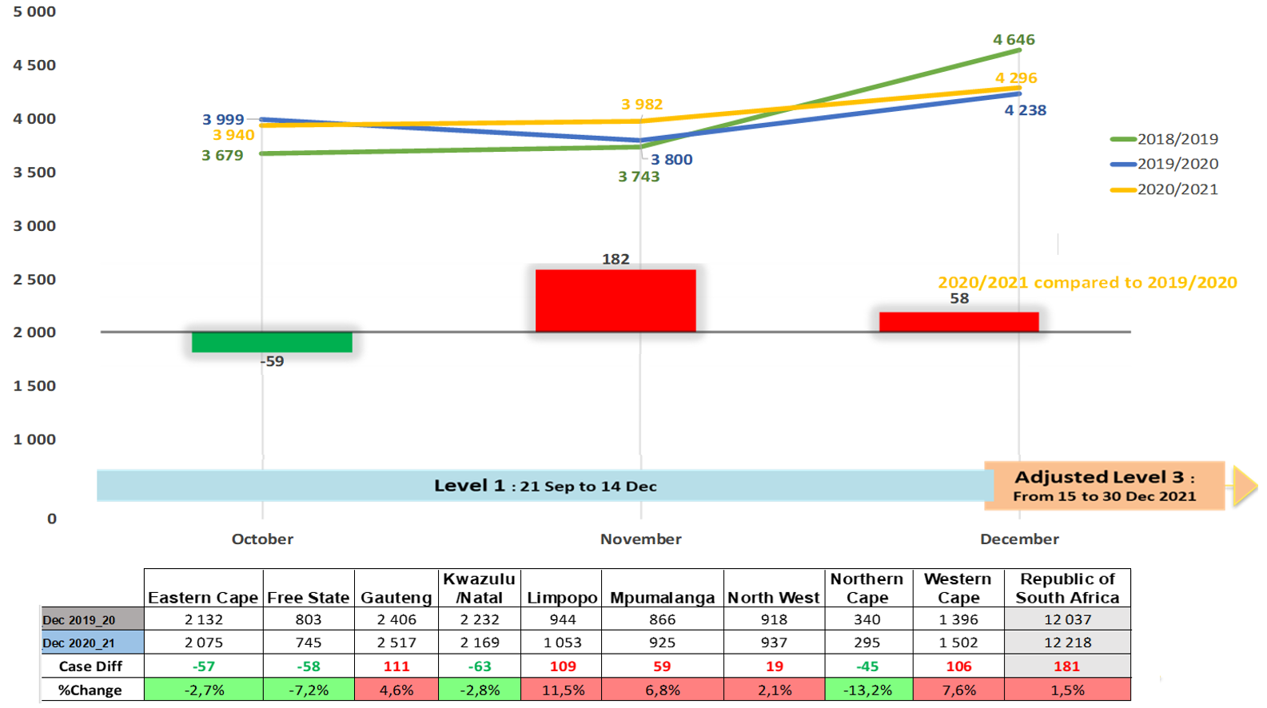
Rape

Slide 22
RAPE: TOP 30 STATIONS
Position | Station | Province | October to December 2016_17 | October to December 2017_18 | October to December 2018_19 | October to December 2019_20 | October to December 2020_21 | Case Diff
1 | INANDA | KWAZULU/NATAL | 102 | 92 | 107 | 83 | 85 | 2
2 | LUSIKISIKI | EASTERN CAPE | 35 | 53 | 77 | 43 | 71 | 28
3 | UMLAZI | KWAZULU/NATAL | 76 | 77 | 87 | 66 | 69 | 3
4 | MANKWENG | LIMPOPO | 54 | 47 | 50 | 37 | 69 | 32
5 | MTHATHA | EASTERN CAPE | 60 | 76 | 76 | 75 | 69 | -6
6 | TEMBA | GAUTENG | 60 | 52 | 47 | 47 | 66 | 19
7 | HARARE | WESTERN CAPE | 34 | 41 | 45 | 51 | 63 | 12
8 | THOHOYANDOU | LIMPOPO | 53 | 83 | 61 | 64 | 62 | -2
9 | MAMELODI EAST | GAUTENG | 30 | 40 | 40 | 62 | 60 | -2
10 | KRAAIFONTEIN | WESTERN CAPE | 40 | 48 | 59 | 36 | 60 | 24
11 | EMPANGENI | KWAZULU/NATAL | 56 | 55 | 64 | 49 | 60 | 11
12 | DELFT | WESTERN CAPE | 40 | 62 | 74 | 54 | 59 | 5
13 | KHUTSONG | GAUTENG | 15 | 11 | 17 | 20 | 57 | 37
14 | IVORY PARK | GAUTENG | 49 | 37 | 41 | 29 | 54 | 25
15 | KHAYELITSHA | WESTERN CAPE | 34 | 41 | 36 | 38 | 54 | 16
16 | KAGISO | GAUTENG | 51 | 47 | 44 | 33 | 53 | 20
17 | PLESSISLAER | KWAZULU/NATAL | 51 | 40 | 52 | 76 | 51 | -25
18 | MFULENI | WESTERN CAPE | 51 | 31 | 49 | 48 | 51 | 3
19 | NYANGA | WESTERN CAPE | 58 | 62 | 52 | 62 | 48 | -14
20 | TONGA | MPUMALANGA | 43 | 32 | 28 | 25 | 48 | 23
21 | HILLBROW | GAUTENG | 38 | 31 | 37 | 41 | 48 | 7
22 | GIYANI | LIMPOPO | 31 | 25 | 28 | 58 | 47 | -11
23 | DIEPSLOOT | GAUTENG | 43 | 56 | 51 | 47 | 46 | -1
24 | SESHEGO | LIMPOPO | 58 | 42 | 48 | 50 | 45 | -5
25 | TAUNG | NORTH WEST | 20 | 31 | 25 | 38 | 45 | 7
26 | DUTYWA | EASTERN CAPE | 40 | 30 | 28 | 41 | 44 | 3
27 | TEMBISA | GAUTENG | 32 | 43 | 27 | 47 | 43 | -4
28 | HONEYDEW | GAUTENG | 44 | 25 | 34 | 41 | 43 | 2
29 | TSAKANE | GAUTENG | 50 | 45 | 48 | 50 | 42 | -8
30 | GUGULETHU | WESTERN CAPE | 52 | 50 | 33 | 48 | 42 | -6

Slide 23
Rape: Place of occurrence
Oct to Dec 2020
Place of occurrence | EC | FS | GP | KZN | LP | MP | NW | NC | WC | Total
Residences of perpetrator/ victim (including residence known by victims/ perpetrator e.g. family/friends/ neighbours) | 920 | 447 | 527 | 922 | 328 | 310 | 536 | 145 | 769 | 4 904
Public place e.g. Street/Open field/ Recreational centre/ Park/ Beach / Parking area / Abandoned building | 333 | 111 | 178 | 293 | 269 | 144 | 210 | 57 | 185 | 1 780
Mode of Transport e.g. Bus / Car / Plane / Boat / Ship / Taxi | 42 | 3 | 10 | 17 | 1 | 12 | 21 | 7 | 41 | 154
Agricultural Land / Farm / Plot / Small Holding | 22 | 0 | 7 | 3 | 1 | 0 | 3 | 1 | 30 | 67
Liquor outlets (Shebeen/ Tavern / Pub/ Night club / Bottle Store | 6 | 2 | 6 | 8 | 1 | 8 | 5 | 0 | 8 | 44
Hotel / Guest house / BnB/ Motel / Holiday resort | 8 | 4 | 6 | 9 | 0 | 4 | 2 | 0 | 0 | 33
Prison/ Holding cells | 0 | 2 | 4 | 0 | 11 | 0 | 1 | 0 | 11 | 29
Public transport premises (Bus stop/taxi rank, Railway premises e.g. track/station | 12 | 0 | 13 | 3 | 0 | 4 | 2 | 0 | 15 | 49
Business premises (e.g. Mall/ restaurants /work place / Office Park / Entertainment Centre e.g. Movie Theatre, Gambling Facility | 0 | 2 | 5 | 8 | 0 | 4 | 1 | 2 | 3 | 25
River / Lake / Pool / Dam | 0 | 0 | 13 | 5 | 2 | 0 | 2 | 0 | 4 | 26
Educational institutions (Schools, universities, college, Day Care Facilities) | 1 | 4 | 5 | 5 | 1 | 1 | 0 | 0 | 7 | 24
Sample size: Rape = 7 993

Slide 24
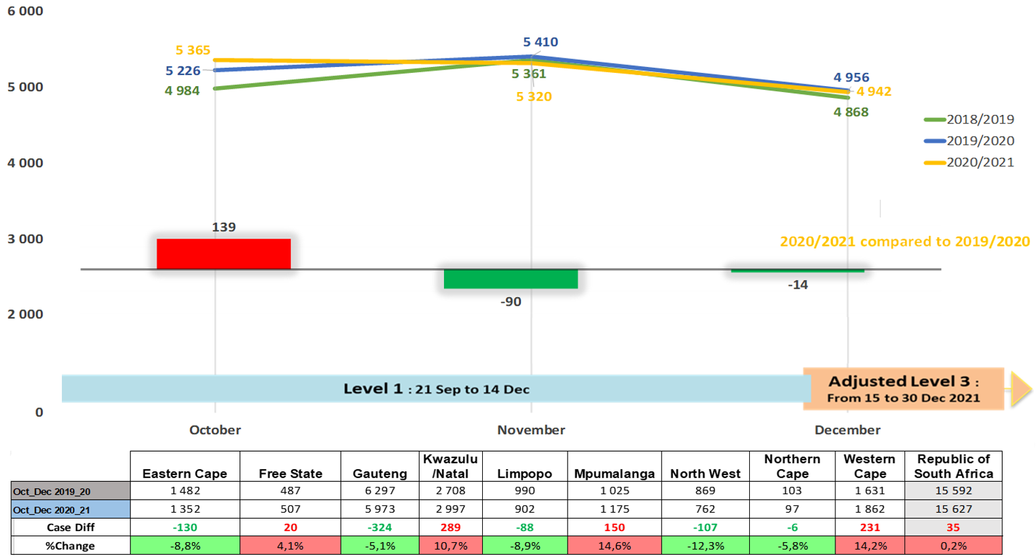
TRIO crimes

Slide 25
TRIO Crimes: TOP 30 STATIONS
Position | Station | Province | October to December 2016_17 | October to December 2017_18 | October to December 2018_19 | October to December 2019_20 | October to December 2020_21 | Case Diff
1 | NYANGA | WESTERN CAPE | 148 | 159 | 141 | 133 | 173 | 40
2 | PLESSISLAER | KWAZULU/NATAL | 60 | 94 | 74 | 107 | 153 | 46
3 | IVORY PARK | GAUTENG | 167 | 141 | 147 | 85 | 137 | 52
4 | UMLAZI | KWAZULU/NATAL | 68 | 86 | 112 | 129 | 127 | -2
5 | TEMBISA | GAUTENG | 82 | 105 | 101 | 85 | 126 | 41
6 | KHAYELITSHA | WESTERN CAPE | 88 | 86 | 94 | 80 | 121 | 41
7 | HARARE | WESTERN CAPE | 80 | 67 | 77 | 89 | 117 | 28
8 | HONEYDEW | GAUTENG | 142 | 133 | 134 | 166 | 116 | -50
9 | INANDA | KWAZULU/NATAL | 93 | 111 | 64 | 128 | 116 | -12
10 | VOSMAN | MPUMALANGA | 65 | 71 | 81 | 93 | 106 | 13
11 | PINETOWN | KWAZULU/NATAL | 152 | 92 | 85 | 89 | 100 | 11
12 | DELFT | WESTERN CAPE | 99 | 99 | 100 | 62 | 98 | 36
13 | AKASIA | GAUTENG | 111 | 63 | 95 | 83 | 97 | 14
14 | MFULENI | WESTERN CAPE | 60 | 104 | 49 | 75 | 93 | 18
15 | MIDRAND | GAUTENG | 87 | 87 | 95 | 83 | 92 | 9
16 | BOOYSENS | GAUTENG | 105 | 96 | 105 | 104 | 91 | -13
17 | MARIANNHILL | KWAZULU/NATAL | 28 | 31 | 66 | 61 | 89 | 28
18 | KRAAIFONTEIN | WESTERN CAPE | 59 | 44 | 39 | 34 | 89 | 55
19 | JEPPE | GAUTENG | 151 | 107 | 81 | 63 | 88 | 25
20 | ROODEPOORT | GAUTENG | 116 | 72 | 79 | 92 | 88 | -4
21 | SOSHANGUVE | GAUTENG | 112 | 82 | 54 | 77 | 87 | 10
22 | GUGULETHU | WESTERN CAPE | 80 | 74 | 75 | 70 | 86 | 16
23 | OLIEVENHOUTBOSCH | GAUTENG | 78 | 101 | 54 | 82 | 86 | 4
24 | SANDTON | GAUTENG | 100 | 94 | 89 | 127 | 86 | -41
25 | PHILIPPI EAST | WESTERN CAPE | 89 | 85 | 95 | 84 | 83 | -1
26 | KEMPTON PARK | GAUTENG | 89 | 103 | 92 | 85 | 82 | -3
27 | DIEPSLOOT | GAUTENG | 86 | 100 | 78 | 73 | 81 | 8
28 | MOFFATVIEW | GAUTENG | 89 | 103 | 97 | 91 | 80 | -11
29 | KAGISO | GAUTENG | 97 | 66 | 57 | 73 | 80 | 7
30 | WITBANK | MPUMALANGA | 90 | 98 | 122 | 97 | 79 | -18

Slide 26
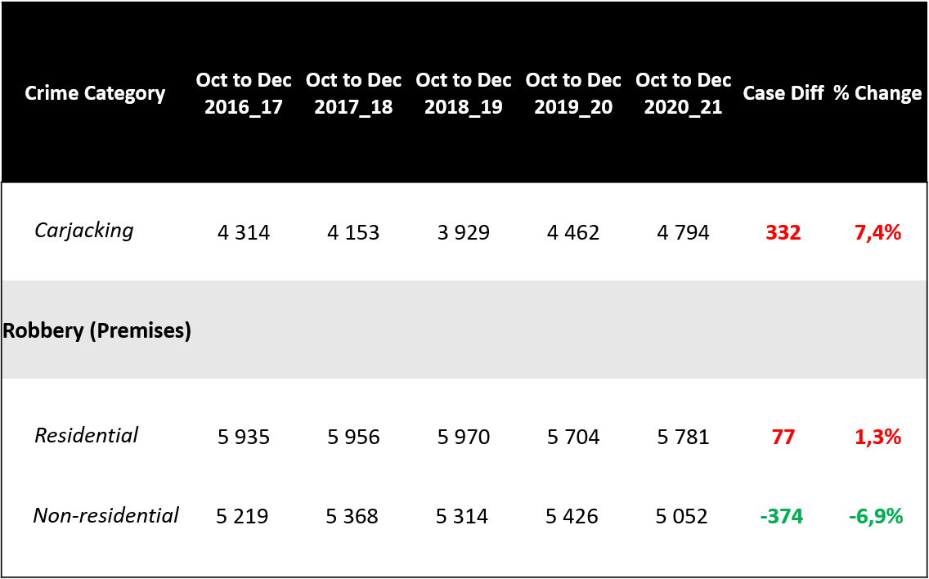
TRIO crimes and CIT’s
Robbery of cash in transit ** | 45 | 62 | 35 | 39 | 65 | 26
** Percentage change above 50%

Slide 27
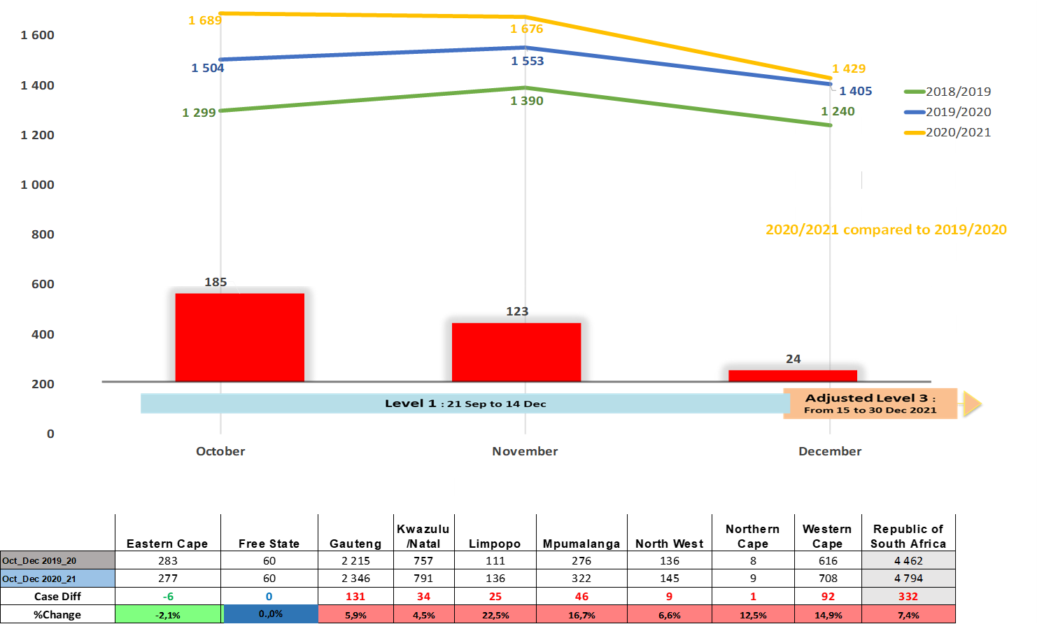
Carjacking

Slide 28
Carjacking: TOP 30 STATIONS
Position | Station | Province | October to December 2016_17 | October to December 2017_18 | October to December 2018_19 | October to December 2019_20 | October to December 2020_21 | Case Diff
1 | NYANGA | WESTERN CAPE | 73 | 59 | 68 | 90 | 133 | 43
2 | UMLAZI | KWAZULU/NATAL | 32 | 32 | 47 | 46 | 73 | 27
3 | HARARE | WESTERN CAPE | 37 | 29 | 35 | 45 | 56 | 11
4 | DELFT | WESTERN CAPE | 40 | 51 | 36 | 28 | 54 | 26
5 | VOSMAN | MPUMALANGA | 25 | 20 | 34 | 51 | 52 | 1
6 | KHAYELITSHA | WESTERN CAPE | 39 | 31 | 42 | 36 | 48 | 12
7 | MOROKA | GAUTENG | 38 | 33 | 26 | 37 | 48 | 11
8 | MFULENI | WESTERN CAPE | 28 | 40 | 22 | 35 | 47 | 12
9 | IVORY PARK | GAUTENG | 44 | 26 | 30 | 31 | 46 | 15
10 | INANDA | KWAZULU/NATAL | 22 | 35 | 18 | 55 | 44 | -11
11 | SAMORA MACHEL | WESTERN CAPE | 0 | 0 | 9 | 9 | 43 | 34
12 | ELDORADO PARK | GAUTENG | 12 | 11 | 26 | 51 | 43 | -8
13 | TEMBISA | GAUTENG | 31 | 47 | 22 | 34 | 42 | 8
14 | MAMELODI EAST | GAUTENG | 30 | 37 | 34 | 76 | 41 | -35
15 | ORANGE FARMS | GAUTENG | 29 | 16 | 26 | 21 | 41 | 20
16 | JEPPE | GAUTENG | 67 | 56 | 36 | 27 | 41 | 14
17 | GUGULETHU | WESTERN CAPE | 38 | 19 | 43 | 31 | 40 | 9
18 | PLESSISLAER | KWAZULU/NATAL | 20 | 25 | 24 | 25 | 38 | 13
19 | EVATON | GAUTENG | 20 | 23 | 31 | 39 | 38 | -1
20 | BOOYSENS | GAUTENG | 64 | 47 | 39 | 58 | 38 | -20
21 | SILVERTON | GAUTENG | 16 | 20 | 11 | 20 | 38 | 18
22 | LINGELETHU-WEST | WESTERN CAPE | 26 | 15 | 41 | 37 | 38 | 1
23 | PHILIPPI EAST | WESTERN CAPE | 35 | 19 | 25 | 40 | 37 | -3
24 | SANDTON | GAUTENG | 25 | 22 | 13 | 31 | 37 | 6
25 | MARIANNHILL | KWAZULU/NATAL | 18 | 17 | 36 | 22 | 37 | 15
26 | PRETORIA WEST | GAUTENG | 18 | 20 | 15 | 29 | 36 | 7
27 | OLIEVENHOUTBOSCH | GAUTENG | 35 | 19 | 17 | 21 | 36 | 15
28 | TSAKANE | GAUTENG | 18 | 15 | 14 | 27 | 36 | 9
29 | BRAMLEY | GAUTENG | 21 | 33 | 20 | 24 | 36 | 12
30 | ATTERIDGEVILLE | GAUTENG | 24 | 33 | 19 | 20 | 34 | 14

Slide 29
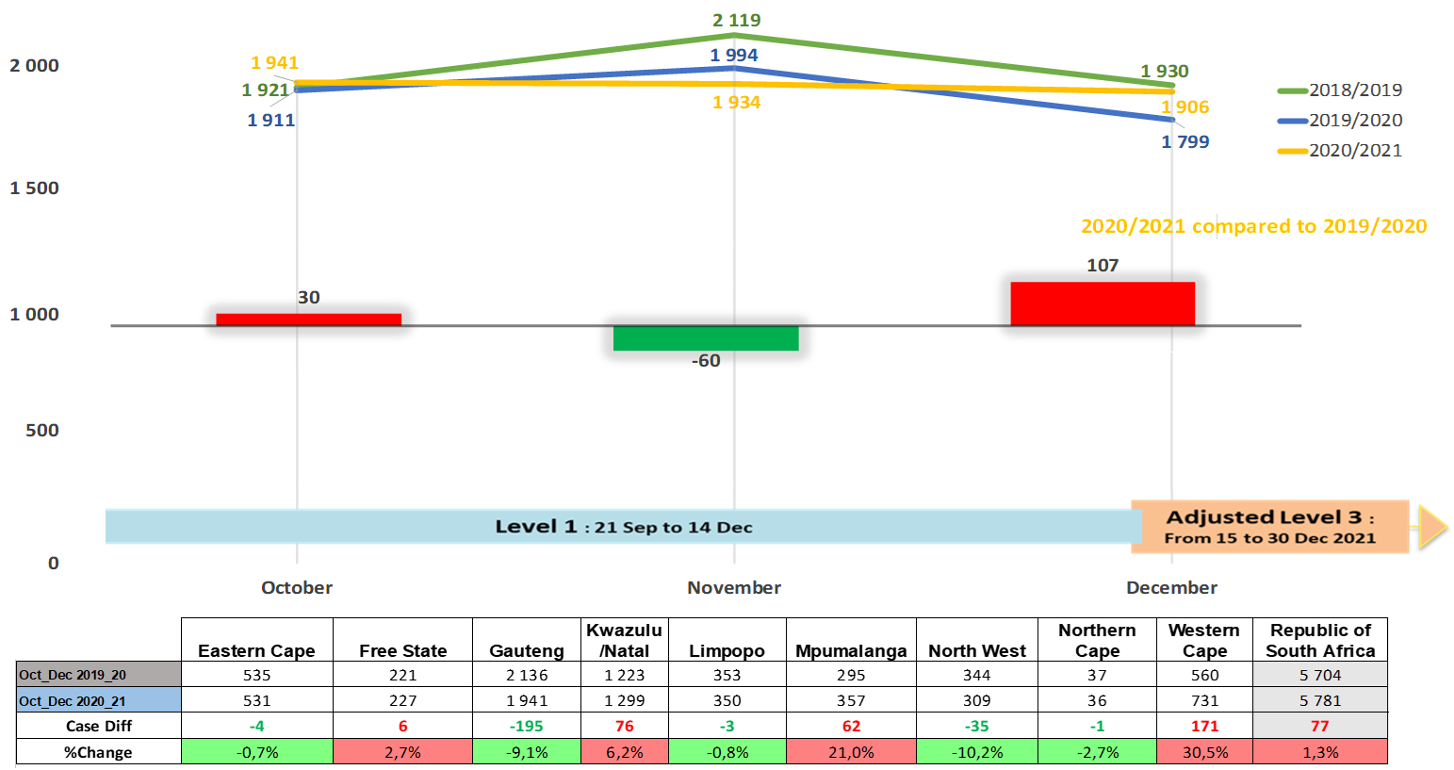
Robbery at residential premises

Slide 30
Robbery at residential premises: TOP 30 STATIONS
Position | Station | Province | October to December 2016_17 | October to December 2017_18 | October to December 2018_19 | October to December 2019_20 | October to December 2020_21 | Case Diff
1 | PLESSISLAER | KWAZULU/NATAL | 16 | 30 | 24 | 47 | 67 | 20
2 | IVORY PARK | GAUTENG | 96 | 89 | 90 | 31 | 65 | 34
3 | HONEYDEW | GAUTENG | 73 | 79 | 72 | 88 | 63 | -25
4 | KHAYELITSHA | WESTERN CAPE | 22 | 23 | 39 | 26 | 55 | 29
5 | KWADUKUZA | KWAZULU/NATAL | 38 | 27 | 24 | 21 | 55 | 34
6 | KRAAIFONTEIN | WESTERN CAPE | 24 | 23 | 20 | 22 | 54 | 32
7 | INANDA | KWAZULU/NATAL | 44 | 61 | 32 | 53 | 53 | 0
8 | DIEPSLOOT | GAUTENG | 67 | 65 | 49 | 49 | 52 | 3
9 | TEMBISA | GAUTENG | 37 | 29 | 52 | 30 | 50 | 20
10 | HARARE | WESTERN CAPE | 29 | 27 | 32 | 31 | 50 | 19
11 | ESIKHALENI | KWAZULU/NATAL | 29 | 20 | 23 | 34 | 49 | 15
12 | AKASIA | GAUTENG | 47 | 22 | 45 | 31 | 49 | 18
13 | THOHOYANDOU | LIMPOPO | 41 | 72 | 30 | 30 | 42 | 12
14 | UMLAZI | KWAZULU/NATAL | 26 | 37 | 33 | 58 | 41 | -17
15 | ROODEPOORT | GAUTENG | 63 | 35 | 36 | 38 | 41 | 3
16 | MULDERSDRIFT | GAUTENG | 23 | 27 | 14 | 21 | 41 | 20
17 | OLIEVENHOUTBOSCH | GAUTENG | 16 | 55 | 30 | 43 | 40 | -3
18 | DELFT | WESTERN CAPE | 48 | 36 | 54 | 31 | 39 | 8
19 | GUGULETHU | WESTERN CAPE | 31 | 40 | 26 | 27 | 38 | 11
20 | PHILIPPI EAST | WESTERN CAPE | 23 | 43 | 58 | 33 | 37 | 4
21 | NYANGA | WESTERN CAPE | 70 | 92 | 61 | 38 | 37 | -1
22 | MTUNZINI | KWAZULU/NATAL | 48 | 22 | 52 | 21 | 35 | 14
23 | WALMER | EASTERN CAPE | 25 | 31 | 33 | 24 | 35 | 11
24 | MPUMALANGA KZN | KWAZULU/NATAL | 7 | 4 | 9 | 18 | 35 | 17
25 | BENONI | GAUTENG | 21 | 23 | 24 | 30 | 34 | 4
26 | KAGISO | GAUTENG | 27 | 22 | 22 | 24 | 33 | 9
27 | MARIANNHILL | KWAZULU/NATAL | 1 | 11 | 19 | 20 | 33 | 13
28 | SOSHANGUVE | GAUTENG | 42 | 41 | 25 | 26 | 33 | 7
29 | MFULENI | WESTERN CAPE | 20 | 33 | 18 | 22 | 32 | 10
30 | SANDTON | GAUTENG | 59 | 59 | 59 | 78 | 30 | -48

Slide 31
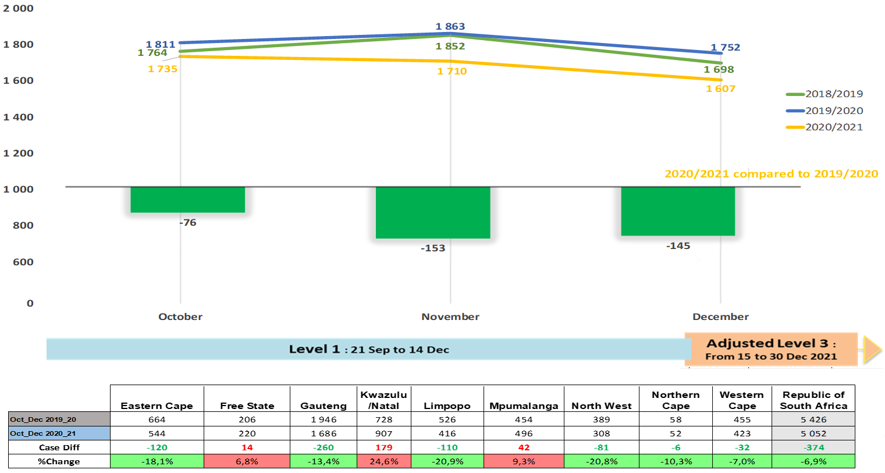
Robbery at non-residential premises

Slide 32
Robbery at non-residential premises: TOP 30 STATIONS
Position | Station | Province | October to December 2016_17 | October to December 2017_18 | October to December 2018_19 | October to December 2019_20 | October to December 2020_21 | Case Diff
1 | PINETOWN | KWAZULU/NATAL | 42 | 33 | 26 | 25 | 61 | 36
2 | KEMPTON PARK | GAUTENG | 28 | 38 | 33 | 46 | 53 | 7
3 | PLESSISLAER | KWAZULU/NATAL | 24 | 39 | 26 | 35 | 48 | 13
4 | WITBANK | MPUMALANGA | 42 | 53 | 74 | 53 | 42 | -11
5 | JHB CENTRAL | GAUTENG | 42 | 54 | 75 | 59 | 41 | -18
6 | HILLBROW | GAUTENG | 27 | 36 | 33 | 20 | 37 | 17
7 | TEMBISA | GAUTENG | 14 | 29 | 27 | 21 | 34 | 13
8 | GERMISTON | GAUTENG | 21 | 13 | 21 | 40 | 34 | -6
9 | PRETORIA CENTRAL | GAUTENG | 18 | 23 | 14 | 31 | 34 | 3
10 | MIDRAND | GAUTENG | 21 | 31 | 24 | 26 | 34 | 8
11 | VOSMAN | MPUMALANGA | 26 | 38 | 34 | 26 | 30 | 4
12 | GREENWOOD PARK | KWAZULU/NATAL | 22 | 25 | 20 | 21 | 29 | 8
13 | VOSLOORUS | GAUTENG | 11 | 12 | 18 | 16 | 29 | 13
14 | MADEIRA | EASTERN CAPE | 10 | 12 | 44 | 51 | 28 | -23
15 | BOOYSENS | GAUTENG | 15 | 16 | 33 | 20 | 27 | 7
16 | SOSHANGUVE | GAUTENG | 23 | 8 | 15 | 21 | 27 | 6
17 | SESHEGO | LIMPOPO | 10 | 14 | 20 | 33 | 27 | -6
18 | SPRINGS | GAUTENG | 19 | 18 | 26 | 36 | 26 | -10
19 | IVORY PARK | GAUTENG | 27 | 26 | 27 | 23 | 26 | 3
20 | EAST LONDON | EASTERN CAPE | 8 | 52 | 18 | 20 | 26 | 6
21 | ROODEPOORT | GAUTENG | 28 | 8 | 20 | 27 | 26 | -1
22 | KAGISO | GAUTENG | 35 | 24 | 8 | 24 | 26 | 2
23 | MOFFATVIEW | GAUTENG | 26 | 25 | 35 | 16 | 25 | 9
24 | HONEYDEW | GAUTENG | 30 | 18 | 28 | 37 | 25 | -12
25 | KRUGERSDORP | GAUTENG | 20 | 8 | 10 | 15 | 24 | 9
26 | THOHOYANDOU | LIMPOPO | 19 | 22 | 26 | 37 | 23 | -14
27 | DURBAN CENTRAL | KWAZULU/NATAL | 31 | 47 | 41 | 21 | 23 | 2
28 | JEPPE | GAUTENG | 61 | 32 | 30 | 23 | 23 | 0
29 | BUSHBUCKRIDGE | MPUMALANGA | 20 | 31 | 43 | 18 | 23 | 5
30 | BRIGHTON BEACH | KWAZULU/NATAL | 9 | 16 | 9 | 17 | 23 | 6

Slide 33
Robbery of cash in transit

Slide 34
Property-related Crime
CRIME CATEGORY | Oct to Dec 2016_17 | Oct to Dec 2017_18 | Oct to Dec 2018_19 | Oct to Dec 2019_20 | Oct to Dec 2020_21 | Case Diff | % Change
Burglary at non-residential premises | 18 735 | 18 100 | 18 124 | 17 179 | 15 550 | -1 629 | -9,5%
Burglary at residential premises | 61 878 | 57 797 | 56 088 | 51 737 | 42 834 | -8 903 | -17,2%
Theft of motor vehicle and motorcycle | 13 150 | 12 577 | 12 115 | 11 772 | 10 099 | -1 673 | -14,2%
Theft out of or from motor vehicle | 33 636 | 32 282 | 30 735 | 28 458 | 22 697 | -5 761 | -20,2%
Stock-theft | 7 704 | 8 739 | 8 948 | 8 437 | 7 854 | -583 | -6,9%
Total Property-Related Crimes | 135 103 | 129 495 | 126 010 | 117 583 | 99 034 | -18 549 | -15,8%

Slide 35
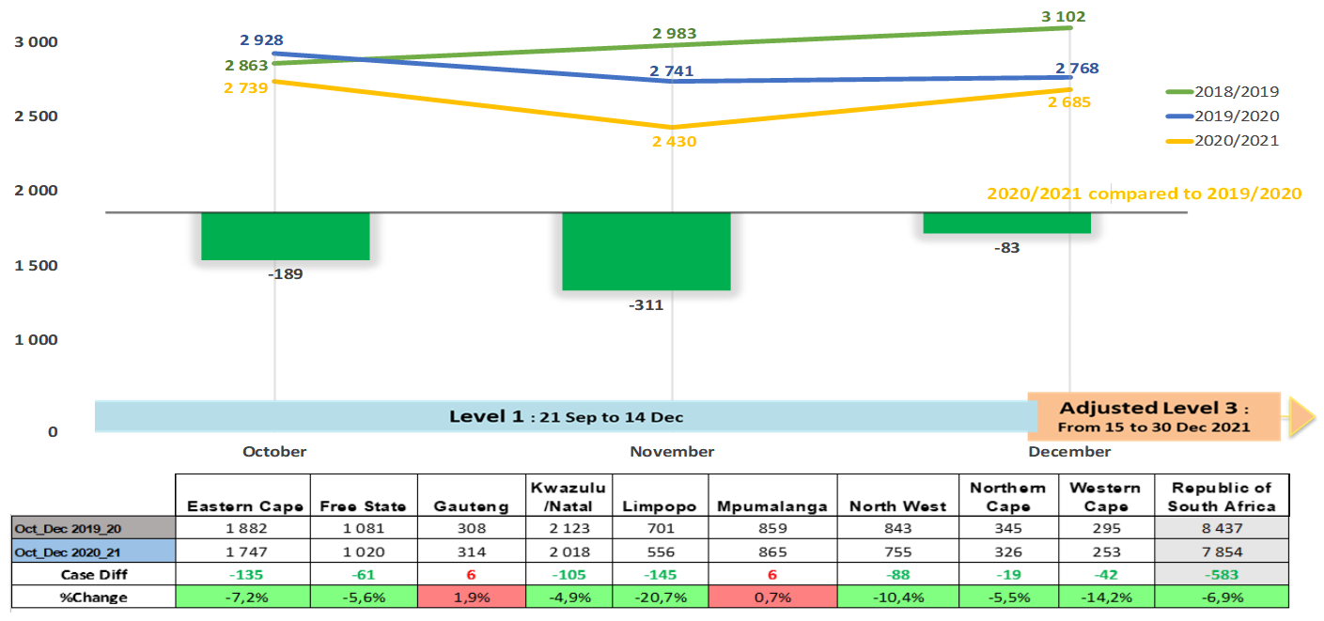
Stock-theft

Slide 36
THE END
Thank you

