Slide 1
SAIT presentation on the Budget Review, 2021
to the
Standing Committee on Finance Select Committee on Finance
Public Hearings: 3 March 2021

Slide 2
SUMMARY
Rates
Government’s stance on incentives
Tax administration: Compliance versus non-compliance
Tax policy engagement
Industry specific approach for manufacturing, farming, and mining

Slide 3
1. RATES
INDIVIDUALS
For individuals, 50% is the theoretical line that avoids the breaking point (Canadian Carter Commission)
Internationally, the breaking point is closer to the low 40% because of the effect of other taxes; SA is past that point:
45% top marginal rate +
15% VAT +
?% Miscellaneous taxes +
Cost due to lack of service delivery (shifting public to private expenditure)

Slide 4
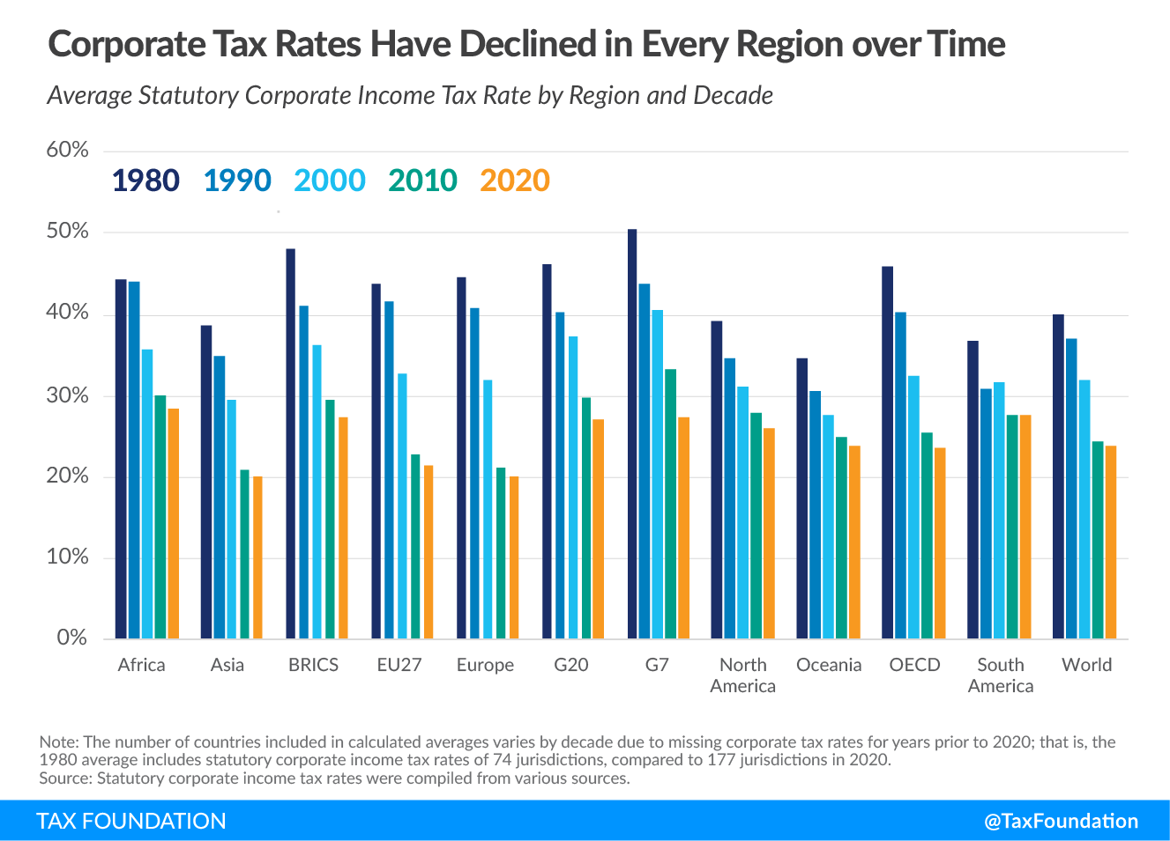

Slide 5
1. RATES
MAKING THE SA CORPORATE TAX RATE MORE COMPETITIVE
The SA corporate income tax rate is currently 28%.
The worldwide average statutory corporate tax rate has consistently decreased since 1980, with the largest decline occurring in the early 2000s.
The BRICS have an average statutory rate of 27.40%, and a weighted average statutory corporate income tax rate of 26.49%.
Europe has the lowest regional average rate, at 19.99% - 24.61% when GDP weighted.
Conversely, Africa has the highest regional average statutory rate, at 28.50% - 28.16% when GDP weighted.

Slide 6
1. RATES
MAKING THE SA CORPORATE TAX RATE MORE COMPETITIVE
The current focus appears to be on limiting tax increases and focusing on pre-planned tax reductions
By working on ensuring the tax rate drops, Government will work towards efficiencies and better tax management, allowing SA to remain competitive, especially during the downturn
BROADENING THE BASE
The measures to broaden the tax base through limiting assessed losses and interest expense deductions have been postponed until 2020.
We generally agree with efforts to broaden the base and lower the rate. However, these efforts must be viewed in the context of the possible tradeoffs.

Slide 7
1. RATES
BROADENING THE BASE
Possible trade-offs:
Limiting assessed losses: The denial of losses will have a radical effect on business with: Unpredictable income streams; start-ups in SA; and new foreign investment.
Denial of excessive interest deductions are generally accepted, but have to take into consideration the busines model in certain industries e.g. banking and real estate.

Slide 8
2. GOVERNMENT’S STANCE ON INCENTIVES
Agree that ineffective incentives lead to abuse, deadweight loss, administrative cost, skewing of the economy and wrong outcomes.
Agree further that many incentives are not effective.
Agree that incentives should be reviewed regularly.
Good incentives are synchronized with good regulations and dovetail with the business models adopted in the relevant industry (East Asia model).
Ineffective and costly incentives are over-engineered (lab-created) rather than organic. E.g. The VCC (section 12J) incentive did not actively develop small businesses and generate economic activity, but rather created a passive investment vehicle for wealthy taxpayers.

Slide 9
2. GOVERNMENT’S STANCE ON INCENTIVES
Incentives are supported on the following understanding:
The design of the incentive should align with the business practices and regulation that are already part of the environment. Deviation from existing and embedded structures allow abuse and deadweight loss.
Any ‘new’ requirement or activity that must be checked or measured is a cost to the industry and/or the administration.
The benefit of economic tailoring of incentives to ensure targeting must be measured against the additional cost that restrictive measures and anti-abuse provisions brings.

Slide 10
2. GOVERNMENT’S STANCE ON INCENTIVES
What is the cost of ineffectual design?;
Hypothetical example to illustrated the cost of design:
Incentive for an individual to keep a chicken for personal use: R10
Targetting a specific chicken and a specific person add to the administrative costs
Cost of administering the chicken incentive for the fiscus: R2
Cost of administering the chicken incentive for the individual: R3
Cost to the fiscus: R12 & benefit value to the individual: R7
Administrative cost: R5 – focused design can lower the cost all round

Slide 11
3. TAX ADMINISTRATION: COMPLIANCE VERSUS NON-COMPLIANCE
Budget rightly recognises the need to target the wholly illegal
Tenderpreneurs: Operating with Government funds, without providing any/minimal goods/services to benefit the economy and not paying taxes.
Wholescale evaders: Businesses that operate outside the tax system but that are part of the economy – e.g. certain cash and carry businesses.
Businesses that keep two sets of books
However, the system is geared towards managing and collecting the taxes from those that are compliant or at least semi-compliant (under-reporting of income and over-statement of expenses).
A new model is required to tackle non-compliance.

Slide 12
3. TAX ADMINISTRATION: COMPLIANCE VERSUS NON-COMPLIANCE
Although artificial intelligence (computer systems) and increased reporting is the way of the future, certain matters should be born in mind:
Over-reliance on systems allow false tells (high refund = risk) and can create an ‘automaton’ employee, unable to apply the legislation, and outsized risk response.
The matter of systems driving the show is particularly concerning in the case of the ‘pay now and argue later’-rule applied to an account on a computer system.
There is a need to ensure that tax administration is fair for the generally compliant: Generally, perceived fairness will strengthen tax compliance.
Unfortunately, the perception from interaction with some officials is that the pervasive attitude (directed at the fully or largely compliant), is still that taxpayers are guilty until proven innocent.

Slide 13
3. TAX ADMINISTRATION: COMPLIANCE VERSUS NON-COMPLIANCE
Without a focussed link between design of the relevant legislation and the eventual risk management and reporting of the information to SARS, the hope of SARS reaching its strategic goals: ensuring tax revenue, fair tax assessment, and positive taxpayer experience, is limited.
Divorcing SARS systems from the legislation, and building the efficiency, not into the legislative design and the systems, but only the systems, will not allow tax officials to concentrate on cases that require human expertise: These cases will remain unidentified, a needle in a haystack.

Slide 14
4. TAX POLICY ENGAGEMENT
Current engagement too limited with too few engagements with industry. If we accept that effective legislative design works within the structures of existing business and industry, then significantly more engagement opportunities are required.
Industry is generally only brought onboard once the main decisions have been made, allowing only superficial discussion, or alternatively a ‘back to the drawing board approach’.
Engagement is generally results orientated, with the result already firmly in mind. This approach unintentionally fosters an adversarial relationship rather than a collegiate relationship where industry and Government work together for the good of the people.

Slide 15
4. TAX POLICY ENGAGEMENT
Since industry have the facts and the actual scenarios, engagement should rather focus on eliciting this information from the industry.
Specifically, private sector dialogue needs to be better crafted to regularly obtain useful information versus creating a scenario where the industry is a supplicant in the relationship, pleading for engagement.

Slide 16
5. INDUSTRY SPECIFIC APPROACH FOR MANUFACTURING, MINING AND FARMING
Looking at the Budget, it is evident that we have to focus on these industries to drive exports.
However, the focus cannot be exclusionary but rather holistic with complementary features.
As part of the analysis one must discuss barriers before getting into any talks about regulations, ‘incentives’ and tax breaks.

Slide 17
5. INDUSTRY SPECIFIC APPROACH FOR MANUFACTURING, FARMING, AND MINING
Manufacturing: We recommend a study to determine key factors for manufacturing success (and where tax plays a role in these). Focus should in particular be on building interrelationships between the various industries forming the supply chan.
Farming: We recommend a study to determine key factors for farming (need to compete with foreign subsidies). Although there are small subsidies available, they are not enough to allow SA to compete internationally.

Slide 18
5. INDUSTRY SPECIFIC APPROACH FOR MANUFACTURING, FARMING, AND MINING
Mining:
From our perspective, it seems that there are various burning issues from a industry and administrative and fiscal point of view that require attention. Various matters regarding diesel rebates and capital allowances, etc. are landing in court.
We recommend a study of the mining tax regime (including the diesel rebate scheme, royalties taxes, capital allowances, etc.) to work towards a more cohesive regime that will provide certainty to current occupants and future investors. Considering the current economic strain, we recommend that the process be started within the current year.
The mining industry as a whole is critical to South Africa’s history and future success, and we are confident that the various role players would be willing to come together to advise on a more cohesive regime.

Slide 19
THANK YOU
32

