Slide 1
PRESENTATION ON SUPPORT RENDERED TO AMATHOLE DISTRICT AREA
MR. X.E NQATHA HON. MEMBER OF THE EXECUTIVE COUNCIL
3 MARCH 2021

Slide 2
PRESENTATION OUTLINE
PURPOSE OF THE PRESENTATION
SUPPORT RENDERED TO AMATHOLE DISTRICT AREA
PILLAR 1
PILLAR 2
PILLAR 3
PILLAR 4
PILLAR 5

Slide 3
PURPOSE
To present the current state of Amathole District Municipality
To present a report on the support provided in current financial year to the Amathole District Area

Slide 4
CURRENT INTERVENTIONS: AMATHOLE DM
Amathole District Municipality has recently been characterised by challenges which are classified under Governance, Institutional, Service Delivery and Financial Challenges.
ROOT CAUSES OF THE CHALLENGES – HAVING IMPACT ON FINANCES
High wage bill with the organizational structure that is not fit for size and purpose.
The wage bill is the main cost driver of the operational budget of the municipality with some of the Directors and senior managers having salary packages around R2m per annum.
The 2018/19 audited annual financial statements revealed the employee related costs of 44 per cent of the total operating expenditure.

Slide 5
CURRENT INTERVENTIONS: AMATHOLE DM CONT…”
THE CHALLENGES – HAVING IMPACT ON FINANCES CONT…”
The current salary bill of the municipality is approximately R70m a month and the annual budgeted salary bill is R800m for the 2020/21 financial year.
Challenges experienced by the Municipality in its efforts to successfully implement the SAP financial system have had a significant impact on the finances of the Municipality.
The system was initially budgeted at R75 million however the actual total costs were almost R120 million and is still no fully functional. The system vendor did not meet the targets in terms of the agreed Service Level Agreement however additional costs were added to the initial costs.

Slide 6
CURRENT INTERVENTIONS: AMATHOLE DM CONT…”
ROOT CAUSES OF THE CHALLENGES – HAVING IMPACT ON FINANCES
The Municipality was unable to bill the consumers for almost the entire period of the 2018/19 financial year due to the system implementation challenges.
High growth in gross consumer debtors for water and sanitation impacting on low collection rate.
The Municipality is not recovering the cost of bulk water purchases due to unaccounted water to the residents and high indigent rate.
High level of creditors is a challenge and the municipality currently owes the Water Board over R 200 million in arrear balances as a result of low collection rate

Slide 7
CURRENT INTERVENTIONS: AMATHOLE DM CONT…”
ROOT CAUSES OF THE CHALLENGES – HAVING IMPACT ON FINANCES
The municipality is not recovering the cost of the bulk water purchases due to high indigent rate of the district. Approximately 80% of costs for sanitation and 89% per cent for water provision services are not being recovered.
The total operating revenue of the municipality has decreased by 16.1 per cent in comparison to the 2019/20 adjusted budget of R 1.86 billion and has decreased to R1.56 billion for the 2020/21 financial year (R300 million).
The 2020/21 equitable share is R 896 million and the employee related costs are R 816 million which is 91 per cent of the total allocation

Slide 8
FOCUS AREAS FOR INSTITUTIONAL CAPACITY
THE AREAS TO BE FOCUSED UPON IN THIS REGARD ARE THE FOLLOWING:
State of the Organizational Structure and its implications:
The current organizational structure is bloated and was recently reviewed for right-sizing and align it with its Powers and Functions;
The current structure is bloated and is characterised with too many management layers such as General Managers and Senior Managers over and above the Directors that are Section 56 Managers (managers directly accountable to the Municipal Manager);
Remuneration packages of Senior Managers at ADM (MM and other SM positions)
The MM and other Senior Managers are remunerated outside the gazetted threshold of the Government Gazettes and this contributes to the escalating personnel costs

Slide 9
FOCUS AREAS FOR INSTITUTIONAL CAPACITY CONT…”
Remuneration packages of Senior Managers at ADM (MM and other SM positions)
According to the Government Gazette No. 43122 of 20 March 2020 Amathole District Municipality is a category 6 municipality.
Amathole District Municipality is currently spending more than 50% of its operating budget on compensation of employees which is far above the prescribed threshold

Slide 10
FOCUS AREAS FOR INSTITUTIONAL CAPACITY CONT…”
Grading of the district municipality and its implications
The restructuring process culminated in the upgrading of the municipality from grade 6 to 7 and no due processes were followed in doing this
This upgrading had had serious financial implication and over time contributed to the current state of affairs of run-away personnel costs;
The adding on of two management layers of General Managers and Senior Managers exacerbated the situation, increasing the monthly CoE to about R60 million a month, which is unsustainable

Slide 11
FOCUS AREAS FOR INSTITUTIONAL CAPACITY CONT…”
Qualification and required competencies of SENIOR MANAGEMENT
Both MM and CFO as well as the rest of the Senior Managers met ALL the qualification and competency levels required for their respective positions and ALL due processes were followed, except for one Senior Manager appointed without submitting Competency Assessment results.
On receipt of the file that was missing the Competency Assessment Results, the department wrote back to the municipality indicating that there is an outstanding document but the municipality never responded to that and as such the department never confirmed the appointment

Slide 12
FOCUS AREAS FOR INSTITUTIONAL CAPACITY CONT…”
Issues pertaining to Labour Relations pertaining to maintaining Labour Peace and Institutional Stability
The relationship between Management and Labour had been characterized with too much animosity which resulted in several strikes or downing of tools from time to time, thus directly affecting provision of water services
LLF engagement borders on dysfunctionality as there is NO effective engagement on matters of mutual interest

Slide 13
CURRENT PROCESS

Slide 14
CURRENT PROCESS
On 20th January 2021, the the Executive Council approved the Mandatory intervention (Section 139 (5)(a) of the Constitution of the Republic of South Africa ) and directed that the MECs for Cooperative Governance & Traditional Affairs and Treasury must monitor the intervention and submit progress reports thereof.
The EXCO further directed that multi - disciplinary teams be assembled to implement the Financial Recovery Plan (FRP).
Subsequently,
Letters were written to the statutory bodies as required by law informing them of the EXCO resolution that Amathole District Municipality is under Section 139 (5)(a).

Slide 15
CURRENT PROCESS CONT…”
Letters were written to the Minister of Cooperative Governance & Traditional Affairs; the Chairperson of the NCOP, the Speaker of the Legislature and the Provincial Chairperson of SALGA.
A letter was written to the MEC for Provincial Treasury requesting him to inform the Minister of National Treasury of the intervention and request the services of Municipal Financial Recovery Services from National Treasury to develop the Financial Recovery Plan as this is their competency and that this is a mandatory intervention. The Minister has confirmed the receipt of the letter.
The Department developed the Terms of Reference (TORs) for the different intervention structures that will be monitoring the implementation of the FRP

Slide 16
CURRENT PROCESS CONT…”
The Head of Department facilitated a session where the TORs were presented to the role players ( the department, Provincial Treasury, National Treasury, National CoGTA & SALGA) with a view to solicit their inputs.
The comments and inputs were then filtered in the TORs and a final document was developed by the department.
The MEC then consulted his counterparts and presented the TORs which were then endorsed.

Slide 17
SUPPORT RENDRED TO AMATHOLE DISTRICT MUNICIPALITIES

Slide 18
PUTTING PEOPLE FIRST: SUPPORT RENDERED
The department has supported all municipalities within ADM district area except Raymond Mhlaba LM by establishing Ward Based Rapid Response Task Team (WBRRTT) constituting various stakeholders, i.e. councillors, Ward Committees, CDWs and traditional Leadership.
The purpose was to revitalise the War Rooms and flatten the curve of the COVID-19 through community behavioural change.
Amahlathi was through MEC outreach programme provided with foot operated water taps, Personal Protective Equipment (PPEs) and water tanks.
Amahlathi was further supported with park homes that are used as office space.
Ward committees of Amahlathi & Great Kei LMs were trained in the development of ward operational plans which serve as a guide for their functionality.
The department supported Mbhashe, Raymond Mhlaba & Ngqushwa during the time of bi-elections.

Slide 19
PILLAR 2: BASIC SERVICE DELIVERY
The department assisted on the project registration and reporting for covid 19 projects and budget maintenance in Amathole DM
The department facilitated a session wherein DEDEA was engaged and as such DEDEA will form part of District Appraisal Committee in order to eliminate delays on approval of EIAs which takes about 3 months to get approved.
The department has supported Mnquma & project registration and monitoring
MISA deployed an engineer to Amahlathi LM as acting Technical Director and the PMU & Project Managers were then appointed after several COGTA engagements. Cost Reimbursement method was introduced for close monitoring and project verification
The department introduced Cost Reimbursement method at Raymond Mhlaba LM for purposes of close monitoring and project verification. This was done because the municipality was encountering challenges in respect of non responsive bidders thus affecting completion of projects.

Slide 20
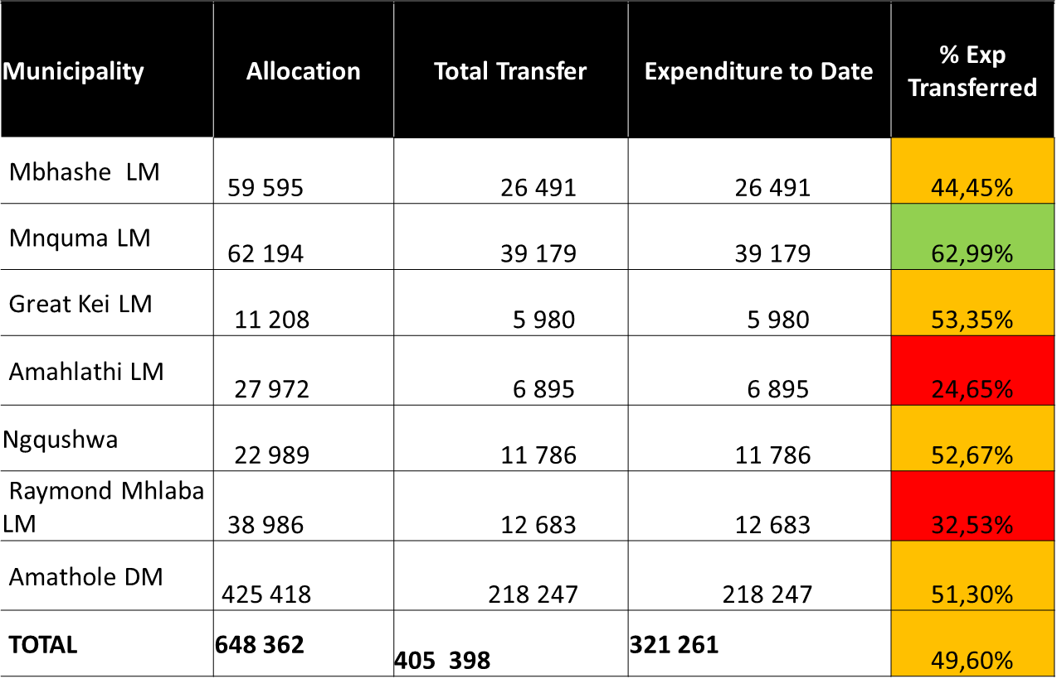
PILLAR 2: BASIC SERVICE DELIVERY 2020/21 MUNICIPAL MIG PERFORMANCE

Slide 21
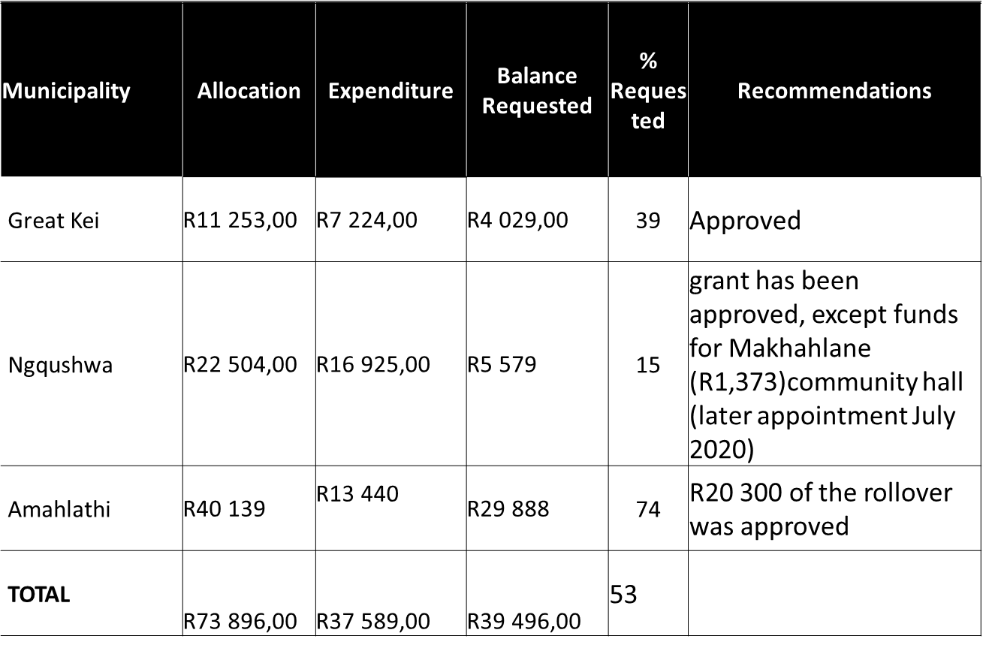
PILLAR 2:2019/20 ROLLOVER -AMATHOLE

Slide 22
COST REIMBURSEMENT
Amathole District have two Municipalities under cost reimbursement model, namely Amahlathi and Raymond Mhlaba municipalities.
The cost reimbursement team has been supporting the Municipalities to enhance the MIG project expenditure,
Site visits have been conducted to substantiate work done versus work scheduled.
The department has supported the municipalities through engagement with Consultants and Contractors to outline implementation process and contract management.

Slide 23
DROUGHT INTERVENTION
COGTA through the PDMC supported Amathole District Municipality with provision of 69 x 5000L Water Tanks for emergency drought intervention
COGTA signed SLA and allocated Water Trucks to the following LMs each for a period of 3 months
1 x Water Truck = Amahlathi LM
1 x Water Truck = Raymond Mhlaba LM

Slide 24
MUNICIPAL DISASTER RELIEF GRANT INTERVENTION
PDMC facilitated funding from National Treasury to address COVID 19 on the following prioritised areas
Sanitation (chemical toilets and their maintenance);
Decontamination of specific selected municipal spaces (e.g. ablution facilities in public spaces); Personal Protective Equipment, and hygiene packs; and
Waste management
The funding was allocated in line with the powers and functions of municipalities, hence some of the municipalities have not been allocated funding for all of the above indicated prioritised areas.

Slide 25
COVID 19 MUNICIPAL DISASTER RELIEF GRANT ALLOCATION PER MUNICIPALITY
Municipality | Funding Allocation R(‘000) | Expenditure R (‘000) | Remarks
Mbashe | 1 341 | 647 500.50 | Latest report still outstanding
Mnquma | 1 937 | 1 937 | Report submitted, monthly reports for each month outstanding
Great Kei | 417 | 417 | Reports submitted, correct reporting template to be used
Amahlathi | 596 | 596 | Monthly, close out reports submitted
Ngqushwa | 328 | 00
 |  |  | Reports outstanding
 |  |  | Monthly, quarterly reports submitted with invoices
Raymond Mhlaba | 745 | 745
ADM | 3 397 | 2 817 840.81 | Reporting up to date
TOTAL | 8 761 | 7 160 341.31

Slide 26
LOCAL ECONOMIC DEVELOPMENT
The department has supported Amahlathi and Ngqushwa LMs in the following:
Review of LED Strategies
Building LED project generation and implementation Capacity.
The programme is being rolled-out currently. LED Projects will be packaged to be presented to Development Finance Institutions for investment.
The partnership with the Canadian municipalities through the Building Inclusive Green Municipalities (BIGM) in Ngqushwa Local Municipality.

Slide 27
FREE BASIC SERVICES
Sessions were held with Great Kei and Amahlathi Local Municipalities for payment plans of Free Basic Electricity (FBE) debt to Eskom.
The payment plans that were presented by Great Kei and Amahlathi Local Municipalities to Eskom were accepted and the supply of FBE was disconfigured.
All municipalities were supported to review their Indigent Policies in line with the National Guidelines for the Implementation of Indigent Policies.
The process was to ensure that all Indigent Policies are relevant and aligned with the policy shifts in respect of the provision of Free Basic Services within the current financial year.
During that process, an assessment of these Indigent Policies was conducted in accordance with the National Indigent Policy Assessment Tool

Slide 28
FREE BASIC SERVICES CONT…”
The department has conducted an Indigent Policy Workshop in Great Kei Local Municipality to capacitate all relevant stakeholders and clarify roles and responsibilities during FBS awareness campaigns, indigent data collection and verification processes.
All municipalities except ADM & Mbhashe were assisted in updating their Indigent Registers.

Slide 29
PILLAR 3: GOOD GOVERNANCE
The department has supported Amahlathi LM in the reviewal of the Rules of Order
Currently the department is giving hands support in the reviewal of the Rules of Order of Great Kei LM
Through the continuous assessment of the functionality of the Councils and their structures, all the municipalities in the district have been given support in areas that were identified to be having weaknesses.
Support has been given on the system of delegation through the reviewal of the Delegation Frameworks.

Slide 30
PILLAR 4: FINANCIAL VIABILITY
The department has facilitated quarterly engagements with municipalities and government departments to improve revenue collection on municipal services owed by departments.
The department in partnership with Rhodes University conducted training for MPAC members
A post graduate intern was deployed to assist Amathole district MPAC with research and reporting
The department assisted Amahlathi and Great Kei LMs with an amount of R10 million to make part payments towards Eskom and Auditor General debt.

Slide 31
PILLAR 5: BUILDING INSTITUTIONAL CAPABILITIES
Support rendered to ADM (with its local municipalities) with regards to the appointments of Senior Managers (including being part of the selection panels) and ALL SM appointments are deemed compliant with MSA Regulations including current MM and CFO positions. Competency Assessment are still outstanding with the recent appointment of Director: Community Services;
Rendered intensive labour relations support on facilitating the resolution of the Management Labour impasse that resulted in the disruptions in service delivery. COGTA facilitation resulted in engagements that ended the industrial action;
COGTA (MCB Officials) is an active participant in the ADM Corporate Services Forum wherein COGTA advices through inputs and formal presentations on HR/EE Plans compliance and WSP submission to LGSETA;

Slide 32
PILLAR 5: BUILDING INSTITUTIONAL CAPABILITIES CONT…”
ADM LM’s supported in reviewing their bloated organograms are Great Kei and Amahlathi LM’s and internal processes for adoption and approval of reviewed organograms underway;
Mnquma LM assisted with their applications for waiver for the remuneration packages of Senior Managers in line with Government Gazette No. 43122 of 2020.

Slide 33
RECOMMENDATION
It is recommended that the Portfolio Committee notes the update on the support rendered to Amathole District and Local Municipalities.

Slide 34
THANK YOU

