Slide 1
LOCAL GOVERNMENT SUPPORT PROGRAMMES PORTFOLIO COMMITTEE
MR THEMBA FOSI
DATE

Slide 2
Outline of Presentation
Purpose
Background
Pre- and Interim Phases
Establishment Phase
Consolidation Phase
Sustainability Phase
Conclusion
Recommendations

Slide 3
Purpose
This report was compiled on request of the Portfolio Committee that CoGTA should prepare a presentation that assesses the previous local government support programmes. The key areas to cover are:
the objective of the programmes,
interventions that were implemented,
lessons learned, and
achievements.

Slide 4
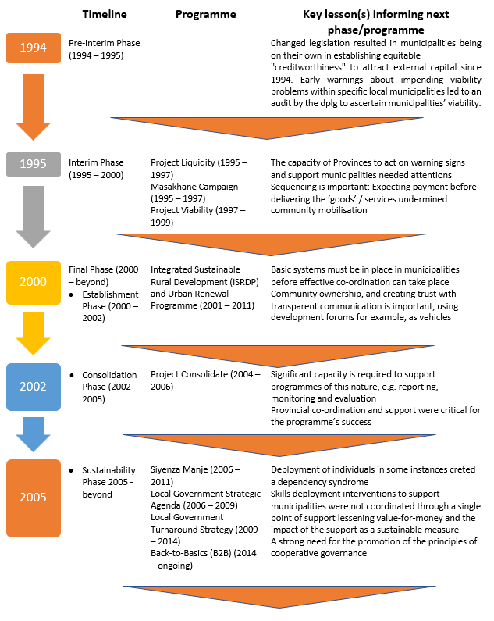
Background

Slide 5
Pre- and Interim Phases(1994 – 2000) (Liquidity, Viability, Masakhane)
Programme Objectives
Determine municipal liquidity/viability
Early warning of impending problems
Promote a culture of payment
Implementation Initiatives
Monitoring
Establishing provincial task teams
Support Programmes
Successes
Some success in reducing municipal insolvency
Lessons Learned
Inadequate provincial capacity to act on warning signs

Slide 6
Establishment Phase(2000 - 2002) (Integrated Sustainable Rural Development & Urban Renewal) (2001 – 2011)
Programme Objectives
To alleviate poverty through:
Implementation Initiatives
Micro and local economic development imperatives
Improved coordination and integration of service delivery across government
Decentralisation of decision making
Demand driven approaches
Fostering partnerships; and
A participatory approach to development
Strengthened Intergovernmental Coordination
Resource Mobilisation
Technical Support
Political Support

Slide 7
Establishment Phase(2000 - 2002) (Integrated Sustainable Rural Development & Urban Renewal) (cont)
Successes
Detailed economic profiles were compiled for each node
An element was introduced to the Local Government Equitable Share (LGES) formula to allow for the prioritization of development in the nodes
Significant progress in the provision of basic services
Poverty levels in the urban nodes (except for Kwa Mashu, where demarcation impacted on the data) dropped significantly
A significant contribution made by the National Treasury through the Neighbourhood Development Grant (NDPG) to crowd in public sector investment
‘Anchor Projects’ e.g. Khayelitsha rail extension, Alexandra London Road linking
Community Investment Programme (economic development in Maruleng and Bushbuckridge

Slide 8
Establishment Phase(2000 - 2002) (Integrated Sustainable Rural Development & Urban Renewal) (cont)
Lessons Learned
Basic systems in municipalities should be in place, e.g. if there are key vacancies at the municipal level, it is often not that useful to deploy a co-ordinator. Basic systems must be in place for effective co-ordination can take place.
Involvement of Political Champions in the Programme was diverse, and their impact varied. A challenge that was never clearly addressed was the implementation of the approach in a context of multi-party democracy, and the need for co-operation when different parties hold leadership positions.
Some of the sharpest lessons were learnt about the challenge of enterprise development in poor areas. First, unlike many developing countries, small South African enterprises must compete with established firms in tightly integrated markets. Second, they must get over the threshold of what social grants can provide before entrepreneurs are motivated to risk resources and energy. And third, they are often trapped in areas with few local resources and even fewer linkages to the regional or national economy.

Slide 9
Consolidation Phase(2002 - 2005) (Project Consolidate)
Programme Objectives
Rally the local government sphere in discharging its service delivery and development mandate;
Implementation Initiatives
Deployment of Technical Experts
Realise the peoples’ contract and mobilize social partners around this programme;
Entrench a people-centred orientation in the entire public sector and a new approach to local government’s mode of operation;
Establish a new and practical benchmark for local government performance excellence; and
Have successful local government elections in 2005/6.
Service Delivery Facilitators
Training Programmes (Jipsa/Ilima/SAMDI)
Financing for Infrastructure

Slide 10
Consolidation Phase(2002 - 2005) (Project Consolidate) (cont.)
Successes
Range of Partnerships with National Sector Departments, Development Finance Institutions
Lessons Learned
Significant capacity was required to support the Programme Director, e.g. M&E, reporting, and strong professional assistant capacity
Revenue collection in the supported municipalities increased by an average of 21.4% (amounting to R1.6 billion over 12 months). Increased revenue has also allowed municipalities to extend and improve service delivery. Improved institutional functioning was observed.
SDF co-ordination proved challenging. Improvements recommended included liaison with provinces to determine needs and stakeholders to ensure appropriate targeting of support

Slide 11
Sustainability Phase(2005 - beyond) (Siyenza Manje)
Programme Objectives
To provide short term specialist skills to implement infrastructure projects
Implementation Interventions
Hands-on expertise was identified, recruited, and deployed to distressed and capacity challenged municipalities for extended periods of time, depending on the situation and changing circumstances of the municipality, with the primary purpose of creating well functioning municipalities
To facilitate the development of policies, systems and processes to enhance infrastructure delivery and financial management
To support the development of municipal in-house capacity through training and mentoring of relevant staff
To contribute to the development of skills by providing opportunities for young professionals and internships
To contribute to the further refinement of a framework for capacity building and the associated tools to be used in providing support to municipalities
The planning cluster provided support on all planning issues towards the compilation of statutory systems and procedures required for planning purposes. These included, master planning, the compilation of valuation rolls, development or refinement of spatial development frameworks and land use management schemes
Capacity Building and Training: Young professionals programme, Artisan Programme, Vulindlela Academy

Slide 12
Sustainability Phase(2005 - beyond) (Siyenza Manje)(cont)
Successes
The number of projects that have been facilitated showed an upward trend with around 1 000 new projects facilitated each year by 2010. Municipalities indicated that technical deployees have unlocked infrastructure projects, often by assisting in setting up systems and policies for supply chain management, by doing project business plans and budgets and by project managing projects.
Lessons Learned
The programme was to an extent centred around individual deployees, creating a dependency syndrome within some municipalities.
As the Siyenza Manje was better paying, it attracted skilled and experienced people from municipalities, thus creating vacancy rates

Slide 13
Sustainability Phase(2005 - beyond) (Local Government Strategic Agenda)
Programme Objectives
Mainstreaming hands-on support to Local Government to improve municipal governance, performance and accountability.
Implementation Interventions
The Five-Year Local Government Strategic Agenda pursued 5 key performance areas to contribute to good governance. The five key performance areas were:
Addressing the structure and governance arrangements of the State in order to better strengthen, support and monitor Local Government.
Refining and strengthening the policy, regulatory and fiscal environment for Local Government, and giving greater attention to enforcement measures.
Municipal Transformation and Organisational Development
Basic Service Delivery
Local Economic Development
Municipal Financial Viability and Management
Good Governance and Public Participation
There were also cross-cutting issues designed to focus on coordination issues, such as capacity-building support initiatives across government, intergovernmental relations, inter-sphere planning, and communications.

Slide 14
Sustainability Phase(2005 - beyond) (Local Government Strategic Agenda) (cont.)
Successes
The National Capacity Building Framework (NCBF) was introduced in 2006 as capacity support for the implementation of the LGSA.
Lessons Learned
Skills deployment interventions to support municipalities were not coordinated through a single point of support lessening value-for-money and the impact of the support as a sustainable measure
During 2007, CoGTA developed the Local Government Anti-Corruption Strategy (LGACS) in order to promote good governance and accountability. The strategy was developed as part of the national strategy to curb nepotism, kickbacks and other corrupt practices that damage the image of local government.
LG ICT Fora were established in all provinces. As part of an overall ICT framework, SITA developed an ICT blueprint for municipalities and are running pilots in some municipalities. On 30 November 2007, the Minister of Communications launched the Municipal Websites Portal.
Varying reports were received on the effectiveness of the Provincial Departments of Local Government and the provincial sector departments, indicating the degree to which inter-sphere fragmentation was occurring

Slide 15
Sustainability Phase(2005 - beyond) (Local Government Turnaround Strategy)
Programme Objectives
Restore the confidence of most of our people in our municipalities, as the primary delivery machine of the developmental state at a local level;
Implementation Initiatives
Municipal Turnaround Strategies
Re-build and improve the basic requirements for a functional, responsive, effective, and efficient developmental local government;
Municipalities to become the nation’s pride; and
To ensure that public representatives are truly accountable to the people.
Improved Collaboration
Financial Management Support, e.g. NT Municipal Financial Management Improvement Programme
Clean Cities and Towns Campaign
Introducing the Municipal Support Agent for technical assistance
Technical Support Units in the Provinces
Operation Clean Audit
Refined ward committee model
Minimum Competency Framework
Community Work Programme

Slide 16
Sustainability Phase(2005 - beyond) (Local Government Turnaround Strategy) (cont.)
Successes
Intergovernmental Collaboration: The Department of Water Affairs (DWA) adopted the Enhanced Local Government Support Approach (ELGSA)
Lessons Learned
The need for an interactive approach to improve the maturity of municipalities’ performance information;
Significant progress was shown by the Municipal Infrastructure Agent (MISA). By the end of June 2013, a total number of 77 technical experts had been placed in over 100 municipalities across the country.
The successful development of the Ward Committee Operational Plans was a major achievement in ensuring that communities participate in the needs analysis, planning and implementation of the Integrated Development Plans regarding the provision of targeted basic services in ward areas, such as gravel roads, high mast lighting, sanitation, waste disposal, etc.
The importance of extensive consultation and engagement with the sector;
The need to undertake a review of reporting requirements imposed on municipalities by other government departments, particularly when it comes to other sectors imposing reporting requirements on municipalities;
A strong need for the promotion of the principles of cooperative governance; and
The need to recognise and address the significant challenges that disparate municipal council objectives and priorities pose to developing common and meaningful outcome measures

Slide 17
Sustainability Phase(2005 - beyond) (Back-to-Basics)
Programme Objective
The B2B approach’s initial aim at its conception was to specifically focus on the challenges in the local government sphere, in the short and medium term particularly, in order to get the basics in municipal services right.
Implementation Initiatives
A provincial verification process for the identification of under-performing municipalities was approved by the Local Government MINMec.
Putting People First
5 Key Results areas were agreed on:
Service Delivery
Good Governance
Sound Financial Management
Institutional Capability

Slide 18
Sustainability Phase(2005 - beyond) (Back-to-Basics) (cont.)
Successes
The mobilisation of fundamental stakeholders, namely the governing party, the various PCCs, MINMec, SALGA, the different municipal troika’s, and the relevant Parliamentary Committees
Municipalities were supported to institutionalise community complaints management processes as part of improving service delivery
Lessons Learned
While B2B has had significant successes, it has not yet had sufficient impact in terms of citizens’ experience of local government resulting in increasing protests.
Provincial Task Teams were established in all 9 provinces.
Support and good governance packages were developed and implemented
Anti-corruption strategies were rolled-out in 18 district municipalities;
Municipalities were monitored for compliance with the MSA regulations in relation to the appointment of senior managers
The uneven participation in provincial task teams, and the lack of central coordination and standardization of work of the provincial task teams resulted in problems with quality of information and in the quality of B2B action plans.
Certain B2B actions plans did not address specific key underlying causes of problems in municipalities.
Some of the B2B action plans were incomplete (e.g. they are missing timeframes and responsibilities allocations).
There was insufficient mobilisation of social partnerships, such as traditional leaders, business, and civil society.

Slide 19
Conclusion
Ten critical intervention areas were identified over time, that if addressed, should significantly improve the effectiveness of municipal support, namely:
Co-ordinated and adequately funded support and monitoring;
(By 2018, National Treasury answered in a parliamentary question that Government spends more than R2.5 billion per year on various forms of capacity building and support for local government. This includes funds allocated through conditional grants and other programmes. This clearly links to the earlier lesson learned during the time of the Local Government Strategic Agenda, already that improved coordination is required to improve value-for-money and the impact of the support as a sustainable measure)
Differentiated and customised municipal support responses;
Ensuring the financial viability of municipalities;
Municipal Shared Support Services through the District Development Model provides an integrated, coordinated and targeted institutional support to District Municipalities

Slide 20
Conclusion (cont.)
Building strategic leadership that is both visible and strong;
Focusing on the building of strong, resilient local economies;
Enforce regulatory and legislative compliance;
Address the continuity of leadership;
Address vacancies and key skills gaps;
Strengthen public participation processes; and
Address bulk infrastructure demand gaps.

Slide 21
IMPROVED COORDINATION: THE DISTRICT DEVELOPMENT MODEL
The specific lessons from past 25 years of IGR practice
Lack of coherence in planning, budgeting and implementation remains challenge;
Sector departments involvement in IDP processes very weak;
Constant changes in priorities and programmes is not driven by development logic and long-term outcomes;
There is a need to shift from Alignment to Joint Plan approach

Slide 22
IMPROVED COORDINATION: THE DEVELOPMENT MODEL
The specific lessons from past 25 years of IGR practice
IGR mechanisms have been poorly utilised to enable joint work and integration – IGR Framework Act (protocols);
Spheres plans lack strategic and long-term approach and there is limited localisation of NDP, MTSF;
Growth and Development Strategies and Spatial Development Frameworks do not always have buy-in from all spheres
Integration needs a performance management structure and expressing it in an Intergovernmental Plan

Slide 23
Why is the District Development Model needed?
DDM is an operational model for
Improved Cooperative Governance
Common vision for development of the country and broken down according to needs and opportunities of each district and metro geographic space (52 spaces);
Vision and priorities supported by well researched, credible and technically sound long-term, implementation plans;
Multi-year long-term and predictable objectives, targets and resource commitments to agreed programmes and projects extending beyond electoral cycles;
An accountability framework and responsibilities for tracking and reporting on implementation and actions within government and to stakeholders and the broader public.

Slide 24
Recommendations
That the journey of local government through the various support programmes implemented since 1995 be noted.

