Slide 1
SUPPORT PROVIDED TO THE DISTRICT AND ITS LOCAL MUNICIPALITIES IN DR. RUTH SEGOMOTSI MOMPATI DISTRICT
PORTFOLIO COMMITTEE ON COOPERATIVE GOVERNANCE AND TRADITIONAL AFFAIRS
PRESENTED BY HON. M. CWAILE MEC COGHSTA NWP
2 MARCH 2021

Slide 2
Presentation Outline
Purpose
Background : Legislative Responsibilities
Status Per B2B Pillar:
Putting People First
Delivering Basic Services
Good Governance
Sound Financial Management
Building Institutional Capabilities
Spatial and Integrated Planning
Local Economic Development;
Disaster Management.
Proposed Reforms in Supporting our Municipalities
Conclusion

Slide 3
PURPOSE
The purpose of the report is to present to portfolio committee on the support provided to DR. Ruth Segomotsi Mompati District and its Local Municipalities.

Slide 4
BACKROUND
The Constitution of South Africa recognises 3 spheres of governance (national, provincial and local) “which are distinctive, interdependent and interrelated”.
Section 152(1) of the Constitution, 1996 stipulates that the mandate of local government is to provide democratic and accountable government for local communities; ensure provision of services to the communities in a sustainable manner; promote social and economic development; promote a safe and healthy environment and encourage the involvement of communities and community organizations in the matters of local government. These constitutional mandates remain our foundation to put necessary systems and controls in place if we were to change the phase of local government in our province.

Slide 5
BACKROUND
Section 152(2) of the Constitution stipulates that a municipality must strive, within its financial and administrative capacity, to achieve the mandate as set out in Section 152(1) above. Furthermore Section 153 of the Constitution stipulates that a municipality must structure and manage its administration and budgeting and planning processes to give priority to the basic needs of the community and to promote the social and economic development of the community.
The National and Provincial Government in terms of Section 154 of the Constitution must by legislative and other measures support and strengthen the capacity of municipalities to manage their own affairs, to exercise their powers and to perform their functions.

Slide 6
FOCAL AREA (B2B PILLAR) | SUPPORT PROVIDED | NAME OF MUNICIPALITY
1. PUTTING PEOPLE AND THEIR CONCERNS FIRST
Response to community concerns | Supported municipalities through contact or electronic workshops or working sessions to develop sample draft registers of community concerns; to enable municipalities themselves to develop responsive improvement plans to address such concerns including developing a tracking system to monitor implementation of remedial actions in line with their customer care systems (e.g. Batho Pele policies). | Lekwa Teemane LM, Greater Taung LM, Mamusa LM, Kagisano Molopo LM and Naledi LM
Maintain functional ward committees | Monitored and supported community participation in the implementation of government socio-economic developmental programmes. | Lekwa Teemane LM, Greater Taung LM, Mamusa LM, Kagisano Molopo LM and Naledi LM

Slide 7
FOCAL AREA (B2B PILLAR) | SUPPORT PROVIDED | NAME OF MUNICIPALITY
2. DELIVERING BASIC SERVICES - 1
Implementation of Infrastructure service delivery programmes | BASIC SERVICES Provided support at Provincial Energy Forum, and held One-on-one sessions with municipalities. WASTE MANAGEMENT EPWP PSC Meeting, Project Site Visits, Conduct One on One IWMP Meeting. Conduct cleaning campaign awareness. Participate in Waste Management Activities. Participate in the District Waste Forum. Conduct Induction for the newly appointed EPWP participants . Conducedt training for the EPWP participants. MIG Supported municipalities with Implementation Readiness . Conducted Working Session on additional funding application. 2019/20 Registrations and capturing of outstanding expenditures. Project Site inspection and Expenditure reconciliation. Kagisano , Naledi , Lekwa Teemane and Mamusa have reported expenditure for the month of January 2021 Naledi , Lekwa Teemane and Mamusa LMs were part of municipalities spending 40% and below ivereced letters of intention to stop a portion of their allocation as stated in the DoRA (MIG Framework) | Dr Ruth Segomotsi Mompati DM Lekwa Teemane Lm, Greater Taung LM, Kagisano Molopo Mamusa LM and Naledi LM
Review and implementation of indigent Policies | Municipalities were supported with the review and implementation of indigent policies | Lekwa Teemane Lm, Greater Taung LM, Kagisano Molopo Mamusa LM and Naledi LM

Slide 8
FOCAL AREA (B2B PILLAR) | SUPPORT PROVIDED | NAME OF MUNICIPALITY
2. DELIVERING BASIC SERVICES - 2
Implementation of Basic Services | Conducted an assessment on provision and access to basic services (water,sanitation & energy) in all Local Municipalities within Dr RSM. Conducted an assessment on indigent management and Free Basic: Services programme (Free Basic -Water; -Sanitation; -Energy; -Refuse Removal) in all Local Municipalities within Dr RSM. Conducted Indigent policy assessment in line with Cogta National Indigent Policy Implementation Guidelines in all Local Municipalities within Dr RSM. Assisted Dr Ruth Segomotsi Mompati District Municipality with drafting a district support plan for local municipalities on Indigent Management (resources for Indigent awareness and registration community outreach campaigns) & software system for Indigent Management); for submission to Council for approval. | Dr Ruth Segomotsi Mompati DM Lekwa Teemane Lm, Greater Taung LM, Kagisano Molopo Mamusa LM and Naledi LM
EPWP | Kagisano Molopo LM benefited from EPWP Project budget transferred to the Department of Cogta (Budget = R 2 114 000.00 for the financial year 2020/21) The municipality was able appoint 15 participants which received stipends for a period of 8 months. | Lekwa Teemane Lm, Greater Taung LM, Kagisano Molopo Mamusa LM and Naledi LM
Water and Sanitation | Support provided by province funding the Dipudi water augmentation (Sedibeng Water Board) in Kagisano Molopo. The project entailed refurbishment of existing boreholes sitting, drilling & equipping of boreholes for water supply in Dipodi village. Geohydrological investigation report has been completed. Bloemhof sewer reticulation, Lekwa-Teemane, request from municipality. Planning to be completed for possible implementation in 2021/2023. The department has supported the municipality in undertaking the geohydrological studies. Provincial CoGTA in conjunction with provincial Human Settlements assisted with the Mamusa water & sanitation emergency intervention which was aimed at attending to water shortages and rive sewer blockages & bad flows within the areas of Ipelegeng townships, its extensions and Schweizereneke town. | Kagisano Molopo; Lekwateemane

Slide 9
FOCAL AREA (B2B PILLAR) | SUPPORT PROVIDED | NAME OF MUNICIPALITY
3. Building Institutional Capabilities & Good Governance
Compliance with MSA regulations on the appointment and conditions of employment of officials | 17 June 2020 – Conducted telephonic working session with Dir Corporate Services on assessment of the status of organization development and related matters Contact session not possible due to Covid-19 level 5 hard lock down | Greater Taung LM
 | 15 June 2020 – Conducted telephonic working session with Dir Corporate Services on assessment of the status of organization development and related matters Contact session not possible due to Covid-19 level 5 hard lock down | Mamusa LM
 | 24 June 2020 – Conducted telephonic working session with Dir Corporate Services on assessment of the status of organization development and related matters Contact session not possible due to Covid-19 level 5 hard lock down | Kagisano Molopo LM
 | Assisted municipalities to develop and implement PMS core elements to manage institutional performance as per Chapter 6 of the MSA. | Dr Ruth Segomitsai Mompati LM, Lekwa Teemane LM, Greater Taung LM, Mamusa LM, Kagisano Molopo LM and Naledi LM
 | The department has provided supported the DM to review the Profiles with information on gender based violence. The Task team has been established | Dr RSM and LMs

Slide 10
GOOD GOVERNANCE - CHALLENGES
Water and Sanitation challenges – arising from the fact that the District as the Water Service Authority is not assisting the LM. | Mamusa LM
Allegations levelled against the Accounting Officer on Fraud and Corruption on a tender valued at about 16m to HT Pelotona controctor. The resolution taken to suspend the Mayor of the municipality by council; on the special council meeting of the 19th February 2021 is now being contested in the courts. | Dr Ruth Segomitsai Mompati DM.

Slide 11
FOCAL AREA (B2B PILLAR) | SUPPORT PROVIDED | NAME OF MUNICIPALITY | CHALLENGES | REMEDIAL ACTION
4. SOUND FINANCIAL MANAGEMENT - 1
Municipalities supported with revenue management enhancement initiatives | Assessed Credit Control & Debt Collection Policies of all local municipalities in the District to ensure that it’s in line with the National CoGTA framework (which is compliant with Section 97 of Municipal Systems Act). Monitored the Implementation of Credit Control and Debt Collection Policies by municipalities. Assisted Municipalities by Facilitating Payments of Outstanding Government Debts- Letters on outstanding debts for Maquassi Hills and Lekwa Teemane were sent to Government department owing municipalities Working session (in conjunction with Public Works Provincial and PT) on the reconciliation of the Provincial Public Works Asset Register and the municipalities’ billing systems to ensure that all properties are being billed. | Naledi LM Greater Taung LM Maquassi Hills Lekwa Teemane | Municipalities not fully implementing credit control measures to all defaulting consumers. | Council should strengthen their oversight on the implementation of credit control. Facilitate engagements sessions with Government departments owing municipalities. Continuous monitoring of implementation of credit control. Council should embark on Responsible Citizenry Campaign to encourage consumers to pay for their services

Slide 12
FOCAL AREA (B2B PILLAR) |  | SUPPORT PROVIDED | NAME OF MUNICIPALITY | CHALLENGES | REMEDIAL ACTION
4. SOUND FINANCIAL MANAGEMENT - 2
Assessment of Municipal Post Audit Action Plan | Conducted an assessment of the 2018/19 municipal post audit action plans for municipalities in the district except GTLM Followed up with municipalities on the implementation of PAAP- a template was developed with the assistance of DCoG to assess progress on PAAP |  | Mamusa, Lekwa Teemane, | GTLM audit process for 2018/19 concluded late due to late submission of AFSs to AG Municipalities are non responsive to submit an update | Continuous monitoring of the implementation of PAAP.
Municipal Public Accounts Committee monitored on Council oversight role | Held one on one engagements on the preparation and compilation of Oversight reports on the Annual Reports for 2018/19 financial year Assessed oversight reports and gave feedback to municpalities Conducted an induction for the newly elected MPAC members In partnership with PT and SALGA, rolled out capacity building sessions on roles and responsibilities of MPAC with regard to the management of UIF&W expenditure. Held Support staff forum and provided workshop on the rules of order on virtual meetings, LG Municipal Structures Amenmdment Bill, MFMA sec 32 –roles of MPAC on the investigation of UIF&W expenditure |  | Mamusa, Lekwa-Teemane, Kagisano Molopo, Naledi, Greater Taung and DRSM | Reshuffling of MPAC members as and when which result in the poor performance of the Committee. Manager MPAC Support staff appointed as acting CFO at Naledi LM MPAC not provided with tools of trade and competent support staff. Appointment of MPAC support staff on contract basis | Council and management to support MPAC

Slide 13
FOCAL AREA (B2B PILLAR) | SUPPORT PROVIDED | NAME OF MUNICIPALITY | CHALLENGES | REMEDIAL ACTION
4. SOUND FINANCIAL MANAGEMENT- MPRA - 1
Municipalities supported on Municipal Property Rates Act Implementation | Guided the municipality to extend the validity of the current valuation roll which is ending 30 June 2021. Approval for extension 30 June 2022. | Lekwa Teemane LM | The municipality failing to appoint new municipal valuer Lack of funding for the compilation of a new valuation roll | Advised the municipality to immediately go out on tender; Further provided the municipality with draft tender document to assist with the specifications for the tender Advised the municipality to apply for MSIG in pursuit of funding the compilation of a new valuation roll Advised the municipality to continue performing supplementary valuations in order to generate more revenue

Slide 14
FOCAL AREA (B2B PILLAR) | SUPPORT PROVIDED | NAME OF MUNICIPALITY | CHALLENGES | REMEDIAL ACTION
4. SOUND FINANCIAL MANAGEMENT-MPRA - 2
Municipalities supported on Municipal Property Rates Act Implementation | Guided the municipality on performing supplementary valuation in line with section 78. Assisted the municipality in the appeal board sittings. | Naledi LM | The municipality failing to implement supplementary valuations; | Advised the municipality to continue performing supplementary valuations in order to generate more revenue. Finalisation of the outstanding appeals scheduled for the 1st week in March 2021
 | Guided the municipality to implement a new valuation roll 01/07/2020. | Mamusa LM | The municipality indicated a limited number of objections. | Advised the municipality to continue performing supplementary valuations in order to generate more revenue.

Slide 15
FOCAL AREA (B2B PILLAR) | SUPPORT PROVIDED | NAME OF MUNICIPALITY | CHALLENGES | REMEDIAL ACTION
4. SOUND FINANCIAL MANAGEMENT- MPRA - 3
Municipalities supported on Municipal Property Rates Act Implementation | Guided the municipality to implement a new valuation roll 01/07/2020. | Greater Taung LM | None; Limited number of objections | Advised the municipality to continue performing supplementary valuations in order to generate more revenue.
 | Guided the municipality on performing supplementary valuation in line with section 78. | Kagisano Molopo lm | The municipality failing to implement supplementary valuations; | Advised the municipality to continue performing supplementary valuations in order to generate more revenue.
All five municipalities have complied with section 14(2) of MPRA in terms of a resolution levying rates within 60 days of a date of the resolution by publishing in the provincial gazette. All five municipalities were assisted with annual Review and adoption of rates policies and rates By-law and promulgation of by-law.

Slide 16
FOCAL AREA (B2B PILLAR) | SUPPORT PROVIDED | NAME OF MUNICIPALITY
5. Building Institutional Capabilities
Compliance with MSA regulations on the appointment and conditions of employment of officials | Monitored and supported municipal HRM practitioners and related councilors (including local labour forums) to comply with their obligation to ensure compliance with MSA regulations on the appointment and conditions of employment of officials (Sub-outcome 3, Action 6), through capacity building intervention initiatives: | Dr Ruth Segomitsai Mompati LM, Lekwa Teemane LM, Greater Taung LM, Mamusa LM, Kagisano Molopo LM and Naledi LM
 | Evaluated the following appointment reports of senior managers: CFO (Q1). Dir Community Services (Q1), Chief Audit Executive (Q3), Dir Planning and Development (Q3), Dir Technical Service (Q3), Dir Corporate Services (Q3). | Dr Ruth Segomotsi Mompati DM
 | Assisted in the shortlisting and interviews of CFO and MM in Q1; currently evaluating appointment report of CFO in Q4 Processed the Extension of the Acting Municipal Manager. Submitted Naledi records of disciplinary proceedings to National Cogta | Naledi LM
 | Evaluated appointment report for Director Corporate Services | Greater Taung LM
 | Evaluated appointment report for Municipal Manager. | Mamusa LM
 | Evaluated application for Extension of tenure for Acting Municipal Manager. | Lekwa Teemane LM

Slide 17
FOCAL AREA (B2B PILLAR) | SUPPORT PROVIDED | NAME OF MUNICIPALITY
6. SPATIAL AND INTEGRATED PLANNING
SPLUMA | Provision of support for the development of a new Spatial Development Framework. Due to lack of town planning personnel, land use application assessment and report preparation for Municipal Planning Tribunal support is provided for land use applications received by the municipality. | Kagisano Molopo LM
 | Provision of support for the development of a new Spatial Development Framework. Due to lack of town planning personnel, land use application assessment and report preparation for MPT support is provided. Providing support for the establishment of the Municipal Planning Tribunal Providing town planning support to service providers and members of the public. Technical support at project steering committees for township establishment projects | Mamusa LM
 | Providing support to the sole town planner at the municipality on: Technical support at project steering committees for township establishment projects | Lekwateemane LM
 | Provision of technical support at project steering committee for the surveying and pegging of Lykso township. | Greater Taung LM
 | Provision of support for the development of a new Spatial Development Framework at Project Steering Committee. | Naledi LM
 | District and its local municipalities were workshopped on the alignment of IDPs and One Plan. | District and ALL Locals
 | All municipalities were given Revised IDP Guidelines as part of planning for the fifth generation of IDPs and first generation of One Plan. | District and ALL Locals

Slide 18
FOCAL AREA (B2B PILLAR) | SUPPORT PROVIDED | NAME OF MUNICIPALITY
7. LOCAL ECONOMIC DEVELOPMENT
LED | In terms of 5% of MIG LED infrastructure grant – Lekwa Teemane Local Municipality was assisted to register LED Infrastructure projects for the financial year 2021/2022. On Community Works Programme (CWP) – there is continuous monitoring for all the local municipalities to ensure that all sites are Covid-19 compliant. All participants in the programme are provided with hand sanitizers and two clots masks. A total of 5400 jobs are created throw the CWP programme in the District. | Lekwa Teemane LM
Review and implementation of indigent Policies | Municipalities were supported with the review and implementation of indigent policies | Lekwa Teemane Lm, Greater Taung LM, Kagisano Molopo Mamusa LM and Naledi LM

Slide 19
FOCAL AREA (B2B PILLAR) | SUPPORT PROVIDED | NAME OF MUNICIPALITY
8. DISASTER MANAGEMENT
Implementation of Disaster Management | One on one engagement in Disaster management policy frameworks The PDMC provided financially support to the District to the amount of R 466 000. 00. The allocation was redirected to address water challenges (disaster) in the Province. | Dr Ruth Segomotsi Mompati Lekwa-teemane Mamusa Kagisano Molopo Naledi Greater Taung LM
Fire Brigade Services | Support with implementation of fire brigade service policy and legislation; The Department procured new fire fighting vehicles for Naledi and Greater Taung Local Municipalities at a total cost of R6 053 418. 00. The District was provided a hands-on-support and coordination of stakeholders during the veld fires in Naledi, Mamusa and Lekwa-Teemane local municipalities. | Lekwa-teemane Mamusa Kagisano Molopo Naledi Greater Taung

Slide 20
MUNICIPAL CHALLENGES |  | REMEDIAL ACTION
1. | Most of our Local Municipalities does not have Waste Management Powers and Functions. | The sub directorate seeks administrative and political intervention to ensure that municipalities have their powers and functions, particularly the Dr Ruth Segomotsi Local municipalities.
2. | Most of our municipalities does not have Integrated Waste Management Plans. | COGTA and DEDECT to encourage municipalities to utilize the in-house portal to develop the IWMP. Seeks intervention to ensure that, there are structures at municipalities to provide relevant information. Further fast track endorsement of the IWMP by the relevant MEC.
3. | Most municipalities does not have Waste Management Officers as well as relevant human resources responsible for waste management within municipalities. | To fast track appointment of WMO within municipalities.

Slide 21
MUNICIPAL CHALLENGES |  | REMEDIAL ACTION
4. | Most municipalities does not have waste management organogram / Institutional Arrangement | To fast track appointment /waste management functional structure within municipalities.
5. | Does not have tools for trade / Yellow Fleet etc, Tipper Trucks, Landfill Compactor Trucks | To fast track the approval/endorsement of the IWMP and handing over of powers and functions to the local municipalities.
6. | Inadequate funding towards Waste Management and infrastructure,(Landfill sites and Transfer Stations). | The Minister to intervene to say each and every Business Plan received from municipalities will only be approved or considered if the 5% from MIG will be directed to at least one waste project, further more the National Treasury allows funding towards waste projects.

Slide 22
PROPOSED REFORMS IN SUPPORT OF OUR MUNICIPALITIES

Slide 23
Reasons for Introduction of Reforms in Support of Municipalities
Enhanced Support to Municipalities as it will be targeted and introduce a differentiated support to municipalities.
Role of Each Sphere will clearly be demarcated and agreed to, accountability enhanced.
Provincial return on SMI investment will be easily measurable.

Slide 24
OUR APPROACH TO SUPPORTING OUR MUNICIPALITIES
“We cannot solve today’s problems with the same level of thinking that created the problems in the first place” (Albert Einstein).
Tool for packing and aligning the APP with our section 154 support:
PROVINCIAL INTEGRATED SUPPORT PLAN: NAME OF A MUNICIPALITY
Department /Programme | APP Indicator | Problem Statement | Strategic Action (s) | Department Budget | Municipal Response | Expected Outcome | Impact Prognosis

Slide 25
GOVERNANCE/OVERSIGHT STRUCTURES
As alluded changing strategic orientation is not easy and it requires bold leadership and political will. At the same time we need a collective effort and unity of purpose and partnership with leaders in Local Government and Provincial Government. We need to improve the political management of municipalities and be responsive to the needs and aspirations of local communities. In order to achieve this we urgently require:
Mayors and Municipal Mayoral Committees with a vision to change and the calibre of leadership to drive the change process and the developmental agenda.
Speakers of Councils who are able to effectively manage the business of Council and lead it in its engagement and outreach programmes.
Councillors that will inspire and organize for our common purpose of serving our people, and creating a dynamic link with their constituencies.
Municipal Managers and senior managers that understand the core mandate and orientation, understand their specific role in delivering the local government vision as envisaged in the White Paper and act in a manner that ensures that local government primarily serves its people by delivering basic services.

Slide 26
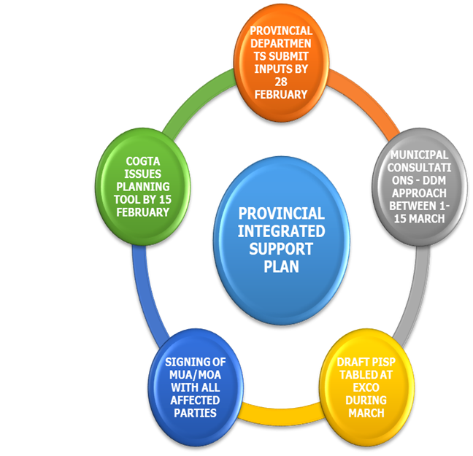
PROVINCIAL INTEGRATED SUPPORT PROCESS PLAN
Proposed process to guide the Development, Implementation and Accountability of the Provincial Integrated Support Plan:
COORDINATION AND PLANNING

Slide 27
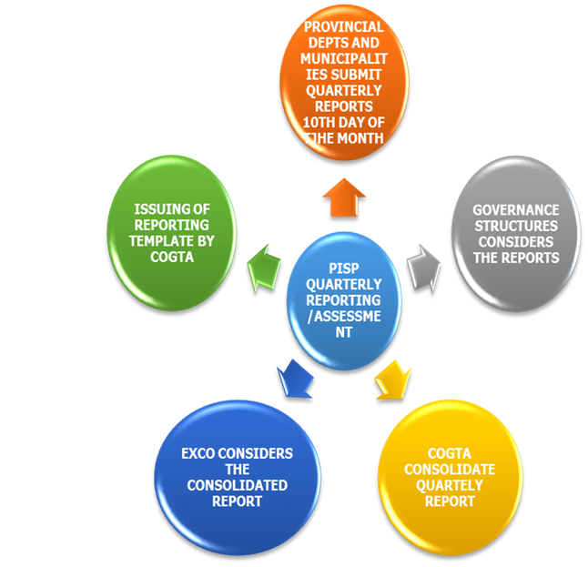
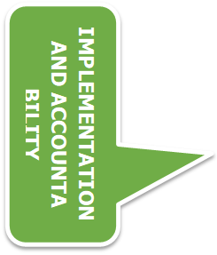
PROVINCIAL INTEGRATED SUPPORT PROCESS PLAN

Slide 28
Conclusion
The implementation of the District Development Model was supported by having both the Deputy Ministers Sotyu and Nzuza visiting the district to have first-hand information on projects within the district and were introduced as DDM Cabinet Champions to assist the District to implement the DDM.

Slide 29
Siyabonga
Realeboga
Ro livhuwa
THANK YOU

