Slide 1
SENTECH Quarter Two ended Sept 2020
Performance Report
Presented to: Portfolio Committee on Communications
Date: 2 March 2021

Slide 2
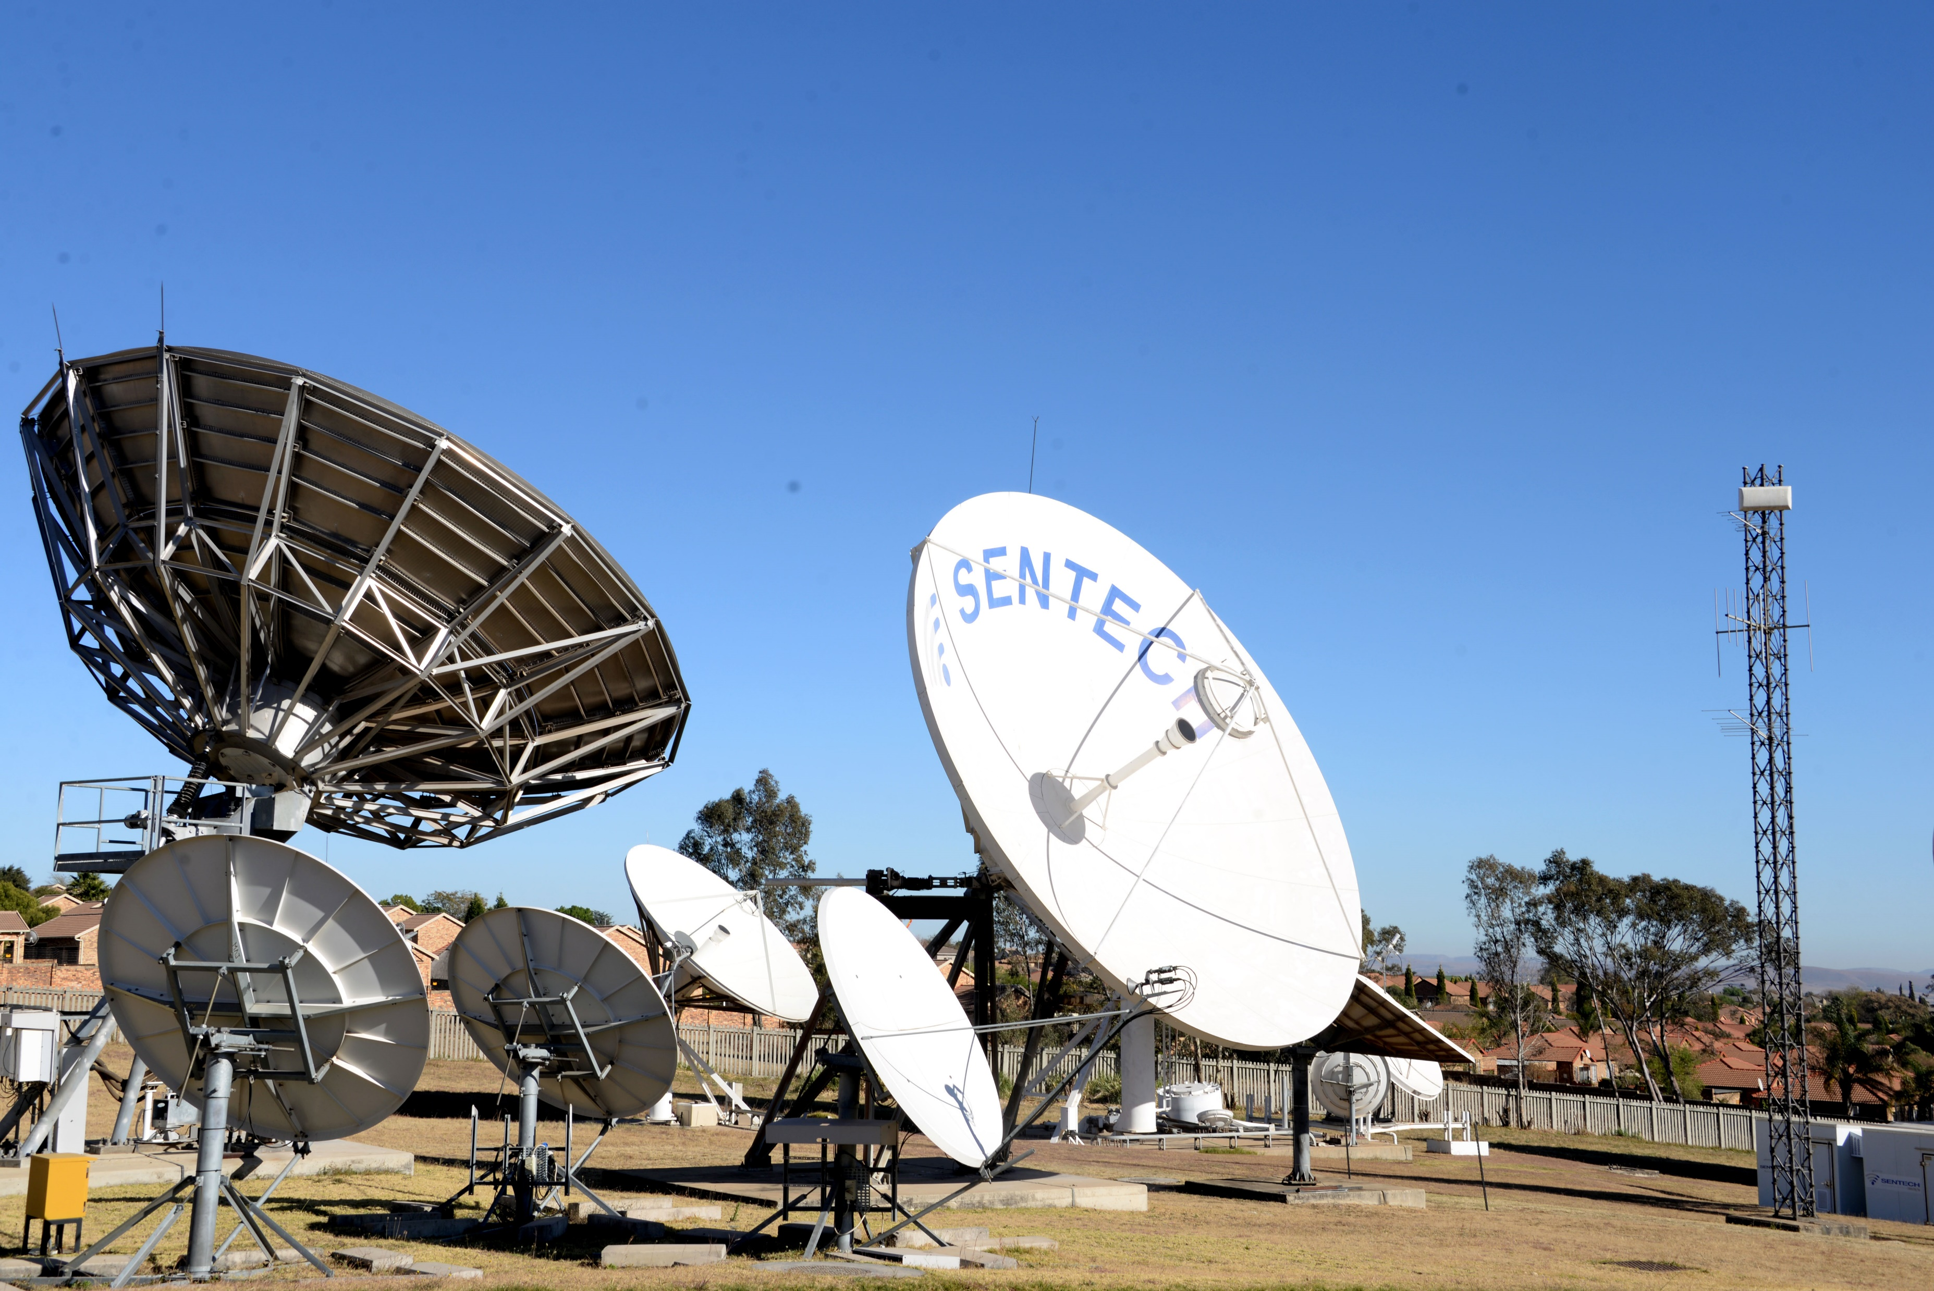
Presentation Outline
Quarter 2 Results Presentation:
Performance Highlights
Financial Performance
Human Capital Report
Risk Management Plan
Conclusions

Slide 3
Performance Highlights

Slide 4
Business highlights
Indicator | Variance (R’000) | Actual (R’000)
▲Total Revenue | 48 711 | 739 567
▲Continuing business revenue | 57 778 | 662 526
▲EBIT | 69 285 | 136 304
▲Net Profit | 42 818 | 80 821

Slide 5
Portfolio Performance
Revenue performance for Q2 2020 was 10% (R58m) above budget (R662m actual vs R604m budget).

Slide 6
Performance against predetermined objectives
82% achievement of predetermined objectives
Strategic Pillar | Outcome | Annual KPI Target | Q2 | Q2 Actual Performance | Achieved / Not Achieved
Optimisation and Growth | Sustainable growth Optimised cost structure | R1,185 million | R604 million (cumulative) | R663 million | Achieved
 |  | R 137 million | R67 million (cumulative) | R136 million | Achieved
Innovation and Digital Readiness | Right technology in the right place at the right time / able to use | Two 4IR technologies initiated (Data Analytics and AI) | Data Analytics strategy developed AI strategy developed | Data Analytics strategy not developed AI strategy not developed | Not Achieved
 | Focused pipeline of innovative products and platforms that deliver strategic and operational value | 2 digital products launched for commercial customers | Business model and plan developed for 2 digital products | Business model and plan for 2 digital products developed | Achieved
Customer Centricity | Satisfied customers/ stakeholder High customer Loyalty NPS | Customer satisfaction levels of baseline +5% | Engagements with top 5 Tier 1 customers | Engagements were held with 6 customers i.e. SABC, MultiChoice, PRIMEDIA, Vodacom, MTN and Cell C | Achieved
 |  | 99.80% Weighted average availability based on product | Weighted average availability based on product revenues of 99.80% | Weighted average availability based on product revenues of 99.87% | Achieved
 |  | Blue print for the NBNC developed | Project plan and resource; terms of references and requirements finalised | Project plan and resource, terms and requirements not finalised | Not Achieved
Talented People | Right people in the right place at the right time with the right skills and mindset | 90% of planned skills training interventions implemented | 45% of planned skills training interventions implemented | 49.8% of planned skills training interventions were implemented | Achieved
Transformation | Contribution to industry transformation goals | 100% of allocated budget spent on ESD | ESD revised project plan developed and necessary resources acquired | ESD revised project plan developed and necessary resources (R5million) acquired | Achieved
Environmental Preservation | Carbon footprint reduced Energy efficiencies achieved | 2 sites converted to green energy supply | Design and solutions requirements concluded for 2 sites | Design and solution requirements concluded for 2 sites i.e. Durban North and Potgietersrus site | Achieved
Reputation | Clean audit Increased brand equity | Clean audit achieved | No performance required | No performance required | No performance required

Slide 7
Network Performance
We achieved 99.87% weighted network
National Network Performance - Q2 FY2020/21
Network Services | SLA Target (%) | SENTECH Performance(%) | R'000 | Weighted Ave | KPI SLA Target
Analogue Television | 99,70 | 99,88 | 154761 | 50,93 | 50,89
FM Radio | 99,70 | 99,85 | 83447 | 27,45 | 27,44
Medium Wave Radio | 99,50 | 99,98 | 2488 | 0,82 | 0,82
Satellite | 99,80 | 99,99 | 41852 | 13,79 | 13,76
Connectivity Services | 99,70 | 100,00 | 3025 | 1,00 | 0,99
DTT Commercial | 99,61 | 99,59 | 17915 | 5,88 | 5,89
 |  |  | 303488 | 99,87 | 99,80

Slide 8
Financial Performance

Slide 9
Financial Summary

Slide 10
Statement of Profit or Loss
Description | Quarter 2 FY2021 |  |  |  | YTD September 2020
 | Actual | Budget | Variance |  | Actual | Budget | Variance
 | R'000 | R'000 | R'000 | % | R'000 | R'000 | R'000 | %
Revenue | 324,539 | 303,343 | 21,197 | 7% | 662,526 | 604,748 | 57,778 | 10%
Employee costs | (106,445) | (106,825) | 380 | 0% | (211,273) | (209,361) | (1,913) | (1%)
Depreciation and amortisation | (54,606) | (68,423) | 13,817 | 20% | (128,286) | (137,563) | 9,276 | 7%
Lease expenses | (28,402) | (12,322) | (16,080) | (130%) | (38,944) | (24,607) | (14,337) | (58%)
Operating expenses | (66,724) | (64,040) | (2,685) | (4%) | (112,011) | (113,946) | 1,935 | 2%
Direct expenses | (62,776) | (71,071) | 8,294 | 12% | (112,749) | (138,362) | 25,613 | 19%
Dual Illumination costs | 39,049 | 44,844 | (5,795) | (13%) | 77,041 | 86,109 | (9,067) | (11%)
Normalised Operating Profit | 44,635 | 25,507 | 19,128 | 75% | 136,304 | 67,019 | 69,285 | 103%
Dual Illumination Revenue | (39,049) | (44,844) | 5,795 | 13% | (77,041) | (86,109) | 9,067 | 11%
Dual Illumination costs | 39,049 | 44,844 | (5,795) | (13%) | 77,041 | 86,109 | (9,067) | (11%)
Operating Profit | 44,635 | 25,507 | 19,128 | 75% | 136,304 | 67,019 | 69,285 | 103%
Finance income | 14,408 | 11,068 | 3,340 | 30% | 32,925 | 23,594 | 9,331 | 40%
Finance costs | (38,627) | (30,061) | (8,566) | 28% | (88,408) | (52,610) | (35,798) | 68%
Profit Before Taxation | 20,416 | 6,513 | 13,903 | 213% | 80,821 | 38,003 | 42,818 | 113%
Taxation | (5,717) | (1,824) | (3,893) | (213%) | (22,630) | (20,991) | (1,639) | (8%)
Profit or (Loss) for the year | 14,700 | 4,690 | 10,010 | 213% | 58,193 | 17,012 | 41,180 | 242%

Slide 11
Management Letter Points
As part of the client engagement process, the external audit engagement team identified issues that required reporting to management and other parties charged with governance.
To deal with these issues, and in accordance with normal practice, the external auditors wrote to draw managements’ attention to certain matters which were identified during the audit of SENTECH’s financial statements for the year ended 31 March 2020.
During the 2019/20 financial year end audit, a total of 8 management letter points were raised with key findings related to Finance, SCM, Legal and Operations divisions. The table below provides a summary progress that is made to date regarding the MLPs.
Status | FY2020 MLPs | % of total
Completely Addressed | 5 | 62,5%
In Progress | 2 | 25%
Not completed | 1 | 12,5%
Total | 8 | 100%

Slide 12
Human Capital Report

Slide 13
Human Capital
Head count of 499 at a salary bill of R 107 658 755.33 for the Quarter
Staff turnover at 0.40% which is below the 10% standard norm.
Staff cost at 33% (target is 32% for year end)
598 (49.8%) training interventions against target of 1020 (85%) implemented
Total Recordable Injury Rate (TRIR) level at 0,1887% which is below 1% target
Employment Equity
Women representation is currently 37%. The target is to achieve 38% representation for women by the end of the financial year.
The current employment equity statistics reflect that:
88% of staff in the organisation is black and 34% women.
At top management levels, 100% are black and 0% women;
100% of Executive management is black and 57% women.
At senior management 88% are black and 47% are women, and
81% of specialists and middle management levels are black and 31% women.
The number of people living with disabilities is 1.2% (6).

Slide 14
Risk Management

Slide 15
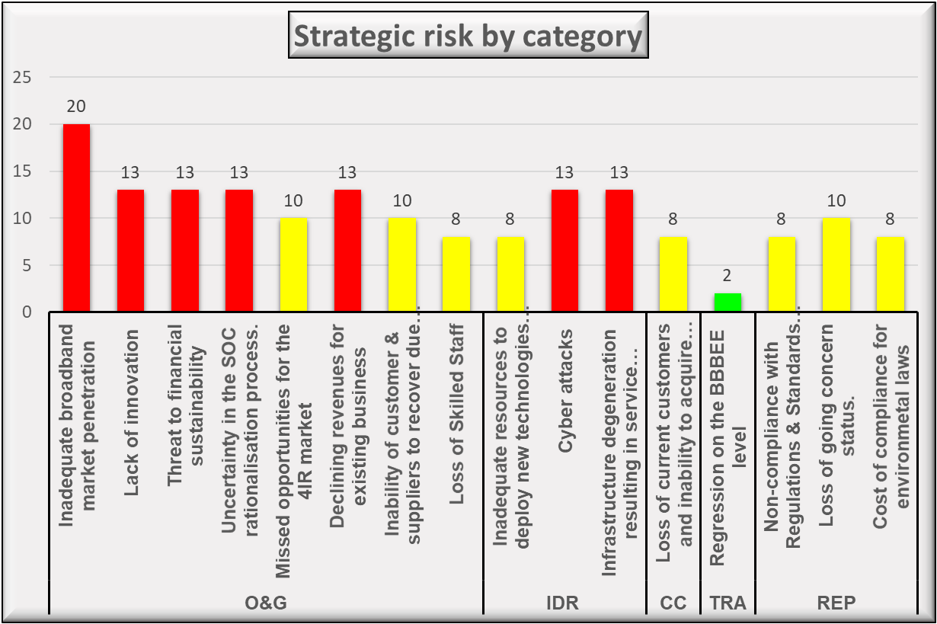
Strategic Risks

Slide 16
Strategic Risks
New and Emerging Risks
The emerging risk is due to the SABC announcing a reduction in DTT sites or going DTH instead of DTT. This will have a direct impact on SENTECH’s sustainability and the failure of DTT as a platform.
Business Continuity Management
The BC plan was invoked during the last quarter of the 2019/20 financial year. The plan has been implemented and supporting documents reviewed and developed as required. There were 19 new cases that have been reported during quarter bringing the total number of confirmed Covid-19 cases to 29.
The BC risks are being monitored and the BC plan was successfully implemented to ensure continuity of operations and limiting the spread of the virus.
There were also two IT incidents reported during the quarter that had a significant impact on operations. The IT disaster recovery (DR) was implemented however in some areas it failed. Plans are underway to close the gaps and limit disruptions to ensure business continuity.

Slide 17
Strategic Risks
Progress on implementation of FPP
Fraud prevention plan was revised for the financial year 2020/21 that includes the awareness programmes.
There were two fraud awareness activities conducted during quarter 2. The one related to the use of the fraud hotline and the aim was to encourage employee to continue using the hotline.
The second awareness was on the ways to spot fraud red flags.
Fraud risks
All the identified fraud risks are constantly being monitored.
There were a total of 13 fraud risks of which only one is rated high. The high risk is related to theft and vandalization at sites.
There are no changes to the other fraud risks.

Slide 18
Conclusion

Slide 19
Conclusion
For the period under review continuing business revenue was 10% above budget (R662m actual vs R604m budget) and EBIT was R69m above budget (R136m actual vs R67m budget). Operating expenditures was 3% (R21m) below budget (R603m actual vs R623m budget).
Overall product performance was above budget. DTT Commercial came marginally below target (99.59 performance against SLA of 99.61) which was triggered by load shedding incidents that exposed underperforming UPS’s. Analogue TV services remain under threat due to ageing infrastructure and technology obsolescence which amplifies the urgency for the full implementation of digital migration.
The organisation has noted a decline in the number of Covid-19 infections and 18 cases were reported for the period under review. The organisation continues to intensify Covid-19 safety messaging and providing necessary support to the affected colleagues and their families.
It should be noted that the set targets were executed amidst the Corvid-19 pandemic and in a period of national lockdown which carried stringent trade regulations under alert levels 3 to 1. Management reviewed and implemented the set KPIs in order to ensure that the organisation remains sustainable and relevant to survive the prevailing tough economic climate.

Slide 20
Thank You!

