Slide 1
NATIONAL FORENSIC OVERSIGHT AND ETHICS BOARD
BRIEFING TO THE PORTFOLIO COMMITTEE ON POLICE
PROGRESS REPORT
ESTABLISHMENT AND OPERATIONS OF THE DNA BOARD
2 MARCH 2021

Slide 2
Presentation outline
Background
Board introduction
Governance
Engagement with Ministry
Plan of Action
Concluding remarks

Slide 3
Board introduction
NAME | DESIGNATION
Adv. L Nkosi-Thomas | Chairperson
Adv. R Rawat | Private
Mr. D Morema | Private
Dr. K Ehlers | Private
Mr. R Sono | Private
Dr. N Myeza | Private
Mr. AP Rapea | Public sector (Civilian Secretariat for Police Service)
Adv. O Sewpaul | Public sector (Department of Justice & Constitutional Development)
Mrs. A Grove | Public sector (Department of Health)
Mr. L Mthethwa | Department of Correctional Services

Slide 4
Background
On 21 October 2020 the Civilian Secretariat for Police Service delivered the following presentation to the Committee:
Handover Report of the National Forensic Oversight and Ethics Board (DNA Board); and
Status update on the appointment of the new National Forensic Oversight and Ethics Board.
The following areas of concern, among others, were flagged by the Committee:
Functionality of the National Forensic DNA Database (NFDD);
DNA casework backlogs;
Unavailability of buccal sample kits; and

Slide 5
Background
Contract management.
Delays in the approval of the DNA Bill;
Signing of the SLA in respect of the SAPS acquiring the CODIS
software to conduct familial searches on the NFDD (SAPS and
FBI);
Delays in the approval of the DNA Bill;
Rollout of awareness campaigns; and
The finalisation of the Board appointment process.
In accordance with section 15V(5)(a) of the DNA Act, the Minister is required to inform Parliament of, among others, the appointment of the Board – Notice placed in ATC on 14 October 2020

Slide 6
Governance
 | MEETING DESCRIPTION | DATE | ACTIONS
1 | Inaugural meeting with the Minister of Police | 30 November 2020 | Minister requests the Board to develop a Plan of Action (PoA).
2 | Inaugural meeting of the DNA Board and the Division: Forensic Services | 7 December 2020 | N/A
3 | Ad Hoc Sub-committee | 18 December 2020 | Mapping out a process for the development of the PoA.
4 | Board meeting | 5 February 2021 | Preparatory meeting and review of PoA.

Slide 7
Engagement with Ministry
On 30 November 2020, the Board held its inaugural meeting with the Minister and Deputy Minister; providing an opportunity to better understand the Ministry’s overall policy intent with respect to ensuring the effectiveness and efficiency of the Division: Forensic Services.
The following areas and/or factors were highlighted as key constraints to the optimal functionality of the Division:
Ineffective supply chain management systems and processes leading to protracted delays in the procurement of buccal sample kits, consumables, and the awarding of bids/contracts for the calibration and maintenance of equipment.
Shortage of buccal sample kits at service delivery points and the resultant growing DNA casework backlogs – especially GBV cases.

Slide 8
Engagement with Ministry
In seeking to address these matters in a systematic and coordinated manner, the Minister requested the Board to develop a Plan of Action (PoA) as a basis for:
Identifying specific areas and/or factors that currently, or may in future, impede the effective functioning of the Forensic Science Laboratory (FSL), and the NFDD, more specifically;
Regular tracking and measurement of progress against predetermined priority areas, targets and performance metrics (short-, medium- and long-term) ;
Implementation of appropriate risk mitigation strategies and measures; and
Facilitating regular reporting on progress (Parliament and Minister).

Slide 9
Plan of Action
On 7 December 2020 the Board met with the Division: Forensic Services (DFS) to get a deeper understanding and appreciation of the challenges hampering its effective and efficient functionality.
Following a detailed briefing by the Division, the Board resolved to establish an ad-hoc sub-committee to facilitate the development of the PoA.
The following members were unanimously nominated to serve on the sub-committee:
Dr. K Ehlers – Chairperson
Adv. R Rawat
Mr. D Morema
Mr. R Sono

Slide 10
Plan of Action
Terms of Reference were drafted for the sub-committee and approved by the Board.
The PoA draws on the key priority areas identified by the Division: Forensic Service in its Turnaround Strategy (presented to the Committee on 11 November 2020).
It is augmented by data and findings from a recent evaluation on the DNA Act concluded by the Evaluations Directorate within the Civilian Oversight, Monitoring and Evaluation Unit.
A common thread can be drawn through the various issues identified in this study, concerns raised by the DFS, as well as those identified in the Handover report presented to the Committee on 21 October 2020.

Slide 11
Plan of Action
Specific emphasis will be placed on assessing and tracking the adequacy of corrective measures implemented in the following areas:
Contract management (e.g. procurement of buccal kits, consumables and
the awarding of bids for the calibration and maintenance of equipment);
Reduction of DNA casework backlogs (GBV);
Establishment of Forensic Investigative Units;
Finalisation of the CODIS (Familial searching) software acquisition process (signing of the SLA between SAPS and FBI);
Monitoring of the utilisation and impact of forensic products in the investigation of crime and court outcomes;
Inadequate baseline (operational) budget adjustments to support service delivery demands;

Slide 12
Plan of Action
Modernisation and maintenance of forensic equipment and
methods;
Staffing requirements to meet increasing demands for forensic
products;
Modernisation of IT infrastructure to support the optimal processing
of forensic exhibit material and records;
Full accreditation of all laboratories to conduct DNA analysis.

Slide 13
Plan of Action

Slide 14
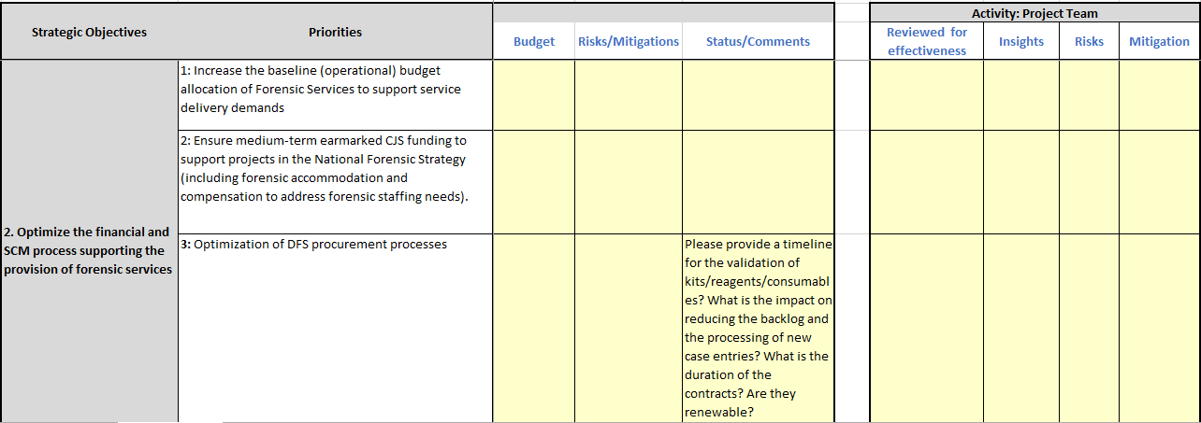
Plan of Action

Slide 15
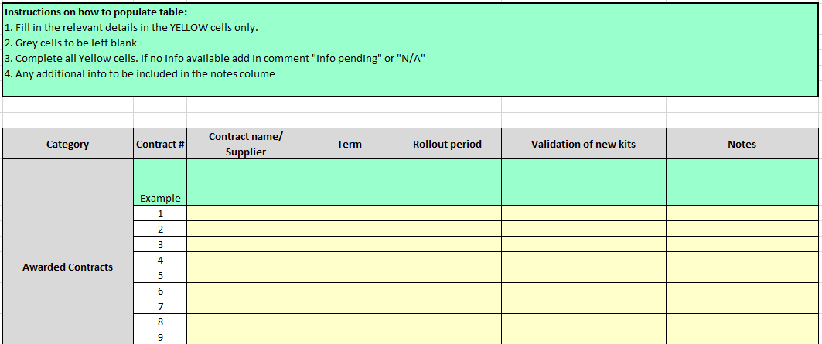
Plan of Action

Slide 16
Plan of Action

Slide 17
Concluding remarks
The Board has adopted a phased approach to monitoring and overseeing progress made by the DFS in respect of progress reported against key priority areas identified in its Turnaround Strategy.
Over the immediate-term, emphasis will be placed on finding urgent solutions to the contract management challenges hampering the functioning of the FSL and the NFDD.
Moreover, focus will be given to strategies and measures put in place to reduce DNA casework backlogs, with an active focus on timelines provided for the reduction of these backlogs..
Monitor progress on the signing of the CODIS SLA (Familial searching).

Slide 18
Concluding remarks
Facilitate the promulgation of section 36(D)(1) of the DNA Act – ensures sufficient national representation for the taking of buccal samples.
Monitor progress in relation to the establishment of Forensic Investigative Units in all provinces to support the follow up of forensic investigative leads.
The Board has developed a positive and constructive working relationship with the Minister, Deputy Minister and their staff, and receives the necessary support as and when required.
Working relations between the Board, the DFS and the Civilian Secretariat are positive and encouraging.

Slide 19
Thank You

