Slide 1
NORTH WEST
DEPARTMENT OF HEALTH
PRESENTATION NATIONAL PORTFOLIO COMMITTEE ON HEALTH MANAGEMENT OF COVID-19
HON MADODA SAMBATHA
24 February 2021

Slide 2
PURPOSE
Providing Information
Obtaining further advice and direction

Slide 3
CONTENT
Definitions
Current COVID 19 situation in South Africa and the North West
Weekly increase in COVID 19 cases
Hospital admissions
Morbidity data
Affected NWDoH Staff
Analytical Summary
Treatment Response
Challenges, Strengths, Risks
Benchmarking with Western Cape and Eastern Cape
Vaccine roll-out
Way Forward

Slide 4
PILLARS OF THE NW COVID-19 STRATEGY
PREVENTION
PPE
Health Education, Screening, Screening
Management of contacts, (Quarantine)
Management of confirmed persons (isolation)
Vaccination
TREATMENT
Different degrees of illness persons general and ICU beds
SURGE PREPAREDNESS
Additional space for quarantine, isolation and treatment
MANAGEMENT OF HUMAN REMAINS
E
P
I
AND
I
N
F
O
MX
TRA
I
N
I
NG
COMMUN
I
CAT
I
ON
COL
LABORAT
I
ON
DES
IRED
OUTCOME
Mx of
other DB
contributors
Mx of
other DB
contributors
Mx of
other DB
contributors
Mx of
other DB
contributors
Mx of
other DB
contributors
STAFF WELLNESS - PHYSICALLY AND MENTALLY
Referral System
Administrative Processes HR, Finance, SCM, Discipline
Infrastructure (Buildings, Equipment, ICT)
Governance and Community Participation

Slide 5
Key Data as at 22 February 2021
Routine data for week 6 and 7; Year 2021 – (8 to 21 February 2021)

Slide 6
DISTRIBUTION
1 504 588

Slide 8
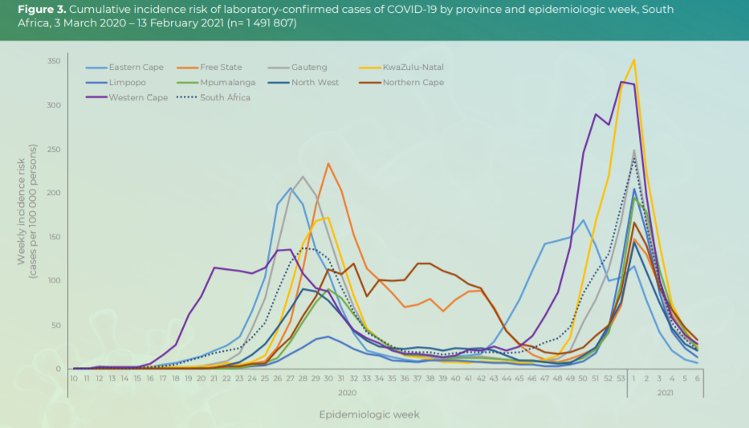
National Weekly Increase/ Decrease
Notes:
KZN average has passed WC and starting to catch EC
FS is catching NW - FS % growth was the highest over the last week
NC average almost 100 now
GP average is over 5000 daily

Slide 9
Provincial Weekly Increase / Decrease
Notes:
KZN average has passed WC and starting to catch EC
FS is catching NW - FS % growth was the highest over the last week
NC average almost 100 now
GP average is over 5000 daily

Slide 10
INTERPRETATION OF SLIDES 8 and 9
The Charts depicts the following:
  Eastern Cape started its second surge in October 2020 and was also first to show a decrease in daily numbers of positive persons in the first week of December 2020 and this province currently records the lowest daily numbers out of all 9 provinces
  NW started its second surge during the first week of December 2020 and started to show a decline in daily positives in the second week of January 2021
  NW Currently has the third lowest daily positives after EC and Limpopo while NC, KZN, WC, and Mpumalanga record the highest daily numbers
  All nine provinces are currently on a downward trajectory
  All 4 districts of the NW Province are on a downward trajectory
  NW’s current average recovery rate at 92%, below SA recovery rate of 94%. The reason for the lower recovery rate is that NW surged later than other provinces like EC, WC, GP and KZN

Slide 11
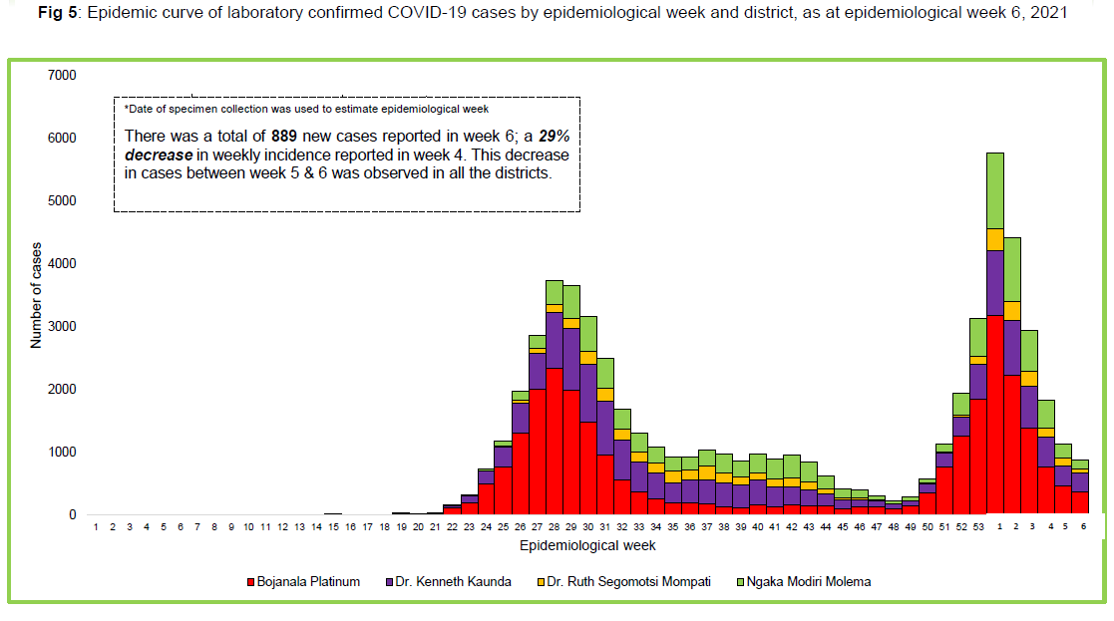
COMPARISON BETWEEN FIRST AND SECOND SURGE
Notes:
KZN average has passed WC and starting to catch EC
FS is catching NW - FS % growth was the highest over the last week
NC average almost 100 now
GP average is over 5000 daily

Slide 12
INTERPRETATION OF SLIDE 11
The Charts provides a picture of the current increase in daily numbers compared to the first peak
The officials of the NW government, supported by the EXCO need to continue working in unison to flatten the curve
This means that apart from going to work and undertaking activities to generate legal income, citizens must stay at home and adhere to the red toolbox
  Health education (education on adherence to red toolbox) by all departments and MECs and Premier
  Law enforcement by the police

Slide 13
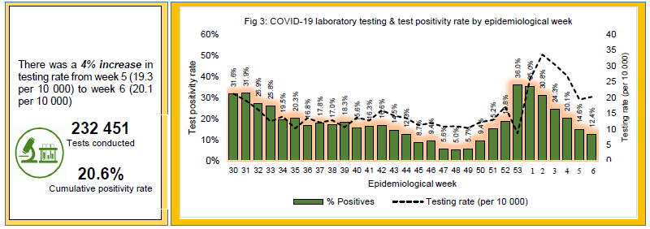
CONTACT TRACING

Slide 14
QUARANTINE SITES
District | Name of Public Quarantine facility | Number beds | Current admissions | Name of Private Quarantine facility | Number beds | Current admissions
Dr RSM | Christiana All Seasons Resort Hotel | 46 | 0 | Molopo Travel Inn | 26 | 0
Dr RSM | Taung Hotel School | 33 | 0 | The Times | 17 | 0
Dr RSM | - | - | - | Klondike | 20 | 0
TOTAL =0 |  |  | 0 |  |  | 0

Slide 15
QUARANTINE SITES
District | Name of Public Quarantine facility | Number beds | Current admissions | Name of Private Quarantine facility | Number beds | Current admissions
Dr KK | Potch Dam | 26 | 16 | Lafloza | 74 | 0
Dr KK | - | - | 0 | Ngwenya | 431 | 0
Dr KK | - | - | 0 | White House guest house | 14 | 0
 |  |  |  | Harmony East Boarding House | 185 | 2 (isolation)
 |  |  |  | Harmony Mazenzele | 42 | 9(isolation)
 |  |  |  | Harmony Chief Phera | 22 | 0
TOTAL = 27 |  |  | 16 |  |  | 11

Slide 16
QUARANTINE SITES
District | Name of Public Quarantine facility | Number beds | Current admissions | Name of Private Quarantine facility | Number beds | Current admissions
NMM | Cookes-Lake | 10 | 04 | Kobo Segole | 29 | 0
NMM | Mafikeng Hotel school | 16 | 0 | Lowatla | 05 | 0
NMM | Madikwe River Lodge | 16 | 0 | - | - | -
NMM | Mafikeng Game Reserve | 29 | 0 | - | - | -
TOTAL = 04 |  |  | 04 |  |  | 0

Slide 17
QUARANTINE SITES
District | Name of Public Quarantine facility | Number beds | Current admissions | Name of Private Quarantine facility | Number beds | Current admissions
Bojanala | Bakgatla Resort | 43 | 17 | Bleskop Hostels | 168 | 20
Bojanala | Manyane Resorts | 45 | 0 | Bleskop Single quarter | 72 | 0
Bojanala | - | - | - | Impala Mine | 1 040 | 142
Bojanala | - | - | - | Sundown Ranch | 60 | 0
TOTAL = 179 |  |  | 17 |  |  | 162

Slide 18
Provinces | Population * | 819 February 2021 Week 6 | % Per Population |  | Death | Proportion of Death per confirmed case | % Death per Population
Eastern Cape | 6 734 001 | 193637 | 2,9% |  | 10940 | 5,6% | 0,162%
Free State | 2 928 903 | 79313 | 2,7% |  | 2846 | 3,6% | 0,097%
Gauteng | 15 488 137 | 401632 | 2,6% |  | 8592 | 2,1% | 0,055%
KwaZulu-Natal | 11 531 628 | 326703 | 2,8% |  | 9069 | 2,8% | 0,079%
Limpopo | 5 852 553 | 61370 | 1,0% |  | 1493 | 2,4% | 0,026%
Mpumalanga | 4 679 786 | 70011 | 1,5% |  | 1053 | 1,5% | 0,023%
North West | 4 108 816 | 60214 | 1,5% |  | 1027 | 1,7% | 0,025%
Northern Cape | 1 292 786 | 33504 | 2,6% |  | 599 | 1,8% | 0,046%
Western Cape | 7 005 741 | 275983 | 3,9% |  | 10580 | 3,8% | 0,151%
Unknown |  | 0 |  |  | 0
Total | 59 622 351 | 1 502 367 | 2,5% |  | 46199 | 3,1% | 0,077%
* Source: Statsa 2020 Mid-year population estimates

Slide 19
INTERPRETATION OF SLIDE 18
  Slide 18 shows that with regard to percentage of population who tested positive for COVID-19, the NW shares the second lowest place with Mpumalanga after Limpopo that has the lowest percentage of population who are positive.
  WC has the highest percentage of positive population, followed by EC, KZN and Free State while GP and NC shares the 3rd place

Slide 20
MORTALITY IN THE NWP

Slide 21
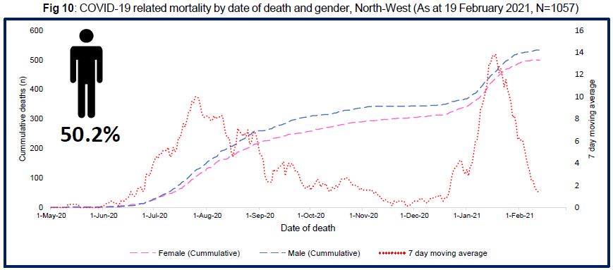

Slide 22
INTERPRETATION OF SLIDES 24 AND 25
  50,2% of those who died are male while 49,8% are female
  Average number of deaths over a 7 day period measured as a weekly reduced significantly from the end of October to the end of November 2020 , but started to increase slightly from beginning of December 2020 until the second week of January 2021.
  Deaths increased sharply during the second week of January then started to decrease again during the third week of January 2021.
  The NW currently has a case fatality rate of 1.6%, meaning that 1.6% of people who contract Covid-19 have died

Slide 24
NWDOH STAFF STATUS
CATEGORIES | CONFIRMED | RECOVERIES | RECOVERY RATE | DEATHS | CASE FATALITY RATE | ACTIVE CASES | HOSPITALISED
DOCTORS | 224 | 222 | 99.11% | 0 | 0% | 2 | 0
NURSES | 1824 | 1763 | 96.66% | 30 | 1.64% | 31 | 2
OTHER | 1987 | 1927 | 97.03% | 34 | 1.71% | 26 | 0
TOTAL | 4035 | 3912 | 96.98% | 64 | 1.59% | 59 | 2

Slide 25
HOSPITALIZATION

Slide 26
HOSPITALIZATION

Slide 27
ANALYTICAL SUMMARY
There is a decrease of positive cases observed from week one to week 6 of 2021
From week 2 to week 3, hospitalization admissions reduced by 80%, and by 32% from week 5 to week 6
Current Case Fatality rate is 1.9% and is below the national rate of 2.7%

Slide 28
BED CAPACITY
We have strengthened our emergency medical services with additional vehicles and have contracted additional EMS officers to ensure that patients can be safely transported from areas where there are bed pressures to the hospitals in Dr Kenneth Kaunda that have available capacity.
The following additional beds were made available IMMEDIATELY
  Increase operational beds at Westvaal from 60 to 110 already in place and will be escalated to 142 beds with staff recruitment and on demand
  An additional 32 beds at Tshepong hospital through repurposing the surgical ward
  Reopening of Duff Scott will avail another 100 beds on demand
  Field hospital in Mahikeng with 20 beds is available now that a second generator has been installed
    An additional 22 beds at ward one in JST – 6 ICU and 16 general
    Additional beds next to the gateway clinic at JST
    An additional 32 beds at JMM – 6 ICU, 8 High Care and 18 general
Additional bed capacity that was realized to manage Covid-19 cases is now being used for the vaccination programme

Slide 29
EQUIPMENT AND STAFFING
Currently have sufficient equipment, oxygen and ventilators
Oxygen is mainly provide through cylinders and we have started a process of installing reticulated oxygen
We do however plead with the community to adhere to the amended level 3 lockdown regulations and to the Red Toolbox so that current increase in daily numbers is halted because there is not an endless supply of beds and equipment
With regard to staffing, the three large hospitals namely Job Shimankana Tabane, Klerksdorp-Tshepong and Mahikeng were experiencing pressure with regard to shortage of staff. This is because some of the staff also contract Covid-19 and then are off from work until they are well. The NWDoH continue to work with the Provincial Treasury to reprioritize available funds to be able to appoint additional staff where needed.
Additional staff are now required for the vaccination programme

Slide 30
CHALLENGES FOR THE NWDOH
NWDoH Currently has only 2 challenges
Contact tracing – wrong phone numbers, not found at addresses
Limited Capacity of Environmental Health in Municipalities
Staffing for vaccination programme
Transport for persons to be vaccinated
However, the following will arise as challenges if we do not flatten the curve
Bed availability
Reticulated Oxygen

Slide 31
CHALLENGES FOR THE NWDOH
Item | Preparedness level | Comment
HR |  | Recruitment of additional staff is ongoing
Bed availability |  | Monitoring the situation closely. Currently there are adequate beds
PPEs |  | There is a two month buffer
Equipment |  | Adequate number of beds, we continue to procure as demand grows Sufficient ventilators, sufficient oxygen. Piped Oxygen needs attention – started project with NDoH in this regard
Drug availability |  | Medicines needed for COVID-19 symptomatic treatment is available
Transport |  | Inadequate transport particularly for contact tracers. The process of leasing additional transport is at advanced stage.

Slide 32
STRENGTHS OF THE NWDOH
Dedicated frontline staff and managers
  Willing to multi-task
  Take problems in their stride, immediately think of options for solutions and act
    Large numbers of staff testing positive
Guidance from NW Covid-19 Command Council
Action from NW Covid-19 District Command Councils
Good cooperation with Provincial Treasury
Good cooperation with sister departments (provincial and national), other provincial departments, private sector, NGO sector, academia
Consequence management

Slide 33
STRENGTHS OF THE NWDOH
Received the following Donations
  Field Hospital - NDoH
  Beds - NDoH
  PPE - NDoH, Mines, Insurance Companies
  Cuban Brigade - NDoH
These donations have been given and received following PFMA prescribed asset management procedures

Slide 34
STRENGTHS OF THE NWDOH continued
[01/28, 14:38] Person 1: *PLEASE TAKE NOTE* That Covid-19 testing can no longer be done at Tshepong Hospital due to the computer used for the analysis having being stolen.
[01/28, 14:39] Any response on the above because it is trending
[01/28, 14:57] Person 2: Covid testing is done and has never stopped at Tshepong. The computer was stolen but was retrieved after a day. The perpetrator was arrested. Laptop was retrieved on Tuesday from the police station, unfortunately all programs were deleted but the supplier managed to load all the programs again. The lab have processed all backlog samples. We no longer have any backlog and are testing today's samples.

Slide 35
STRENGTHS OF THE NWDOH continued
NWDoH promptly deals with fake news

Slide 36
CURRENT RISKS
Cross border and inter- provincial travelling to hot-spot provinces
The rapid rise of infections is being fuelled by so-called super spreader events including, family and social gatherings, music and cultural events
Social Behaviour e.g. people are not wearing of masks, non -compliance to social distancing and not washing hands or sanitising – lack of adherence even from our own staff (frontline and management)
Excessive alcohol consumption is also driving up the number of trauma cases in our hospitals
Venues are often poorly ventilated and their permitted capacity is being exceeded
Hand sanitizers not being used, and masks are being worn to gain entry, only to be taken off once inside
Spike in Covid -19 cases as employees return to workplaces.

Slide 37
Lessons Learned
Covid-19 is a new rapidly evolving disease and we have to work with the knowledge we have at any given time while being continually prepared to respond to the impact of new evidence provided by research
COVID-19 is a societal matter that requires community participation and behavioural changes in the communities to combat spread
National and Provincial Command Councils are key to the required coordinated response
District Command Councils are key to facilitating the multi-sectoral approach at ground level which is required to address social determinants of health and the DCC should continue to function even after Covid-19 has been eliminated
Lockdown measures, together with adherence to the RED TOOLBOX are hugely successful in minimising transmission
Collaboration with other sectors and government departments facilitates effective responses in both prevention and treatment of Covid-19
Standardized COVID 19 protocols in both Public and Private sector are important for effective management of the pandemic.
Adequate staffing is key
Provision of appropriate PPE and Psychosocial support for front line workers are key.

Slide 38
Lessons learned continued
Establishment of OHS committees at all levels including in mining and big businesses is key.
Establishment of workplace plans and continuous monitoring of implementation of workplans are key
Aggressive communication and social mobilization activities e.g. MEC led campaigns through different media platforms and community engagement and distribution of materials are key
Ward Based Response Teams are required to arrest the spread

Slide 39
LESSONS FOR NW OUT OF BENCHMARKING WITH EC AND WC
NW province has a strong, comprehensive covid-19 management and resurgence management strategy including all the aspects of EC and WC plans
Similar to those two provinces, the NW also have Staffing pressure Nurses, doctors EMS Officers. This is less severe in NW because of the post filling drive that started in 2018 and continues to be addressed through consultations with Provincial Treasury
NW Province has to:
  Increase compliance by citizens since this is a huge problem and compliance needs to be enforced through
    Strengthen environmental Health services at municipal level – the NWDoH contracted additional environmental Health Officers but this is not enough
    Enforce compliance with Regulations - SAPS

Slide 40
WAY FORWARD
Vaccine Rollout Plan

Slide 41
VACCINATION ROLL-OUT
Vaccination is one of many interventions required to prevent infection and death
Vaccination confers personal protection to a person who is vaccinated against a disease and it reduces the risk of infection
Vaccination of communities aims to achieve herd (population) immunity and prevent ongoing transmission.
'population immunity', is the indirect protection from an infectious disease that happens when sufficient immunity develops in a population either through vaccination or through previous infection.
Conventionally population immunity is achieved when more than 67% of the community develops immunity
Population immunity Lowers the possibility for a pathogen to circulate in the community therefore protecting those who cannot be vaccinated (due to health conditions, like allergies, or their age) from the disease targeted by the vaccine

Slide 42
VACCINATION ROLL-OUT
Total Population of North West Province 4.1 Million
Population immunity target 67%
Population to be vaccinated to achieve population
immunity 2.7 million

Slide 43
VACCINATION ROLL-OUT PILLARS
Governance, co-ordination and planning
Identification and prioritisation of target population
Vaccine allocation and vaccination site readiness
Human resources including training and supervision
Vaccine administration, cold chain, logistics and infrastructure
Safety surveillance
Data management, information systems and monitoring and evaluation
Communication and Demand creation
Financing and Budgeting

Slide 44
VACCINATION ROLL-OUT – PHASE 1
This phase is characterized by a situation where there is a limited supply of vaccines
It therefore targets the persons at highest risk of acquiring the COVID infection
In South Africa the target group in phase 1 is Frontline Health Care workers as they are highly exposed to persons having COVID 19
In North West Province the priority health care workers are Health Care Professionals, Non Professionals, support staff in the Health facilities, Private Practitioners, Traditional Health Practitioners, Environmental Health Practitioners
The phase 1 vaccination that started on 17th February 2021 will continue for 3 months

Slide 45
VACCINATION ROLL-OUT – PHASE 2
Phase 2 vaccination will occur when an increased number and types of vaccines
The target groups are:
    -Essential workers including personnel in SAPS, Education, Social Development, SASSA, Judiciary, Traffic departments, Home Affairs
    -Essential workers in Retail, mines, transport industry, big businesses, media
    -Members of legislature, traditional authorities
    -The elderly (>60 years)
    -Those in confinement such as prisons
    -Those aged above 18 years with other illnesses
3. The phase will continue for 6 months

Slide 46
VACCINATION ROLL-OUT – PHASE 3
This is the continuity phase aimed at vaccinating all other community members not covered in phase 1 and 2
There will be a high number of vaccine doses and type in this phase
The phase is expected to last 6 months

Slide 47
VACCINATION ROLL-OUT - GOVERNANCE
Consultative Platform
  Legislature members and Civil Society
Political Steering Committee
  Exco members
  chaired by the Premier
Vaccine Roll-out Coordinating Team
  Departmental officials, officials from private sector, business, organized labour
  Chaired by the Accounting Officer

Slide 48
VACCINATION ROLL-OUT – FINANCING AND BUDGET
Vaccines are procured centrally by NDOH. Provinces are responsible for additional budgetary needs. NWP is Still in process of quantifying the budgetary needs
  Additional staffing
  Pharmaceutical consumables
  Networking and computer hardware
  Transport of staff to and from vaccination sites
  Transport of vaccine from storage points to vaccination points (phase two)
  Additional security features
  Communication particularly payment for radio slots

Slide 49
VACCINATION SITES OF NW
23 Public Sector Sites
17 Private Sector Sites
40 Sites in NWP

Slide 50
VACCINATION SITES OF NW
No | Vaccination Site | No | Vaccination Site
1 | Witrand Hospital | 2 | Potchefstroom Hospital
3 | Klerksdorp-Tshepong Hospital | 4 | Venterdorp CHC
5 | Nic Bodestein Hospital | 6 | Sweizer-Reyneke Hospital
7 | Christiana Hospital | 8 | Taung Hospital
9 | Ganyesa Hospital | 10 | Joe Morolong Memorial Hospital
11 | Delareyville CHC | 12 | Mafikeng Provincial Hospital
13 | Bophelong Psychiatric Hospital | 14 | Gelukspan Hospital
15 | General De la Rey Hospital | 16 | Lehurutshe Hospital
17 | Zeerust Hospital | 18 | Swart Ruggens CHC
19 | Moses Kotane Hospital | 20 | Boitekong CHC
21 | Brits Hospital | 22 | JST Hospital
23 | Mathibestad Clinic

Slide 51
VACCINATION SITES OF NW
No | Vaccination Site | No | Vaccination Site
1 | Victoria Hospital | 2 | Life Anncron Hospital
3 | Mediclinic Brits | 4 | Beethoven Recovery Center
5 | Life La femme Hospital | 6 | Peglarae Hospital
7 | Netcare Ferncrest Hospital | 8 | Kgatelopele Wellness Center
9 | Wilmed Park Hospital | 10 | Sunningdale Hospital
11 | Mooimed Hospital | 12 | Mediclinic Potch Hospital
13 | Rustenburg Medicare Hospital | 14 | Parkmed Neuroclinic
15 | Vryburg Private Hospital | 16 | Rustenburg Private Eye Clinic
17 | M-Care Potchefstroom

Slide 52
VACCINATION ROLL-OUT – PERFORMANCE TO DATE

Slide 53
VACCINATION ROLL-OUT – PERFORMANCE TO DATE

Slide 54
WAY FORWARD
  Continued Implementation of the COVID 19 resurgence plans
  Continued focused support and care of the front line health workers
  Continue education to strengthen adherence to the red tool box
    This must continue to be done through leaflets and posters printed in the languages used in NW, radio slots, health education in malls and on street corners, loud hailers, Health Education in clinics and schools
  Continue the current strong focus on contact tracing
    Strengthen implementation of ward based interventions
    The continued support of DEDECT and DPW to DoH with regard to quarantine facilities
  Continued optimal management of sick persons in hospitals
    Continued training of staff on treatment protocols
    Provision of PPE for staff
    Bed, equipment and medicine availability
    Staff availability
    Health education to patients and family members
  Roll-out of the Coronavirus vaccination in three phases

Slide 55
WAY FORWARD
RECOMMENDATIONS TO THE EXCO PLANNING LEKGOTLA
That EXCO Lekgotla directs that COGTA
    Develop a plan to strengthen environmental Health services at municipal level
    The development of a framework for converting current District Covid-19 Command Councils into a platform for managing the social determinants of Health post Covid-19

Slide 56

THANK YOU
FOR YOUR CONTRIBUTION TOWARDS
HEALTH SYSTEM STRENGTHENING!
Doing good for others is not a duty…
It is a Joy!

