Slide 1
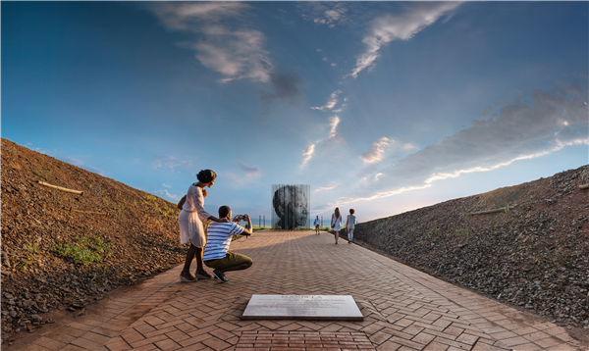
SA Tourism Annual Report FY2019 – 20
Presentation to Select Committee
23 February 2021

Slide 2
CONTENTS
Strategic Overview of SA Tourism
Global Performance of Tourism Sector
Organisational Performance by Programme
Financial Performance & Audit Outcome
Governance

Slide 3
STRATEGIC OVERVIEW OF SAT
Vision
To position South Africa as an exceptional tourist and business events destination that offers a value-for-money, quality tourist experience that is diverse and unique.
Mission
To contribute to inclusive economic growth by increasing the volume of tourists and the value they add to the South African economy.
South African Tourism is mandated by the Tourism Act (2014) to market South Africa as a domestic & international tourist destination by promoting the country’s tourism products, services and facilities.
As a government entity, its purpose is to improve the lives of South Africans by contributing to the inclusive growth of the country’s economy through tourism.

Slide 4
STRATEGIC OVERVIEW OF SAT
South African Tourism has the following strategic objectives:
Contribute to inclusive economic growth by increasing the number of international and domestic tourists.
Contribute to an enhanced, recognised, appealing, resilient and competitive tourism and business events brand for South Africa across the target markets and segments.
Enhance stakeholder and partner collaboration, both local and international, to improve delivery on South African Tourism’s mandate.
Contribute to an improved tourist experience in line with the brand promise.
Position South African Tourism’s corporate brand in such a way that it becomes recognised as a tourism and business events industry leader in market intelligence, insights and analytics.
Achieve operational efficiencies in all activities, including optimising human capital, marketing and other resources available to South African Tourism.

Slide 5
GLOBAL PERFORMANCE OF THE TOURISM SECTOR
Globally, tourism was on the rise as international tourism increased by 3.8% between January and December 2019 compared to the same period in 2018 reported the UNWTO, the World Tourism Organisation, although growth was slower compared to the exceptional rates of 2017 (+7%) and 2018 (+6%).
Demand was slower mainly in advanced economies, particularly Europe. The Middle East (+8%) led growth, followed by Asia and the Pacific (+5%). International arrivals in Europe and Africa (both +4%) increased in line with the world average, while the Americas saw growth of 2%.
While stronger economic growth, more affordable air travel, technological changes, new businesses models and greater visa facilitation around the word accelerated growth in recent years, it was widely believed that tourism had not yet reached its peak.
However, in 2020, the world as we knew it changed with the outbreak of the coronavirus (COVID-19). The pandemic has seen many countries’ economies shut down and strict restrictions on movement of people introduced. Many sectors were adversely impacted, with the tourism completely shut down globally, with about 90% of all flights grounded.
In South Africa, the impact on the domestic economy is severe, compounded by the downgrade of the country’s credit rating to sub-investment levels by Moody’s in March 2020.
The rating agency predicted South Africa’s economy would shrink to -2.5% in 2020.

Slide 6
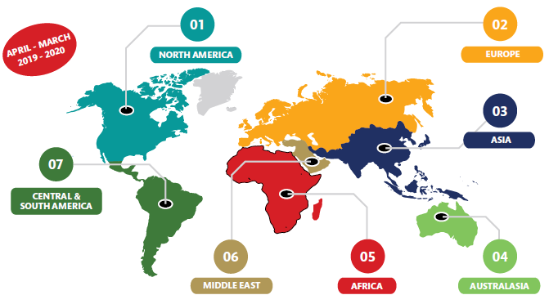
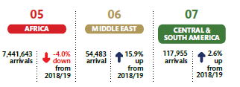
International tourist arrivals to South Africa declined by 4.2% from 2018/19 to reach 10.0 million in 2019/20. Growth was recorded from the Middle East as well as Central and South America.

Slide 7
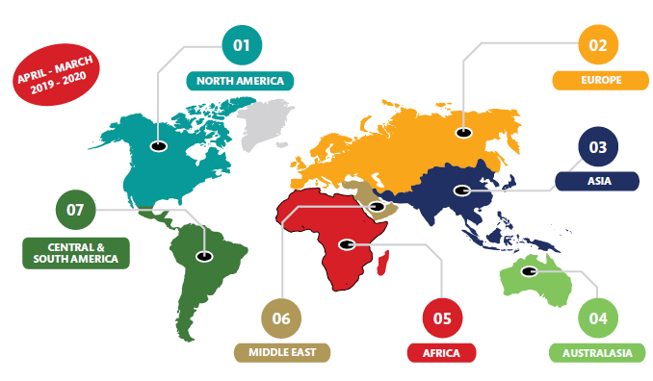
On average, international tourists stayed 16.3 nights in South Africa in 2019/20, up from 11.7 nights in 2018/19. Tourists from Australasia and Africa stayed fewer nights in 2019/20 compared to 2018/19.
Source: South African Tourism Departure Surveys

Slide 8
Visiting friends and family, exploring scenery and relaxing at the bush, berg or beach continued to be the main reasons for domestic travel. A “recommendation” by a friend or family member plays an important role in a traveller’s planning and consumption journey. Domestic trips were more frequent in number but shorter in duration with a greater average spend per trip. Travel increased in the domestic market due to off-peak season product promotions. The increased was driven by better partnerships between SA Tourism and trade; affordable deals have resulted in the spike in growth in this fiscal.
Source: South African Tourism Domestic Surveys

Slide 9
FY19/20 Performance Dashboard
In the FY19/20, SAT achieved 23 out of 37 KPIs, made significant progress on 4 and did not achieve 10.

Slide 10
2019/20 Organisational Performance Results: Programme 1
Programme 1: Corporate Support
Key Performance Indicator | Annual Target | Actual achievement | Deviation from planned target to actual achievement | Comment on deviations
Staff satisfaction score achieved | 3.57 | 3.60 | 1% | Target exceeded due to efforts carried out, such as tem alignment sessions and manager training, that were carried out in order to address issues that were raised in the previous survey.
Labour turnover rate | 8% | 5% | 38% | Target exceeded as the staff find purpose in working at SA Tourism.
Percentage vacancy rate maintained | 7% | 8% | -14% | Target not achieved. South African Tourism had a large number of vacancies following the organisational design process. Due to specialised skills required in in-country office positions, locally sourced recruitment agencies had to be used. At contracting stage, legal and financial implications arose that had to be negotiated to mitigate risks for the organisation. There were also several resignations occurring during reporting period. Following the appointment of a permanent Hub Head in South Europe, the business had to reconfigure the in-country operating model to ensure that a fit-for-purpose model was adopted, especially after several business challenges were experienced in market. Due to stringent country labour laws, legal advice had to be sought, after which recruiting commenced via locally sourced recruitment agencies, specifically to ensure compliance with local labour laws and mitigate language barriers. The recruitment process had begun by the end of the fiscal year in the respective markets.

Slide 11
2019/20 Organisational Performance Results: Programme 1
Programme 1: Corporate Support
Key Performance Indicator | Annual Target | Actual achievement | Deviation from planned target to actual achievement | Comment on deviations
Compliance with Employment Equity Act achieved | Compliance with Employment Equity Act | Employment Equity Plan submitted to the Department of Labour as per statutory deadline | - | Target achieved.
Unqualified audit report achieved | Unqualified audit report | South African Tourism received an unqualified audit report with material compliance for the 2019/20 financial year from the Auditor-General of South Africa | - | Target achieved.
B-BBEE-level achieved | Level 4 | Level 8 | -100% | Target not achieved. The organisational assessment review process has been undertaken and this will assist in the development of the overall B-BBEE strategy to achieve the targeted level.

Slide 12
2019/20 Organisational Performance Results: Programme 2
Programme 2: Business Enablement
Key Performance Indicator | Annual Target | Actual achievement | Deviation from planned target to actual achievement | Comment on deviations
Quarterly stakeholder meetings | 4 | 12 | 200% | Target exceeded due to engagement with multiple stakeholders in order to ensure alignment in building the five-year strategy.
Annual national stakeholder meeting | 1 | 1 | - | Target achieved.
Quarterly market insight reports | 4 | 4 | - | Target achieved. A cumulative total of 956 downloads.
Tourism performance dashboard | Develop and launch performance dashboard | The tourism performance dashboard was developed but there was no external launch | -10% | South African Tourism developed a performance dashboard. However, a public launch could not be held due to a potential conflict of interest with the NTVIS initiative. A soft launch was thus held instead and the dashboard is live and accessible at www.southafrica.net. This dashboard will be incorporated into the Tech Hub value proposition.

Slide 13
2019/20 Organisational Performance Results: Programme 3
Programme 3: Leisure Tourism Marketing
Key Performance Indicator | Annual Target | Actual achievement | Deviation from planned target to actual achievement | Comment on deviations
Number of international tourist arrivals (millions) | Financial year: 11.4 Calendar year: 11.3 | Financial year: 10.0 Calendar year: 10.2 | Financial year: - 12% Calendar year:- 10% | Target not achieved. 270,000 cancellations of tickets in travel to SA in the month of September 2019 due to attacks on foreign nationals. The banning of travel of key high-risk countries from entry in SA due to the spread of COVID-19 pandemic.
Total tourist foreign direct spend (TTFDS) (billion rand) | Financial year: 90.7 Calendar year: 88.4 | Financial year: 75.0 Calendar year: 84.1 | Financial year: - 17.3% Calendar year: -5% | Target not achieved. There is a linear relationship between spend and arrivals. When arrivals decrease or increase the spend is likely to follow. However, the rate of increase or decrease is not perfectly linear.

Slide 14
2019/20 Organisational Performance Results: Programme 3
Programme 3: Leisure Tourism Marketing
Key Performance Indicator | Annual Target | Actual achievement | Deviation from planned target to actual achievement | Comment on deviations
Number of global impressions from digital channels (millions) | 8.9 | 29.0 | 226% | Target exceeded. The launch of the two brand adverts in February supported by a media broadcast plan resulted in an exponential increase in impressions. In addition, a number of digital display adverts were also launched to support the brand adverts.
Number of SA specialist graduates | 750 | 3 019 | 303% | Target exceeded. SA Specialist is promoted to tourism businesses to empower their sales force. Some big tour operators have incorporated SA Specialist as part of their training programmes. The programme was promoted to travel trade to keep the knowledge updated while their businesses were affected due to the COVID-19 pandemic.
Percentage geographic spread of international tourist arrivals achieved | 24% | 20% | -17% | Target was not achieved due to the decline in tourist arrivals.
Seasonality index of international tourist arrivals | 1.50% | 1.4% | 7% | Target exceeded as the decline in arrivals led to less people visiting South Africa during the peak periods.

Slide 15
2019/20 Organisational Performance Results: Programme 3
Programme 3: Leisure Tourism Marketing
Key Performance Indicator | Annual Target | Actual achievement | Deviation from planned target to actual achievement | Comment on deviations
Percentage brand positivity achieved (average of Feb and Nov wave) | 40% | 39% | -3% | Target was not achieved due to media reports on crime negatively affecting how people perceive South Africa. In addition, there has been limited coverage of brand campaigns due to the transition between brand communication agencies.
Percentage brand awareness achieved (average of Feb and Nov wave) | 78% | 77% | -1% | SA Tourism had limited visibility globally due to the transition of media agencies.
Number of domestic holiday trips (millions) achieved | Financial year: 2.7 Calendar year: 2.6 | Financial year: 7.3(Apr 2019–Feb 2020) Calendar year: 7.1 | Financial year: 170% Calendar year: 173% | The deal-driven campaigns that were launched by SA Tourism and private sector were instrumental in driving demand in domestic travel. The number of travellers and people mentioning that they cannot afford travel reduced noticeably.
Domestic holiday revenue (billion rand) | Financial year: 8.1 Calendar year: 7.9 | Financial year: 18.9 (Apr– Feb 2020) Calendar year: 17.3 | Financial year: 133% Calendar year: 119%

Slide 16
2019/20 Organisational Performance Results: Programme 3
Programme 3: Leisure Tourism Marketing
Key Performance Indicator | Annual Target | Actual achievement | Deviation from planned target to actual achievement | Comment on deviations
Reach of domestic campaign (millions) | 37.1 | 120 | 223% | Target exceeded due to #TravelWeek, a deal driven campaign in partnership with the private sector was instrumental in driving demand in domestic travel.
Click-through to domestic tourism packages¹⁶ | 150 000 | 445 671 | 197% | Target exceeded due to the success of the #TravelWeek and the Move with Cassper campaigns.
Geographic spread of domestic tourists | 13% | 16% | 23% | Target exceeded as domestic travellers took advantage of deals in different provinces.
Seasonality index of domestic tourists | 28.5% | 37.1% | -30% | Target was not achieved due to high number of domestic travel concentrated at some peak periods and not consistent throughout the year.

Slide 17
2019/20 Organisational Performance Results: Programme 3
Programme 3: Leisure Tourism Marketing
Key Performance Indicator | Annual Target | Actual achievement | Deviation from planned target to actual achievement | Comment on deviations
Number of SMEs participating at South African Tourism Tradeshow Platforms | 182 | 199 | 9% | Target exceeded due to an additional platform created for SME Sustainability Village Vendors at Meetings Africa and Africa’s Travel Indaba.
Number of SMEs included in all South African Tourism hosting activities | 37 | 53 | 43% | Target exceeded as there has been a focus on increasing the number of provinces featured per hosting and for each province, a minimum of one SME product/experience is featured.

Slide 18
2019/20 Organisational Performance Results: Programme 4
Programme 4: Business Events
Key Performance Indicator | Annual Target | Actual achievement | Deviation from planned target to actual achievement | Comment on deviations
Number of business events hosted in South Africa | 168 | 230 | 37% | Target exceeded. International conferences rotate around the world based on regional cycles; destinations are eligible to bid for these conferences based on its geographic location. South Africa hosted an increased amount of international conferences in 2019/20 based on the country’s eligibility to bid for international conferences within the African and Middle East rotation cycles.
Number of international delegates hosted in South Africa | 90 300 | 100 019 | 11%
Number of bids supported for international and regional business events | 115 | 115 | - | Target achieved.
Number of qualified leads generated | 345 | 388 | 12% | Target exceeded due to SA Tourism maximising its efforts at business events platforms in order to generate leads.

Slide 19
2019/20 Organisational Performance Results: Programme 4
Programme 4: Business Events
Key Performance Indicator | Annual Target | Actual achievement | Deviation from planned target to actual achievement | Comment on deviations
Number of meetings held at Meetings Africa | 13 700 | 8 164 | -40% | Target not achieved. There were enough buyers and exhibitors that attended the event as space was 100% sold and buyer target was exceeded. Due to short duration of the event (two days) and constrained space floor, the anticipated meetings could not all happen. The target was set based on online matchmaking lead indicator.
Number of meetings held at Indaba | 20 000 | 18 842 | -6% | Target was not achieved due to the change of dates for Indaba to accommodate the national elections, there were a few cancellations from exhibitors and buyers. This affected the number of meetings held.
Number of international tourism market access platforms where SA Tourism participates | 6 | 6 | - | Target achieved.

Slide 20
2019/20 Organisational Performance Results: Programme 5
Programme 5: Tourist Experience
Performance Indicator | Annual Target | Actual achievement | Deviation from planned target to actual achievement | Comment on deviations
Number of graded accommodation establishments achieved | 5 500 | 5 173 | -6% | Target was not achieved due to the large number of cancellations, a lack of demand, a lack of value recognition in the voluntary grading process and expensive fees.
Number of graded rooms achieved | 133 140 | 122 938 | -8%
Number of officials / frontline staff that attended the Welcome training | 800 | 518 | -35% | Target not achieved. The final training was planned for March. However, all confirmed travel plans to conduct the training had to be cancelled. This was a proactive decision made by SA Tourism leadership in response to the early threats posed by COVID19 pandemic.
Number of Speed Marketing sessions to promote tourism products and services | 7 | 7 | - | Target achieved.

Slide 21
REMEDIAL ACTIONS FOR NEW FY
The following remedial actions has been put in place in the new FY in order to improve the organisation’s level of performance per programme:
Institutional Architecture Programme underway to reposition SAT which includes review of organisational structure. Once this process is finalised, vacancies will be filled.
The Tourism Performance Dashboard, whilst not publicly launched, is being incorporated into the Tech Hub value proposition.
The Tourism Sector Recovery plan which is a multi pronged public & private sector collaboration forms the basis and thrust for restoring international and domestic tourism activity.
Through the National Convention Bureau, a hybrid solution is being explored and will be introduced for business events, specifically for Meetings Africa and the Indaba, both of which are planned for May 2021, to achieve the planned number of meetings held at these key business events.

Slide 22
FINANCIAL PERFORMANCE AS AT 31 MARCH 2020
Programme |  | Annual Budget R'000 | Audited R’000 | % of Expenditure on Total Budget
1 | Corporate Support | 130 023 | 152 190 | 117%
2 | Business Enablement | 80 730 | 79 059 | 98%
3 | Leisure Tourism Marketing | 1 005 446 | 960 976 | 96%
4 | Business Events | 180 068 | 178 855 | 99%
5 | Visitor Experience | 102 031 | 77 021 | 75%
Total |  | 1 498 298 | 1 448 101 | 97%

Slide 23
Reasons for variances at programme level
Programme 1
Corporate support 117% - The variance is due to accounting for non-cash balance as part of the overall programme expenditure i.e., translation of foreign financial transactions into presentation currency, property, plant and equipment depreciation and amortisation of intangible assets.
Programme 2
Business enablement 2% variance is due to suspension of fieldwork linked to departure survey as result of Covid-19 in Q4.
Programme 3
The investment is mainly due to a decision to suspend extensive external facing marketing activities as a result of the impact of Covid-19 on the tourism sector. The entity made a tactical decision to keep the brand alive through minimum investment in social media marketing.
Programme 4
Planned participation in one of our strategic exhibition platforms did not take place during February 2020. ITB Berlin was cancelled as a result of Covid-19.
Programme 5
The entity made a decision to suspend all media and trade hosting during the global pandemic. The variance is due to no hosting and trade training taking place during this period.

Slide 24
Collaboration with Provinces
Areas of Collaboration
Marketing
(international and Domestic)
Events
(Provincial and National)
Business Events
Market Access Platforms (International and Domestic)
Quality Assurance and Visitor Experience
Research and information Sharing
Digital Platforms
Transformation and new entrants into the market
Capacity Building and Support
Partnerships (Brand SA, DIRCO, SAA, etc)

Slide 25
Collaboration & Related Spending in Provinces
The engagement between SA Tourism and Provincial Tourism Authorities (PTAs) is through a collaborative MOU, implemented through the SAT PTAs CEOs Forum, Marketing Forum and Business Events Coordinating Forum.
For the period under review, the total spend in provinces was R156,2m on the following projects implemented in provinces:
Bid support R61m
Sho’t Left Travel Week Media (9 provinces) R25m
(TV, Radio, Outdoor, Digital, Print, Activations)
Move For Me Domestic Awareness Campaign in partnership R1.2m with Universal Music (9 provinces)
Speed Marketing Programmes R2m (Northern Cape, Eastern Cape, KwaZulu-Natal, Western Cape)
Media support with CNBC (Business Events and Leisure) R20m
(TV, Digital and Social media platforms)
Hosting Programme (Trade and Media) – (9 provinces) R47m

Slide 26
Future Projects between SAT & PTAs
In an endeavour to improve collaboration between SA Tourism and PTAs and to further drive the recovery of the sector, the following projects are currently being implemented:
The Summer Campaign was rolled out in 4 provinces during Quarter 3 of FY20/21: Northern Cape; Limpopo, North West & Mpumalanga. The objective of the campaign is to increase domestic tourism trips and spend among the core domestic traveller market within the VTSD. The next phase of the campaign is tentatively scheduled for April 2021 in the remaining provinces.
The National Association Project seeks to develop a provincial bidding program for National Association conferences and meetings to host these business events in Villages, Townships, and Small Dorpies (VTSD).
Enterprise and Supplier Development (E&SD) programme aimed at producing a singular pipeline for introducing SMMEs to the market.
A partnership evaluation tool has been developed which focuses on the key pillars i.e. Economic Growth, Brand and Marketing, Enterprise impact - which focuses on how partnerships will benefit SMMEs development/empowerment.

Slide 27
AUDIT OUTCOME FOR THE PERIOD ENDED 31 MARCH 2020
South African Tourism obtained an unqualified audit opinion with findings for the financial year-ended 31 March 2020. The 2019-20 audit highlighted a number of internal control deficiencies which are being addressed in order to improve South African Tourism’s audit outcomes. Findings for FY19/20 were raised in the following areas:
Internal control area | Mitigations
Performance Information Management | The internal audit function will audit the accuracy, validity and completeness of Performance Information on a quarterly basis.
Supply Chain Management | Non-compliance with NTR Practice note 7 of 2009/10 paragraph 4.1.2 and 4.2 South African Tourism will formally write to Treasury to seek exemption from fully complying with the requirements of NTR Practice note 7 of 2009/10 paragraph 4.1.2 and 4.2 Preferential Procurement Policy Framework Act (PPPFA) section 6-Garona contract The matter was referred to Internal audit for independent assessment in line with the Irregular Expenditure Framework. The assessment execution work has been completed. Internal audit consultations are being held to verify assessment findings.
ICT Management | Remedial action dealt with in the ICT Governance report.
Annual Financial Statements | All misstatements noted by the AGSA were corrected prior to the issuance of the audit report. The audit report reflects this.

Slide 28
MITIGATION OF AG AUDIT FINDINGS
A detailed plan of action has been developed to mitigate audit findings raised by the AG for FY19/20.
In line with the principles of combined assurance, the Audit and Risk Committee, EXCO, Internal Audit, as well as Governance, Risk and Compliance worked collaboratively to ensure quality assurance while maintaining independence.
No matters were reported in the various reports of the internal auditors, the audit report on the annual financial statements or the management report of the Auditor-General of South Africa that indicate any material deficiencies in the systems of internal control or any deviations therefrom.
The Audit and Risk Committee monitors the audit register, ensuring that corrective measures on findings raised by both the internal and external auditors are implemented. Accordingly, it may be reported that the internal controls over financial reporting for the period under review were efficient and effective.
As part of the Audit and Risk Committee’s responsibilities, predetermined objectives and KPIs are reviewed quarterly in line with the approved strategic plan and annual performance plan. In addition to the financial and non-financial performance information, the Audit and Risk Committee ensures that South African Tourism complies with all applicable South African and international laws.

Slide 29
OVERVIEW OF GOVERNANCE
The SAT strategy and corporate plan align and comply with the provisions of the PFMA and, to the extent applicable, the King IV Report on Corporate Governance for South Africa 2016 (King IV).
The Department of Tourism and various parliamentary committees oversee its performance.
The Board comprises 13 members, including a representative of the Department of Tourism. In accordance with the Tourism Act, the Minister of Tourism appoints Board members for a period of three years.
The Board serves as the Accounting Authority of South African Tourism.
The Board is governed by the provisions of the PFMA, Tourism Act, Board Charter and other governance protocols.
Section 54 of the PFMA sets out its fiduciary duties and responsibilities.
Four subcommittees help the Board fulfil its role:
Marketing and Commercial Committee.
Human Capital and Remuneration Committee.
Audit and Risk Committee.
TGCSA Awards Committee.

Slide 30
RISK MANAGEMENT & GOVERNANCE
Risk management forms part of SAT’s business strategy, ensuring that the organisation can identify and manage risks that impact on business performance and achieving objectives.
The SAT Board is ultimately accountable for risk governance within the organisation & supports the organisation in setting and achieving its strategic objectives.
The Board approved a Risk Management Policy and Framework to guide the organisation with risk management.
The Board identified nine strategic risks that could threaten the achievement of SAT’s strategic goals and performance targets for 2019/20.
Risk assessments were conducted at a strategic and operational level as part of inculcating a risk culture within the organisation.
A risk appetite framework (which includes a risk-bearing capacity) has been established and forms part of the risk reporting and monitoring philosophy.
A risk maturity assessment was conducted mid the three-year risk management strategy and it highlighted that risk maturity within the organisation is at a repeatable Level 2.

Slide 31
INTERNAL AUDIT
SAT Internal Audit unit provides independent, objective assurance and consulting services designed to add value and improve organisation`s operations.
Based on the results of the audit engagements, consultancy services rendered and reports considered on governance, risk management and internal controls (financial and non-financial), the overall Internal Audit opinion is that, in all significant respects, SA Tourism control environment is adequate and/or effective to be relied upon except for specific areas that requires improvements.
Except for the confirmed cases of irregular expenditure that have been reported to management which did not result in losses for the organisation, nothing has come to the attention of SA Tourism Internal Audit that suggests any critical breakdown in the functioning of controls that could have resulted in significant losses for the organisation in the year under review and up to the date of this report.
The Audit and Risk Committee continued to oversee the Internal Audit function. Through the approval of the audit plan, the Audit and Risk Committee provided guidance on Internal Audit’s focus on the organisation’s key priorities and risks.

Slide 32
THANK YOU

